Slide 1
Foundation Models
Jacopo Staiano
jacopo.staiano@unitn.it
Marco Bronzini
marco.bronzini-1@unitn.it
University of Trento
October 15, 2025

Slide 2
Overview
Lab 1
Metrics for Natural Language Generation (NLG)
Real-world use cases (MT, QA with RAG)
Lab 2
Lab 3
Lab 4
Extract latent features from LLM embeddings by training a classification model
Friday, October 10
Wednesday,
October 15
November

Slide 3




LLM-based pipeline
OBJECTIVE / TASK
DATA
METRICS
LLMs as…
Data collection
Synthetic data
GitHub
Hugging Face
TensorFlow Datasets
Web Scraping
Modality
Text
Image/video
Humans
Audio
Open datasets
Classification
Precision, Recall, F1 score
Jaccard similarity
Regression
MAE, MSE, MAPE
Text Generation
Lexical-based (e.g., ROUGE)
Semantic-based (e.g., BERTScore)
a black-box tool
a subject of study
Training
Question-answering
Steering
Interpretability (probing)
Information extraction
Text generation
Machine Translation

Slide 4


TASK
PROBING: Extract latent features from the vector space of neural models (Information decoding )
Identification of human-interpretable features
Concepts (e.g., 🐶, 🐼)
Linguistic features (e.g., noun, agent)
Abstract properties (e.g., truthfulness)
…
There’s limited understanding of internal representations of LLMs
[2.4, 0.5, …,1.2]
INFORMATION DECODING

Slide 5




LATENT FEATURES
SEMANTIC
Truthfulness
Language
Tense
Subjectivity
The Geometry of Truth: Emergent Linear Structure in Large Language Model Representations of True/False Datasets
CLEF 2025
EnglishTense: A large scale English texts dataset categorized into three categories: Past, Present, Future tenses
MASSIVE: A 1M-Example Multilingual Natural Language Understanding Dataset with 51 Typologically-Diverse Languages
LEXICAL

Slide 6














PIPELINE
LLM
DOC
Train a classifier model (also called probe)
$$L_{1}$$
$$ℝ^{t×d}$$
EMBEDDINGS
…
$${ t}_{1,1}$$
$$…$$
$$…$$
[2.4, 0.5, …,1.2]
b
a
$$L_{n}$$
$$…$$
FEATURE A
$$…$$
$${ t}_{n,1}$$
$${ t}_{n,d}$$
a
b
Which layers?

Slide 7
PIPELINE
LLM
“I walked to school yesterday”
Train a classifier model (also called probe)
$$L_{1}$$
$$ℝ^{t×d}$$
FUTURE
EMBEDDINGS
…
$${ t}_{1,1}$$
$$…$$
$$…$$
[2.4, 0.5, …,1.2]
PRESENT
PAST
$$L_{n}$$
$$…$$
PAST
$$…$$
$${ t}_{n,1}$$
$${ t}_{n,d}$$
PAST
PRESENT
FUTURE
Which layers?

Slide 8
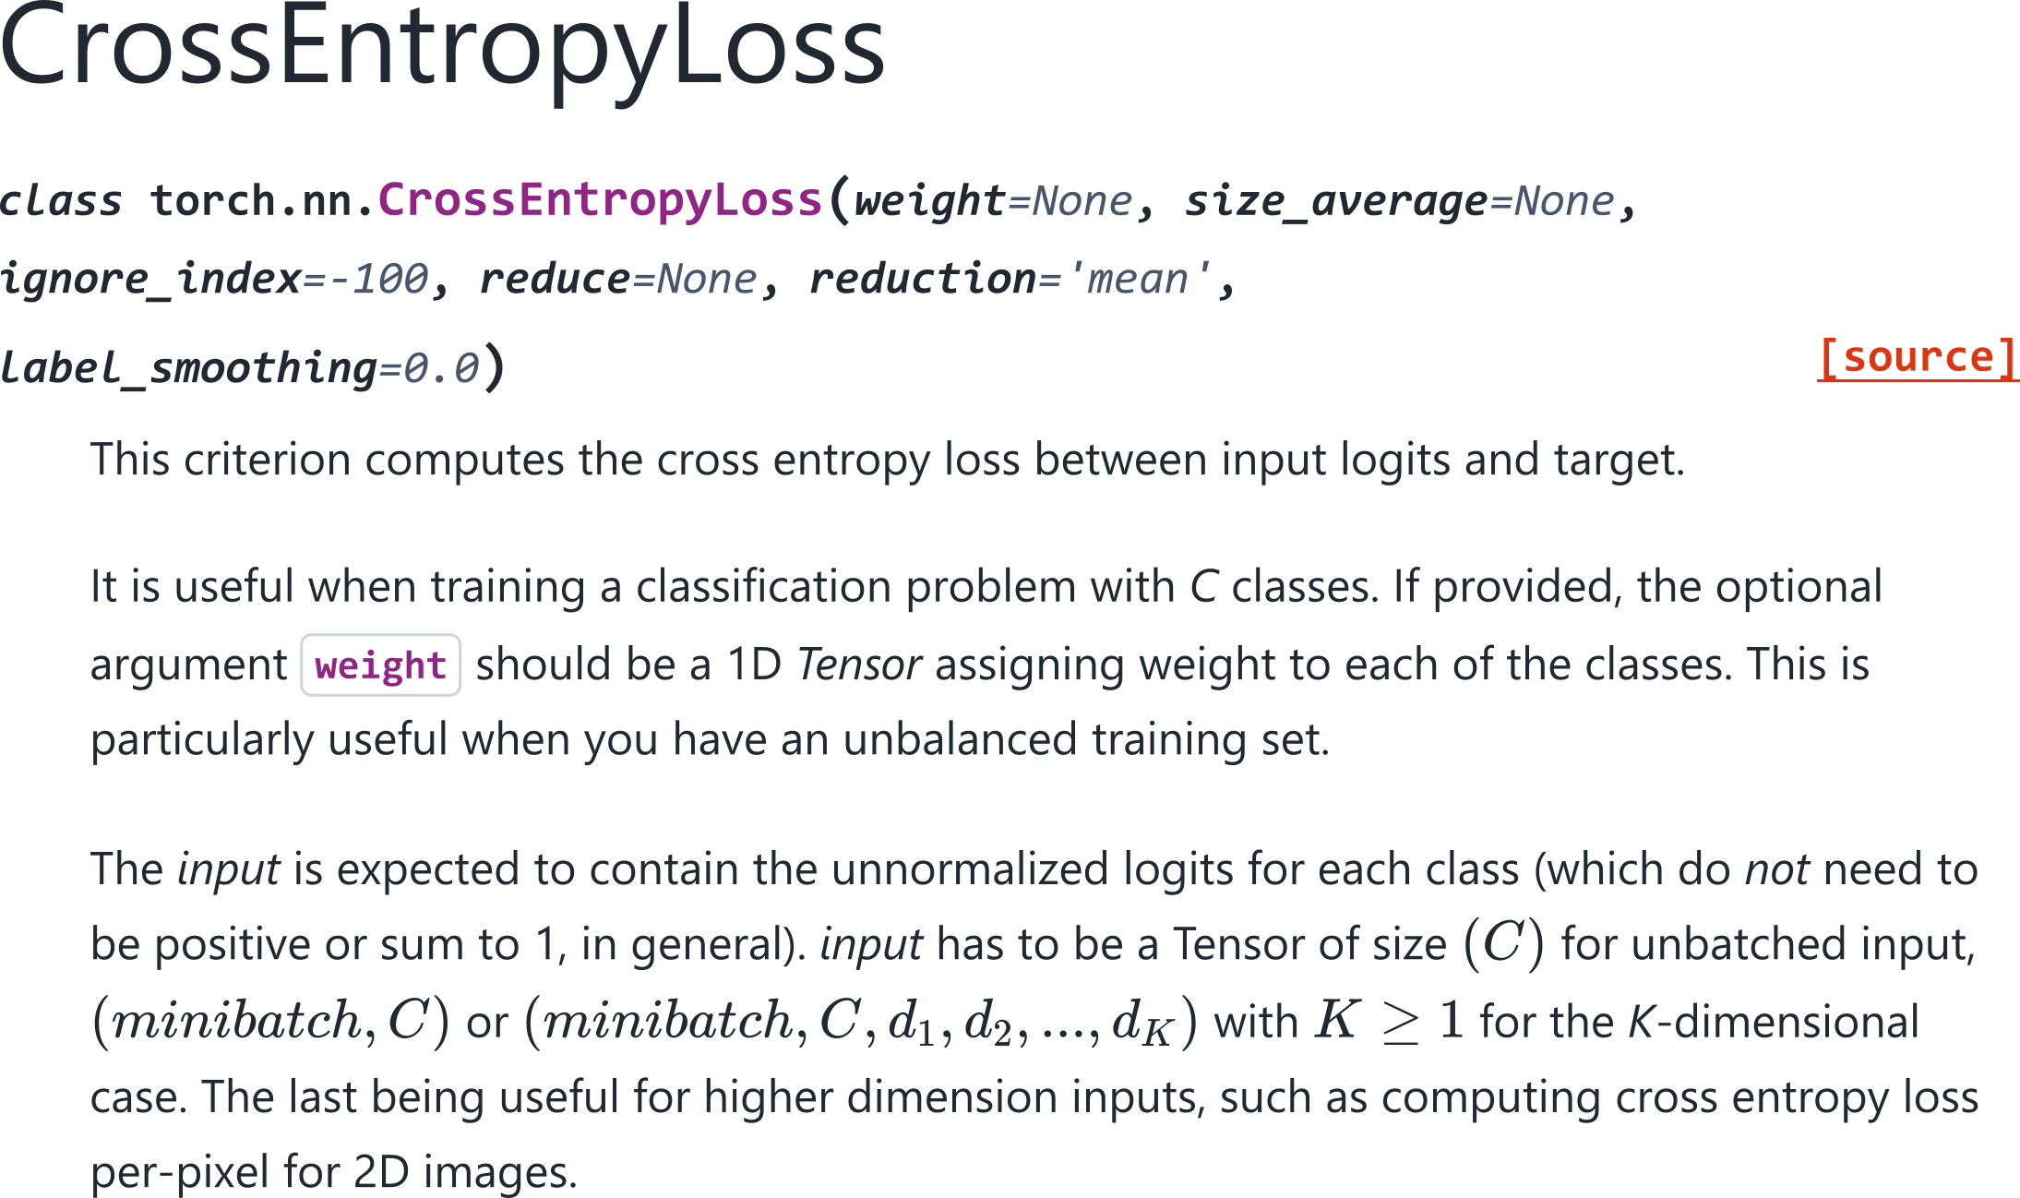
LOSS FUNCTION
CrossEntropyLoss - PyTorch

Slide 9
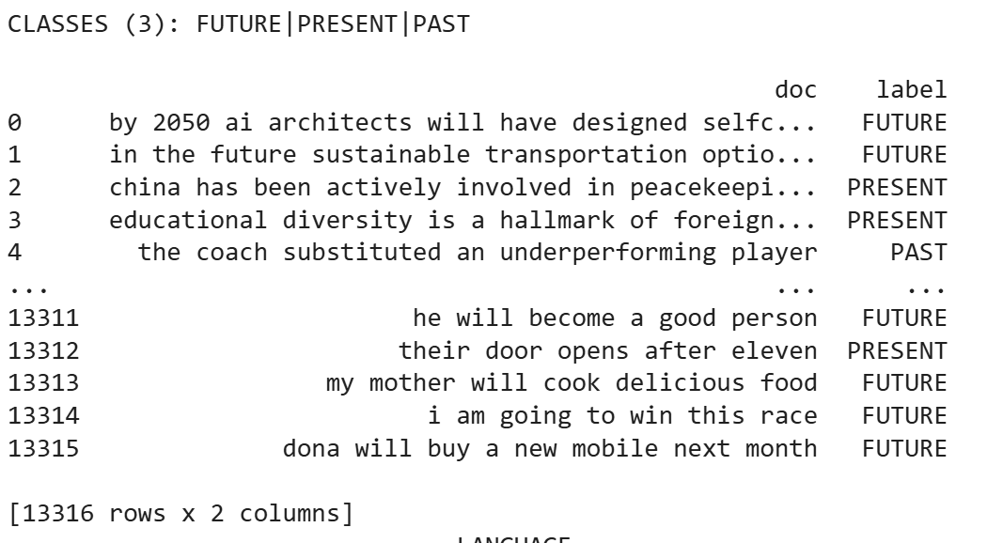
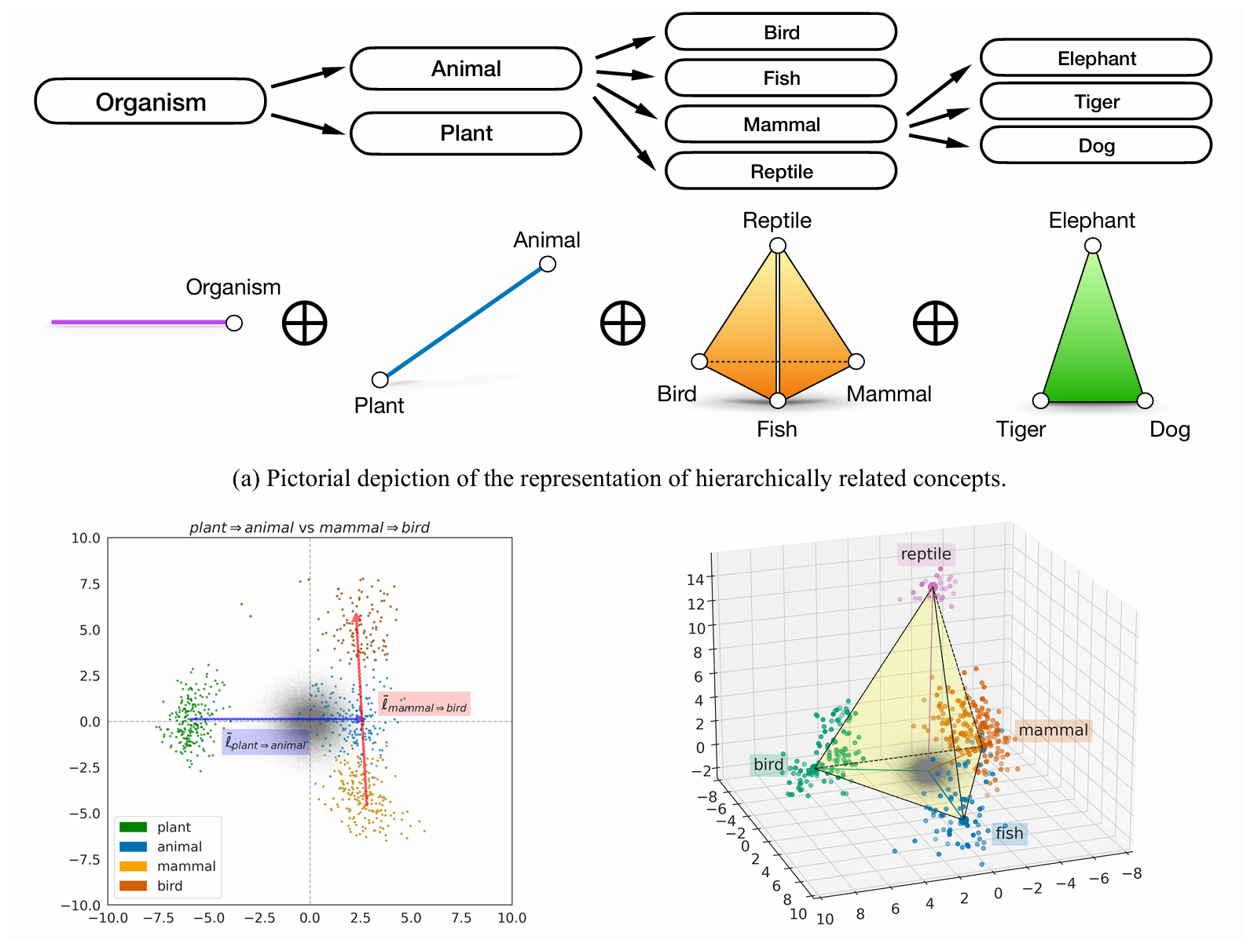
DATASETS (1): Tense
EnglishTense: A large scale English texts dataset categorized into three categories: Past, Present, Future tenses
Three classes
PAST
PRESENT
FUTURE
Input features as directions/subspaces in the LLM vector space
TENSE, LANGUAGE, …
TENSE
The Geometry of Categorical and Hierarchical Concepts in Large Language Models
PAST
PRESENT
FUTURE

Slide 10
DATASETS (2): Language
MASSIVE: A 1M-Example Multilingual Natural Language Understanding Dataset with 51 Typologically-Diverse Languages
what is the best italian restaurant around here
can you shuffle the light colors in the house
send reply to joe
en-US
Six languages
it-IT
ja-JP
en-US
comprami un biglietto del treno per modena
Inserisci la riunione con paolo domani alle dieci
ripeti questo brano tre volte
es-ES
fr-FR
de-DE
it-IT
Input features as directions in subspaces
[2.4, 0.5, …,1.2]
comprami un biglietto del treno per modena
ITALIAN LANGUAGE
[9.1, 1.3, …,0.8]
send reply to joe
ENGLISH LANGUAGE
LEXICAL
LANGUAGE

Slide 11
DATASETS (3): Subjectivity
CLEF 2025
In states with shortages, it's also far more difficult to find teachers for math, science, and special education classes
Yet little of substance has been done for Serbia’s LGBTQ+ people
objective
Two classes
subj
obj
If it consolidates power into the hands of the government, we can expect the situation to be pushed hard
Gone are the days when they led the world in recession-busting
subjective
Input features as directions in subspaces
From LEXICAL to SEMANTICS
Not anymore based on the syntax of the input
Based on the knowledge and reasoning of the language model*
SUBJECTIVE
OBJECTIVE
Linguistic analysis → abstract reasoning
* thus, small LLMs might struggle

Slide 12
DATASETS (4): Truthfulness
The Geometry of Truth: Emergent Linear Structure in Large Language Model Representations of True/False Datasets
Apple A5 was created by Google
The mother tongue of Thomas Joannes Stieltjes is English
FALSE
Two classes
TRUE
FALSE
Apple A5 was created by Apple
The mother tongue of Thomas Joannes Stieltjes is Dutch
TRUE
Syntax
Semantics
Factuality
The quality of being actual or based on fact
FURTHER STAGE → Claim verification
A LLM benchmark an input against its internal knowledge

Slide 13
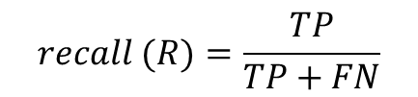

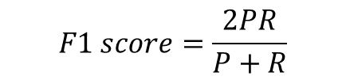
METRICS
We are going to evaluate the performance of our trained prone using traditional classification metrics:
True Negative (TN)
True Positive (TP)
False Negative (FN)
False Positive (FP)
Precision
Recall
F1 score
p$recision (P)=\frac{TP}{TP+FP}$
$$recall (R)=\frac{TP}{TP+FN}$$
$$F1 score=\frac{2PR}{P+R}$$

Slide 14
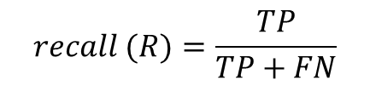

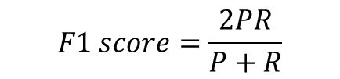
METRICS
We are going to evaluate the performance of our trained prone using traditional classification metrics:
Precision
Recall
F1 score
p$recision (P)=\frac{TP}{TP+FP}$
$$recall (R)=\frac{TP}{TP+FN}$$
$$F1 score=\frac{2PR}{P+R}$$
After having compute these metrics for each class, we can compute the average via:
Weighted Average
Macro Average
Average all scores, weighted by the number of true samples in each class
Average all scores equally

Slide 15

Practical Tutorial
Please, open the following notebook:
https://colab.research.google.com/github/saturnMars/FM_2025/blob/main/Lab2_probing.ipynb

Slide 16
Degree of freedom
Latent features being targeted
We cannot find what is not encoded
Choice of the hidden layer
There’s not right answer, but the median layer is generally the best one
Variability of language models
The dimension matters, especially the embedding dimension
Number of data
More data should lead to increase the generaralization
Architecture of the probing model
It has a huge impact on findings

Slide 17
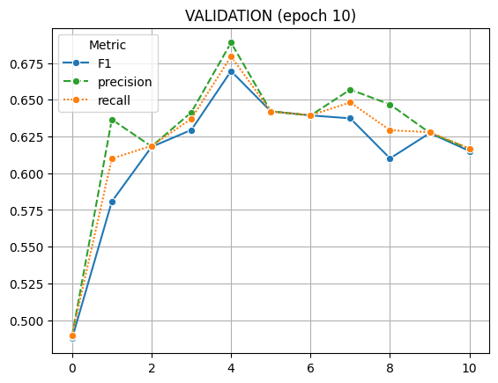
Truthfulness (GPT-2 → 130M, 768 dim)
[TEST] F1 score = 0.65
The earth is flat --> False (0.54)
Water boils at 100 degrees Celsius --> False (0.94)
The sky is green --> False (0.92)
The sky is blue --> False (0.78)
Renault 8 is produced by Fiat --> False (0.87)

Slide 18
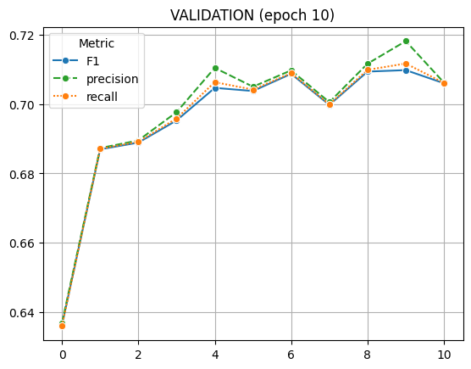
Truthfulness (GPT-2, XL → 1.5B, 1600 dim)
[TEST] F1 score = 0.71
The earth is flat --> False (0.88)
Water boils at 100 degrees Celsius --> True (0.58)
The sky is green --> False (0.68)
The sky is blue --> True (0.82)
Renault 8 is produced by Fiat --> False (0.81)

Slide 19

QUIZ
MENTI (8829 1189)
https://www.menti.com/al3exyz6vt47

