Slide 1
Foundation Models
Paolo Rota
paolo.rota@unitn.it
Marco Bronzini
marco.bronzini-1@unitn.it
University of Trento
November 7, 2025

Slide 2
Overview
Lab 1
Metrics for Natural Language Generation (NLG)
Real-world use cases (MT, QA with RAG)
Lab 2
Lab 3
Lab 4
Extract latent features from LLM embeddings by training a classification model
Generate video captions using:
CLIP-inspired models (Contrastive Captioners)
Vision-Language Models (VLMs)
Agents using LangChain
Friday, October 10
Wednesday,
October 15
Friday, November 7
Wednesday, November 12

Slide 3
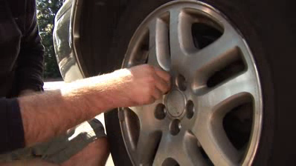
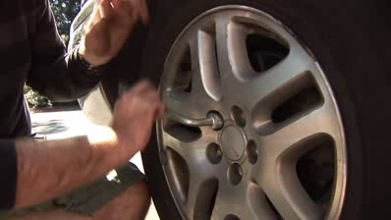
Multi-modal setting: Video Captioning
VIDEO: collection of images
TEXT: Short textual description
A person is changing a car tire.
Generative models
e.g., 30 frames per second (FPS)

Slide 4
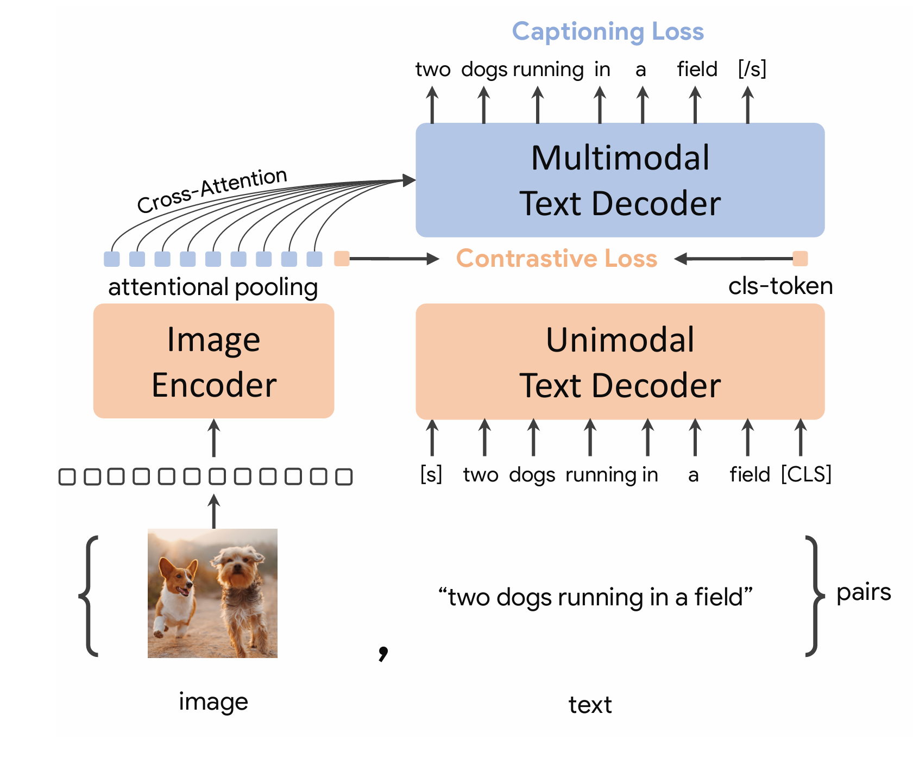
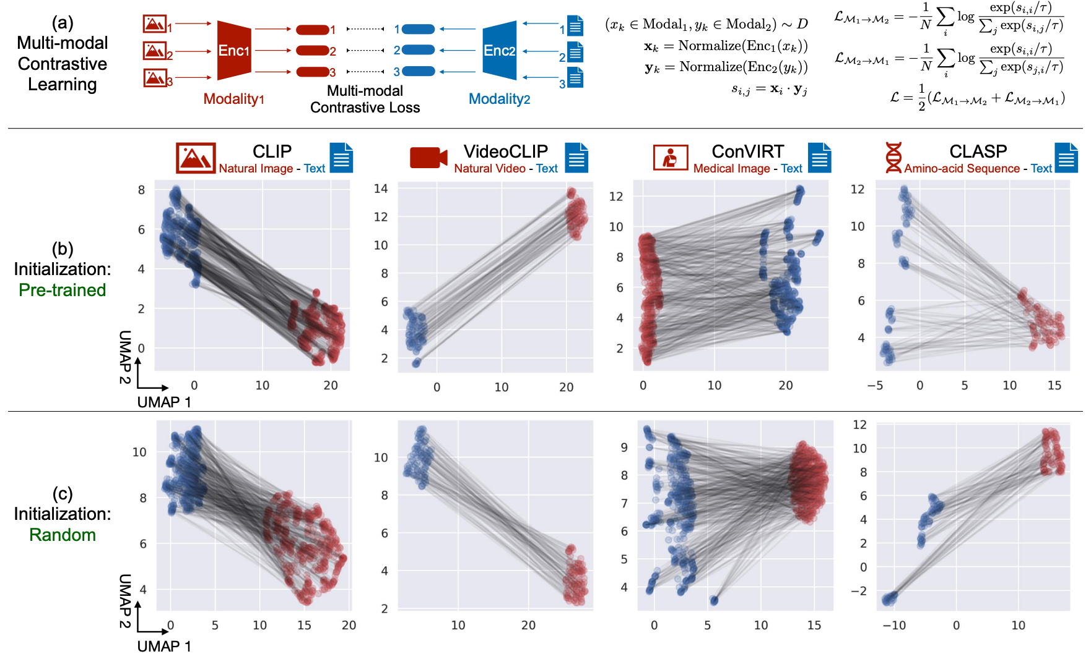
Approach: Contrastive Captioners
It is a unified model trained from scratch on image-text pairs, which combines:
contrastive learning (e.g., CLIP)
caption generation (e.g., GPT-style decoding).
Vision Encoder
Text Encoder/Decoder:
Training
Contrastive loss aligns image and text embeddings (like CLIP).
Captioning loss (cross-entropy) trains the model to generate descriptive text.
A transformer-based visual backbone
A transformer that serves both as a:
It extracts visual tokens
(1) contrastive encoder for alignment
(2) generative decoder for captioning
CoCa: Contrastive Captioners are Image-Text Foundation Models
TRAINING
Mind the Gap: Understanding the Modality Gap in Multi-modal Contrastive Representation Learning
Notes:
Image or video frame sequence.

Slide 5
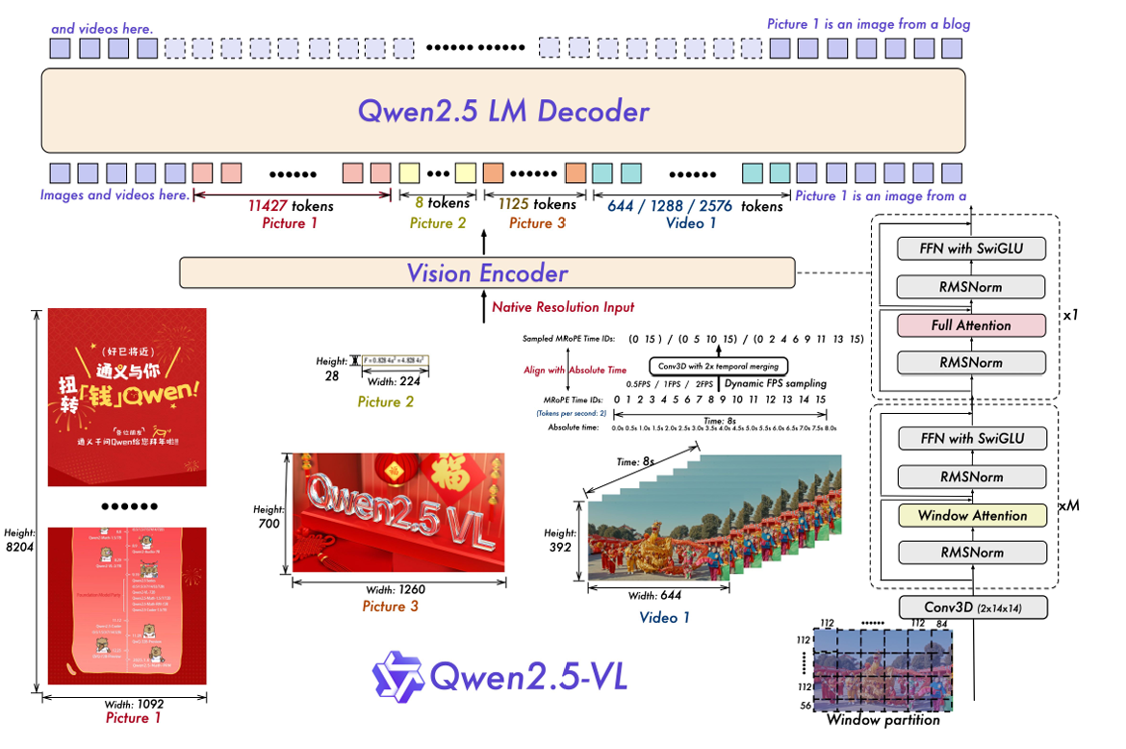
Approach: Vision-Language Models (VLMs)
A generative model able to understand images and text inputs using:
a vision encoder
a large language model
Vision Encoder
Large Language Model
Adapter / Connector
Pretrained visual backbone
(e.g., CLIP-ViT, EVA, Swin)
A pretrained textual model
(e.g., T5, GPT, Llama)
It extracts visual tokens
It can be frozen or fine-tuned
A lightweight module
(e.g., MLP or cross-attention)
It maps vision features
to language token space
PRE-TRAINED
TRAINING
Qwen2.5-VL Technical Report
Notes:
Image or video frame sequence.

Slide 6
Comparison
Aspect | Contrastive Captioners (CoCa) | Vision-Language Models (VLMs)
Vision Encoder | Trained from scratch | Pretrained (e.g., CLIP-ViT)
Language Model | Trained from scratch | Pretrained (e.g., LLaMA)
Connector | None (joint fusion) | Explicit projection
Training Objective | Contrastive + Captioning (joint) | Alignment + instruction tuning
Integration | End-to-end unified | Modular (vision + language + adapter)
Flexibility | Less modular but efficient | Highly modular and extensible
Compute Efficiency | Heavy one-time training | Cheaper fine-tuning with reused parts

Slide 7

Practical Tutorial
Please, open the following notebook:
https://colab.research.google.com/github/saturnMars/FM_2025/blob/main/Lab3_video.ipynb
CoCa versus VLMs using NLG metrics

Slide 8

QUIZ
MENTI (2153 2489)
https://www.menti.com/al4ika5zijuu

