Slide 1
Foundation Models
Jacopo Staiano
jacopo.staiano@unitn.it
Marco Bronzini
marco.bronzini-1@unitn.it
University of Trento
October 15, 2025

Slide 2
Overview
Lab 1
Metrics for Natural Language Generation (NLG)
Real-world use cases (MT, QA with RAG)
Lab 2
Lab 3
Lab 4
Extract latent features from LLM embeddings by training a classification model
Friday, October 10
Wednesday,
October 15
November

Slide 3

LLM-based pipeline
OBJECTIVE / TASK
DATA
METRICS
LLMs as…
Open datasets
Data collection
Synthetic data
GitHub
Datasets
TensorFlow Datasets
Web Scraping
Modality
Text
Image/video
Humans
Audio
Classification
Precision, Recall, F1 score
Jaccard similarity
Regression
MAE, MSE, MAPE
Text Generation
Lexical-based (e.g., ROUGE)
Semantic-based (e.g., BERTScore)
a black-box tool
a subject of study
Training
Question-answering
Steering
Interpretability (probing)
Information extraction
Text generation
Machine Translation

Slide 4


TASK
PROBING: Extract latent features from the vector space of neural models (Information decoding )
Identification of human-interpretable features
Concepts (e.g., 🐶, 🐼)
Linguistic features (e.g., noun, agent)
Abstract properties (e.g., truthfulness)
…
There’s limited understanding of internal representations of LLMs
[2.4, 0.5, …,1.2]
INFORMATION DECODING

Slide 5
LATENT FEATURES / DATASETS
SEMANTIC
Truthfulness
Language
Tense
Subjectivity
The Geometry of Truth: Emergent Linear Structure in Large Language Model Representations of True/False Datasets
CLEF 2025
EnglishTense: A large scale English texts dataset categorized into three categories: Past, Present, Future tenses
MASSIVE: A 1M-Example Multilingual Natural Language Understanding Dataset with 51 Typologically-Diverse Languages
LEXICAL

Slide 6














PIPELINE
LLM
DOC
Train a classifier model (often called as probe)
$$L_{1}$$
$$ℝ^{t×d}$$
EMBEDDINGS
…
$${ t}_{1,1}$$
$$…$$
$$…$$
[2.4, 0.5, …,1.2]
b
a
$$L_{n}$$
$$…$$
FEATURE A
$$…$$
$${ t}_{n,1}$$
$${ t}_{n,d}$$
a
b

Slide 7
PIPELINE
LLM
“I walked to school yesterday”
Train a classifier model (often called as probe)
$$L_{1}$$
$$ℝ^{t×d}$$
FUTURE
EMBEDDINGS
…
$${ t}_{1,1}$$
$$…$$
$$…$$
[2.4, 0.5, …,1.2]
PRESENT
PAST
$$L_{n}$$
$$…$$
PAST
$$…$$
$${ t}_{n,1}$$
$${ t}_{n,d}$$
PAST
PRESENT
FUTURE

Slide 8
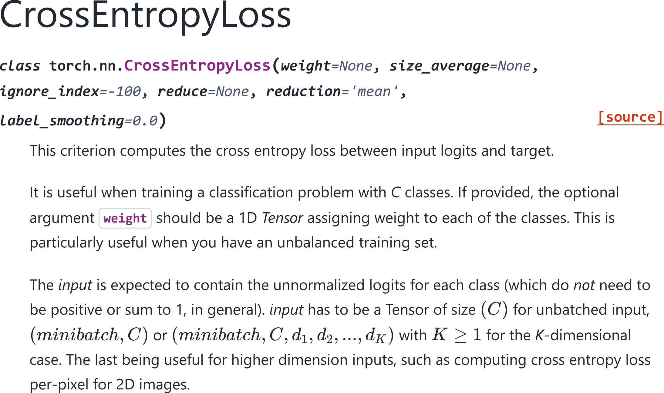
LOSS FUNCTION
CrossEntropyLoss - PyTorch

Slide 9
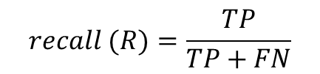

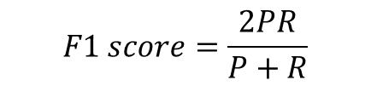
METRICS
We are going to evaluate the performance of our trained prone using traditional classification metrics:
True Negative (TN)
True Positive (TP)
False Negative (FN)
False Positive (FP)
Precision
Recall
F1 score
p$recision (P)=\frac{TP}{TP+FP}$
$$recall (R)=\frac{TP}{TP+FN}$$
$$F1 score=\frac{2PR}{P+R}$$

Slide 10
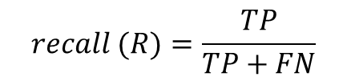

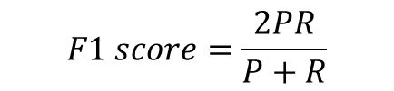
METRICS
We are going to evaluate the performance of our trained prone using traditional classification metrics:
Precision
Recall
F1 score
p$recision (P)=\frac{TP}{TP+FP}$
$$recall (R)=\frac{TP}{TP+FN}$$
$$F1 score=\frac{2PR}{P+R}$$
After having compute these metrics for each class, we can compute the average via:
Weighted Average
Macro Average
Average all scores, weighted by the number of true samples in each class
Average all scores equally

Slide 11

Practical Tutorial
Please, open the following notebook:
https://colab.research.google.com/github/saturnMars/FM_2025/blob/main/Lab2_probing.ipynb

