Slide 1

Net Zero CO₂ Emissions plan of Japan by 2050
1
Submitted To: Presented By:
Dr. Anna Agarwal Saransh Sharma
Dr. Rajeev Jindal

Slide 2
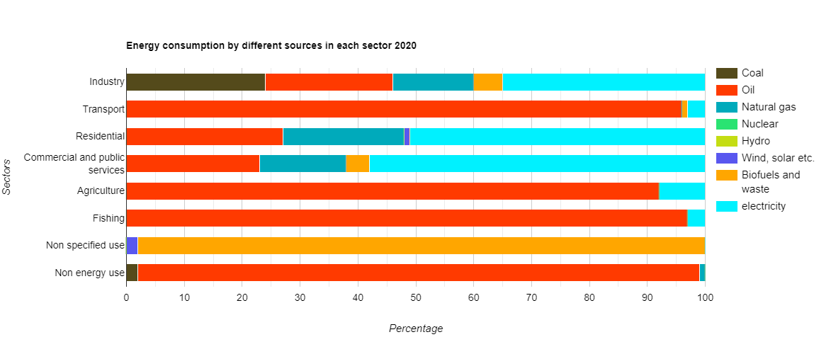
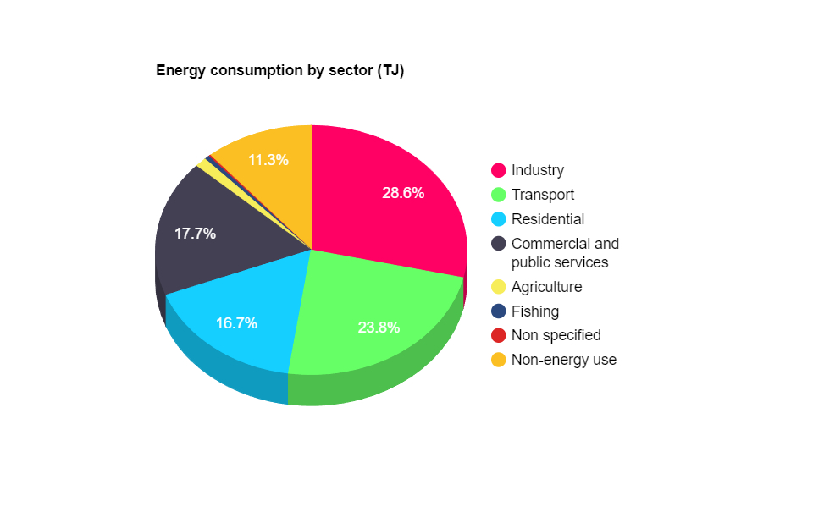
Energy Demand in 2020
2
Energy consumption from different sources by each sector
Energy Consumption by each sector
Overall oil accounted for 50.4 % of total energy consumption dominating Transport, agriculture and fishing sector. Electricity accounted for more than half of consumption for Residential, Commercial and public services sector and for 30% overall.
Source-Energy Statistics Data Browser – Data Tools - IEA

Slide 3
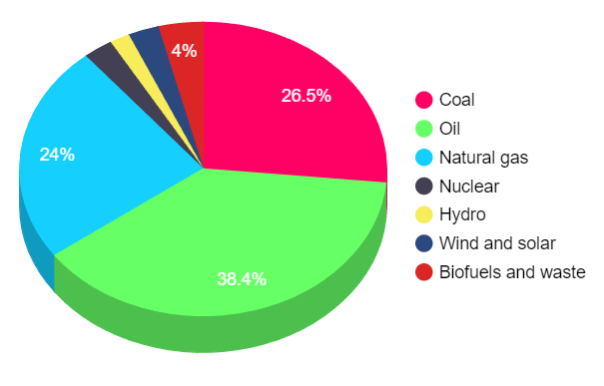
Energy Supply in 2020
3
0.644 EJ
Coal and oil accounts for 6.20 EJ and 4.27 EJ
More than 88 % dependency on fossil fuels
Less than 9 % from renewable (Hydro, wind and solar, biofuels and waste)
4.27 EJ
6.20 EJ
6.20 EJ
Total primary energy supply by different sources
Source-Energy Statistics Data Browser – Data Tools - IEA

Slide 4
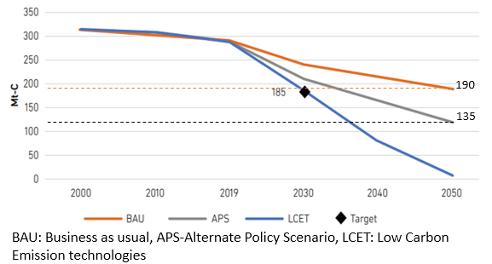
CO₂ Emissions
4
The total emission reduction in 2050 in comparison to what current trends leads to
BAU - 57.78 %
APS - 70 %
LCET- 100 %
2020 CO₂ emissions – 284 Mt-C
2023 CO₂ emissions - 334 Mt-C
Mainly from fossil fuel energy supply (16.67 EJ).
Source - Energy Outlook and Energy-Saving Potential in East Asia 2023 (eria.org) ; CO2 emissions - Our World in Data

Slide 5
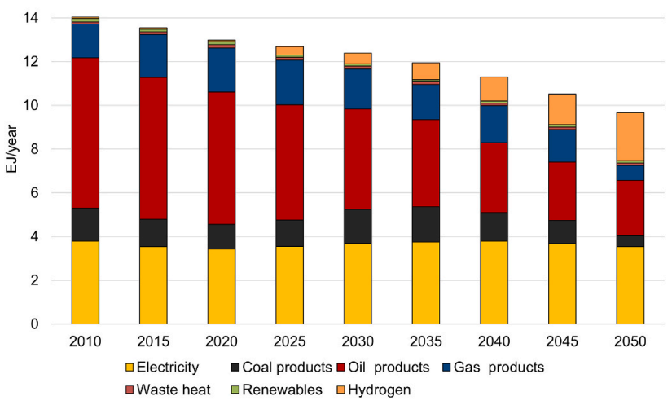
Demand side
5
Assumptions-
The cost, insurance, and freight (CIF) prices for crude oil, coal, and liquified natural gas (LNG) will increase from 2010 to 2050 by 67%, 27%, and 34%, respectively.
The CIF prices for hydrogen will be 330 JPY/kg-H2 (3.0 USD/kgH2 in 2050.
The population will decline to 97 million by 2050
The house-hold population will be 47.2 million.
Transition of Primary energy consumption in LCET case scenario
Source - Japan's pathways to achieve carbon neutrality by 2050 – Scenario analysis using an energy modeling methodology – ScienceDirect

Slide 6
Demand side
6
Decarbonisation of electricity which accounted for 3.8 EJ energy consumption in 2050.
Fuel shifting from gasoline to electricity.
The share of electricity and hydrogen increases from 27% (3.8 EJ) in 2010 to 59% (5.7 EJ) in 2050.
Hydrogen will play major role as the country has less CCS facilities and biomass resources availability in dispatchable powerplants (2 EJ in 2050).

Slide 7
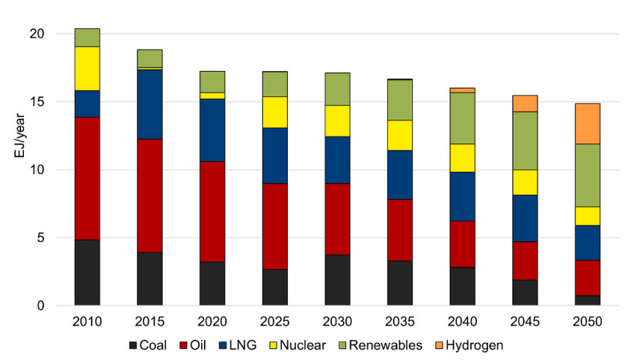
Supply side
7
Assumptions-
Maximum Nuclear power generation capacity by 2050 will be 19 GW.
(generation capacity of 47.5 GW in 2011)
Maximum Renewable power generation capacity of 337.6 GW by 2050.
Transition of Primary energy supply in base case scenario
Source - Japan's pathways to achieve carbon neutrality by 2050 – Scenario analysis using an energy modeling methodology - ScienceDirect

Slide 8
Supply side
8
Systems comprising low carbon energy sources such nuclear and hydrogen contribute to 3.4 EJ (60%)
650 TWh energy generation from renewables
Solar and wind will become 4.5 and 11.2 times the current capacities.
178.4 Mt-C of CO2 emissions reduction by reducing share of fossil fuel by 10.47 EJ (62%)

Slide 9
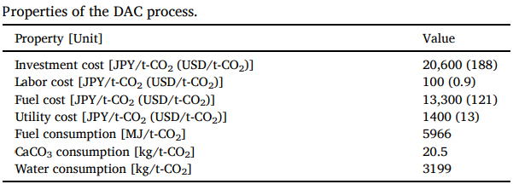
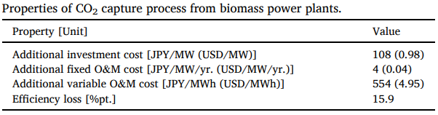
Carbon Capture
9
Assumptions-
Maximum CO2 storage of 81.88 Mt-C/yr
Direct air capture carbon storage and Bio energy with cabon capture and storage available by 2030
Post-combustion CO2 capture technologies using monoethanolamine
Source - Japan's pathways to achieve carbon neutrality by 2050 – Scenario analysis using an energy modeling methodology - ScienceDirect

Slide 10
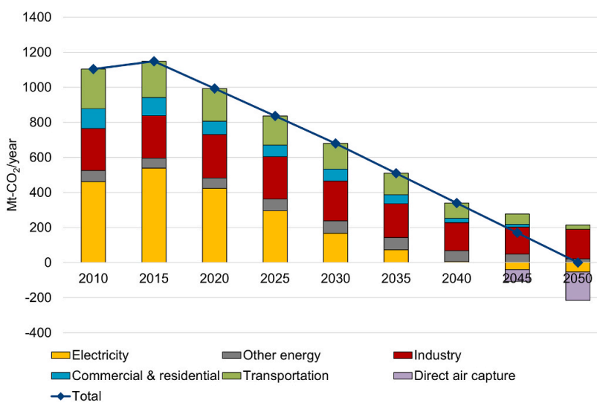
Net Zero Transition
10
58.68 Mt-C of CO2 will be removed by 2050 through DACCS and BECCS processes (Carbon Capture)
178.4 Mt-C of CO2 emissions reduction by reducing share of fossil fuel by 10.47 EJ and using low carbon energy sources (Supply side)
Remaining 35.85 Mt-C reduction will be due to energy efficiency and population decline

Slide 11
Additional Policy measure
11
The 3 E’s principle(environment, energy security, economic efficiency + safety) is the key to Japan policy. More focus on energy security and economic efficiency should be implied.
Policies that promote development of dispatchable capacity and adjust the capability for output fluctuation of renewables.
Policies related to hydrogen imports for stable supply in place of fossils.

