Slide 1
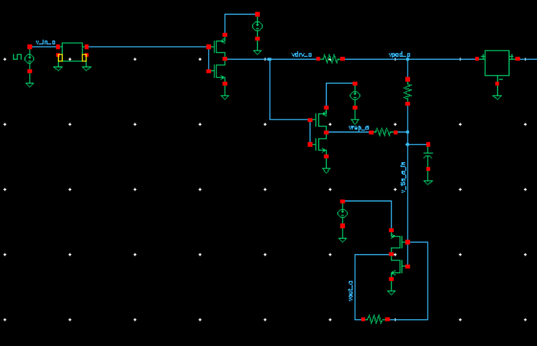
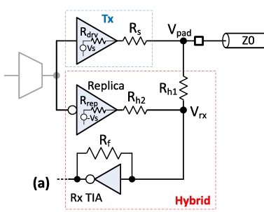
Full circuit, now with TIA
Channel
Main driver
Replica driver
Transimpedance amplifier

Slide 2
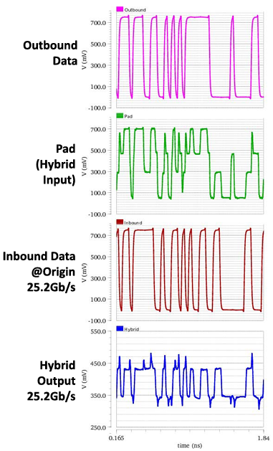
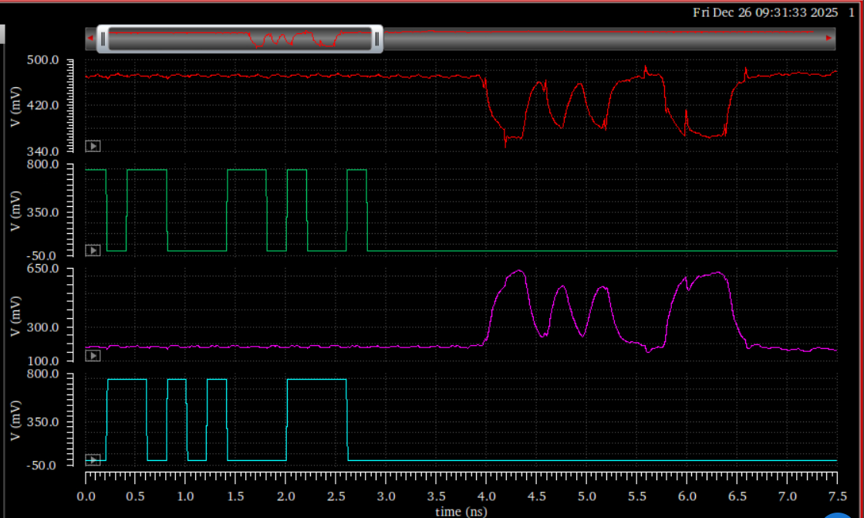
Result: TIA output == inbound data as expected
Paper
My results
Hybrid output
Outbound data
TIA output
Inbound data

Slide 3
Explanation
In both the paper and my simulation, the TIA input signal is 100 mV peak-to-peak
In the paper, the TIA had an open-loop gain of 5, so my output peak-to-peak swing of roughly 400-500 mV makes sense
Paper: Rf=1.2k
Mine: Rf=6k

Slide 4
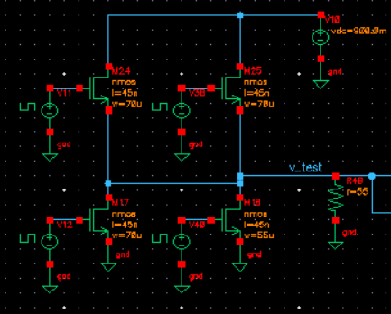
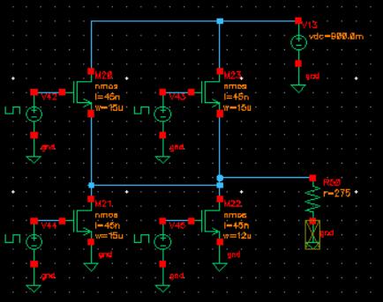
Extension to PAM3
CMOS-inverter-based drivers are no longer suitable
I used the PAM3 output driver from this paper:
  H. Park, J. Song, J. Sim, Y. Choi, J. Choi, J. Yoo, and C. Kim, “30-Gb/s 1.11-pJ/bit single-ended PAM-3 transceiver for high-speed memory links,” IEEE Journal of Solid-State Circuits, vol. 56, no. 2, pp. 581–590, 2020.
I kept the main driver and replica driver output resistance the same, so the other resistances need not change
  Rdrv = 55, Rrep = 275

Slide 5
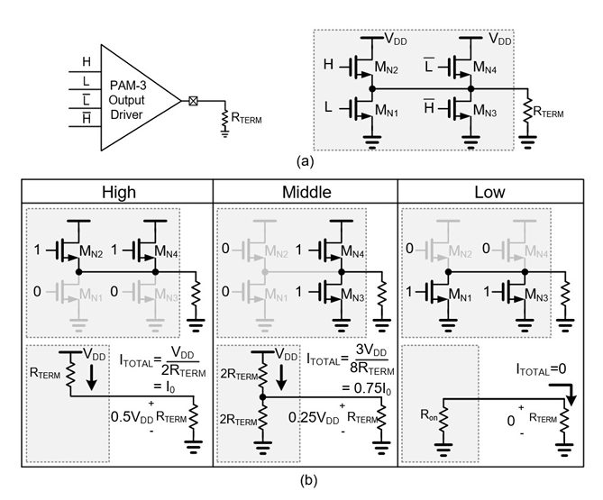
PAM3 output driver operation (from the paper)

Slide 6
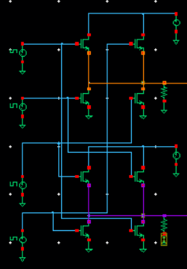
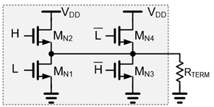
Full circuit
H
Main driver
L
!H
Replica driver
!L

Slide 7
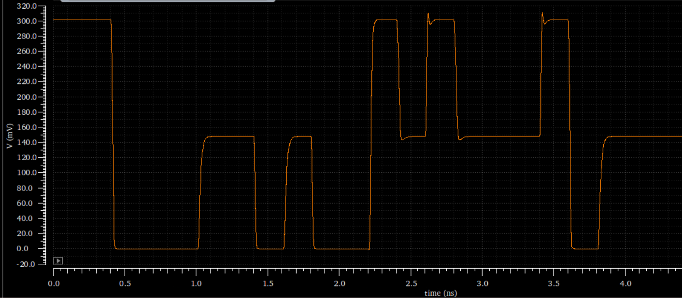
My PAM3 driver output signal with 300mV peak-to-peak swing (same as the paper)

Slide 8
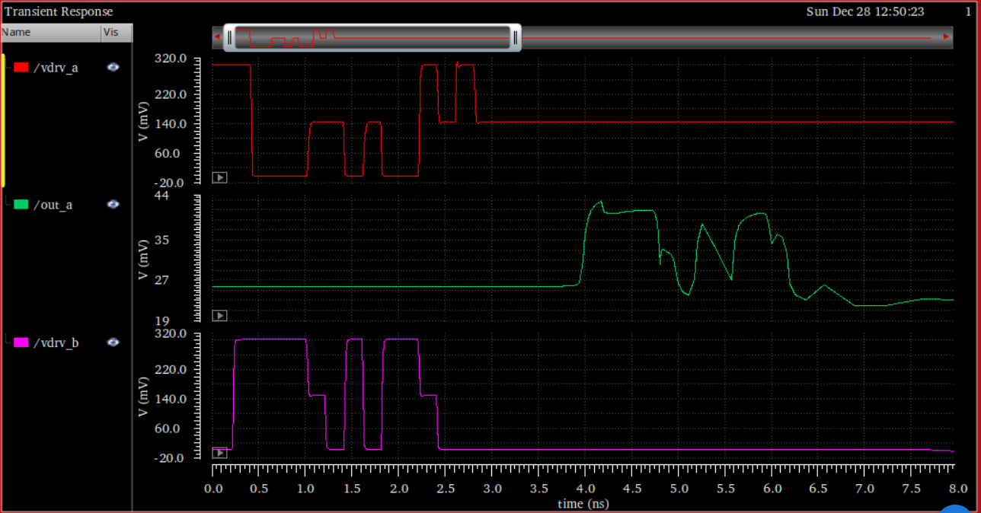
Full transceiver function with PAM3: hybrid output matches inbound data, as desired, but with significant distortion
Outbound data
Hybrid output
Inbound data

