Slide 1
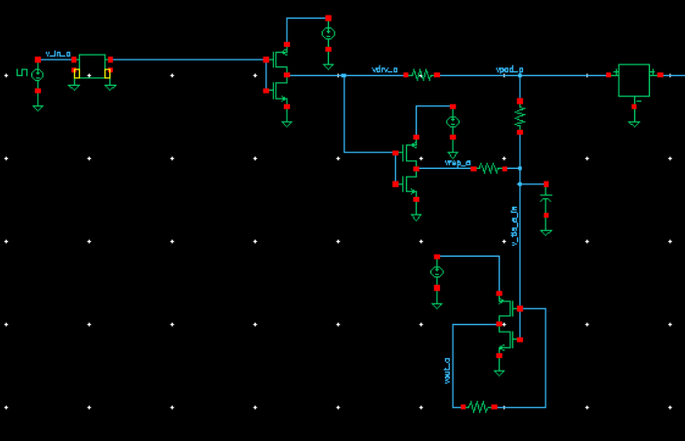
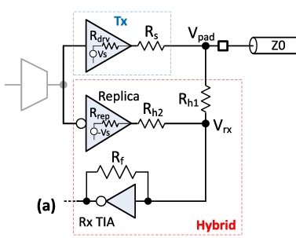
Full circuit, now with TIA
Channel
Main driver
Replica driver
Transimpedance amplifier

Slide 2
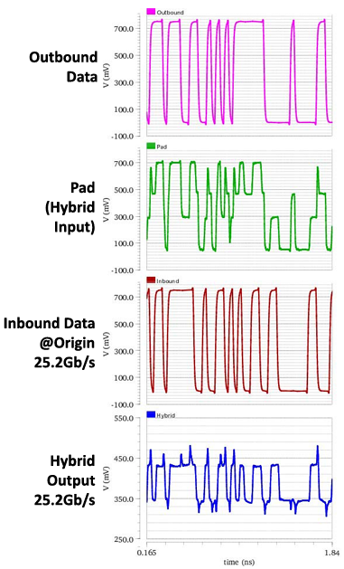
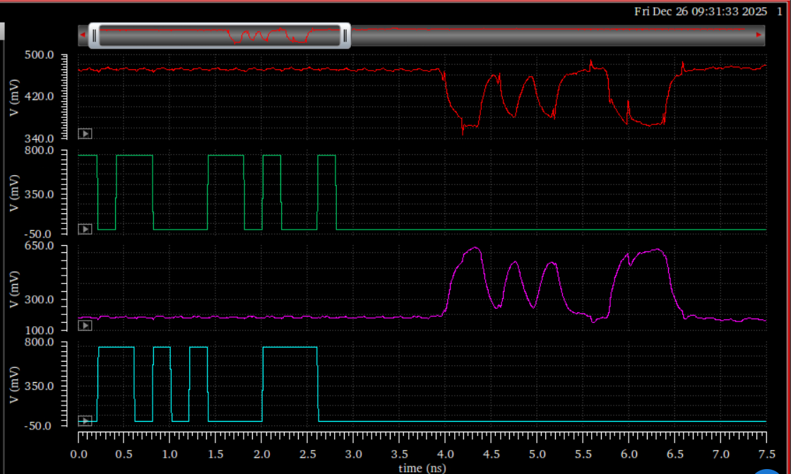
Result: TIA output == inbound data as expected
Paper
My results
Hybrid output
Outbound data
TIA output
Inbound data

Slide 3
Explanation
In both the paper and my simulation, the TIA input signal is 100 mV peak-to-peak
In the paper, the TIA had an open-loop gain of 5, so my output peak-to-peak swing of roughly 400-500 mV makes sense
Paper: Rf=1.2k
Mine: Rf=6k

Slide 4
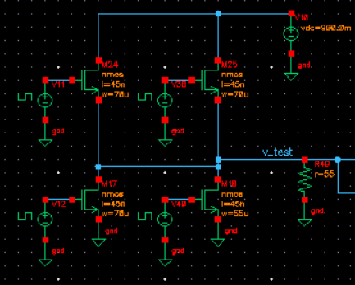
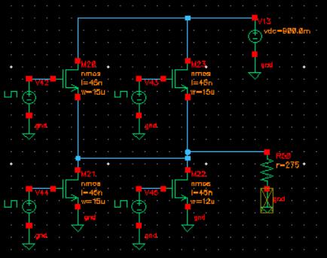
Extension to PAM3
CMOS-inverter-based drivers are no longer suitable
I used the PAM3 output driver from this paper:
  H. Park, J. Song, J. Sim, Y. Choi, J. Choi, J. Yoo, and C. Kim, “30-Gb/s 1.11-pJ/bit single-ended PAM-3 transceiver for high-speed memory links,” IEEE Journal of Solid-State Circuits, vol. 56, no. 2, pp. 581–590, 2020.
I kept the main driver and replica driver output resistance the same, so the other resistances need not change
  Rdrv = 55, Rrep = 275

Slide 5
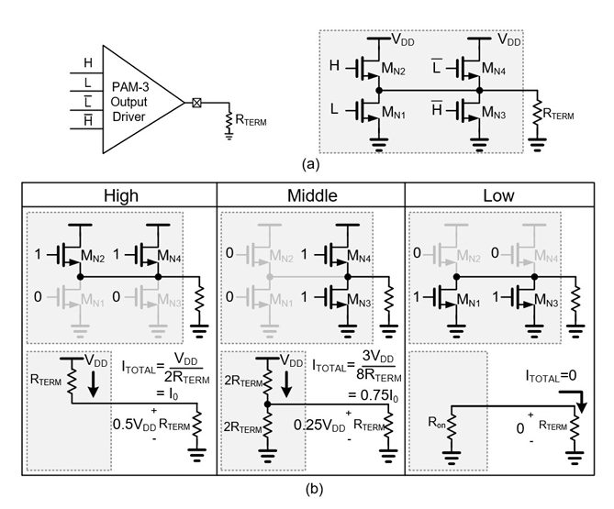
PAM3 output driver operation (from the paper)

Slide 6
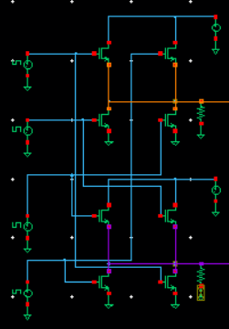
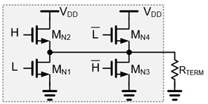
Full circuit
H
Main driver
L
!H
Replica driver
!L

Slide 7
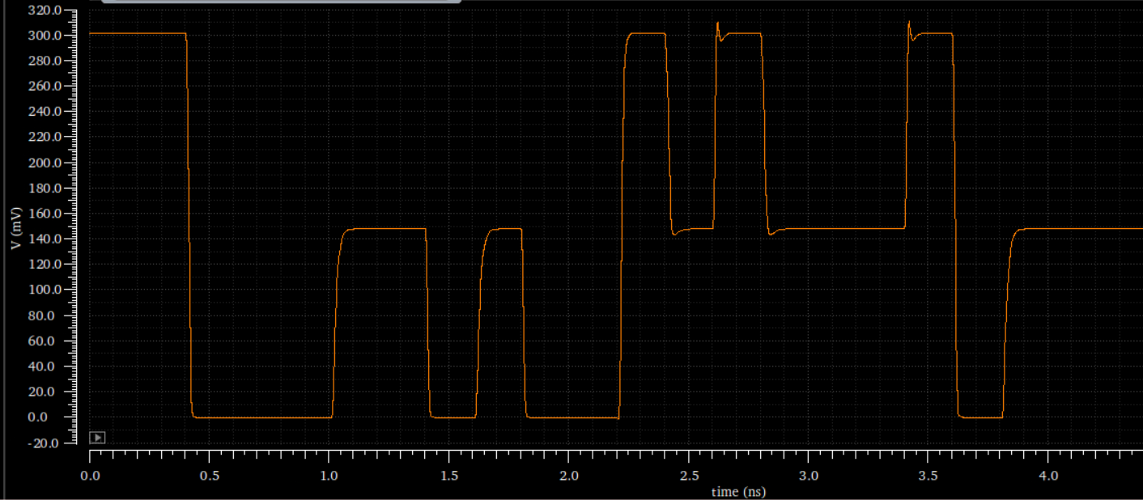
My PAM3 driver output signal with 300mV peak-to-peak swing (same as the paper)

Slide 8
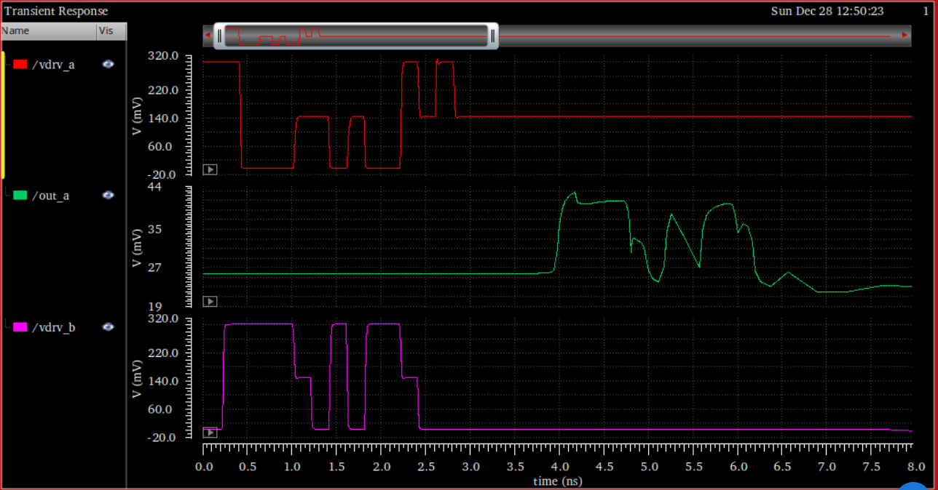
Full transceiver function with PAM3: hybrid output matches inbound data, as desired, but with significant distortion
Outbound data
Hybrid output
Inbound data

Slide 9
Post-cursor ISI
Outbound data
Hybrid output
Inbound data

Slide 10
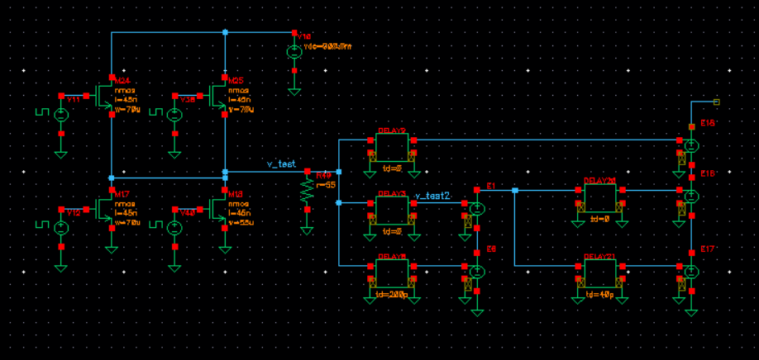

1-tap TX Feed-Forward Equalization (FFE)
TX FIR equalization should boost high frequency sections during bit transitions
Should help with migration from NRZ to PAM3 by reducing impact of ISI

Slide 11
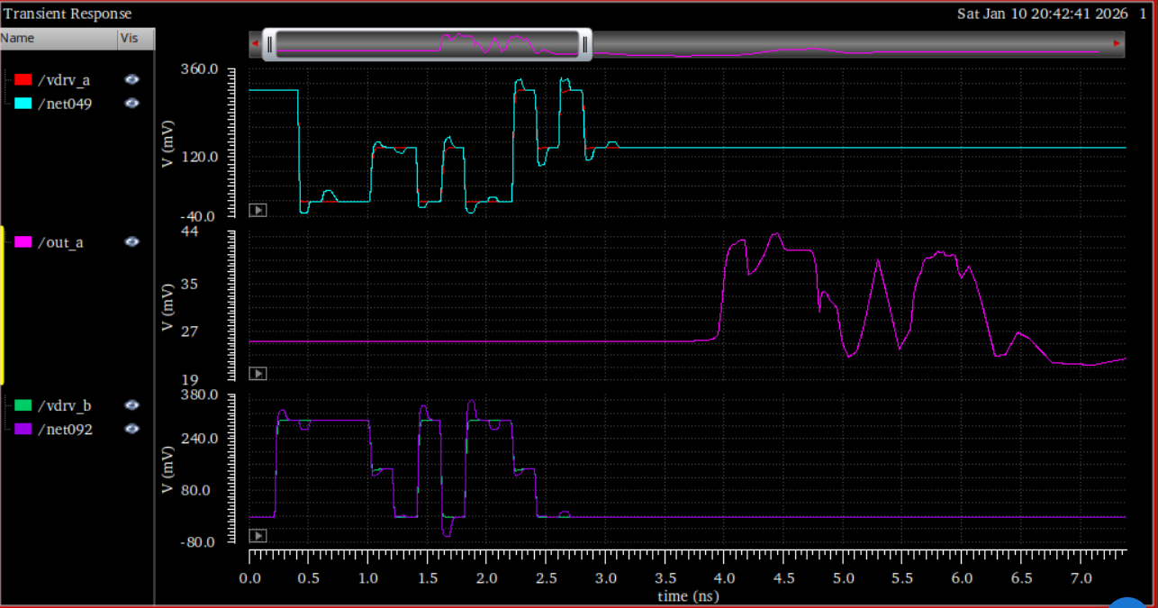
Graph with TX FIR equalization
Outbound data
Hybrid output
Inbound data

Slide 12
Graph with TX FIR equalization
Outbound data
Hybrid output
Inbound data

Slide 13
Outbound data
Before Tx equalization
Slightly improved level separation
After Tx equalization
Hybrid output
Inbound data
Outbound data
Hybrid output
Inbound data

Slide 14
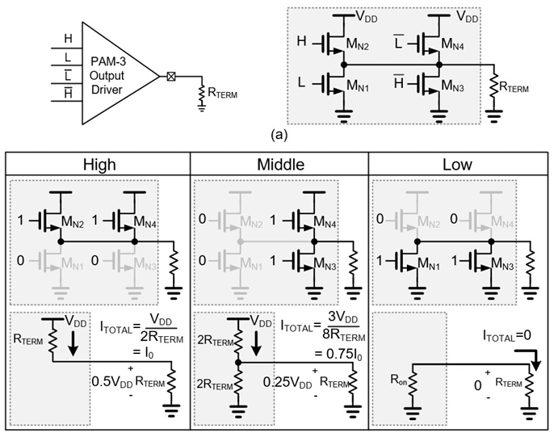
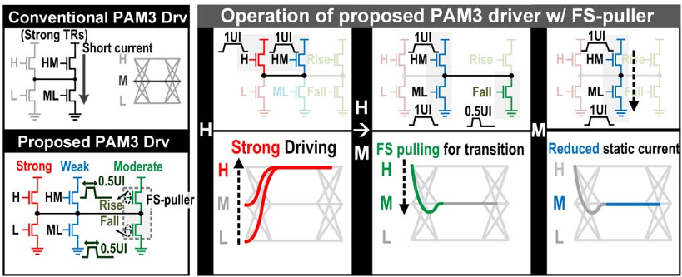
30-Gb/s 1.11-pJ/bit Single-Ended PAM-3 Transceiver for High-Speed Memory Links (JSSC 2021)
A 0.275pJ/b 42Gb/s/pin Clock-Referenced PAM3 Transceiver Tolerant to Supply Noise, Reference Offset and Crosstalk for Chiplets and Short-Reach Memory Interfaces (ISSCC 2025)
Driver
Equalization
  Tx: N/A
  Rx: DFE + CTLE
Clock-referenced PAM3
  Transmitter: a_k = {-A, 0, A}
    D(t) = a_k + n(t)
    CLK_p(t) = +A + n(t)
    CLK_n(t) = -A + n(t)
  Receiver: n(t) gets cancelled
    y_p(t) = D(t) – CLK_p(t) = a_k - A
    y_n(t) = D(t) – CLK_n(t) = a_k + A
Driver
Equalization
  Tx: capacitive-peaking + implicit equalization from FS-puller
  Rx: DFE

Slide 15
ISSCC 2025 paper
Promises
  Noise cancellation
  Reduced static current, power consumption
Drawbacks
  Nonlinear source
    Mid-level impedance control
PAM 2.5, PAM4

