Slide 1
Nvidia paper NRZ

Slide 2
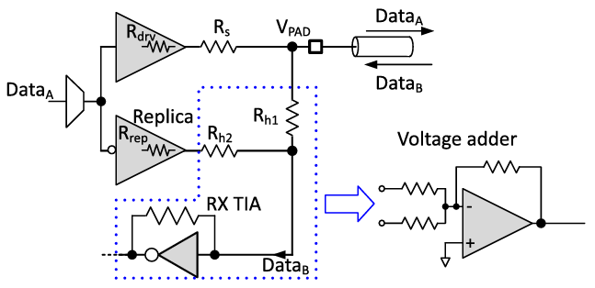
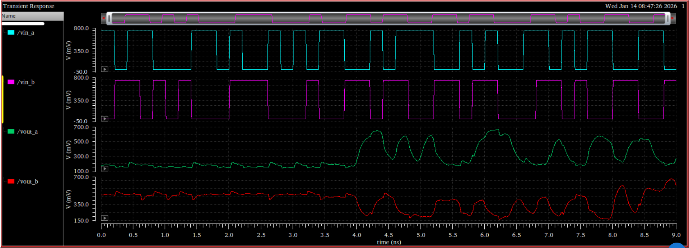
vin_a
vin_a == vout_b
vin_b == vout_a
with 3.77ns channel delay
vout_a

Slide 3
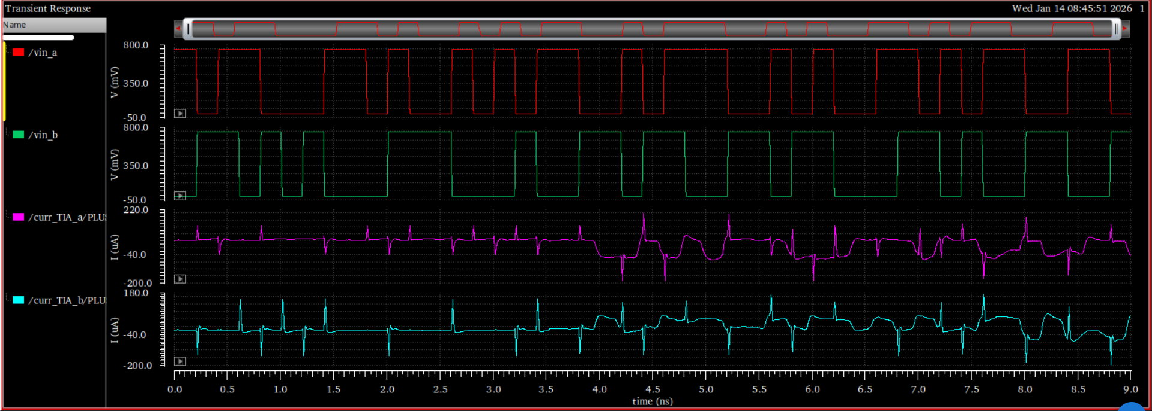
vin_a
curr_TIA_a

Slide 4
Nvidia paper PAM3

Slide 5
vin_a
vin_a == vout_b
vin_b == vout_a
with 3.77ns channel delay
vout_a

Slide 6
vin_a
curr_TIA_a

Slide 7
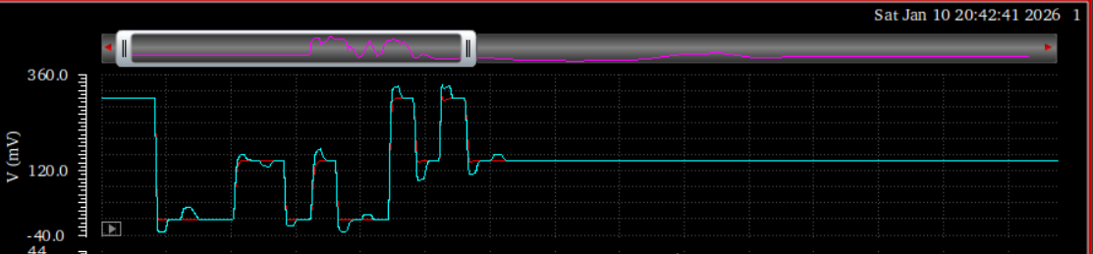

Problem from last time (Tx FIR equalization)

Slide 8
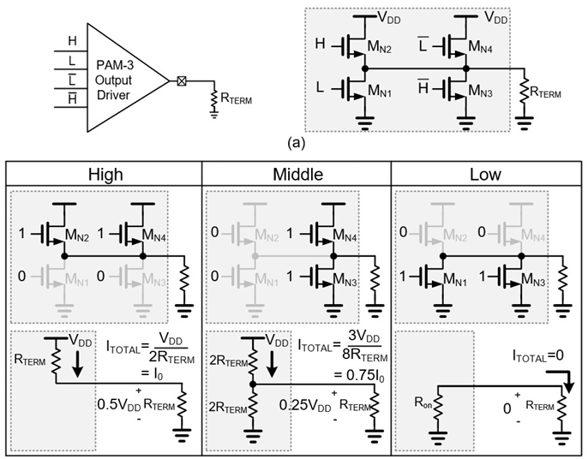
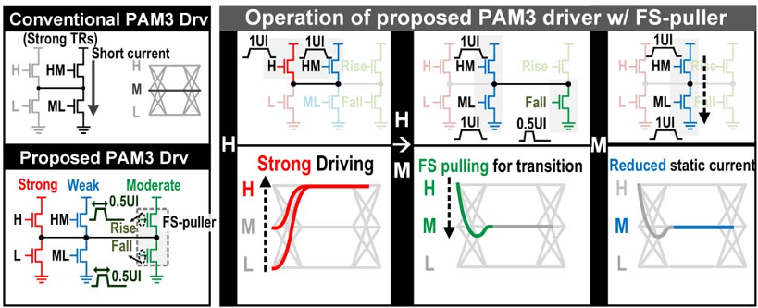
30-Gb/s 1.11-pJ/bit Single-Ended PAM-3 Transceiver for High-Speed Memory Links (JSSC 2021)
A 0.275pJ/b 42Gb/s/pin Clock-Referenced PAM3 Transceiver Tolerant to Supply Noise, Reference Offset and Crosstalk for Chiplets and Short-Reach Memory Interfaces (ISSCC 2025)
Driver
Equalization
  Tx: N/A
  Rx: DFE + CTLE
Clock-referenced PAM3
  Transmitter: a_k = {-A, 0, A}
    D(t) = a_k + n(t)
    CLK_p(t) = +A + n(t)
    CLK_n(t) = -A + n(t)
  Receiver: n(t) gets cancelled
    y_p(t) = D(t) – CLK_p(t) = a_k - A
    y_n(t) = D(t) – CLK_n(t) = a_k + A
Driver
Equalization
  Tx: capacitive-peaking + implicit equalization from FS-puller
  Rx: DFE

