Slide 1
High-Speed Wireline Link Optimization
Extension of Junbo’s MATLAB Model to Simultaneous Bidirectional Signaling for Die-to-Die

Slide 2
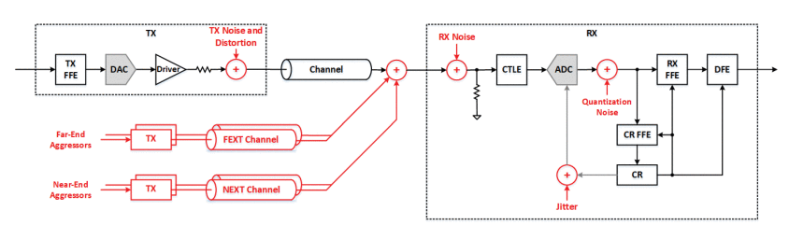
Current block diagram
Key changes required:
Remove clock recovery
Enable Tx and Rx on both sides of channel
Enable hybrid circuit for near-end echo cancellation

Slide 3
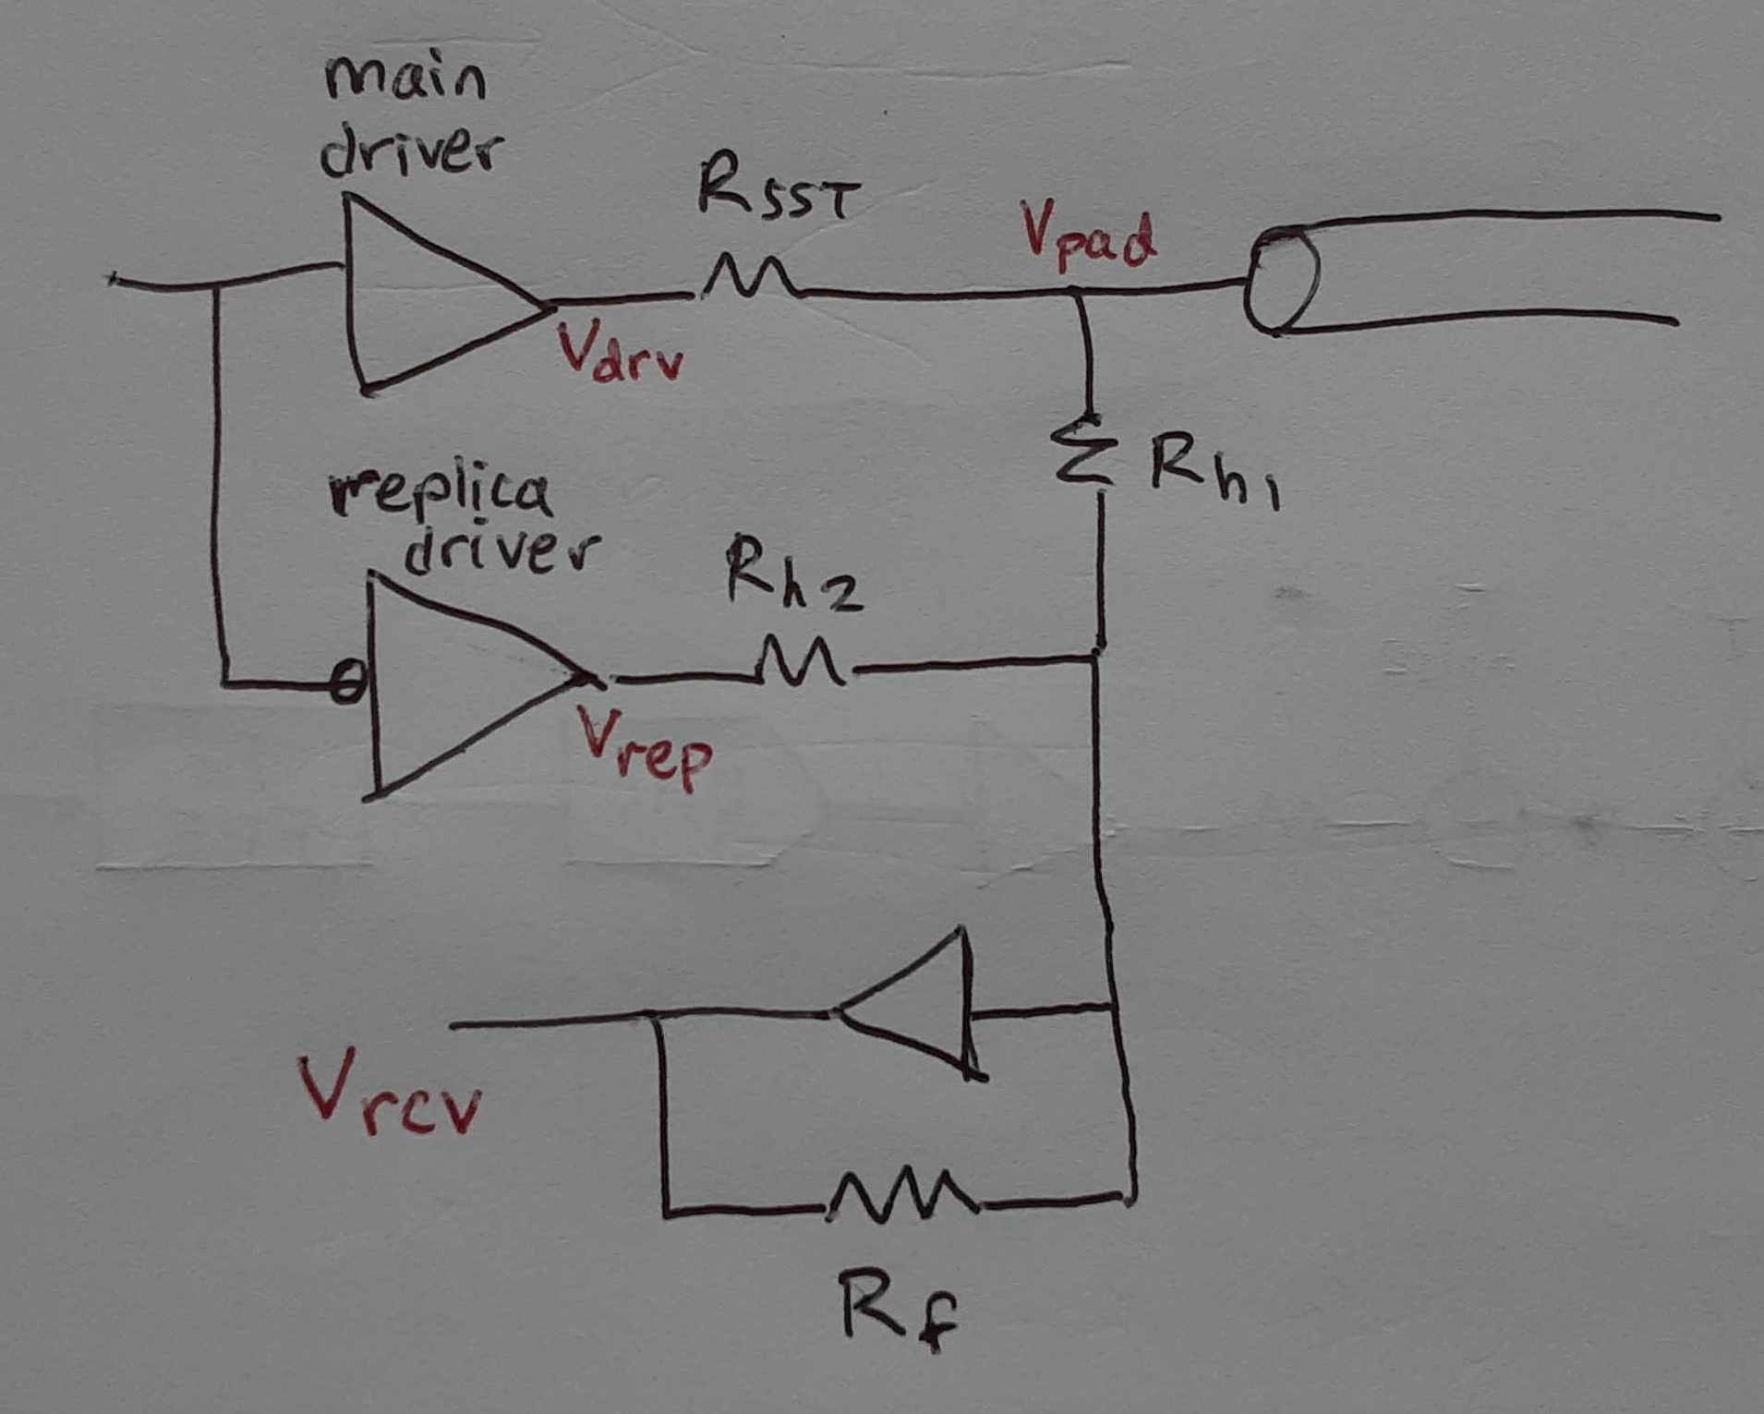
Hybrid circuit for near-end echo cancellation

Slide 4
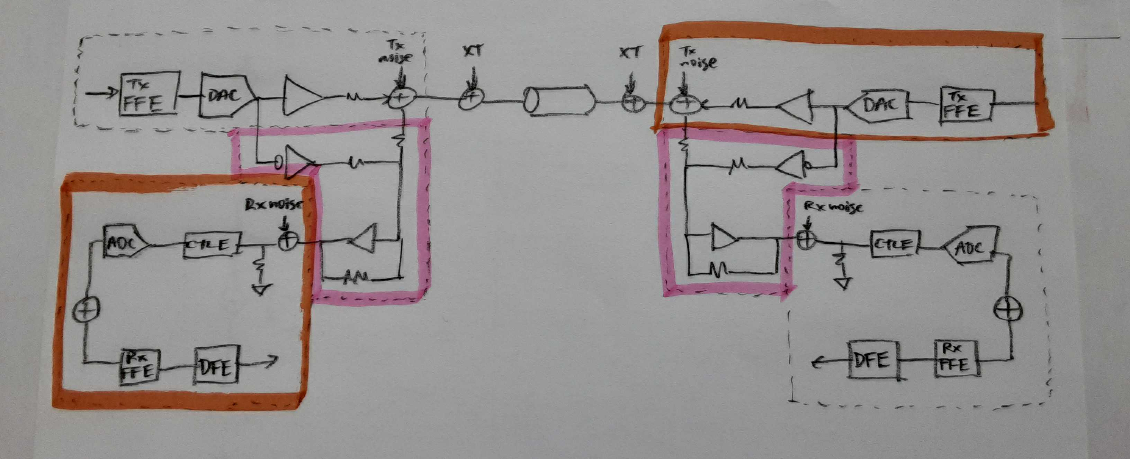
Proposed block diagram
Added Tx and Rx on both sides of channel
Added hybrid circuit for near-end echo cancellation

Slide 5
Current Code Flow

Slide 6
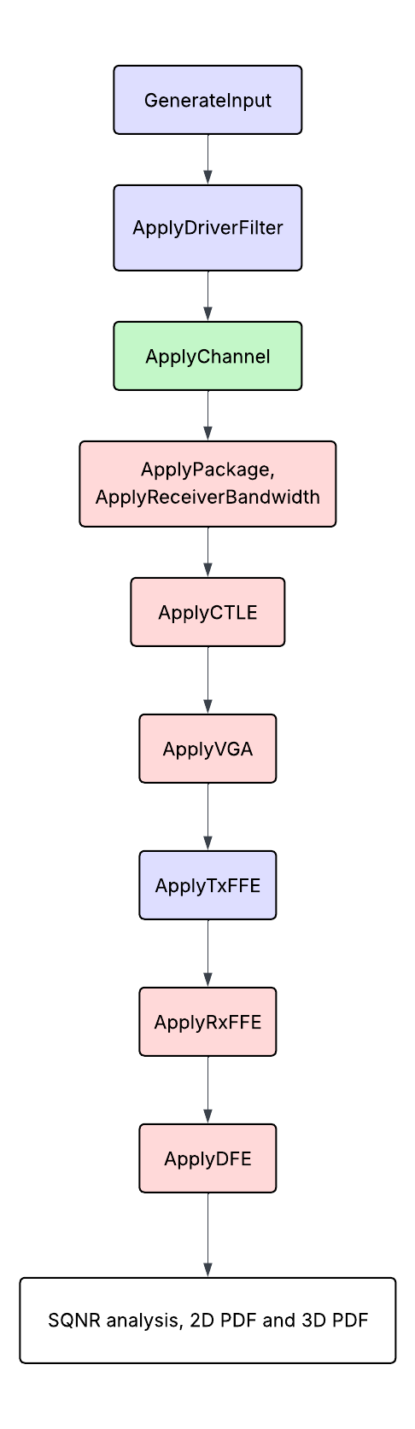
Transmitter
Channel
Receiver

Slide 7
Proposed Code Flow

Slide 8
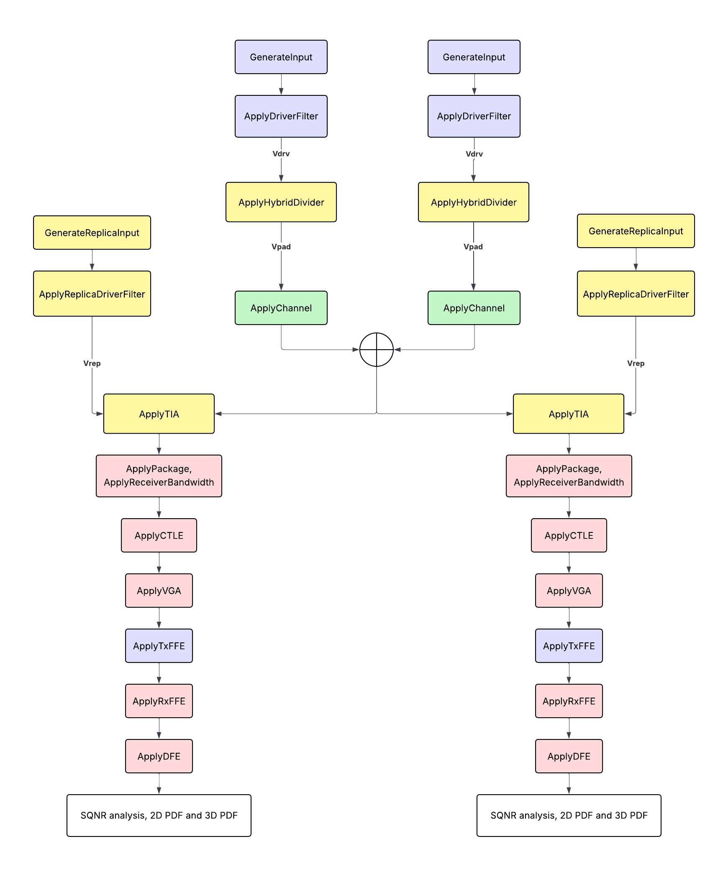
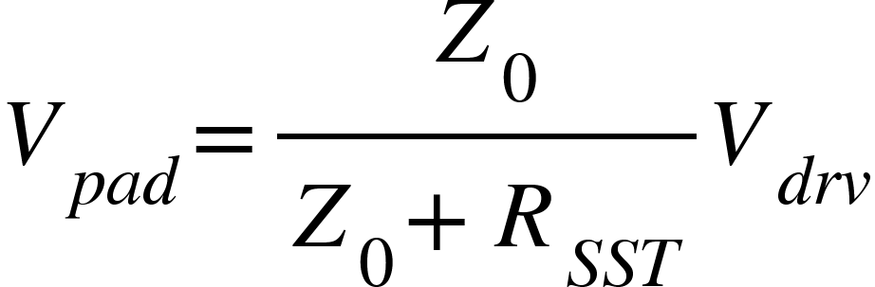
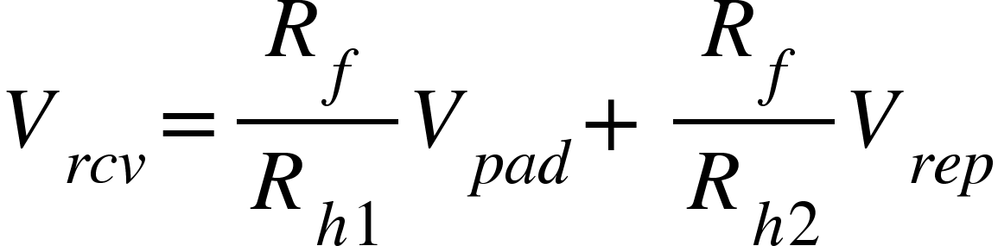
GenerateReplicaInput = GenerateInput
ApplyReplicaDriverFilter = ApplyDriverFilter
Transmitter
Channel
Receiver
Hybrid
ApplyHybridDivider
ApplyTIA

