Slide 1
Nvidia paper LTSpice Simulation
Satvick Acharya

Slide 2
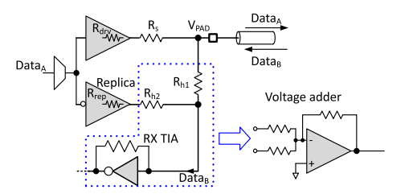
Component | LTSpice implementation
Main driver | 2-transistor CMOS inverter
Replica driver | 2-transistor CMOS inverter
Rx TIA | 2-transistor CMOS inverter with feedback resistor
Transmission line | LTSpice “tline”
5 nm transistors | From ChatGPT: .model M1 nmos level=54 version=4.7 tox=1.0n nch=1 u0=250 vsat=1.2e7 vth0=0.35 + rdsw=100 vdsat=0.1 cox=3e-2 cgso=1e-10 cgdo=1e-10 .model M17 pmos level=54 version=4.7 tox=1.0n nch=1 u0=90 vsat=1.0e7 vth0=-0.35 + rdsw=100 vdsat=0.1 cox=3e-2 cgso=1e-10 cgdo=1e-10
Main driver

Slide 3
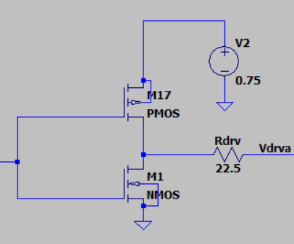
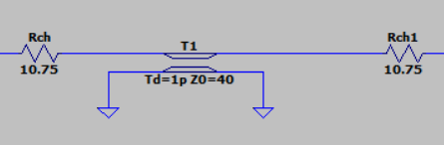
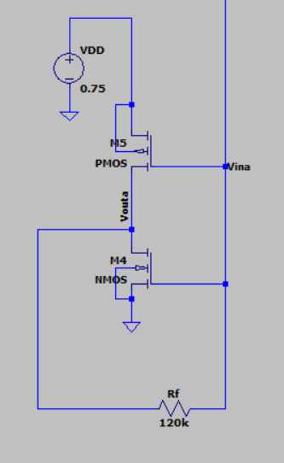
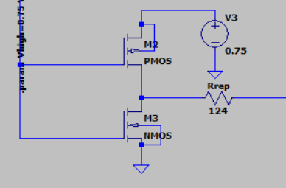
Channel
Main driver
TIA
Replica driver

Slide 4
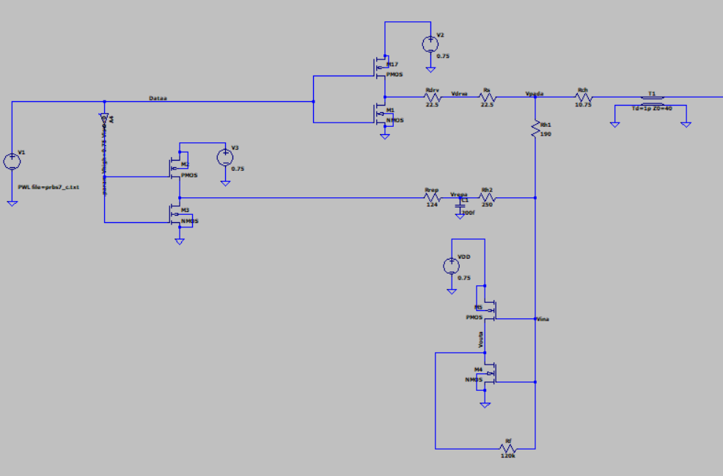
Main driver
Channel
Replica driver
TIA

Slide 5
Vdrv
Vdata
Vrep
Vout

Slide 6
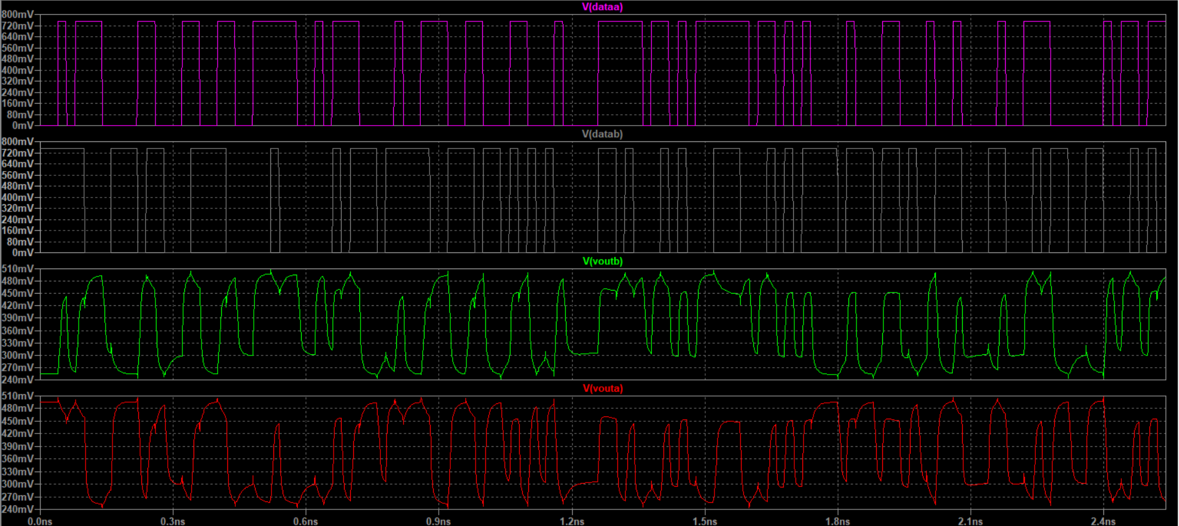
Vdata_a = Vout_b and Vdata_b = Vout_a

Slide 7
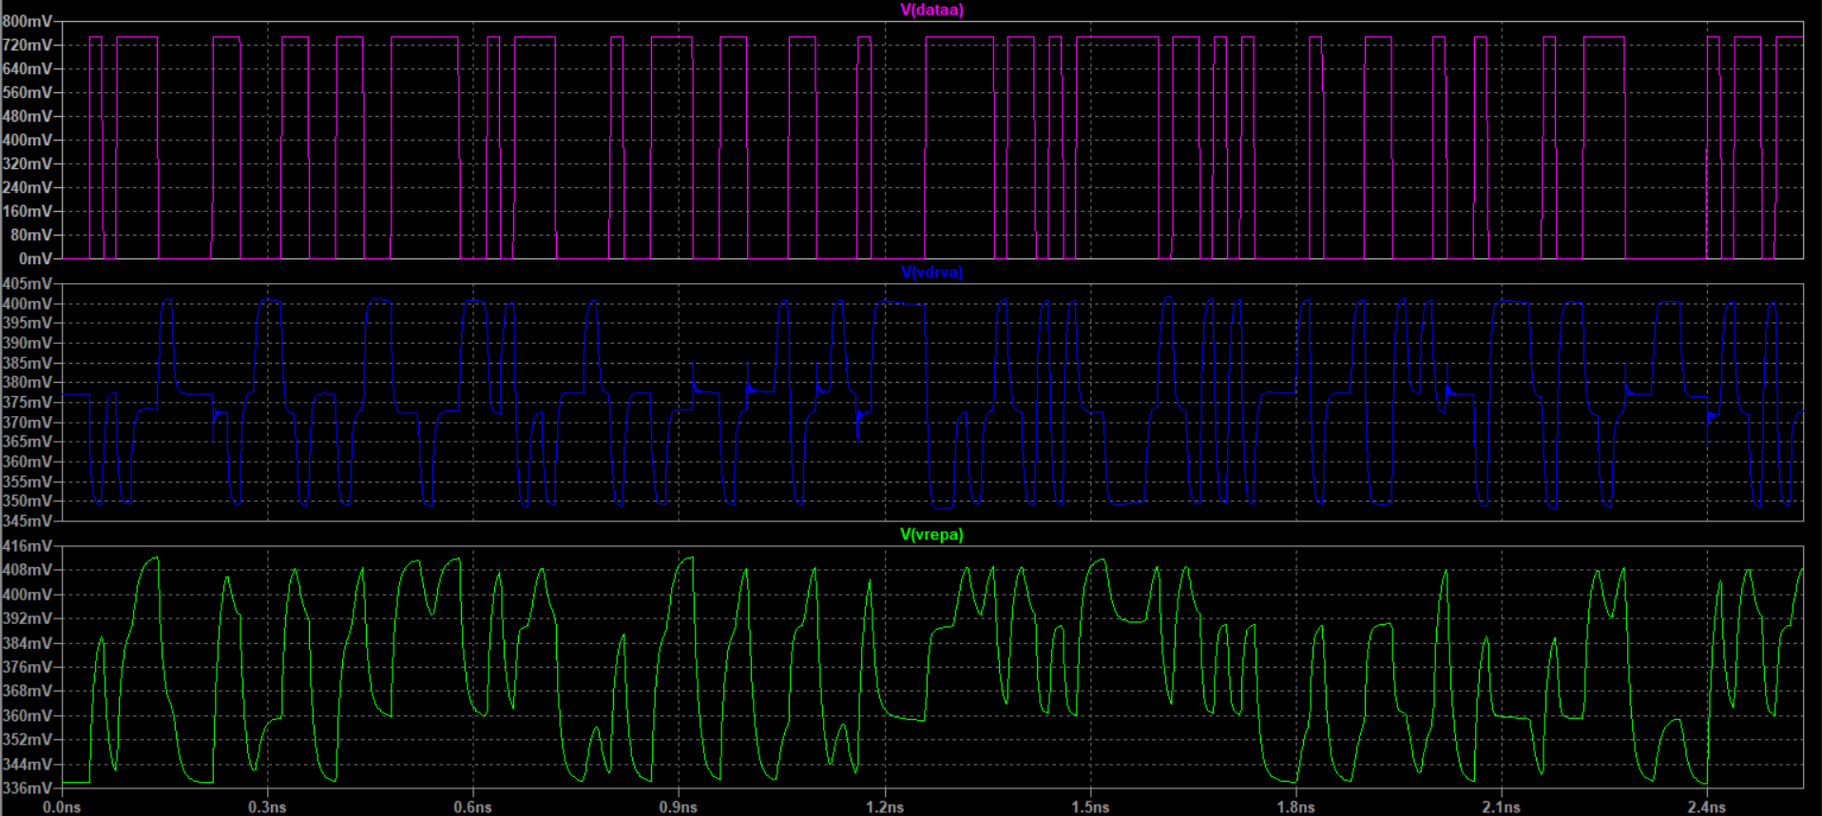
Vdrv_a is a flipped version of Vrep_a

Slide 8
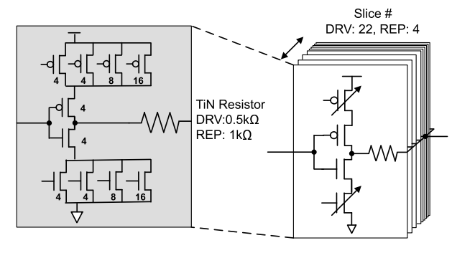
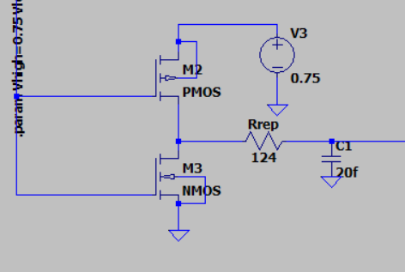
Deviations from paper / limitations of my simulation
Main and replica driver topology is different in the paper
I used a 1 ps delay transmission line with no timing/synchronization circuitry
I will need to implement this eventually
Extra shunt capacitance at replica driver output
I added this later, because without it, I was unable to achieve Vout_a = Vdata_b or Vout_b = Vdata_a
It helped me achieve Vdrv = Vrep by mimicking the loading effect of the channel

Slide 9
My questions
How can I better model this driver circuit?
I am unsure what the “slices” are referring to as I don’t think it was referenced anywhere else in the paper.
My understanding is that circuits are needed at the replica driver output (like the shunt capacitance I used). What kinds of circuits are commonly used and how does each component impact the shaping of the replica signal?

Slide 10
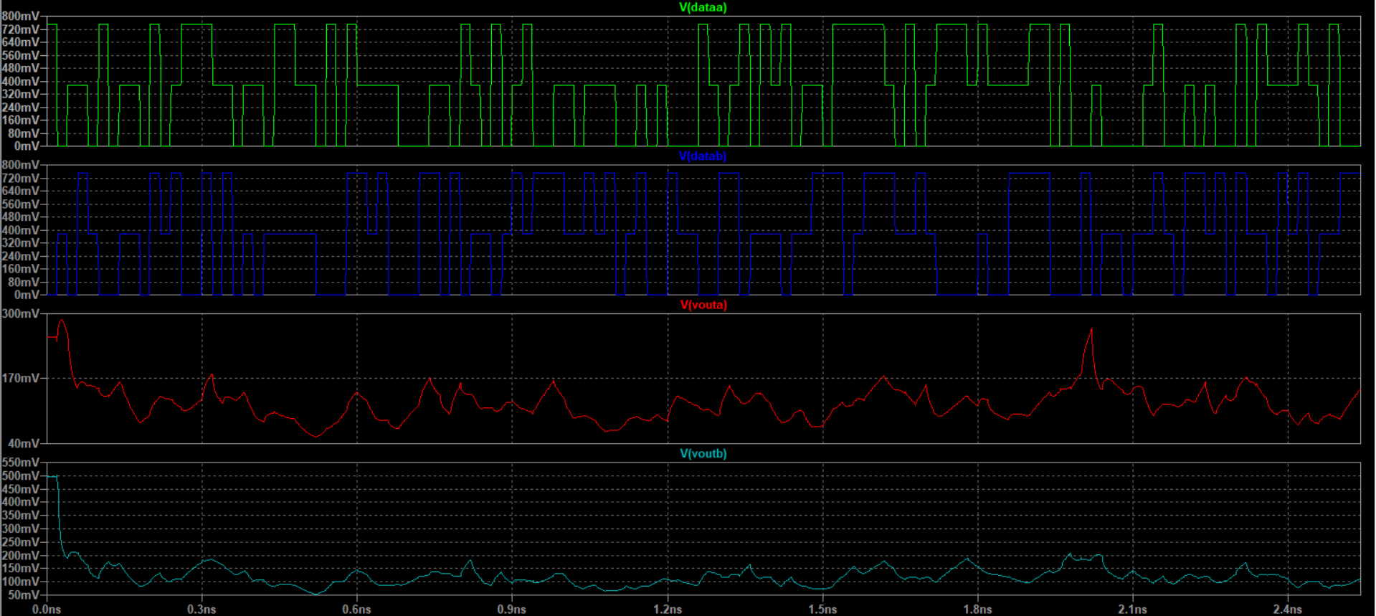
Using the exact same circuit but with PAM3 input signals
I’m going to start experimenting with approaches to improve this result

