Slide 1
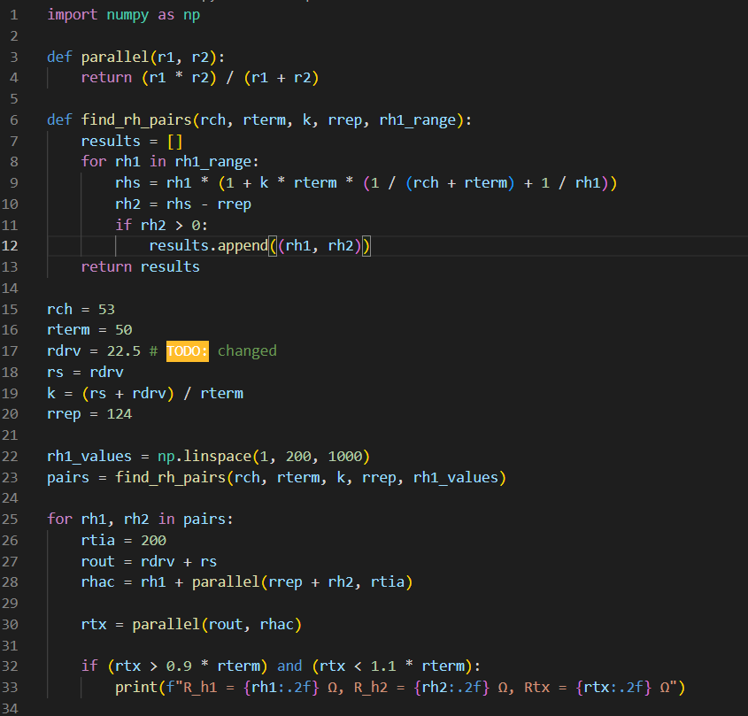
I wrote a Python script to sweep values of Rh1 and Rh2 and provide pairs of values which satisfy both (1) cancellation and (2) termination criteria
Using the exact Rdrv/Rrep parameters from the paper, there are several pairs of Rh1, Rh2 values which satisfy cancellation, but none which yield a termination Rtx near 50.

Slide 2
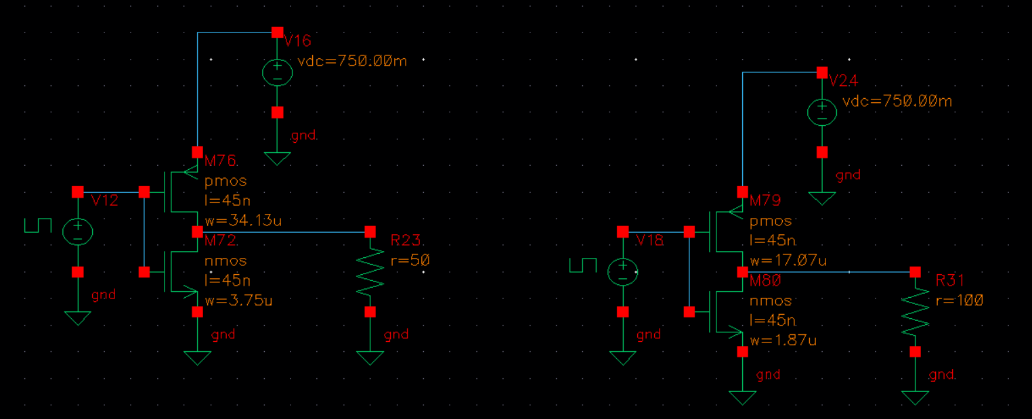

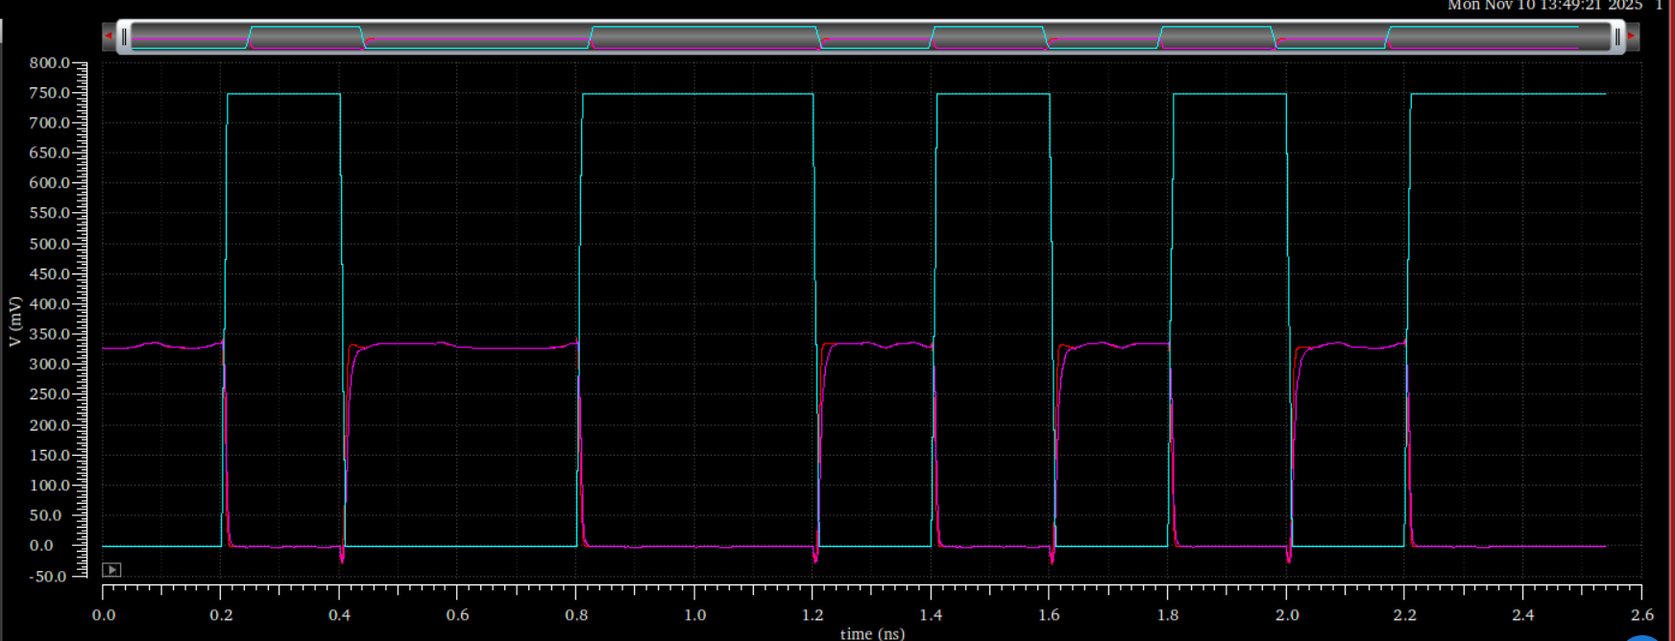
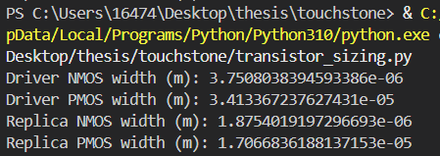
I adjusted my Rdrv and Rrep and sized the CMOS inverters using the parameters from the 45nm BSIM4 files
Driver: Ron = 50
Replica: Ron = 100

Slide 3
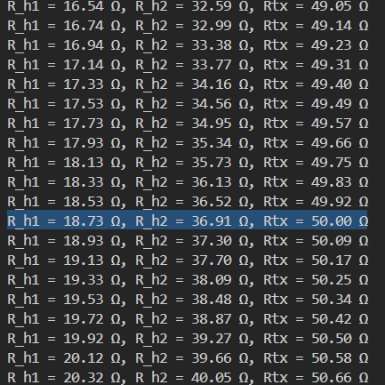
I recalculated the required Rh1 and Rh2 values

Slide 4
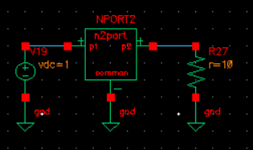
I converted the differential s4p file into a single-ended s2p file using MATLAB and extracted Rch using a DC stimulus
Rch = 53
(paper: 21.5)
Seems plausible since this file is for a long reach channel instead of a die-to-die link

Slide 5
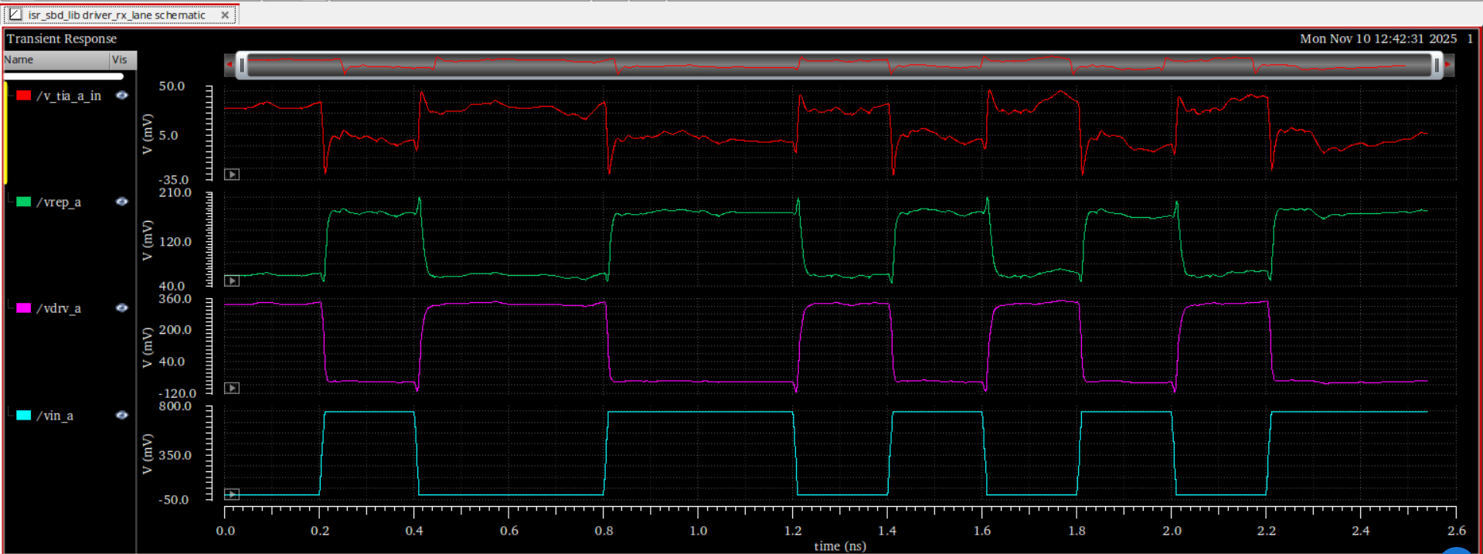
Zeroing out the signal on the other side of the channel: Vdrv and Vrep are complements and Vrx has low ripple, therefore cancellation is satisfied

Slide 6
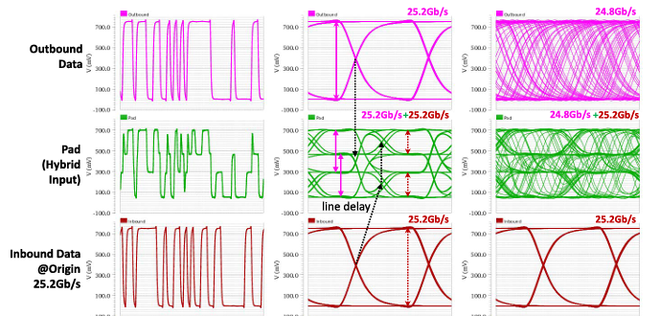
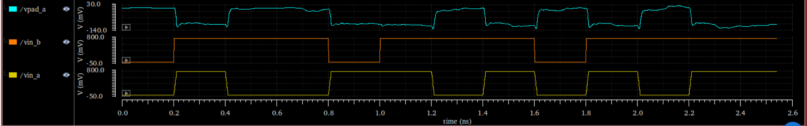
With voltage stimulus from both ends activated, Vpad is supposed to look like a PAM3 signal
Is the outbound signal being attenuated to the point where is disappears at the end of the channel?

Slide 7
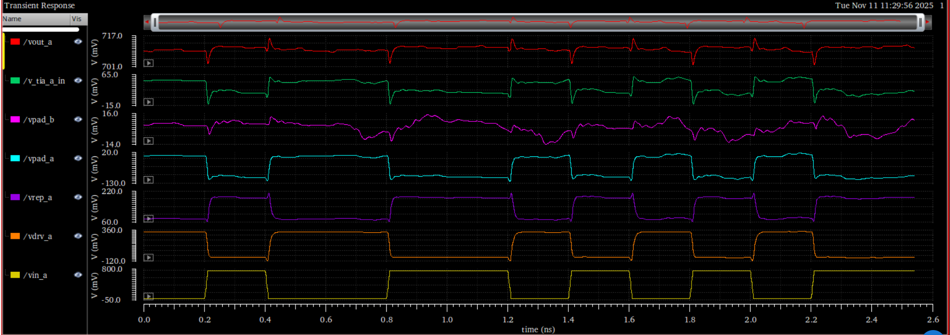
Voltage stimulus at opposite side of channel set to zero again: Vpad on other side of channel is basically 0

