Slide 1
Last week
Attempted s4p-s2p conversion
  Used incorrect port mapping, Junbo provided corrected s2p file
  Z0=100 instead of 50
  Learned about channel propagation delay
Wrote scripts to size transistor widths, Rh1, Rh2
This week:
Resize all components based on new channel
Verify cancellation and termination

Slide 2
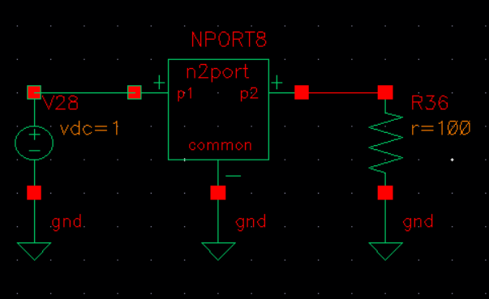
Z0 = 100, Rch = 9.5

Slide 3
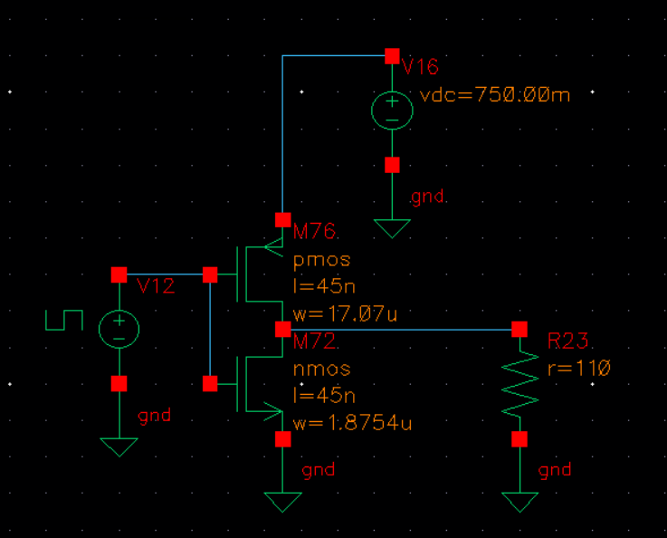
Rdrv=110, Rrep=110 → Rh1=52.5, Rh2=268

Slide 4
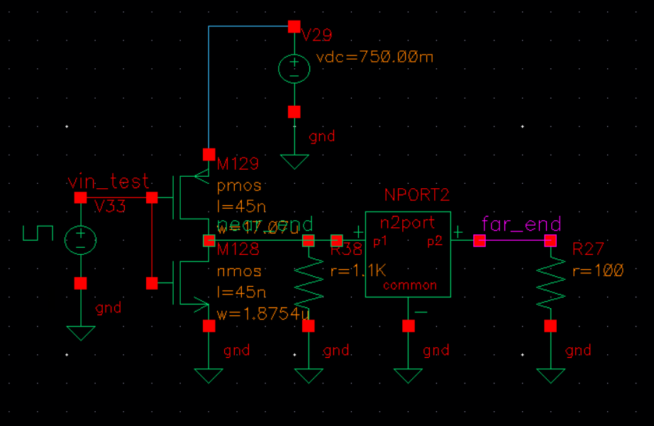
Channel behavior

Slide 5
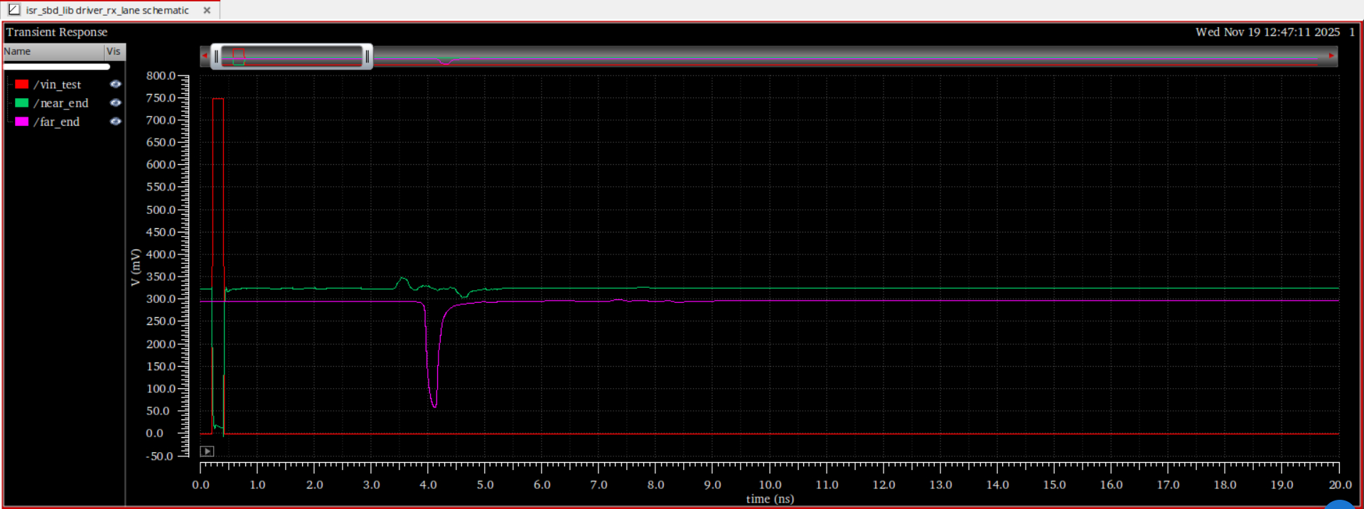
Channel behavior: delay=3.8ns

Slide 6
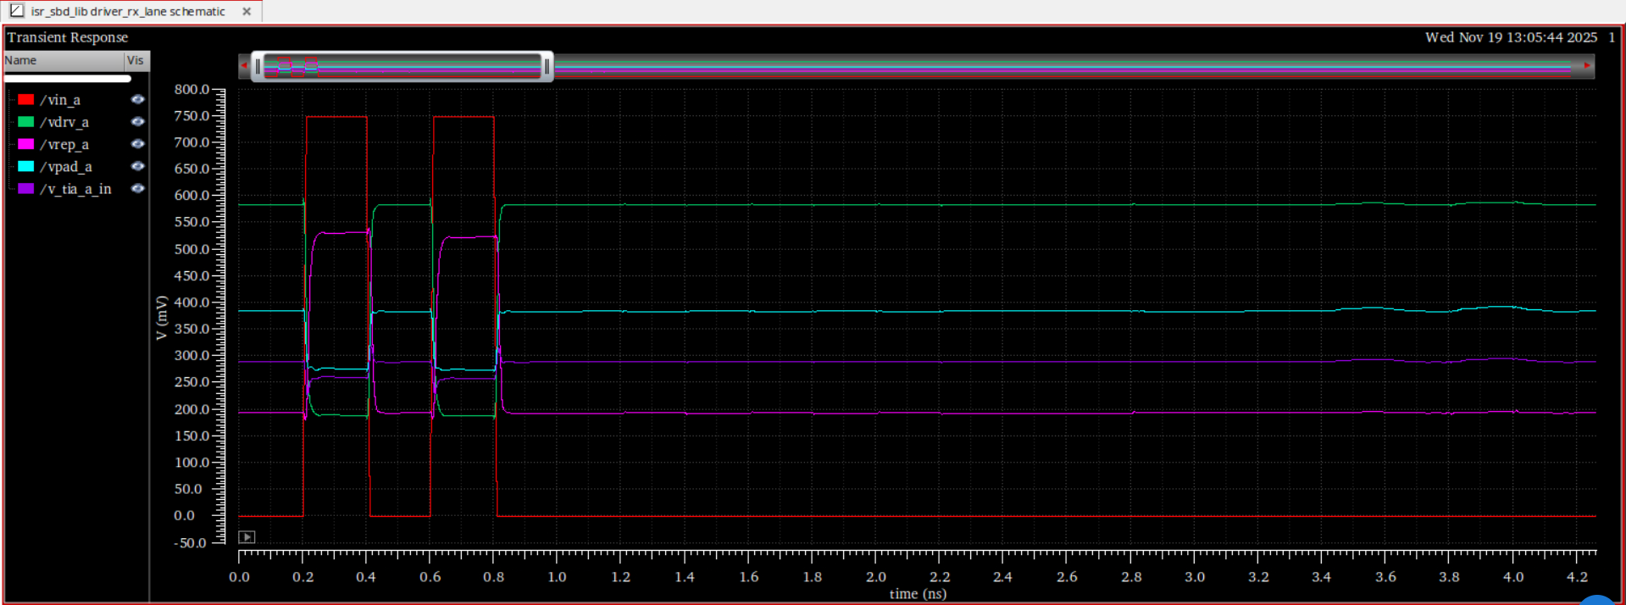
Checking for cancellation condition (Vrx=0 when far end signal is set to 0)

Slide 7
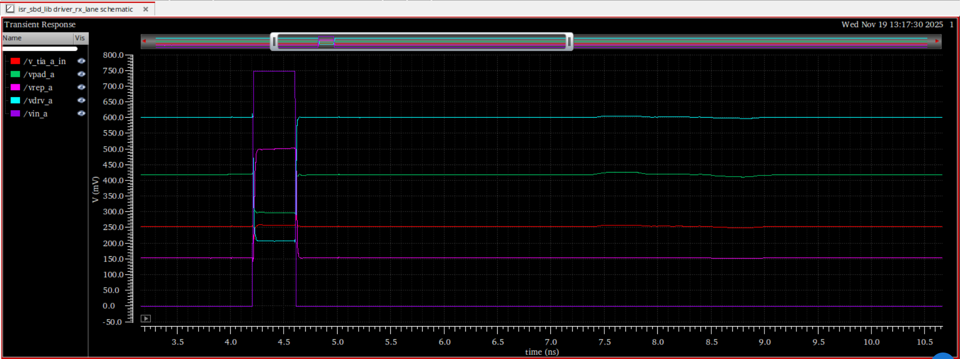
Rh1=52.5 → Rh2=100

Slide 8
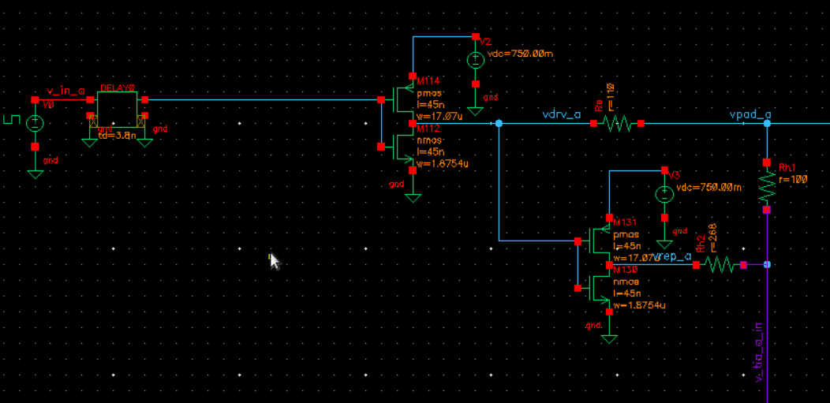
Full circuit with stimulus from both sides and delay to account for channel propagation

Slide 9
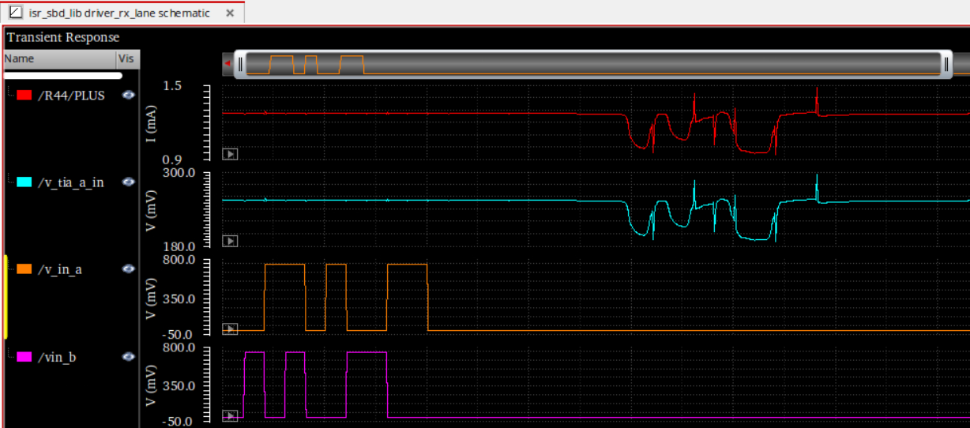
Full circuit with stimulus from both sides and delay to account for channel propagation

