Slide 1
November 26
Formal proof, clarifying details of operation

Slide 2
Things to discuss
Odd behavior with Rh1 sizing
Explanation for equations of operation
Explanation for main driver and replica driver sizing

Slide 3
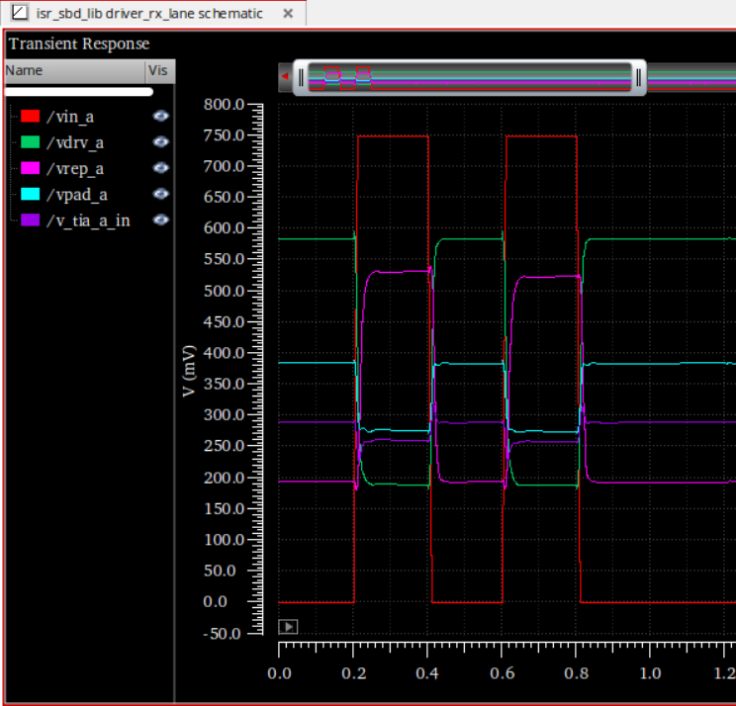
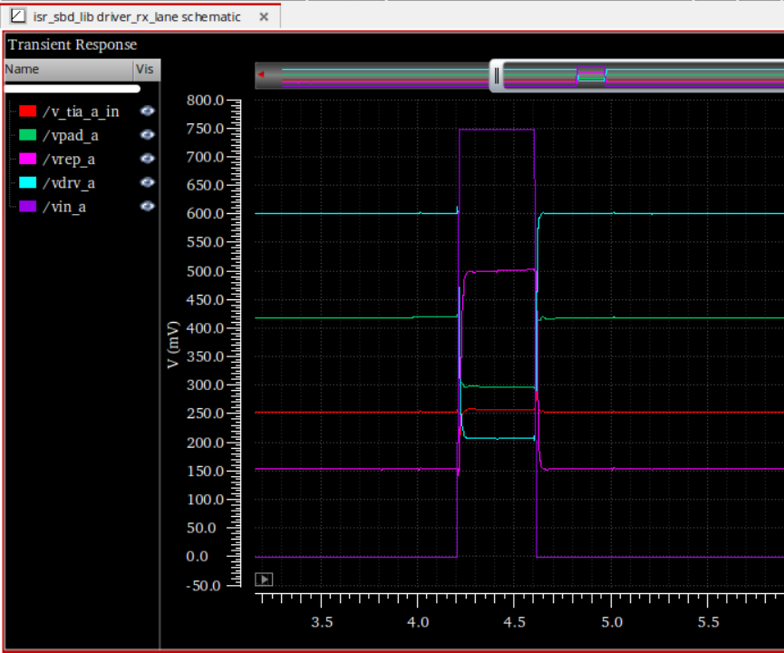
Odd behavior observed last time: Rh1 = 52.5 → Rh1 = 100

Slide 4
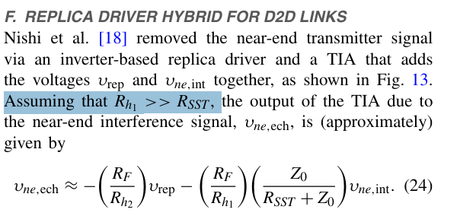
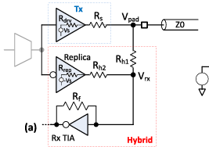

Explanation

Slide 5
Equations of operation
@ 0.5Vdd with 0.5Vdd swing
@ 0.5Vdd with 0.33Vdd swing
@ 0.5Vdd with Vdd swing
@ Vdd/2 with 100 mV swing

Slide 6
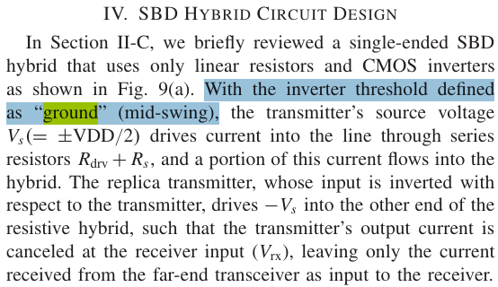
Equations of operation
@ 0.5Vdd with 0.5Vdd swing
@ 0.5Vdd with 0.33Vdd swing
@ 0.5Vdd with Vdd swing
The paper defines 0.5Vdd (in their case 0.375V) to be the “ground reference”
This makes the TIA input node a “virtual ground”
The feedback resistor in the TIA maintains input node at 0.5Vdd
@ Vdd/2 with 100 mV swing

Slide 7
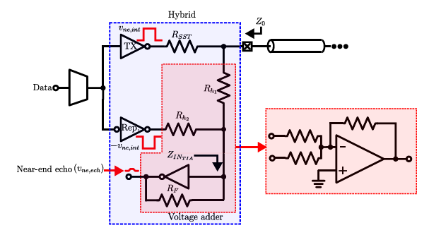

This allows them to treat the TIA as a “near ideal op-amp” → TIA input draws 0 current

Slide 8
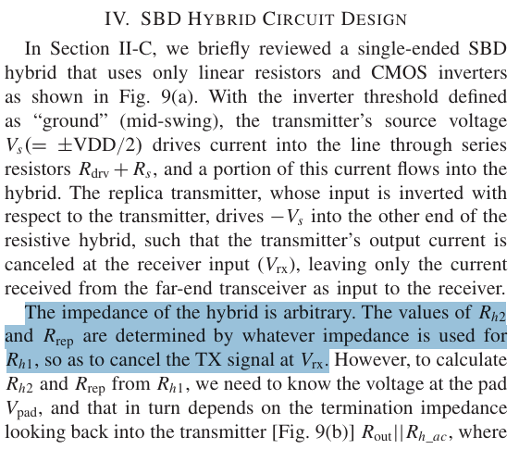
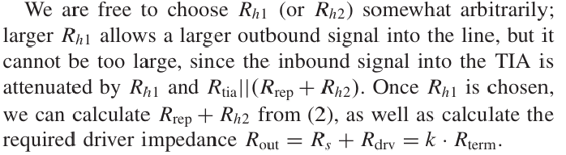
Main driver and replica driver sizing

Slide 9

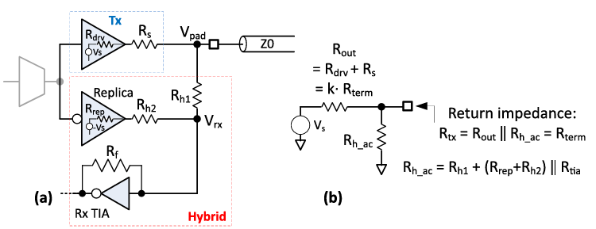
Hybrid circuit design process (version 1)
Choose Rh1, Rh2
Known: Rf
Choose Rdrv, Rs
Calculate Rrep to ensure signal cancellation:
Calculate Rtx and change k if Rtx != Z0:
Hybrid circuit design process (version 2)
Choose Rh1, Rrep
Known: Rf
Choose Rdrv, Rs
Calculate Rh2 to ensure signal cancellation:
Calculate Rtx and change k if Rtx != Z0:

Slide 10
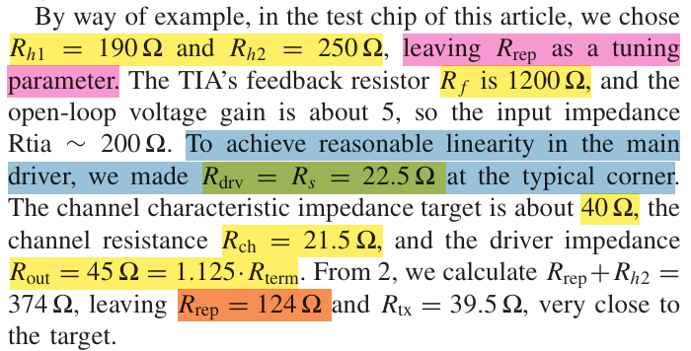
Making Rs = Rdrv maximizes linearity by keeping the nonlinear contribution (Rdrv(V)) to half of the total output impedance.

Slide 11
Regardless, I tried a different Rdrv, Rrep configuration since we established that replicas are usually smaller (by a factor of ~5) to reduce power consumption
Last time:
Rdrv = 110
Rrep = 110
Rh1 = 52.5 100
Rh2 = 268
This time:
Rdrv = 55
Rrep = 275
Rh1 = 918
Rh2 = 1675

