Slide 1
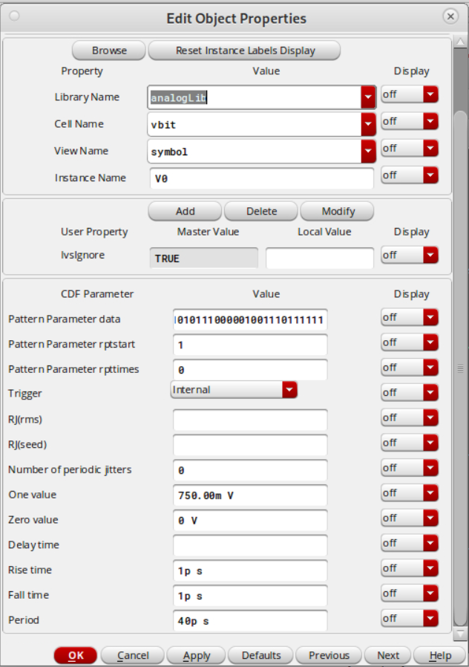
Input stimulus signal

Slide 2
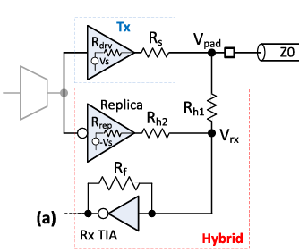
Parameters from paper:
Rdrv = 22.5
Rs = 22.5
Rh1 = 190
Rh2 = 250
Rf = 1.2k
Rtia = 200
Rch = 21.5
Z0 = 40
Rrep = 124 (tuned)

Slide 3

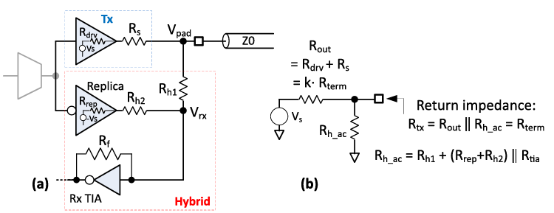
Hybrid circuit design process (version 1)
Choose Rh1, Rh2
Known: Rf
Choose Rdrv, Rs
Calculate Rrep to ensure signal cancellation:
Calculate Rtx and change k if Rtx != Z0:
Hybrid circuit design process (version 2)
Choose Rh1, Rrep
Known: Rf
Choose Rdrv, Rs
Calculate Rh2 to ensure signal cancellation:
Calculate Rtx and change k if Rtx != Z0:

Slide 4
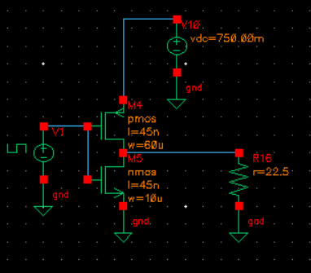
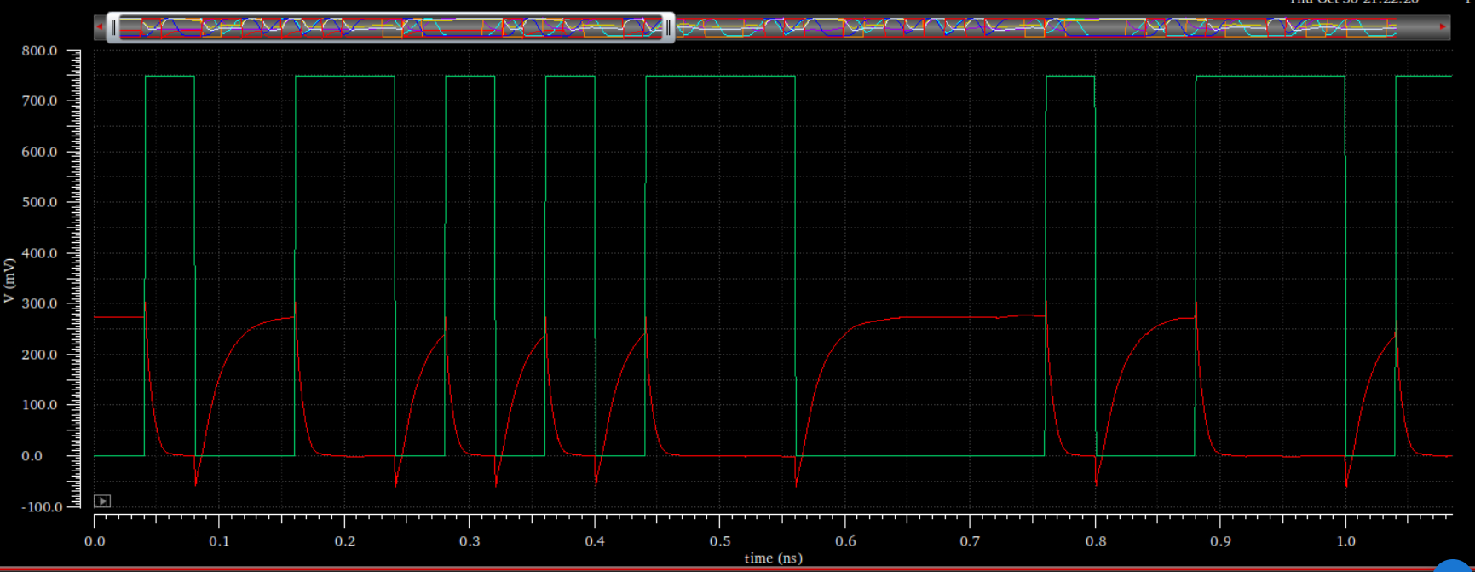
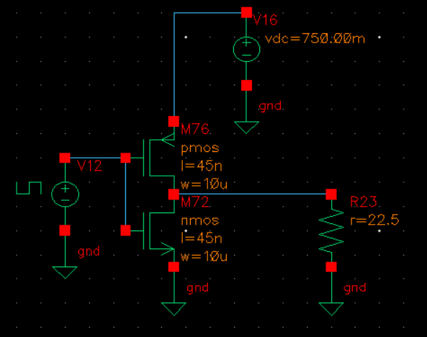
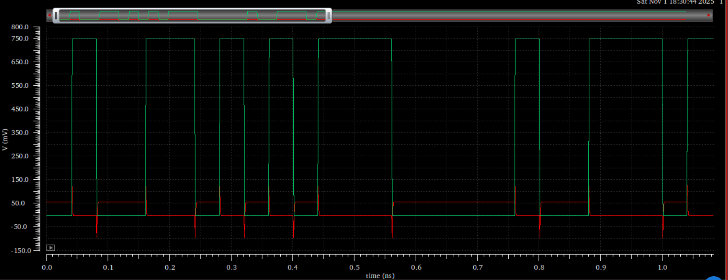
Rdrv = 39
Rrep = 273

Slide 5
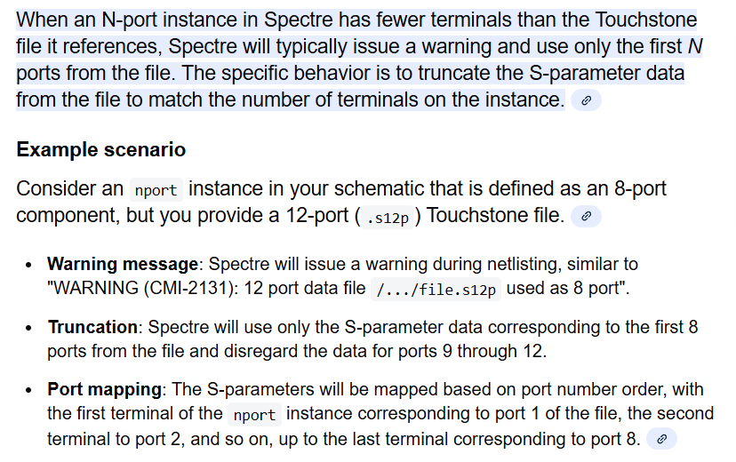
Channel:
Nvidia paper uses single-ended signaling but the s4p file assumes differential signaling

Slide 6
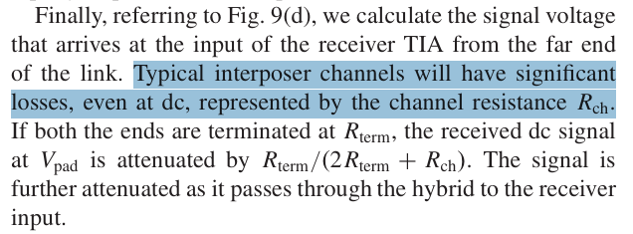
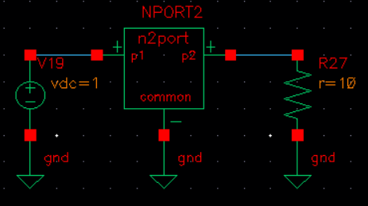
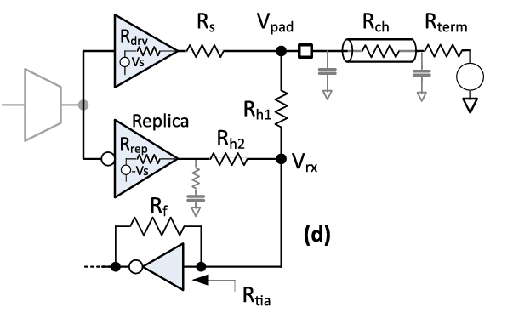
Finding Rch of the channel described by the s4p file
Rch = 0.9 ohms???
V = 1
V = 0.917

Slide 7
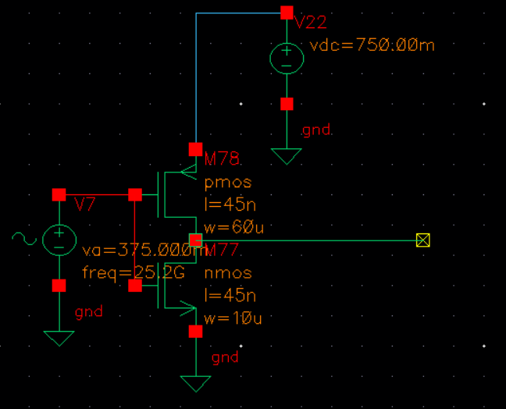
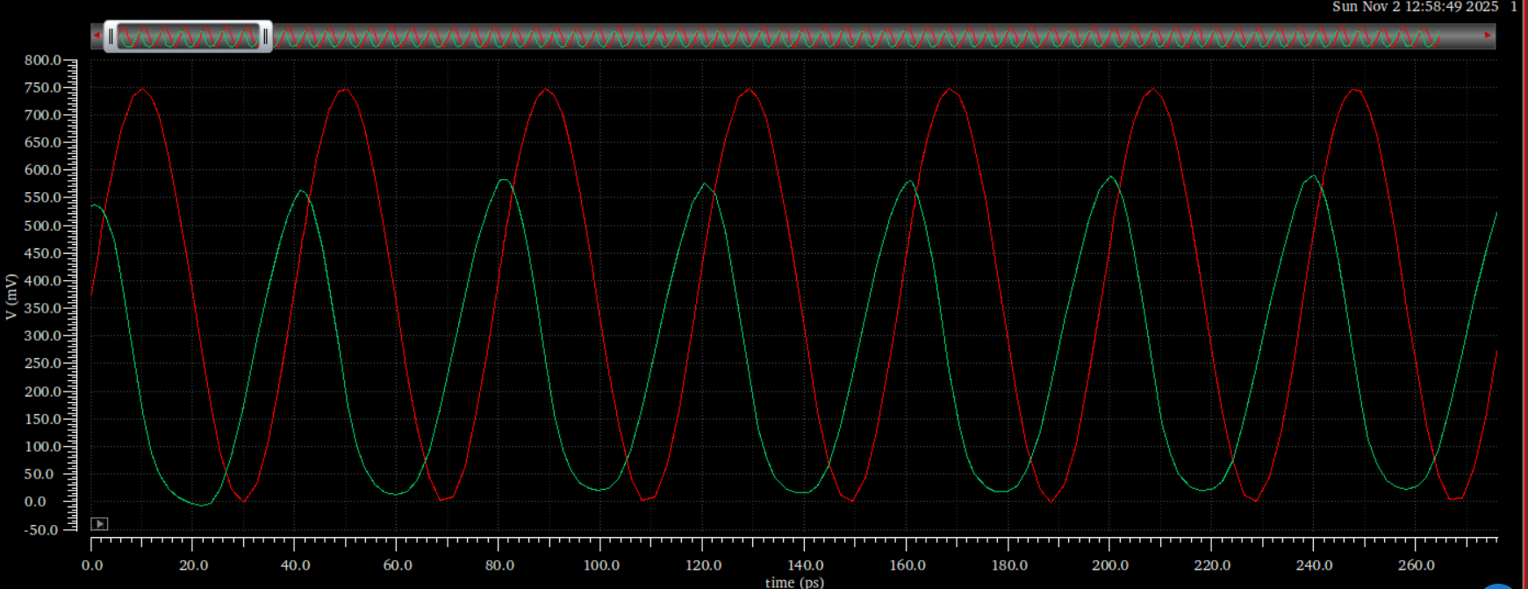
Transimpedance amplifier:
Rtia = Rf / (1 + Av) = 677

Slide 8
My parameters:
Rdrv = 39
Rrep = 273
Rs = 22.5
Rh1 = 190
Rf = 1.2k
Rtia = 677
Rch = 0.9
Z0 = 50
Rh2 = 207.4 (tuned)
Check:
Rtx = 54 ≈ 50

Slide 9
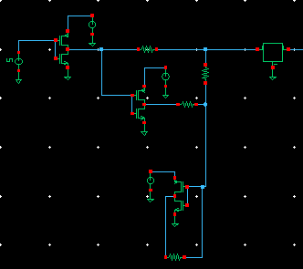
Vdrv
Other side is same, except stimulus voltage is 0
Vrep
Vrx

Slide 10
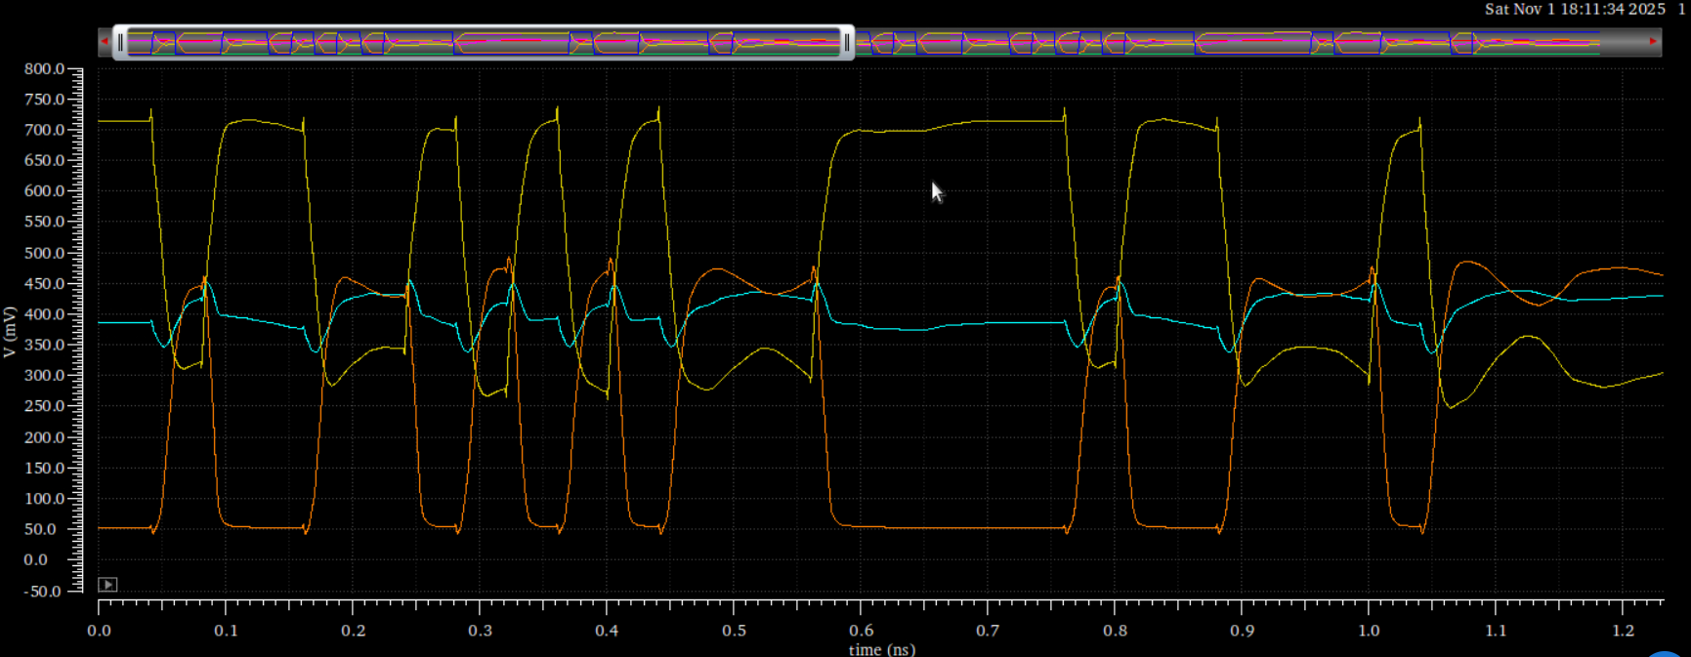
Vdrv
Vrep
Vrx
Goal: Vrx = constant dc voltage

Slide 11
Now with stimulus from both sides:

