Slide 1
Weather Analysis Report
Interactive and visually engaging insights

Slide 2
Key Insights
1. Mean Squared Error (Rainfall Prediction): 31.64
2. Highest Rainfall Month: July
3. Lowest Rainfall Month: January

Slide 3
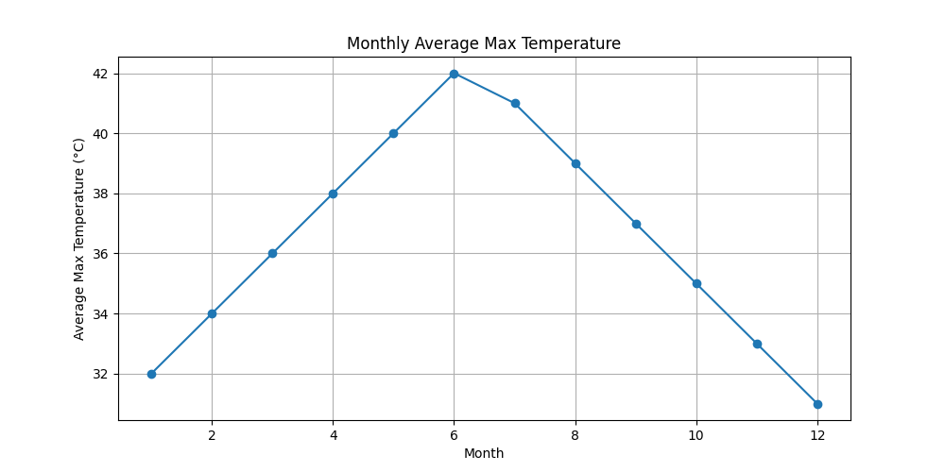
Monthly Average Max Temperature

Slide 4
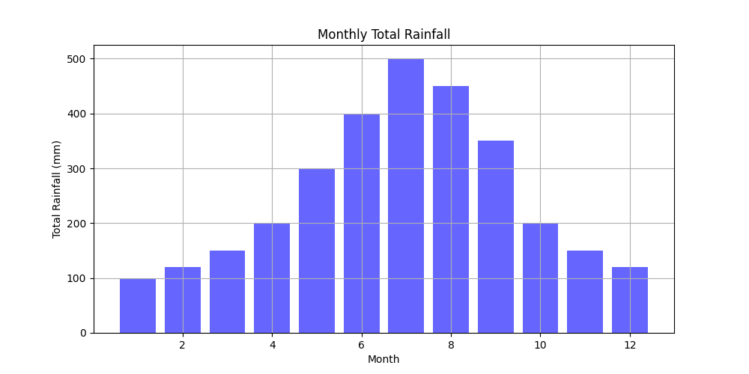
Monthly Total Rainfall

Slide 5
Conclusions and Future Work
1. Use advanced machine learning models (e.g., Random Forest) for predictions.
2. Incorporate additional datasets like wind speed or humidity.
3. Build an interactive web-based weather dashboard.

