Slide 1
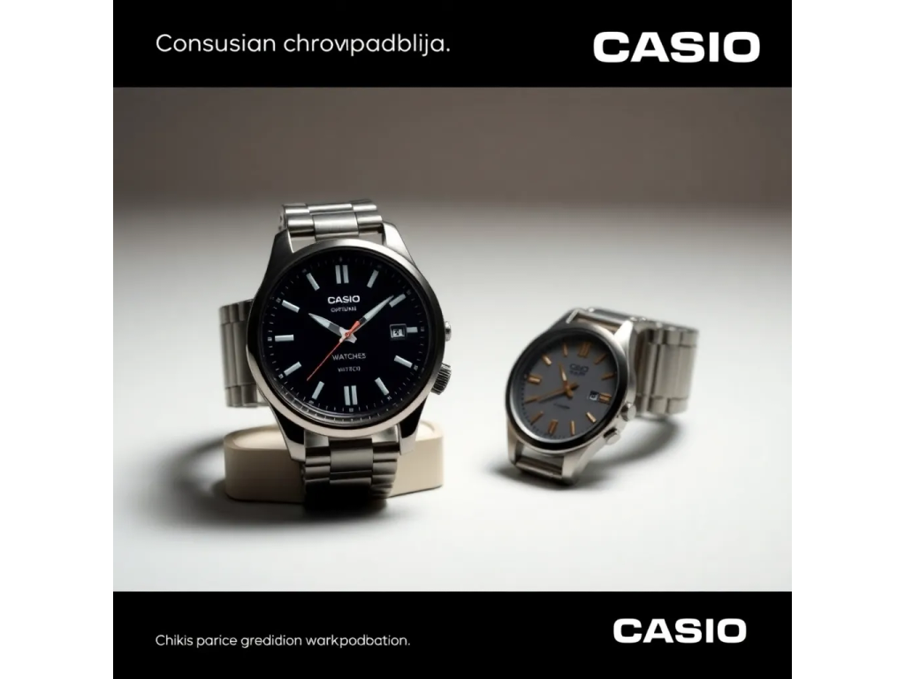
Sure, here is a 5-slide presentation about Casio Watches:

Slide 2

Slide 1: Introduction

Slide 3

* Casio Watches: A Brief Overview
* Founded in 1957, Casio has been a leader in the watch industry for over 60 years
* Known for their durability, style, and innovative technology

Slide 4

Slide 2: Main Features

Slide 5

* Shock-resistant design
* Water resistance up to 200 meters
* Advanced technology including stopwatch, timer, and alarm functions

Slide 6

Slide 3: Design Variety

Slide 7
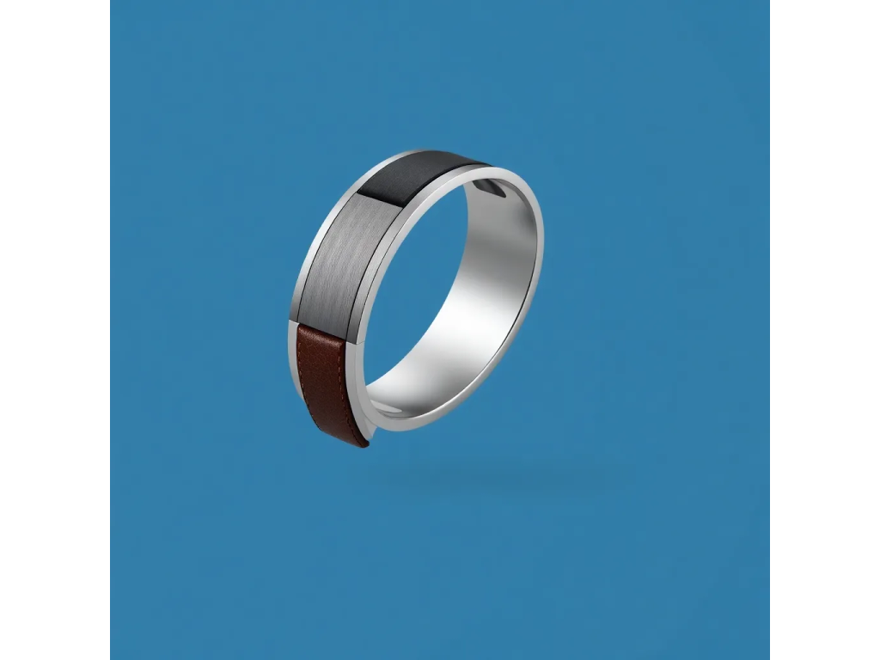
* Stainless steel, leather, and resin band options
* Diverse range of styles, from classic to sporty and trendy
* Customizable watch faces and interchangeable bands

Slide 8

Slide 4: Advanced Technology

Slide 9
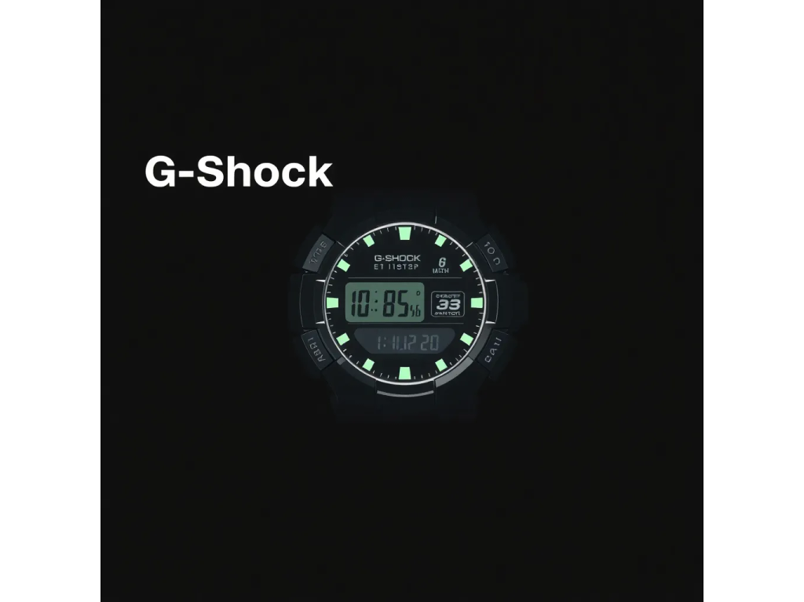
* G-Shock technology for shock resistance and durability
* Pro Trek technology for outdoor enthusiasts, including compass, thermometer, and altimeter
* Smartphone integration for notifications and fitness tracking

Slide 10

Slide 5: Conclusion

Slide 11
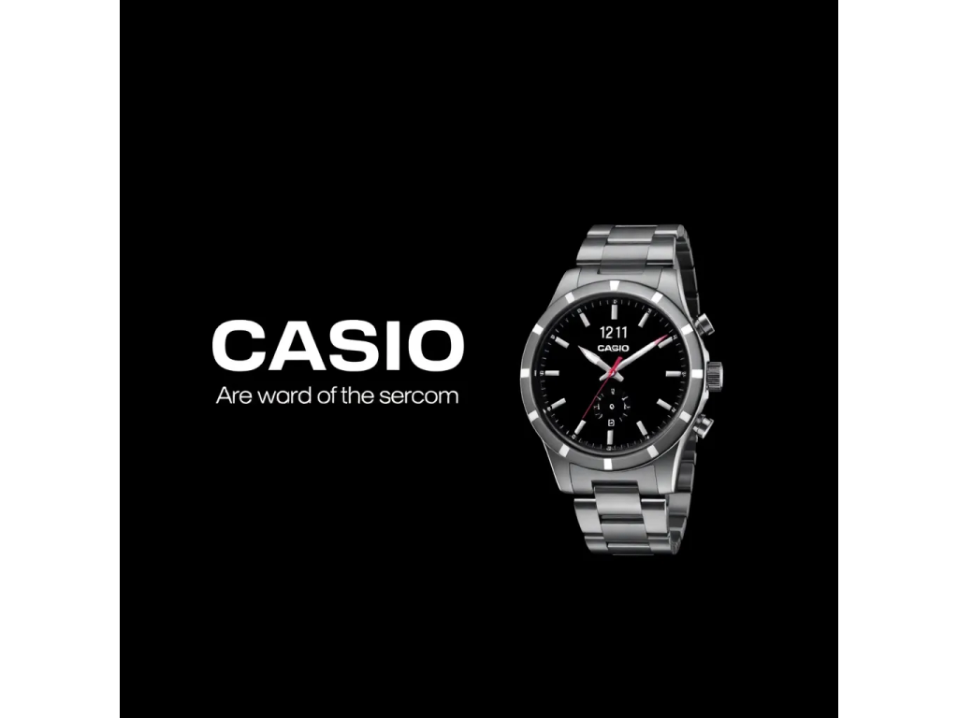
* Casio Watches: A Leader in the Watch Industry
* With their durability, style, and innovative technology, Casio watches are a popular choice for people of all ages and interests
* Whether for everyday wear or outdoor adventures, Casio watches have got you covered.

