Slide 1
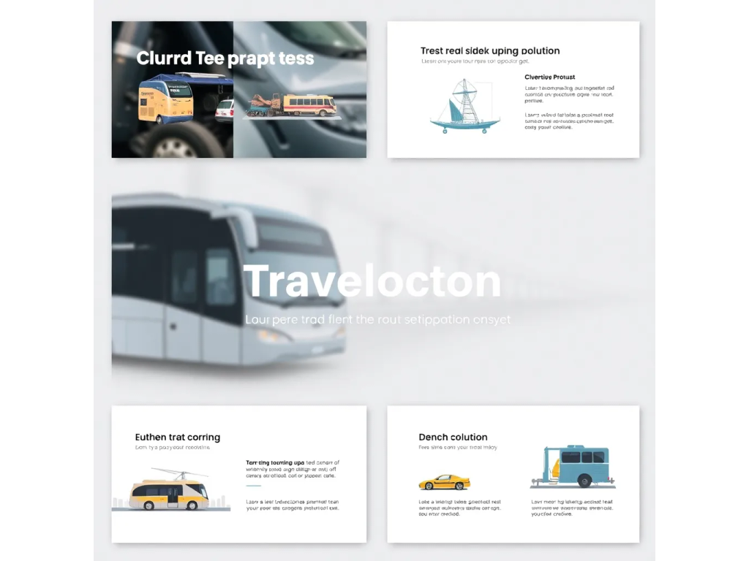
Sure, here is a 5-slide presentation about transportation:

Slide 2

Slide 1: Introduction

Slide 3
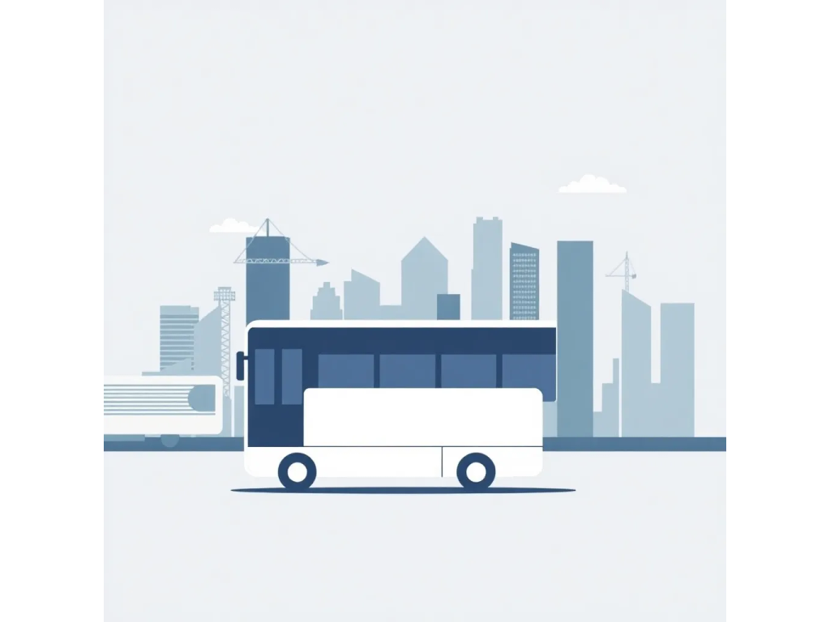
* Transportation is a vital part of modern society
* It enables the movement of people, goods, and services
* Efficient transportation systems are essential for economic growth and development

Slide 4
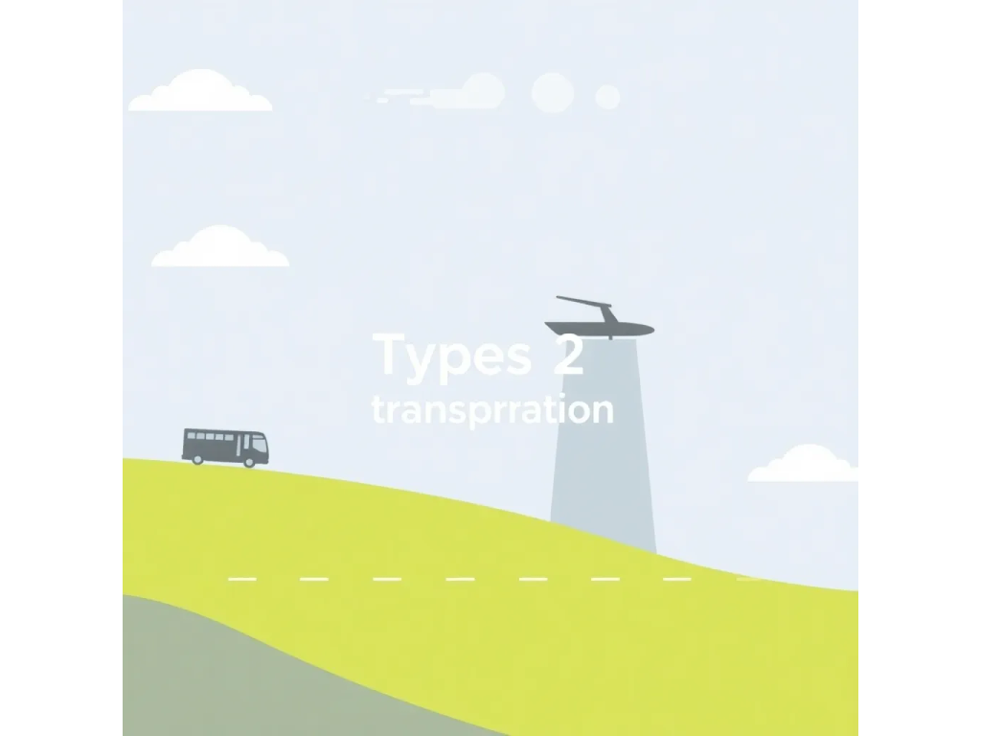
Slide 2: Types of Transportation

Slide 5
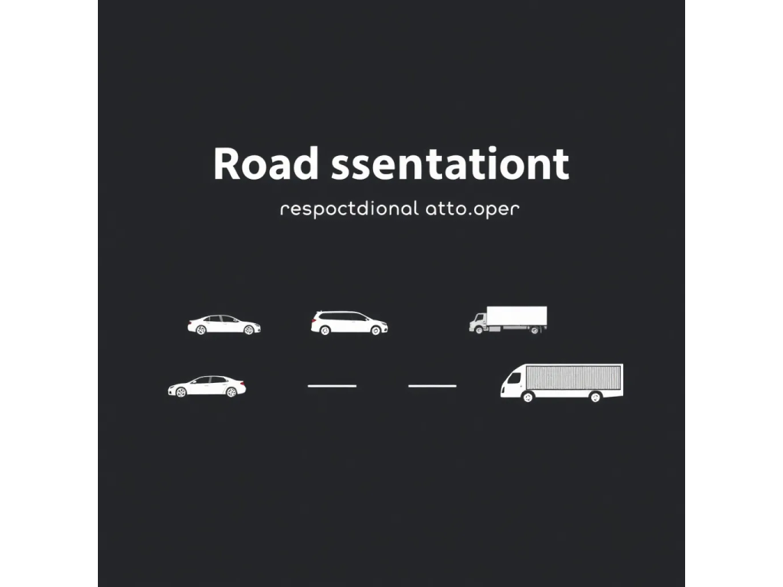
* Road transportation (cars, buses, trucks)
* Rail transportation (trains, subways)
* Air transportation (planes, helicopters)
* Water transportation (ships, boats)

Slide 6
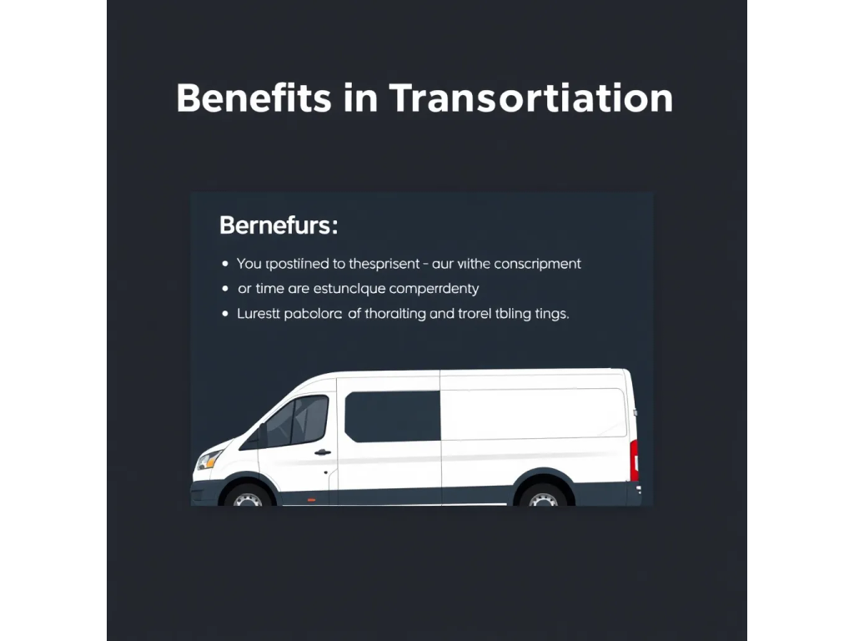
Slide 3: Benefits of Transportation

Slide 7

* Increased mobility and accessibility
* Improved connectivity and communication
* Boosts economic growth and trade
* Enhances quality of life

Slide 8
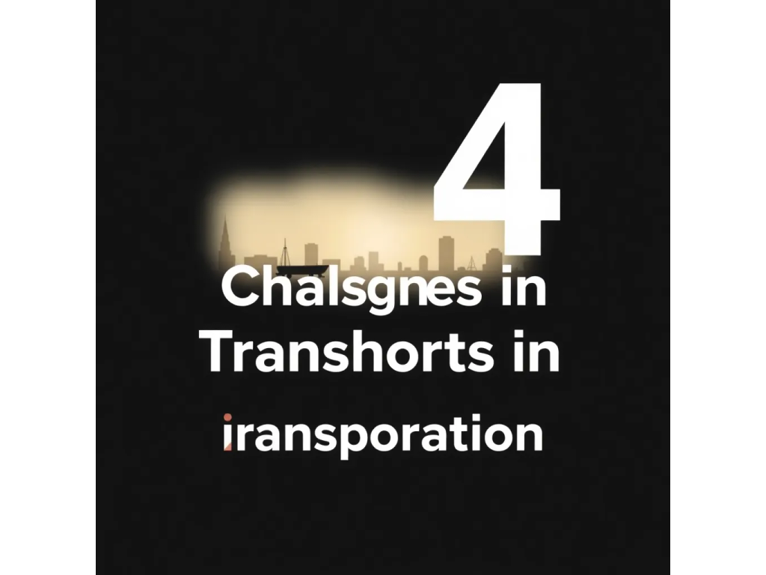
Slide 4: Challenges in Transportation

Slide 9
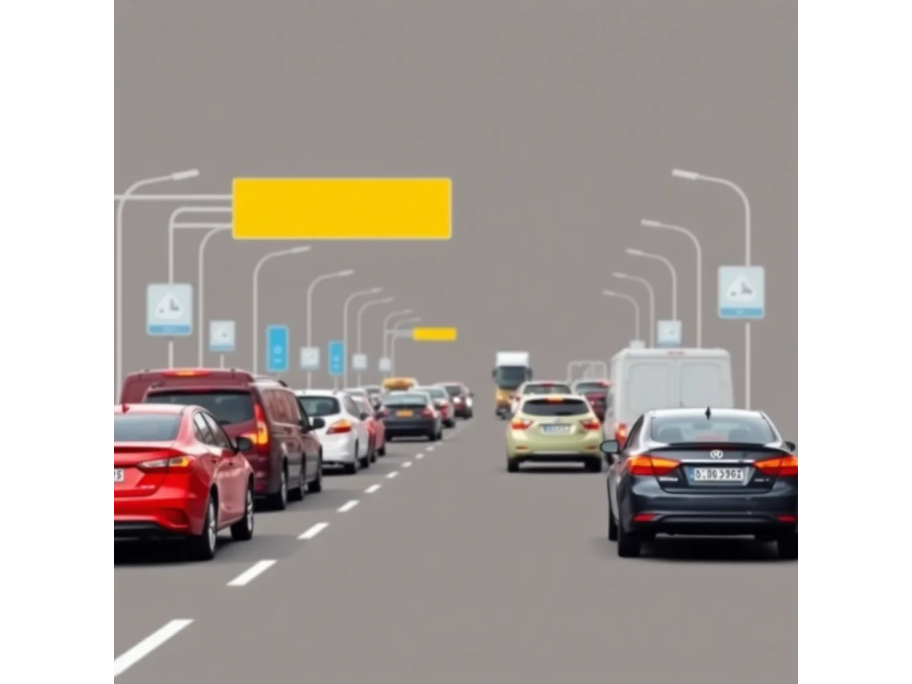
* Congestion and traffic jams
* Safety concerns and accidents
* Environmental impact and pollution
* Infrastructure costs and maintenance

Slide 10

Slide 5: Future of Transportation

Slide 11
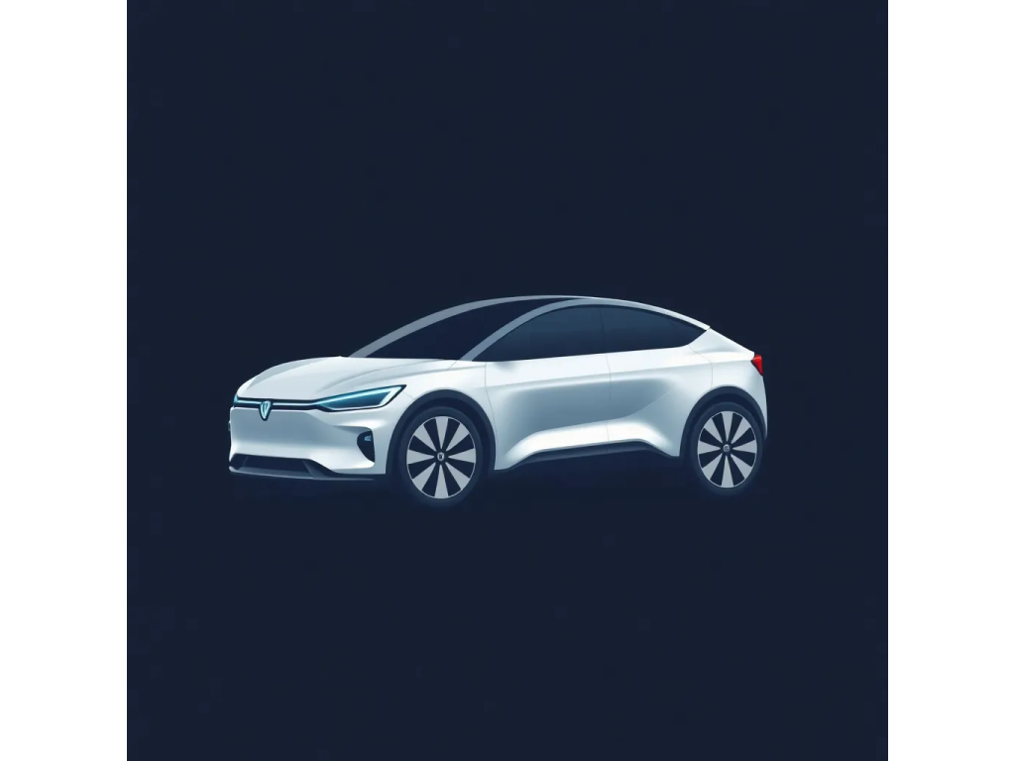
* Electric and autonomous vehicles
* Hyperloop and high-speed rail systems
* Increased use of drones and unmanned aerial vehicles
* Integration of artificial intelligence and smart transportation systems

Slide 12

I hope this helps! Let me know if you have any further questions or need any modifications.

