Slide 1
PROJECT REPORT
Fine-Tuned LLM Chatbot
for Wildlife Surveillance Drone System
Presented by: Satvik Pandey
Base Model: TinyLlama-1.1B • Method: LoRA Fine-Tuning • Framework: HuggingFace + Streamlit
1.1B
500
20MB
~25 min
Parameters
Training Q&A
Adapter Size
Training Time
Wildlife Conservation | AI & NLP | Parameter-Efficient Fine-Tuning

Slide 2
Project Overview
An AI-powered expert chatbot fine-tuned on domain-specific knowledge to assist researchers, conservationists, and students in understanding and deploying wildlife surveillance drone systems.
🤖
BASE MODEL
⚡
FINE-TUNING METHOD
TinyLlama-1.1B-Chat
LoRA (Low-Rank Adaptation)
Lightweight 1.1B parameter
LLaMA-based chat model
Rank=8, Alpha=16
Only 20MB adapter weights
📂
TRAINING DATASET
🖥️
DEPLOYMENT
500 Q&A Pairs
Streamlit Web App
90% train / 10% test
Drone & conservation domain
Apple Silicon (MPS)
Real-time chat interface

Slide 3
Problem Statement
⚠️ Wildlife Conservation Challenges
✅ Our AI Chatbot Solution
Illegal poaching & habitat destruction
Manual monitoring is slow & costly
Hard-to-reach & vast terrains
Limited access to expert knowledge
Real-time decision-making is critical
Fine-tuned LLM for drone & wildlife domain
Instant expert Q&A without internet
Runs efficiently on local hardware
Guides users on drone setup, sensors & AI
Supports anti-poaching decision-making

Slide 4
How It Works
1
2
3
4
5
💬
🔒
🔤
🧠
✅
User Input
System Prompt
Tokenizer
TinyLlama + LoRA
Response
Question asked
via Streamlit UI
Domain constraint
injected
32K vocab
max 512 tokens
1.1B params
LoRA adapter
60–180 tokens
temp = 0.45
Generation Strategy: Temperature 0.45 • Top-p 0.8 • Repetition Penalty 1.2 • Min 60 / Max 180 tokens • Hardware: Apple MPS

Slide 5
Fine-Tuning Approach
⚡ LoRA Fine-Tuning
📂 Training Dataset
Why LoRA?
Total Q&A Pairs
500
Trains only a tiny fraction of parameters (adapters), saving memory and time versus full fine-tuning.
Training Split
450 (90%)
Rank (r = 8)
Test Split
50 (10%)
Low-rank matrices injected into attention layers — efficient and effective.
Domain Focus
Drone / Wildlife
Alpha = 16
Scaling factor that controls how strongly the LoRA update influences the model.
🤖 Base Model: TinyLlama-1.1B
Target Layers
Parameters
1.1 Billion
query projection (q_proj) and value projection (v_proj) of the transformer.
Layers
22 transformer layers
Adapter Size
Attention Heads
32 heads
Only ~20 MB of trainable weights — vs. 2.1 GB full model.
Vocab Size
32,000 tokens
Max Context
2,048 tokens

Slide 6
Training Configuration
📈
Learning Rate
⏱️
Training Time
2e-4
~25 minutes
🔁
Epochs
👣
Total Steps
3
171 steps
📦
Batch Size
💻
Hardware
1 (effective: 8)
Apple Silicon (MPS)
📏
Max Seq Length
⚙️
Precision
512 tokens
Float16 (mixed)
Optimizer: AdamW | LR Schedule: Linear decay to ~0 | Gradient Accumulation: 8 steps

Slide 7
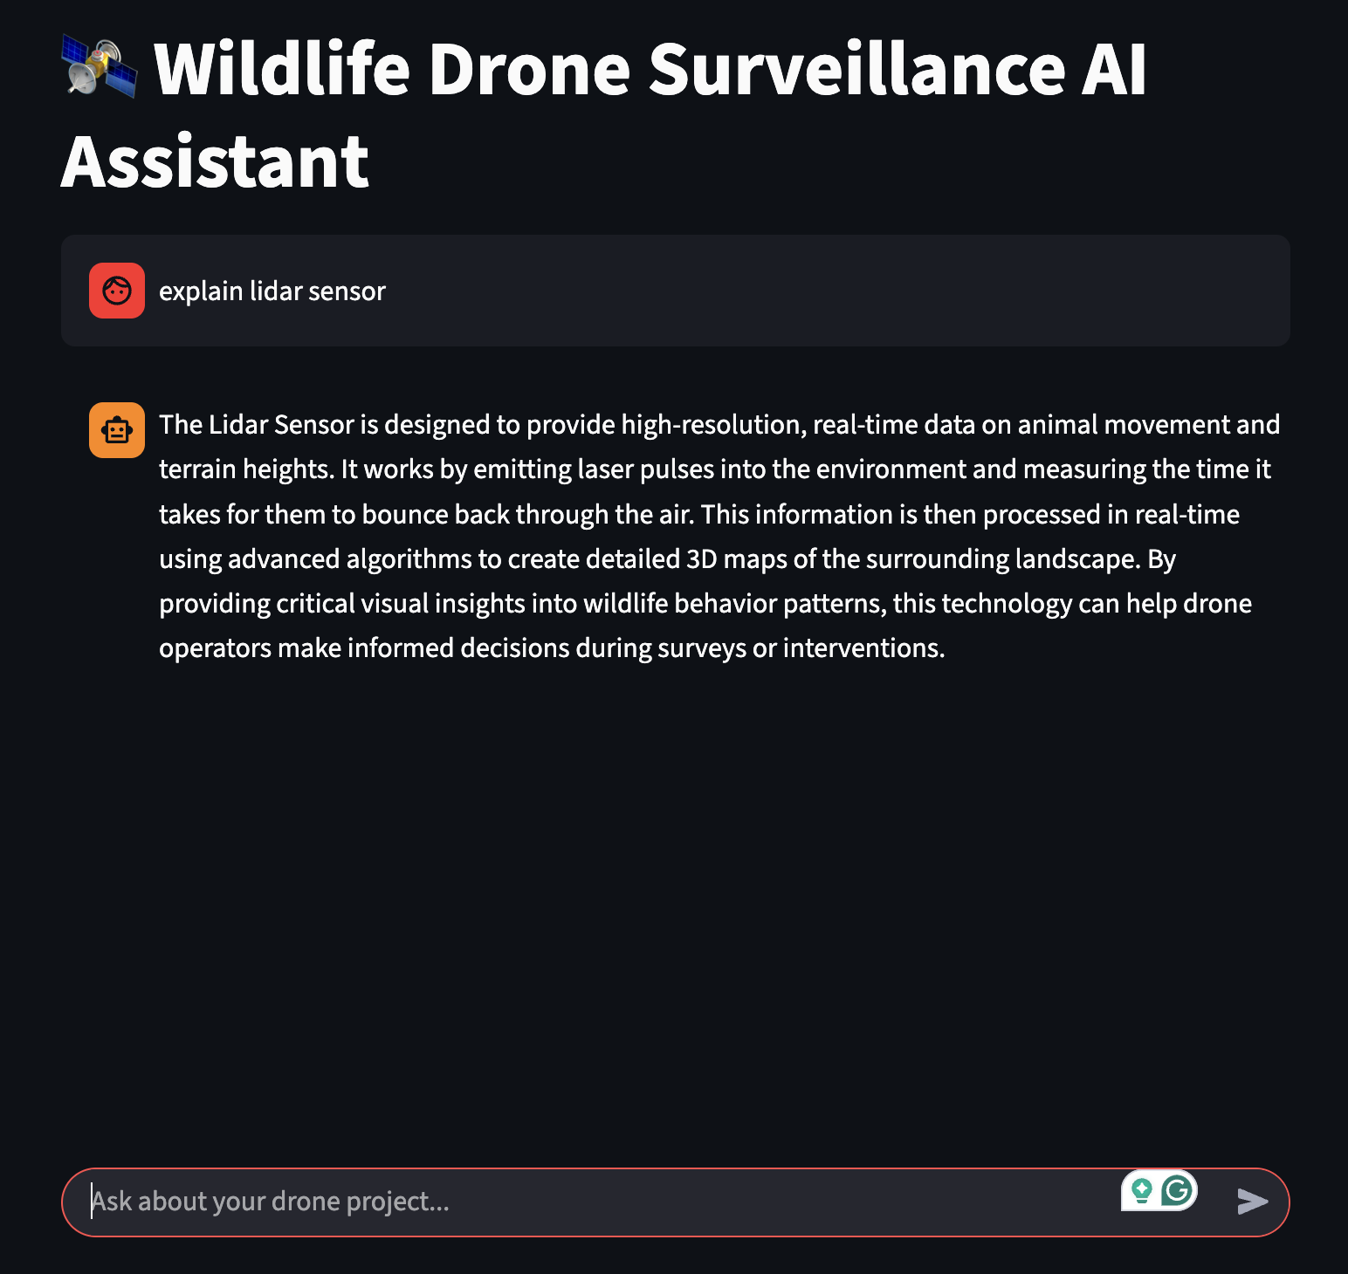
Results & Performance
Initial Loss
2.658
at step 10
Final Loss
1.844
at step 170
Training Time
~25 min
on Apple M-chip
Total Steps
171
3 epochs × 57 batches
Steady convergence observed — loss reduced by ~30.7% over 3 epochs. Gradient norms remained stable (0.12–0.26), indicating healthy training dynamics.

Slide 8
Conclusion
🏆 Key Achievements
🚀 Future Scope
Successfully fine-tuned TinyLlama-1.1B on wildlife drone domain
Achieved 30.7% loss reduction over 3 epochs
Lightweight 20MB LoRA adapter — parameter-efficient
Deployed via interactive Streamlit chatbot interface
Runs on Apple Silicon without GPU cloud dependency
Expand dataset to 2000+ domain-specific Q&A pairs
Integrate real-time drone telemetry data into responses
Deploy as mobile app for field use by conservationists
Explore RAG (Retrieval-Augmented Generation) for accuracy
Multilingual support for global wildlife researchers
Thank You! | Presented by: Gita GS | Fine-Tuned LLM Chatbot for Wildlife Surveillance Drone System

