Slide 1
Airbus Ship Detection
Traditional Machine Learning vs. Convolutional Neural Networks
UE24CS352A – Machine Learning | Mini-Project
Team 9 | Project No. 35
Rohan Suresh (PES1UG24CS383) · Satvik L (PES1UG24CS423)
Reference: Chen, Zheng, Zhou – Stanford CS229 project, 2018

Slide 2
Problem statement
• Given a satellite image, decide: does it contain at least one ship? (binary classification)
• Why: maritime monitoring – illegal fishing, piracy, accident response, traffic management
• Why it is hard: ships are tiny, scenes vary (open sea, docks, clouds, haze, wakes)
• Question we answer: do hand-engineered features + classical models compete with CNNs that learn features from pixels?
• We reproduce the Stanford CS229 study on a laptop-sized subset of the same data
Team 9 | Project No. 35 · Airbus Ship Detection · 2

Slide 3
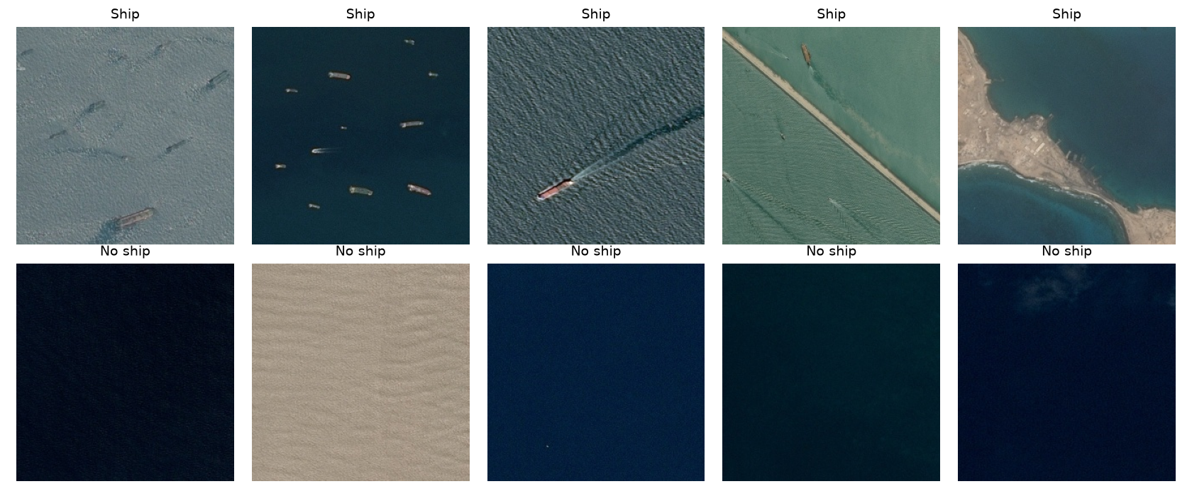
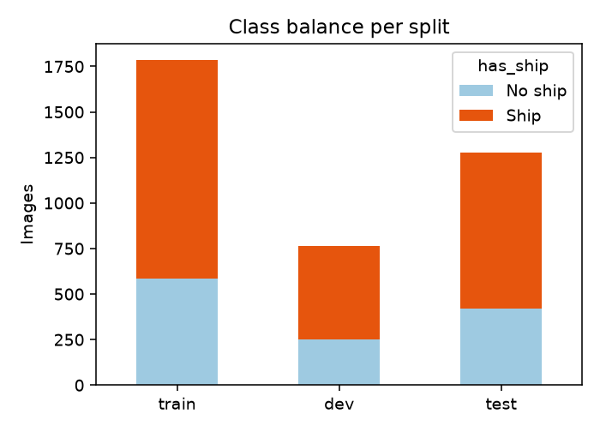
Dataset
• Kaggle Airbus Ship Detection Challenge: 192,555 images, 768×768 RGB, 31 GB
• Labels: CSV of run-length-encoded ship masks; no mask = no ship (22% have a ship)
• Our subset: 3,829 images (≈0.6 GB download), labels from the official CSV
• Ship-enriched: 67.2% ship / 32.8% no ship → baseline accuracy 67.2%
• Resized to 256×256; stratified 7:3:5 split → 1,786 train / 766 dev / 1,277 test
Team 9 | Project No. 35 · Airbus Ship Detection · 3

Slide 4
Pipeline
• download_data → subset, resize to 256×256, labels, train/dev/test split
• features → colour histogram, Haralick texture, Hu moments, raw pixels
• train_traditional → LDA, KNN, Naive Bayes, Random Forest, SVM × 8 feature sets + 10-fold CV
• train_cnn → TL-CNN (frozen DenseNet-169) and SIM-CNN (from scratch)
• evaluate_cnn → threshold scan on dev, test metrics, confusion matrices
• demo → live prediction on unseen images with all three best models
• One command runs everything: python run_all.py (settings in config.py, seeds fixed)
Team 9 | Project No. 35 · Airbus Ship Detection · 4

Slide 5
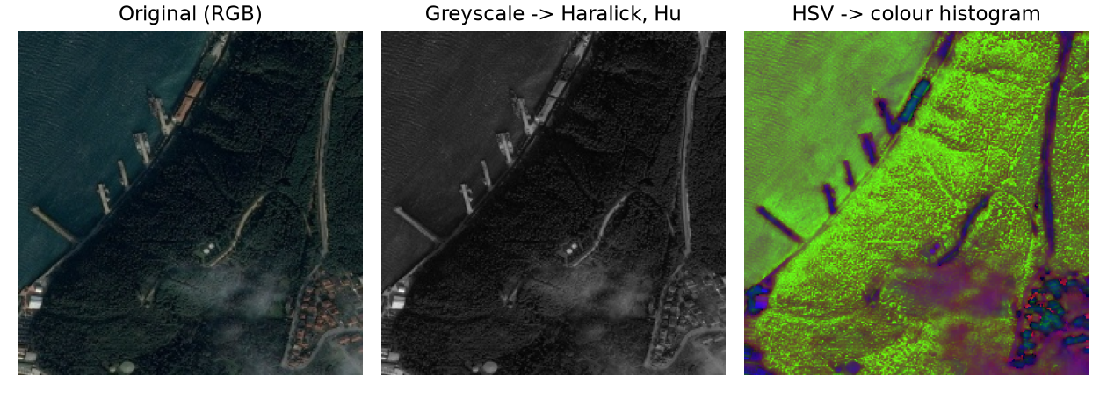
Feature engineering (traditional models)
• His – colour histogram in HSV, 8×8×8 bins = 512 values → colour
• Ha – 13 Haralick statistics of the grey-level co-occurrence matrix → texture
• Hu – 7 Hu moments of the grey image → shape
• Raw – image shrunk to 32×32×3 and flattened = 3,072 values → 'no feature engineering'
• All are global descriptors: one vector describes the whole image
• Standardised (zero mean, unit variance) with training-set statistics
Team 9 | Project No. 35 · Airbus Ship Detection · 5

Slide 6
Five traditional classifiers
• LDA – Gaussian classes with a shared covariance → linear decision boundary
• k-NN (k = 5) – majority vote of the 5 closest training images (Euclidean distance)
• Naive Bayes – Bayes' rule assuming features are independent given the class
• Random Forest – 70 decision trees on bootstrap samples and random feature subsets, majority vote
• SVM (RBF kernel) – maximum-margin boundary in a non-linear feature space
• Each trained on 8 feature combinations = 40 experiments, plus 10-fold cross-validation
Team 9 | Project No. 35 · Airbus Ship Detection · 6

Slide 7
Results – traditional models (test accuracy)
 | His | Ha | Hu | His+Ha | Ha+Hu | Hu+His | All three | Raw pixels
LDA | 0.748 | 0.784 | 0.683 | 0.849 | 0.785 | 0.756 | 0.854 | 0.537
KNN | 0.785 | 0.829 | 0.674 | 0.838 | 0.825 | 0.795 | 0.839 | 0.735
NB | 0.526 | 0.734 | 0.672 | 0.525 | 0.676 | 0.531 | 0.532 | 0.625
RF | 0.915 | 0.854 | 0.733 | 0.918 | 0.854 | 0.913 | 0.919 | 0.822
SVM | 0.761 | 0.832 | 0.680 | 0.848 | 0.825 | 0.762 | 0.850 | 0.808
• Random Forest is best: 91.9% with all features (paper: 93%)
• Feature engineering vs raw pixels: LDA +32, KNN +10, NB -9, RF +10, SVM +4 points
• 'More is less': the 512 correlated histogram bins break Naive Bayes's independence assumption
• Baseline (always 'ship') = 67.2%; NB with all features falls below it
Team 9 | Project No. 35 · Airbus Ship Detection · 7

Slide 8
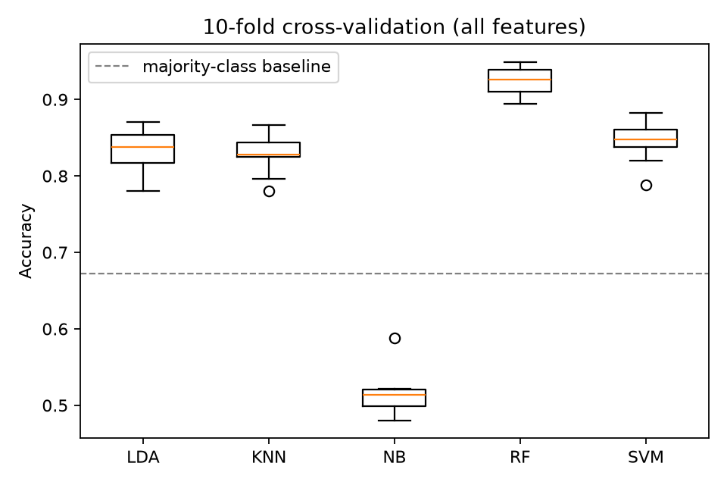
10-fold cross-validation (all features)
• LDA: 83.4% ± 2.5%
• KNN: 82.9% ± 2.4%
• NB: 51.5% ± 2.8%
• RF: 92.4% ± 1.7%
• SVM: 84.6% ± 2.5%
• Random Forest: highest mean and among the smallest spread → most reliable
Team 9 | Project No. 35 · Airbus Ship Detection · 8

Slide 9
Two convolutional neural networks
• SIM-CNN – trained from scratch
• 4 × [3×3 conv → ReLU → 2×2 max-pool], filters 16 / 32 / 64 / 128
• 256×256×3 → 16×16×128 → FC(128) → dropout → FC(1) → sigmoid
• 4,292,001 trainable parameters; augmentation: flip, rotate, shift, zoom, shear, brightness
• TL-CNN – transfer learning
• ImageNet-pretrained DenseNet-169, all weights frozen (feature extractor)
• global max-pool → BatchNorm → dropout → FC(128) → FC(1) → sigmoid
• only the head is trained: 216,577 parameters
• Both: binary cross-entropy, Adam, batch 64, 30 epochs, LR decay, best-dev-loss checkpoint
Team 9 | Project No. 35 · Airbus Ship Detection · 9

Slide 10
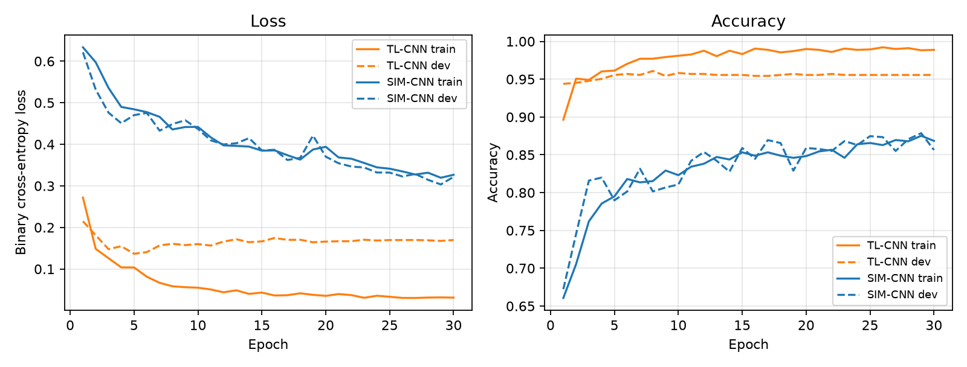
CNN training curves
• TL-CNN: final train acc 98.9%, best dev acc 96.1%
• SIM-CNN: final train acc 86.8%, best dev acc 87.9%
• Solid = train, dashed = dev
• We keep the weights of the epoch with the lowest dev loss
Team 9 | Project No. 35 · Airbus Ship Detection · 10

Slide 11
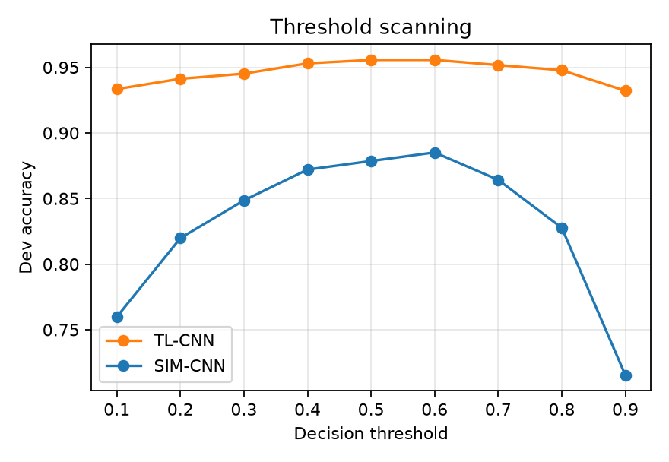
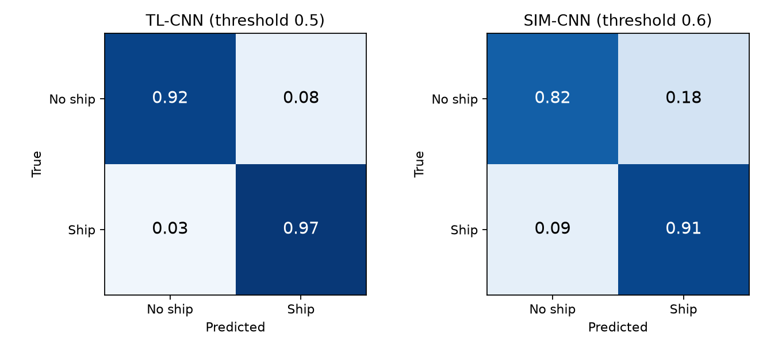
Threshold scanning and confusion matrices
• Imbalanced classes → 0.5 is not automatically the best cut-off; we scan 0.1–0.9 on the dev set
• TL-CNN @ 0.5: accuracy 95.3%, precision 96.3%, recall 96.7%, specificity 92.4%
• SIM-CNN @ 0.6: accuracy 88.0%, precision 91.1%, recall 91.0%, specificity 81.9%
Team 9 | Project No. 35 · Airbus Ship Detection · 11

Slide 12
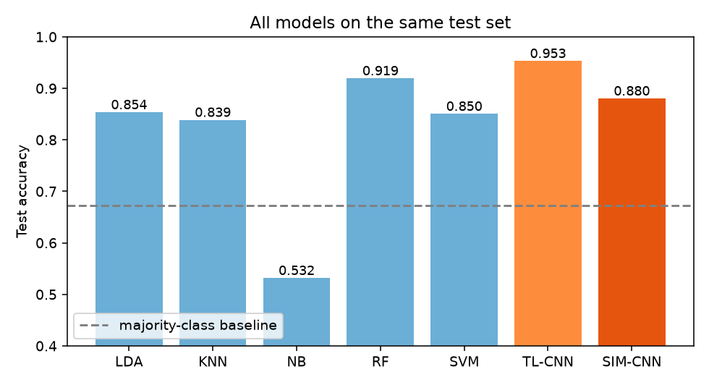
All models on the same test set
Model | Accuracy | Precision | Recall
LDA (all features) | 85.4% | 87.0% | 92.0%
KNN (all features) | 83.9% | 85.6% | 91.4%
NB (all features) | 53.2% | 91.4% | 33.4%
RF (all features) | 91.9% | 93.2% | 94.9%
SVM (all features) | 85.0% | 84.3% | 95.5%
TL-CNN (thr 0.5) | 95.3% | 96.3% | 96.7%
SIM-CNN (thr 0.6) | 88.0% | 91.1% | 91.0%
Always predict 'Ship' | 67.2% | 67.2% | 100.0%
Best overall: TL-CNN (95.3%). Best traditional: Random Forest (91.9%).
Team 9 | Project No. 35 · Airbus Ship Detection · 12

Slide 13
Comparison with the Stanford report
 | Stanford report | Our reproduction
Images (train / dev / test) | 7,000 / 3,000 / 5,000 | 1,786 / 766 / 1,277
Class balance | ≈16% ship (natural) | 67% ship (ship-enriched subset)
Best traditional model | Random Forest, 93% | Random Forest, 91.9%
TL-CNN test accuracy | 90% | 95.3%
SIM-CNN test accuracy | 94% | 88.0%
Hardware / framework | Azure GPU, Keras | Laptop CPU, PyTorch
• Same conclusions for traditional models: Random Forest wins, feature engineering helps, Naive Bayes is fragile
• CNN ranking differs: TL-CNN beat SIM-CNN here, probably because we had about 4× less training data
• Absolute numbers are not directly comparable – different subset and class balance
Team 9 | Project No. 35 · Airbus Ship Detection · 13

Slide 14
Conclusions, limitations, future work
• Random Forest on hand-engineered features is a strong, cheap baseline (91.9%)
• CNNs: TL-CNN (95.3%) scored higher than SIM-CNN (88.0%) on our test set
• Feature choice matters as much as the algorithm; more features can hurt
• Limitations: small ship-enriched subset, CPU-only, one run per model, image-level labels only
• Future work: full dataset, fine-tune the DenseNet backbone, segment/localise ships (U-Net)
Team 9 | Project No. 35 · Airbus Ship Detection · 14

Slide 15
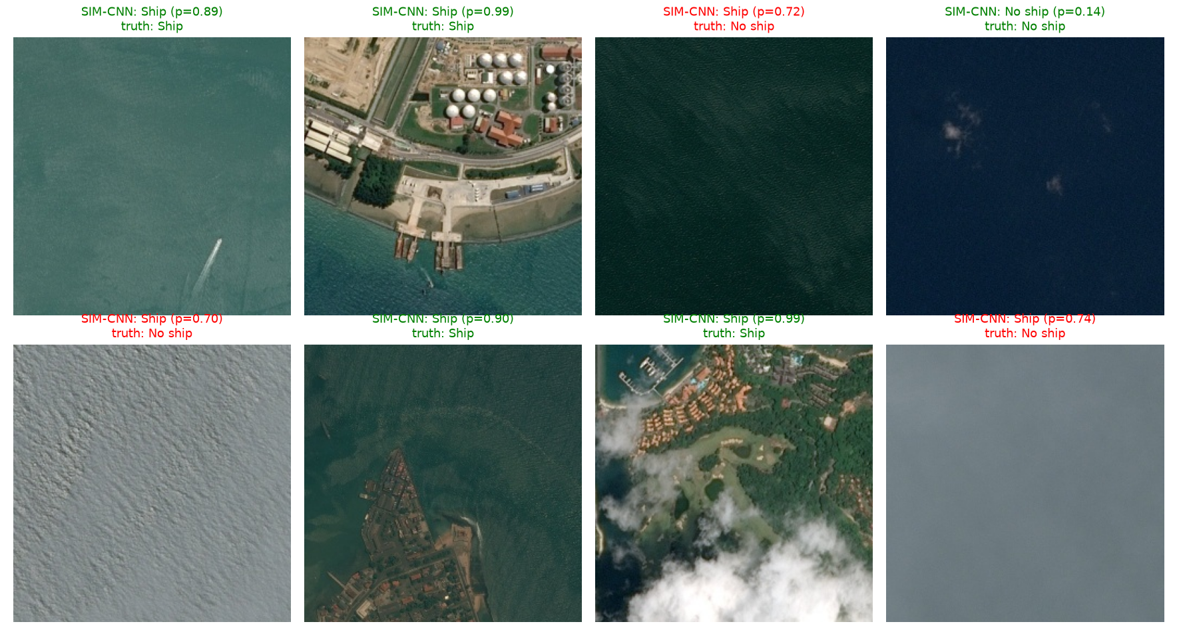
Live demo
• python -m src.demo → 8 random unseen test images
• python -m src.demo --n 12 --seed 7 → a different selection
• python -m src.demo --image my.jpg → any image
• Prints P(ship) from Random Forest, TL-CNN and SIM-CNN; shows the images with the verdict
Team 9 | Project No. 35 · Airbus Ship Detection · 15

