Slide 1
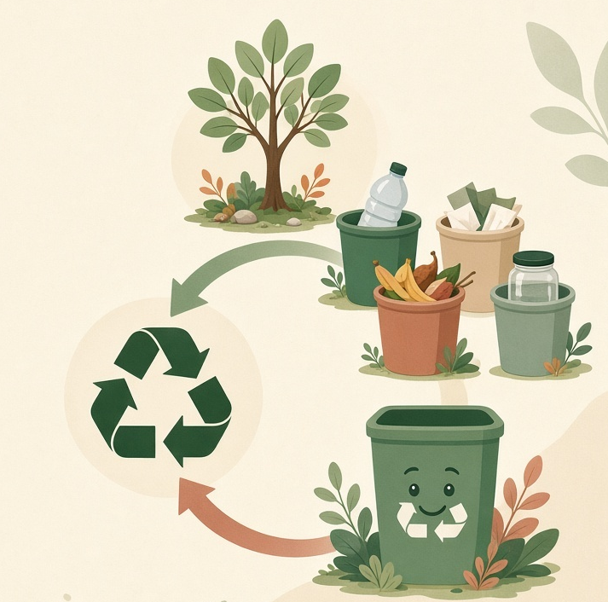
HACKAITHON GROUP 3
NATIONAL LEVEL · 2026
TerraLoop
Measure Waste. Close the Loop.
A working Python desktop app that turns daily household waste into numbers, a hotspot, a score — and a plan.
Python + OOP
Tkinter App
SDG 11 · 12 · 13
Satvik · Kanav · Nipun · Tanvi
Myra's Global Tech HACK-AI-THON 2026 · National Group Challenge

Slide 2
TERRALOOP · 02
ROADMAP
Twenty slides. One working prototype.
01–04
Problem & SDGs
15–16
Live product
The measurement gap. Goals 11, 12, 13.
Dashboard, add, records, simulator.
05–08
Solution design
17–18
Challenges + AI
Pipeline, seven screens, OOP pillars.
What was hard. Five agents named.
09–12
Inside the code
19
Limits & future
Classes, CRUD, score math, What-If.
Honest prototype. Clear next steps.
13–14
Worked example
20
Close
Six records → 10.3 kg, 73%, 69/100.
Team, run command, questions.
HackAIThon Group 3 · Myra's Global Tech HACK-AI-THON 2026
2 / 20

Slide 3
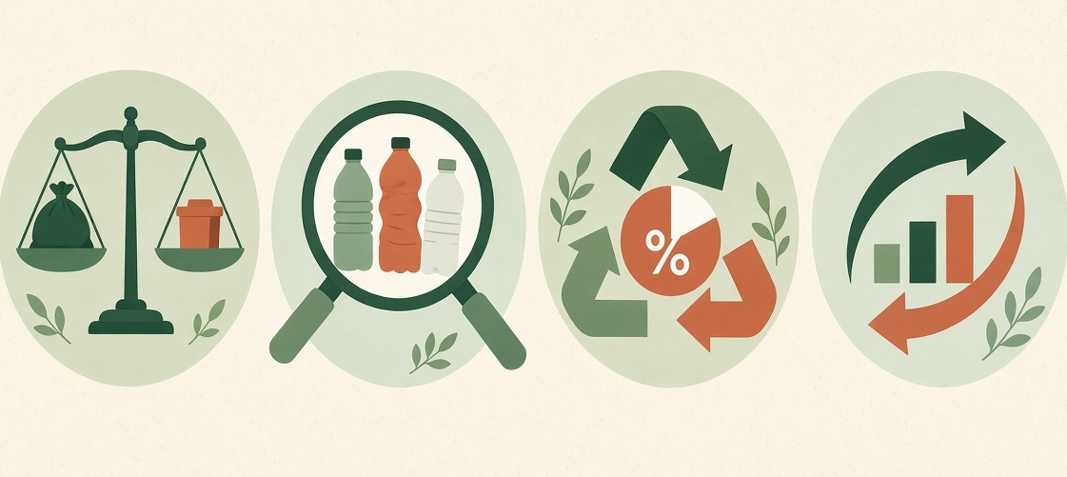
TERRALOOP · 03
THE PROBLEM
Waste happens. Measurement does not.
How much waste, really?
Which category dominates?
What share is recycled?
Is the habit improving?
THE EVERYDAY GAP
Households produce plastic, organic, paper, glass, metal and e-waste every day. Almost none of it is written down. So families guess. Societies guess. Campaigns guess.
Without a hotspot you cannot aim. Without a recycling rate you cannot tell if effort is working. Without a simulation you cannot test a habit before you change your kitchen.
HackAIThon Group 3 · Myra's Global Tech HACK-AI-THON 2026
3 / 20

Slide 4
TERRALOOP · 04
WHO IT IS FOR
A school project with a real kitchen use-case.
Households
Students
Anyone who wants a weekly picture of what left the house — not a municipal dashboard.
A complete OOP + Python example: classes, CRUD, formulas, a GUI, a report.
Teachers / judges
Campaigns
Every number on screen can be added up from six sample rows by hand.
A pattern you can scale later: record → analyse → advise → simulate.
HackAIThon Group 3 · Myra's Global Tech HACK-AI-THON 2026
4 / 20

Slide 5
TERRALOOP · 05
SDG RELEVANCE
Three goals. One household tool.
Required theme: Python Fundamentals + OOP + SDGs. Each goal maps to a feature the user can see.
SDG
SDG
SDG
11
12
13
Sustainable Cities
and Communities
Responsible Consumption
and Production
Climate Action
A measured household is the smallest unit of a cleaner city. TerraLoop makes that unit visible.
Recycling rate, category bars and the hotspot turn vague “we recycle” into a checkable percentage.
Cutting plastic and routing e-waste correctly is climate work at kitchen scale — small, but real.
HackAIThon Group 3 · Myra's Global Tech HACK-AI-THON 2026
5 / 20

Slide 6
TERRALOOP · 06
THE SOLUTION
From a kitchen bin to a decision in five steps
01
02
03
04
05
Record
Analyse
Advise
Simulate
Report
Category, kg, date, recycled flag, note.
Totals, %, recycling rate, hotspot, score.
Rules tied to this household’s pattern.
Cut one category by N%. Compare before / after.
Period summary on screen. Save as TXT.
HACKATHON FIT · MINIMUM REQUIREMENTS, THEN MORE
Household + WasteRecord classes. Add / update / delete / search. Total waste, category percentages, recycling rate, sustainability score, recommendations, selected-period report. Extra: hotspot, What-If simulator, TXT export, Tkinter GUI.
HackAIThon Group 3 · Myra's Global Tech HACK-AI-THON 2026
6 / 20

Slide 7
TERRALOOP · 07
ARCHITECTURE / WORKFLOW
One pipeline. Each box is a class.
User Input
WasteRecord
WasteManager
WasteAnalyzer
Rules + Sim
User Action
→
→
→
→
→
Add Waste
One object
CRUD + filter
Math layer
Advice
Better habits
Household
Name and member count — used to label every report.
WasteRecord
id, date, category, weight kg, recycled flag, note.
WasteManager
Owns the list. Add, update, delete, search, 7 / 30 / all-time filter.
WasteAnalyzer
Pure math. The UI never calculates. The simulator reuses this class.
RecommendationEngine
If-then rules on analyzer output. Not machine learning.
SustainabilitySimulator
Copies records, shrinks one category, reruns the analyzer.
TerraLoopApp
Tkinter shell. Composes the others. Holds no secret business logic.
HackAIThon Group 3 · Myra's Global Tech HACK-AI-THON 2026
7 / 20

Slide 8
TERRALOOP · 08
KEY FEATURES
Seven screens. One sidebar. Nothing hidden.
01
02
03
04
Dashboard
Add / Edit
Records
Hotspot
Period filter. Four live cards. Hotspot banner.
Validates kg > 0 and blocks future dates.
Search, category filter, edit, delete.
Bars + % for every category in the window.
05
06
07
08
Recommendations
What-If
Report
TXT Export
Fire at ≥25% category, <50% recycle, >10% e-waste.
Slider 5–90%. Current vs projected side by side.
Period narrative with grade and SDG mapping.
Save the report for judges, teachers or home.
HackAIThon Group 3 · Myra's Global Tech HACK-AI-THON 2026
8 / 20

Slide 9
TERRALOOP · 09
OOP IMPLEMENTATION
The theme is the architecture — not a label.
Classes & Objects
Encapsulation
Household, record, manager, analyzer, recommender, simulator, app. Every logged item is a WasteRecord object in memory.
Only WasteManager mutates the list. Other classes ask for data. A record keeps its own fields and status().
Abstraction
Composition
Dashboard calls recycling_rate(). It never sees the division. Score logic can change without touching a widget.
TerraLoopApp wires the parts. The simulator does not copy formulas — it builds a new analyzer on a modified copy.
FOR THE JUDGES
A new category, a new metric or a new rule can be added without rewriting the window. That is the OOP requirement done properly — a design that can grow.
HackAIThon Group 3 · Myra's Global Tech HACK-AI-THON 2026
9 / 20

Slide 10
TERRALOOP · 10
INSIDE THE CODE · DATA MODEL
Two objects hold the facts. Nothing else stores waste.
class Household:
def __init__(self, name, members=1):
self.name = name
self.members = members
class WasteRecord:
def __init__(self, record_id, record_date,
category, weight, recycled, note=""):
self.record_id = record_id
self.record_date = record_date
self.category = category # one of 6
self.weight = float(weight)
self.recycled = bool(recycled)
self.note = note
Six categories
Plastic, Paper, Organic, Glass, Metal, E-Waste. A dropdown — not free text — so analysis stays clean.
status() on the record
The row knows if it is Recycled or Not Recycled. The table does not decide.
Household is a label
Name and member count ride on every report. They do not change the math.
HackAIThon Group 3 · Myra's Global Tech HACK-AI-THON 2026
10 / 20

Slide 11
TERRALOOP · 11
INSIDE THE CODE · WASTEMANAGER
One class owns the list. CRUD never leaks into the GUI.
class WasteManager:
def add_record(self, date, category, weight,
recycled, note=""):
record = WasteRecord(self.next_id, date,
category, weight, recycled, note)
self.records.append(record)
self.next_id += 1
def update_record(self, record_id, **fields): ...
def delete_record(self, record_id): ...
def search(self, text="", category="All"): ...
def filter_period(self, window): # 7 / 30 / all
Add assigns the ID
next_id lives here so edit and delete always find the same row.
Search is a filter
Keyword over note / date / category, plus an exact category dropdown.
Period is a date cut
Last 7 days, last 30 days, or all time. Analyzer only sees the cut list.
Validation at the door
Weight must be > 0. Date cannot be in the future. Bad rows never enter the list.
HackAIThon Group 3 · Myra's Global Tech HACK-AI-THON 2026
11 / 20

Slide 12
TERRALOOP · 12
INSIDE THE CODE · ANALYZER
The UI never divides. WasteAnalyzer does all the math.
class WasteAnalyzer:
def total_waste(self):
return sum(r.weight for r in self.records)
def recycling_rate(self):
rec = sum(r.weight for r in self.records if r.recycled)
tot = self.total_waste()
return 0 if tot == 0 else (rec / tot) * 100
def category_percentages(self): ...
def hotspot(self):
return category with the largest share
def sustainability_score(self):
rec = rate * 0.60
div = max(0, 20 - largest_% * 0.20)
e = max(0, 20 - e_waste_%)
return round(min(100, rec + div + e))
60 / 20 / 20
Recycling drives the score. Concentration and e-waste trim the rest. Cap 100.
Hotspot = max share
Not a map. The category that owns the largest slice of the period.
Same class, two uses
Dashboard and What-If both construct a WasteAnalyzer. No copied formulas.
Grade bands
80+ Excellent · 60+ Good · 40+ Fair · below 40 Poor.
HackAIThon Group 3 · Myra's Global Tech HACK-AI-THON 2026
12 / 20

Slide 13
TERRALOOP · 13
WORKED EXAMPLE
Six sample rows. Every dashboard figure follows.
Date
Category
kg
Status
10.3 kg
2026-09-01
Plastic
1.8
Recycled
Total waste · 1.8+3.2+1.4+1.1+0.7+2.1
2026-09-03
Organic
3.2
Recycled
2026-09-05
Paper
1.4
Recycled
7.5 kg
2026-09-07
Glass
1.1
Recycled
Recycled · the four Recycled rows
2026-09-09
E-Waste
0.7
Not recycled
2026-09-11
Plastic
2.1
Not recycled
73%
Recycling rate · 7.5 ÷ 10.3 × 100
Plastic 38%
Hotspot · 3.9 ÷ 10.3
HackAIThon Group 3 · Myra's Global Tech HACK-AI-THON 2026
13 / 20

Slide 14
TERRALOOP · 14
SCORE, RULES, SIMULATOR
From 73% recycling to a 69 score — then a plan.
SCORE ON THE SAMPLE
RULES THAT FIRE
Recycling 73 × 0.60 = 43.8
Diversify 20 − (37.9 × 0.20) = 12.4
E-waste 20 − 6.8 = 13.2
────────────────────────────────
Total rounded and capped 69
Category share ≥ 25% → hotspot action
Recycling rate < 50% → segregate more
E-waste share > 10% → authorised drop
On this sample: Plastic 38% and Organic 31% trigger advice. Recycling is already 73%, e-waste is 6.8% — those two rules stay quiet.
WHAT-IF · SAME ANALYZER, THINNER COPY
Pick a category and a cut of 5–90%. Every matching row is multiplied by (1 − pct/100). A new WasteAnalyzer runs on that copy. Current vs projected totals, rate and score appear side by side — no second formula sheet.
HackAIThon Group 3 · Myra's Global Tech HACK-AI-THON 2026
14 / 20

Slide 15
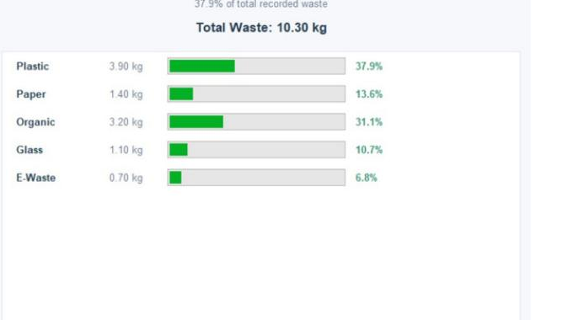
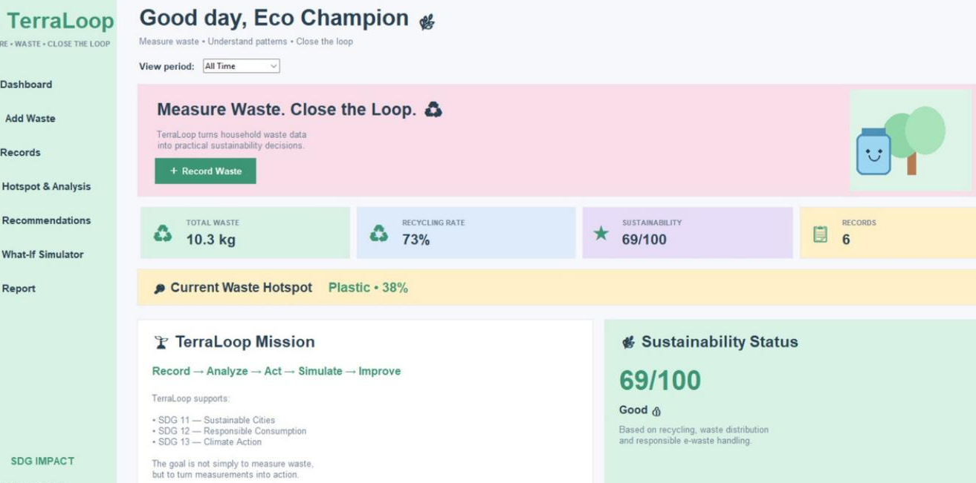
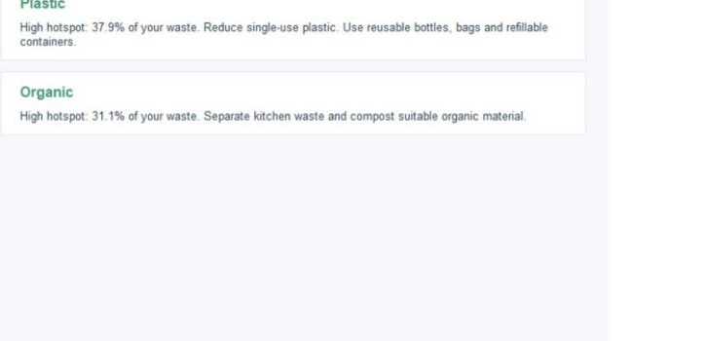
TERRALOOP · 15
DEMO / RESULTS
The same six records the judges can re-add
10.3 kg
73%
69/100
Plastic
TOTAL WASTE
RECYCLING
SCORE
HOTSPOT 38%
HackAIThon Group 3 · Myra's Global Tech HACK-AI-THON 2026
15 / 20

Slide 16
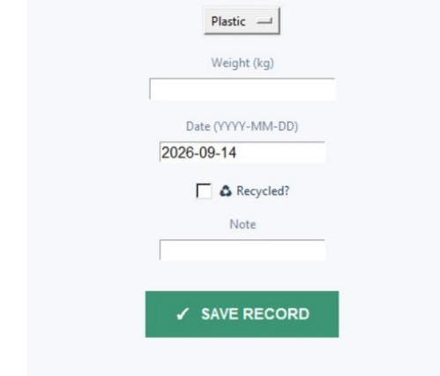
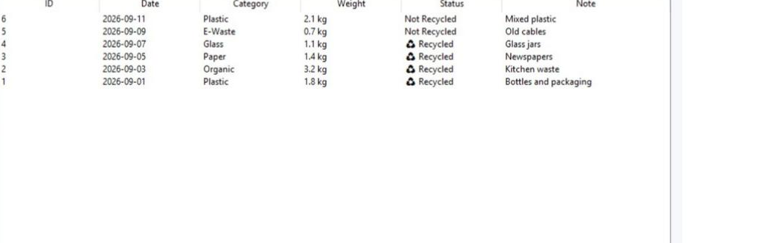
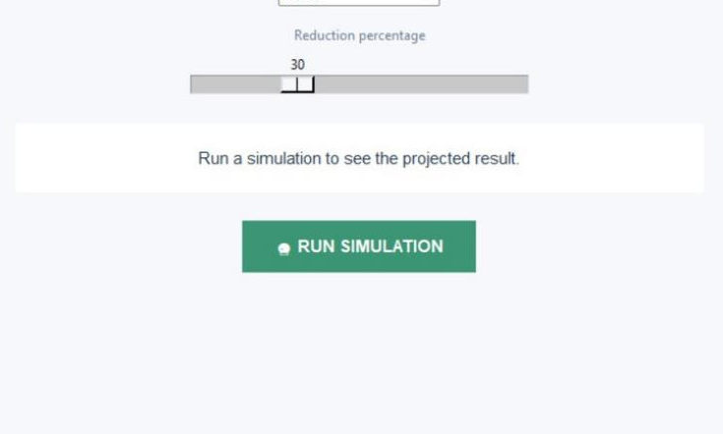
TERRALOOP · 16
THE WORKING APP
Add. List. Simulate. Same session.
WHAT YOU SEE IN THE DEMO
Six sample rows load on start.
Edit record #2, delete one row, filter Last 30 Days.
Hotspot stays Plastic until you cut it in the simulator.
Every figure on the dashboard can be added up from the Records table by hand.
HackAIThon Group 3 · Myra's Global Tech HACK-AI-THON 2026
16 / 20

Slide 17
TERRALOOP · 17
CHALLENGES
AI helped us move faster. It did not replace judgement.
Three problems we had to solve as a team — not as a prompt.
01
02
03
Understanding and verifying AI-generated code
Matching the brief with the generated code
Documentation and code consistency
We had to go through the generated code and understand how each class, function and calculation worked before using it in the final project. Nothing shipped until we could explain it.
AI can produce a working app. We still had to check that TerraLoop covered every requirement: OOP classes, waste analysis, recycling rate, recommendations and simulation.
Keeping the README, documentation, screenshots and presentation consistent with the actual final code was hard — especially when features or wording changed during development.
HackAIThon Group 3 · Myra's Global Tech HACK-AI-THON 2026
17 / 20

Slide 18
TERRALOOP · 18
AI TOOLS WE USED
Five agents. Five jobs. The team still owned the result.
Declared because the hackathon asks teams to name the AI they used.
ChatGPT
Claude
Google Gemini
Code generation, debugging, planning and problem-solving.
Documentation and content refinement.
Brainstorming, feature ideas and technical assistance.
Microsoft Copilot
Grok
Research, coding assistance and troubleshooting.
Refining the presentation and documentation.
HackAIThon Group 3 · Myra's Global Tech HACK-AI-THON 2026
18 / 20

Slide 19
TERRALOOP · 19
LIMITATIONS & FUTURE
Honest about the prototype
CURRENT LIMITS
FUTURE SCOPE
1. In-memory only — close the window, the log is gone.
1. SQLite so history survives a restart.
2. One household. No logins or family accounts.
2. Accounts for a family or a housing society.
3. Score is a custom heuristic, not a certified index.
3. Month-by-month trend charts.
4. Recommendations are rules, not predictions.
4. Benchmark the score against a city average.
5. No municipal recycling feed to benchmark against.
5. Web or mobile client on the same classes.
6. Desktop Tkinter — not a phone app yet.
6. Optional later forecast — clearly separate from today’s rules.
HackAIThon Group 3 · Myra's Global Tech HACK-AI-THON 2026
19 / 20

Slide 20
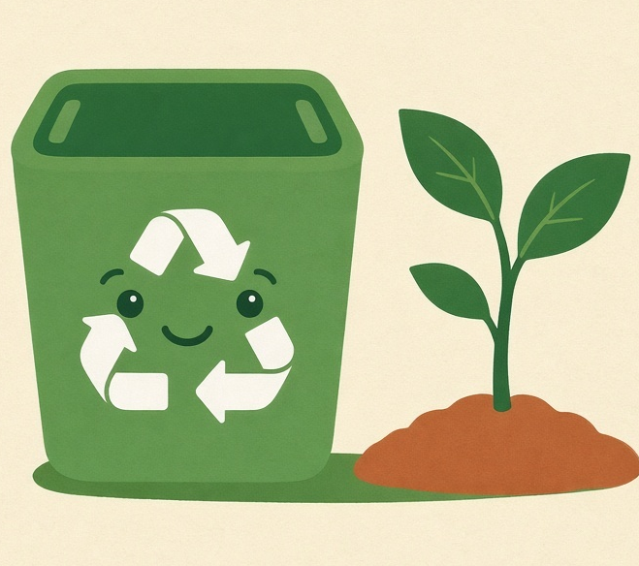
Close the loop.
A modest Python app. Real OOP. Numbers a household can act on.
Kanav
Satvik
Nipun
Tanvi
Application code
Docs & GitHub
Presentation, testing,
code, GitHub & more
Demo video
Run python First.py
Python 3 · Pillow · Standard library otherwise
Thank you.
Questions welcome. · HackAIThon Group 3
Myra's Global Tech HACK-AI-THON 2026 · National Level Group Challenge

