Slide 1
Lab 10: Artificial Intelligence and CracKING captchas
Satvik Anand
404823011

Slide 2
TOPICS
Explain what AI is and how it works
What are CAPTCHAs
How AI cracking CAPTCHAs is a measure of how good the AI is
How does the AI crack CAPTCHAs
Next steps

Slide 3
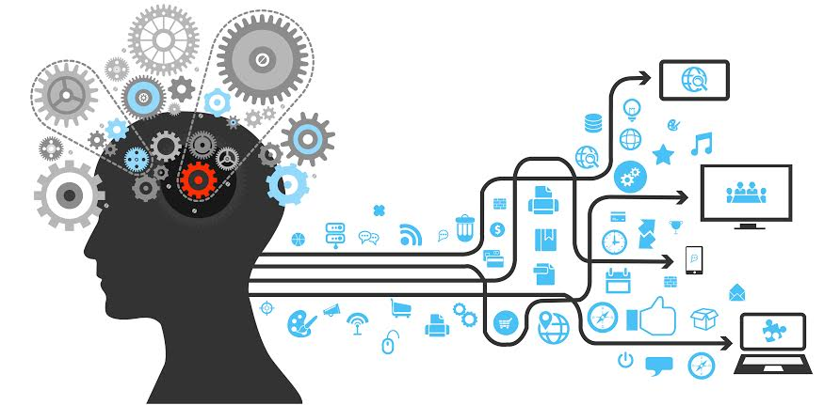
Artificial intelligence

Slide 4
Machine learning
Machine learning deals with making computers learn without being explicitly programmed
You basically create programs that are trained to recognize new patterns and evolve on the basis of these patterns.
Once you have created these patterns, you’re able to eliminate the eventual need to write code because your basic programs are doing everything for you

Slide 5
CAPTCHA
CAPTCHA stands for Completely Automated Public Turing Test To Tell Computers and Humans Apart
What it actually is the squiggly lines/characters that you’ve seen on tons of websites.
Turing Test is a test that is used to decide whether a machine is capable of acting in an intelligent manner

Slide 6
Things taken in account in created captchas
Metadata accessible to robots.
Predetermined CAPTCHAs with predetermined answers
Random strings of letters to prevent brute force attacks
Distorting
Puzzles and extrapolation

Slide 7
Breaking captchas
Lots of attempts
Ticketmaster sued a tech company which was able to buy tickets in bulk
These attempts were only exploiting a weakness in the CAPTCHA which could be fixed

Slide 8
Breaking captchas
New methods involve deep learning
There are downfalls to deep learning as well.
Deep learning is a technique where you have layers of neurons and you train those neurons to respond in a way that you decide.

Slide 9
Recursive CORTICAL NETWORK
AI sees things and builds its own model of what it sees.
Tries to correlate new images with the models that it has in its memory
Understands contours and shapes

Slide 10
Next steps
Long term goal through these kinds of experiments is to build machines that are fully able to think like humans
It’s not clear how much impact this will have on information security
So AI which requires less training is better than that which requires more training

