Slide 1
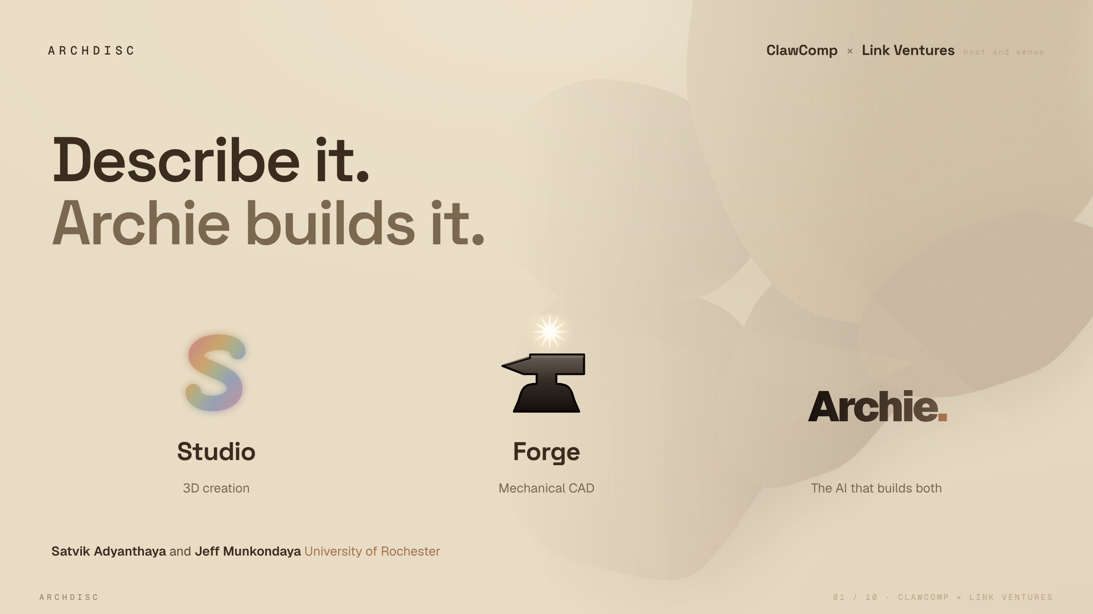
Notes:
We're ArchDisc, and our whole idea is four words. Describe it, Archie builds it. We have two apps. Studio for 3D art, and Forge for real engineering. And one AI, Archie, that builds in both. I'm Satvik, this is Jeff. Give us a few minutes, and we'll show you how anyone can make real things, just by saying what they want.

Slide 2
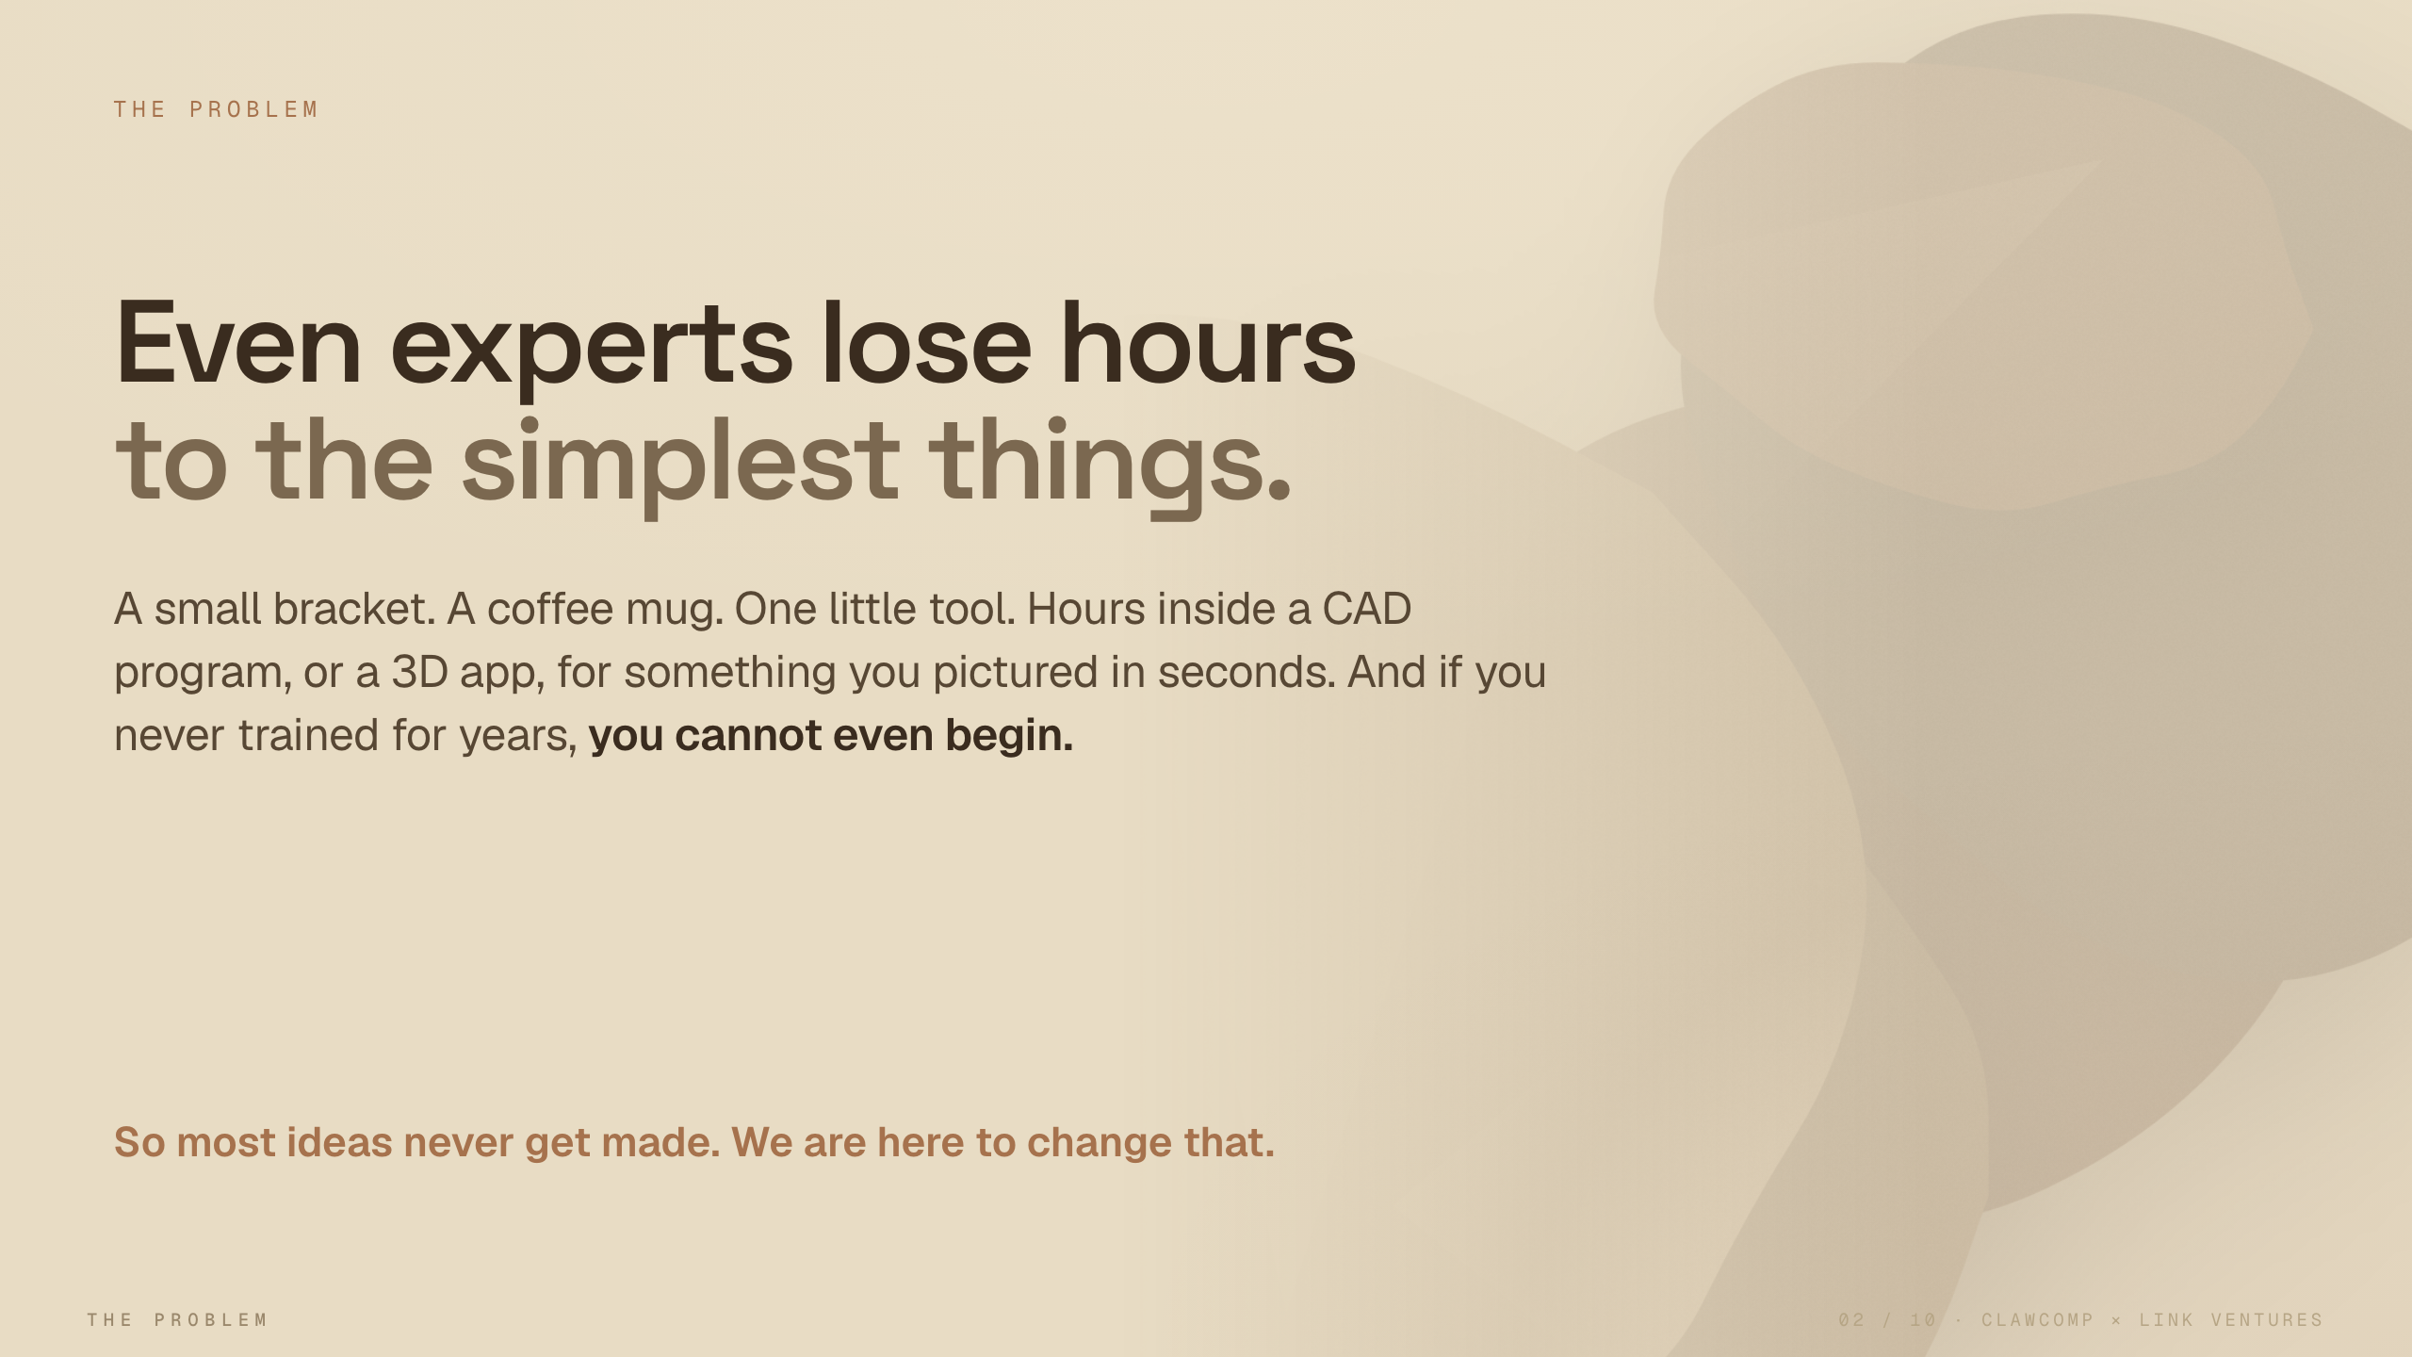
Notes:
Here's what bugs us. Making real things is still painfully slow. An expert can lose hours on something as small as a bracket or a coffee mug. And if you never trained for years, you can't even start. So most ideas just die in someone's head. That is the gap we close.

Slide 3
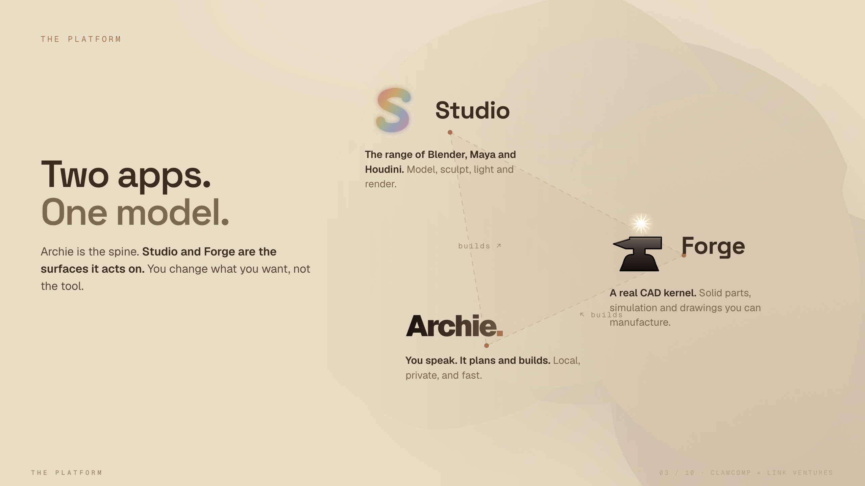
Notes:
So how does it work. Two apps, one brain. Studio gives you the power of Blender, Maya and Houdini. Forge gives you a real engineering kernel, for parts you can actually build. And Archie runs through both. You don't learn the tool. You say what you want, and it builds it.

Slide 4
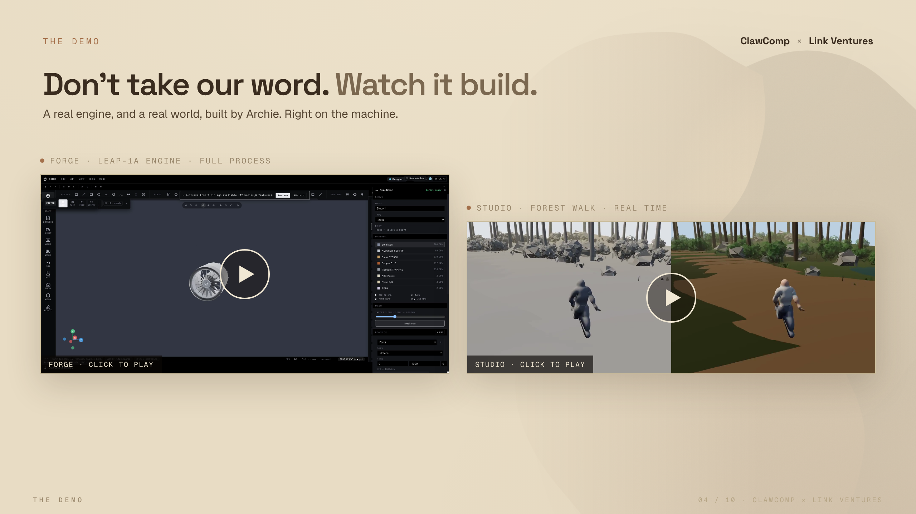
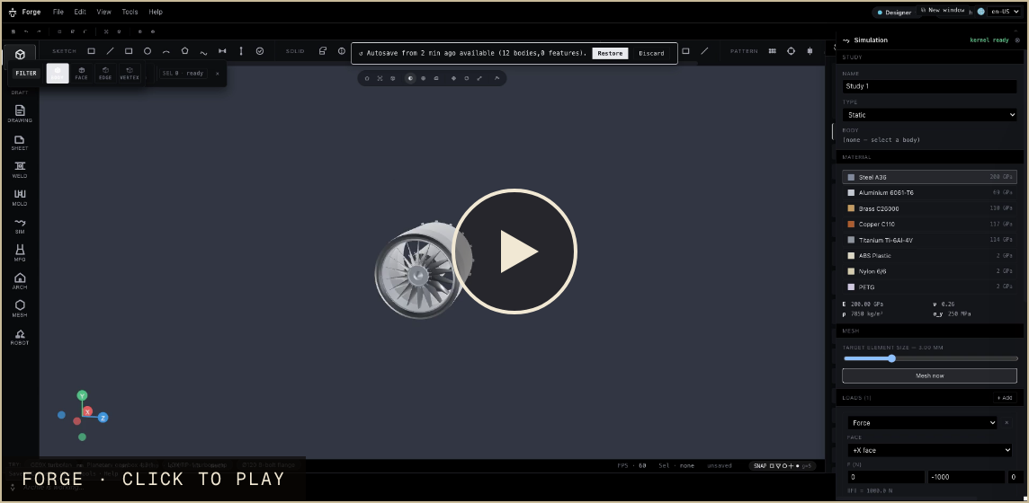
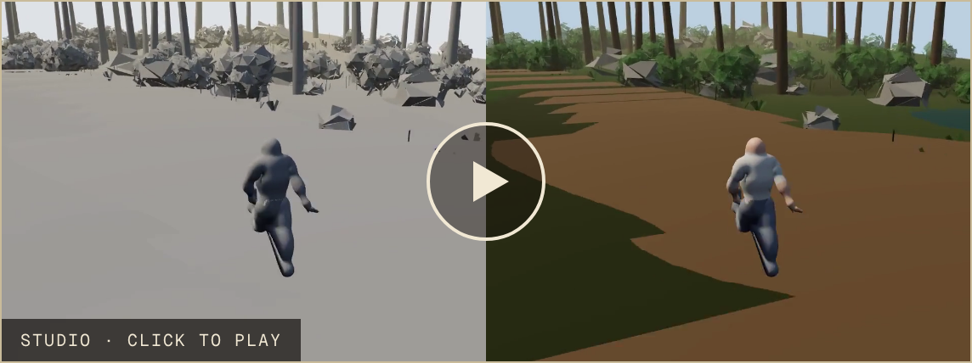
Notes:
Don't take our word for it. Watch. On the left, Forge builds a real jet engine, the whole process. On the right, Studio walks you through a living forest, in real time. One sentence each. No cloud, no waiting. This is real, and it runs today.

Slide 5
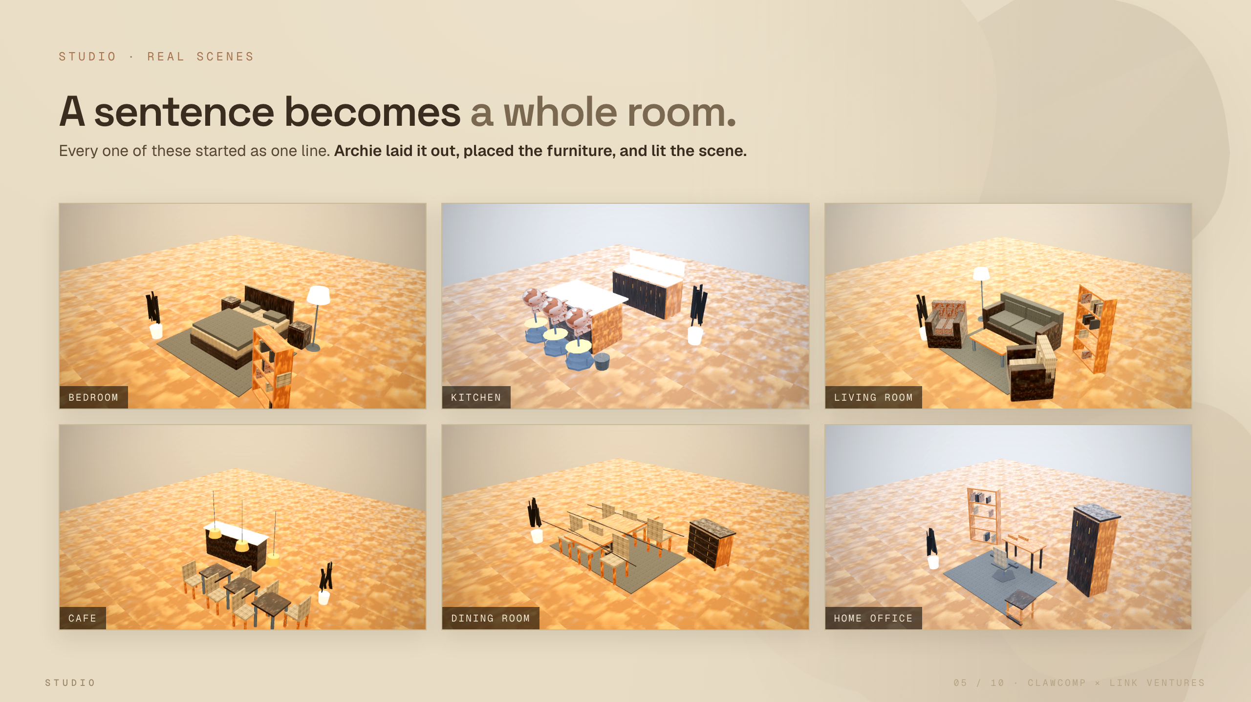
Notes:
And it is not only engineering. This is Studio. Every one of these rooms began as a single line. A cozy bedroom. A bright kitchen. A little cafe. Archie laid out the space, placed the furniture, and lit the scene. What used to take an artist days now takes a moment.

Slide 6
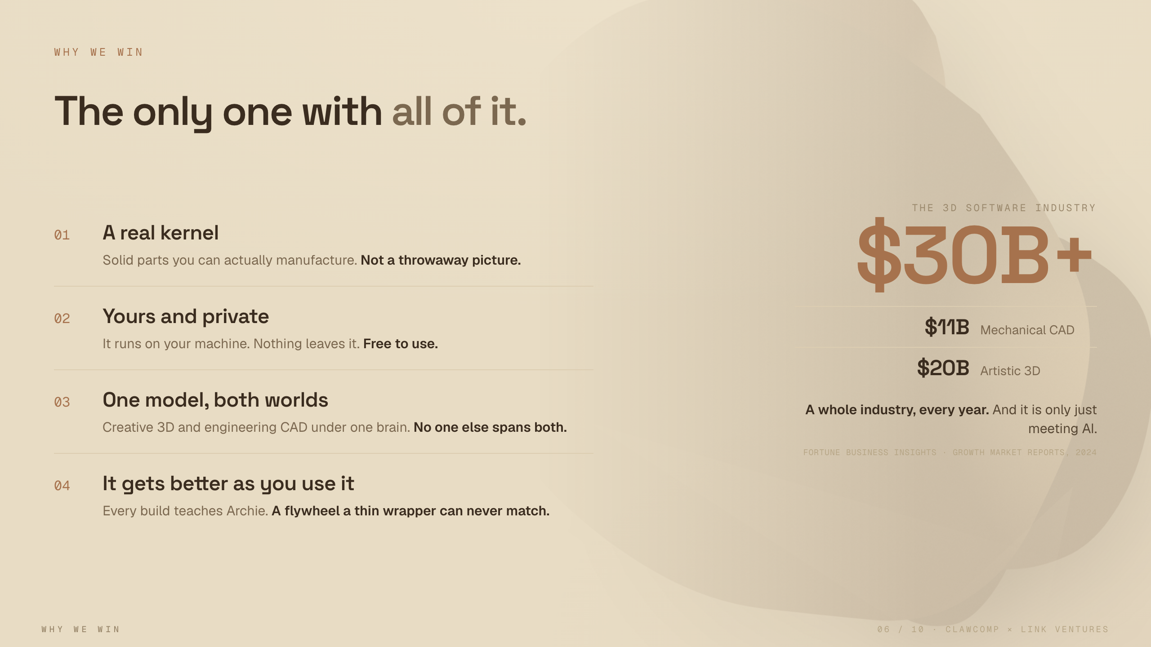
Notes:
Why us, and why now. Four things. It is a real kernel, so you get parts you can build, not just a pretty picture. It is yours and private, free on your own machine. It is one model across art and engineering, and no one else spans both. And it gets smarter every time someone uses it. All of that, in a 3D software industry already worth thirty billion a year.

Slide 7
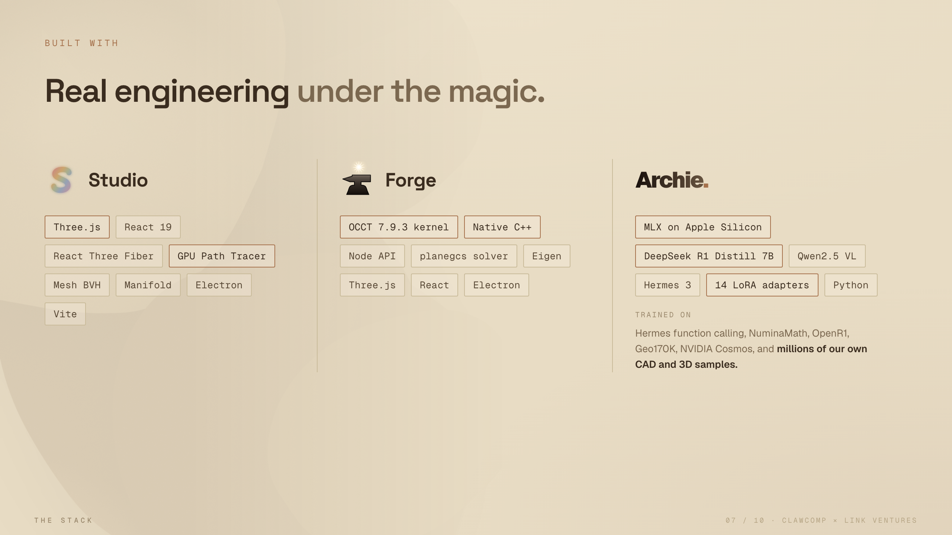
Notes:
And this is not a thin wrapper on someone else's AI. There is real engineering underneath. A native kernel for Forge. A full 3D engine for Studio. And our own models, trained on millions of our own samples, running right on your laptop. We built the hard parts ourselves.

Slide 8
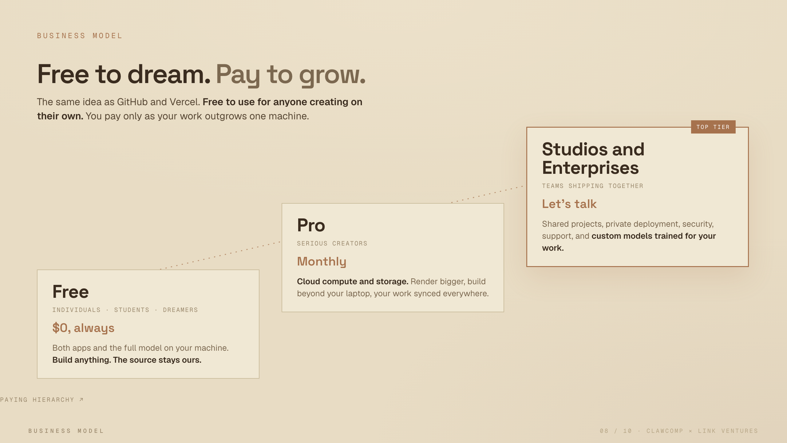
Notes:
How we make money is simple, and you have seen it work before. The same as GitHub and Vercel. Free for anyone creating on their own. They build anything, the source stays ours. When their work outgrows one machine, they pay for Pro, for cloud power and storage. And teams pay the most, for working together, security, and their own custom models.

Slide 9
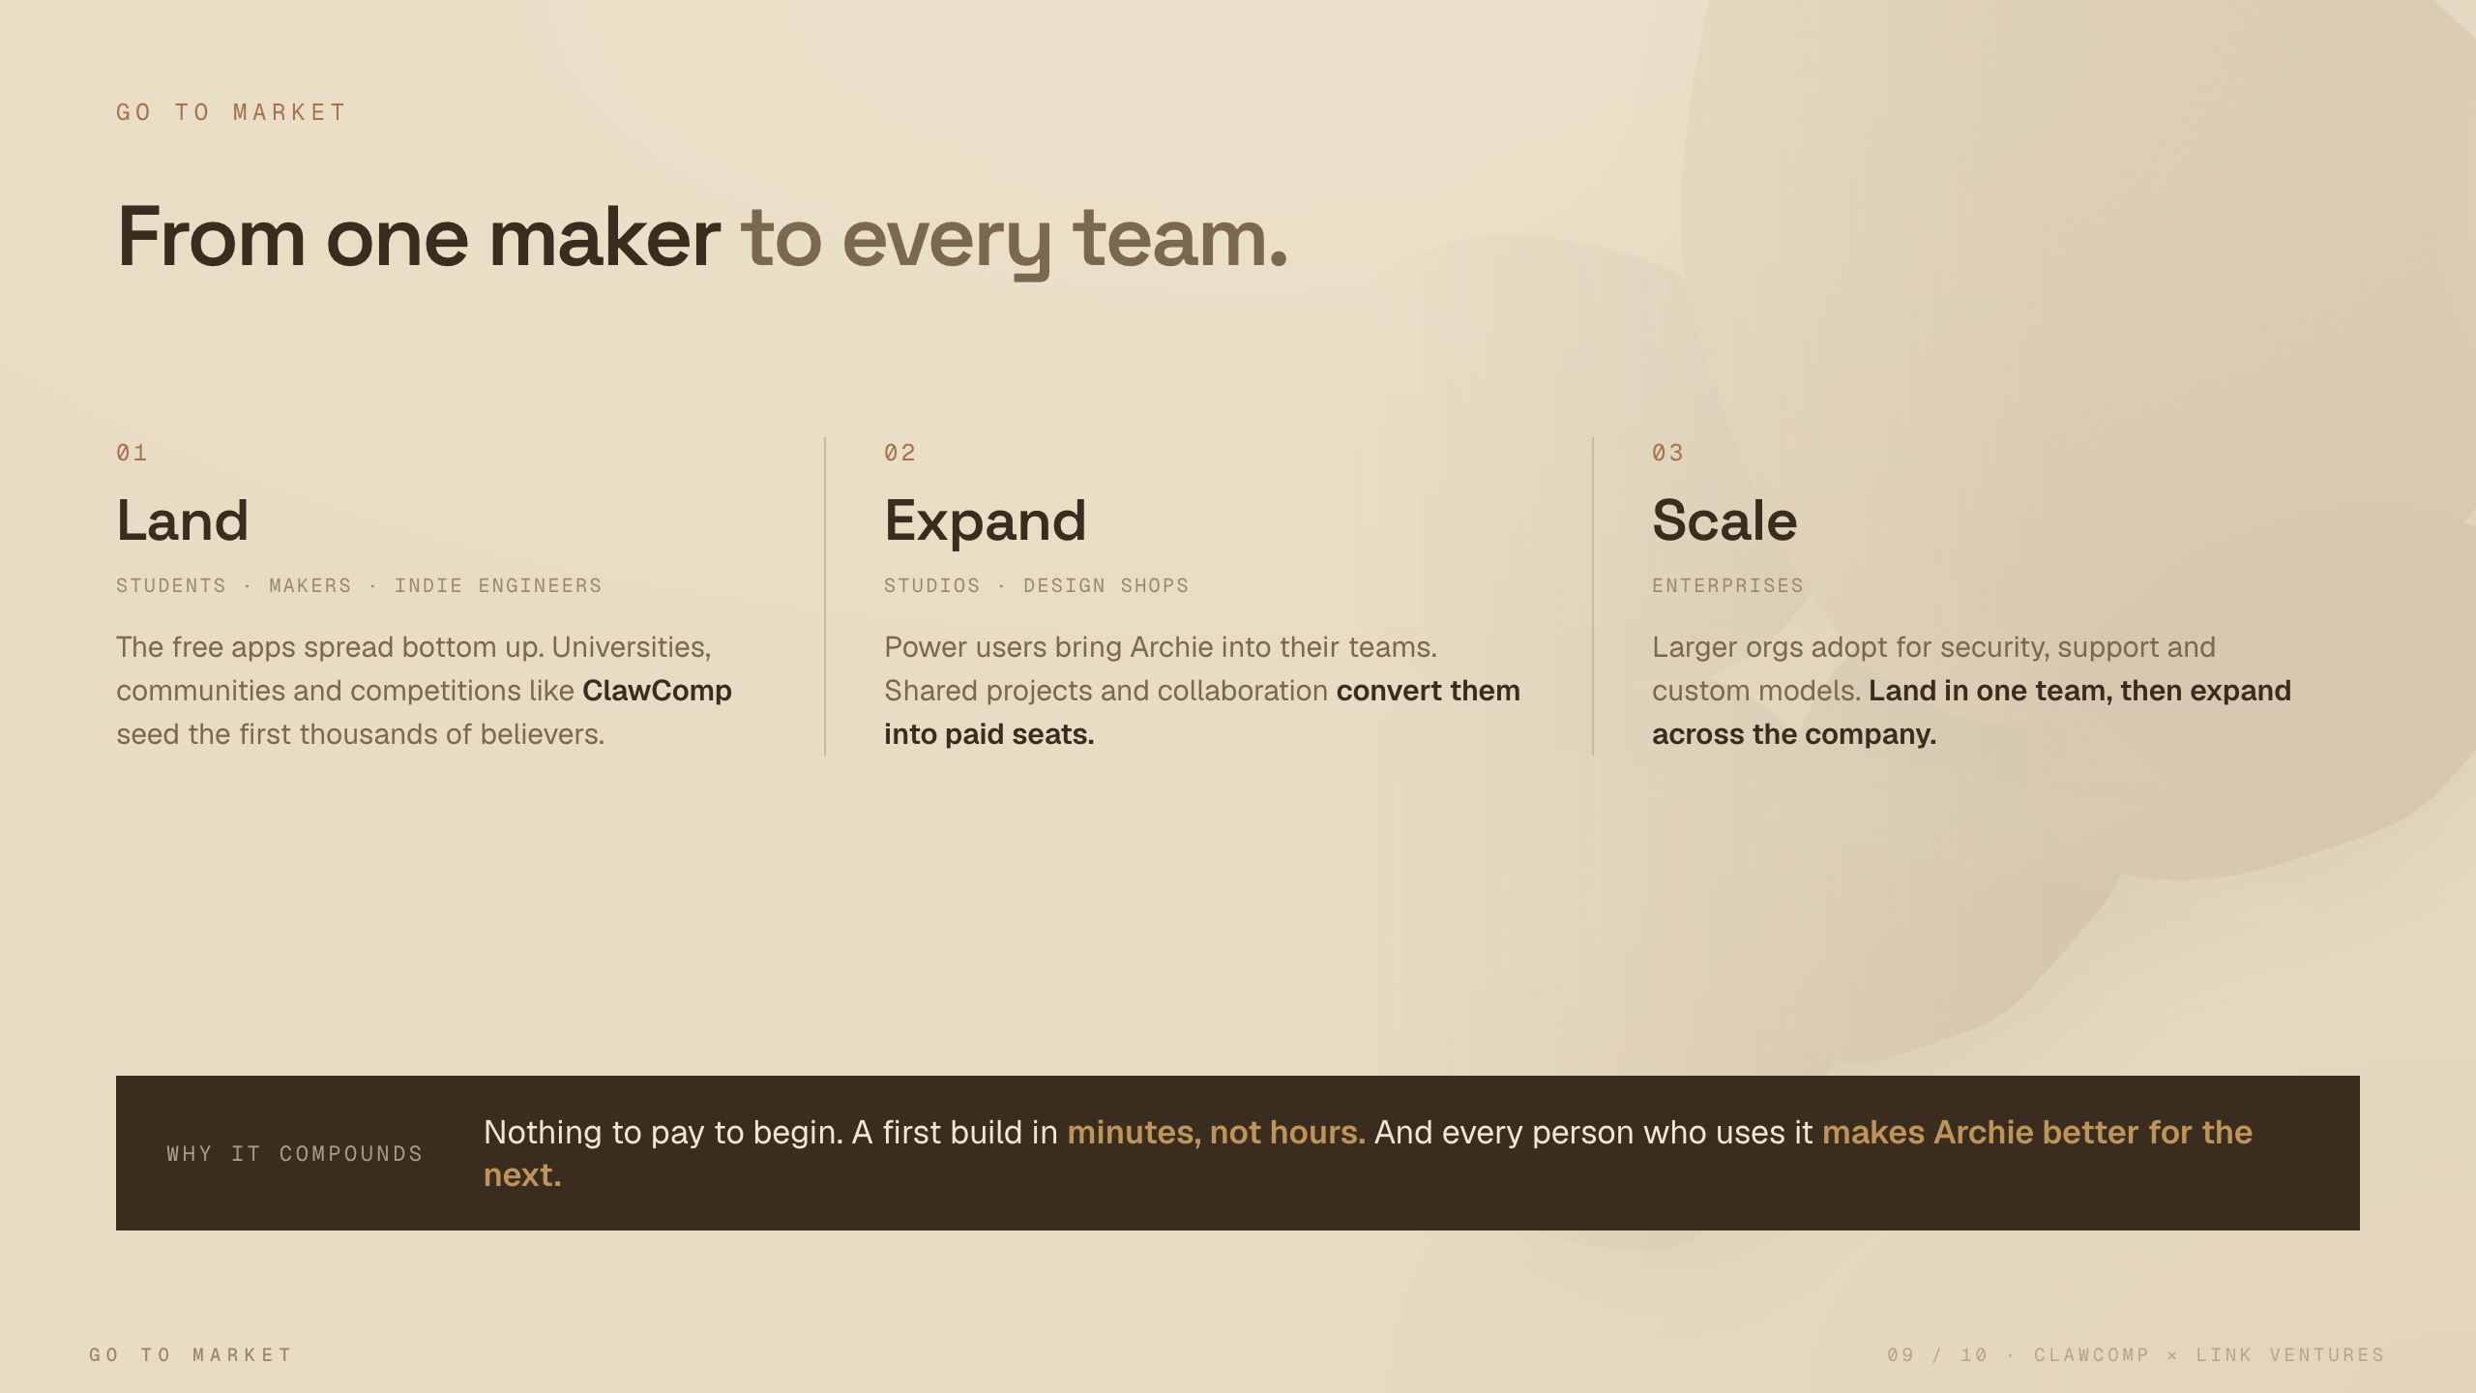
Notes:
Our path is bottom up. We land with students, makers and indie engineers, the people who love to try things for free. Competitions like ClawComp bring us the first thousands. Those people pull us into their studios, and studios pull in the big companies. And every user makes Archie better for the next one. It compounds.

Slide 10
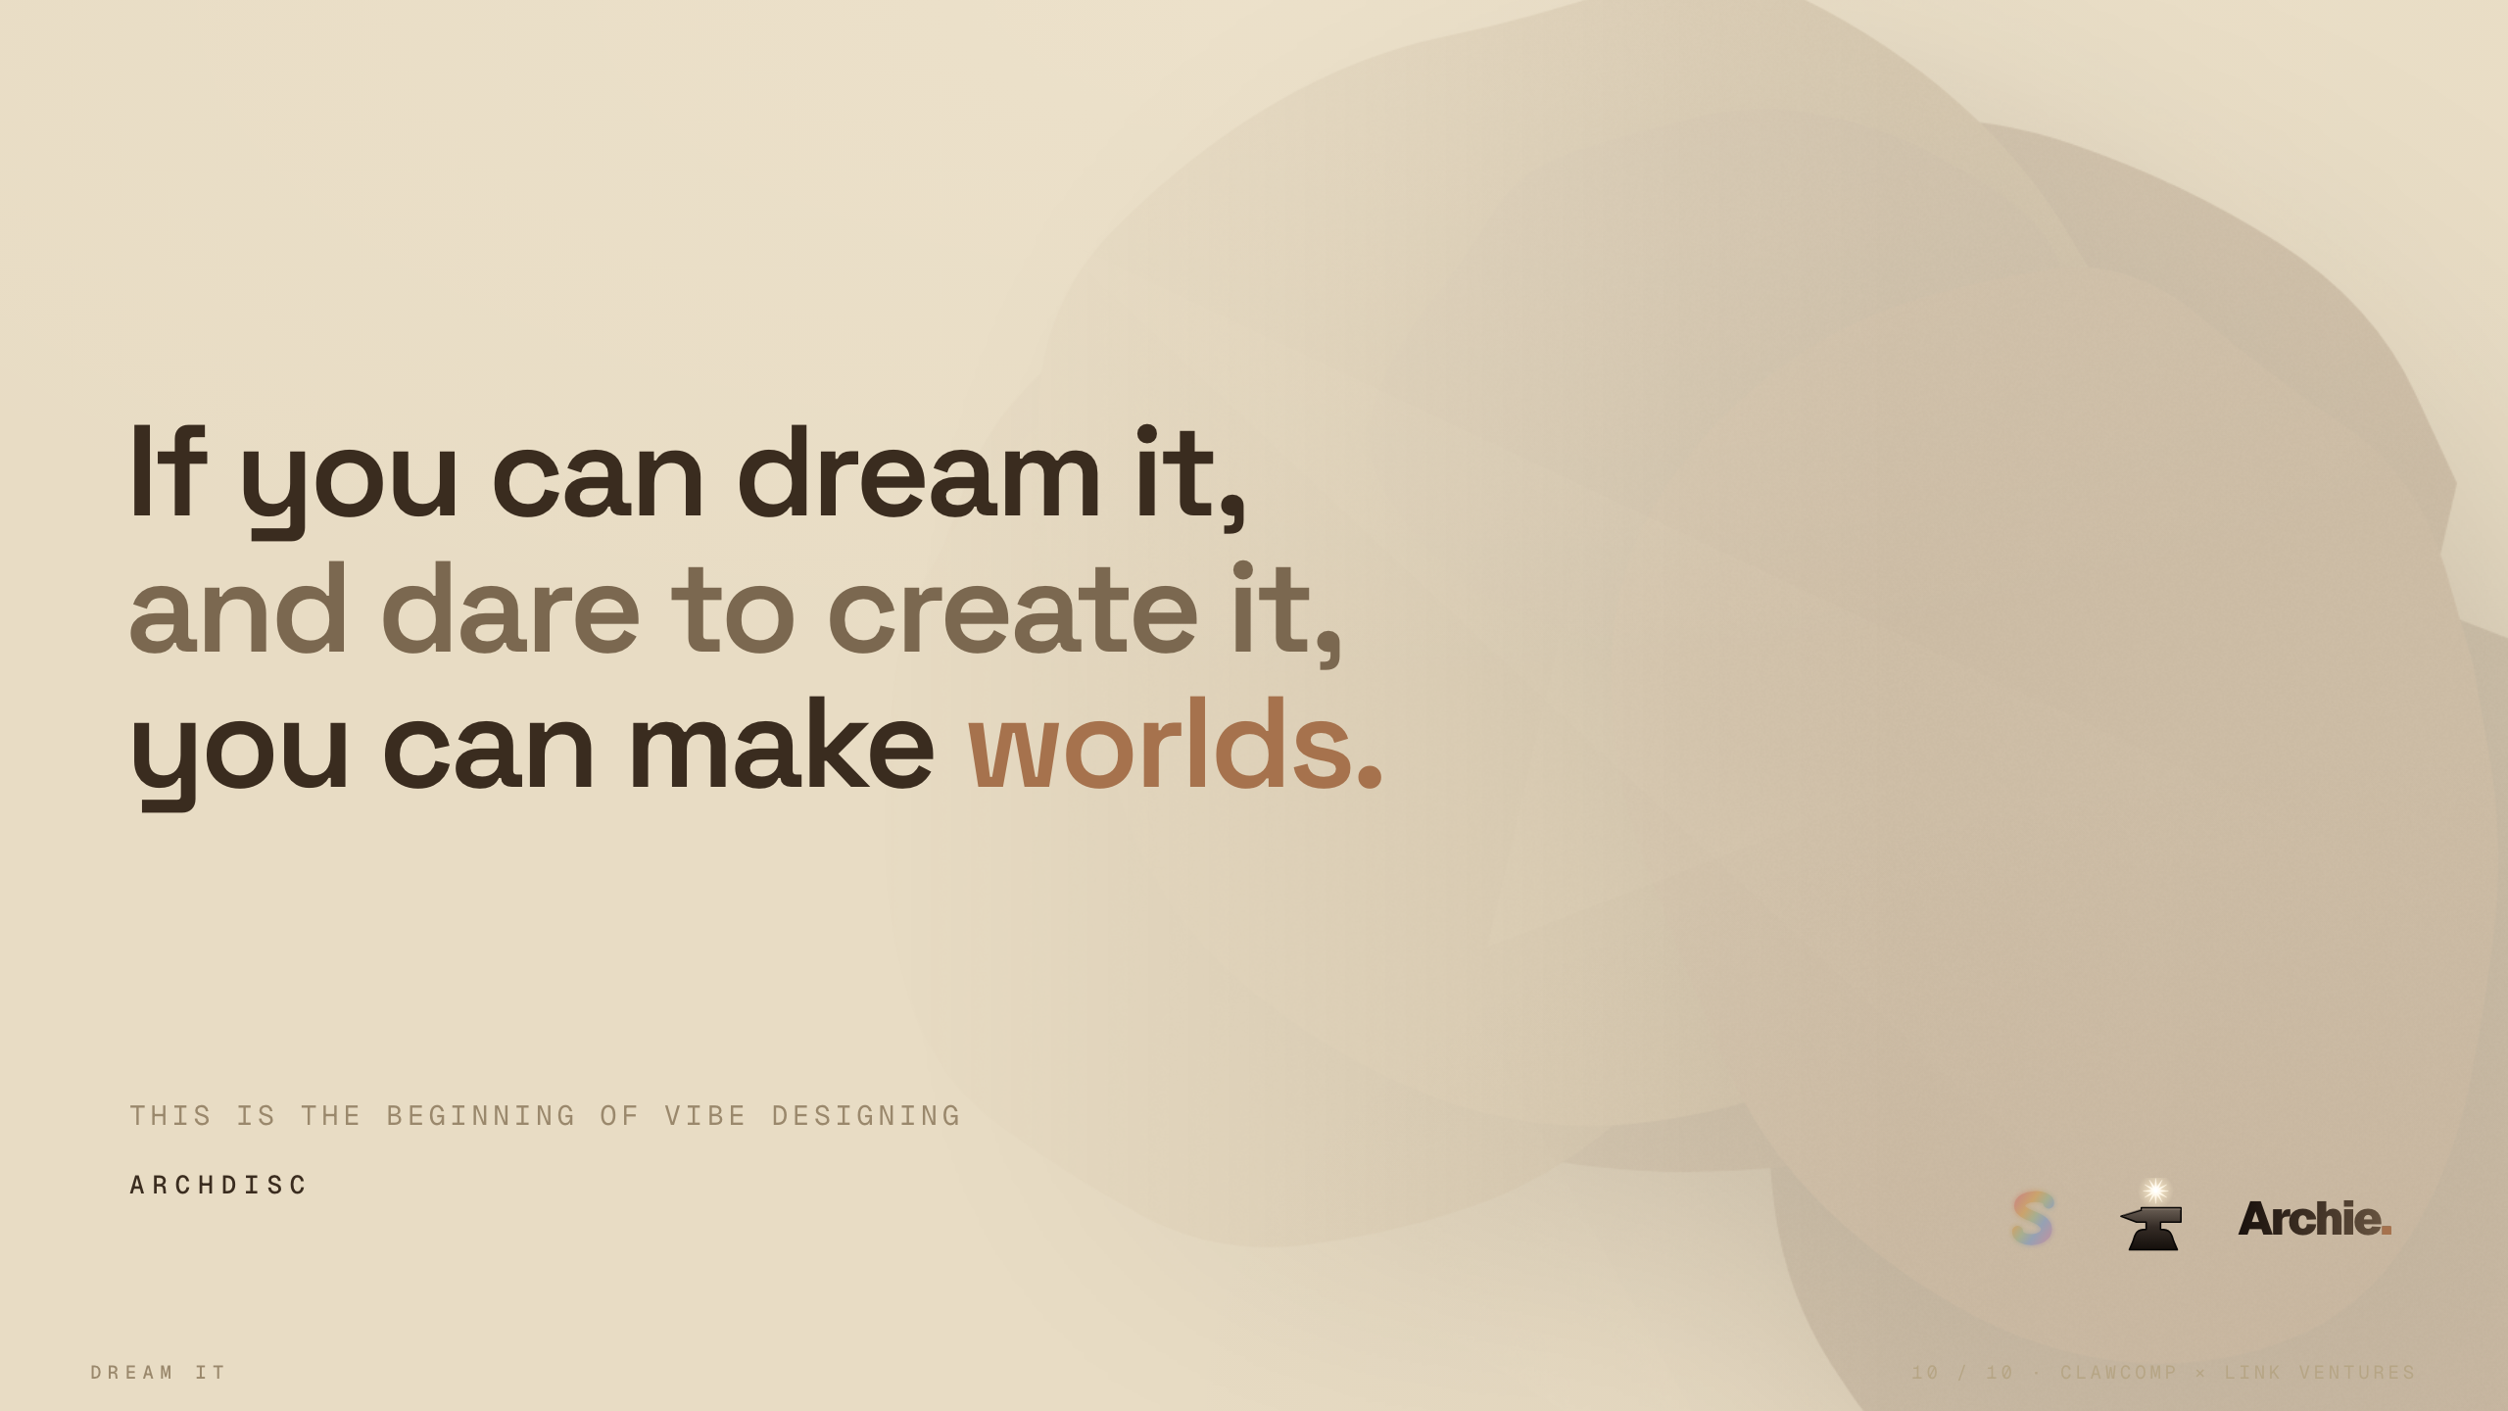
Notes:
So here is what we believe. If you can dream it, and you dare to create it, you can make worlds. That used to take years. Now it takes a sentence. This is the beginning of what we call vibe designing. We would love for you to build it with us. Thank you.

