Slide 1



CIS 434: Social Media and Text Analytics
Notecount.AI
Client Name: Tumblr
Presented by:
Jinnan Meng, Mingyang Liu, Naushin Adnin, Ruofan Wang ,
Satvik Adyanthaya , Tianyu Chu
Date of Submission: 04/30/2026

Slide 2





Tumblr at a Glance
PLATFORM
CONTENT SPREAD
CORE CHALLENGE
ANALYTICS GAP
Large-scale microblogging platform for short-form content: text, images, GIFs, videos & links.
Content diffusion driven by reblogging, tagging, and following mechanisms.
Highly unstructured, text-heavy posts make moderation and analytics expensive at scale.
Limited automated tools for creators to understand performance, audience, & engagement.

Slide 3



Target Audience
Our Main Target is to find Solution for Travel Content Creators
on Tumblr
CREATORS
NEEDS
VALUE
Travel vloggers
Travel bloggers
Tumblr influencers
Understand what drives engagement
Identify high-performing content
Improve reach & visibility
Predict engagement performance
Identify winning topics & tone
Enable data-driven decisions

Slide 4



Problem Identification
Lack of structured analytics for creators
Engagement is unpredictable and difficult to evaluate
Titles and tags do not reflect engagement potential
Unstructured text limits meaningful analysis
Noisy, low-quality content distorts engagement signals
Tumblr creators cannot reliably predict high-engagement content due to a lack of structured analytics.

Slide 5




Vision
omg this beach 😍 can’t get over this view
Golden hour coastal sunset in Santorini featuring soft pastel skies, calm ocean waves, and a serene atmosphere ideal for travel photography and quiet evening views along the shoreline.
Current (Unstructured)
Desired (Structured Insight)
Sentiment: Neutral | Predicted: Low Engagement
Sentiment: Positive | Predicted: High Engagement

Slide 6

What kind of sentiment and topics lead to higher engagement on Tumblr posts?

Slide 7

Objective
Develop a model to predict high vs. low engagement based on sentiment, topic, and textual features.
Predict high vs. low engagement Identify key drivers (sentiment & topics) Enable data-driven content strategy

Slide 8

Data & Methodology
DATA COLLECTION
PREPROCESSING & CLEANING
FEATURE ENGINEERING
(SENTIMENT +VADER + LDA + TF-IDF)
MODEL TRAINING
(XGBOOST)
Cross-platform analysis using Tumblr (primary) and Reddit (validation dataset).

Slide 9



Data Overview
DATASET
02
FEATURES USED
Tumblr:
40,000+ posts
(primary dataset)
Reddit:
2,000+ posts
(validation dataset)
.
Sentiment(VADER)
Topic (LDA)
Text Length
TF-IDF (text features)
ENGAGEMENT DEFINITION
Tumblr: note_count
Reddit: upvotes + comments
01
03

Slide 10
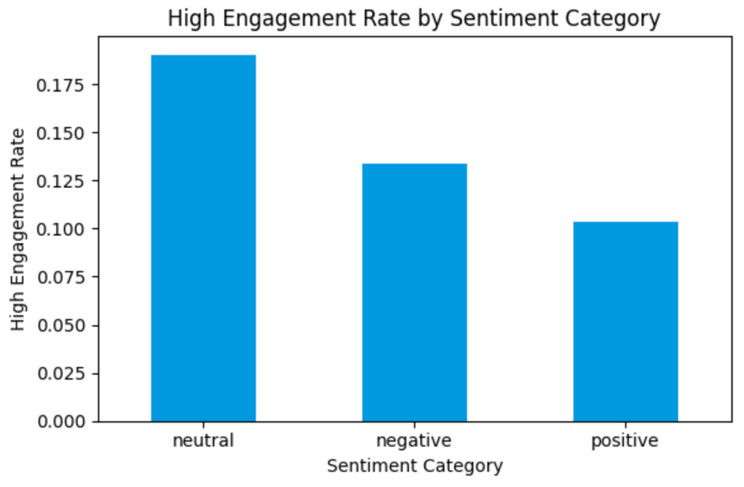
Sentiment vs Engagement
KEY INSIGHT
Neutral posts have the highest engagement rate
Positive posts show relatively lower engagement
Tumblr engagement favors neutral, informative content over emotional content.

Slide 11
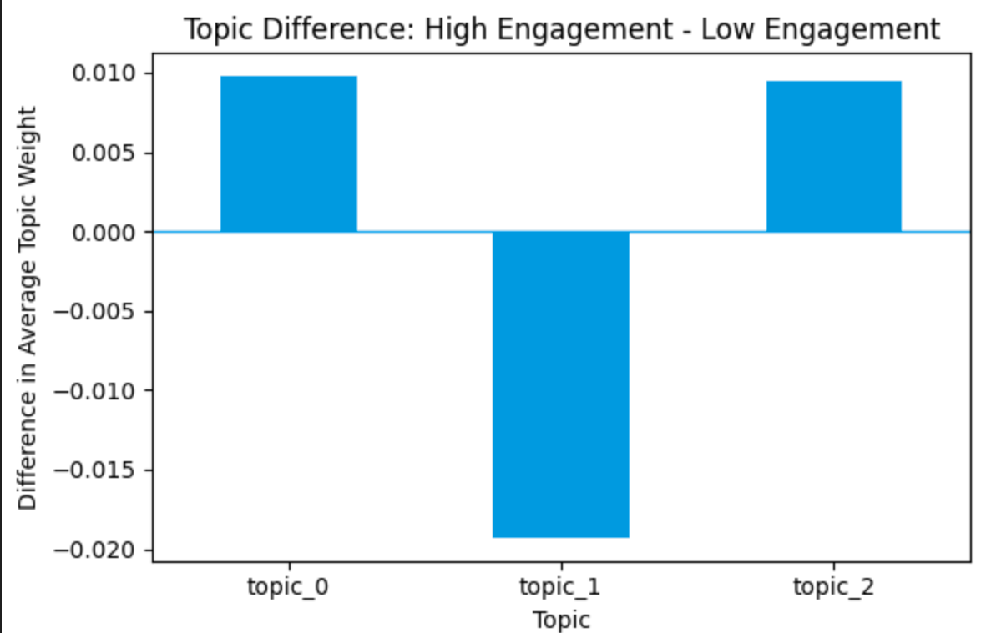
Impact on Engagement
KEY INSIGHT
Some topics show slight differences in engagement
No topic consistently dominates performance
Content quality matters more than topic category on Tumblr.

Slide 12
Model Performance
01
02
03
REDDIT:
~81% ACCURACY
TUMBLR: ~78% ACCURACY
XGBOOST MODEL USED
Model performance shows that Tumblr engagement is more variable and harder to predict, confirming platform-specific differences.

Slide 13
Summarizing Our Key Results
1.
SENTIMENT IMPACT
2.
CONTENT & TOPIC INSIGHT
3.
MODEL PERFORMANCE
Reddit: emotional content drives higher engagement
Tumblr: neutral and descriptive content performs better
Reddit: Q&A and interactive posts perform best
Tumblr: engagement depends more on content quality than topic
XGBoost achieved strong prediction accuracy
Reddit: ~81%
Tumblr: ~78%
Tumblr engagement is harder to predict
Engagement drivers vary significantly across platforms.

Slide 14

Recommendation: Use Our App
From Insights to Action: Powered by Notecount.AI
PREDICT ENGAGEMENT BEFORE POSTING
Real-time score
Identify weak content early
UNDERSTAND WHY CONTENT UNDERPERFORMSS
Notecount.AI
Sentiment, topic, and structure breakdown
Model explains key drivers
OPTIMIZE CONTENT INSTANTLY
AI suggestions to improve engagement
Rewrite captions for better performance
MOVE FROM GUESSWORK → DATA-DRIVEN POSTING
Manual analysis is not scalable but our app automates this.

Slide 15

Limitations & Future Work
Focused only on travel-related content
Limited number of high-engagement posts
Simple features (TF-IDF, sentiment, topics)
May not generalize to other platforms or domains

Slide 16
Key Takeaway
Tumblr
Reddit
Both
Write descriptive, neutral-toned content
Lead with emotion & interaction
Use data before you post
Notecount.AI turns this insight into actionable, predictive decisions

Slide 17
Let’s check out our App!
Notecount.AI

Slide 18
From normal posts to posts with a motive, that’s the power of Notecount.AI.

