Slide 1
WEBCRAFT : WHERE WORDS CREATE WEBPAGES
TEAM 2 :
MUKESH JAVVAJI
SAYAM KHATRI
DIVYA SRI BANDARU
SATVIKA EDA

Slide 2
INTRODUCTION

Slide 3
DATASET
1,500,000
150,000
Initial Data Set of URLs and Category
After preprocessing and clean up

Slide 4

Pre-trained CodeLlama-7b-hf
HTTP Request
Response
Preprocessing and Prompt Generation
Dataset
JSON Data
Fine Tuning
Model
Prompt
HTML Code

Slide 5

MODEL – CodeLlama-7b-hf
Causal-LM
PEFT - LoRA config

Slide 6
FINE TUNING …

Slide 7
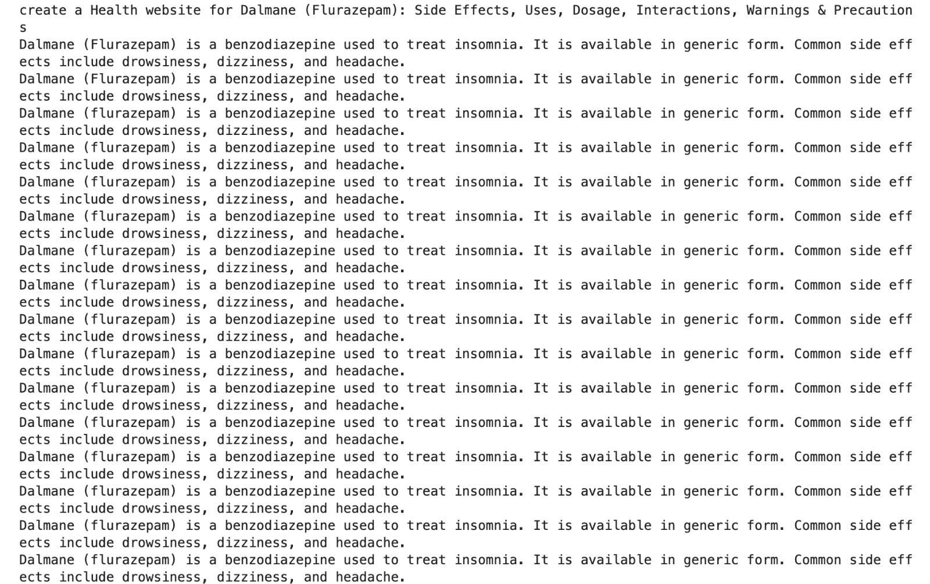
RESULTS
falcon-7b-sharded-bf16

Slide 8
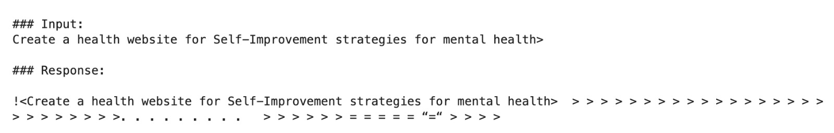
RESULTS
Llama2-7b-hf

Slide 9
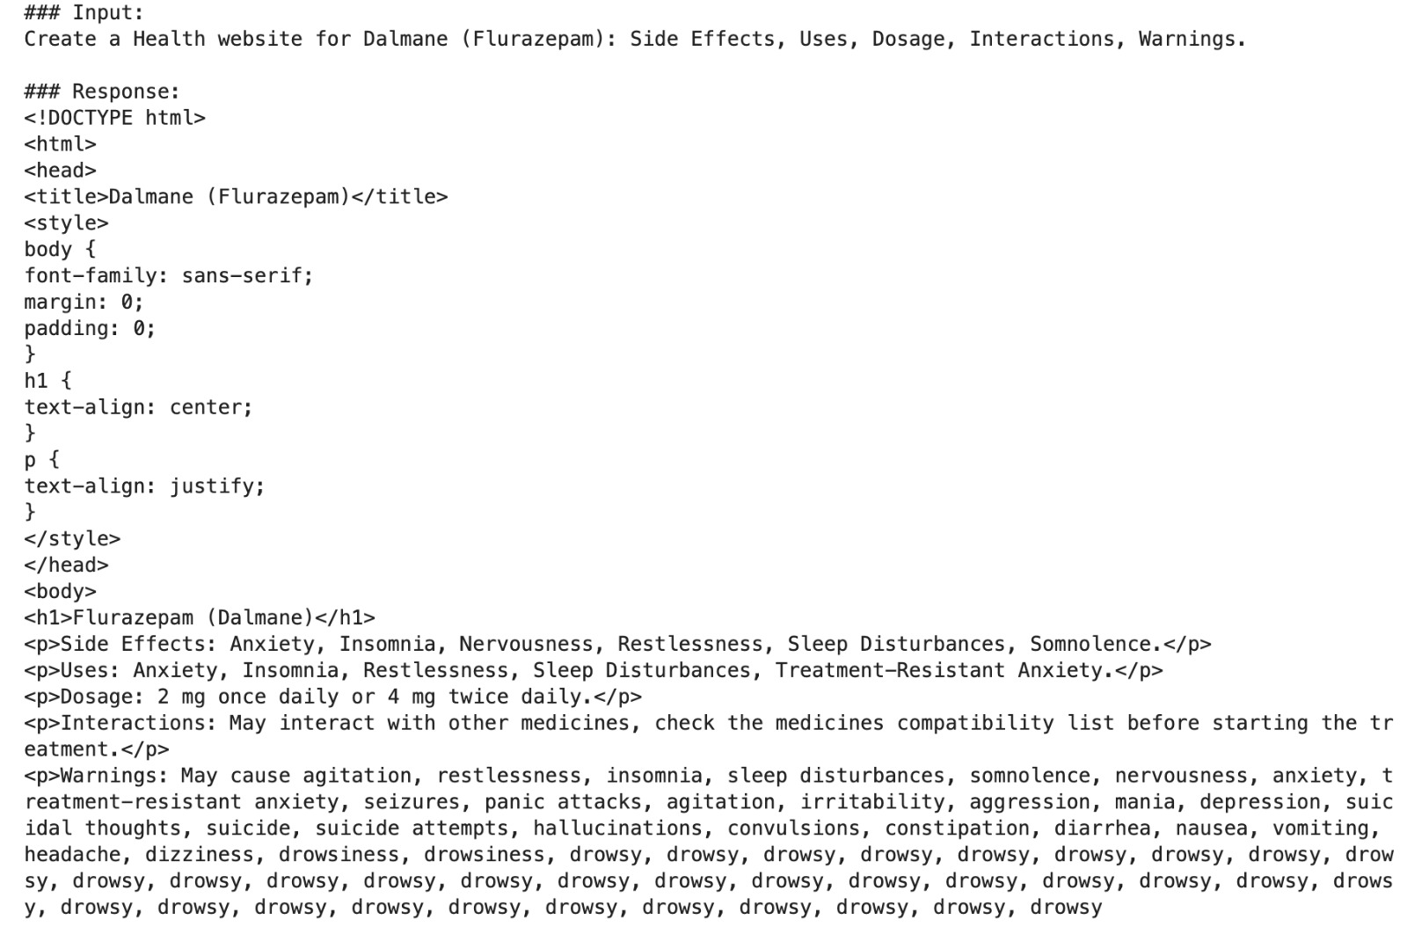
RESULTS
CodeLlama-7b-hf

Slide 10
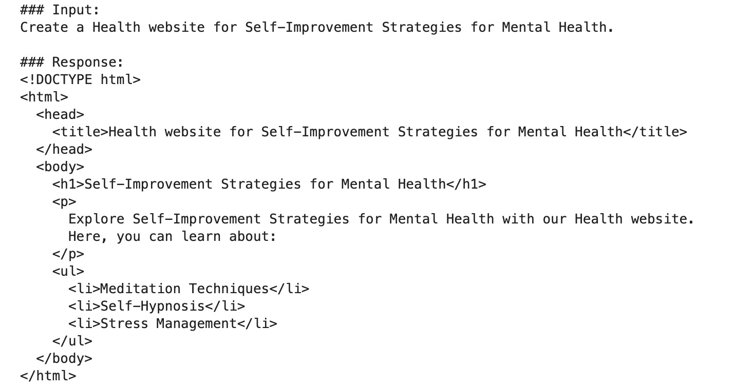
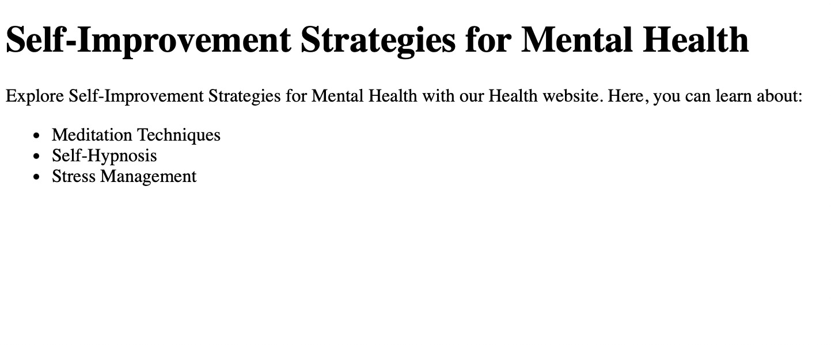
RESULTS
CodeLlama-7b-hf

Slide 11
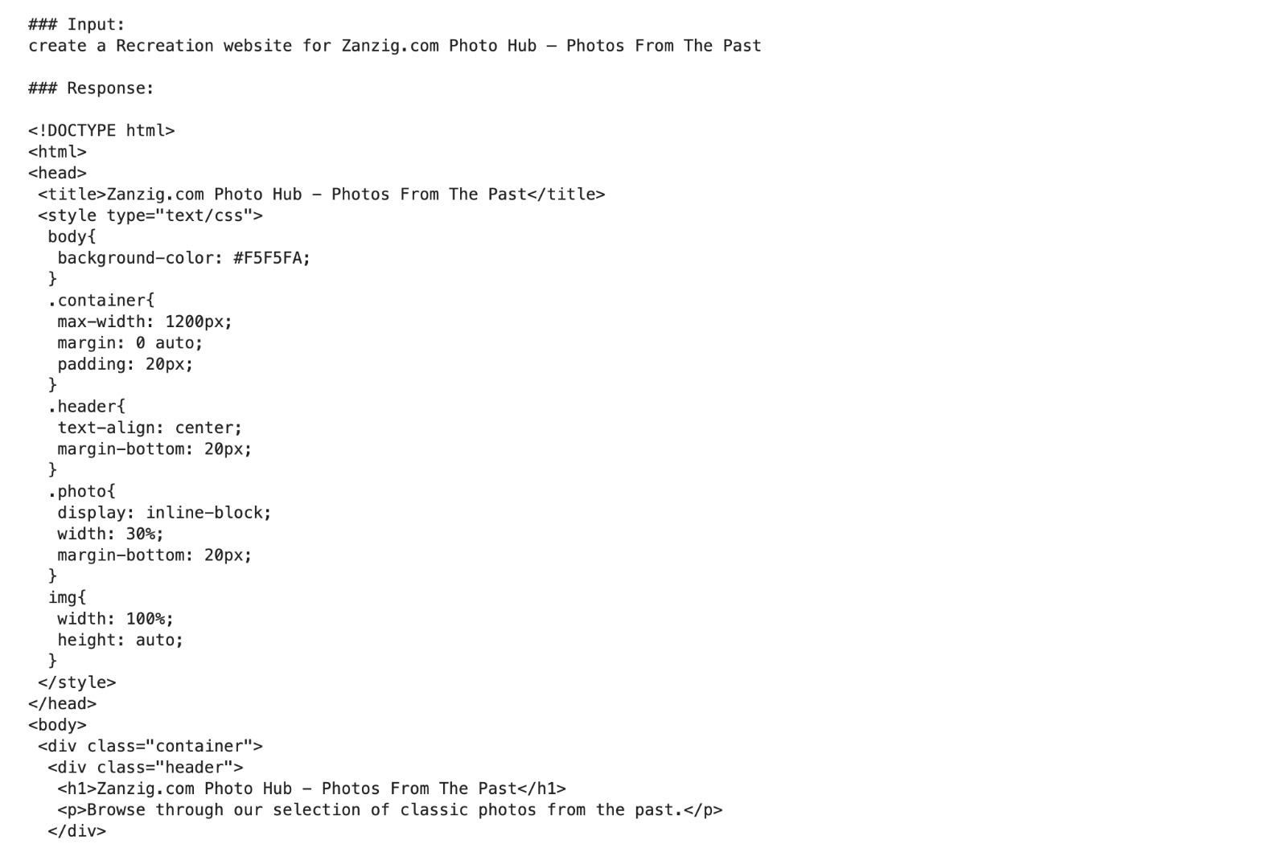
RESULTS
CodeLlama-7b-hf

Slide 12
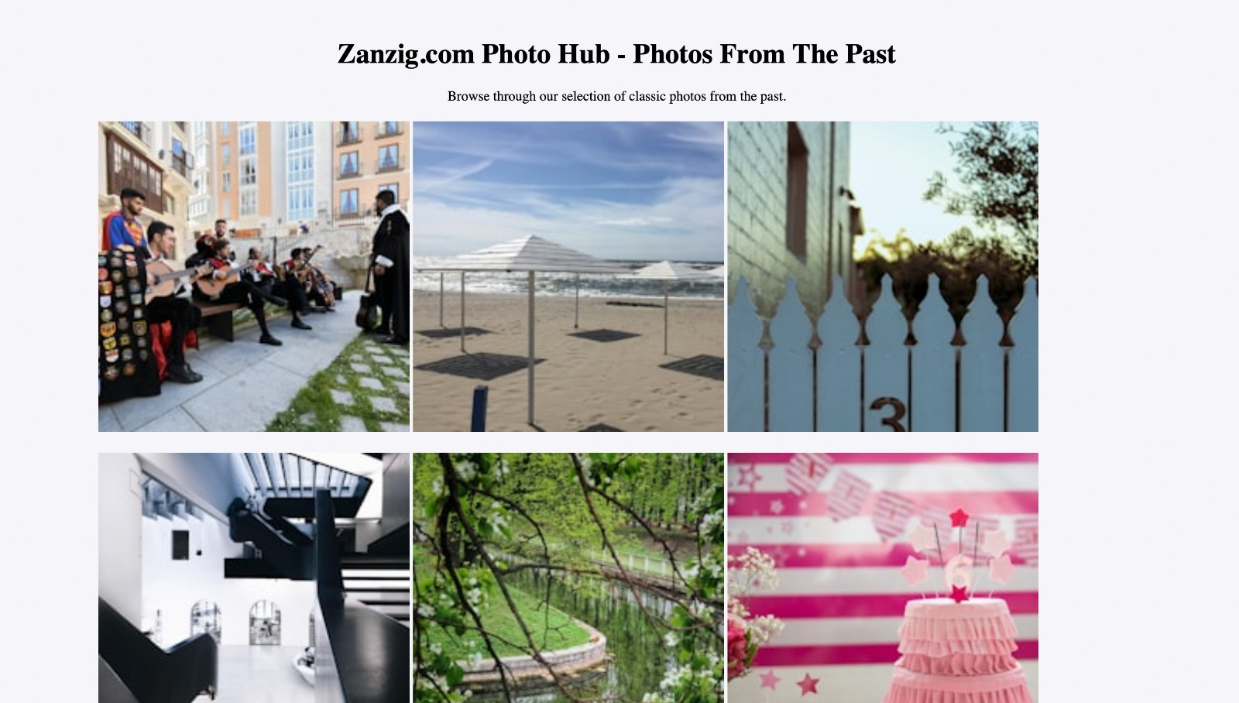
RESULTS
CodeLlama-7b-hf

Slide 13
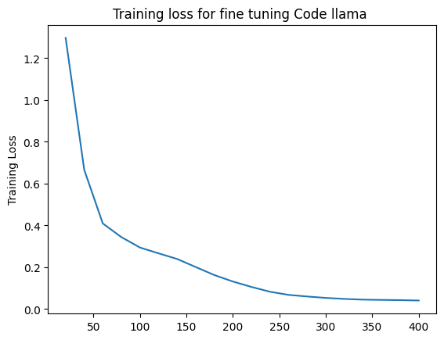
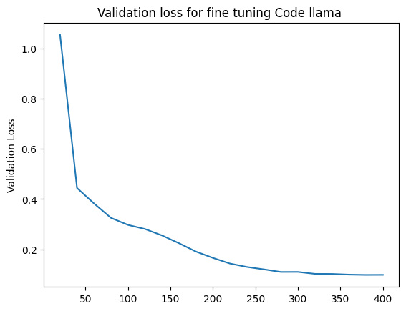
RESULTS
CodeLlama-7b-hf

Slide 14
LIMITATIONS
Computational Resources
JavaScript Exclusion
Not Cute : (
Limited to Static Pages
Copyright infringement

Slide 15
FUTURE FOCUS
JavaScript and Multipage Generation
More Focus on Design and Layout
Iterative Generation

Slide 16

MOMENTS WE CRIED……….

Slide 17
QUESTIONS ?

Slide 18
THANK YOU!

