Slide 1
Satvika Chilakala
Final Project
3/21/2024 Annual Review

Slide 2
KEYLOGGER AND SECURITY
Protecting your data in the digital age
3/21/2024 Annual Review

Slide 3


AGENDA
Introduction: Overview of keyloggers and their significance in cybersecurity.
Problem Statement: Discuss the specific issues caused by keyloggers.
Project Overview: Explain the goals and scope of the project.
End Users: Identify who benefits from the solution.
Solution and Value Proposition: Detail the proposed solution and its benefits.
Unique Aspects of the Solution: Highlight what makes this solution innovative.
Modeling and Results: Present the findings and effectiveness of the solution.
3/21/2024 Annual Review

Slide 4

PROBLEM STATEMENT
Description: The rising threat of keyloggers in cybersecurity.
Keyloggers record keystrokes to capture sensitive information.
They can be used to steal passwords, credit card numbers, and other confidential data.
3/21/2024 Annual Review

Slide 5

PROJECT OVERVIEW
Develop a comprehensive solution to detect and prevent keyloggers and Emphasize the importance of early detection and prevention.
Identifying different types of keyloggers
Hardware and software keyloggers.
Evaluating existing security measures
Firewalls, antivirus software, and encryption.
3/21/2024 Annual Review

Slide 6

WHO ARE THE END USERS?
Individuals: Concerned about personal data security and privacy.
Businesses: Need to protect corporate data and ensure compliance with security standards.
Organizations: Require robust security measures to safeguard sensitive information.
Security Professionals: Aim to understand and mitigate keylogging threats.
3/21/2024 Annual Review

Slide 7

YOUR SOLUTION AND ITS VALUE PROPOSITION
Solution
Multi-layered security.
Real-time monitoring and alerts.
Value Proposition
Enhanced security with minimal impact.
Cost-effective compared to financial losses.
Easy to implement and integrate.
User-friendly interface.
3/21/2024 Annual Review

Slide 8

THE WOW IN YOUR SOLUTION
Covers software and hardware keyloggers.
Regular updates for emerging threats.
Simple installation and maintenance.
Flexibility for different systems.
Demonstration: Real-time demonstration of a simple keylogger to illustrate the threat and the effectiveness of security measures
3/21/2024 Annual Review
8

Slide 9
MODELLING
1.Purpose
Monitor and record keystrokes on a computer system.
2.Components
Keyboard Listener: Captures keystrokes.
Log Writer: Stores keystrokes in a file or database.
Optional Features: Capture screenshots, track application usage
3.Implementation in Python
Use libraries like ‘pynput’ for keyboard monitoring.
4.Legal and Ethical Considerations
Authorization: Obtain consent before deploying.
Privacy: Handle captured data responsibly
5.Security Concerns
Data Encryption: Protect captured data from unauthorized access.
Detection: Antivirus software may classify keyloggers as malware.
3/21/2024 Annual Review
9

Slide 10
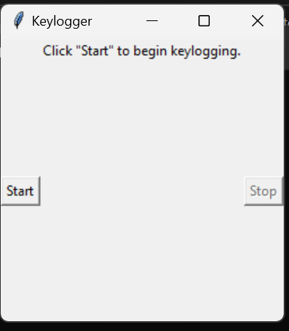
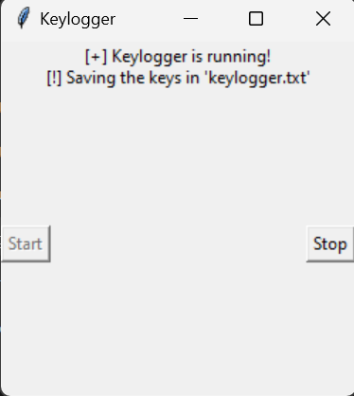
RESULTS
3/21/2024 Annual Review
10

