Slide 1


THE ANALYSIS
CREATED BY
SATVIK KISHORE

Slide 2
RESEARCH QUESTIONS
Are there differences in quality across directors?
What are the differences in quality across four shows and their constituent seasons?
Which characters were the most liked/disliked?

Slide 3





DATA
Seasons: 7 Episodes: 176
TNG (1987-1994)
SCRIPTS
DS9 (1993-1999)
Seasons: 7 Episodes: 173
Director
CHARACTER PROMINANCE
VOY (1995-2001)
Seasons: 7 Episodes: 168
ENT (2001-2005)
Seasons: 5 Episodes: 97
CHARACTER PROMINENCE = Percentage of words spoken by each main character within each episode
Sources: www.chakoteya.net/StarTrek/index.html datasets.imdbws.com

Slide 4
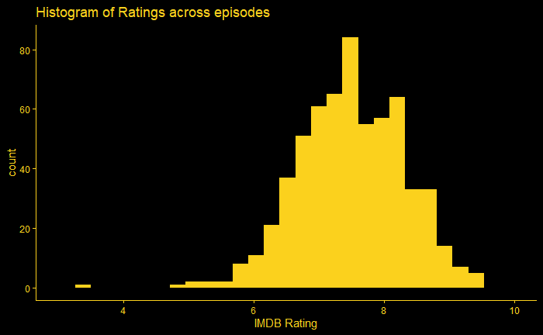
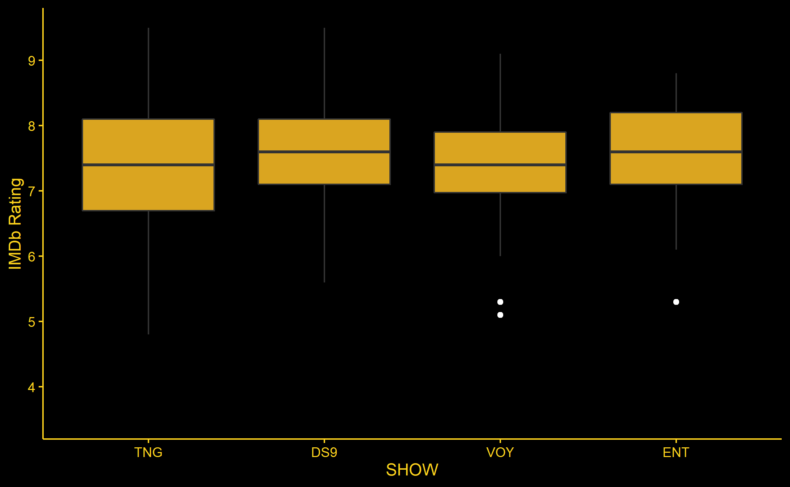
EXPLORATORY DATA ANALYSIS
73 Unique Directors, with 33 directing more than 4 episodes

Slide 5
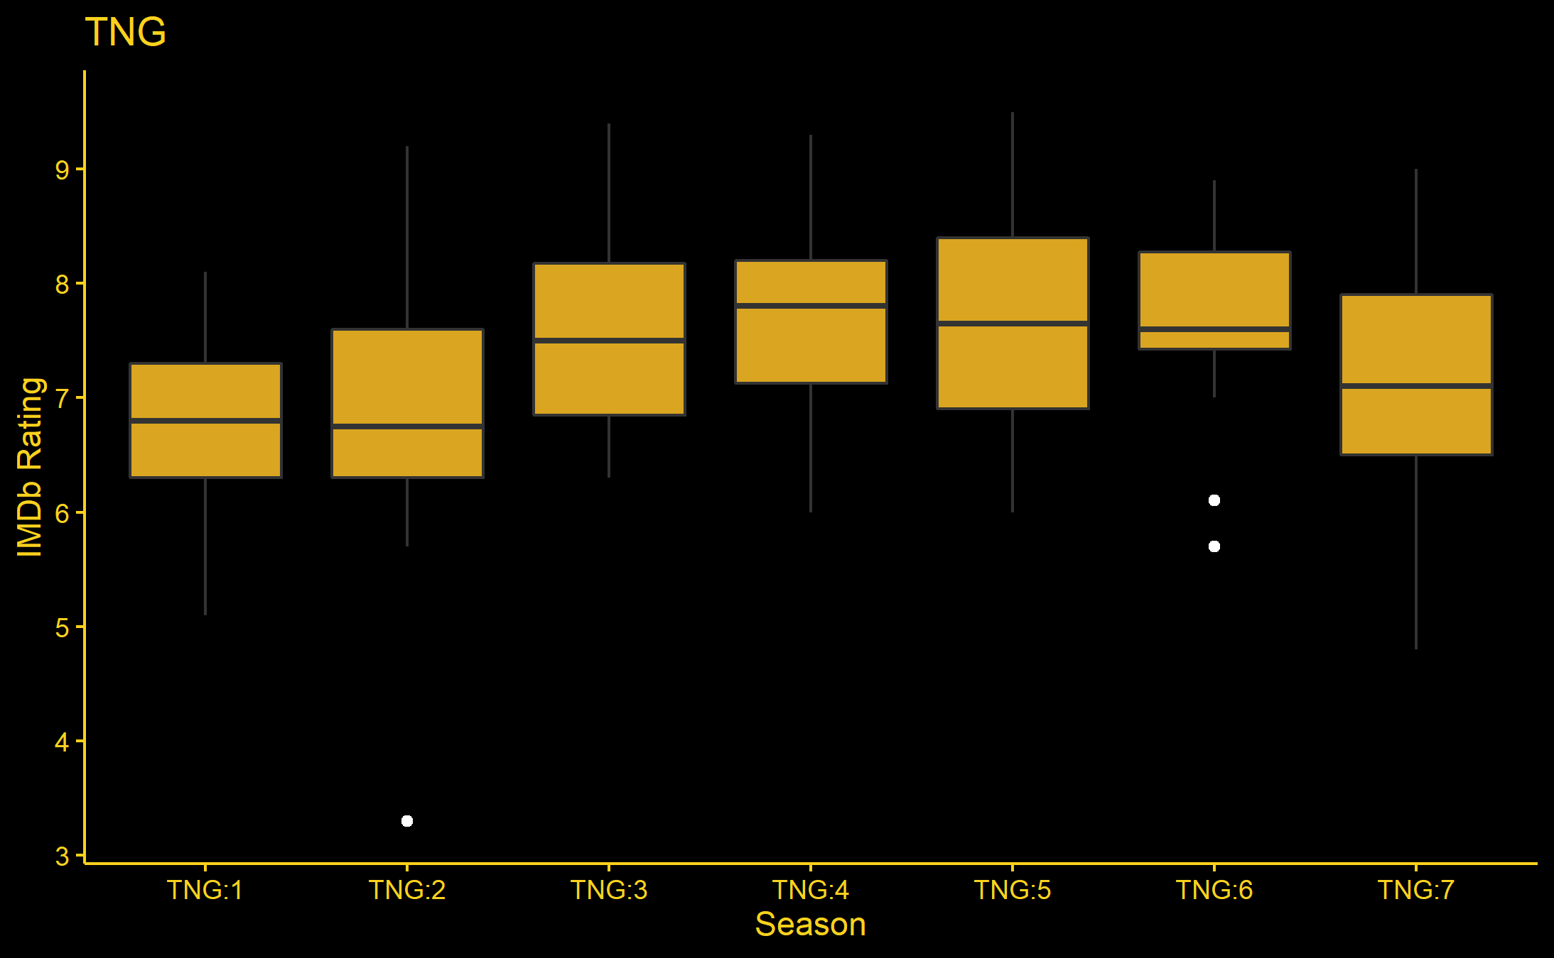
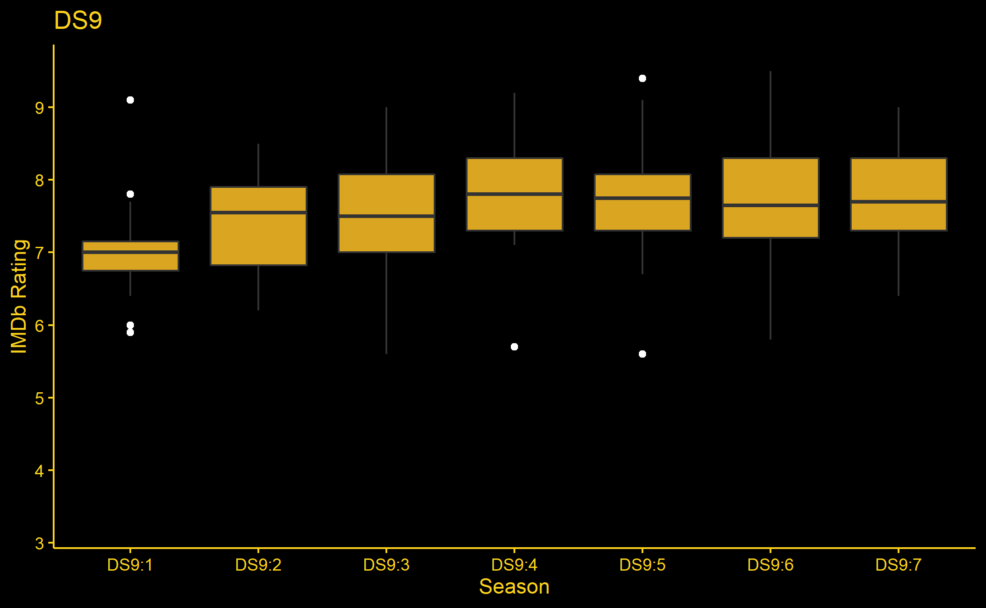
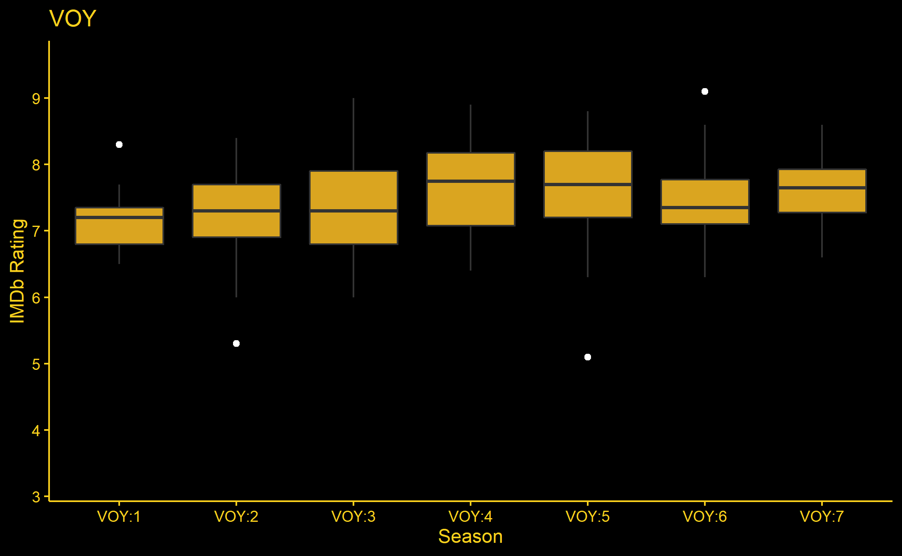
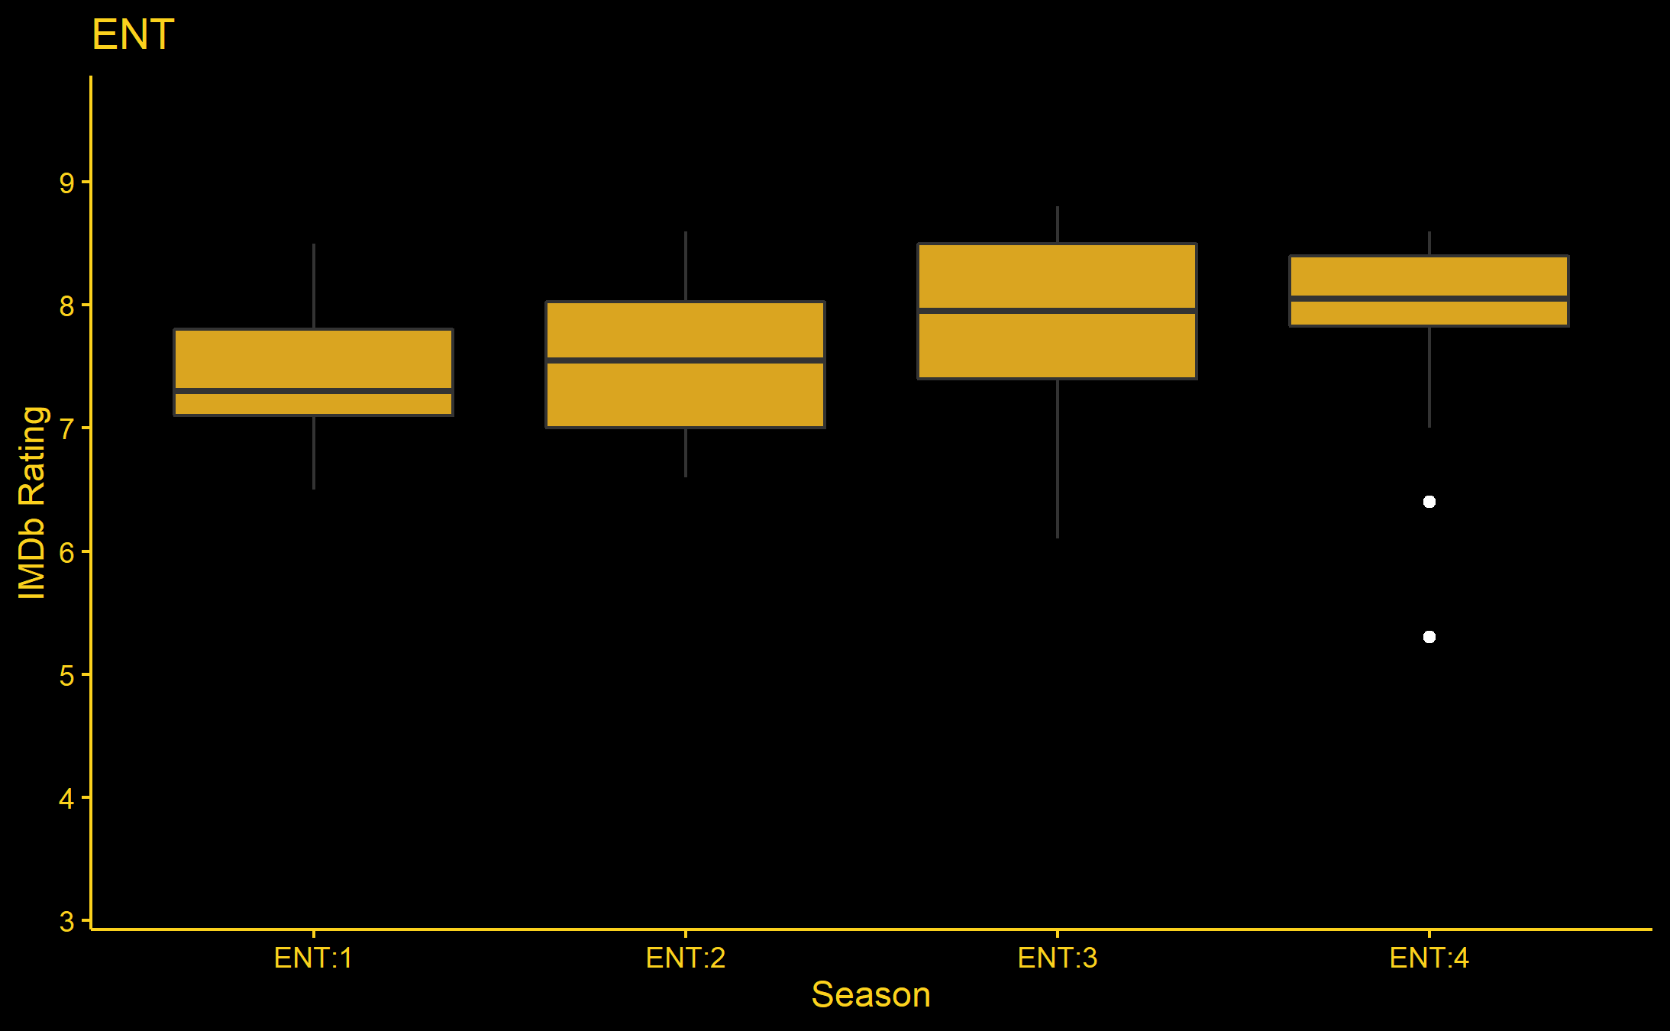
EXPLORATORY DATA ANALYSIS (cont.)

Slide 6
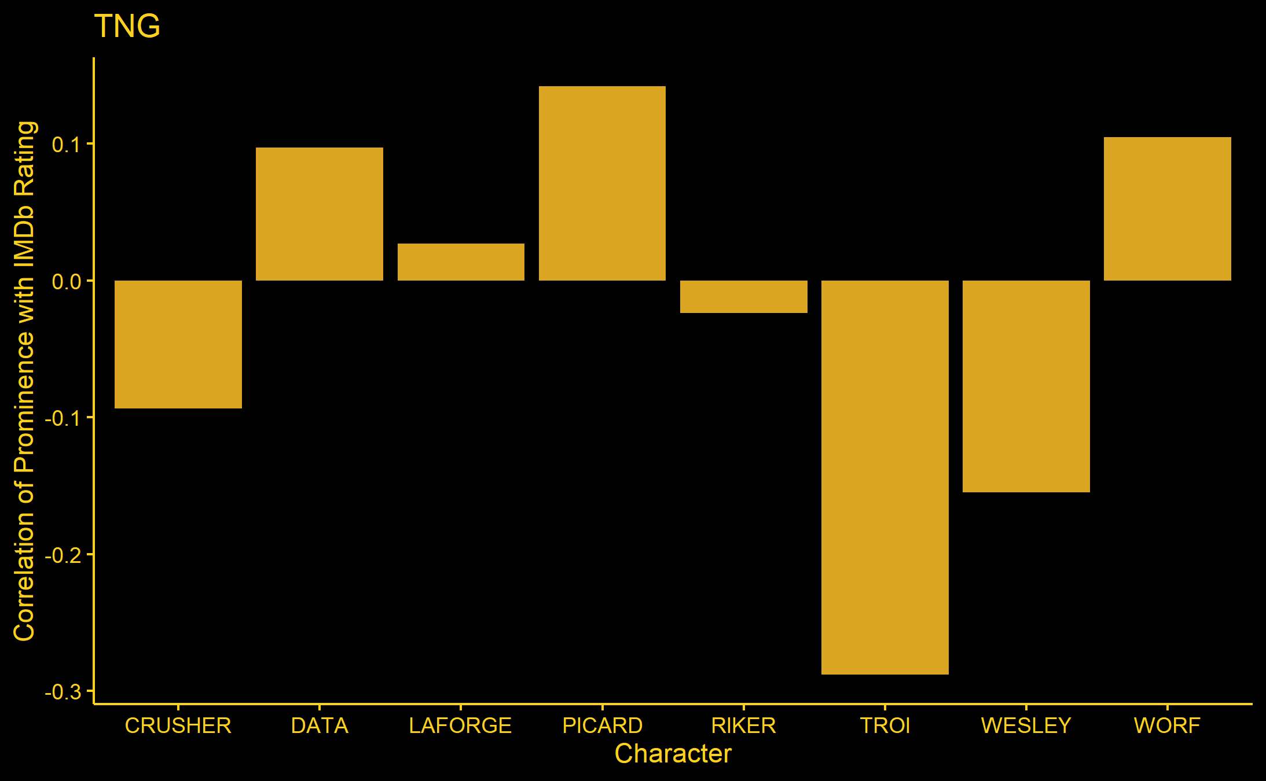
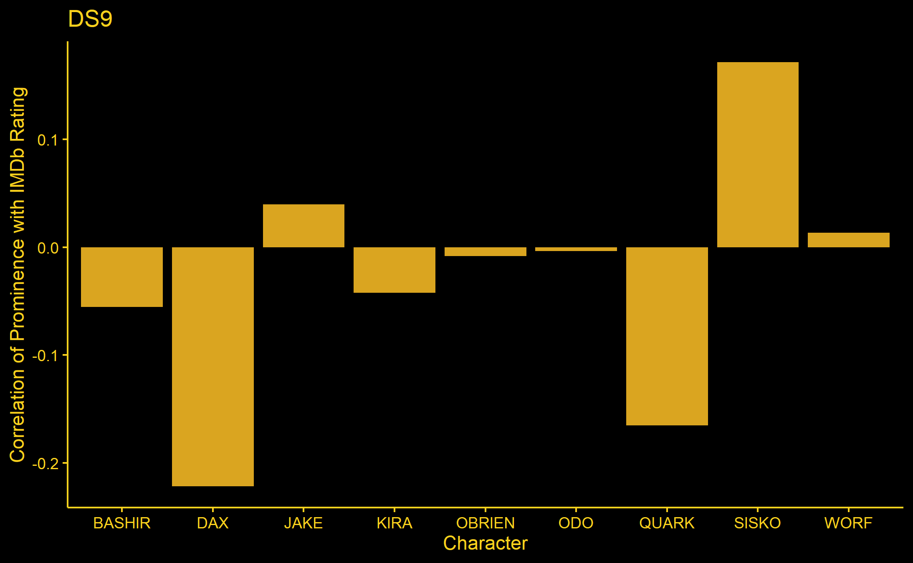
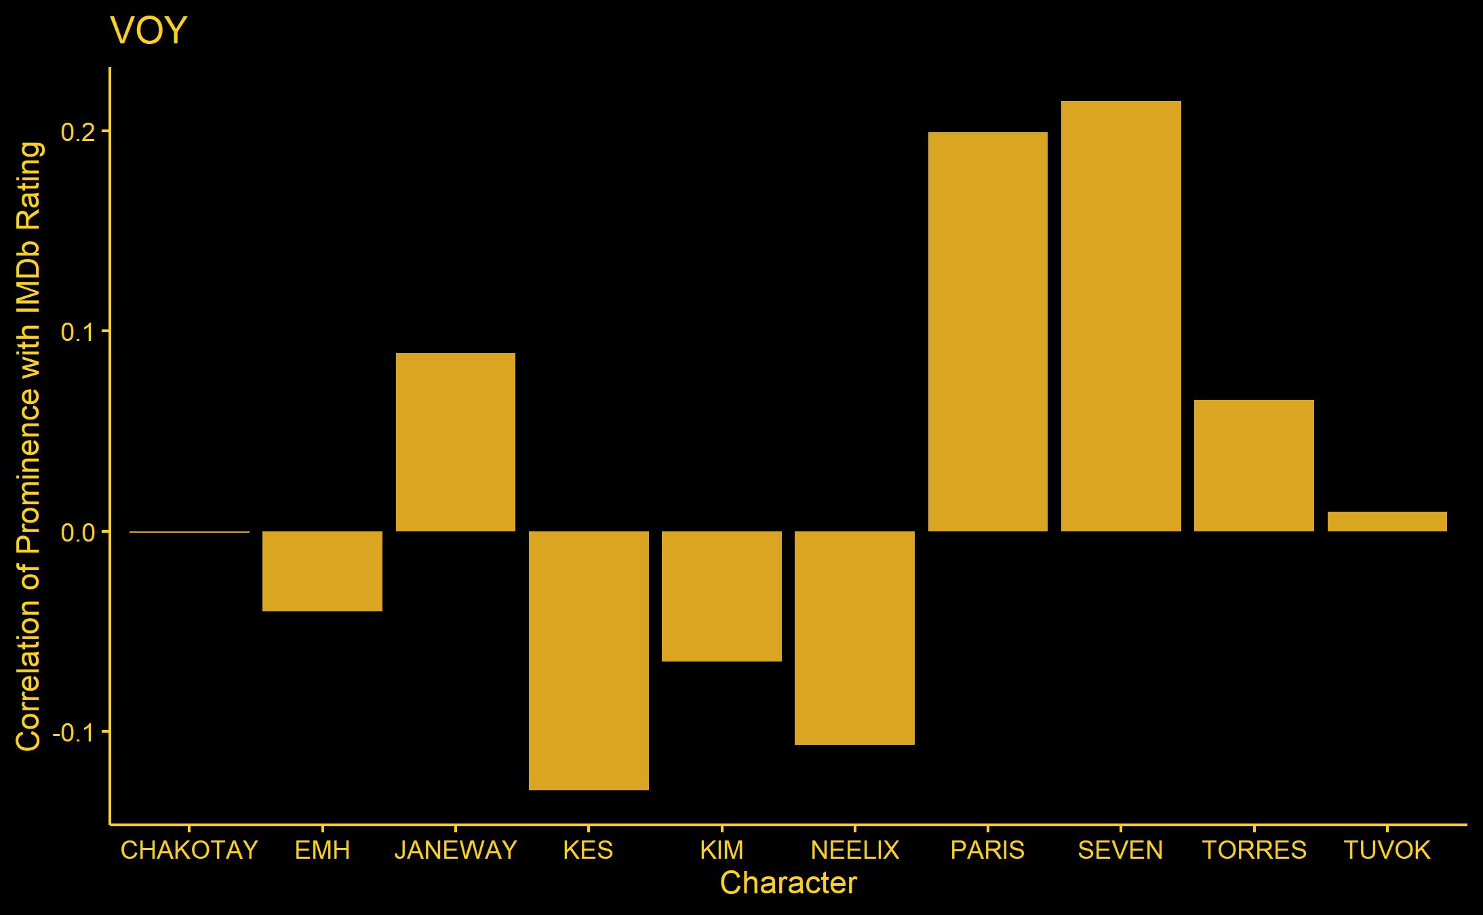
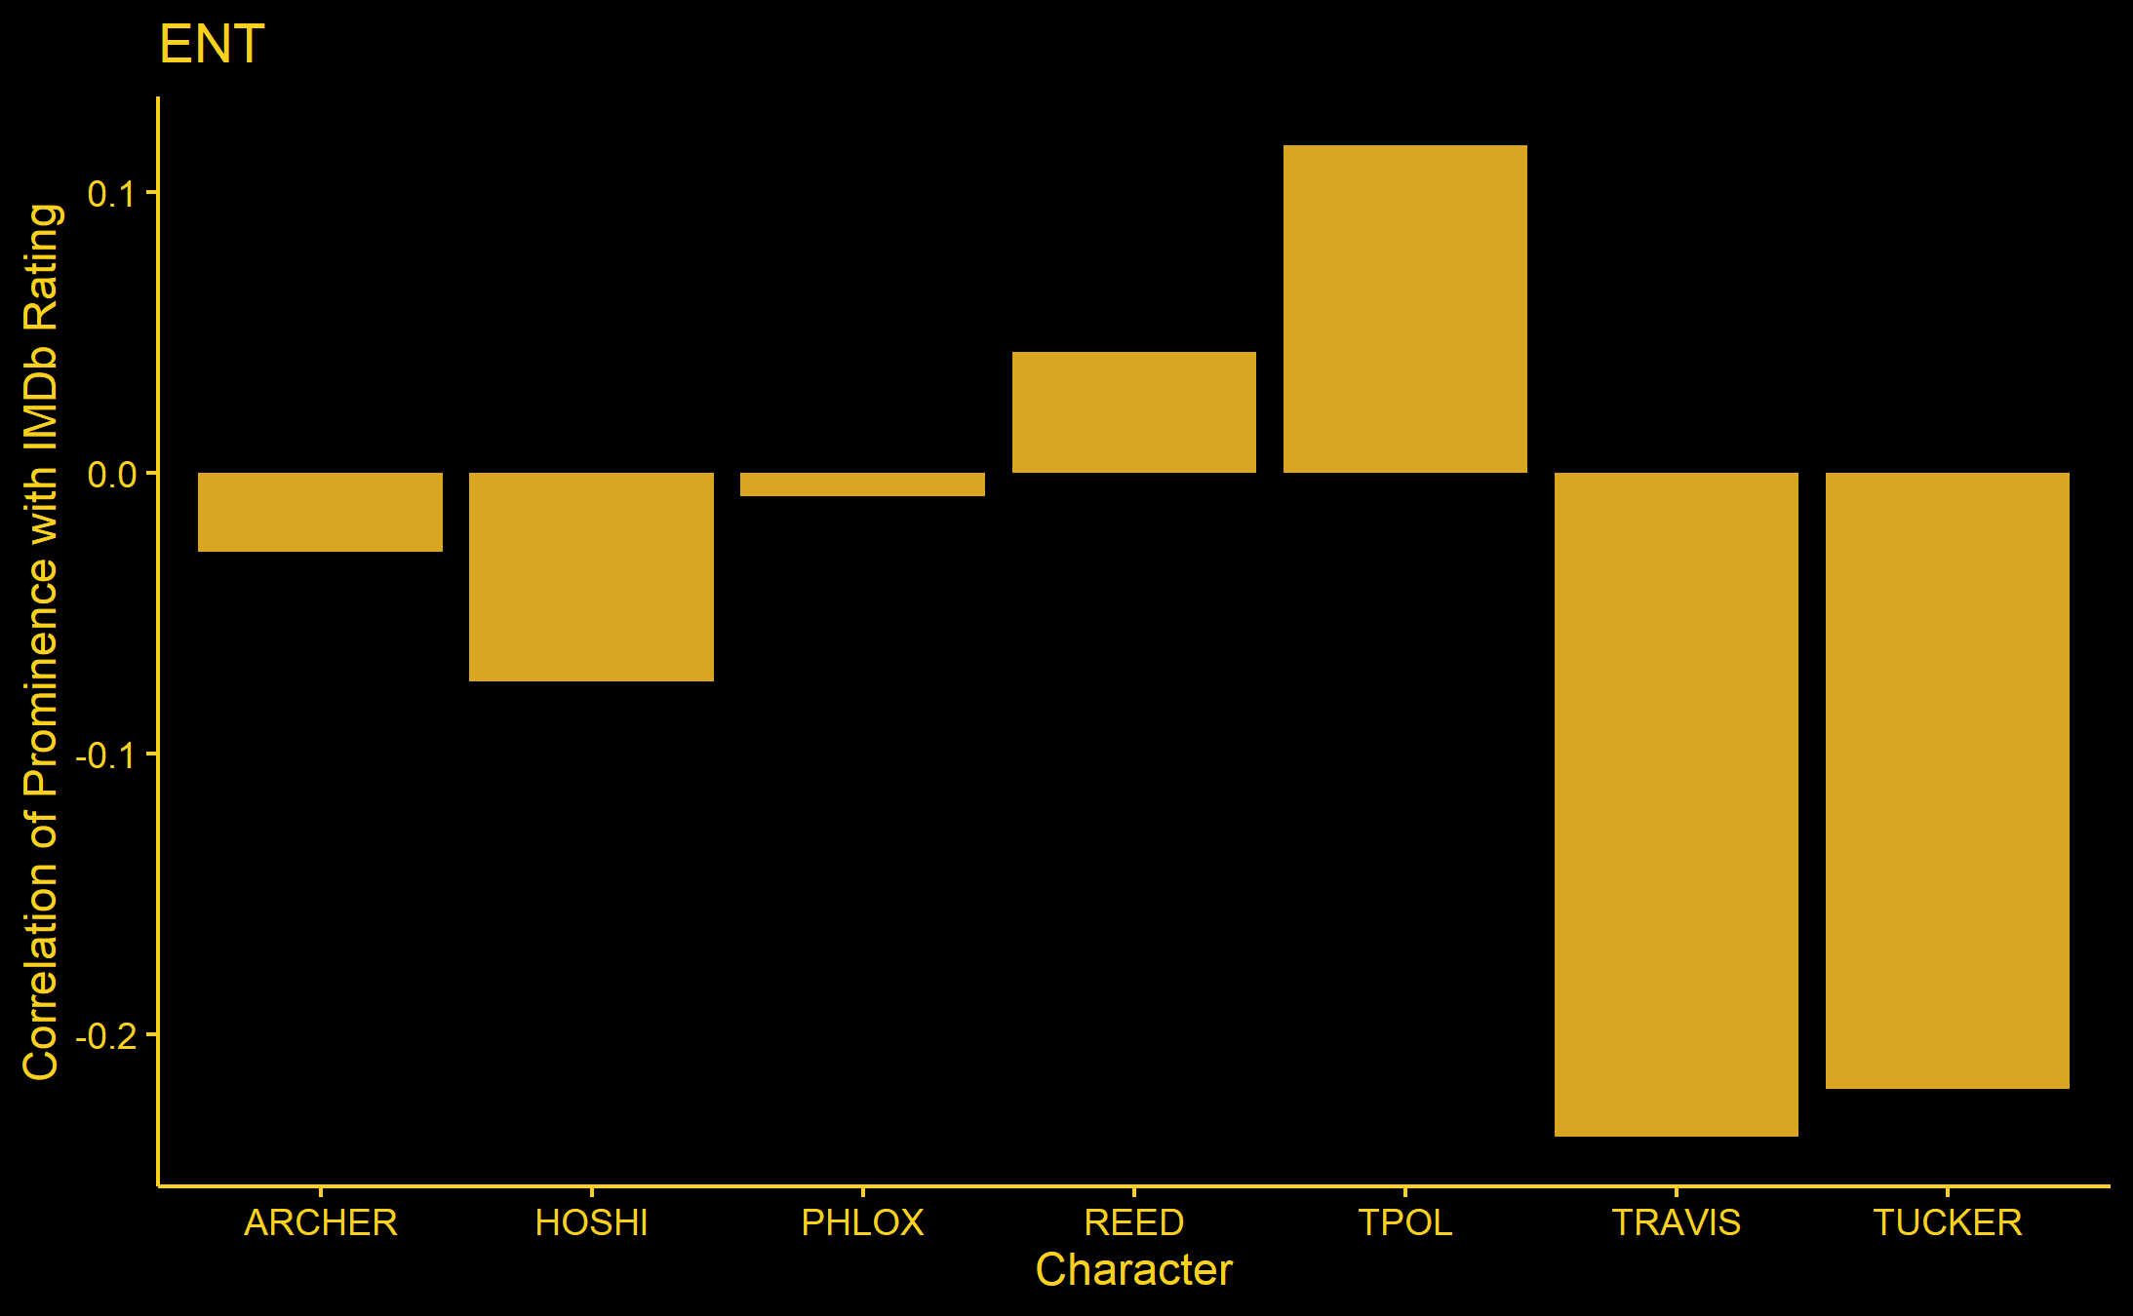
EXPLORATORY DATA ANALYSIS (cont.)

Slide 7

FINAL MODEL
Linear Hierarchical Model with levels as Show:Season and Director. The fixed effect covariates were the character prominence variables (33 in number)
$y_{ijk}=β_{0}+β_{0,j}+β_{0,k}+\sum_{p=1}^{33}{β_{p}x_{p,i}+ε_{i}}$
Where y is the IMDb rating, j is show:season, k is director, p is the index for cast prominence, β are the linear coffiecients, x is the covariate for cast prominence, and ϵ is the residual

Slide 8
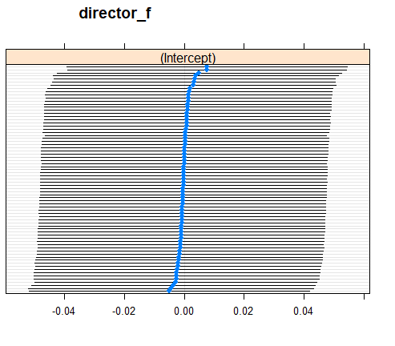
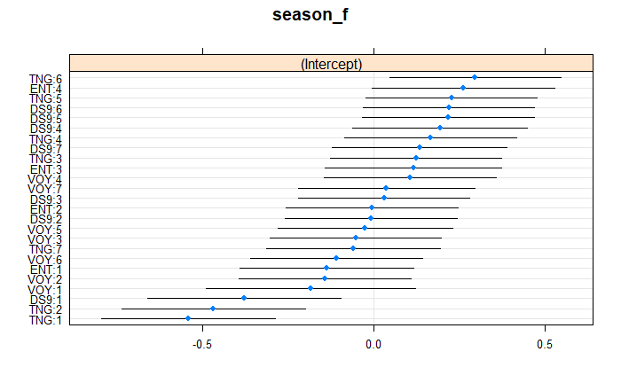
RESULTS: RANDOM EFFECTS
Variability Explained: 0.1%
Variability Explained: 11.75%

Slide 9
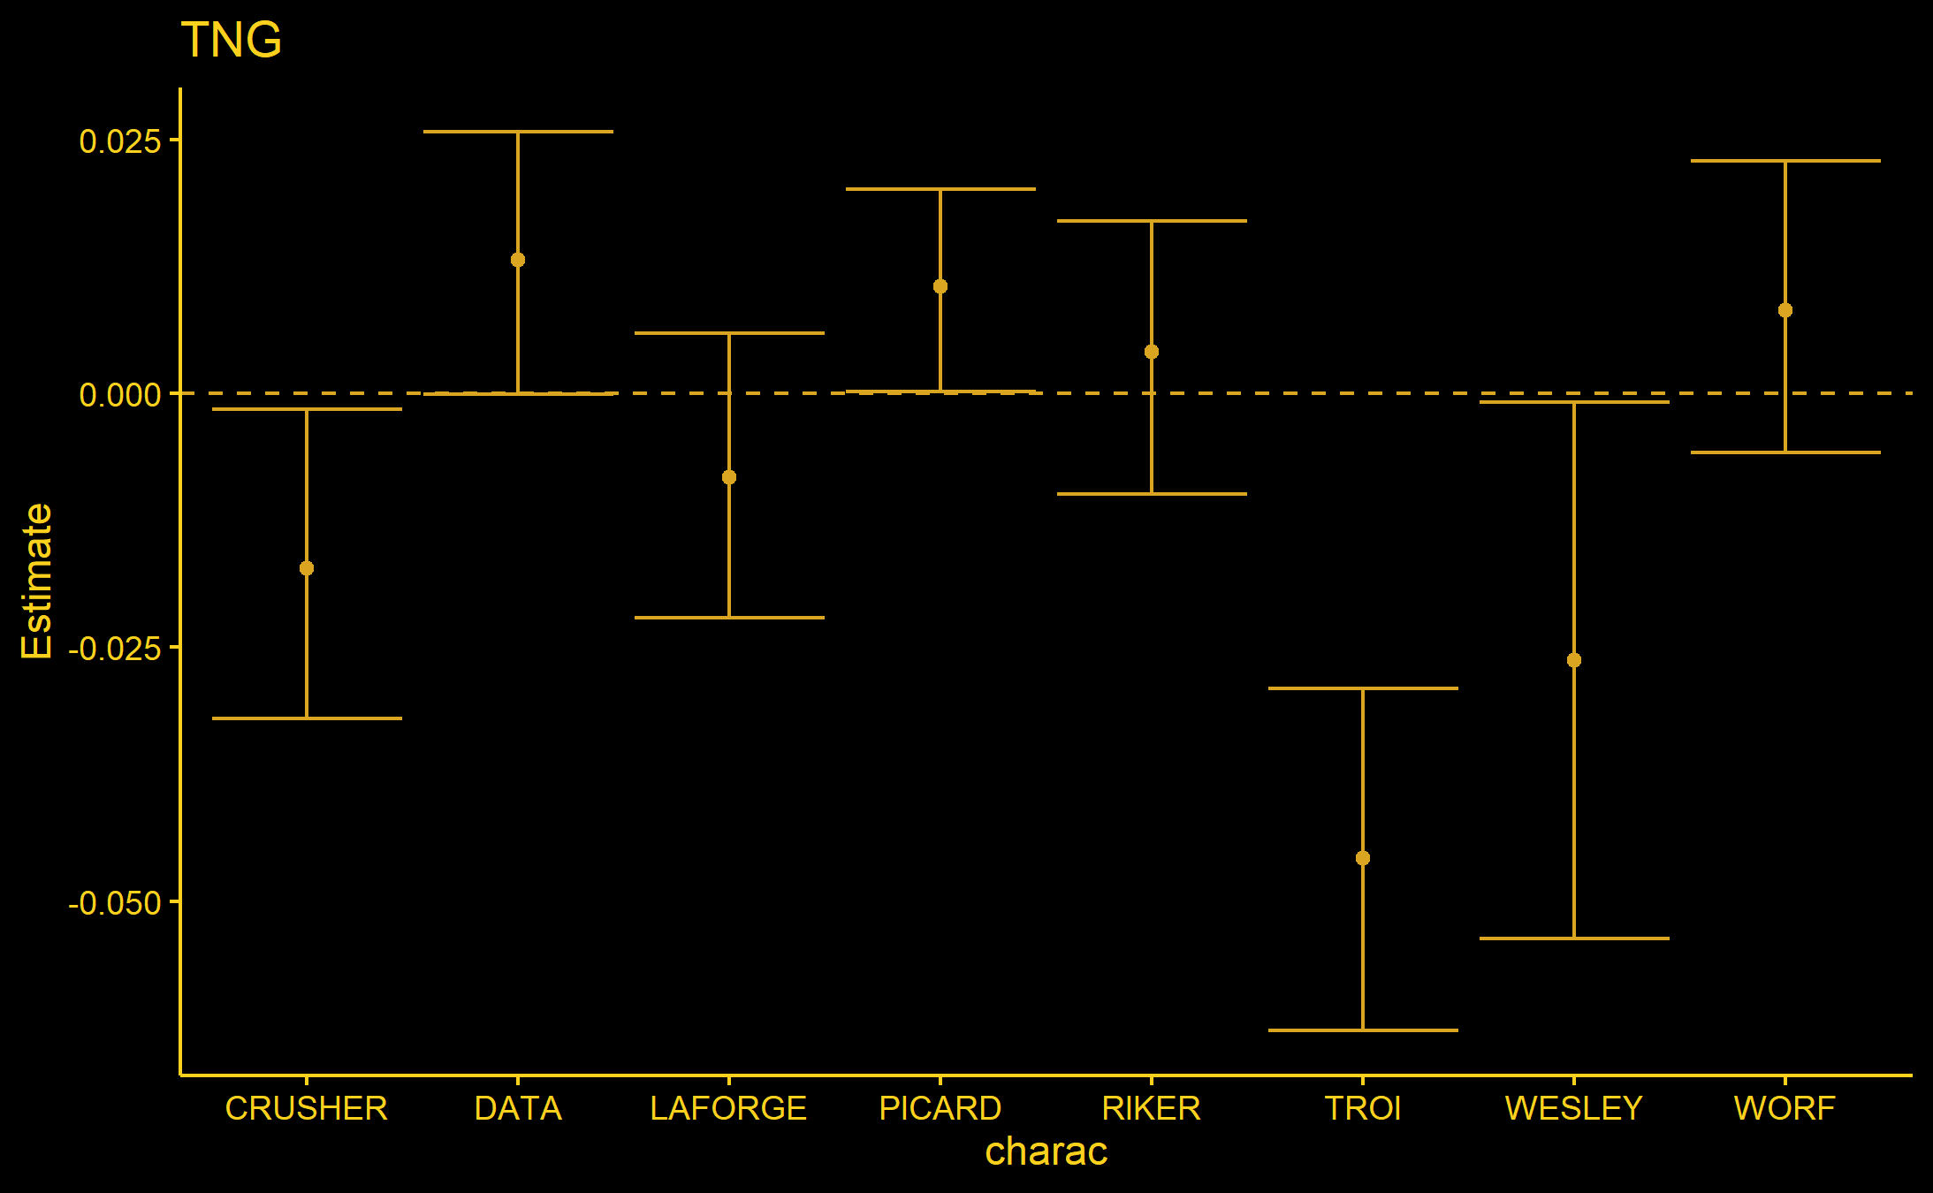
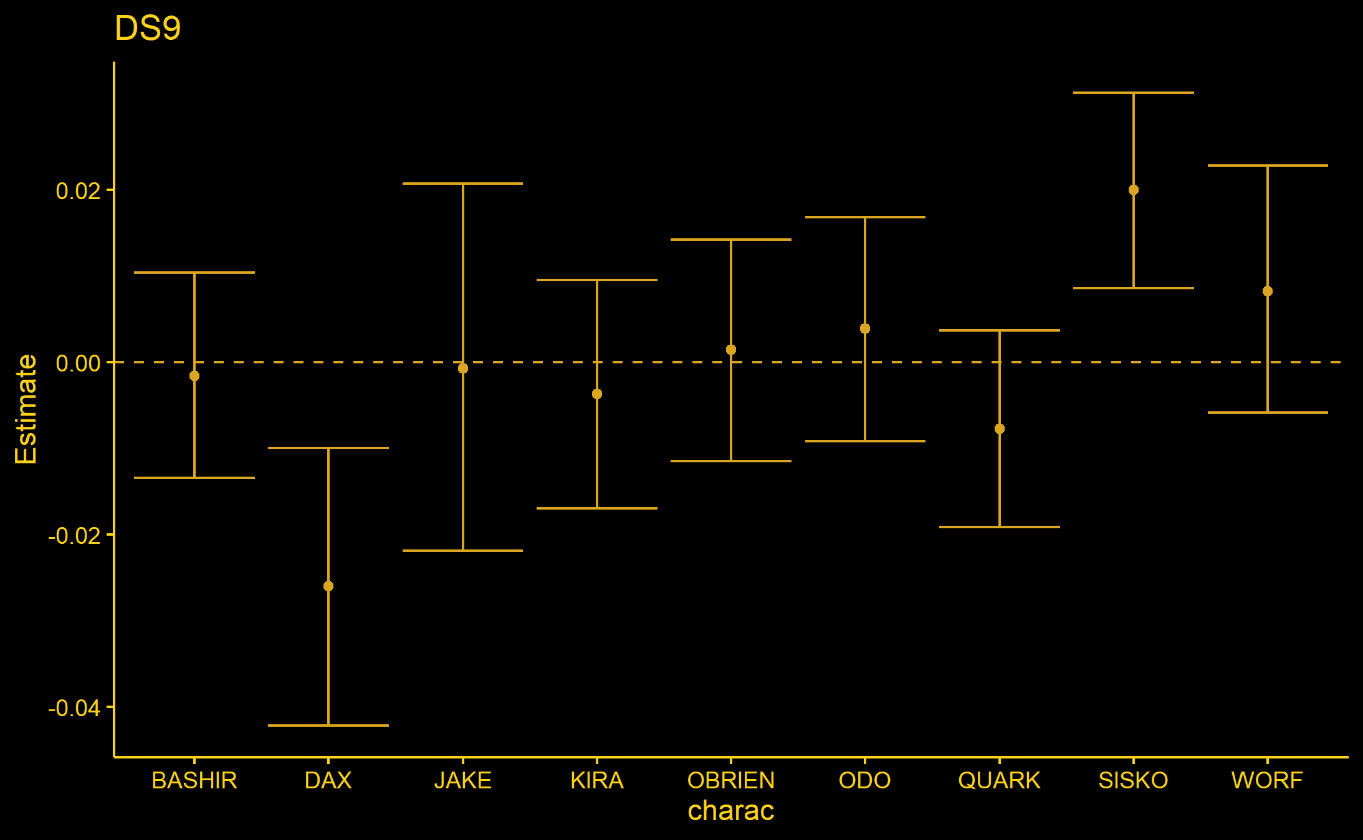
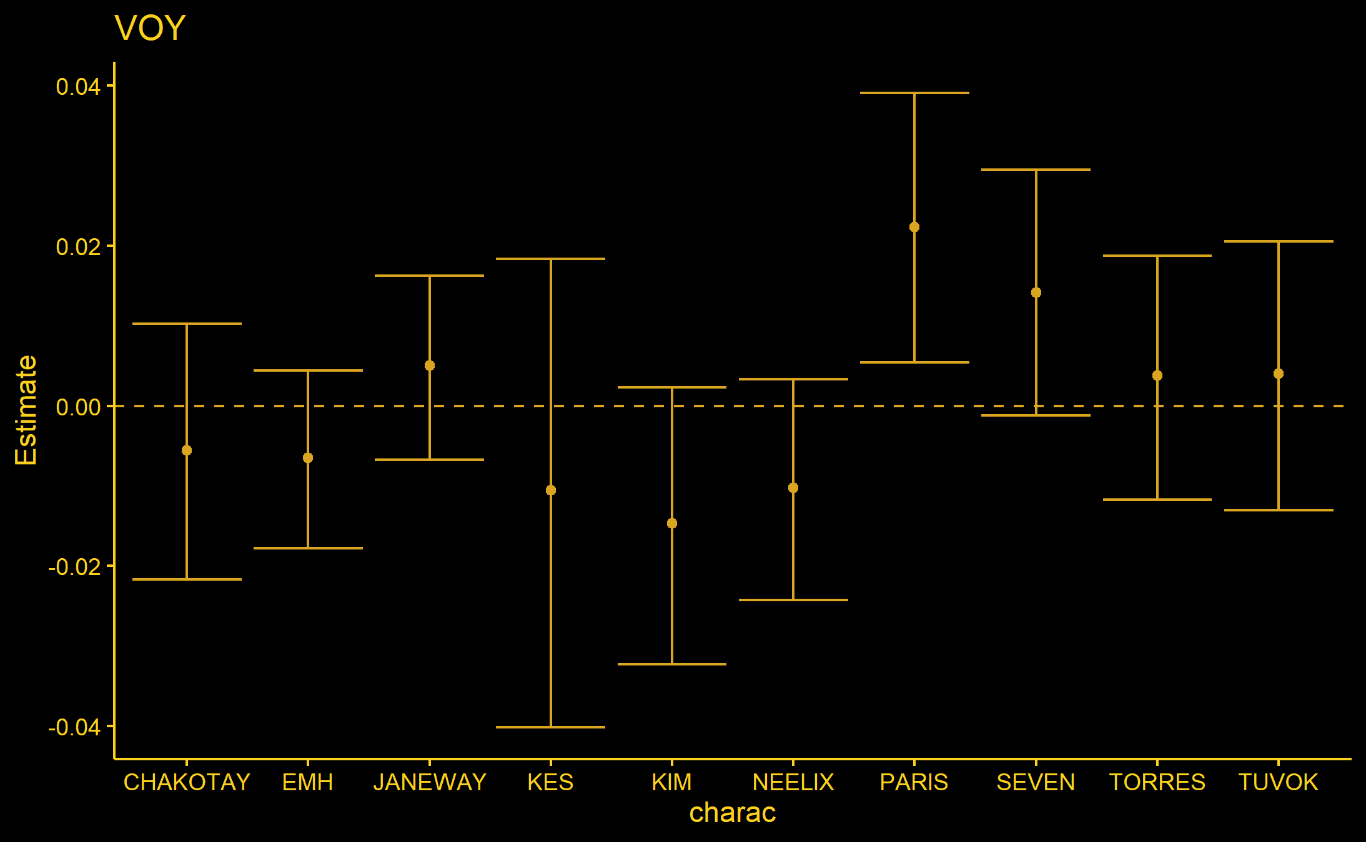
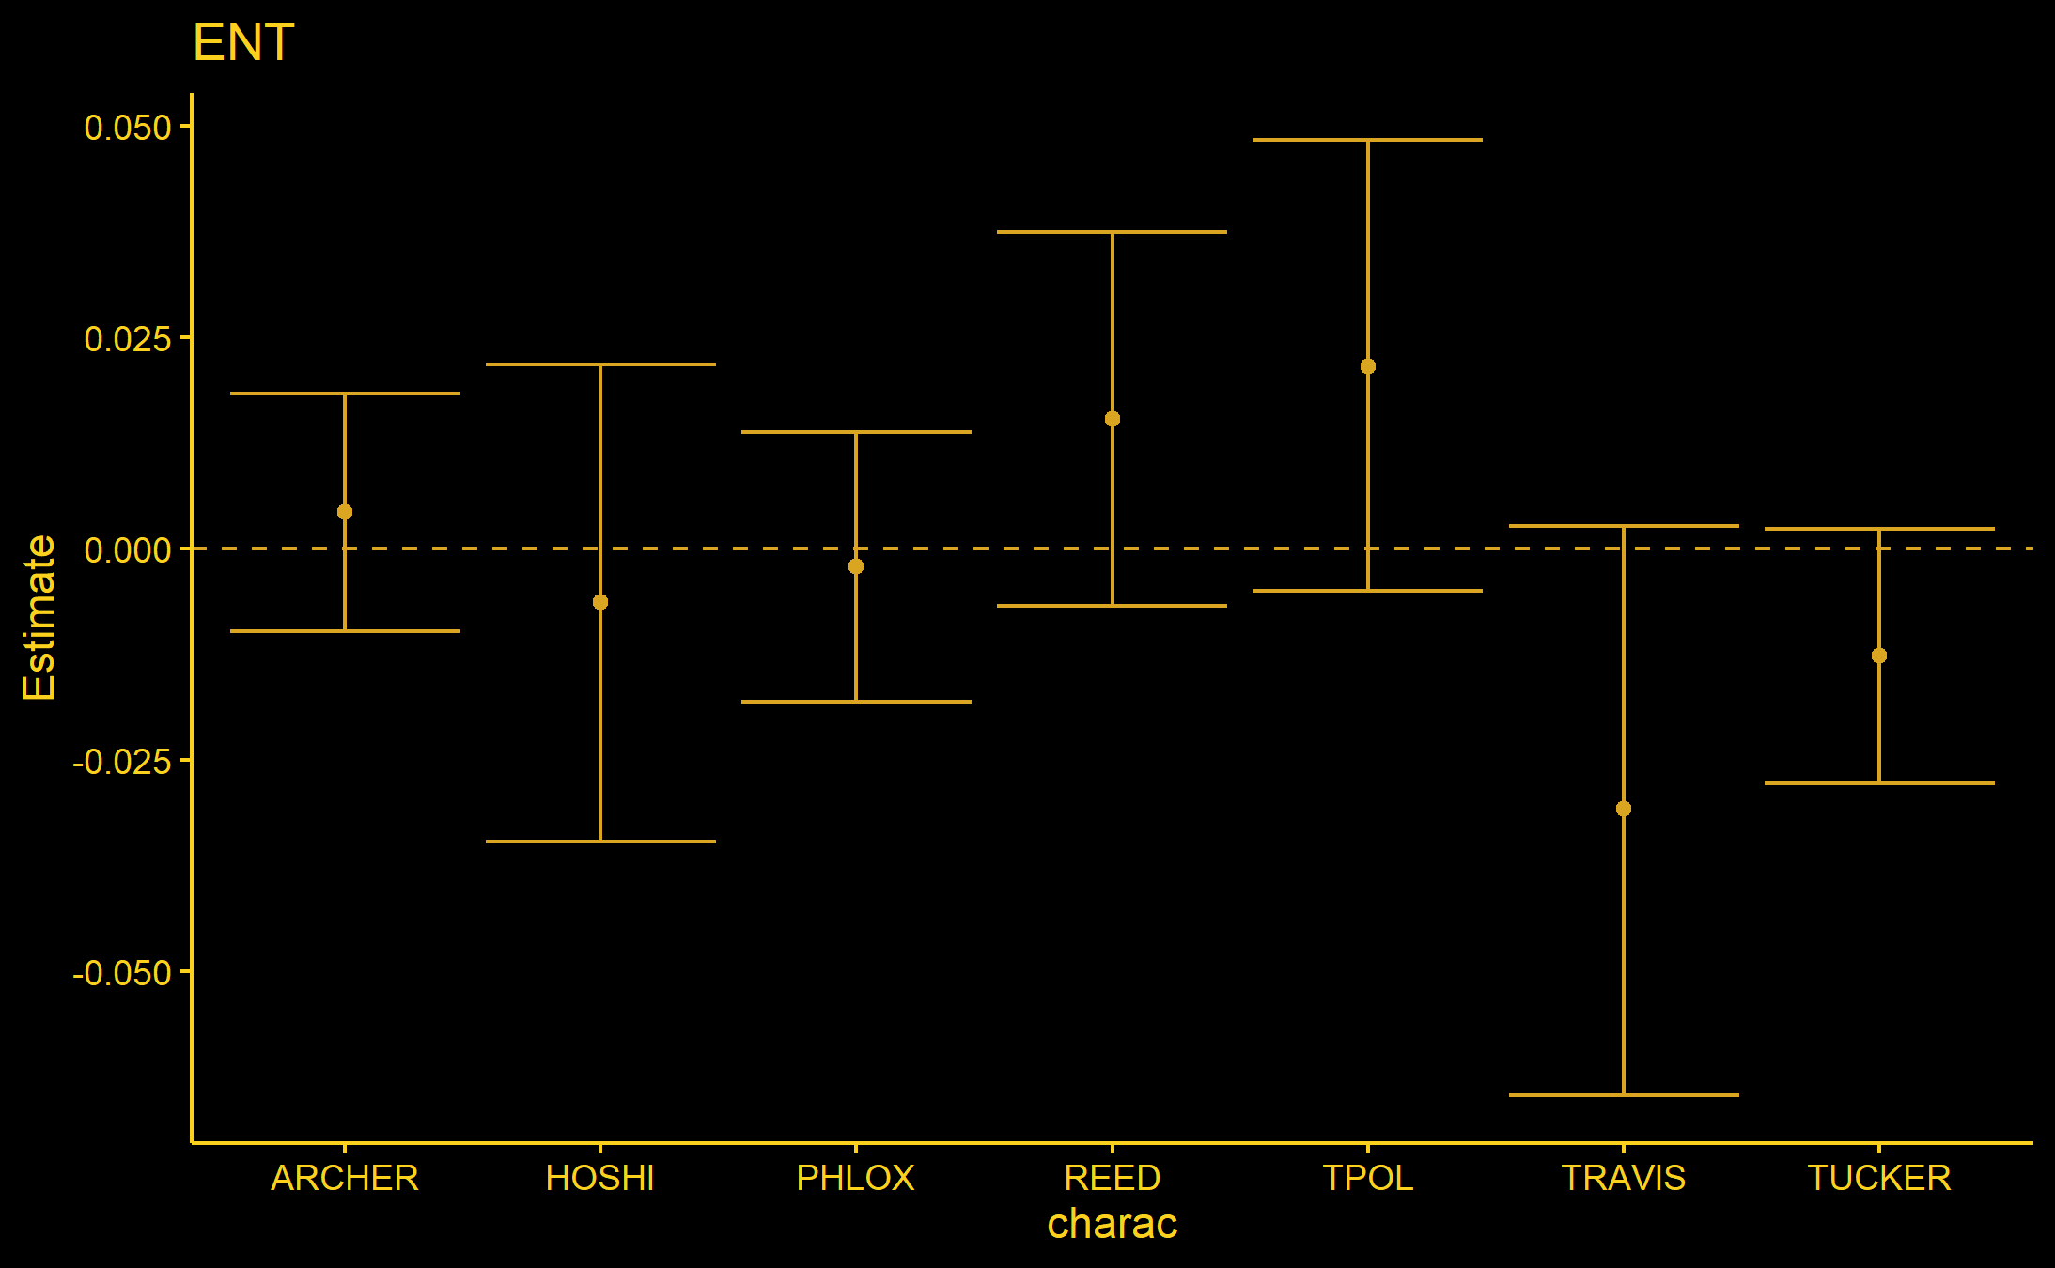
RESULTS: FIXED EFFECTS

Slide 10
CONCLUSIONS
No significant difference in quality across directors was observed
There are significant differences across seasons across shows
Character prominence plays a large role in reception of the episodes
LIMTATIONS
Not enough data to observe differences in directors
Unable to include writers in the analysis due to the nature of the data

