Slide 1
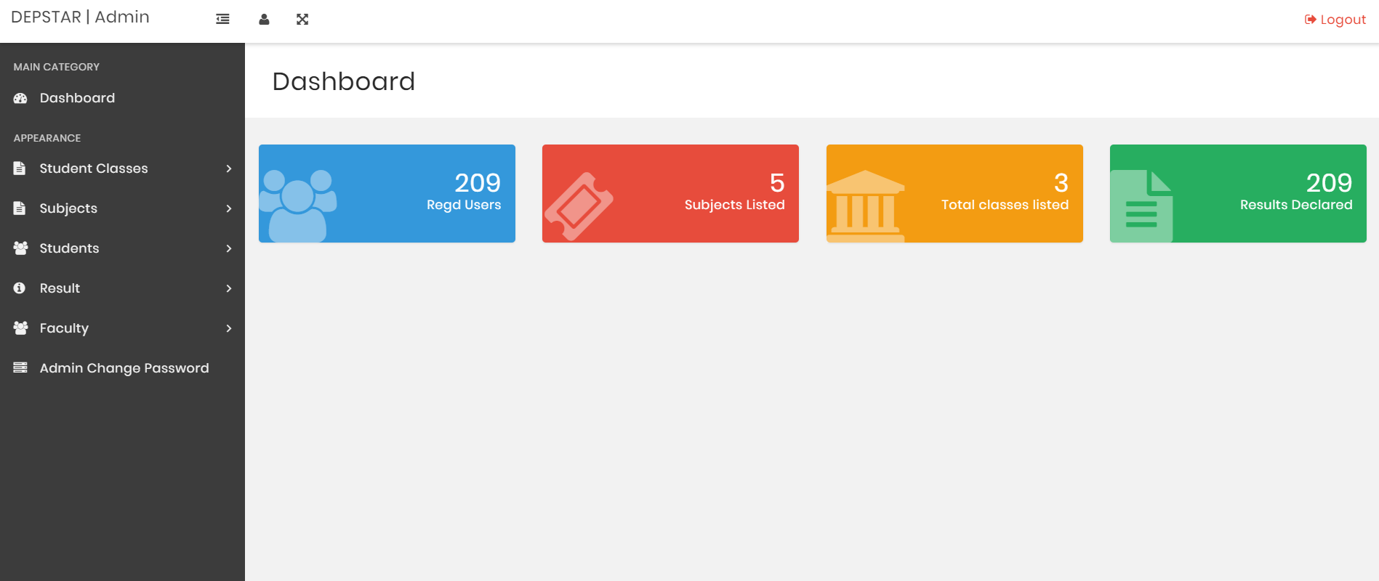
Admin Mode-Dashboard

Slide 2
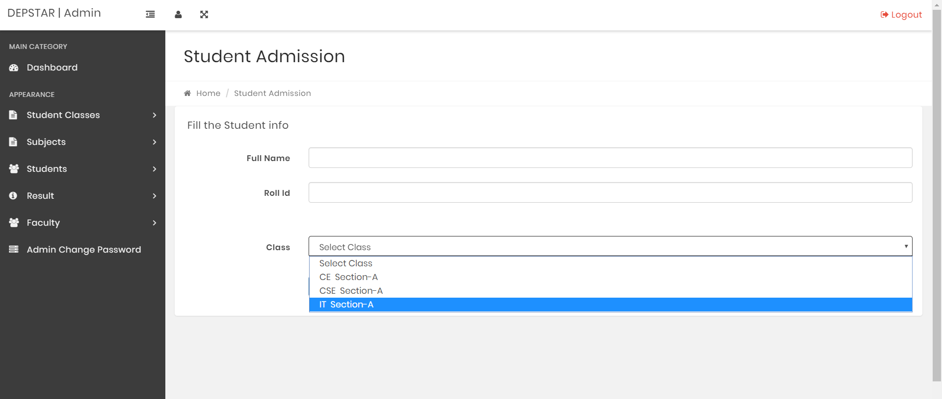
Admin Mode-Add Student

Slide 3
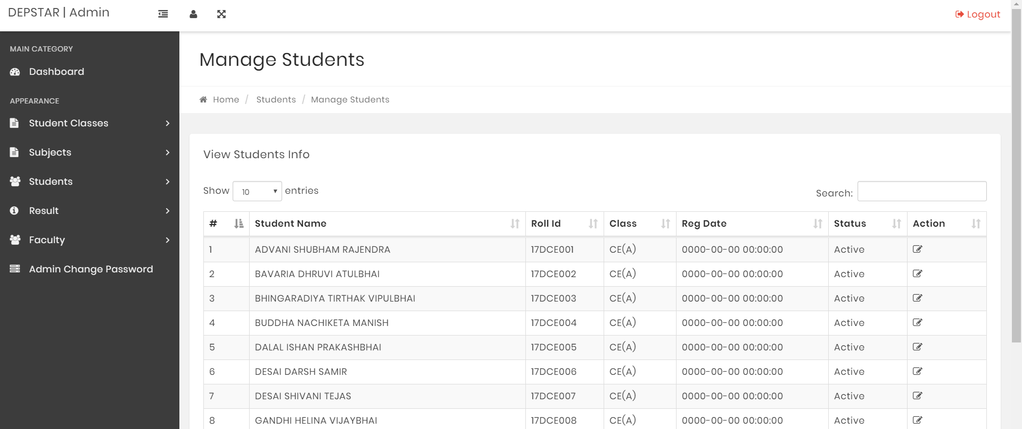
Admin Mode-Manage Student

Slide 4
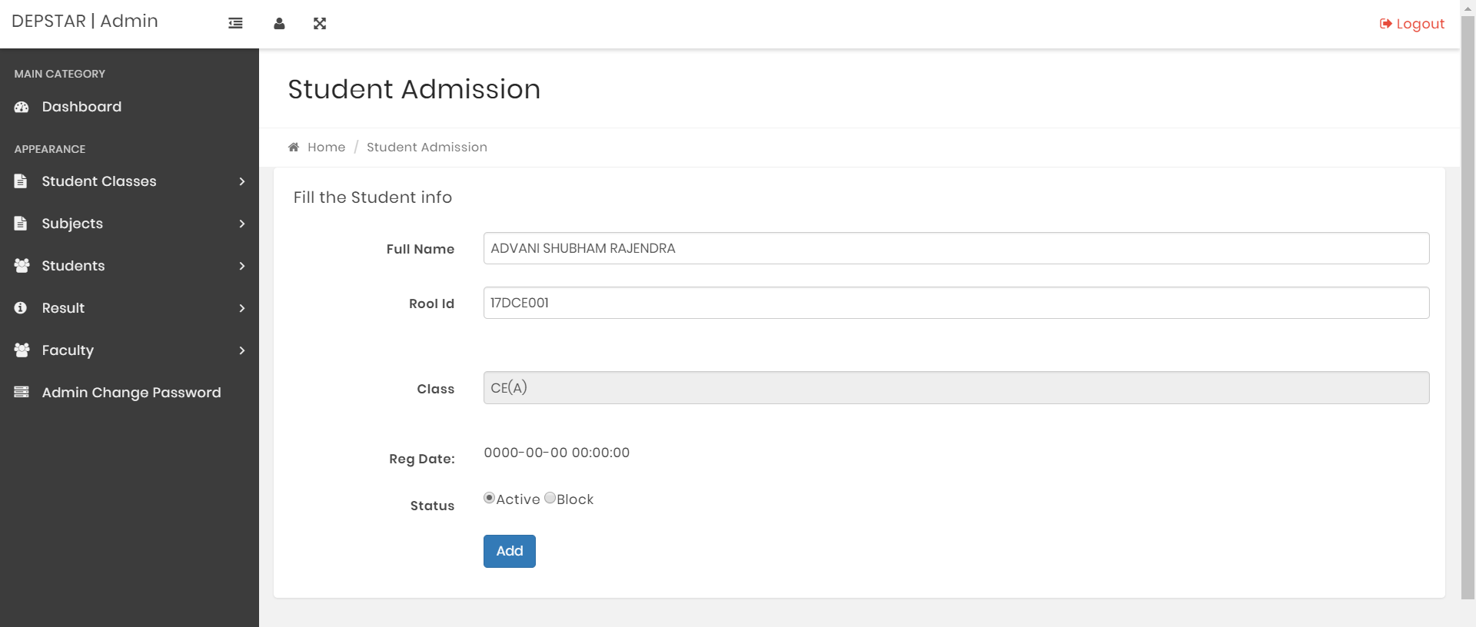
Admin Mode-Manage Student

Slide 5
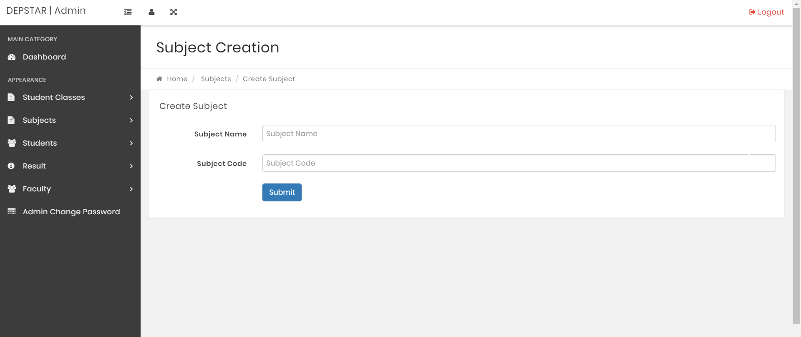
Admin Mode-Add Subjects

Slide 6
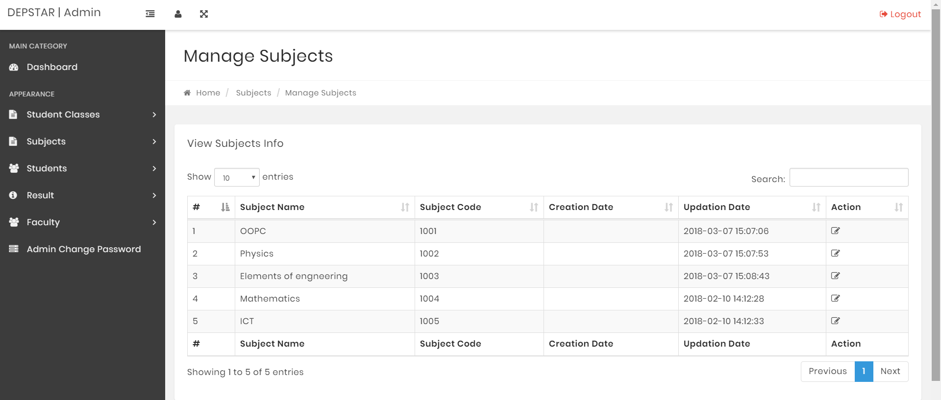
Admin Mode-Manage Subjects

Slide 7

Admin Mode-Manage Subject

Slide 8
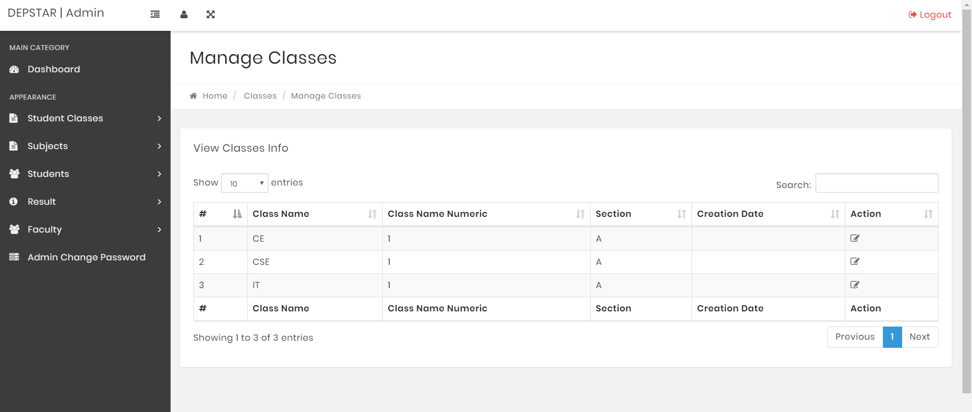
Admin Mode- Manage Classes

Slide 9
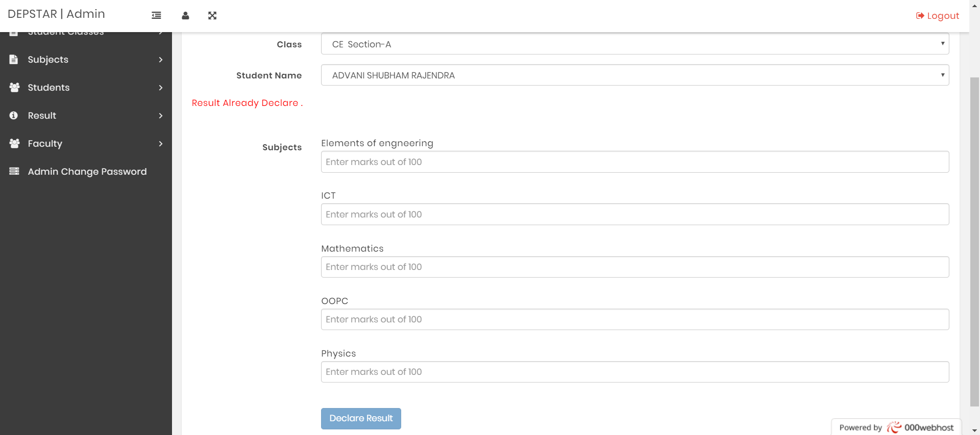
Admin Mode- Add Result

Slide 10
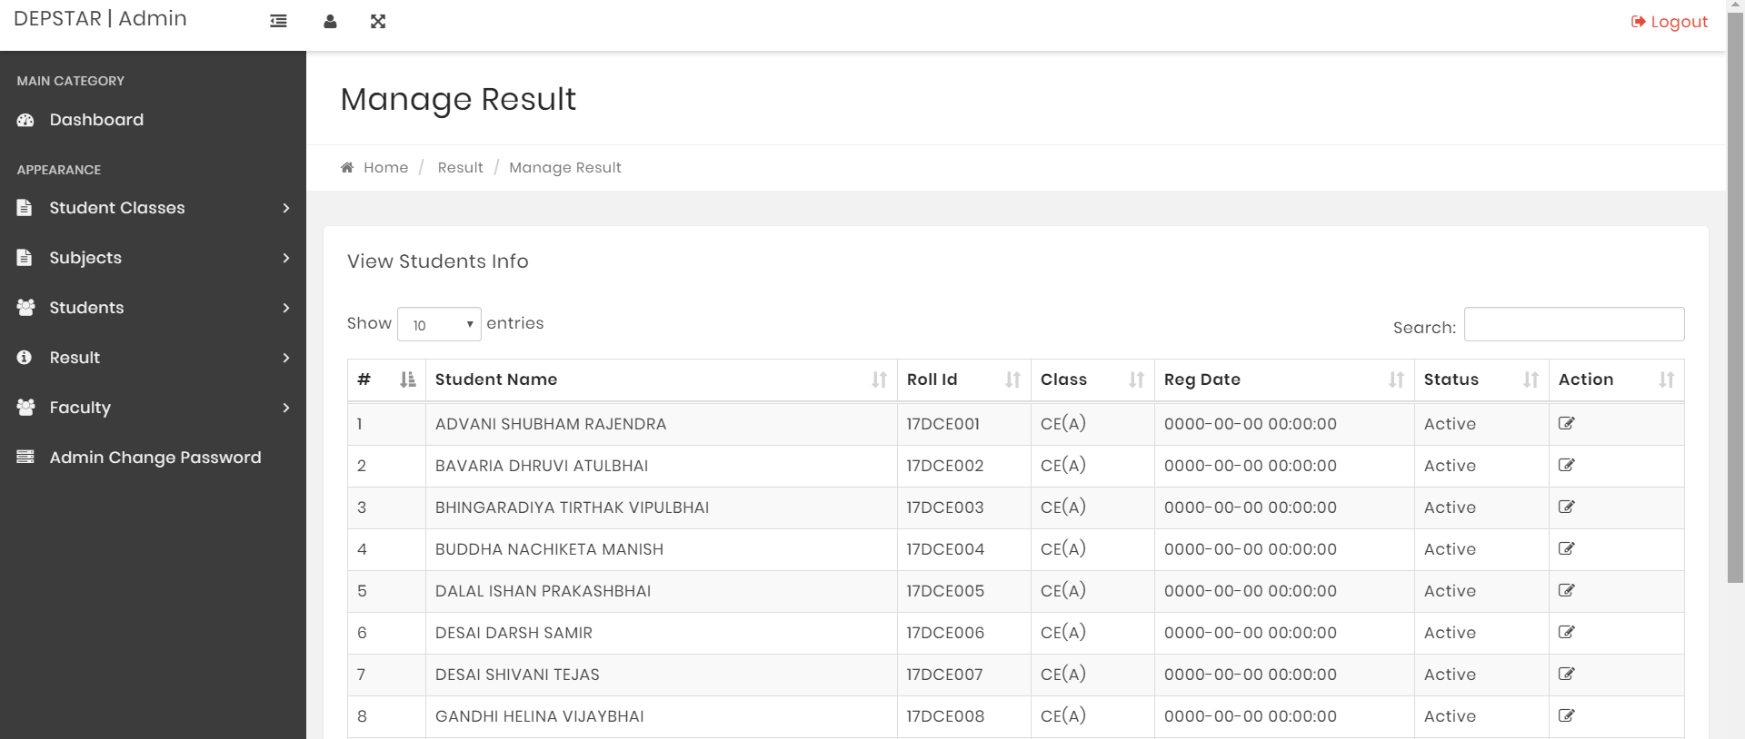
Admin Mode-Manage Result

Slide 11

Admin Mode-Manage Result

Slide 12
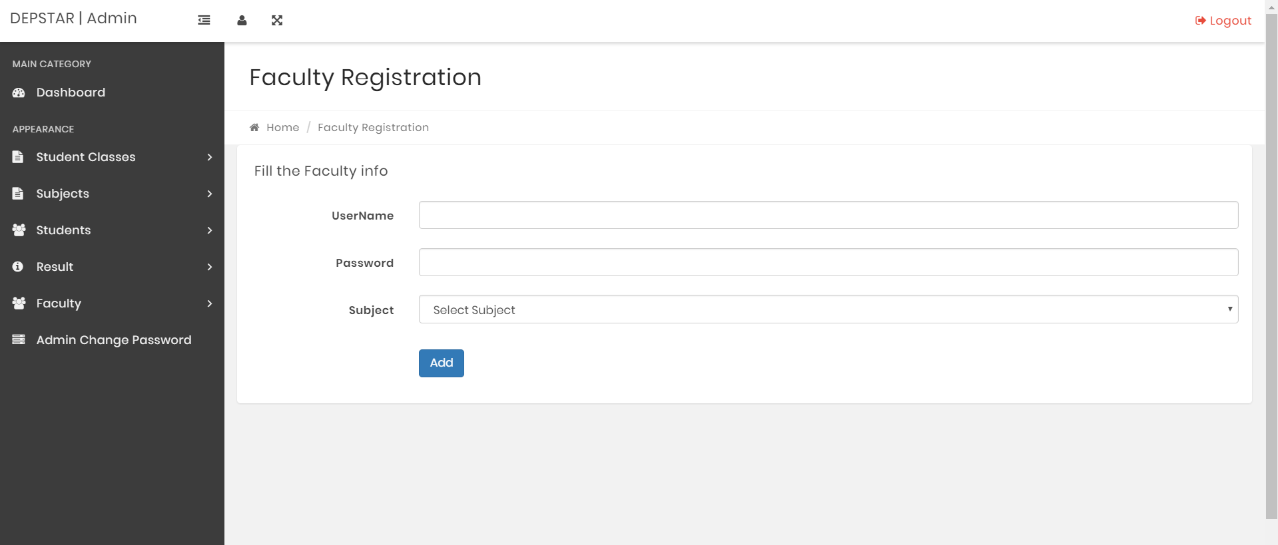
Admin Mode-Faculty Creation

Slide 13
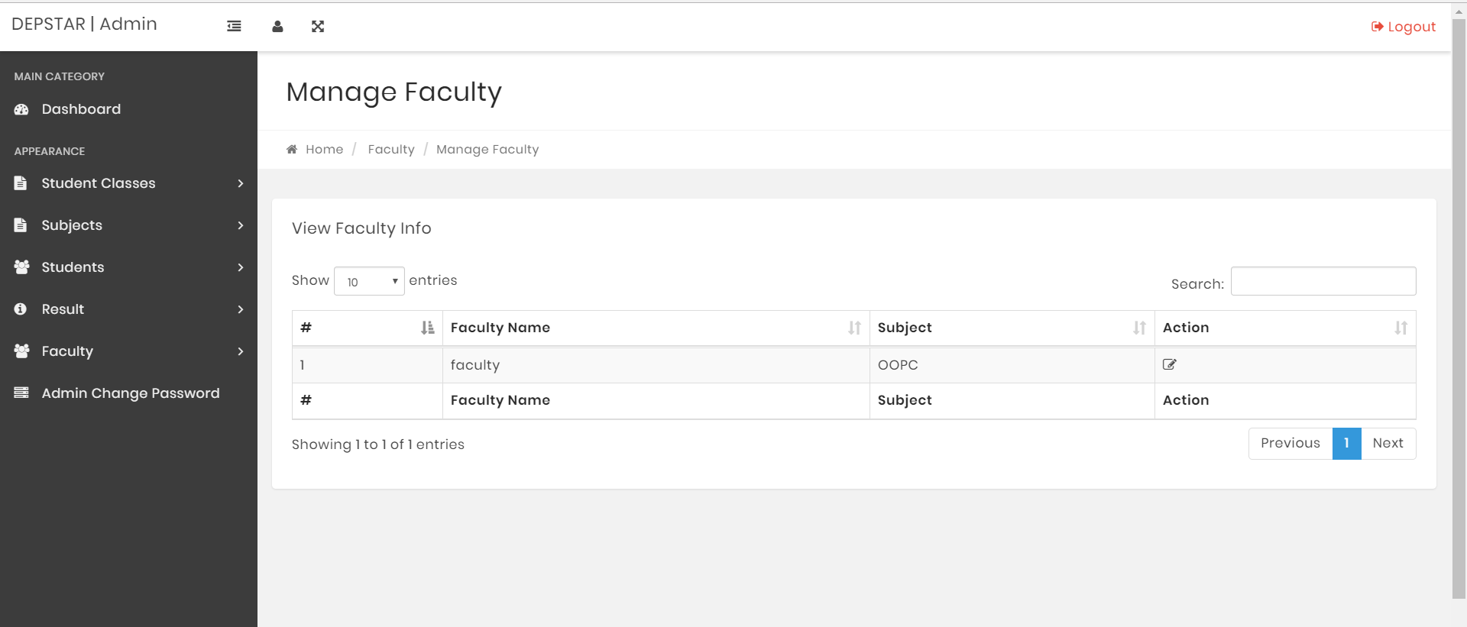
Admin Mode-Manage Faculty

Slide 14
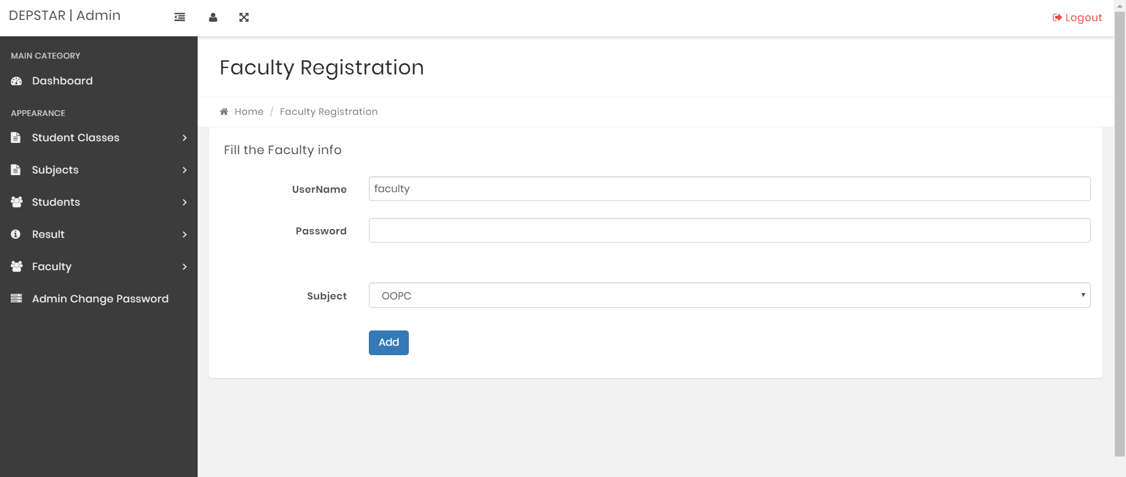
Admin Mode-Manage Faculty

Slide 15
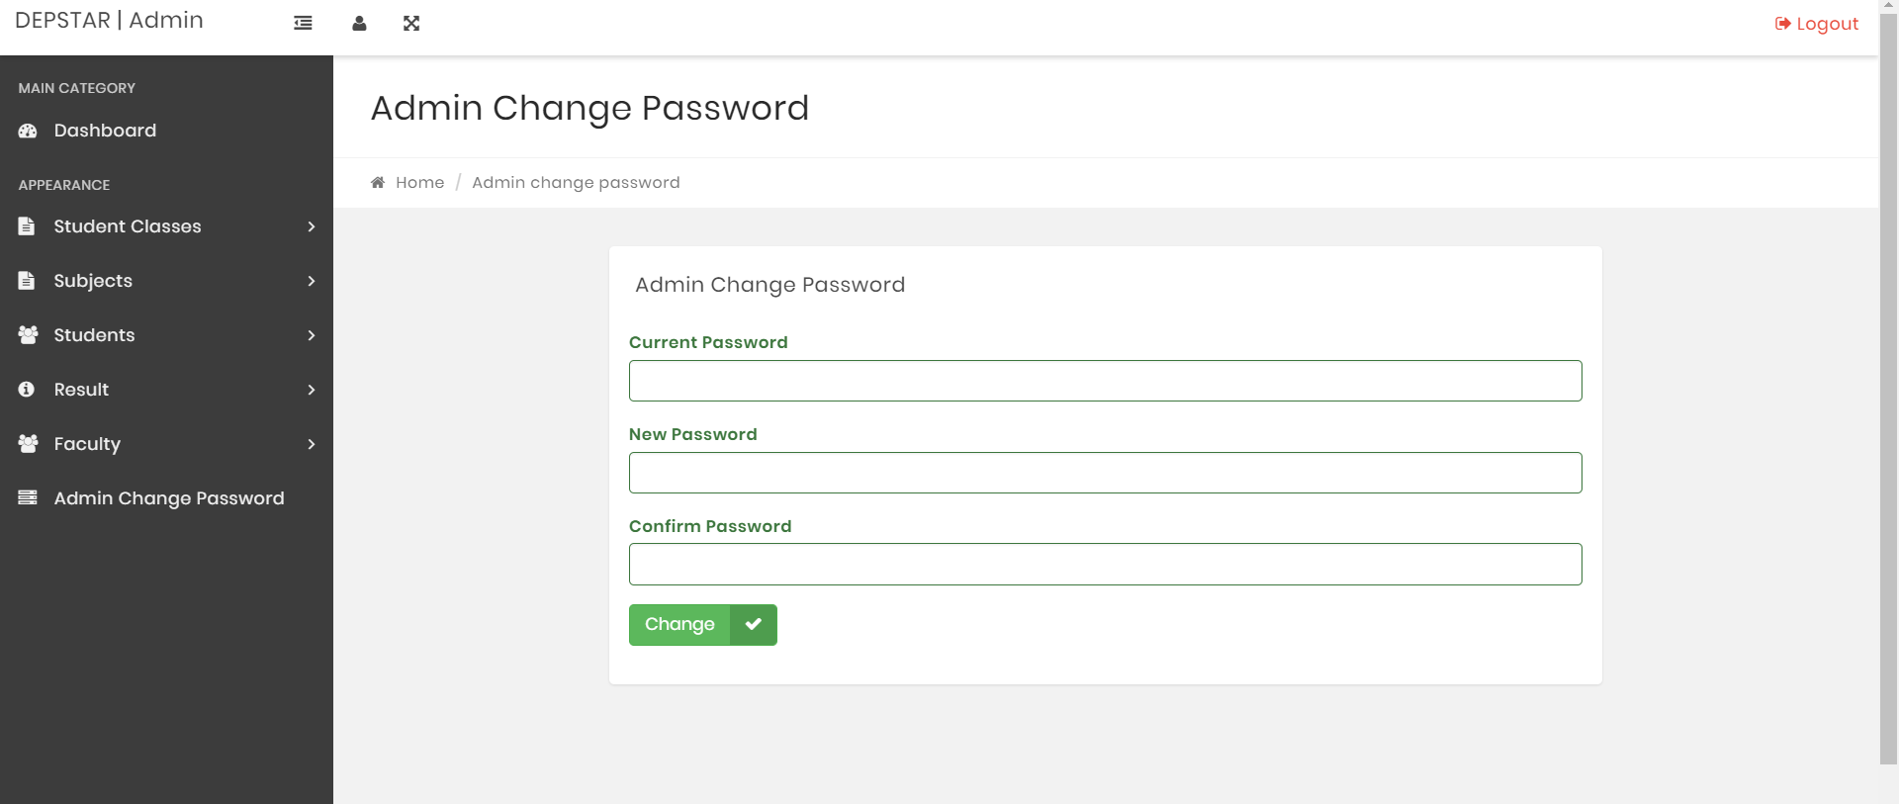
Admin Mode- Admin Password Change

Slide 16
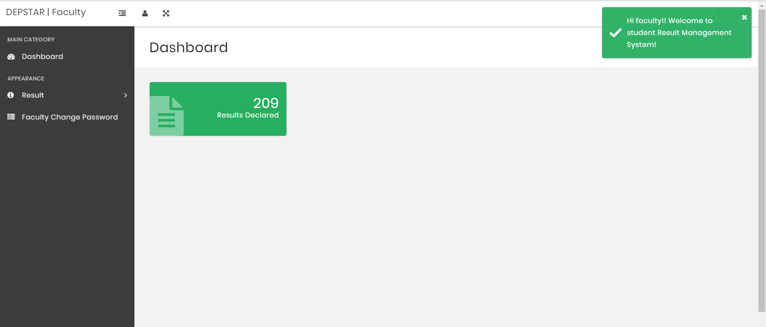
Faculty Mode- Dashboard

Slide 17
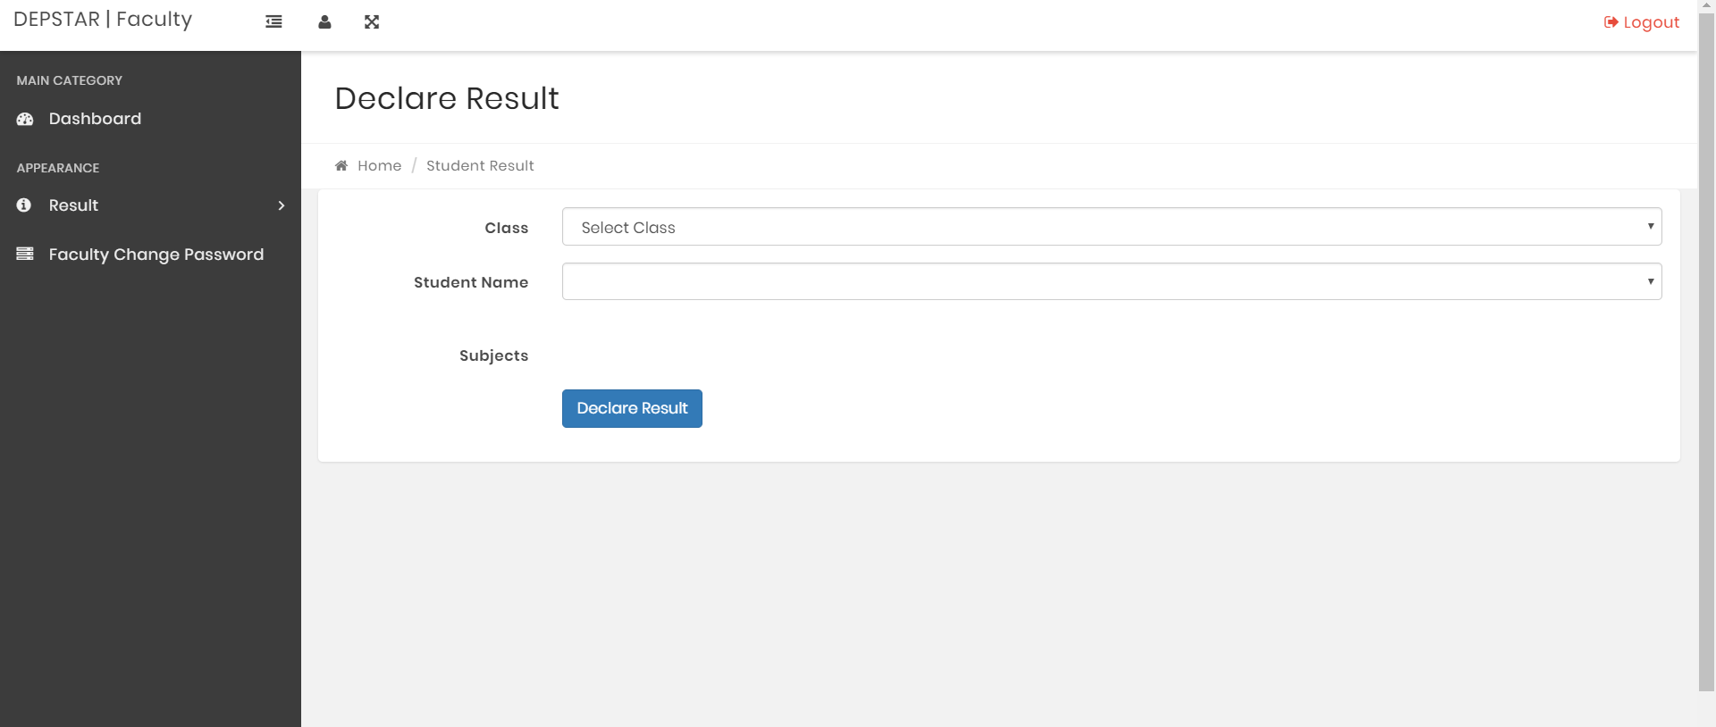
Faculty Mode- Add Result

Slide 18
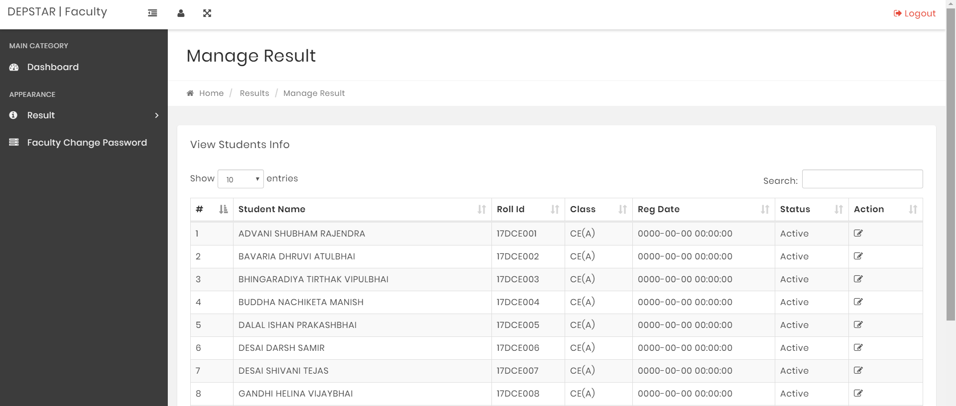
Faculty Mode- Manage Result

Slide 19
Faculty Mode- Manage Result

Slide 20

Faculty Mode- Faculty Password Change

Slide 21
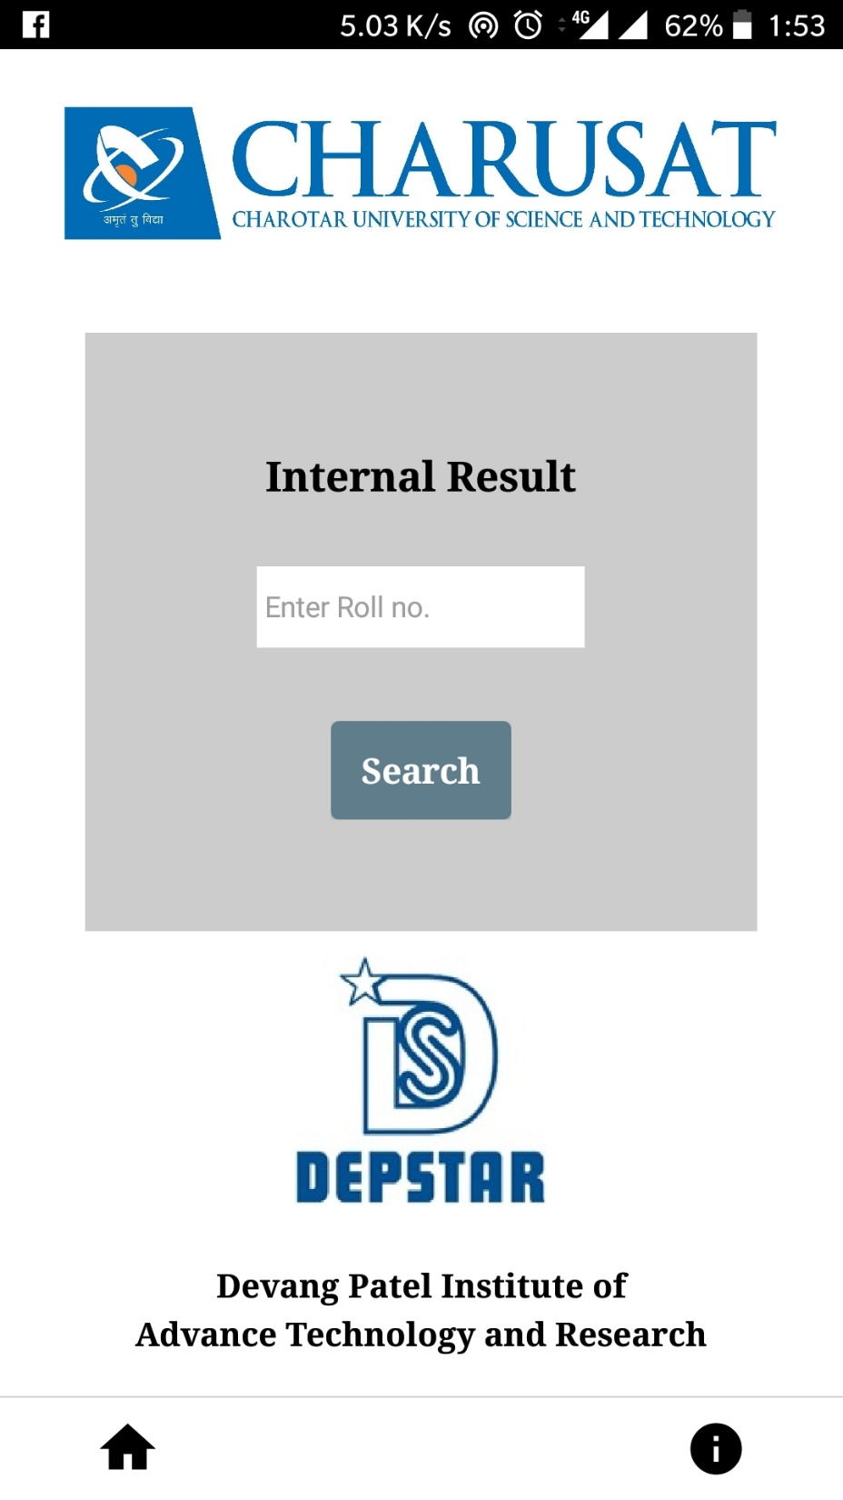
Student Mode

Slide 22

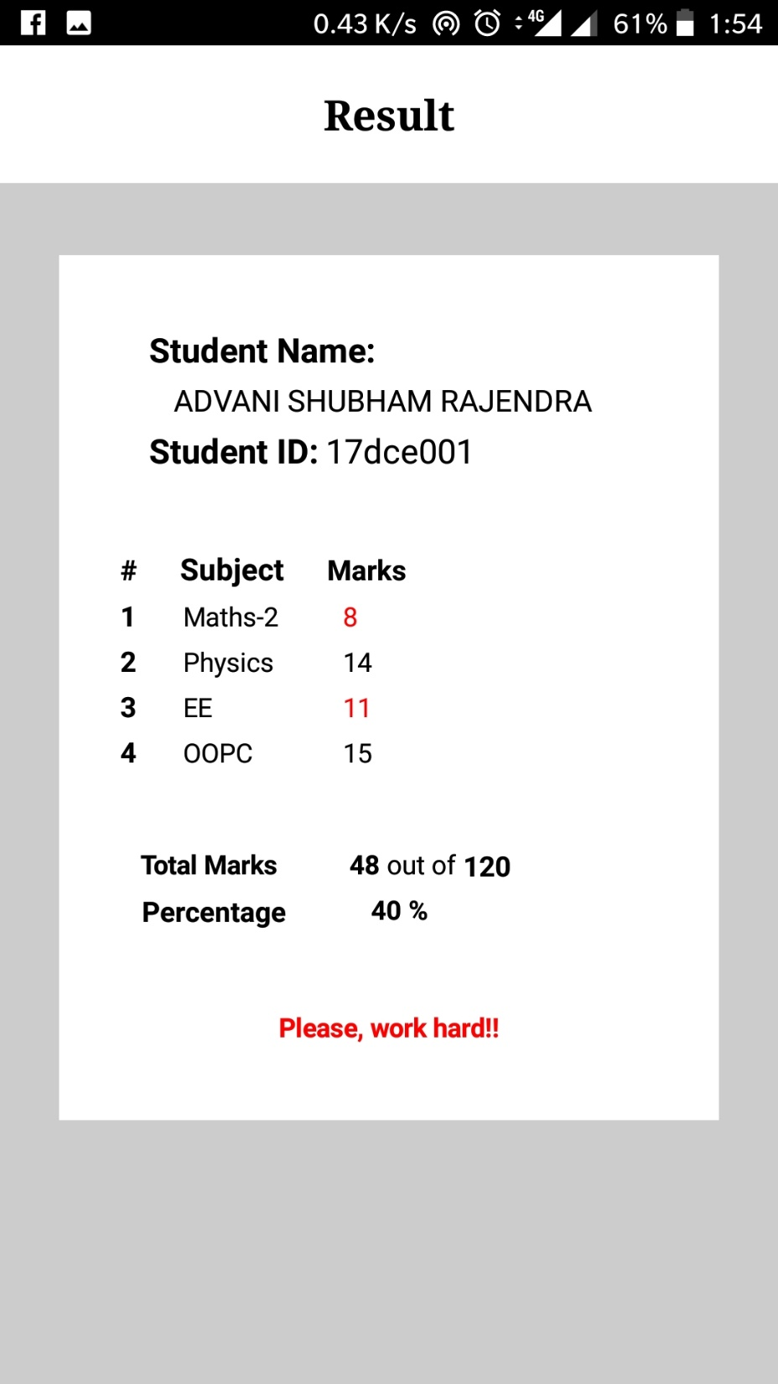
Student Mode

