Slide 1
CAPSTONE PROJECT
FOUNDATIONS OF DATA SCIENCE
Business Analytics Report
Synthetic Online Retail Dataset
Customer Behaviour & Sales Analysis
1,000
13
11
5
Satvik Kesarwani
Records
Features
Visualizations
Categories

Slide 2
01 PROBLEM STATEMENT
Analysing 1,000 transactions from a Synthetic Online Retail Dataset to uncover patterns in customer behaviour, product performance & sales trends.
PROJECT SCOPE
01
Identify top-performing product categories & inventory priorities
1,000
02
Transactions
Understand customer demographics — age, gender & spending patterns
13
03
Analyse price sensitivity and its effect on quantity and reviews
Features
04
Evaluate payment method preferences for optimisation
5
Categories
05
Discover seasonal sales trends to guide promotional planning
11
Visualizations

Slide 3
02 DATASET DESCRIPTION
synthetic_online_retail_data.csv — 1,000 rows × 13 features | Source: Kaggle
Category
Column(s)
Description
Customer
age, gender
Buyer demographics
Product
category_name, product_name, price
Item and pricing details
Order
customer_id, product_id, order_date, quantity
Transaction record
Payment
payment_method
Mode of payment used
Feedback
review_score
Customer satisfaction score (1–5)
Derived
total_amount
price × quantity = revenue per order

Slide 4
03 DATA WRANGLING STEPS
Step
Action
Detail
Missing Values
Fill — Mean
review_score: 103 nulls filled with mean (3.99)
Missing Values
Fill — Label
gender: nulls replaced with 'Unknown' (103 records)
Duplicates
Drop
All duplicate rows removed for data integrity
Data Types
Convert
order_date: object → datetime64 format
New Feature
Engineer
total_amount = quantity × price | Range: Rs.20.84 – Rs.2,437.65
Filtering
Explore
Price > Rs.100, gender = M, price between Rs.100–Rs.500
Sorting
Order
Dataset sorted by price in descending order

Slide 5
04 VISUALIZATIONS — Category & Gender
Category Count
Gender Distribution
✓ Focus inventory & promotions on Sports & Outdoors and Electronics — they lead in demand.
✓ Nearly equal gender split — design balanced campaigns targeting both M & F equally.

Slide 6
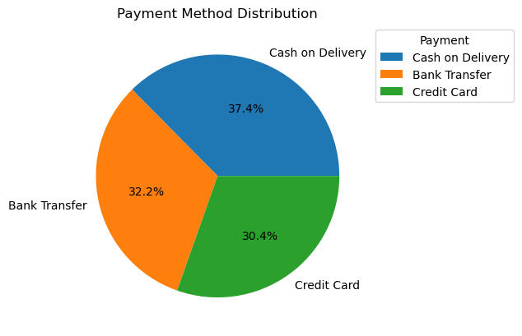
04 VISUALIZATIONS — Payment & Price
Payment Method Distribution
Price Distribution
✓ COD dominates (37.4%). Offer cashback on digital payments to shift users to online modes.
✓ Mean price Rs.251.85. Price products in Rs.100–Rs.400 to match peak customer demand.

Slide 7
04 VISUALIZATIONS — Satisfaction & Quantity
Customer Satisfaction (Review Scores)
Quantity Distribution per Order
✓ Avg rating 3.99/5. 75% gave 5★. Investigate 1–2★ customers and offer recovery coupons.
✓ Avg 3 items/order. Launch combo offers for 4–5 items to boost average order value.

Slide 8
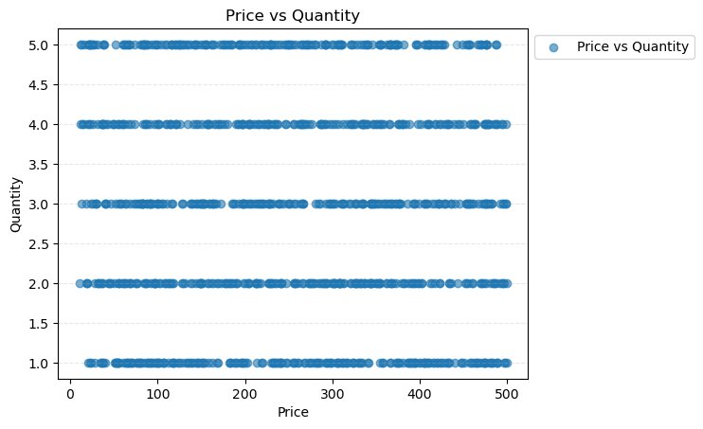
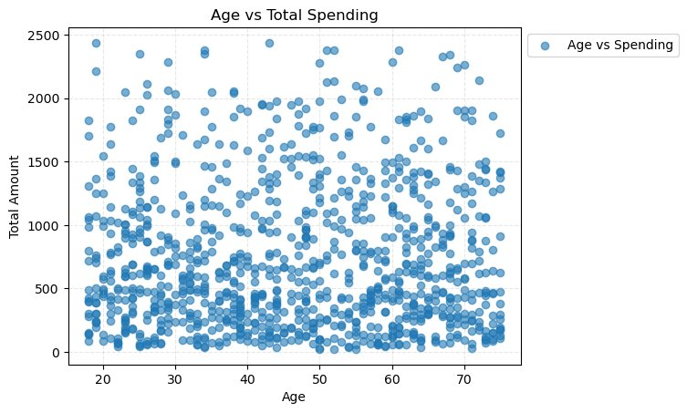
04 VISUALIZATIONS — Scatter Plots
Price vs Quantity
Age vs Total Spending
✓ No correlation — price does not affect qty
✓ Ages 28–35 & 50–55 are top spenders

Slide 9
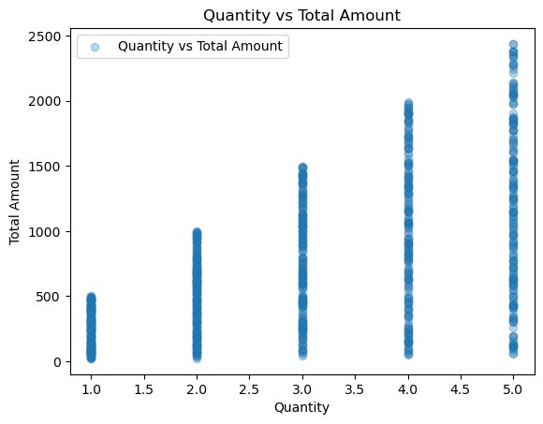
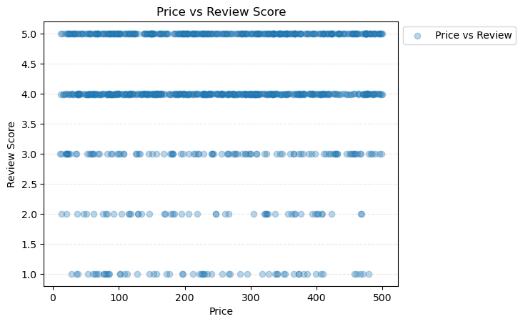
04 VISUALIZATIONS — Scatter Plots
Quantity vs Total Amount
Price vs Review Score
✓ Strong positive — max Rs.2,437.65 at qty 5
✓ No correlation — high price doesn’t mean better reviews.

Slide 10
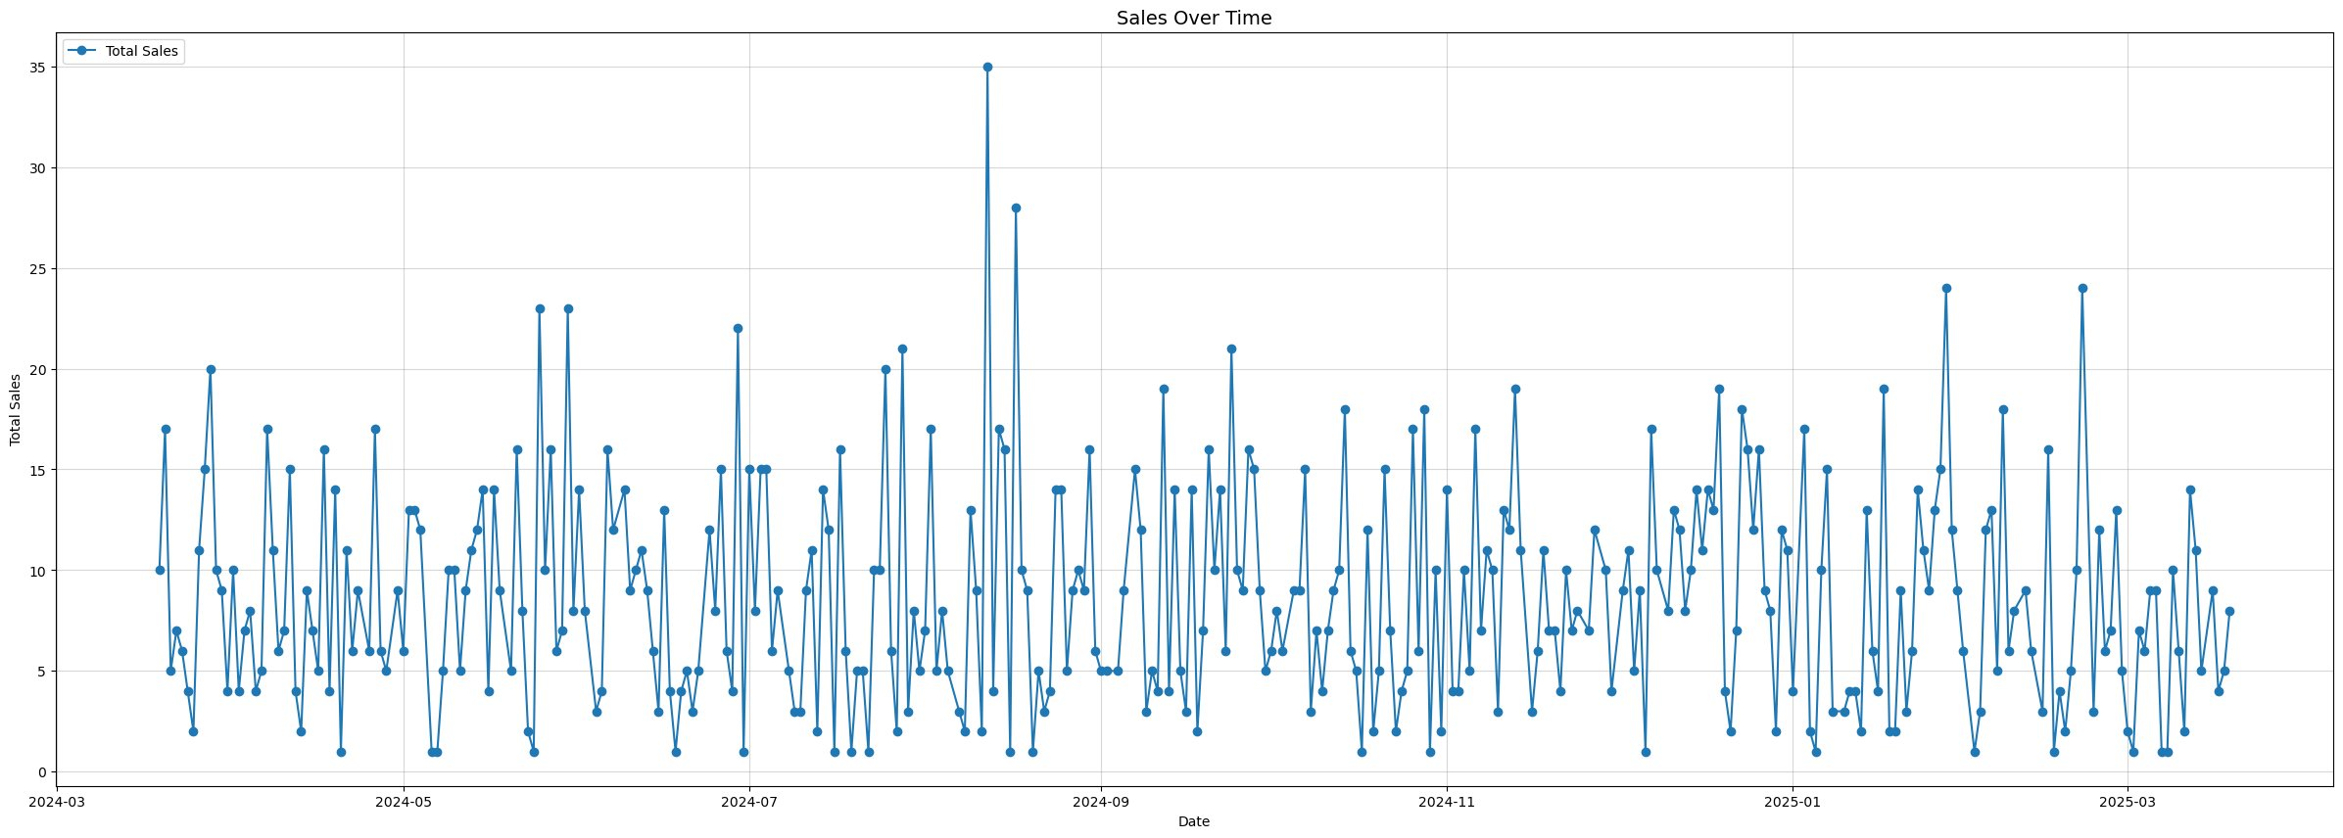
04 VISUALIZATIONS — Sales Over Time
Peak: 12 Aug 2024 — Rs.8,788.71 (single-day record) | August 2024 is the strongest month
✓ Pre-stock inventory in July. Use off-peak discounts to stabilise year-round revenue.

Slide 11
05 KEY INSIGHTS
01
Sports & Outdoors leads with 211 orders across 5 categories
07
Price & quantity show NO correlation — low price sensitivity
02
Gender split is nearly equal: M 45.7%, F 44.0%, Unknown 10.3%
08
Qty vs Amount: strong positive — max Rs.2,437.65 at qty 5
03
Cash on Delivery dominates at 37.4%; digital payments >62%
09
Ages 28–35 & 50–55 are top spenders (avg Rs.1,013 & Rs.977)
04
Price is uniformly spread Rs.10–Rs.500; mean Rs.251.85
10
Price & review score: NO correlation — quality matters more
05
Avg order qty = 3 items; 50% buy 3 or fewer items
11
Peak sales: 12 Aug 2024 — Rs.8,788.71 (Aug is strongest month)
06
Customer rating avg 3.99 / 5; 75% gave 5 stars

Slide 12
06 BUSINESS RECOMMENDATIONS
01
Increase stock for Sports & Outdoors (211) and Electronics (207) to prevent stockouts during peak demand.
Inventory
02
Keep products in Rs.100–Rs.400 range. Mean Rs.251.85 captures peak demand and maximises conversion.
Pricing
03
Promote UPI & digital wallets with cashback. Reduces COD operational costs and speeds fulfilment.
Payment
04
Target ages 28–35 and 50–55 — highest spenders at avg Rs.1,013 and Rs.977 respectively.
Marketing
05
Follow up on review scores < 3 via email/WhatsApp with discount coupons to prevent churn.
Retention

Slide 13
07 CONCLUSION
Key Takeaway
Finding
Evidence
Most Popular Category
Sports & Outdoors
211 orders
Customer Age Range
32–61 years
Interquartile range
Average Spend
Rs.737.33 / transaction
Mean of total_amount
Preferred Payment
Cash on Delivery (37.4%)
374 of 1,000 orders
Peak Sales Period
August 2024
Rs.8,788.71 on 12 Aug
Customer Satisfaction
3.99 / 5.0
75% gave 5-star rating

