Slide 1

Predictive analysis
Player transfers in soccer
ADITYA BHARDWAJ SATVIK SHETTY VARUN JAYATHIRTHA

Slide 2
Why player transfers?
Soccer teams have become major business ventures for owners who expect a solid return on investment
To remain competitive, team strength needs to be worked upon
One such way is PLAYER TRANSFERS
Scouting for talent is a complex task
We aim to use Data Mining techniques to ease this task and find potential upgrades on the existing players

Slide 3
What we propose
In this project, we analyze an European Soccer Database with important information spanning across the top 11 leagues.
We first classify the players according to their playing positions (defense, attack, midfield)
After assessing the player skills, we identify the weak areas in a team that need to be strengthened and find the corresponding player(s) in that position who might be the weak link.
Finally, based on the team capability, we find a suitable replacement who can prove to be an improvement.

Slide 4
EXPLORING THE DATA SET
European Soccer Database : https://www.kaggle.com/hugomathien/soccer
Multiple tables spanning across 11 leagues and 8 years containing key statistics and information in tables like:
Country [ Tuples: 11 , Attributes: 2 ]
League [ Tuples: 11 , Attributes: 3 ]
Match_info [ Tuples: 25979 , Attributes: 115 ]
Player [ Tuples: 11060 , Attributes: 7 ]
Player_Attributes [ Tuples: 183978 , Attributes: 42 ]
Team [ Tuples: 299 , Attributes: 5 ]

Slide 5
Prepping the data set
DATA CLEANSING
Existence of a lot of information that wasn’t relevant to our analysis
Multiple rows consisting of null values
Handling missing data and mapping among tables
SAMPLING
Consuming the entire data set would be time consuming and would require more resources
We use a subset of the data ( For example: Seasons 2013-2016 ) for our prediction
Helps keep the focus on latest pertinent data

Slide 6
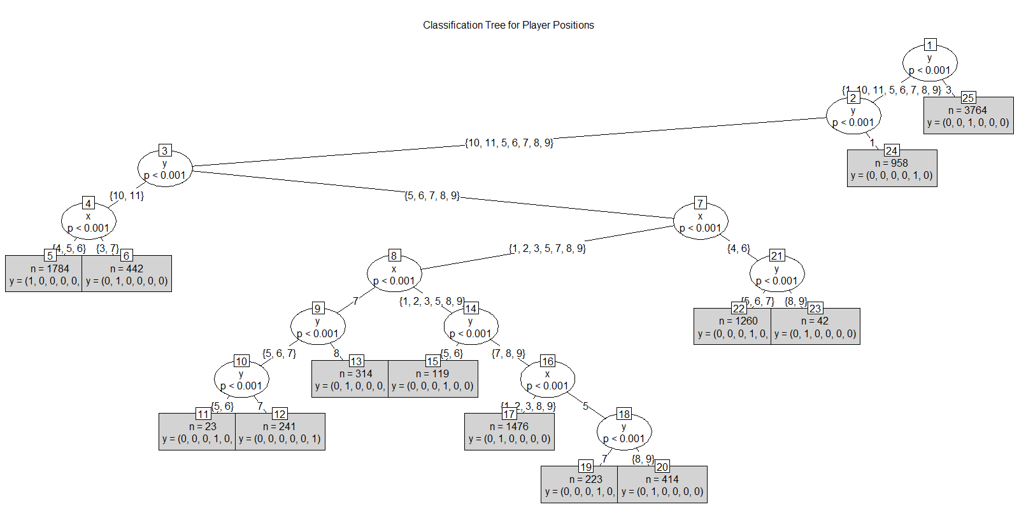
PLAYER Classification – Part 1
The most important part of this analysis is to correctly identify the playing position of each player before we identify the weakness in a team
Our first classification technique is based on playing field positions
Using the (x,y) co-ordinates of the players in matches, we map them to appropriate positions
We then build a decision tree based on the class(playing position)

Slide 7
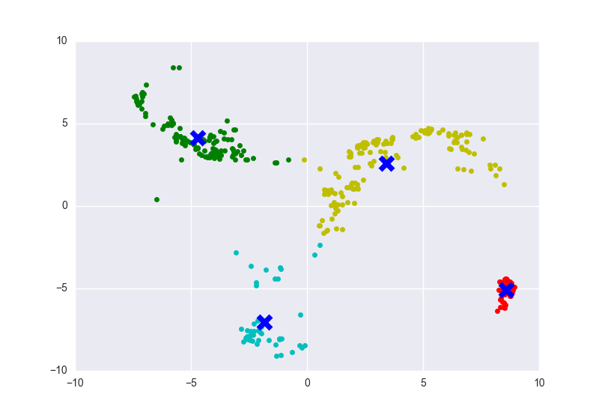
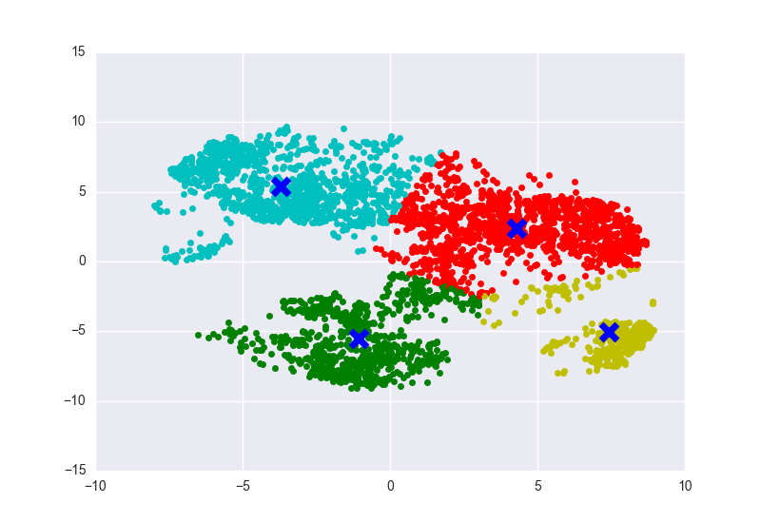
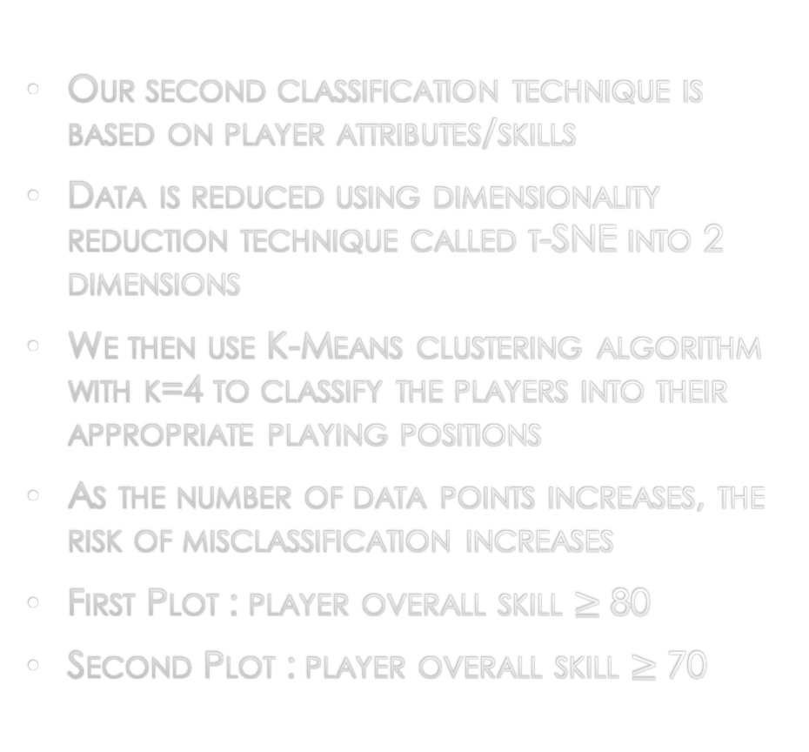
PLAYER Classification – Part 2
Our second classification technique is based on player attributes/skills
Data is reduced using dimensionality reduction technique called t-SNE into 2 dimensions
We then use K-Means clustering algorithm with k=4 to classify the players into their appropriate playing positions
As the number of data points increases, the risk of misclassification increases
First Plot : player overall skill $≥$ 80
Second Plot : player overall skill $≥$ 70

Slide 8
PLAYER Classification – Part 2
To better classify these players, we see that using DBSCAN results in a better clustering than K-MEANS for higher number of data points.
<WRITE MORE>

Slide 9
Identifying the weakness
TEAM WEAKNESS
Once we find the playing positions for each player, we then assess the strengths of the team based on player attributes
We find the MEAN of each playing position ( Defense, Midfield, Attack )
The position with the lowest mean is the one that needs improvement
WEAKEST PLAYER
We search for the weakest player in the position found earlier

Slide 10
Predicting the replacement

