Slide 1
DEVOPS & CI / CD
CONFIDENTIAL | © 2019 EPAM Systems, Inc.

Slide 2
Agenda
Background Introduction
Pillars and Benefits
Teams and Structure
Continuous Integration
Continuous Delivery
Continuous Deployment
Jenkins Demo
CONFIDENTIAL | © 2019 EPAM Systems, Inc.

Slide 3
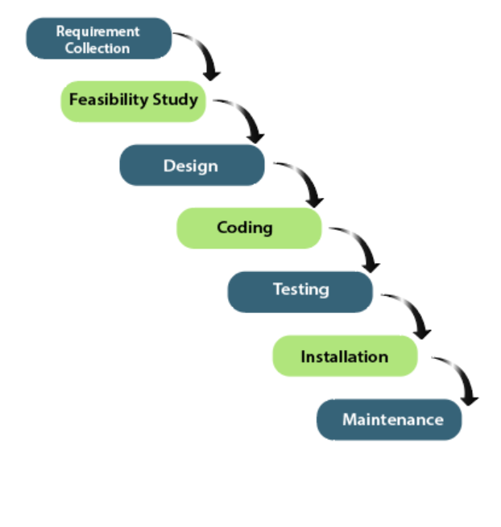
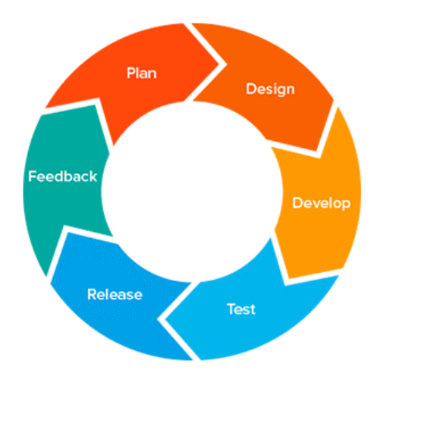
DEVOPS – Background & Introduction
AGILE
WATERFALL MODEL
Source Link
Source Link

Slide 4
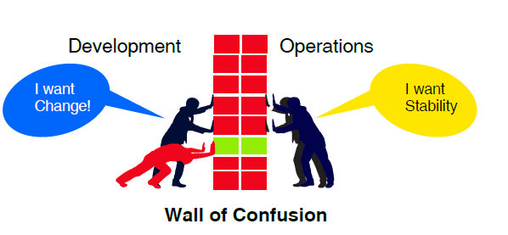
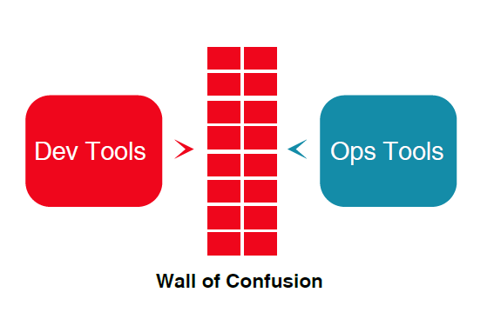
DEVOPS –Introduction
One Team One Goal
Source Link

Slide 5

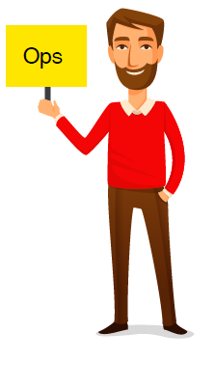
DEVOPS –Introduction
Communication
Collaboration
Culture
Integration
One Team One Goal
DevOps is the union of tools, process, people, and culture to enable continuous delivery of value to our end users.

Slide 6
DEVOPS –Key Pillars and BENEFITS
5 Pillars of DevOps
Agile Development
Test Automation
Continuous Integration
Continuous Deployment
Proactive Operational resiliency
Benefits
Business
Faster Time to Market
Increased Quality
Increased organizational effectiveness
Cultural
Happier, more productive teams
Higher Employee Engagement
Great Professional Opportunities
Technical
Continuous Delivery of software
Faster resolutions to the problems
Great Professional Oppurtunites

Slide 7
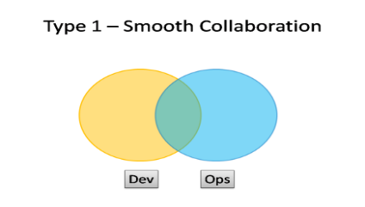
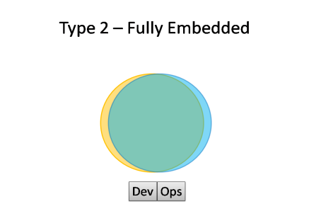
DEVOPS –Team structure
ANTI TYPE A – Separate Silos
ANTI TYPE B - Separate DevOps Silos
ANTI TYPE C – We Don’t Need Ops
Dev
OPS
Dev
OPS
Dev
OPS
Devops
Devops
5 Topologies in which DevOps can be made to Work
 | TYPE 1 : Smooth Collaboration Each Specialization where needed , but also sharing where needed Suitability: An organization with strong technical leadership. Potential effectiveness : HIGH
 | TYPE 2 : Fully Embedded Very little separation between Dev and Ops sometimes called as NoOps Suitability: An organization with single main web based product or service. Potential effectiveness : HIGH Adopters : Netflix , Facebook

Slide 8
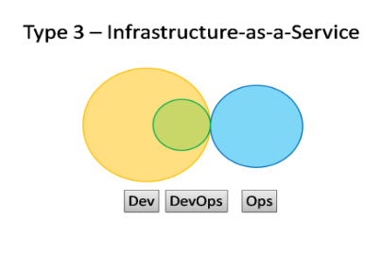
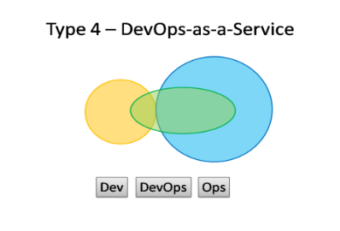
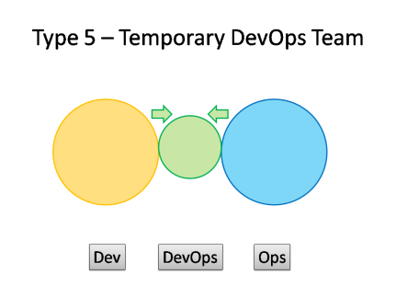
DEVOPS –Team structure
 | TYPE 3 : Infrastructure-as-a-Service Operation Provides the elastic infrastructure A team with in Dev acts as a source of expertise and does most of the communication with the Iaas team. Suitability: An organization with several product and services with a traditional Ops department. Potential effectiveness : MEDIUM
 | TYPE 4 : DevOps-as-a-Service Dev team reach out to service providers to help them build test environment and automate their infrastructure and monitoring. Suitability: Smaller team or organization with limited experience of Operational issues. Potential effectiveness : MEDIUM
 | TYPE 5 : Temporary DevOps Team Temporary team has a mission to bring Dev and Ops closer together. Ideally towards a Type 1 or Type 2 model , and eventually make itself obsolete. Suitability: as per precursor to Type 1 topology. Potential effectiveness : LOW to HIGH

Slide 9
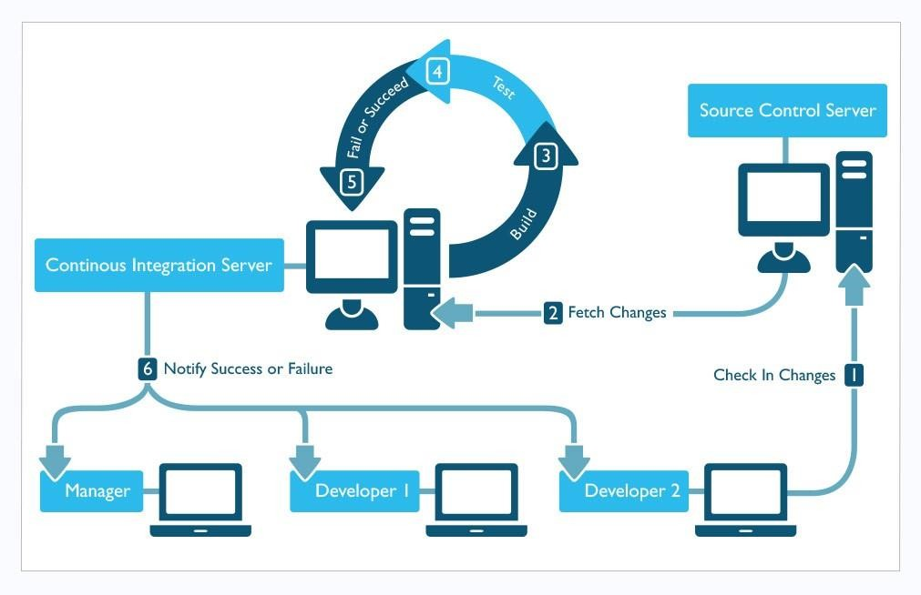
DEVOPS –Continuous Integration
Continuous Integration (CI) is a development practice that requires developers to integrate code into a shared repository several times a day. Each check-in is then verified by an automated build, allowing teams to detect problems early.
Typical CI process (source: www.pepgotesting.com)

Slide 10
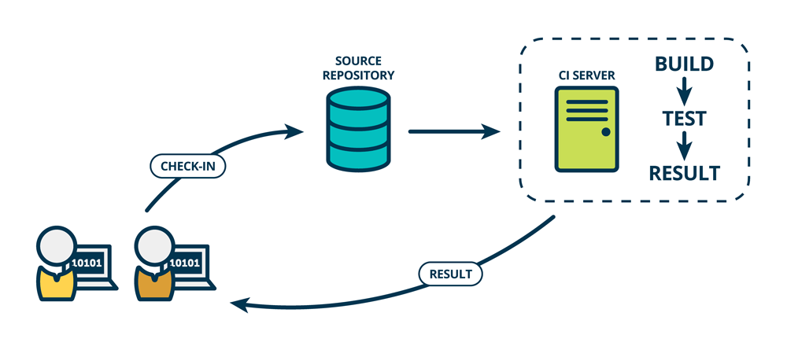
DEVOPS –Continuous Integration flow

Slide 11
DEVOPS –Continuous Delivery
Continuous Delivery (CD) is an extension of continuous integration to make sure that you can release new changes to your customers quickly in a sustainable way.
Ingredients
Automation
Practices and Patterns
Collaboration
Configuration Management
Continuous Integration
Automated testing in place

Slide 12
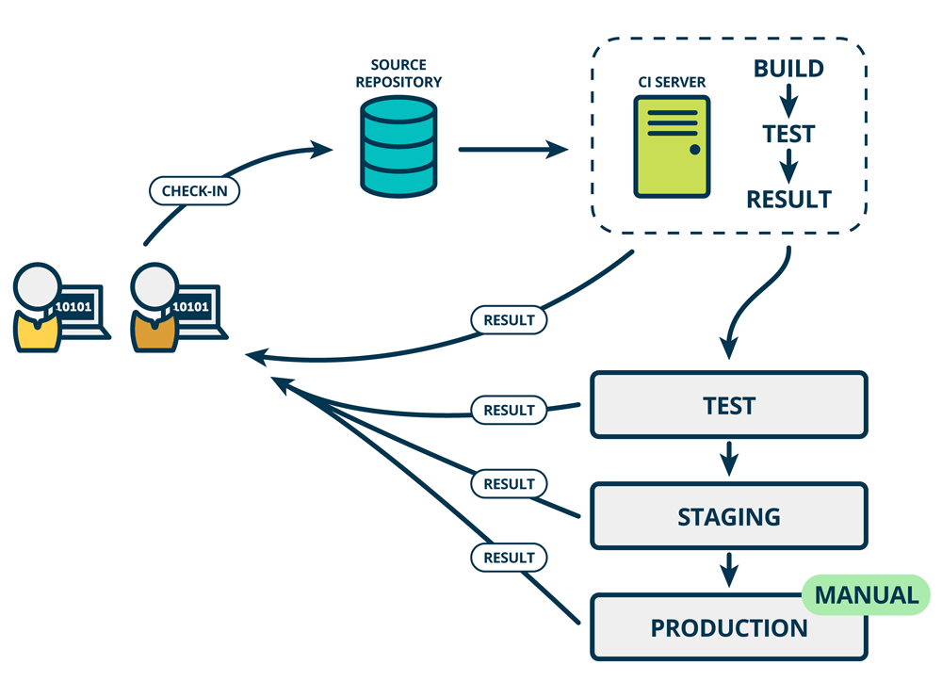
DEVOPS –Continuous Delivery Flow

Slide 13
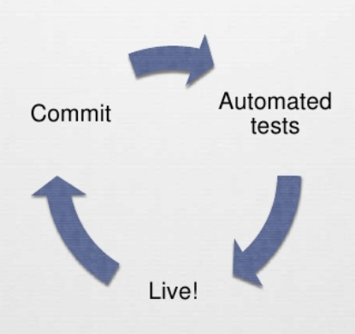
DEVOPS –Continuous Deployment
Continuous deployment (CD) goes one step further than continuous delivery. With this practice, every change that passes automated tests be deployed to production.
Continuous deployment might be challenging or practically not possible for companies that are constrained by regulatory or other requirements.

Slide 14
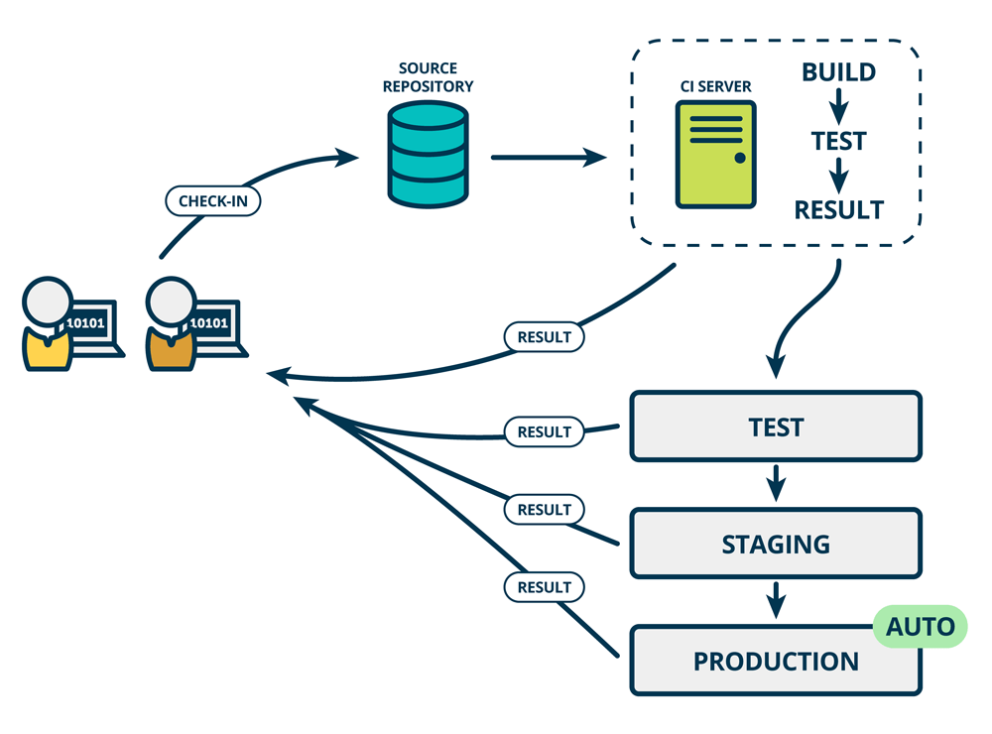
DEVOPS –Continuous Deployment Flow

Slide 15
References
https://developers.redhat.com/blog/2017/09/06/continuous-integration-a-typical-process/
https://www.mindtheproduct.com/what-the-hell-are-ci-cd-and-devops-a-cheatsheet-for-the-rest-of-us/
https://newrelic.com/devops/benefits-of-devops
CONFIDENTIAL | © 2019 EPAM Systems, Inc.

