Slide 1
AWS Kumo Series#1
CONFIDENTIAL | © 2020 EPAM Systems, Inc.

Slide 2
USECASE – Develop a simple mini version of abc.com
Build Application of ABC.com
Infrastructure preparation
Network Management
Storage Management
User Management
Streaming Analysis
Bigdata Processing
Datawarehouse

Slide 3

Let's try to build a Media application
(with/without AWS Services)

Slide 4
AWS APPLICATION MANAGEMENT SERVICES

Slide 5






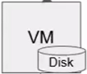



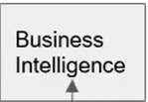






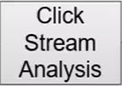

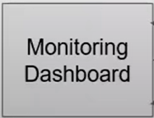
Users
IP
Web Server
Private Network
Web Server
App Server
Users Clicks/Actions
Storage
Data Warehouse
NoSQL
DB
DB
ETL
Relational
Database

Slide 6
Users
IP
Web Server
Private Network
Web Server
App Server
Users Clicks/Actions
Storage
Data Warehouse
NoSQL
DB
DB
ETL
Relational
Database

Slide 7






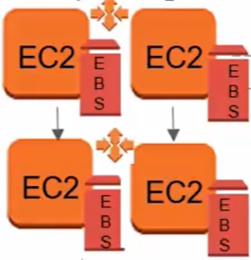
















Users
Route53
(abc.com)
Web Server
ELB
Web Server
App Server
Users Clicks/Actions

Slide 8
Users
Route53
(abc.com)
Web Server
ELB
Web Server
App Server
Users Clicks/Actions

Slide 9
AWS APPLICATION MANAGEMENT SERVICES

Slide 10
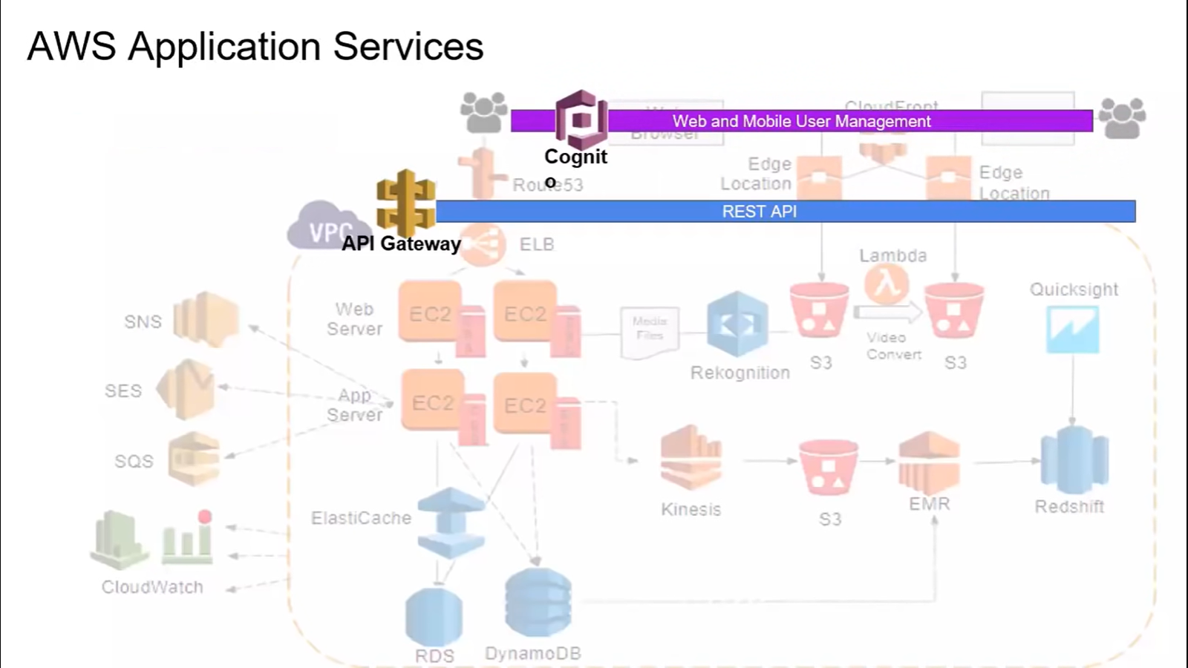

Slide 11
AWS SECURITY MANAGEMENT SERVICES

Slide 12
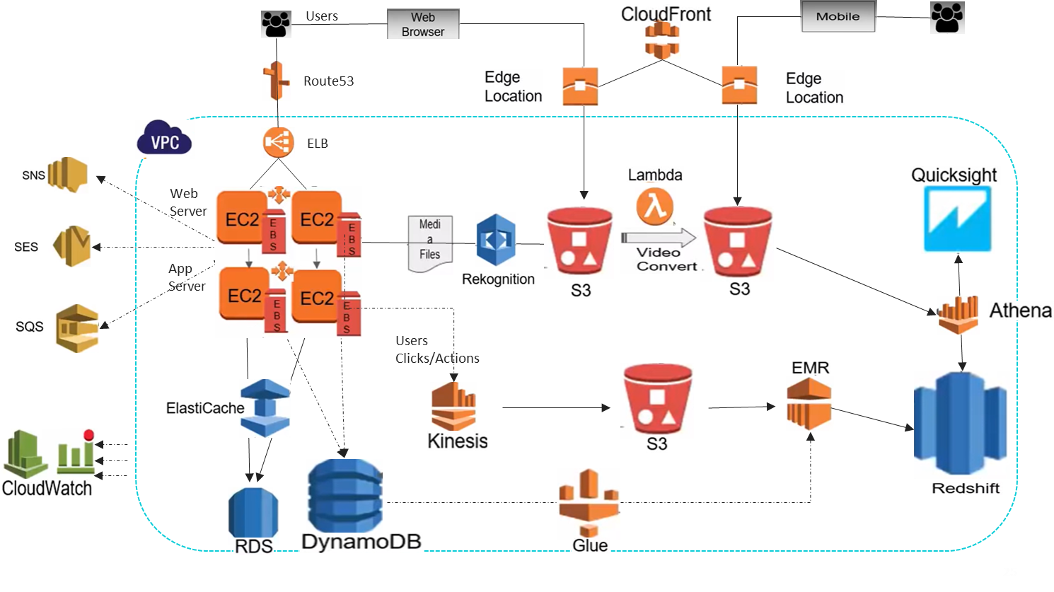










Slide 13
AWS DEVOPS SERVICES

Slide 14





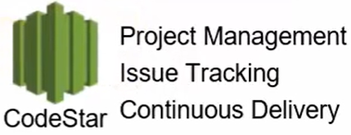






Slide 15
THANK YOU

