Slide 1
DXC Techno-Thon’22 CoDetta Cloud Provisioning and Monitoring
Shubham Saitwal

Slide 2
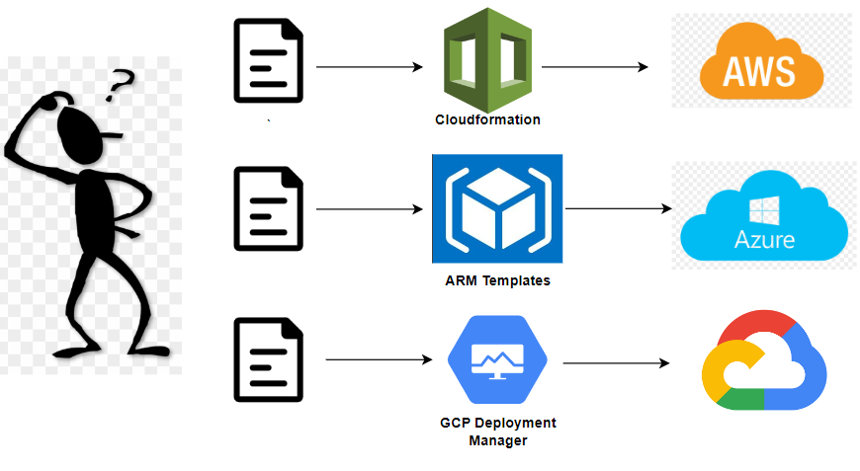
Why Codetta???

Slide 3
Problem Statement
Complexity to understand and choices of IaC (Infrastructure as a Tool) tools.
Manual intervention in handling Infrastructure.
Tracking of Provisioning and monitoring of Infrastructure.
Speed and Consistency of provisioning infra.
Scalability

Slide 4
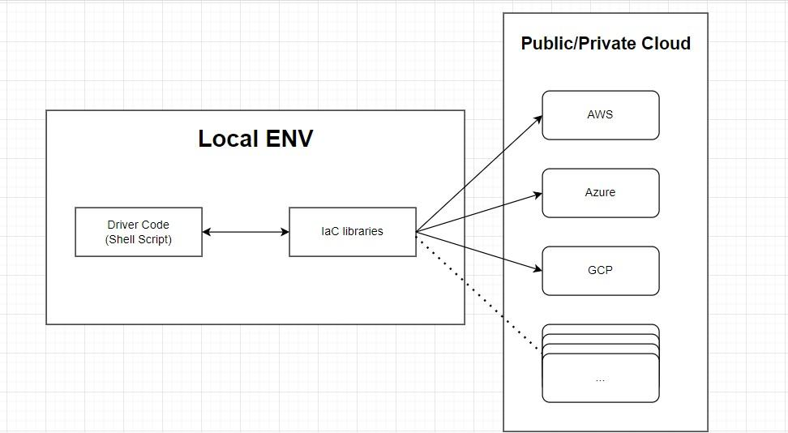
Architecture

Slide 5
Working at code level
The Driver code will fetch the library files on local computer. The user will only need to modify the variables as per the required resource specification.
Initialization | Planning | Deployment
Download and install cloud APIs / Plugins as per required Cloud.(AWS, Azure etc) Do not affect actual Infrastructure. | Generate a descriptive plan of the Infrastructure. (list of the resources in JSON /YAML format is generated which can be stored in git for Quality and Backtracking purpose) | Provision the resources in the Cloud. Current state of cloud infra is stored locally/remotely

Slide 6
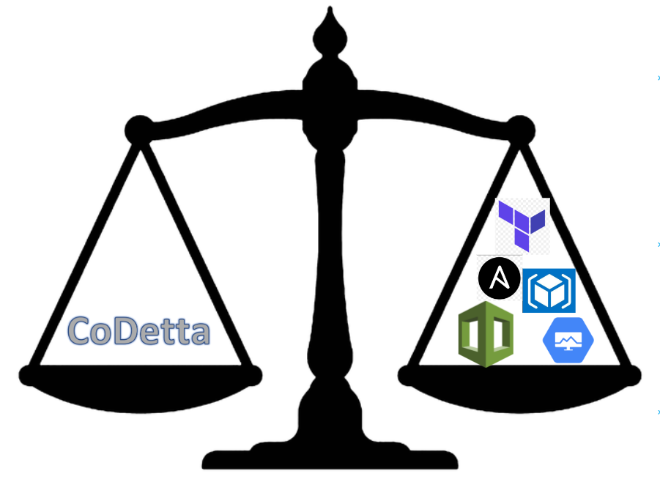
System Requirements:
Powershell (Open-source)
Azure/AWS CLI (Open-source)
Codetta IaC libraries (Open-source)

Slide 7
Unique Selling Point (USP)
Only GUI based IaC tool.
100% Open Source and free to use libraries.
Minimal knowledge of IaC required.

Slide 8
How far it can go?
Potential to become a full-fledge codeless provisioning product.
Only GUI based IaC tool available in the market.
Compatible with any public/private cloud available in market ( AWS, Azure, GCP, Oracle, Ali Cloud , VSphere)

Slide 10
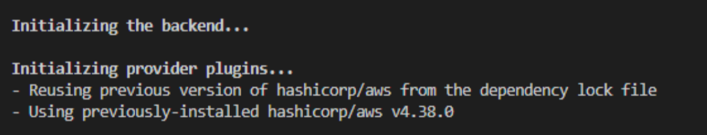
Code level functioning:
init

Slide 11
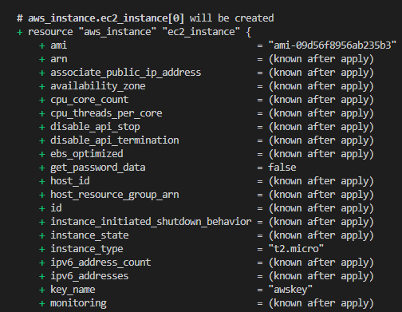
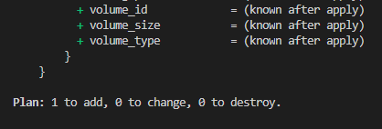
Plan:

Slide 12
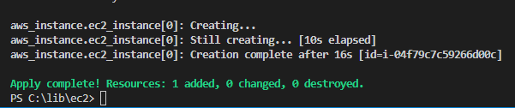
Apply:

