Slide 1

Practicum 2
Diabetes Readmission Prediction
Team:
Satwick Bodduna (11810077)
V .Venkata Sai Kushwanth Reddy (11810002)

Slide 2
Executive Summary (Abstract)
Motivation:
Hospital readmissions among patients with diabetes are substantial and costly.
Although prior studies have shown that receipt of outpatient quality of care significantly reduces the risk of hospitalization among patients with diabetes, little is known about its impact on hospital readmission.
Identify the key factors that influence readmission for diabetes and to predict the probability of patient readmission.
Method:
To assess the impact of outpatient quality of care on 30-day readmission among patients with diabetes by using various classification algorithms in machine learning

Slide 3
Executive Summary (Abstract) cont..
Models:
Data Pre-Processing, Model Building & Prediction
Message:
Most hospitals can agree that their main goals are centered on improving outcomes, creating more satisfied patients, and better value.
For these reasons, it is important for the hospitals to improve focus on reducing readmission rates.
Higher readmission rate could tarnish hospital quality and make it potential to face with regulatory concerns. Goal is to help hospitals to understand patients better for superior health service

Slide 4
Business Problem
Business Understanding:
The stakeholder of this project will be the hospital officials who can use the results to figure out which patients have higher readmission chances.
This will help hospital save millions of dollars and improvise the healthcare quality.
Objective:
To build a model which captures maximum variance of features in the data and Predict accurate readmission rates by applying different classification algorithms

Slide 5
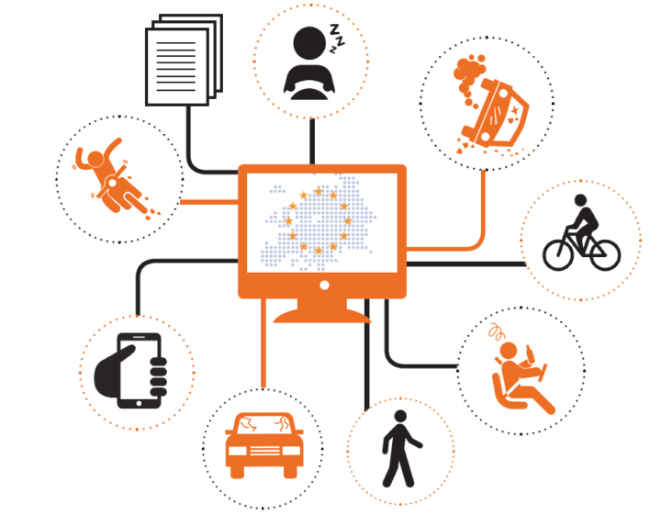
Data Requirement & Collection
Data was collected from UCI website, It represents 10 years (1999-2008) of clinical care at 130 US hospitals and integrated delivery networks.
Dataset includes over
50 features representing patient and hospital outcomes
There are around 1,00,000 records.
Data is available in the form of CSV file.
Used Python language for applying ML techniques on the data.

Slide 6

Process Steps
Step 1
1)Data Wrangling
2)Data Transformation
3) Feature Engineering
Step 2
Step 3
Step 4
Step 5
Data Collection
EDA & Visualizations
Modelling:
1)Logistic
2)Decision Trees
3)Random Forest
4)AdaBoost Classification
5)AdaBoost
With hyperparameter
Model Validating

Slide 7
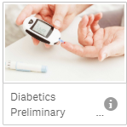
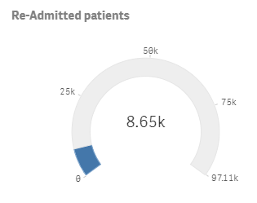
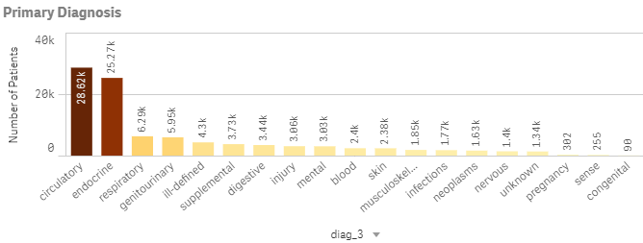
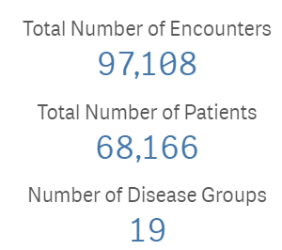
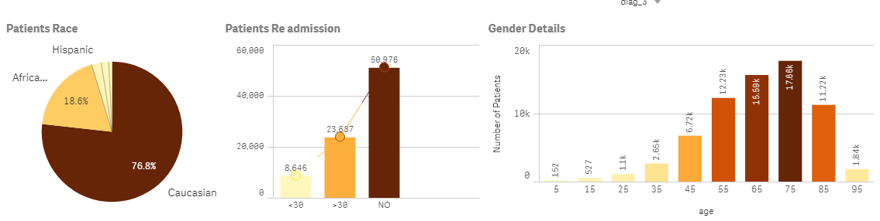
Data Understanding (EDA Using Qlik sense)

Slide 8
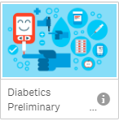
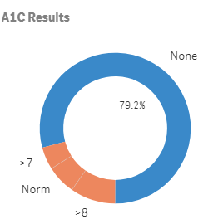
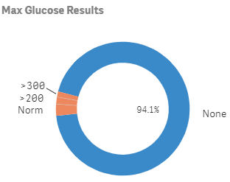
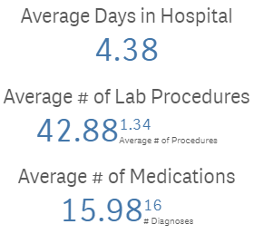
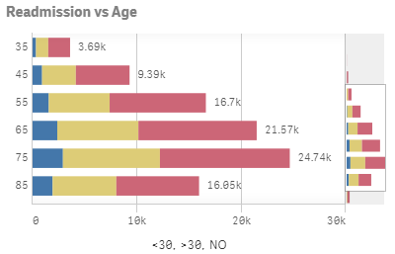
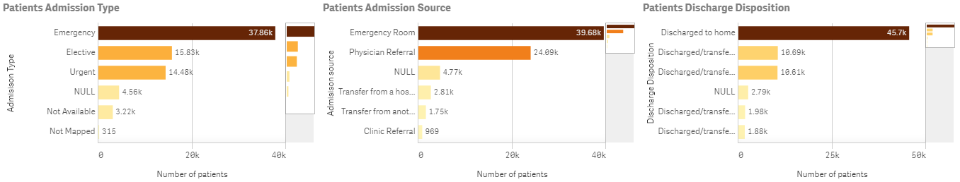
Data Understanding (EDA Using Qlik sense)

Slide 9
Data Preparation
Data types:
Numerical
Categorical
Objects
Data Cleaning:
Dropping columns with more missing values rather than imputing
Dropping duplicate rows based on unique patient Id reduced 30% of data
Data Cleaning:
Standardizing & Log transform on numeric data
Mapping AIC codes with their corresponding diseases
Transforming categorical to binary columns

Slide 10
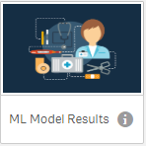
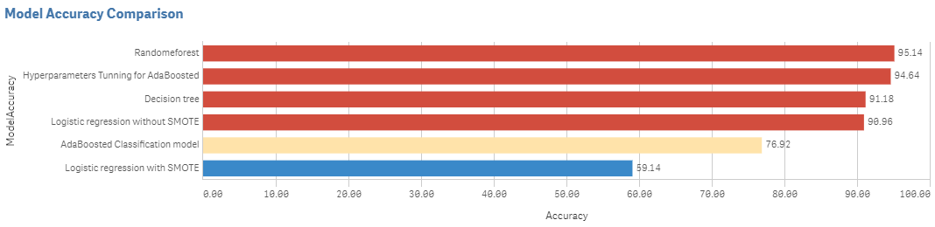
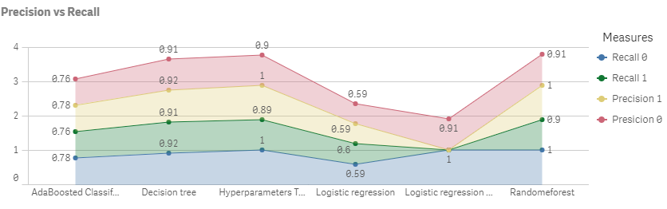
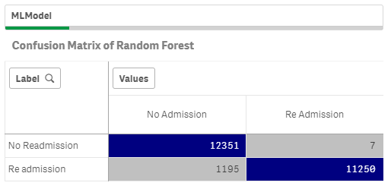
Modeling Techniques used & Evaluation

Slide 11
Business Recommendation
As Our Model give us good accuracy, and able to determine factors that lead to higher readmission in patients
Algorithm is predicting which patients will get readmitted can help hospitals save millions of dollars while improving quality of care
Hospitals can use this Machine learning algorithm in there hospital before discharging any diabetics patient which will save the quality of the hospital and penalties which applied by the Hospital Readmission Reduction Program before they add there in to the list
Dashboard Link : https://ap.qlikcloud.com/edit/5cda52744330420d4f19a1c5
QlikID: satwickbodduna
Password: Hyderbad@2019

Slide 12
Thank You
Satwick Bodduna (11810077)
V .Venkata Sai Kushwanth Reddy (11810002)

