Slide 1
Event Extraction From Crime News Article Headlines
Perisetla Sri Satwik IIT2020060

Slide 2
Event Extraction
It is a process of identifying and categorizing events described in the given text.
Several techniques have been proposed for event extraction, including rule-based methods, machine learning-based methods, and clustering techniques
We focus on event extraction from crime news articles headlines using DBSCAN clustering technique.

Slide 3
Preprocessing
Data collection : I have collected the data from news-api. It is a web service that provides access to news articles from various sources. It allows us to retrieve news articles from different categories such as technology, sports, crime etc.. I have requested the crime data from it and stored it in a csv file.
Text Cleaning : Stop word removal, puncuations and special characters removal
Tokenization and Lemmatization
Word Embeddings using Spacy

Slide 4
DBSCAN
DBSCAN stands for Density-Based Spatial Clustering of Applications with Noise. It is a clustering algorithm that groups together data points that are closely packed together and separates out points that are in low-density regions as noise.
The algorithm works by first identifying a "core" point and then expanding the cluster by adding neighboring points that are within a specified distance and density threshold. This process continues until all reachable points have been added to the cluster.
One of the key advantages of DBSCAN is its ability to handle clusters of arbitrary shapes and sizes, unlike traditional clustering algorithms such as k-means, which assumes that clusters are spherical and have a uniform density. DBSCAN is also less sensitive to the choice of initial parameters, making it easier to use in practice.

Slide 5
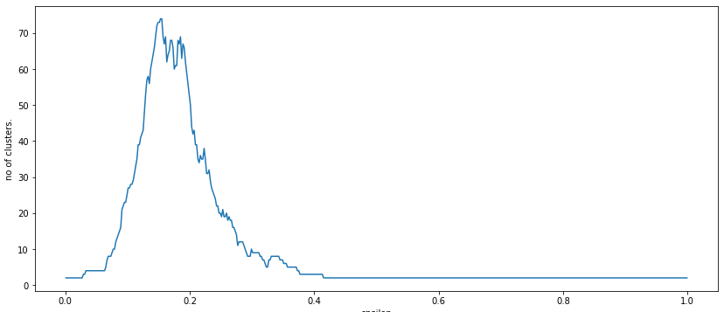
If we see here as the epsilon value increases the number of clusters are getting very low. Since we want to end up with very similar sentences in the same cluster, the target should be a value that returns a higher number of classes. For that reason I have taken the eps value of 0.1.
No of clusters vs epsilon

Slide 6
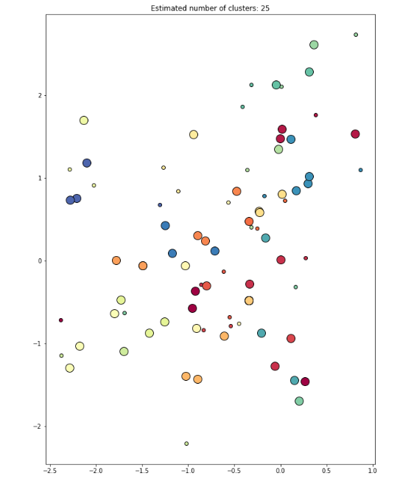
Above is a picture of how clusters are produced. A total of 25 clusters are produced for eps = 0.1

Slide 7
DataSet and tools used
Used News-api to get news articles from last 15 days and stored them in a dataframe.
Tools Used :
Python
Numpy
Pandas
Matplotlib
Spacy
Nltk
News-api
Sklearn
Github Link : [https://github.com/satwik-060/Crime-News-Event-Extraction]

Slide 8
Conclusion
I have implemented event extraction from crime news article headlines which are scraped from API.
Then preprocess it performing cleaning data , tokenization and lemmatization and convert them into word embeddings.
Use a clustering algorithm (DBSCAN) to cluster the most similar news articles based on the information extracted from the text.

Slide 9
References
[1] Rexy Arulanandam , Bastin Tony Roy Savarimuthu , Maryam A. Purvis. Extracting Crime Information from Online Newspaper Articles
[2] Rollo, Federica & Po, Laura & Bonisoli, Giovanni. (2022). Online News Event Extraction for Crime Analysis.
[3] Q. Li, Q. Zhang, J. Yao and Y. Zhang, "Event Extraction for Criminal Legal Text," 2020 IEEE International Conference on Knowledge Graph (ICKG), Nanjing, China, 2020, pp. 573-580, doi: 10.1109/ICBK50248.2020.00086.
[4]https://towardsdatascience.com/natural-language-processing-event-extraction-f20d634661d3

Slide 10
Thank you!!!

