Slide 1


KALINGA INSTITUTE OF INDUSTRIAL TECHNOLOGY
Department of Computer Science and Engineering
A Framework for Classifying
Kidney Stones Using
Explainable Transformer
Presentd By :
Satwik Gupta (2305075)
Saurabh Sharma (2305076)
Shirsh Mohan (2305245)
Soham Dey (2305250)
Swayam Kashyap (230258)
Under the Supervision of
Dr. Roshni Pradhan
KIIT, Bhubaneswar, Odisha, India

Slide 2
PROBLEM STATEMENT & MOTIVATION
10%+
16th
5th
1:1M
Global population
affected by CKD
Leading cause of
death (2016)
Projected rank
by 2040
Nephrologist ratio
in South Asia
Kidney Cysts
Nephrolithiasis (Kidney Stones)
Fluid-filled pockets on kidney surface; water density 0–20 Hounsfield units
Crystalline deposits in kidneys; affects ~12% of global population
Renal Cell Carcinoma
AI Solution Needed
Kidney cancer ranks among the 10 most widespread cancers worldwide
Shortage of nephrologists demands automated, reliable diagnostic systems

Slide 3
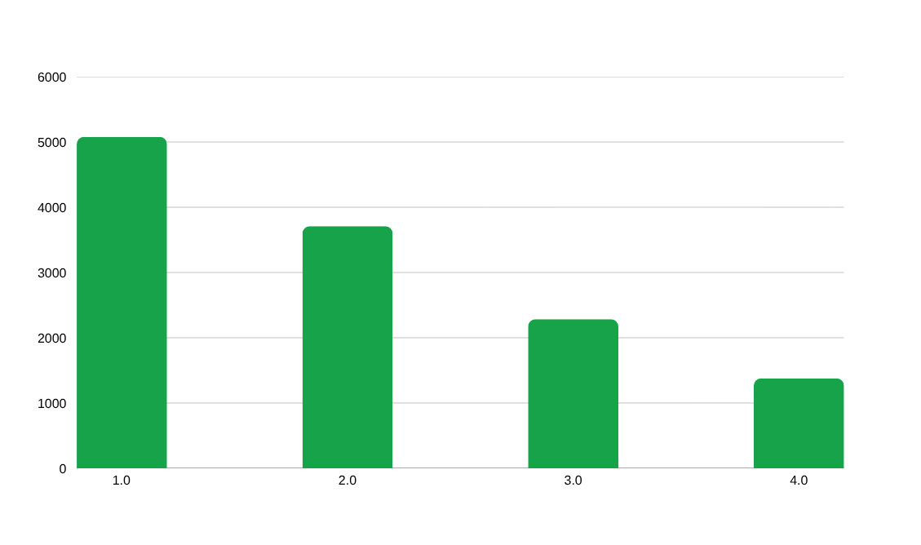
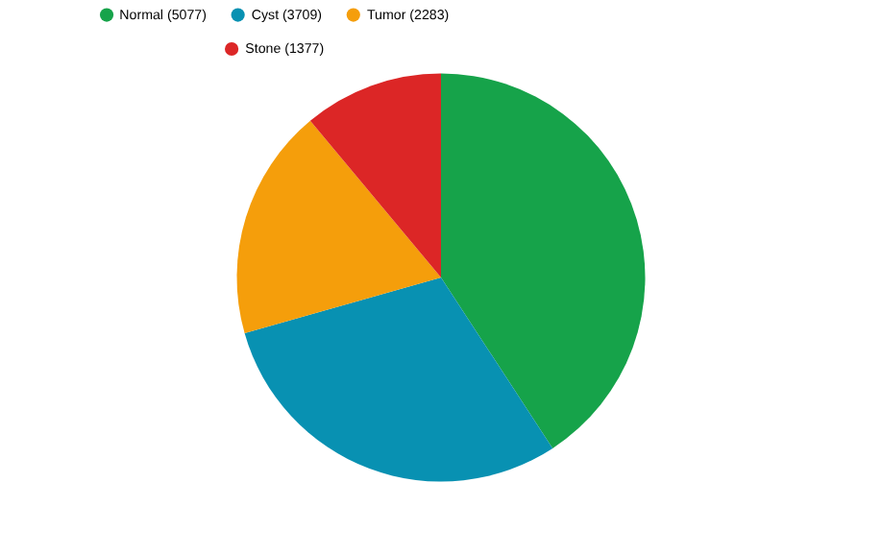
DATASET: CT KIDNEY DATASET
Dataset Overview
12,446 annotated CT images
Source: PACS at DCIMCH, Dhaka, Bangladesh
Coronal & axial slices (complete abdomen + urogram)
Patient data anonymized (DICOM → JPEG lossless)
Annotated using Philips IntelliSpace Portal 9.034
Data Split Strategy
80%
10%
10%
Training
Validation
Test

Slide 4
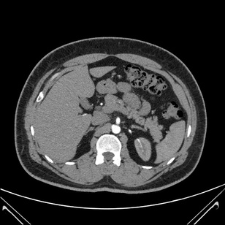
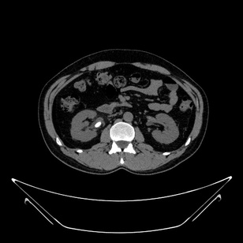
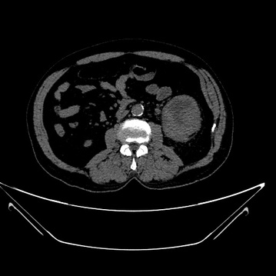
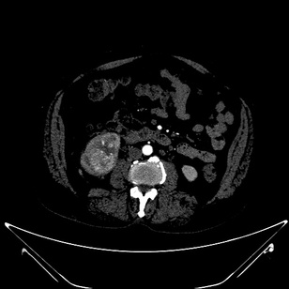
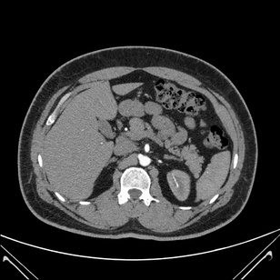
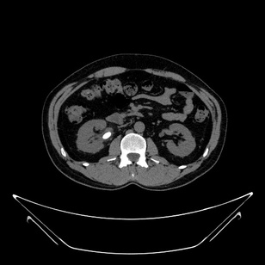
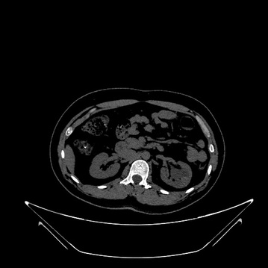
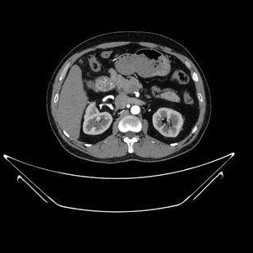
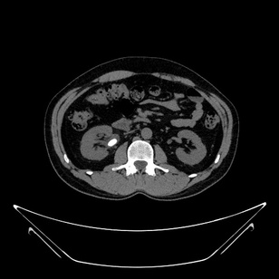
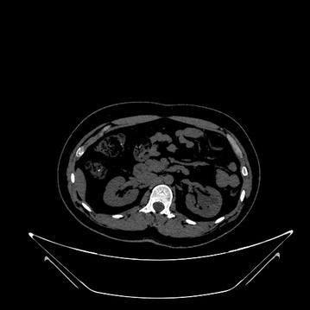
CT SCAN SAMPLES - ALL FOUR CLASSES
🔵 Normal
🟠 Stone
🟣 Cyst
🔴 Tumor
Fig. 2 from paper — Representative CT images of kidney cyst, normal, stone, and tumor classes with highlighted regions of interest

Slide 5
METHODOLOGY & PIPELINE
1
2
3
4
5
6
Data Collection
Preprocessing
Splitting
Oversampling
Model Training
Evaluation
12,446 CT images
from PACS/DCIMCH
Resize 224×224
Normalize, Z-norm
80% Train
10% Val / 10% Test
RandomOverSampler
Balance classes
6 models trained
Early stopping
Acc, F1, AUC
10-fold CV
Preprocessing Details
Training Configuration
• Image resizing: 224×224 pixels (ViT-compatible)
• Optimizer: Adam (lr = 1×10⁻⁵)
• Pixel normalization: rescale = 1/255
• Loss: Sparse Categorical Cross-Entropy
• Z-normalization: Xb = (X[i] - μi) / σi
• Early Stopping: patience = 5 (restore best weights)
• Color mode: RGB (3-channel tensors)
• Two-phase training strategy for convergence
• Batch size: 16 | No stochastic augmentation
• Hardware: Google Colab Pro (26.3 GB RAM, 16 GB GPU)
• Oversampling on training only (1,300/class balanced)
• Max epochs: 100 | 10-fold cross-validation

Slide 6
DEEP LEARNING MODELS IMPLEMENTED
Transformer
Transformer
CNN
Vision Transformer (ViT)
DINO (Self-Supervised)
VGG16
Treats images as patch sequences. CLS token for global aggregation. Multi-head self-attention. Best performer.
Teacher-student architecture. No labeled data required. Enhanced Grad-CAM explainability. Semantic attention maps.
Pre-trained CNN with modified head. Global avg pooling + dense + dropout. Efficient feature extraction.
Acc: 99.37%
Acc: 98.00%
Acc: 98.47%
Transformer
Transformer
CNN
EANet
Swin Transformer
ResNet50
External attention mechanism using shared learnable memory Mk and Mv. Reduces redundancy efficiently.
Shifted window self-attention. Hierarchical stages. Balances local and global feature extraction.
Residual skip connections for gradient flow. Pre-trained, fine-tuned top layers. Lower localization.
Acc: 98.35%
Acc: 97.27%
Acc: 94.02%

Slide 7
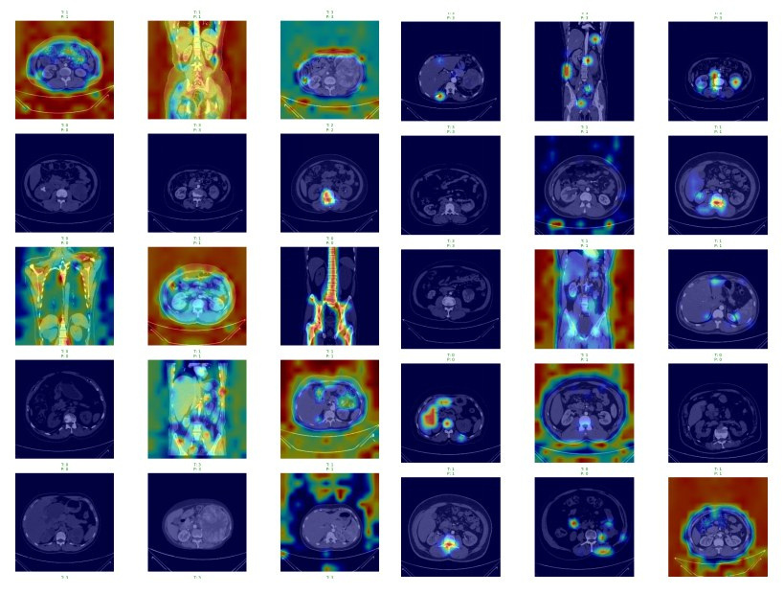
GRAD-CAM HEATMAP VISUALIZATIONS (from Paper)
Row 1–2: ViT model
Row 3–4: DINO model
Row 5: ResNet50 / VGG16
Cols: Cyst · Normal · Stone · Tumor

Slide 8
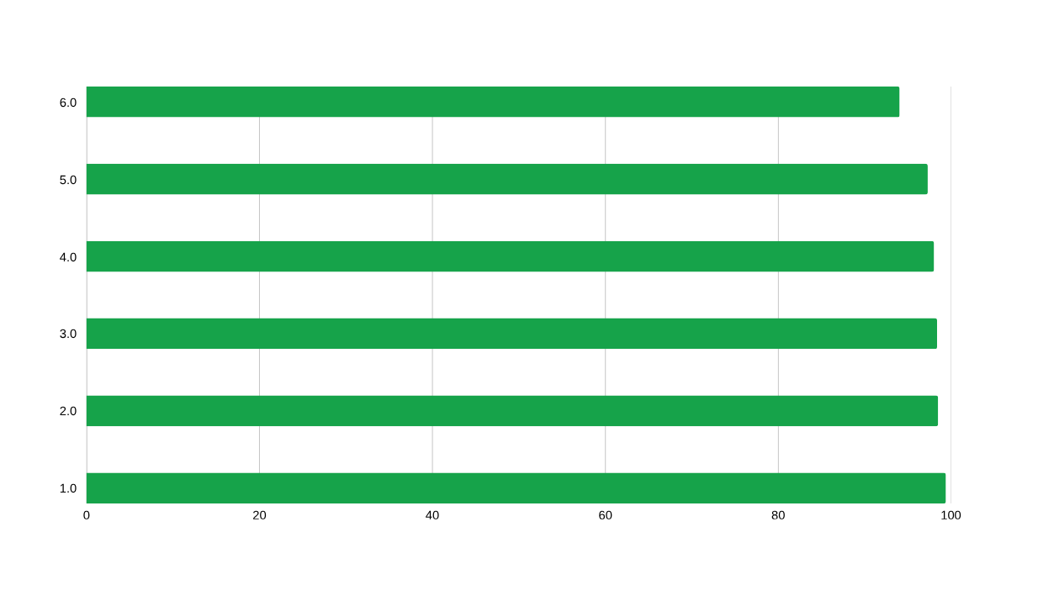
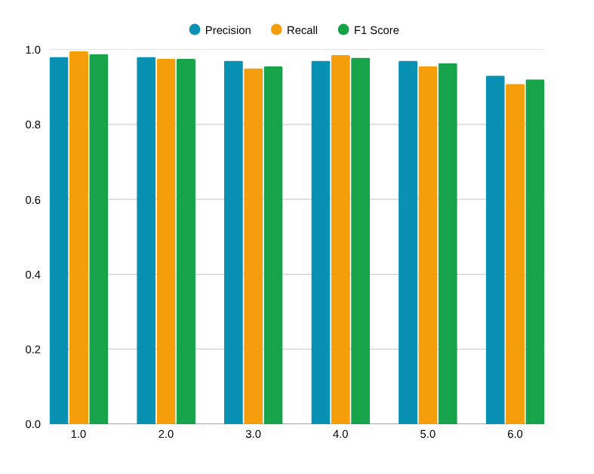
PERFORMANCE RESULTS
ViT Class-wise Performance (Best Model)
Class | Precision | Recall | F1 Score
Cyst | 1.00 | 1.00 | 1.00
Normal | 1.00 | 0.98 | 0.99
Stone | 0.93 | 1.00 | 0.96
Tumor | 1.00 | 1.00 | 1.00

Slide 9
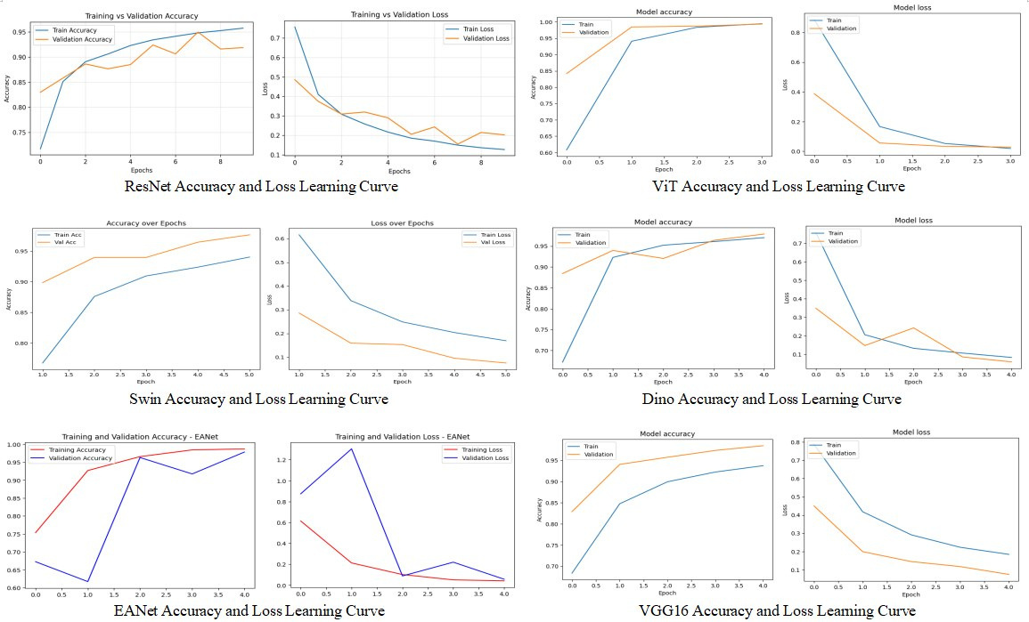
TRAINING & VALIDATION CURVES - ALL MODELS
ViT converges fastest with minimal overfitting. EANet shows volatile early epochs but stabilizes. ResNet50 shows slower convergence.

Slide 10
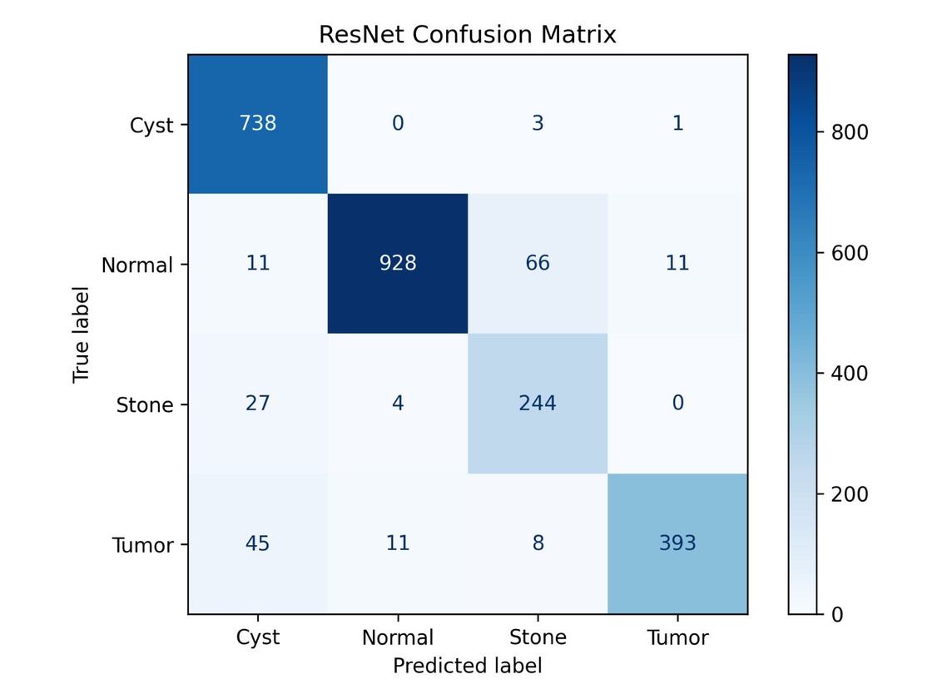
CONFUSION MATRIX ANALYSIS
ResNet50 Lowest Performer (94.02%)
Misclassification Analysis
ResNet50
66 Normal → Stone misclassifications; 45 Tumor → Cyst; weakest stone recall (77%). Global features poorly captured.
Swin Transformer
22 Stone → Cyst misclassified. Good on Cyst/Normal/Tumor but stone detection slightly weaker.
VGG16
Near-perfect confusion matrix. Minor stone misclassifications only. Precision 0.98 across all classes.
ViT (Best)
Near-perfect across all 4 classes. Cyst & Tumor at 100% precision/recall. Only minor stone→cyst confusion.

Slide 11
GRAD-CAM EXPLAINABILITY ANALYSIS
How Grad-CAM Works
Model Interpretability Comparison
Gradient-weighted Class Activation Mapping (Grad-CAM) highlights regions in CT images that most influence the model's predictions.
Model | Localization | Explainability
ViT | ⭐⭐⭐⭐⭐ | Token-level attention
DINO | ⭐⭐⭐⭐⭐ | Semantic self-supervised
VGG16 | ⭐⭐⭐⭐ | High-level conv features
ResNet50 | ⭐⭐⭐ | Dispersed regions
EANet | ⭐⭐⭐⭐ | External attention
Swin | ⭐⭐⭐⭐ | Window-based features
w_k^c = (1/Z) Σ_i Σ_j (∂y^c / ∂A_ij^k)
L_GradCAM = ReLU( Σ_k w_k^c · A^k )
VGG16 / ResNet50
Extract from final conv layers → spatial feature maps
Key Finding: DINO and VGG16 provide the best localization of anatomical abnormalities. ViT achieves the best balance of accuracy + interpretability.
ViT
Grad-CAM on token embeddings → 14×14 grid → upsample to 224×224
DINO
CNN models attend to broader, less precise regions.
Transformer models focus on clinically relevant kidney structures.
Self-supervised attention maps → semantically richer localization

Slide 12
VISION TRANSFORMER (ViT) ARCHITECTURE
Input
Image
224×224
Patch
Embedding
16×16 patches
CLS Token
+ Positional
Encoding
Transformer
Encoder
Blocks
CLS
Token
Output
Softmax
Classifier
4 classes
Patch Embedding
Encoder Block
Classification
224×224 image → 196 patches (16×16 each)
Multi-head self-attention (global)
CLS token aggregates global info
Linear projection to fixed embedding dim
Layer normalization for stability
Fully connected + softmax
Sequence of patch embeddings created
FFN with GELU activation + residual
4 classes: Cyst, Normal, Stone, Tumor
ViT achieves 99.37% accuracy highest among all 6 models by leveraging global self-attention to capture long-range dependencies in CT anatomy.

Slide 13
CONCLUSIONS
1.
12,446 CT images annotated covering cyst, tumor, stone and normal — publicly released on Kaggle
2.
Vision Transformer (ViT) achieved best accuracy of 99.37%, surpassing all CNN and other transformer architectures
3.
DINO provides superior interpretability via self-supervised attention, enabling precise Grad-CAM localization
4.
Transformer-based models significantly outperform CNNs on F1, precision, recall, and AUC metrics
5.
Framework suitable for real-world clinical deployment, assisting radiologists in early kidney disease diagnosis
6.
Work contributes towards building a digital twin of renal function at pathological level

Slide 14
Thank You

