Slide 1



Battery Store Success Engine:
Analytics and Insights for Retail Growth
Presentation By -
NAME : - SATWIK GUPTA
ROLL NUMBER : - 23f2005647
1

Slide 2
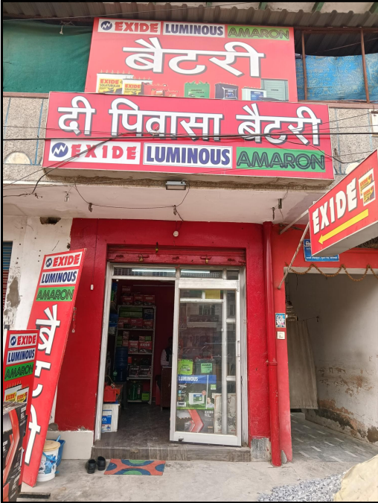
About the Project
Data spanning 16 weeks was collected from "The Pivasa Battery," a shop operating under a B2C model, for the purpose of this project.
The project aimed to identify and resolve business challenges faced by the shop owner to improve business operations.
2

Slide 3
1
The shop struggles to expand its customer base and improve market reach.
Problem Statements
2
Revenue generation is limited as the owner is new to the business.
The shop needs to optimize stock levels by accurately forecasting demand to avoid both stockouts and overstocking.
3
3

Slide 4
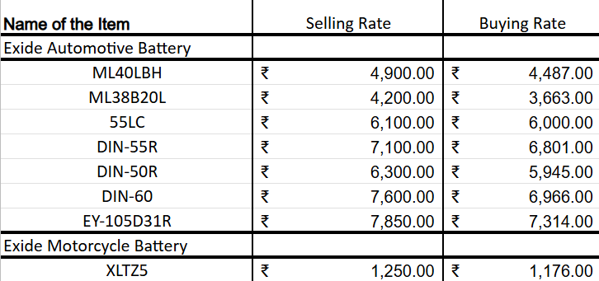
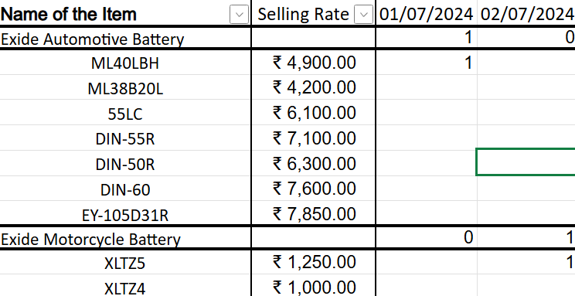
Data Collection :
Manual data entry of daily sales (quantity and product name) was done in Excel for 16 weeks (July 1st to October 31st).
Daily sales data includes the quantity and name of each product sold.
Cost and selling prices for each product were also obtained from the owner.
4

Slide 5


Information processing
Data Cleaning
Descriptive Analysis
Statistical Analysis
Manual Excel data entry from receipts/records.
Each new item created a new row.
Customer names removed for privacy.
Low-selling (1-2 sales) item categories excluded.
Excel's built-in formulas were used to quickly obtain key summary statistics from the sales data.
Functions like MAX, MIN, and SUM were applied within Excel to generate descriptive statistics.
Presenting the data visually made it easier to grasp the trends and patterns.
Using pie charts allowed for direct visual comparison of the sales contribution of various items.
Weekly sales quantity was analyzed using a Pareto chart to pinpoint the top-selling items.
A Pareto chart was also used to analyze profit contribution, highlighting the most profitable items.
Mean and standard deviation were calculated for each item's total inventory to understand its distribution relative to the average and identify unusual stock levels.
5

Slide 6
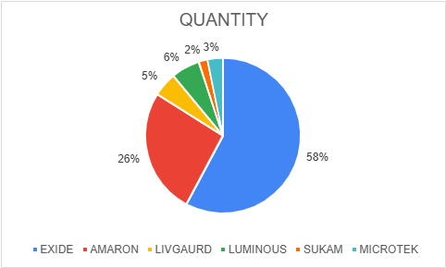
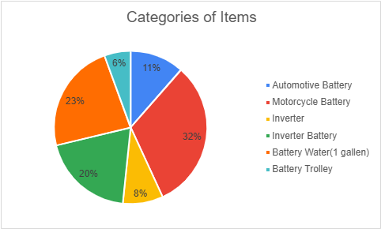
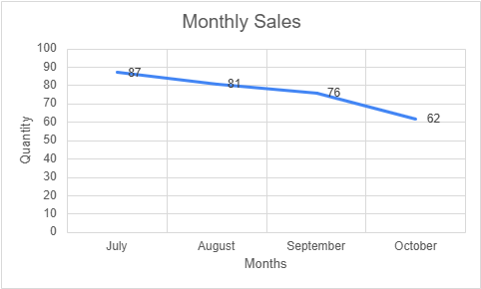
RESULTS :
EXIDE emerged as the most popular brand, commanding the largest share of total sales
The motorcycle battery category emerges as the top-selling item
Four-month line graph showed a gradual sales decline, potentially due to seasonal winter decrease in demand for power supplies.
6

Slide 7

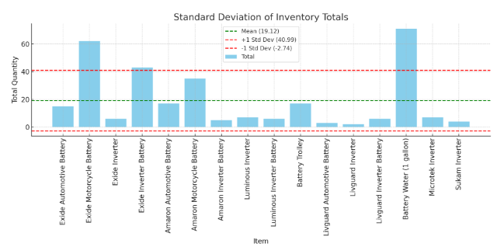
RESULTS :
Visualizing item inventory levels relative to the mean and standard deviation to identify potential overstock or understock situations.
7

Slide 8
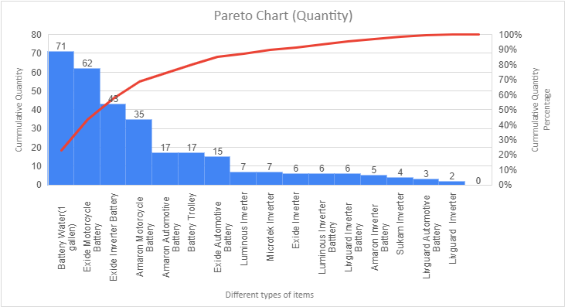
RESULTS :
The top-selling products (e.g., Battery Water, Exide Motorcycle Battery, Exide Inverter Battery) accounted for the majority of total units sold.
8

Slide 9
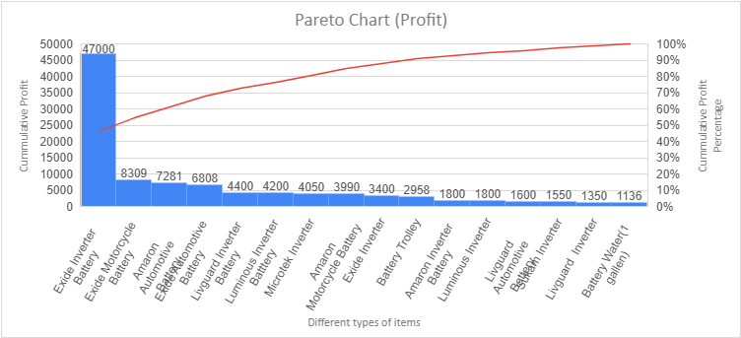
RESULTS :
The Exide Inverter Battery, despite lower unit sales, contributed the highest profit due to its high margin.
9

Slide 10

Recomendations :
Focus on consistently stocking Exide products due to their high demand to ensure sales and customer satisfaction.
Motorcycle batteries are the top-selling category, suggesting increased stocking and promotional focus could drive further sales.
Adjust inventory for seasonal demand to prevent overstocking during low sales.
Manage inventory by monitoring items outside the standard deviation to adjust stock and prevent capital being tied up in overstocked, inconsistent-demand products.
Focus inventory and marketing efforts on the top four to five high-performing products like Battery Water, Exide Motorcycle Battery, and Exide Inverter Battery, which drive approximately 80% of sales.
Prioritize shelf space and marketing for Exide Inverter Batteries, the highest profit-generating category, to optimize stock.
10

Slide 11

THANK YOU
11

