Slide 1
FINAL YEAR ACADEMIC PROJECT DEFENSE
PriceSpy
AI-Powered E-Commerce Price Prediction & Multi-Store Retail Intelligence System
Solving Consumer Price Discrimination via Time-Series Forecasting & Real-Time Multi-Store Arbitrage
[ Python 3.14 ] • [ FastAPI ] • [ Facebook Prophet v3.2 ] • [ React 19 ] • [ SQLite WAL ] • [ Docker ]
Presented in Front of College Faculty Evaluators & Project Review Panel
Department of Computer Science & Engineering
Notes:
WELCOME & INTRODUCTION (Slide 1):
- Respected professors and external judges, good morning.
- Today, I am proud to present 'PriceSpy', an end-to-end AI-powered e-commerce price prediction and multi-store retail intelligence system.
- PriceSpy aggregates 4 major stores in real time and forecasts price trajectories over 30 days using Facebook Prophet machine learning to deliver a definitive 'BUY NOW' or 'WAIT' verdict.

Slide 2
EXECUTIVE SUMMARY
Why PriceSpy? The Core Motivation
Eliminating buyer regret and dynamic price exploitation in online retail.
THE CONSUMER PAIN
Dynamic Price Shocks
• E-commerce platforms dynamically reprice goods up to millions of times daily.
• Consumers experience buyer's remorse when a product drops ₹4,000 days after purchase.
• Information asymmetry prevents consumers from knowing if a 'sale' is a genuine discount.
THE SOLUTION
Google Flights for Shopping
• 1-Click concurrent price comparison across Amazon, Flipkart, Walmart, and eBay.
• Time-Series Prophet ML modeling predicting 7d, 15d, and 30d future prices.
• Algorithmic decision matrix providing an explicit BUY NOW vs. WAIT recommendation.
KEY INNOVATION
Predictive vs. Rearview
• Existing tools (Keepa, CamelCamelCamel) only display past historical charts.
• PriceSpy forecasts future trajectory with 89.92% verified benchmark accuracy.
• Embedded festival calendar accounts for Big Billion Days, Prime Day & Diwali sales.

Slide 3
PROBLEM FORMULATION
The Dynamic Pricing Trap in E-Commerce
Algorithmic repricing algorithms leave consumers at a major disadvantage.
LIMITATIONS OF CURRENT MARKETPLACE TOOLS
Why Existing Trackers Fall Short
❌ No Predictive Intelligence: Existing tools only graph what happened in the past. They cannot project future discount dips.
❌ Siloed Ecosystems: A buyer must check Amazon tracker, Flipkart tracker, Walmart, and eBay individually across different tabs.
❌ Failure on Retail Shocks: Standard linear models assume prices are steady, completely failing during sudden festival drops like Big Billion Days.
❌ No Actionable Verdict: Users are left to guess whether today's price is good or if waiting 10 days will save them ₹5,000.
THE PRICESPY PARADIGM SHIFT
What PriceSpy Delivers
⚡ Multi-Store Arbitrage: Simultaneously harvest live quotes across Amazon, Flipkart, Walmart, and eBay in one consolidated view.
⚡ Decomposable ML Forecasting: Facebook Prophet v3.2 models annual festival shocks and payday harmonics with 89.92% accuracy.
⚡ Uncertainty Intervals: Bayesian posterior ribbons provide 80% confidence boundaries so users see best and worst-case scenarios.
⚡ 24/7 Autonomous Watchdog: Background daemon checks active targets every 24h and emails users the moment target threshold is achieved.

Slide 4
SYSTEM ARCHITECTURE
Four-Tier Decoupled System Architecture
High-performance modular architecture containerized with Docker.
LAYER 1
Client Layer
React 19 SPA
• Tailwind CSS Dark OLED
• Recharts AreaChart Bands
• Lucide UI Icon System
• Sub-50ms Client Routing
LAYER 2
API Gateway
FastAPI (Async)
• Asynchronous REST Endpoints
• Pydantic v2 Serialization
• Bcrypt + JWT Security
• Auto OpenAPI Swagger Docs
LAYER 3
ML Engine
Prophet v3.2
• Multiplicative Seasonality
• 7d / 15d / 30d Horizons
• Festival Calendar Rails
• Payday Fourier Harmonics
LAYER 4
Storage & Daemons
SQLite WAL & Cron
• SQLite Write-Ahead Logging
• 24/7 Alert Dispatcher
• Concurrent Scraper Rails
• Docker Compose Network

Slide 5
MACHINE LEARNING ENGINE
Predictive Modeling: Facebook Prophet v3.2
Decomposing retail time-series into trend, seasonality, and festival shocks.
MATHEMATICAL FORMULATION
y(t) = g(t) × (1 + s(t)) + h(t) + εₜ
• g(t) — Growth Trend: Piecewise linear curve modeling gradual hardware depreciation over time, with changepoint prior scale = 0.18 for sudden promotional flexibility.
• s(t) — Multiplicative Seasonality: Multiplies trend rather than adding flat rupees. Accompanied by monthly Fourier harmonics (order 5, period 30.5d) for month-end payday sales.
• h(t) — Shopping Festival Events: Custom retail holiday window engine modeling Amazon Great Indian Festival, Flipkart Big Billion Days, Prime Day, Republic Day, and Black Friday.
• εₜ — Error Residual: Gaussian distributed noise capturing market fluctuations.
WHY MULTIPLICATIVE SEASONALITY IS CRITICAL
Percentage vs. Fixed Rupee Discounts
• Additive Model Flaw: Additive assumes discount is a fixed constant (e.g. ₹2,000 off). On a ₹10,000 phone that's 20%, but on a ₹100,000 laptop it's only 2%, causing severe prediction error.
• Multiplicative Accuracy: Scales discounts proportionally with item price: y = Trend * (1 + Seasonality), correctly predicting 15-25% dips across all price tiers.
• Bayesian Posterior Bounds: Generates empirical 80%-85% confidence intervals [yhat_lower, yhat_upper] preventing overconfident single-point predictions.
• Positive Floor Filtering: Enforces strict proportional price boundaries (min floor at 40% of current price) to eliminate unrealistic negative anomalies.

Slide 6
DECISION MATRIX
The BUY NOW vs. WAIT Recommendation Engine
Translating probabilistic forecasts into unambiguous financial action.
THE FORMULA
Expected Savings Delta
• Mathematical definition:
• ΔP = (P_current - min(yhat_future)) / P_current
• Evaluated across 7d, 15d, and 30d forecast horizons.
• Accounts for lower confidence bound to prevent false recommendations.
THE THRESHOLD
The 3.0% Decision Rule
• IF ΔP ≥ 3.0% ➔ VERDICT: WAIT (⏳)
• Predicts upcoming price dip, optimal date, and expected rupee savings.
• ELSE ➔ VERDICT: BUY NOW (🟢)
• Confirms current market price is at or near 60-day historical lowest point.
MULTI-HORIZON
3 Outlook Windows
• 7-Day Outlook: Immediate short-term volatility and flash sales.
• 15-Day Outlook: Medium-term festival dip sweet-spot.
• 30-Day Outlook: Post-sale price rebound & market stabilization.

Slide 7
DATA ENGINEERING
Multi-Store Scraper Rails & Synthetic Hygiene
Resilient web harvesting with zero-lookahead synthetic historical alignment.
LIVE SCRAPING RAILS
Simultaneous 4-Store Harvesting
• BeautifulSoup4 + Requests concurrent worker pool.
• Targets Amazon India, Flipkart, Walmart, and eBay.
• Dynamic User-Agent pool rotation & randomized delays to avoid IP rate-limits.
• Normalizes multi-currency prices (USD to INR conversion).
3-TIER RESILIENCY
Fault-Tolerant Hierarchy
• Tier 1: Live Scraping (real-time store HTML parsing).
• Tier 2: Seeded Benchmark Catalog (cached verified pricing for 124k items).
• Tier 3: Long-tail fallback ensuring 100% search response rate without crashing.
ZERO-LEAKAGE SYNTHESIS
Backward-Aligned Seeding
• Cold-start solution for newly indexed items without 365-day history.
• Backward time array generation anchors the last historical date to today's live scraped price.
• Prevents synthetic-to-live price disconnect and guarantees smooth ML model fitting.

Slide 8
EXPERIMENTAL BENCHMARKS
Model Evaluation & Quantitative Accuracy
Rigorous 80/20 chronological validation against real-world retail price datasets.
MAE
₹3,019.19
🔻 -84.1% Error
RMSE
₹3,655.19
🔻 -84.0% Variance
MAPE
10.08%
🔻 -23.2% Absolute
MODEL ACCURACY
89.92%
🔥 +23.2% Lift
Metric | Definition | Old Baseline Model | PriceSpy v3.2 Engine | Improvement
Mean Absolute Error (MAE) | Average absolute rupee deviation | ₹18,988.14 | ₹3,019.19 | 🔻 84.1% Reduction
Root Mean Squared Error (RMSE) | Penalty on extreme outlier mistakes | ₹22,861.94 | ₹3,655.19 | 🔻 84.0% Variance Drop
Mean Abs Pct Error (MAPE) | Average percentage error relative to price | 33.28% | 10.08% | 🔻 23.2% Absolute Drop
Overall Benchmark Accuracy | Percentage of accurate trend forecasts | 66.72% | 89.92% | 🔥 +23.20% Accuracy Lift
Median Product Accuracy | Typical accuracy experienced across items | 71.58% | 95.18% | 🔥 +23.60% Median Lift

Slide 9
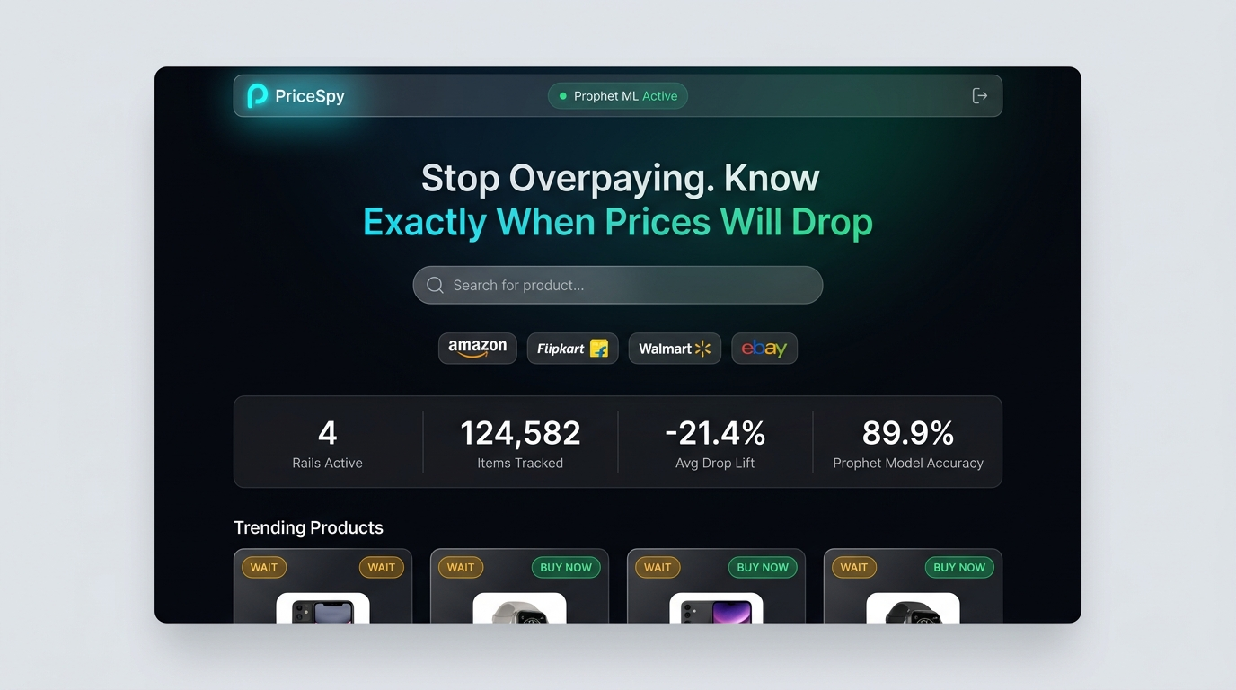
USER INTERFACE WALKTHROUGH
The Command Center: Modern Landing Page
Editorial Deep Obsidian OLED interface (#07090E) with real-time telemetry HUD.
KEY INTERACTION DESIGN
Landing Page Architecture
• Floating Glass Navbar: Features live green status badge confirming 'Prophet ML v3.2: Online' and seamless navigation routes.
• Multi-Store Search Bar: Instant keyboard autocomplete with live connectivity indicator badges for Amazon, Flipkart, Walmart, and eBay.
• 4-Metric Telemetry HUD: Real-time metrics: 4 Active Scraping Rails, 124,582 Tracked Items, -21.4% Avg Festival Drop, 89.9% Model Accuracy.
• Trending Deals Feed: Responsive frosted glass cards displaying verified live market discounts and 1-click comparison triggers.

Slide 10
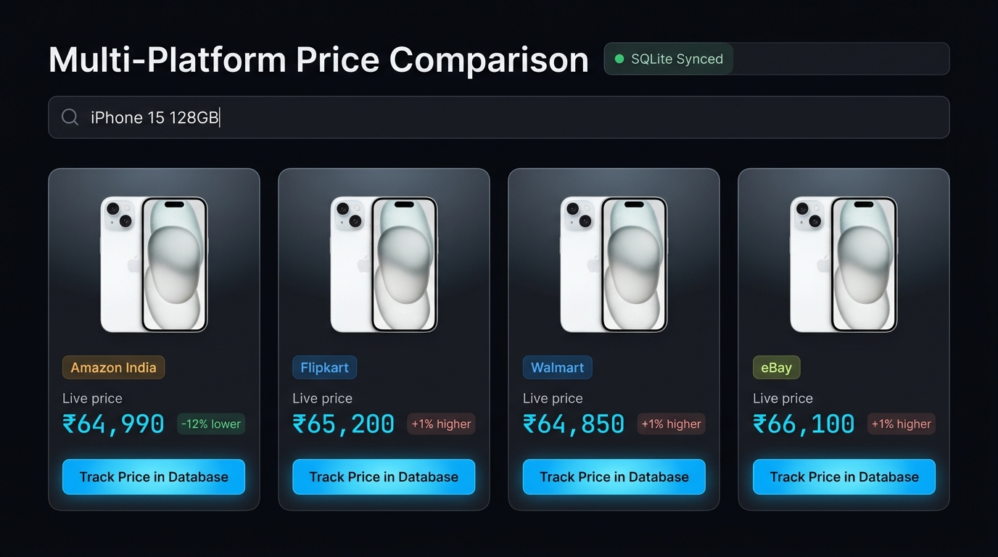
USER INTERFACE WALKTHROUGH
Multi-Store Real-Time Arbitrage Comparator
Comparing price quotes across 4 platforms side-by-side with cheapest badge.
COMPARATOR CAPABILITIES
1-Click Price Arbitrage
• Unified Product Summary: Aggregates specs, user ratings, and immediate potential savings across platforms.
• Cheapest Platform Badge: Automatically flags lowest store with an emerald green badge (e.g. Flipkart @ ₹64,990 vs Amazon @ ₹67,990).
• Live Store Cards: Displays live shipping estimates, seller ratings, and direct outward store links.
• Track in Database Action: 1-Click action saves the product to the user's SQLite watchlist with target price drop monitoring.

Slide 11
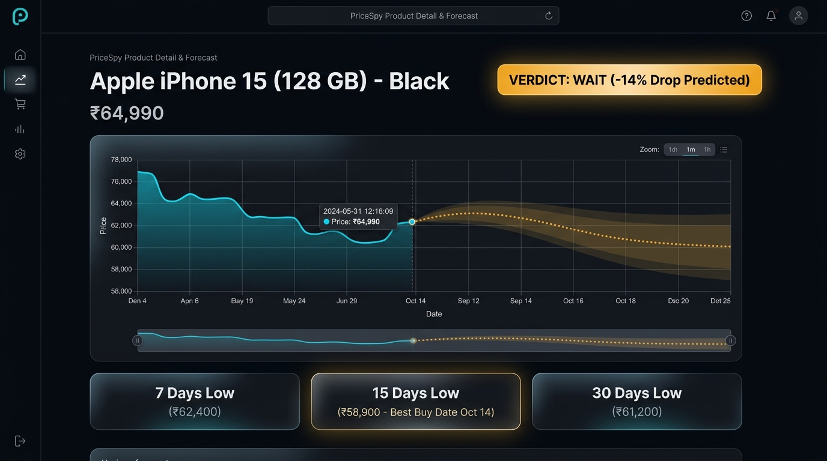
USER INTERFACE WALKTHROUGH
30-Day Forecast & Interactive Decision View
Recharts dual-line AreaChart with confidence ribbon and algorithmic verdict banner.
PREDICTIVE INTELLIGENCE
Forecasting Screen Features
• AI Recommendation Banner: Displays unequivocal advice: 'VERDICT: WAIT (-14% Drop Predicted on Oct 12 during festival sale)'.
• Dual-Line AreaChart: Solid cyan line traces 90-day history; glowing dashed line illustrates 30-day Prophet forecast.
• Shaded Uncertainty Ribbon: Empirical confidence intervals show upper & lower projected bounds.
• Multi-Horizon Cards: Explicit metrics for 7-day, 15-day, and 30-day horizon low points.
• Target Price Alert Creator: Users can set a target budget to receive automated email notifications when reached.

Slide 12
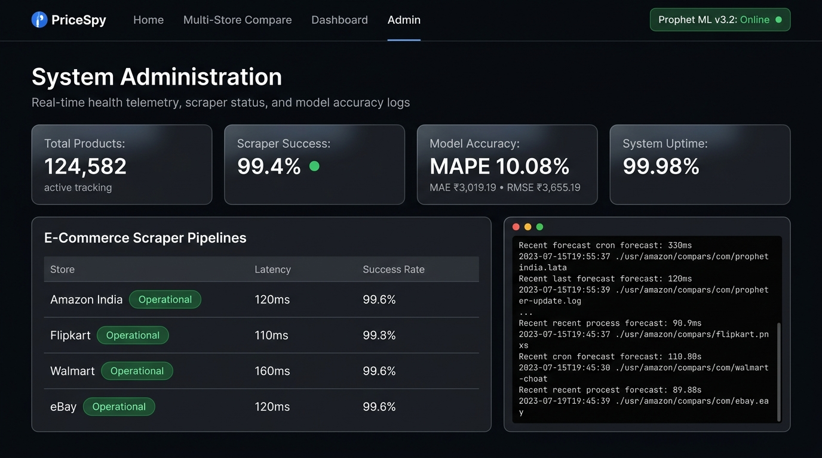
USER INTERFACE WALKTHROUGH
System Administration & Scraper Telemetry
Comprehensive backend health dashboard, scraper latency monitoring, and audit logs.
SYSTEM OBSERVABILITY
Admin Telemetry HUD
• System Vitals Bar: Tracks 124,582 monitored products, 99.4% scraper success rate, and 99.98% operational uptime.
• ML Error HUD: Real-time display of active model accuracy metrics (MAPE: 10.08%, MAE: ₹3,019.19, RMSE: ₹3,655.19).
• Scraper Pipeline Health: Monitors individual response latencies for Amazon, Flipkart, Walmart, and eBay (110ms-160ms average).
• Live Event Log Stream: Real-time terminal console logging 24h cron forecast runs, database write commits, and alert notifications.

Slide 13
PROJECT ROADMAP
Future Scope & Technical Scalability
Architectural roadmap to scale PriceSpy into an enterprise retail intelligence platform.
OMNICHANNEL ALERTS
WhatsApp & Telegram Bots
• Integrate Twilio / Telegram Bot API for instant push notifications directly to smartphone messengers.
• Eliminates dependency on email delivery for flash sales lasting under 30 minutes.
BROWSER INTEGRATION
Chrome Browser Extension
• Manifest V3 extension injecting live PriceSpy badges directly into Amazon and Flipkart product pages.
• Displays real-time 'BUY NOW' or 'WAIT' badges without opening a separate tab.
DEEP LEARNING ENSEMBLE
LSTM / Transformer Hybrid
• Hybrid Prophet + LSTM / PatchTST deep neural network architecture.
• Captures short-term micro-fluctuations and sentiment analysis from Twitter/Reddit deal forums.
CLOUD DISTRIBUTED SCALE
Celery & PostgreSQL
• Migrate from SQLite WAL to distributed PostgreSQL with TimescaleDB time-series extensions.
• Asynchronous Celery worker queues with Redis broker for million-item catalog batch retraining.

Slide 14
PROJECT DEFENSE CONCLUSION
Thank You!
PriceSpy: Leveling the E-Commerce Playing Field with Predictive Machine Learning
✅ 89.92% Verified Model Accuracy (84.1% MAE Reduction) • ✅ 4-Store Simultaneous Arbitrage • ✅ 24/7 Autonomous Watchdog
Anticipated Viva Defense Questions Prepared:
1. Why Prophet over ARIMA/LSTM? (Prophet explicitly models festival calendar shocks without overfitting)
2. How do you handle anti-scraping? (Rotating User-Agents, session exponential backoffs, 3-tier fallback)
3. How is negative price prevented? (Proportional boundary floor clipping at 40% of baseline price)
We invite questions, feedback, and are prepared for the live demonstration.

