Slide 1

Object Recognition using CNN
DS - 303 Project
Satwik Murarka (190020101)
Abhi Manjunath Dasari (190020036)
Mihir Nandawat (190020071)

Slide 2
Honour Code
We declare that the contents of this project are not copied to the best of our knowledge and we have not indulged in any academic malpractice
Satwik Murarka (190020101)
Abhi Manjunath Dasari (190020036)
Mihir Nandawat (190020071)

Slide 3
Overview & Problem Definition
Object Detection is an important aspect of Computer Vision. It has a lot of important applications in real life ranging from autonomous vehicles, aerial surveillance to snapchat filters.
Given a set of images with multiple classes build and train an algorithm to solve the multi-class classification problem with decent accuracy.

Slide 4
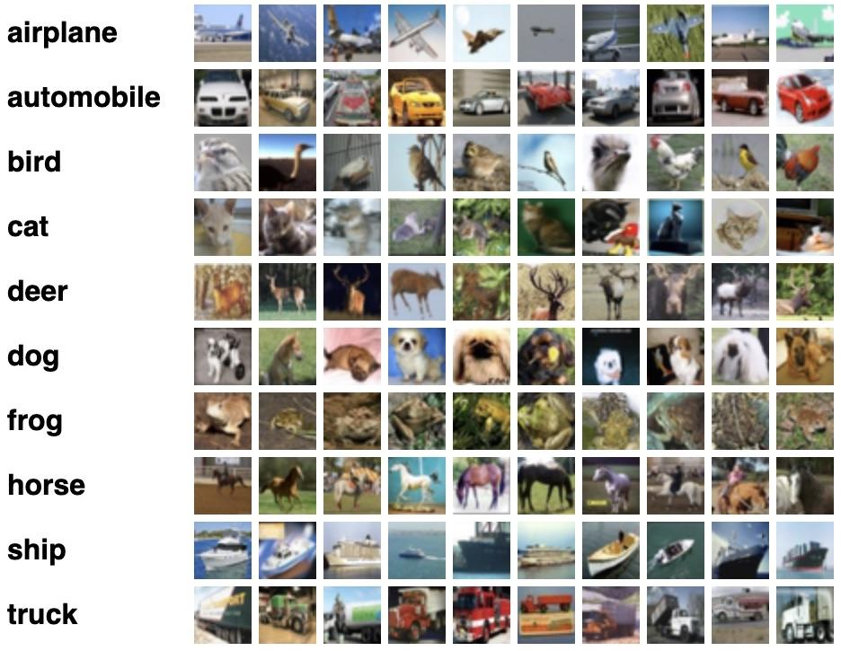
Data
We used CIFAR-10 dataset which consists of 50k labelled images with 10 classes such as airplane, bird etc. along with 10k unlabelled images.
The colored images are of size 32*32 pixels.

Slide 5

Solution
Traditional ANNs cannot be implemented since vectorization of pixels leads to loss of important spatial information of their arrangement. It would have excess of weights and biases which would make it computationally intensive.
So, we used CNN to solve this issue. It is better in the following aspects :-
UnSupervised Feature Detection
Pooling which downscales the image with minimal information loss
Supports parallelization
All of these advantages makes it an excellent choice for this problem.

Slide 6


Method with Mathematical Details
Feature Extraction using Convolution
Filter is a set of weights which are used to extract local features. We use multiple filters to extract different features from an image.
Example: We use Vertical Edge filter (VEF) and Horizontal Edge Filter (HEF) to get the edges of an object. Where, VEF and HEF are matrices as shown in the below image.

Slide 7
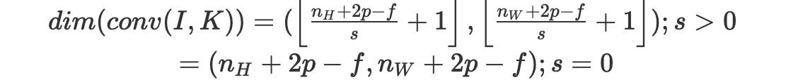
Convolution
Let the dimensions of the image I be (n_{H} , n_{W} , n_{C}) where, n_{H} is the size of the height, n_{W} is the size of width, n_{C} is the size of the channels, which is 3 for a RGB image.
Let the dimensions of the filter K be (f, f , n_{C}) where, f is the dimension of filter K and it is considered to have an odd dimension, n_{C} is the size of the channels.
The convolutional product between the image and the filter is a 2D Matrix where each element of the output matrix is the sum of the element wise multiplication of the cube (filter) and the sub cube of the given image. The top and bottom images shown below are the mathematical equations for convolutional product and dimensions of the output matrix respectively

Slide 8
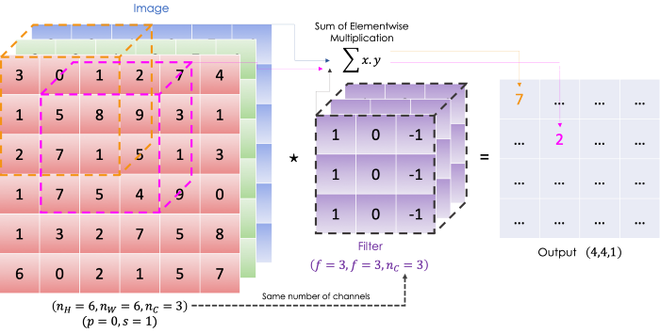
The below image shows an illustration of Convolution Product of an Image and Filter

Slide 9
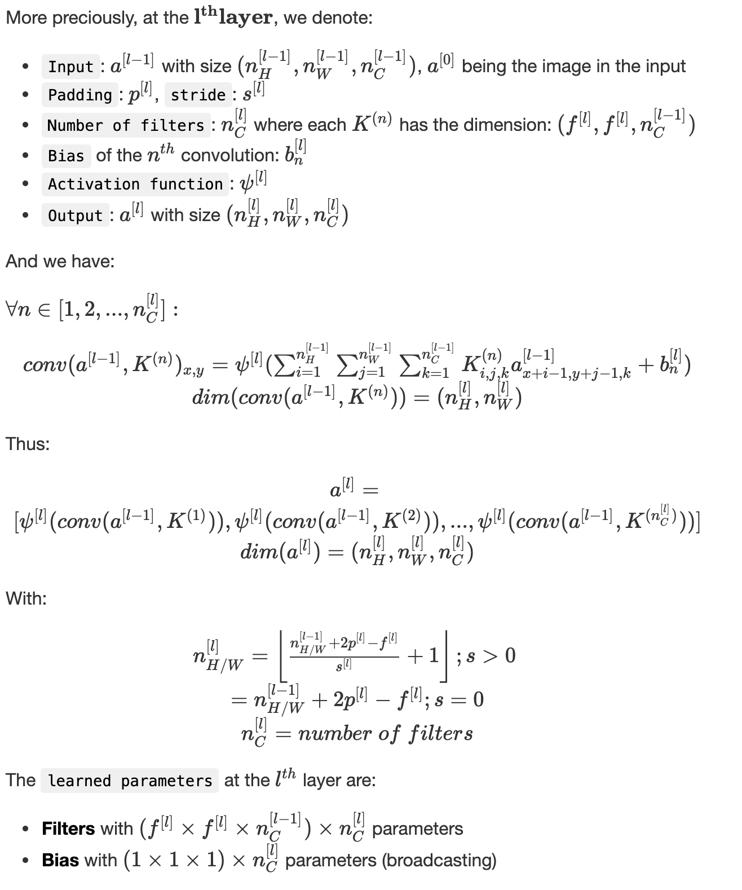
Convolutional Layer
We apply convolutional products on
the input using many filters, followed
by an activation function (represented
by ψ). In this project we used the
Rectified Linear Unit (ReLU) as the
Activation function. The Mathematical
equations for the convolutional product
and other things at l^{th} layer are shown
in the image here

Slide 10
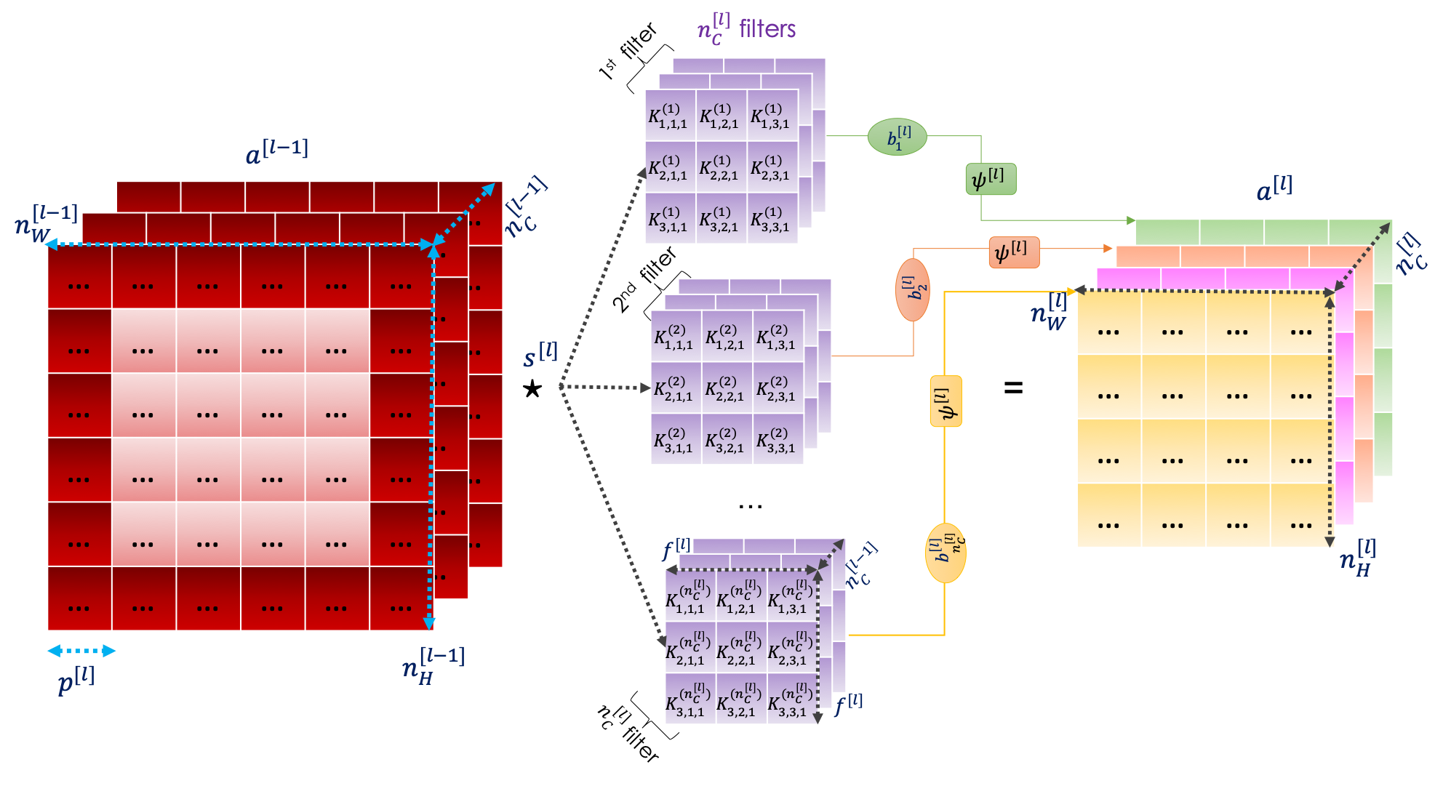
The below image shows an illustration of a Convolution layer

Slide 11
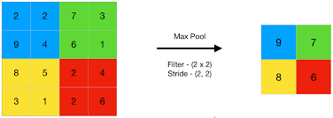
Pooling
The stride is the step taken in the convolutional product. A smaller stride allows to expand the size of the output and vice versa. Stride parameter is denoted by s.
Pooling is the step of summing up the information to downsample the image’s features. The operation affects only the dimensions and is carried out through each channel so, it doesn’t affect n_{C}.Given an image, we slide a filter, with no parameters to learn, following a certain stride, and we apply a function on the selected elements.In convention, we usually set f=2 and consider s=2.
In this project we used Max pooling, in which, maximum value is returned, among all the elements in the filter. The below image is an illustration of Max Pooling.

Slide 12
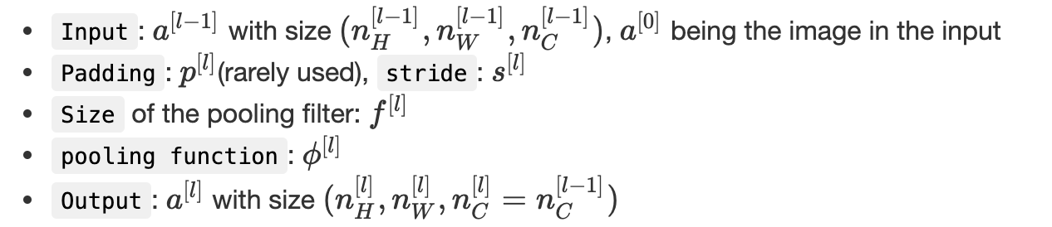
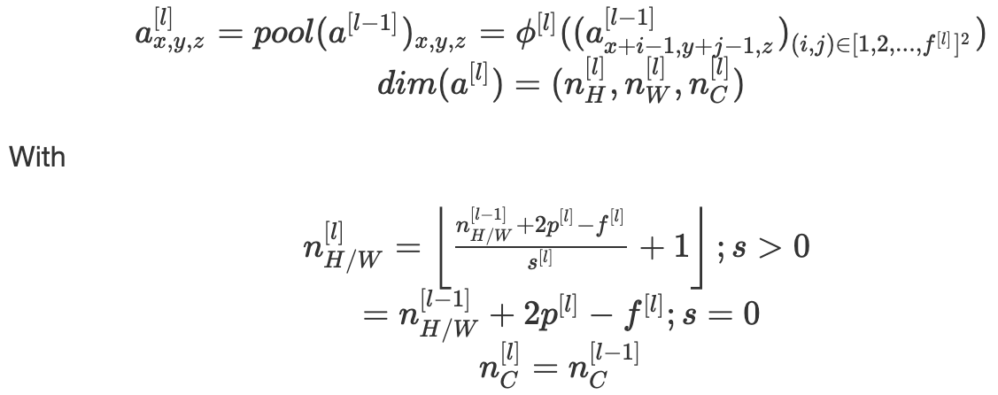
Notations and Mathematical equations used in pooling at l^{th} layer are shown in the below image

Slide 13
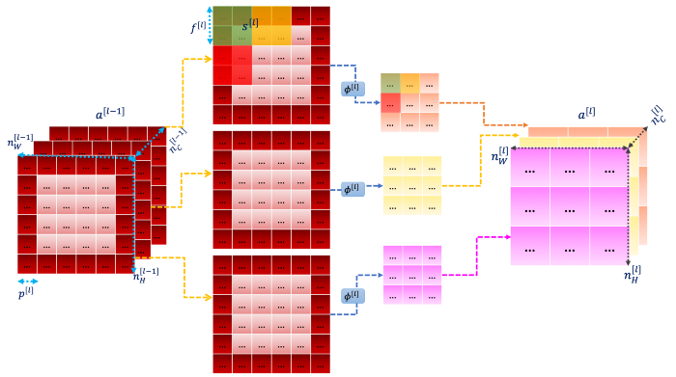
The below image shows an illustration of a Pooling Layer

Slide 14
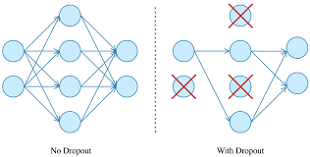
DropOut Layer
During training, some number of layer outputs are randomly ignored or “dropped out.” Dropout is used to prevent a model from overfitting. Dropout works by randomly setting the outgoing edges of hidden units (neurons that make up hidden layers) to 0 at each update of the training phase.

Slide 15
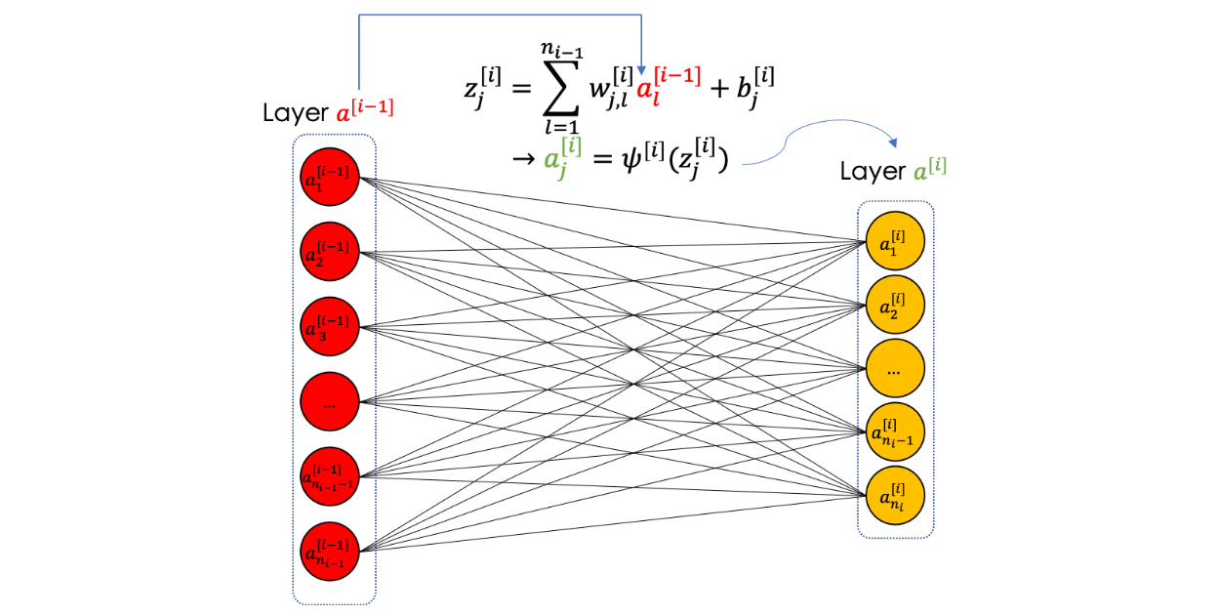
Fully Connected Layer
A fully connected layer is a finite number of neurons which takes a vector as an input and returns another one. The below image is an illustration of a Fully Connected Layer

Slide 16
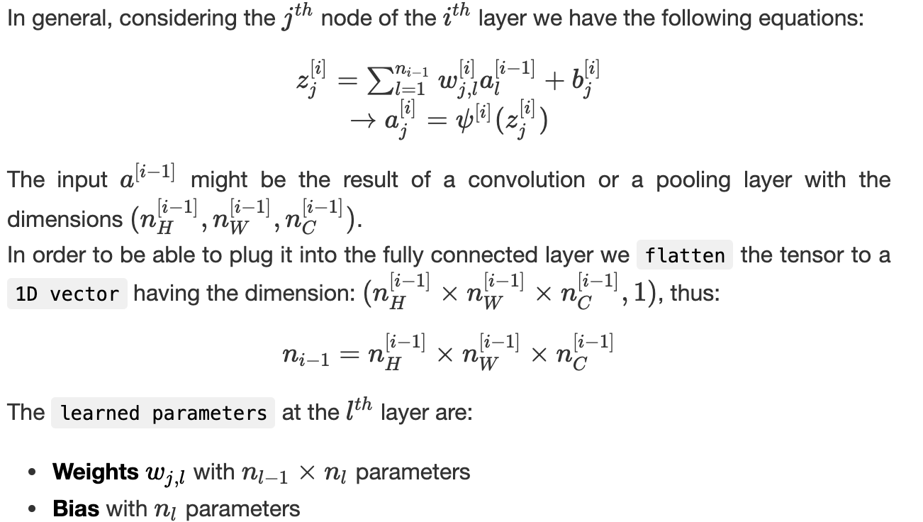
The below image shows the notations and mathematical equations used in a Fully Connected Layer

Slide 17
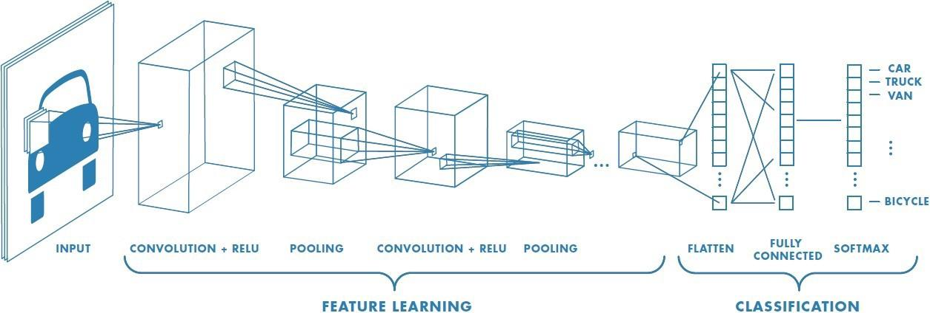
Implementation
Used Keras to build and train model
Implemented traditional ANN first with 2 hidden, 1 input and 1 output layer. It consisted of 2500 nodes and used ReLU in hidden layers. Output layer had Sigmoid as its activation function.
Implemented CNN next with Convolution, Max Pooling and Dropout layers with 32, 64,128 feature maps. It was followed by flattening of input and a fully connected network with 2 hidden layers of 128 and 256 nodes along with ReLU as its activation function.

Slide 18

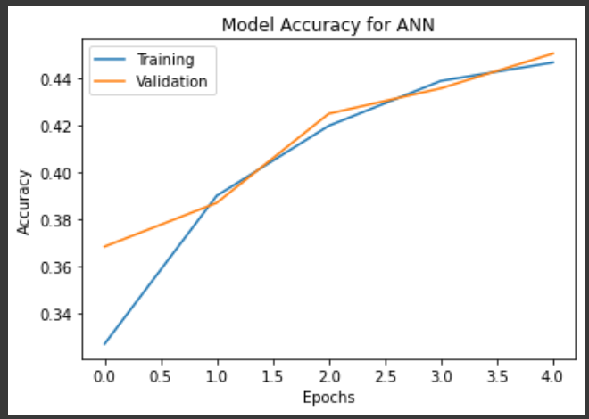
Analysis & Results (1)
For ANN :-
We achieved 45.06% at the end of 5 epochs
The plot for accuracy on the training and validation set with the number of epochs is -

Slide 19
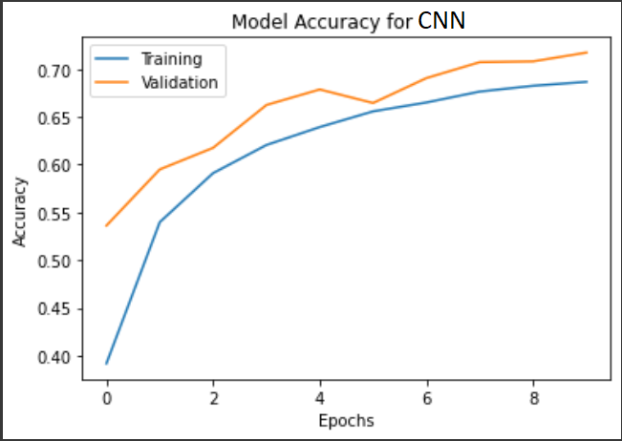
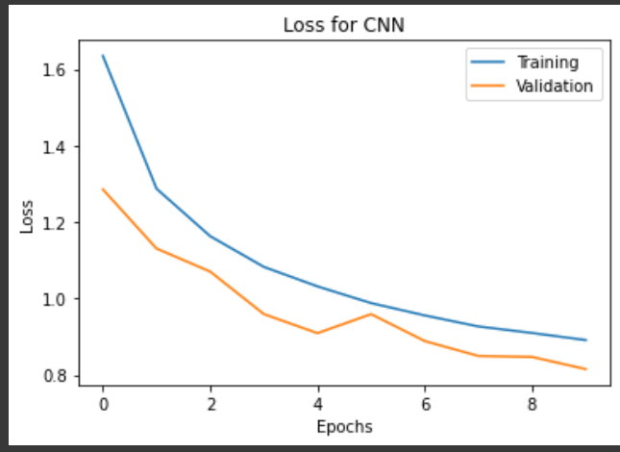
Analysis & Results (2)
For CNN :-
We achieved 71.74% accuracy at the end of 10 epochs
The plot for Accuracy vs Epochs and Loss vs Epochs for CNN are as follows:- :-

Slide 20
Conclusion
Even at 5 epochs CNN outperformed ANN by almost 20% accuracy. Which brings us to the conclusion that CNN is much better than ANN for object identification task and we achieved an accuracy of 71.74% using CNNs.
Contributions of each member
Satwik Murarka - Coded the algorithms, researched ideas, reviewed the ppt
Abhi Manjunath - Prepared the presentation, reviewed the code, researched ideas
Mihir Nandawat - Prepared the presentation, reviewed the code, researched ideas

Slide 21

References-
https://media.geeksforgeeks.org/wp-content/uploads/20190721025744/Screenshot-2019-07-21-at-2.57.13-AM.png
https://towardsdatascience.com/convolutional-neural-networks-mathematics-1beb3e6447c0
http://introtodeeplearning.com/slides/6S191_MIT_DeepLearning_L3.pdf
https://machinelearningmastery.com/dropout-for-regularizing-deep-neural-networks/
https://youtu.be/iaSUYvmCekI

