Slide 1

APPLIED MACHINE LEARNING AND PYTHON IN FINANCE
Team AMD : Final Presentation
Satwik Kashyap Kashyap.sa@husky.neu.edu | Muhammad Rehman Kashyap.sa@husky.neu.edu | Prachi Patel Kashyap.sa@husky.neu.edu | Apurva Kashyap.sa@husky.neu.edu | Nikhil Mirchandani Kashyap.sa@husky.neu.edu

Slide 2
BACKGROUND

Slide 3

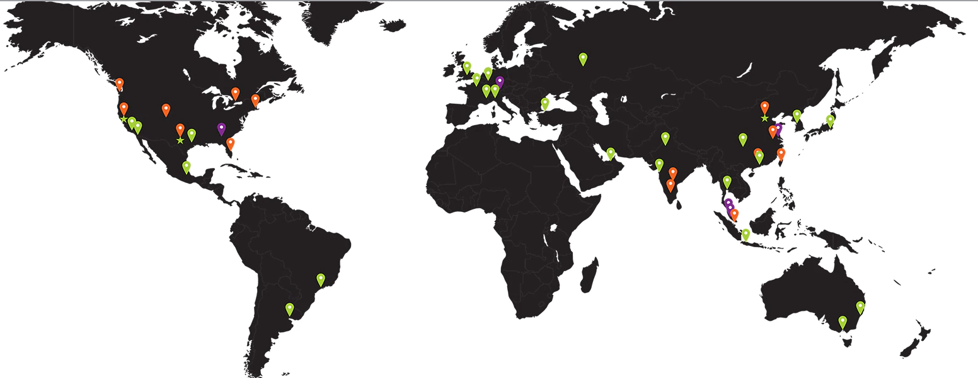
OVERVIEW OF THE COMPANY
Founded in 1969 as a Silicon Valley start-up
Provides leading-edge semiconductor products
AMD has grown into a global company of 10,000 people
Competition with NVIDIA and INTEL

Slide 4
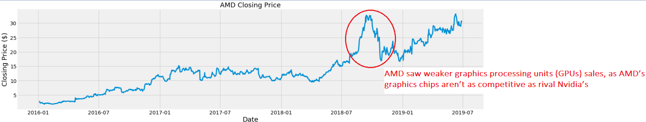
Current closing Price
All time low
All time high
Average Price in last 52 weeks
Highest Volume Traded

Slide 5
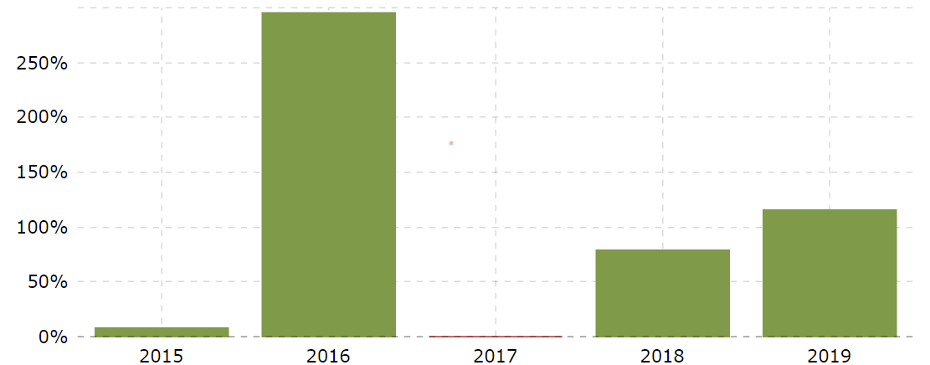
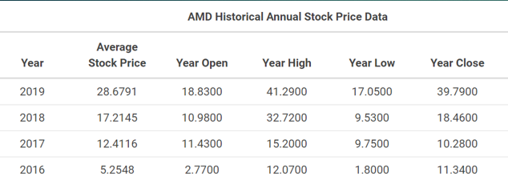
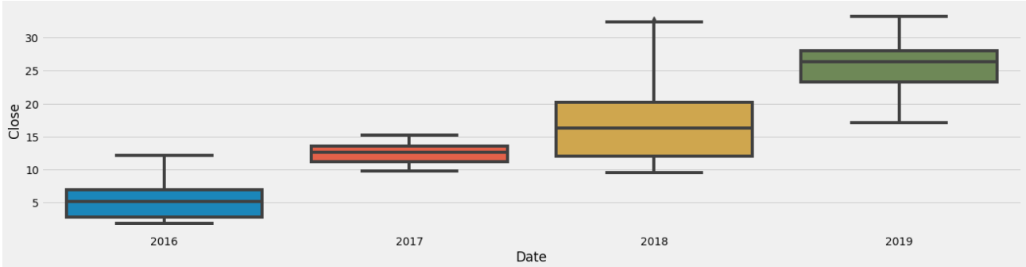
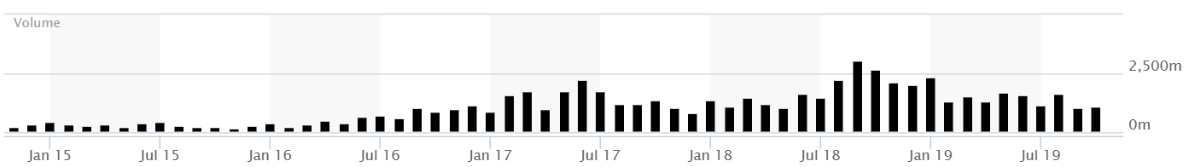

Slide 6
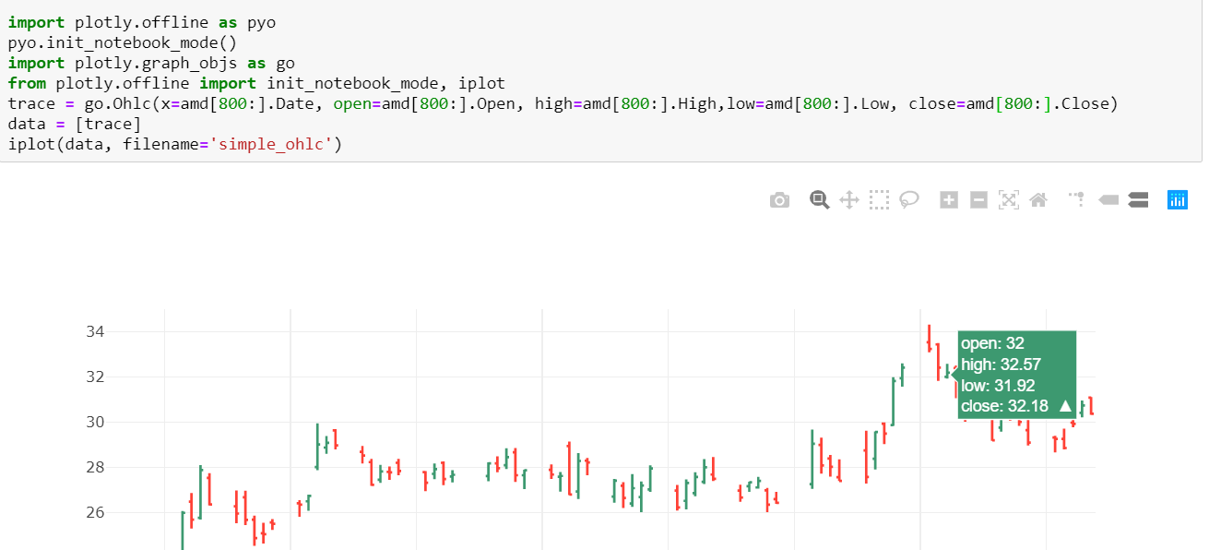
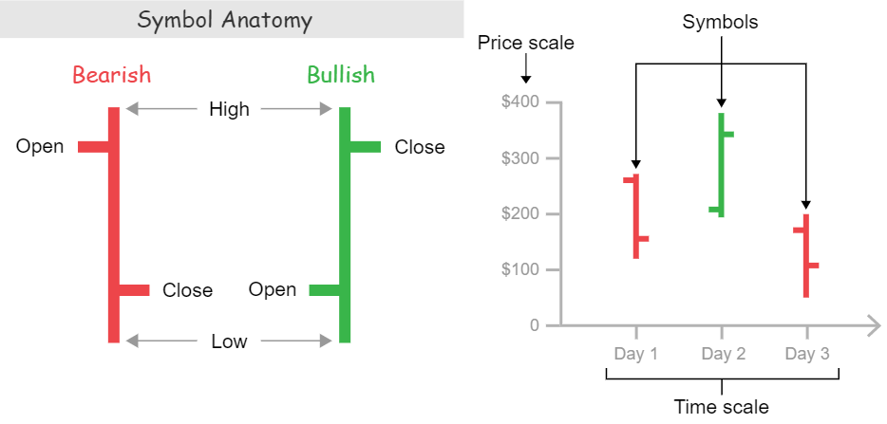
OHLC Chart

Slide 7
STATISTICAL
ANALYSIS

Slide 8
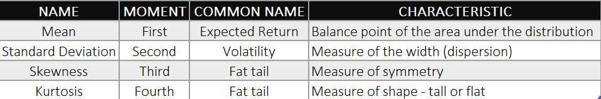
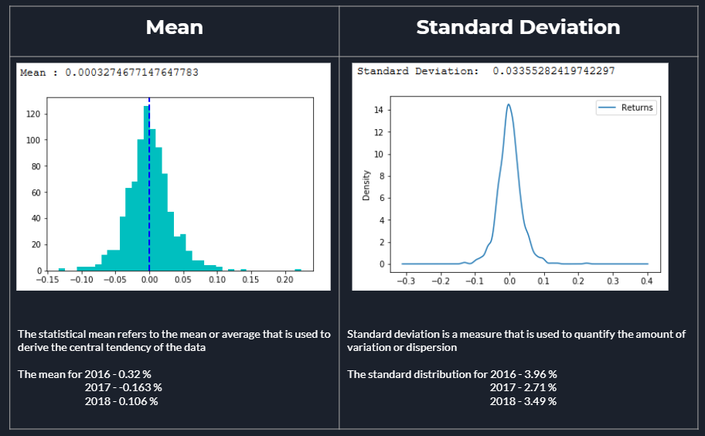
Moments

Slide 9
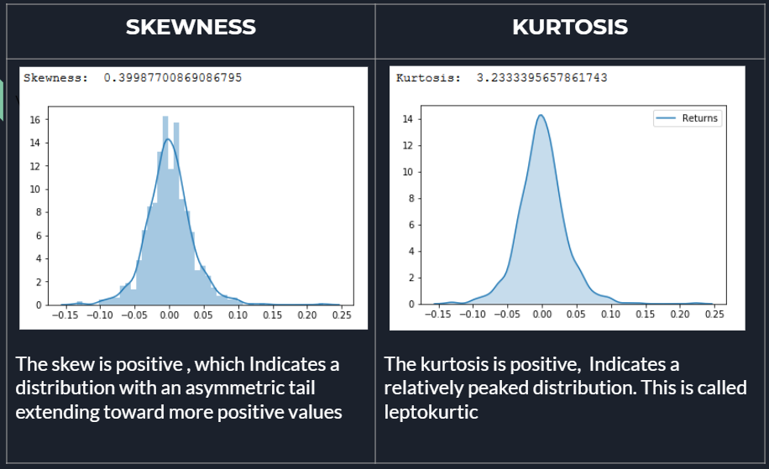

Slide 10
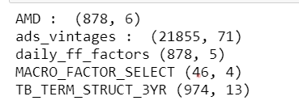
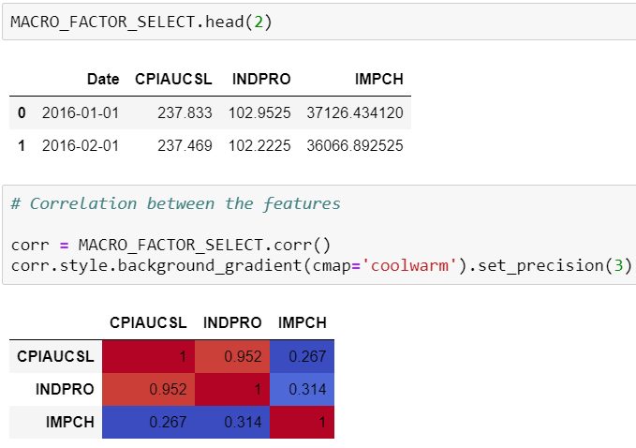
DATASETS :
AMD
ADS Index
Daily Fama French Factor
Macro Factors
Term Structure of the Interest Rate
Macro Factor

Slide 11
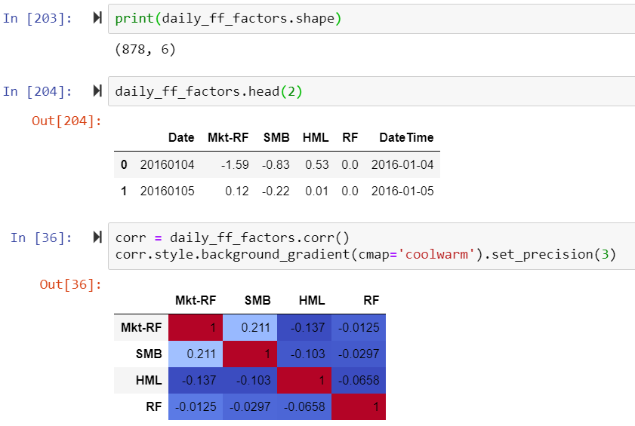
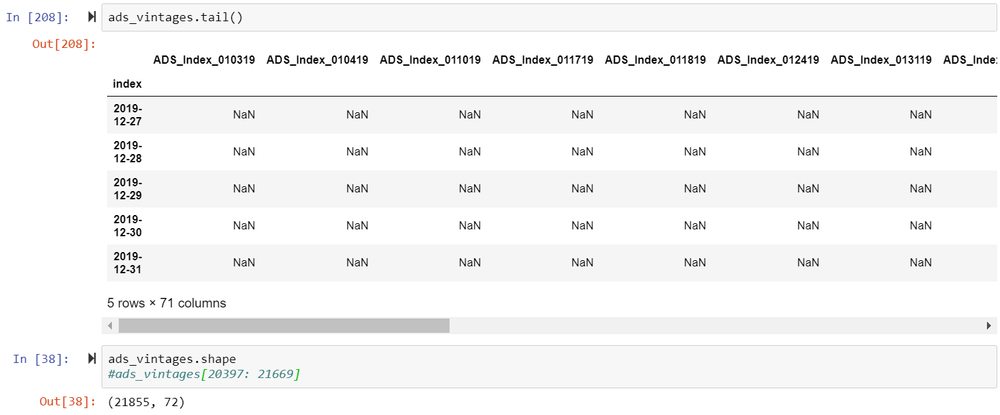
Daily Fama French Factors
Term Structure

Slide 12
MODELS

Slide 13
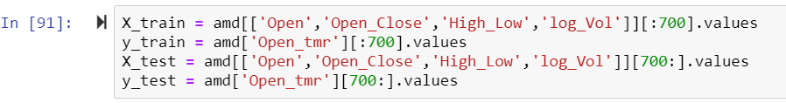
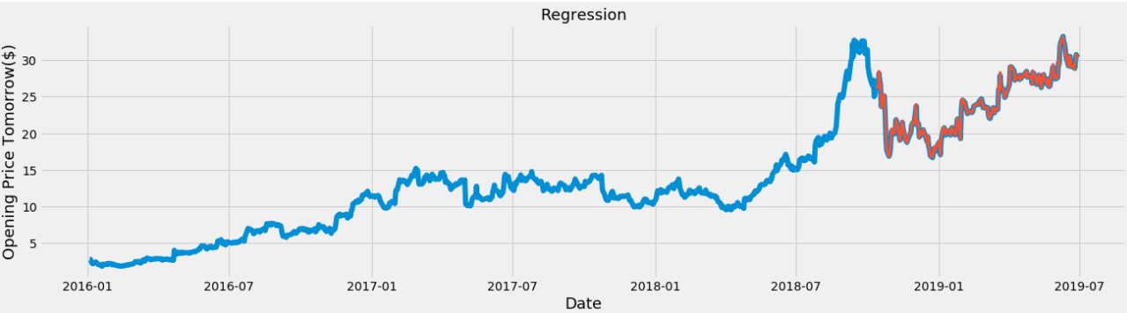
Regression
Yt+1= Yt + [Open-Close]t + [High-Low]t +log_volume(t)

Slide 14
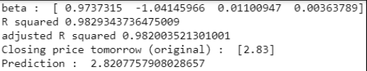

Slide 15
ARIMA

Slide 16
Kaman Filter

Slide 17
Fama French

Slide 18



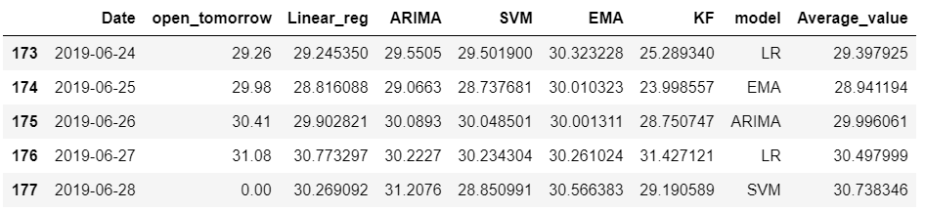

Model Selection
Model selection is the task of selecting a statistical model from a set of candidate models
There are 6 Candidate Model shortlisted.
Our Approach:
Calculate the difference between all the candidate model prediction and the original ‘Open tomorrow’
List out the model with the least difference
Choose two models with the best prediction and take the average

Slide 19
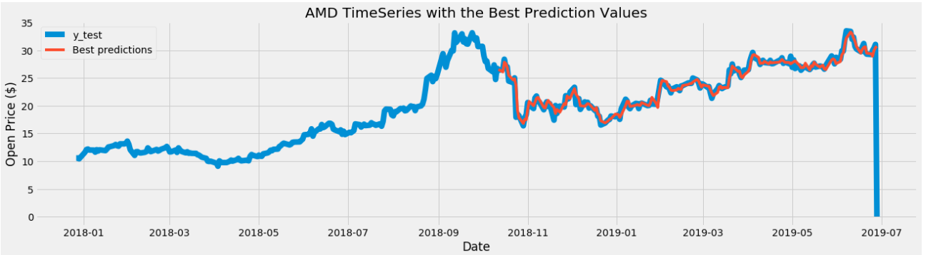

Slide 20
TRADING STRATERGY

