Slide 1

APPLIED MACHINE LEARNING AND PYTHON IN FINANCE
Team AMD : Final Presentation
Satwik Kashyap Kashyap.sa@husky.neu.edu | Muhammad Rehman rehman.mu@husky.neu.edu | Prachi Patel Kashyap.sa@husky.neu.edu | Apurva Kashyap.sa@husky.neu.edu | Nikhil Mirchandani Kashyap.sa@husky.neu.edu

Slide 2
BACKGROUND

Slide 3

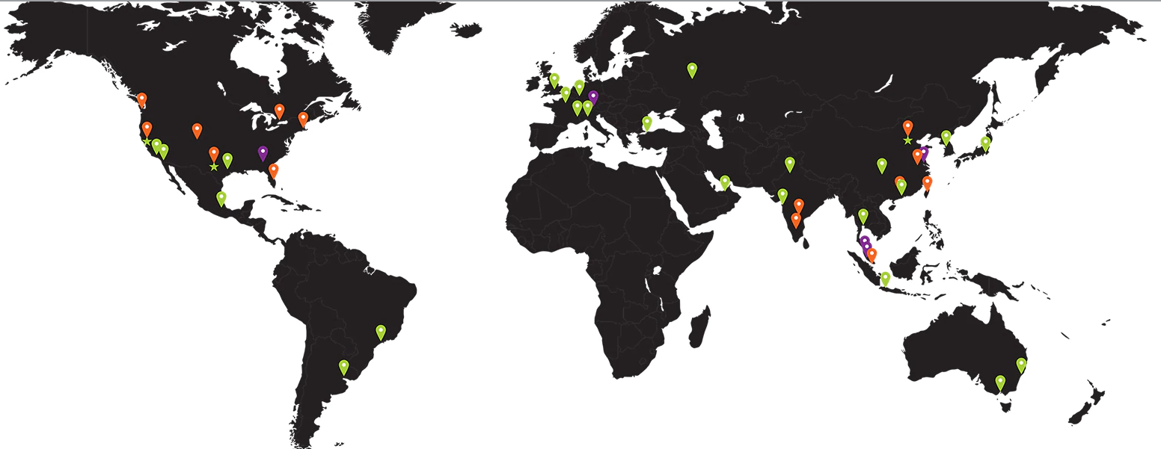
OVERVIEW OF THE COMPANY
Founded in 1969 as a Silicon Valley start-up
Provides leading-edge semiconductor products
AMD has grown into a global company of 10,000 people
Competition with NVIDIA and INTEL

Slide 4
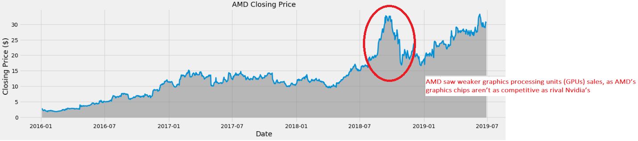
Current closing Price
30.370
All time low
1.75
All time high
34.30
Average Price in last 52 weeks
20.231
Highest Volume Traded
325058400
( 2018-08-27 ) due to 7nanometer chip launch

Slide 5
STATISTICAL
ANALYSIS

Slide 6

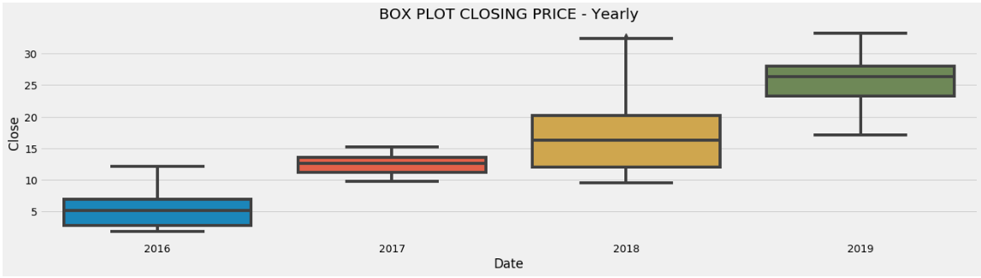


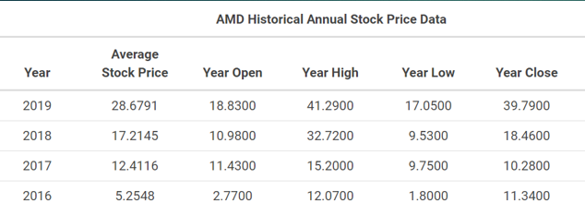

BOX PLOT – Closing Price

Slide 7
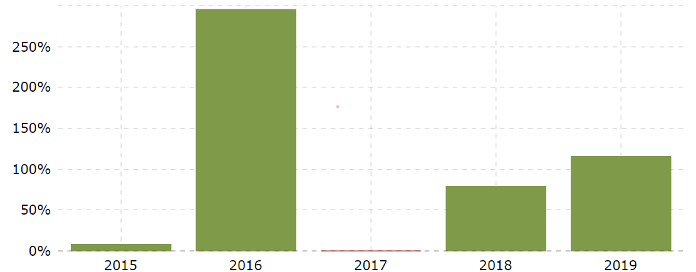
Yearly Return %

Slide 8
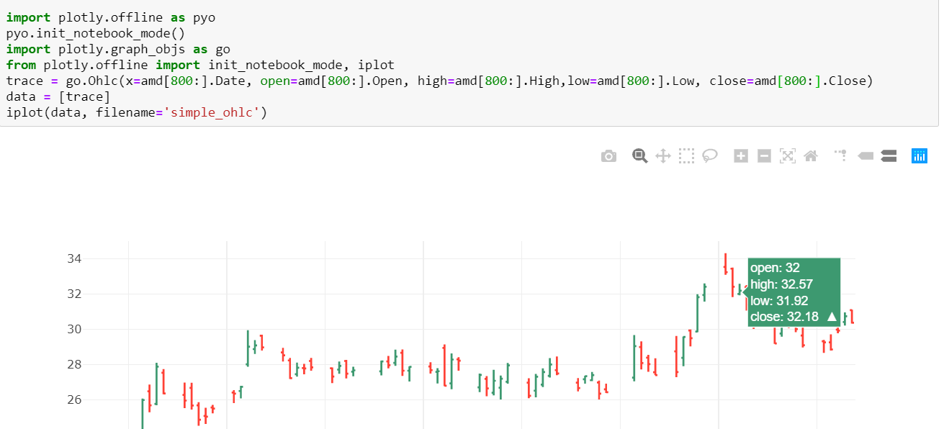
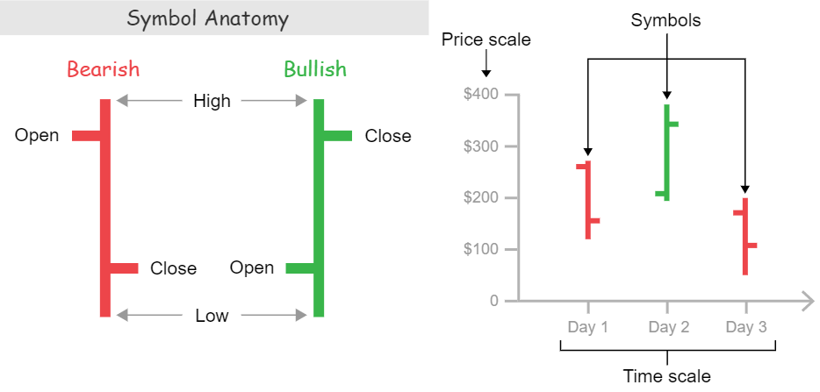
OHLC Chart

Slide 9
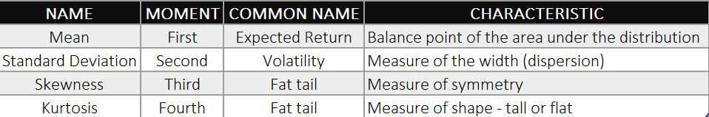
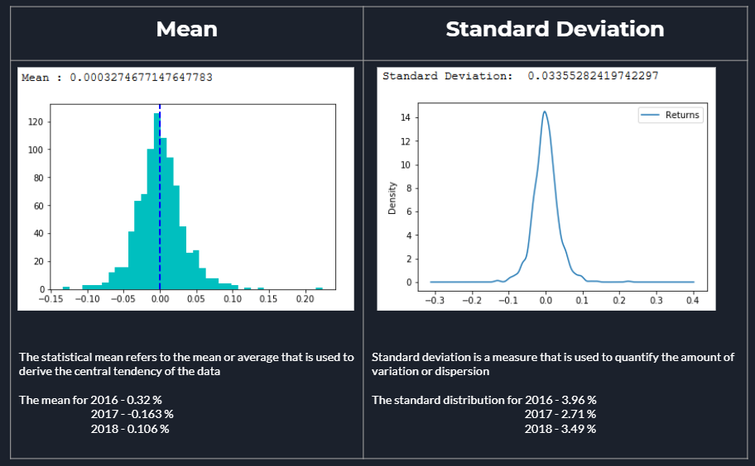
Moments

Slide 10
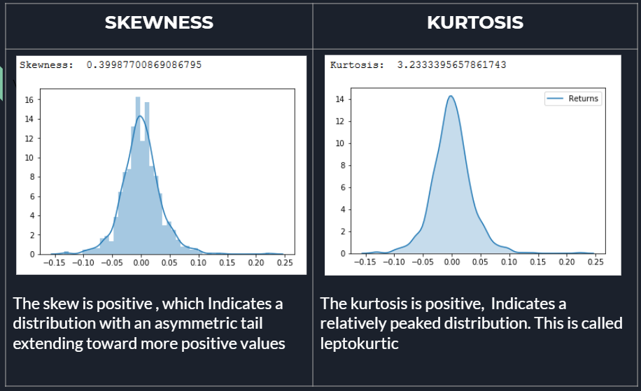

Slide 11
MODELS

Slide 12
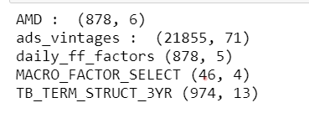
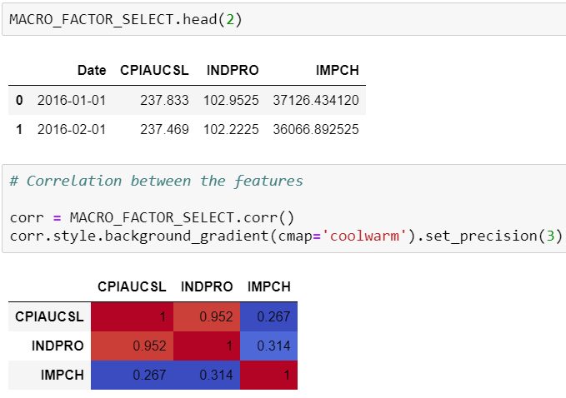
DATASETS :
AMD
ADS Index
Daily Fama French Factor
Macro Factors
Term Structure of the Interest Rate
Macro Factor

Slide 13
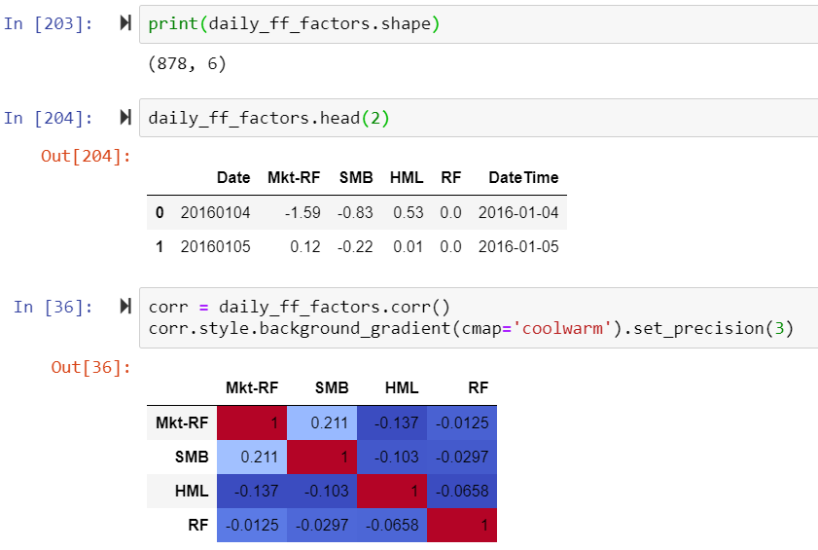
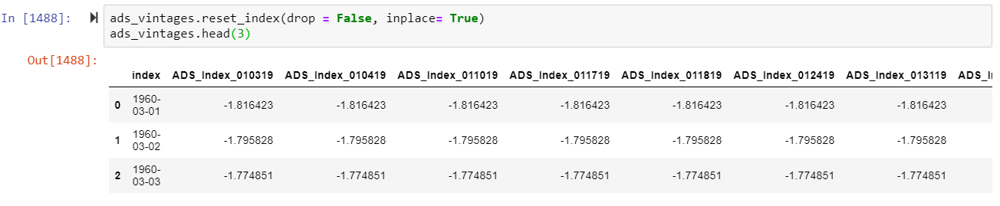
Daily Fama French Factors
ADS INDEX

Slide 14
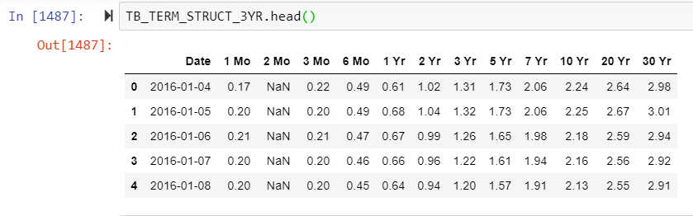
Term Structure
Sample Periods:
In-sample Data :
Contains 3 year of data, 700 data points
Jan 2016 – Dec 2018
Out-sample Data:
Contains 6 months of data, 178 data points
Jan 2019 – June 2019

Slide 15
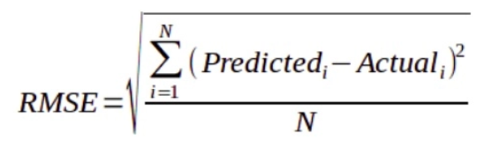
EVALUATION MATRIX

Slide 16
Data from Multiple Sources
DESIGN WORKFLOW
Candidate Model
Model Evaluation
Trading STratergy

Slide 17
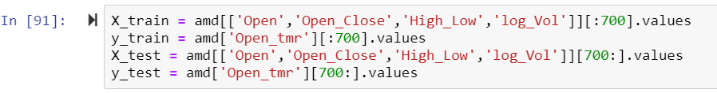
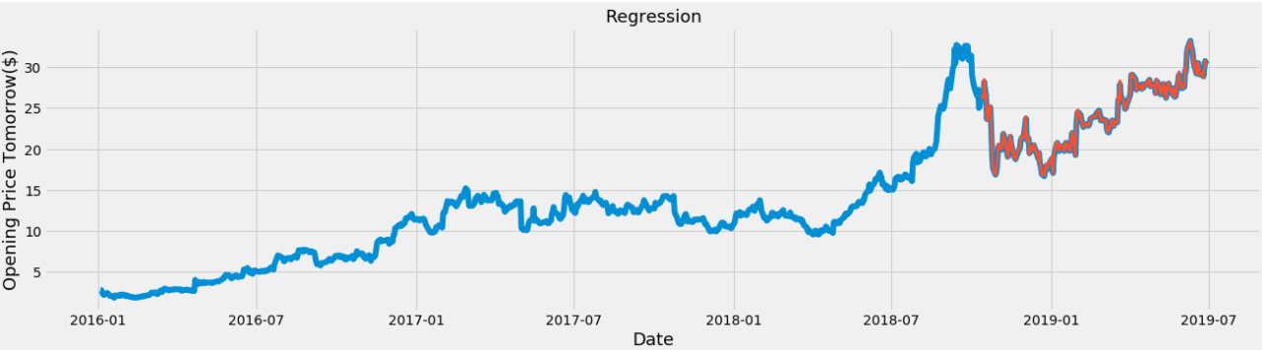
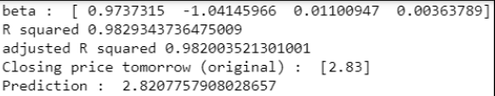
Multivariate Linear Regression
Yt+1= Yt + [Open-Close]t + [High-Low]t +log_volume(t)

Slide 18
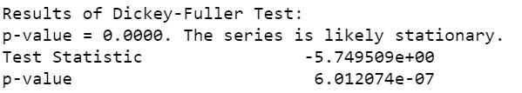
ARIMA
3 parameters: (p,d,q)
P = Number of lagged observations
D = The degree of differencing
Q = The size of the moving average window
Auto-Regressive timeseries model
$$x\left(t\right)=α∗x\left(t−1\right)+ε(t)$$
Moving-Average timeseries model
$x\left(t\right)=β∗x\left(t−1\right)+ε(t)$
RMSE: 1.031
1
Visualize the time series
2
Stationarize the series
3
Plot ACF/PACF charts and find optimal parameters
4
5
Build the ARIMA model
Make predictions

Slide 19
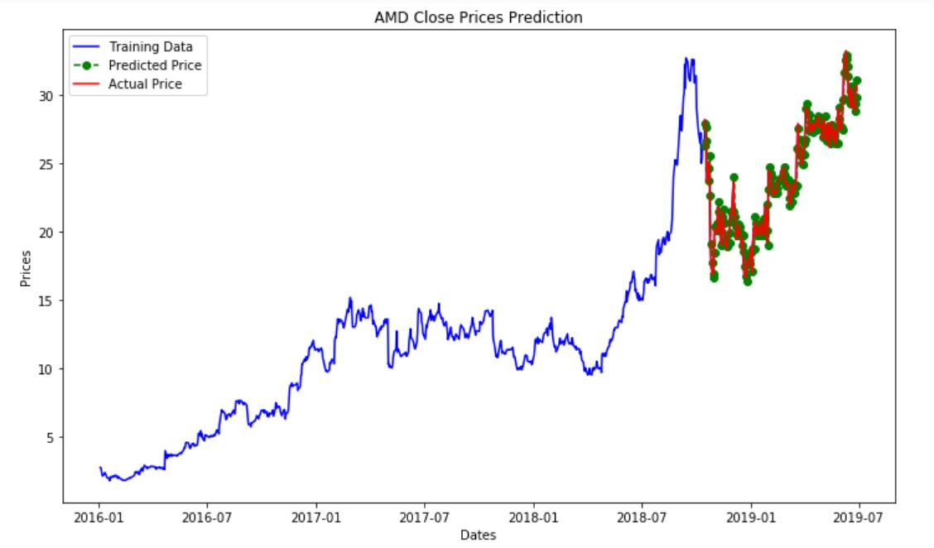
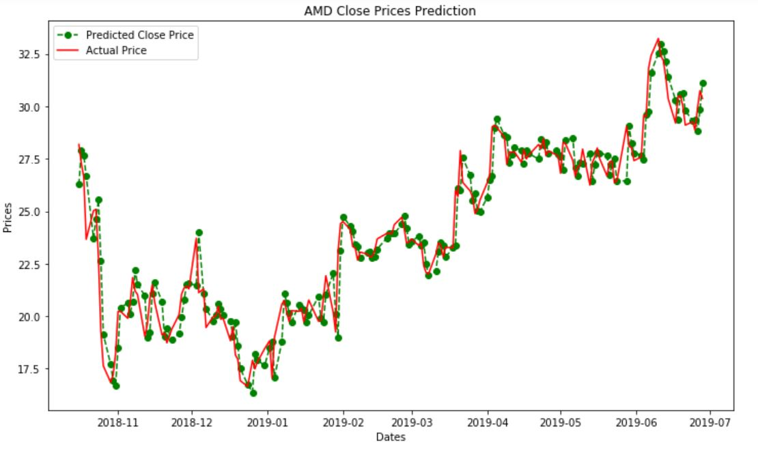
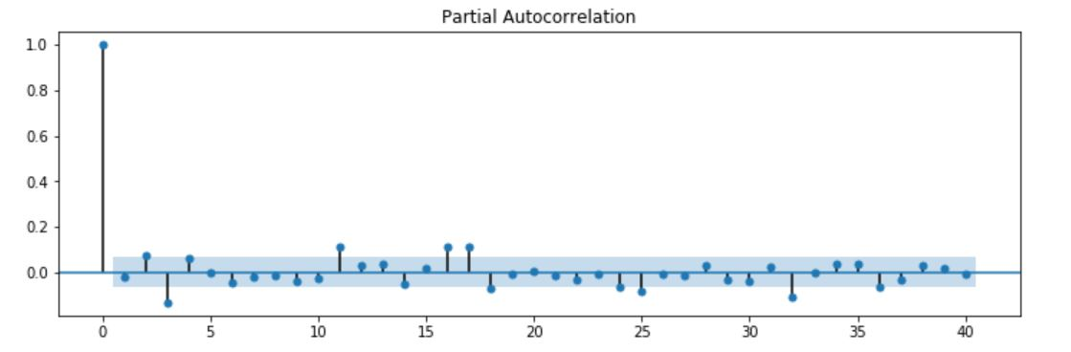
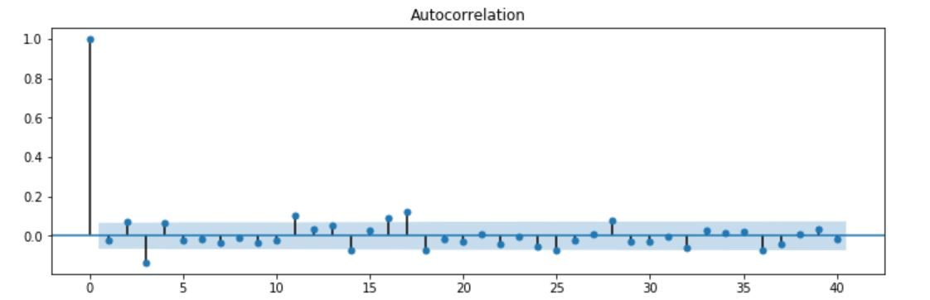

Slide 20
Kaman Filter

Slide 21
Fama French

Slide 22
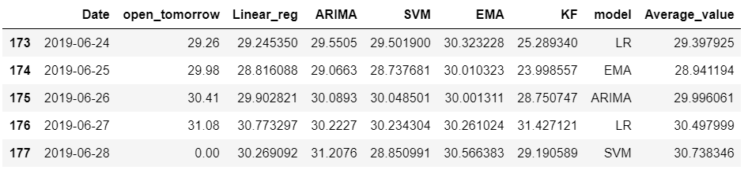
Model Selection
Model selection is the task of selecting a statistical model from a set of candidate models
There are 6 Candidate Model shortlisted.
Approach 1:
Calculate the difference between all the candidate model prediction and the original ‘Open tomorrow’
List out the model with the least difference
Choose two models with the best prediction and take the average

Slide 23
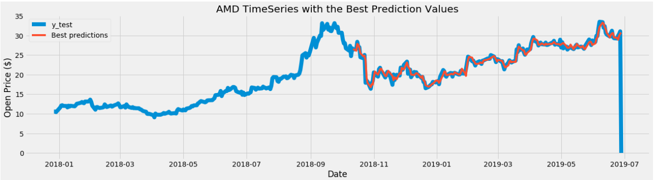

Slide 24
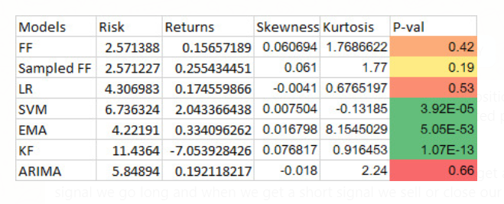
Approach 2:
Calculate the expected return and volatility of the model
Based on the t-test statistics on the generated data
Select the best model based on p-value

Slide 25
TRADING STRATERGY

Slide 26
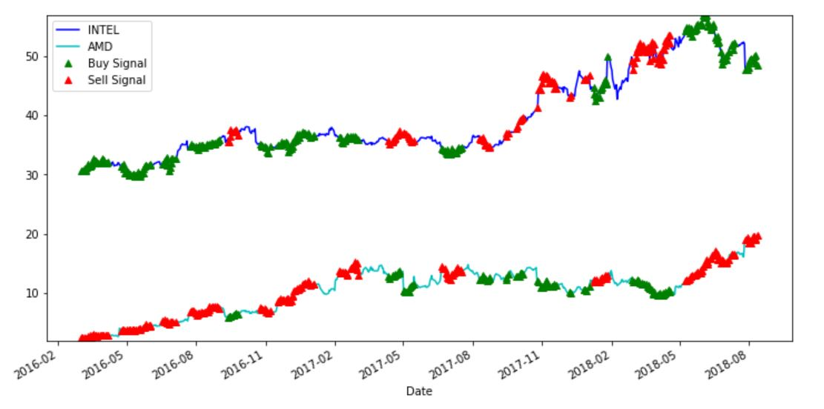
Pairs trading strategy
Market neutral strategy
Cointegration – ratio between the two series will vary around the mean
$$Y=αX+ ϵ$$
AMD VS INTEL
Simple Moving Average
Z-score: (5D MA – 40D MA)/60D MA
Z-score < 1 : buy (1)
Z-score > 1 : sell (-1)
Profit

Slide 27
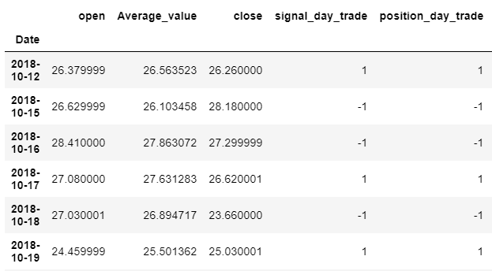
Day Trade
Day trading is the act of buying and selling a financial instrument within the same day or even multiple times over the course of a day.
Based on the predicted price we open and close the positions daily. If predicted price is higher than opening price we go long. If predicted price is lower than opening price we go short.
Money initial : 50000
Number of stocks : 500

Slide 28
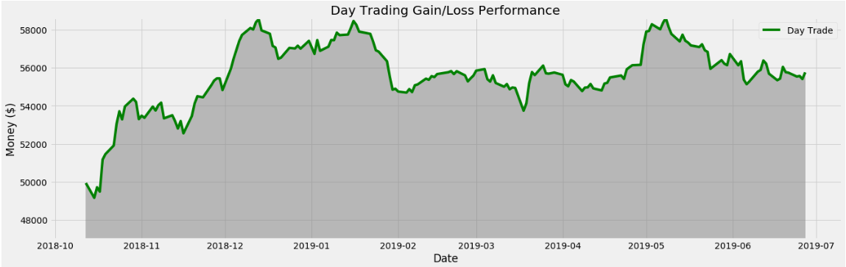
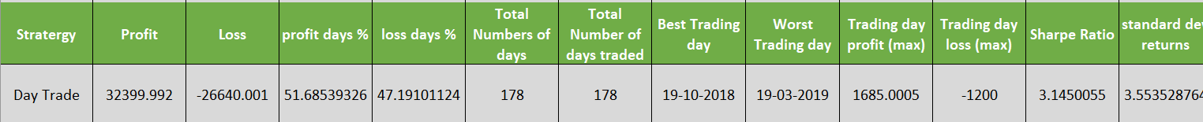
APPROACH 1
APPROACH 2

Slide 29
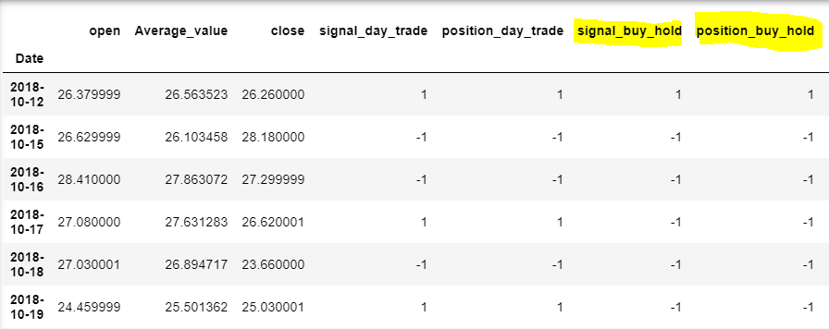
Buy & Hold
We open the position and keep holding it
Money initial : 50000
Number of stocks : 500

Slide 30
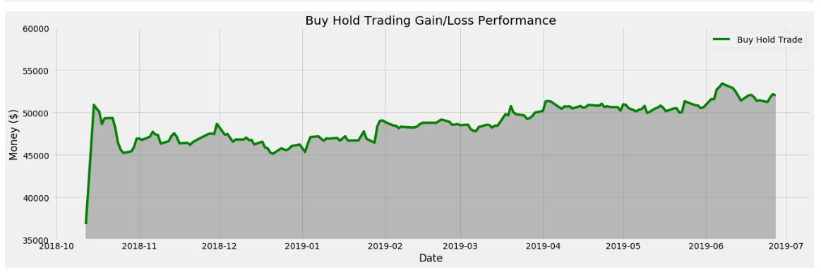
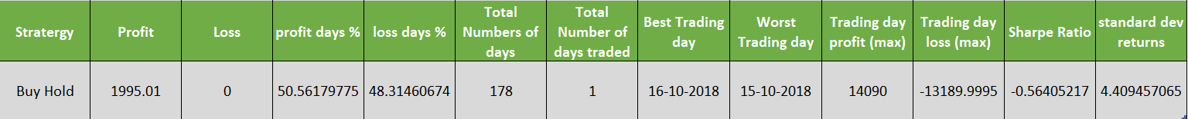
APPROACH 1
APPROACH 2

Slide 31
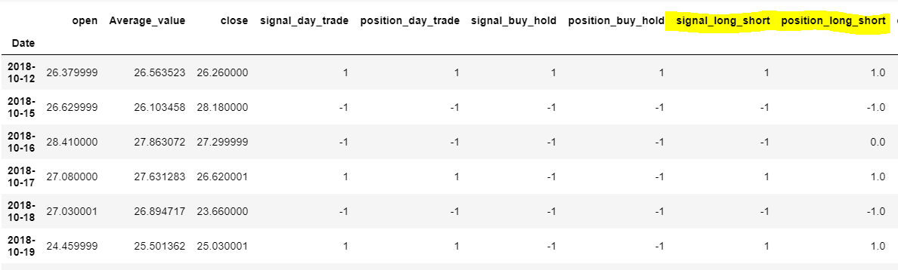
Long Short Trading Strategy
There is no pre-defined trading frequency. When we get a long signal we go long and
when we get a short signal we sell or close our position.
Money initial : 50000
Number of stocks : 500

Slide 32
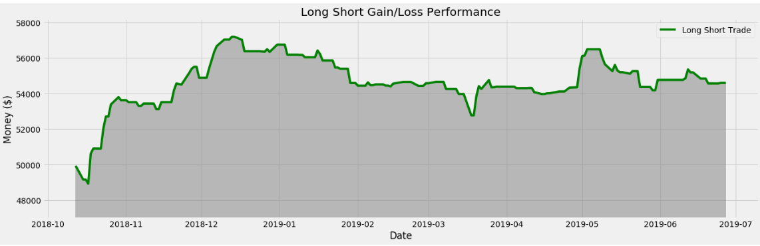
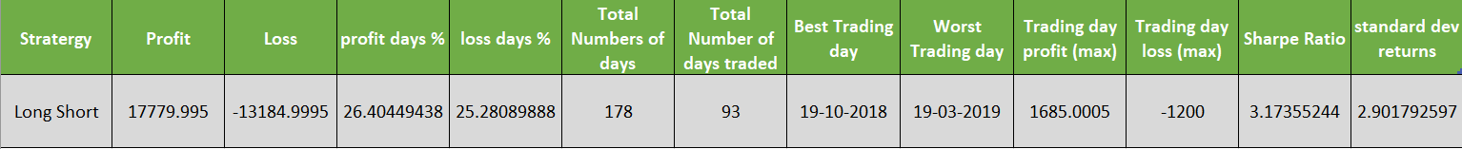
APPROACH 1
APPROACH 2

Slide 33
THANK YOU

