Slide 1

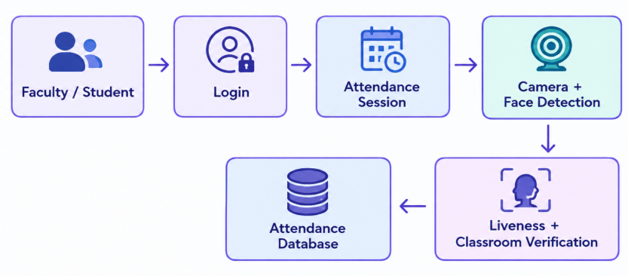
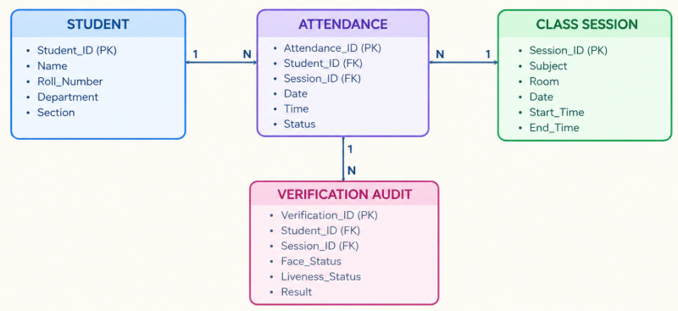
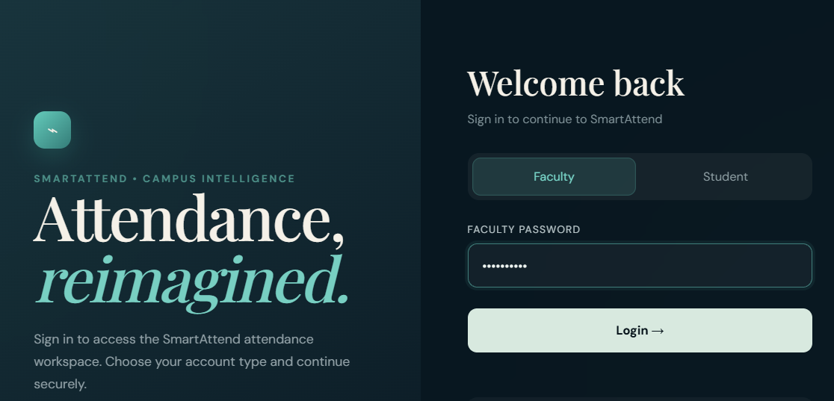
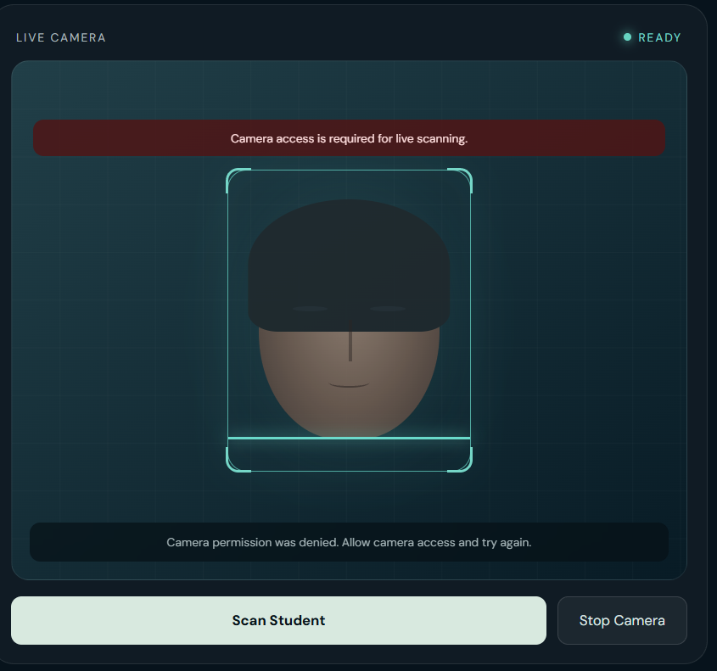
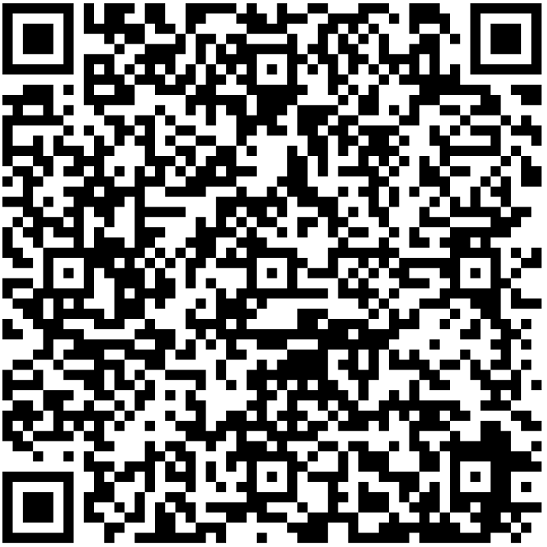
KLH Logo
SMART ATTENDANCE SYSTEM USING FACIAL RECOGNITION
Team ID: 15 | Section: [S-12] | Members: Satwika.N-2520090151, Harshitha .B-2520080007,Krishnasree-2520080009 | Guide: Dr. Khaja Shareef
Database Systems Engineering and Distributed Backend Development (25CS1302E) | KLH Bachupally Campus, AI&DS | PBL 2026-27
Abstract
Tools & Technologies
Smart attendance system for proxy-resistant attendance.
Uses face detection, liveness and session verification.
Reduces proxy attendance and manual effort.
Front-End: HTML, CSS, JavaScript
Back-End: Node.js / REST APIs
Database: MongoDB
Tools: Git & GitHub, Postman, VS Code
Others: Web camera, Face Detection
Problem Statement & Objectives
Problem: Traditional attendance is vulnerable to proxy attendance.
Objective 1: Verify student presence
Objective 2: Reduce proxy attendance
Objective 3: Prevent multiple-person attendance
Scope: Faculty, Students | Attendance, Verification | Classroom-based
System Architecture
[Insert architecture diagram: Front-End – REST API – Database]
Existing vs Proposed System
Feature | Existing System | Proposed System
Attendance | Manual | Automated
Verification | Basic | Multi-factor
Proxy | Possible | Reduced
Records | Manual | Digital
Time Control | No | Time-Locked
ER Diagram & Database Design
[Insert ER diagram with entities, keys and relationships]
Feasibility Study
Technical: Uses web, Camera, MongoDB
Economic: Low-cost , open-source technologies
Operational: Simple faculty & Student workflow
Schedule: Can be developed in modules within the project timeline
Implementation Screenshots
[Screenshot 1]
[Screenshot 2]
Results & Testing
Valid login → Pass
Single face → Attendance allowed
Multiple faces → Blocked
Failed liveness → Blocked
Valid session → Attendance recorded
Conclusion
Future Scope
Automates attendance
Reduces proxy attendance
Improves verification
Maintains digital records
Real-time face recognition
Cloud MongoDB
Mobile application
ERP integration
References: [1] [Author, Title, Year] [2] [Website / Documentation link] [3] [Paper / Book]
QR: GitHub

