Slide 1
Module - 4 (Chapter 4) COMMUNICATION
DISTRIBUTED SYSTEMS

Slide 2
4.1 FOUNDATIONS
Interprocess communication, which allows the communication between two processes, is at the heart of all Distributed Systems (DS).
The rules or protocols to be followed by two communicating processes are discussed.
Layered Protocols
Due to the absence of shared memory, all communication in distributed systems is based on sending and receiving (low level) messages.
When process P wants to communicate with process Q, it first builds a message in its own address space.

Slide 3
Then it executes a system call that causes the operating system to send the message over the network to Q.
Although this basic idea sounds simple enough, in order to avoid confusion, P and Q have to agree on the meaning of the bits being sent.
The OSI reference model
To establish effective communication, International Standards Organization (ISO) developed a reference model called the Open Systems Interconnection (OSI) reference model, usually abbreviated as ISO OSI or OSI model.
The OSI model is designed to allow open systems to communicate.

Slide 4
An open system is one that is prepared to communicate with any other open system by using standard rules that govern the format, contents, and meaning of the messages sent and received.
These rules are formalized in what are called communication protocols.
A protocol is said to provide a communication service.
There are two types of such services
1) Connection-oriented
In the case of a connection-oriented service, before exchanging data the sender and receiver first explicitly establish a connection, and possibly negotiate specific parameters of the protocol they will use. When they are done, they release (terminate) the connection.
Example: The telephone is a typical connection-oriented communication service.

Slide 5
2) Connectionless
With connectionless services, no setup in advance is needed. The sender just transmits the first message when it is ready.
Example: Dropping a letter in a mailbox is an example of making use of connectionless communication service.
In the OSI model, communication is divided into seven levels or layers, as shown in Figure 4.1.
Each layer offers one or more specific communication services to the layer above it.
In this way, the problem of getting a message from A to B can be divided into manageable pieces, each of which can be solved independently of the others.

Slide 6
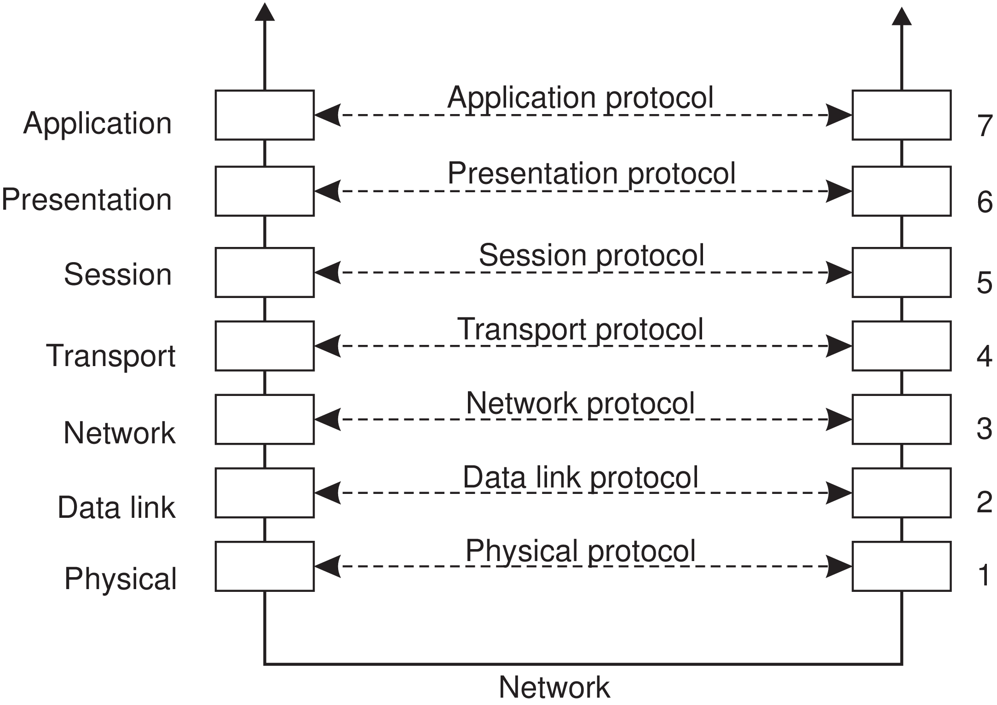
Figure 4.1: Layers, interfaces, and protocols in the OSI model.

Slide 7
Each layer provides an interface to the one above it. The interface consists of a set of operations that together define the service the layer is prepared to offer.
The seven OSI layers are
Physical layer Deals with standardizing how two computers are connected and how 0s and 1s are represented.
Data link layer Provides the means to detect and possibly correct transmission errors, as well as protocols to keep a sender and receiver in the same pace.
Network layer Contains the protocols for routing a message through a computer network, as well as protocols for handling congestion.

Slide 8
Transport layer Mainly contains protocols for directly supporting applications, such as those that establish reliable communication, or support real-time streaming of data.
Session layer Provides support for sessions between applications.
Presentation layer Prescribes how data is represented in a way that is independent of the hosts on which communicating applications are running.
Application layer Essentially, everything else: e-mail protocols, Web access protocols, file-transfer protocols, and so on.

Slide 9
When process P wants to communicate with some remote process Q, it builds a message and passes that message to the application layer as offered to it by means of an interface.
This interface will typically appear in the form of a library procedure. The application layer software then adds a header to the front of the message and passes the resulting message across the layer 6/7 interface to the presentation layer.
The presentation layer, in turn, adds its own header and passes the result down to the session layer, and so on. Some layers add not only a header to the front, but also a trailer to the end.
When it hits the bottom, the physical layer actually transmits the message by putting it onto the physical transmission medium.

Slide 10
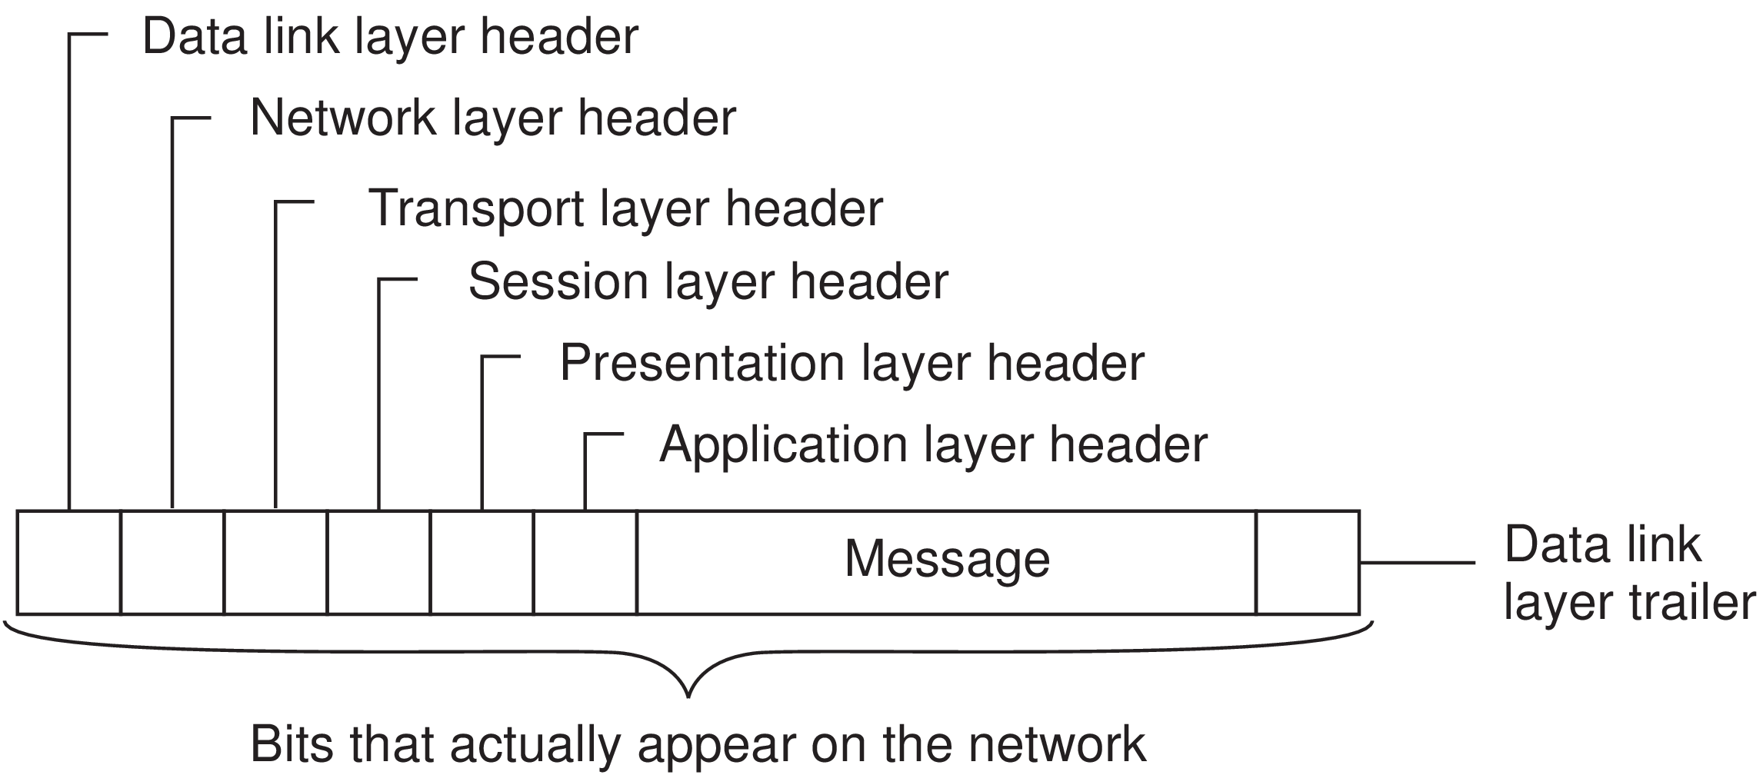
The overall mechanism and message is depicted in Figure 4.2
Figure 4.2: A typical message as it appears on the network.

Slide 11
When the message arrives at the remote machine hosting Q, it is passed upward, with each layer stripping off and examining its own header.
Finally, the message arrives at the receiver, process Q, which may reply to it using the reverse path. The information in the layer-n header is used for the layer-n protocol.
The collection of protocols used in a particular system is called a protocol suite or protocol stack.
A reference model different from its actual protocols.
OSI protocols were never popular, in contrast to protocols developed for the Internet, such as TCP and IP.

Slide 12
Middleware protocols
Middleware is an application that logically lives (mostly) in the OSI application layer.
Some of the examples are discussed.
Domain Name System (DNS)
A distributed service that is used to look up a network address associated with a name, such as the address of a so-called domain name like www.distributed-systems.net.
In terms of the OSI reference model, DNS is an application and therefore is logically placed in the application layer.
As DNS is offering a general-purpose, application-independent service, it forms part of the middleware.

Slide 13
Authentication protocols
These are not closely tied to any specific application, but instead, can be integrated into a middleware system as a general service.
Distributed commit protocols
Either all processes carry out a particular operation, or that the operation is not carried out at all. This phenomenon is also referred to as atomicity and is widely applied in transactions.
As commit protocols can present an interface independently of specific applications, they belong to middleware.

Slide 14
Distributed locking protocol
Using these protocols a resource can be protected against simultaneous access by a collection of processes that are distributed across multiple machines.
These protocols can be designed in an application-independent fashion and they belong to middleware.
An adapted reference model
This is a simplified reference model for communication, as shown in Figure 4.3.
Compared to the OSI model, the session and presentation layer have been replaced by a single middleware layer that contains application-independent protocols.

Slide 15
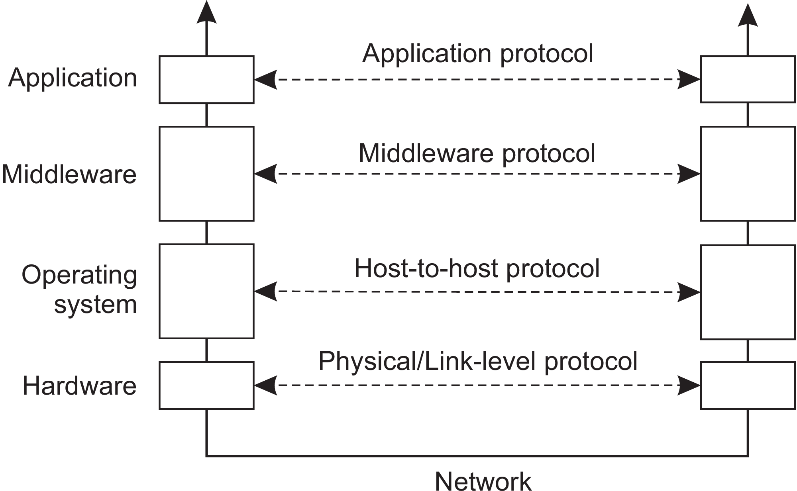
Network and transport services have been grouped into communication services as normally offered by an operating system, which, in turn, manages the specific lowest-level hardware used to establish communication.
Figure 4.3: An adapted reference model for networked communication.

Slide 16
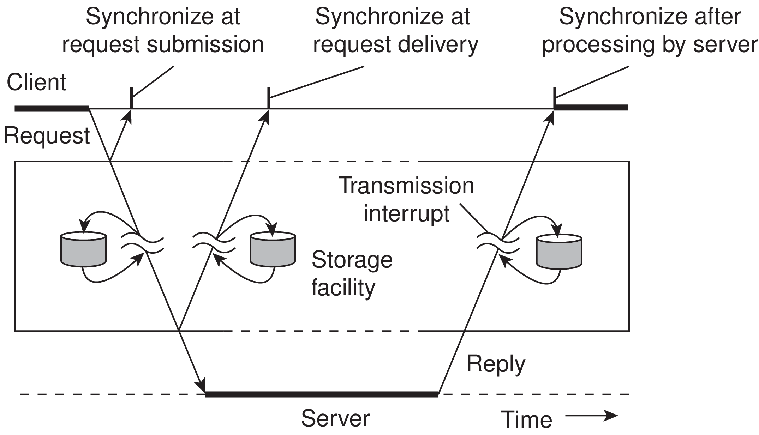
Types of Communication
To understand the various alternatives in communication that middleware can offer to applications, we view the middleware as an additional service in client-server computing, as shown in Figure 4.4.
Figure 4.4: Viewing middleware as an intermediate (distributed) service in application-level communication.

Slide 17
Electronic mail system
The core of the mail delivery system can be seen as a middleware communication service.
Each host runs a user agent allowing users to compose, send, and receive e-mail.
A sending user agent passes such mail to the mail delivery system, expecting it, in turn, to eventually deliver the mail to the intended recipient.
Likewise, the user agent at the receiver’s side connects to the mail delivery system to see whether any mail has come in. If so, the messages are transferred to the user agent so that they can be displayed and read by the user.

Slide 18
Persistent communication
An electronic mail system is a typical example in which communication is persistent.
With persistent communication, a message that has been submitted for transmission is stored by the communication middleware as long as it takes to deliver it to the receiver.
In this case, the middleware will store the message at one or several of the storage facilities shown in Figure 4.4.
As a consequence, it is not necessary for the sending application to continue execution after submitting the message. Likewise, the receiving application need not be executing when the message is submitted.

Slide 19
Transient communication
A message is stored by the communication system only as long as the sending and receiving application are executing.
More precisely, in terms of Figure 4.4, if the middleware cannot deliver a message due to a transmission interrupt, or because the recipient is currently not active, it will simply be discarded.
Asynchronous communication
A sender continues immediately after it has submitted its message for transmission. This means that the message is (temporarily) stored immediately by the middleware upon submission.

Slide 20
Synchronous communication
The sender is blocked until its request is known to be accepted.
There are essentially three points where synchronization can take place.
First: The sender may be blocked until the middleware notifies that it will take over transmission of the request.
Second: The sender may synchronize until its request has been delivered to the intended recipient.
Third: Synchronization may take place by letting the sender wait until its request has been fully processed, that is, up to the time that the recipient returns a response.

Slide 21
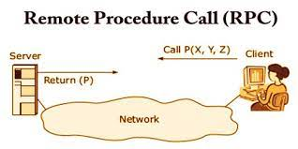
4.2 REMOTE PROCEDURE CALL
Remote procedure call: When a process on machine A calls a procedure on machine B, the calling process on A is suspended, and execution of the called procedure takes place on B. Information can be transported from the caller to the callee in the parameters and can come back in the procedure result. No message passing at all is visible to the programmer. This method is known as Remote Procedure Call, or often just RPC.
B
A

Slide 22
Though the idea of RPC is simple, there exist subtle problems.
The calling and called procedures run on different machines and they execute in different address spaces. This causes complications.
It can be complicated to pass parameters and results between procedures.
Either or both machines can crash and each of the possible failures causes different problems.

Slide 23
Basic RPC operation
The idea behind RPC is to make a remote procedure call look as much as possible like a local one. In other words, we want RPC to be transparent - the calling procedure should not be aware that the called procedure is executing on a different machine or vice versa.
Suppose that a program has access to a database that allows it to append data to a stored list, after which it returns a reference to the modified list. The operation is made available to a program by means of a routine append:
newlist = append(data, dbList)
In a traditional (single-processor) system, append is extracted from a library by the
linker and inserted into the object program.

Slide 24
Even though append eventually does only a few basic file operations, it is called in the usual way, by pushing its parameters onto the stack. The programmer does not know the implementation details of append, and this is, of course, how it is supposed to be.
RPC achieves its transparency in an analogous way.
When append is actually a remote procedure, a different version of append, called a client stub, is offered to the calling client. Like the original one, it too, is called using a normal calling sequence. However, unlike the original one, it does not perform an append operation. Instead, it packs the parameters into a message and requests that message to be sent to the server as illustrated in Figure 4.6.
Following the call to send, the client stub calls receive, blocking itself until the reply comes back.

Slide 25
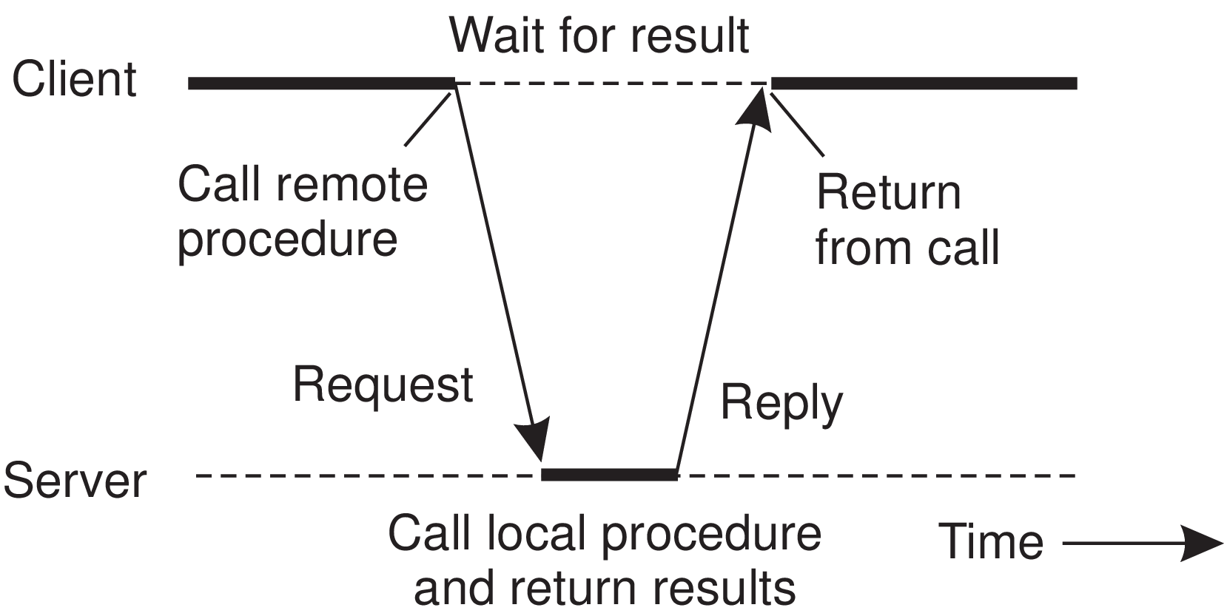
Figure 4.6: The principle of RPC between a client and server program.

Slide 26
When the message arrives at the server, the server’s operating system passes it to a server stub.
A server stub is the server-side equivalent of a client stub: it is a piece of code that transforms requests coming in over the network into local procedure calls. Typically the server stub will have called receive and be blocked waiting for incoming messages. The server stub unpacks the parameters from the message and then calls the server procedure in the usual way.
From the server’s point of view, it is as though it is being called directly by the client - the parameters and return address are all on the stack where they belong.
The server performs its work and then returns the result to the caller (in this case the server stub) in the usual way.

Slide 27
When the server stub gets control back after the call has completed, it packs the result in a message and calls send to return it to the client. After that, the server stub usually does a call to receive again, to wait for the next incoming request.
When the result message arrives at the client’s machine, the operating system passes it through the receive operation, which had been called previously, to the client stub, and the client process is subsequently unblocked.
The client stub inspects the message, unpacks the result, copies it to its caller, and returns in the usual way.
When the caller gets control following the call to append, all it knows is that it appended some data to a list. It has no idea that the work was done remotely at another machine.

Slide 28
Remote services are accessed by making ordinary (i.e., local) procedure calls, not by calling send and receive.
To summarize, a remote procedure call occurs in the following steps
1. The client procedure calls the client stub in the normal way.
2. The client stub builds a message and calls the local operating system.
3. The client’s OS sends the message to the remote OS.
4. The remote OS gives the message to the server stub.
5. The server stub unpacks the parameter(s) and calls the server.
6. The server does the work and returns the result to the stub.
7. The server stub packs the result in a message and calls its local OS.
8. The server’s OS sends the message to the client’s OS.
9. The client’s OS gives the message to the client stub.
10. The stub unpacks the result and returns it to the client.

Slide 29
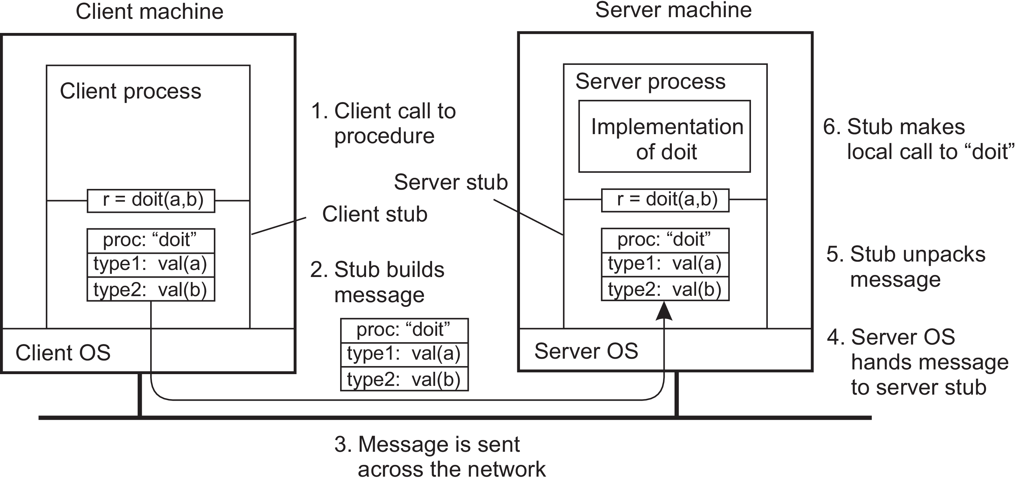
The first steps are shown in Figure 4.7 for an abstract two-parameter procedure doit(a,b), where we assume that parameter a is of type type1, and b of type type2.
Figure 4.7: The steps involved in calling a remote procedure doit(a,b).
The return path for the result is not shown.

Slide 30
Parameter passing
The function of the client stub is to take its parameters, pack them into a message, and send them to the server stub. Packing parameters into a message is called parameter marshaling.
In the previously discussed append operation, we thus need to ensure that its two parameters (data and dbList) are sent over the network and correctly interpreted by the server.
Server will just see a series of bytes coming from client and no additional information is provided with the message.
Placement of bytes may differ between machine architectures.

Slide 31
Some machines, such as the Intel Pentium, number their bytes from right to left (Little endian), whereas many others, such as the older ARM processors, number them the other way (Big endian) (ARM now supports both).
Byte ordering is also important: Machines may use a different ordering when transmitting (and thus receiving) bits and bytes. However, big endian is what is normally used for transferring bytes across a network.
The solution to this problem is to transform data that is to be sent to a machine-and network-independent format, next to making sure that both communicating parties expect the same message data type to be transmitted.
Marshaling and unmarshaling is all about this transformation to neutral formats and forms an essential part of remote procedure calls.

Slide 32
The pointers are passed with more difficulty.
A pointer is meaningful only within the address space of the process in which it is being used.
In the previous append example, the second parameter, dbList, is implemented by means of a reference to a list stored in a database.
If that reference is just a pointer to a local data structure somewhere in the caller’s main memory, we cannot simply pass it to the server. The transferred pointer value will most likely be referring to something completely different.
One solution is just to forbid pointers and reference parameters in general. However, these are so important that this solution is highly undesirable.

Slide 33
Another way is we can simply copy the entire data structure to which the parameter is referring, effectively replacing the copy-by-reference mechanism by copy-by-value/restore.
The pointers and references make only locally sense: they refer to memory locations that have meaning only to the calling process.
Problems can be alleviated by using global references: references that are meaningful to the calling and the called process.
For example, if the client and the server have access to the same file system, passing a file handle instead of a pointer may do the trick.

Slide 34
RPC-based application support
Hiding an RPC requires that the caller and the callee agree on the format of the messages they exchange and that they follow the same steps when it comes to, for example, passing complex data structures. i.e., Both should follow same protocol.
There are at least two ways in which RPC-based application development can be supported.
First: Let a developer specify exactly what needs to be called remotely, from which complete client-side and server-side stubs can be generated.
Second: Embed RPC as part of a programming-language environment.

Slide 35
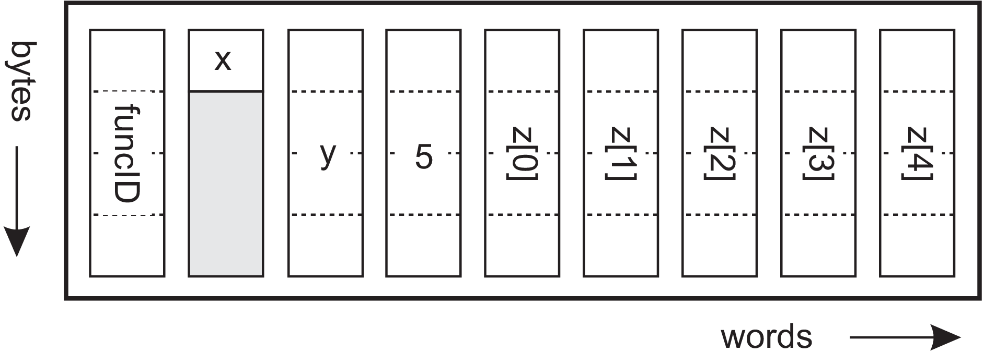
Stub generation
Consider the function someFunction of Figure 4.11(a).
(a)
(b)
Figure 4.11: (a) A function. (b) The corresponding message, and the
order in which bytes and words are sent across the network.

Slide 36
It has three parameters, a character, a floating-point number, and an array of five integers.
Assuming a word is four bytes, the RPC protocol might prescribe that we should transmit a character in the rightmost byte of a word (leaving the next three bytes empty), a float as a whole word, and an array as a group of words equal to the array length, preceded by a word giving the length, as shown in Figure 4.11(b).
Thus given these rules, the client stub for someFunction knows that it must use the format of Figure 4.11(b), and the server stub knows that incoming messages for someFunction will have the format of Figure 4.11(b).
Along with defining message format for RPC client and server should agree on the representation of simple data structures, such as integers and characters.

Slide 37
Caller and callee should agree on the actual exchange of messages.
For example, it may be decided to use a connection oriented transport service such as TCP/IP. An alternative is to use an unreliable datagram service.
After defining RPC protocol, the client and server stubs need to be implemented.
Stubs for the same protocol but different procedures normally differ only in their interface to the applications.
An interface consists of a collection of procedures that can be called by a client, and which are implemented by a server.
Interfaces are often specified by means of an Interface Definition Language (IDL).

Slide 38
Language-based support
The approach described were independent of a specific programming language.
We can also embed RPC into a language itself which simplifies application development and avoids issues related to parameter passing.
A well-known example in which RPC is fully embedded is Java, where an RPC is referred to as a Remote Method Invocation (RMI).
In RMI, a client being executed by its own (Java) virtual machine can invoke a method of an object managed by another virtual machine.

Slide 39
Variations on RPC
In RPC, when a client calls a remote procedure, the client will block until a reply is returned. This strict request-reply behavior is unnecessary when there is no result to return, or may hinder efficiency when multiple RPCs need to be performed.
Asynchronous RPC
Supports situations in which there is simply no result to return to the client.
The server immediately sends a reply back to the client the moment the RPC request is received, after which it locally calls the requested procedure.
The reply acts as an acknowledgment to the client that the server is going to process the RPC.

Slide 40
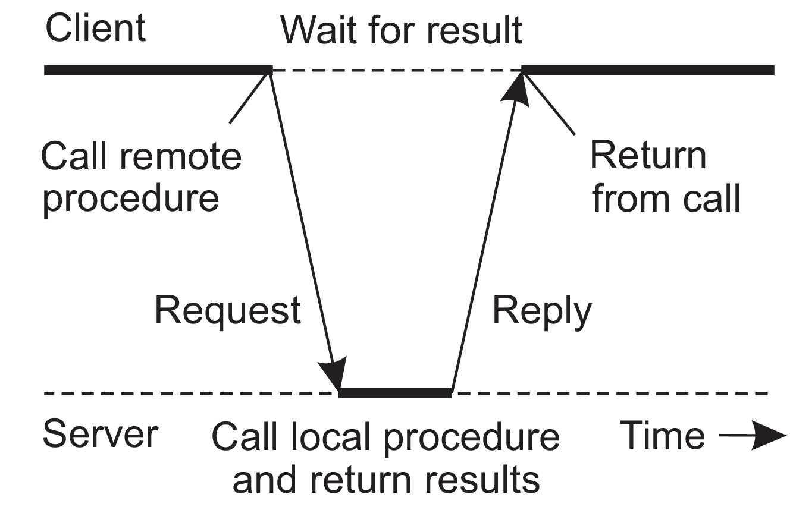
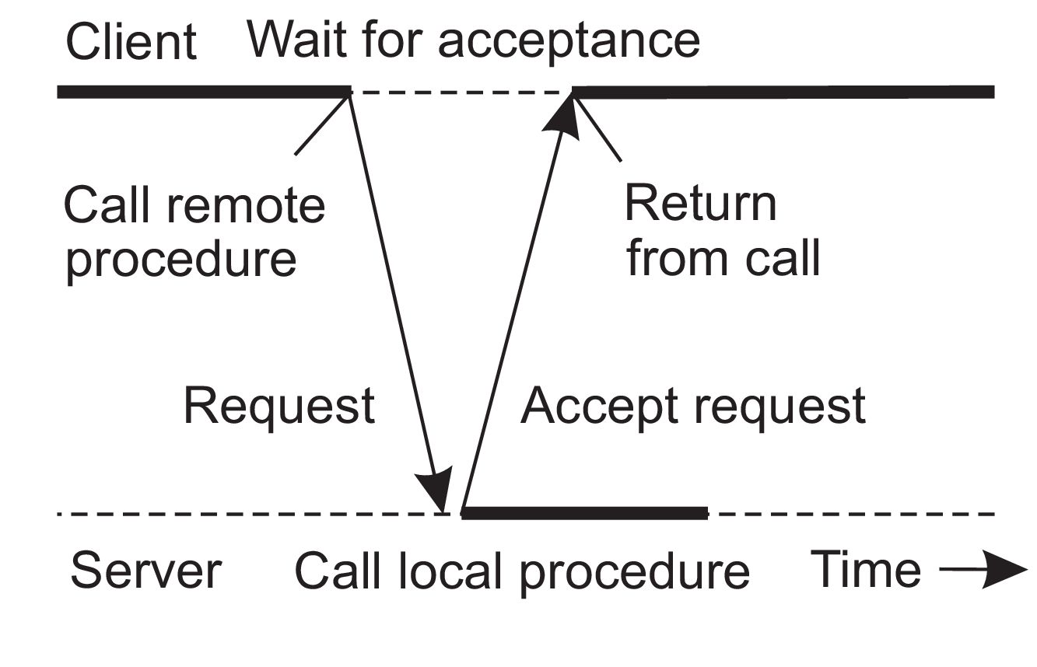
The client will continue without further blocking. Figure 4.13(b) shows how client and server interact in the case of asynchronous RPCs. For comparison, Figure 4.13(a) shows the normal request-reply behavior.
(a) (b)
Figure 4.13: (a) The interaction between client and server in a traditional RPC.
(b) The interaction using asynchronous RPC.

Slide 41
Asynchronous RPCs can also be useful when a reply will be returned but the client is not prepared to wait for it and do nothing in the meantime.
Example: A client needs to contact several servers independently. It sends call requests to all and waits for various results to be returned.
In such situations the communication can be organized as an asynchronous RPC combined with a callback, as shown in Figure 4.14.
In this scheme, also referred to as deferred synchronous RPC, the client first calls the server, waits for the acceptance, and continues. When the results become available, the server sends a response message that leads to a callback at the client’s side.
In deferred synchronous RPC client may poll the server for availability of results.

Slide 42
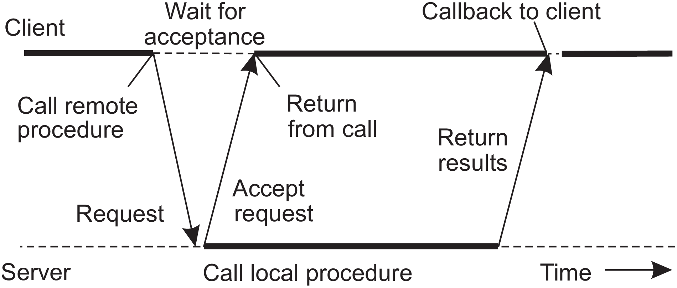
Figure 4.14: A client and server interacting through asynchronous RPCs.

Slide 43
A Variant of asynchronous RPC
Client continues executing immediately after sending the request to the server.
The client does not wait for an acknowledgment of the server’s acceptance of the request.
Such RPCs are referred as one-way RPCs.
The problem with this approach is that when reliability is not guaranteed, the client cannot know for sure whether or not its request will be processed.

Slide 44
Multicast RPC
This facilitates executing multiple RPCs at the same time
Adopting the one-way RPCs, a multicast RPC amounts to sending an RPC request to a group of servers. This principle is shown in Figure 4.15.
In this example, the client sends a request to two servers, who subsequently process that request independently and in parallel.
When done, the result is returned to the client where a callback takes place.

Slide 45
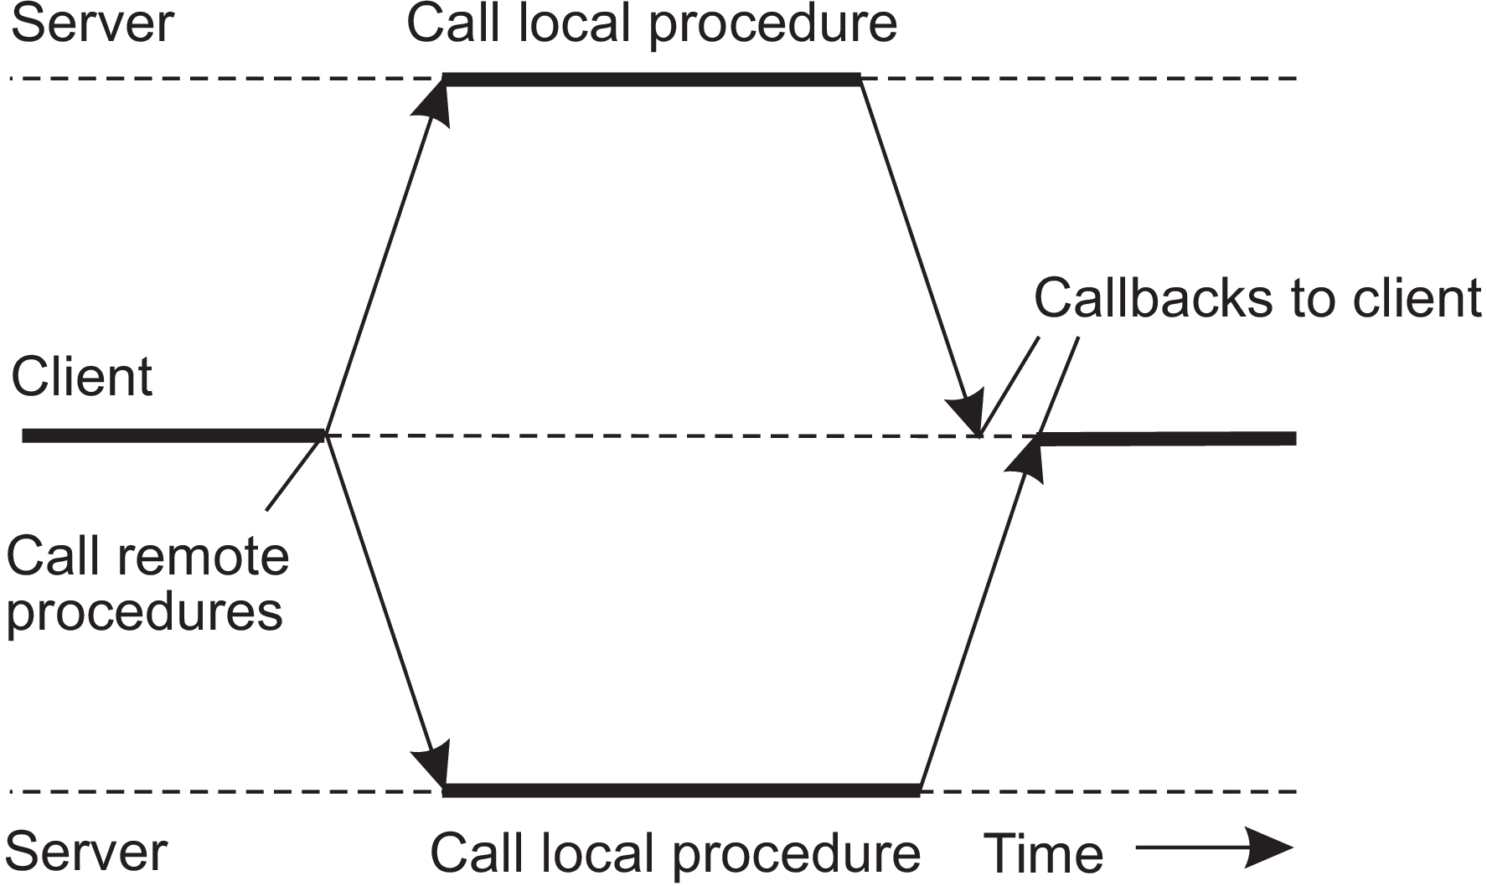
Figure 4.15: The principle of a multicast RPC.

Slide 46
There are several issues that we need to consider
First: The client application may be unaware of the fact that an RPC is actually being forwarded to more than one server. Replication of a server can be completely hidden from a client application.
Second: We need to consider what to do with the responses. In particular, will the client proceed after all responses have been received, or wait just for one? It all depends.
When the server has been replicated for fault tolerance, we may decide to wait for just the first response or majority.
If the servers have been replicated to do the same work but on different parts of the input, their results may need to be merged before the client can continue.

Slide 47
Example: DCE RPC
RPCs are basis of middleware and Distributed Systems in general.
Distributed Computing Environment (DCE) was developed by the Open Software Foundation (OSF), now called The Open Group.
DCE RPC is representative for most traditional RPC systems that use a combination of interface specifications and explicit bindings to various programming languages.

Slide 48
Introduction to DCE
DCE is a true middleware system in that it is designed to execute as a layer of abstraction between existing (network) operating systems and distributed applications.
Customer can take a collection of existing machines, add the DCE software, and then be able to run distributed applications, all without disturbing existing (Nondistributed) applications.
Although most of the DCE package runs in user space, in some configurations a piece (part of the distributed file system) must be added to the kernel of the underlying operating system.
The programming model underlying DCE is the client-server model. User processes act as clients to access remote services provided by server processes.
Some of these services are part of DCE itself, but others belong to the applications and are written by the application programmers. All communication between clients and servers takes place by means of RPCs.

Slide 49
Goals of DCE RPC
RPC system makes it possible for a client to access a remote service by simply calling a local procedure.
This interface makes it possible for client (i.e., application) programs to be written in a simple way, familiar to most programmers.
It also makes it easy to have large volumes of existing code run in a distributed environment with few, if any, changes.
It is up to the RPC system to hide all the details from the clients, and, to some extent, from the servers as well.

Slide 50
RPC system can automatically locate the correct server, and subsequently set up the communication between client and server software (generally called binding).
It can also handle the message transport in both directions, fragmenting and reassembling them as needed (e.g., if one of the parameters is a large array).
RPC system can automatically handle data type conversions between the client and the server, even if they run on different architectures and have a different byte ordering.
As RPC has the ability to hide the details, clients and servers are highly independent of one another. A client can be written in Java and a server in C, or vice versa.
A client and server can run on different hardware and use different operating systems. A variety of network protocols and data representations are also supported.

Slide 51
Writing a client and a server
The DCE RPC system consists of a number of components, including languages, libraries, daemons, and utility programs, among others. Together these make it possible to write clients and servers.
The entire process of writing and using an RPC client and server is summarized in Figure 4.16.
In a client-server system, the glue that holds everything together is the interface definition, as specified in the Interface Definition Language, or IDL.
IDL files can also contain type definitions, constant declarations, and other information needed to correctly marshal parameters and unmarshal results.

Slide 52
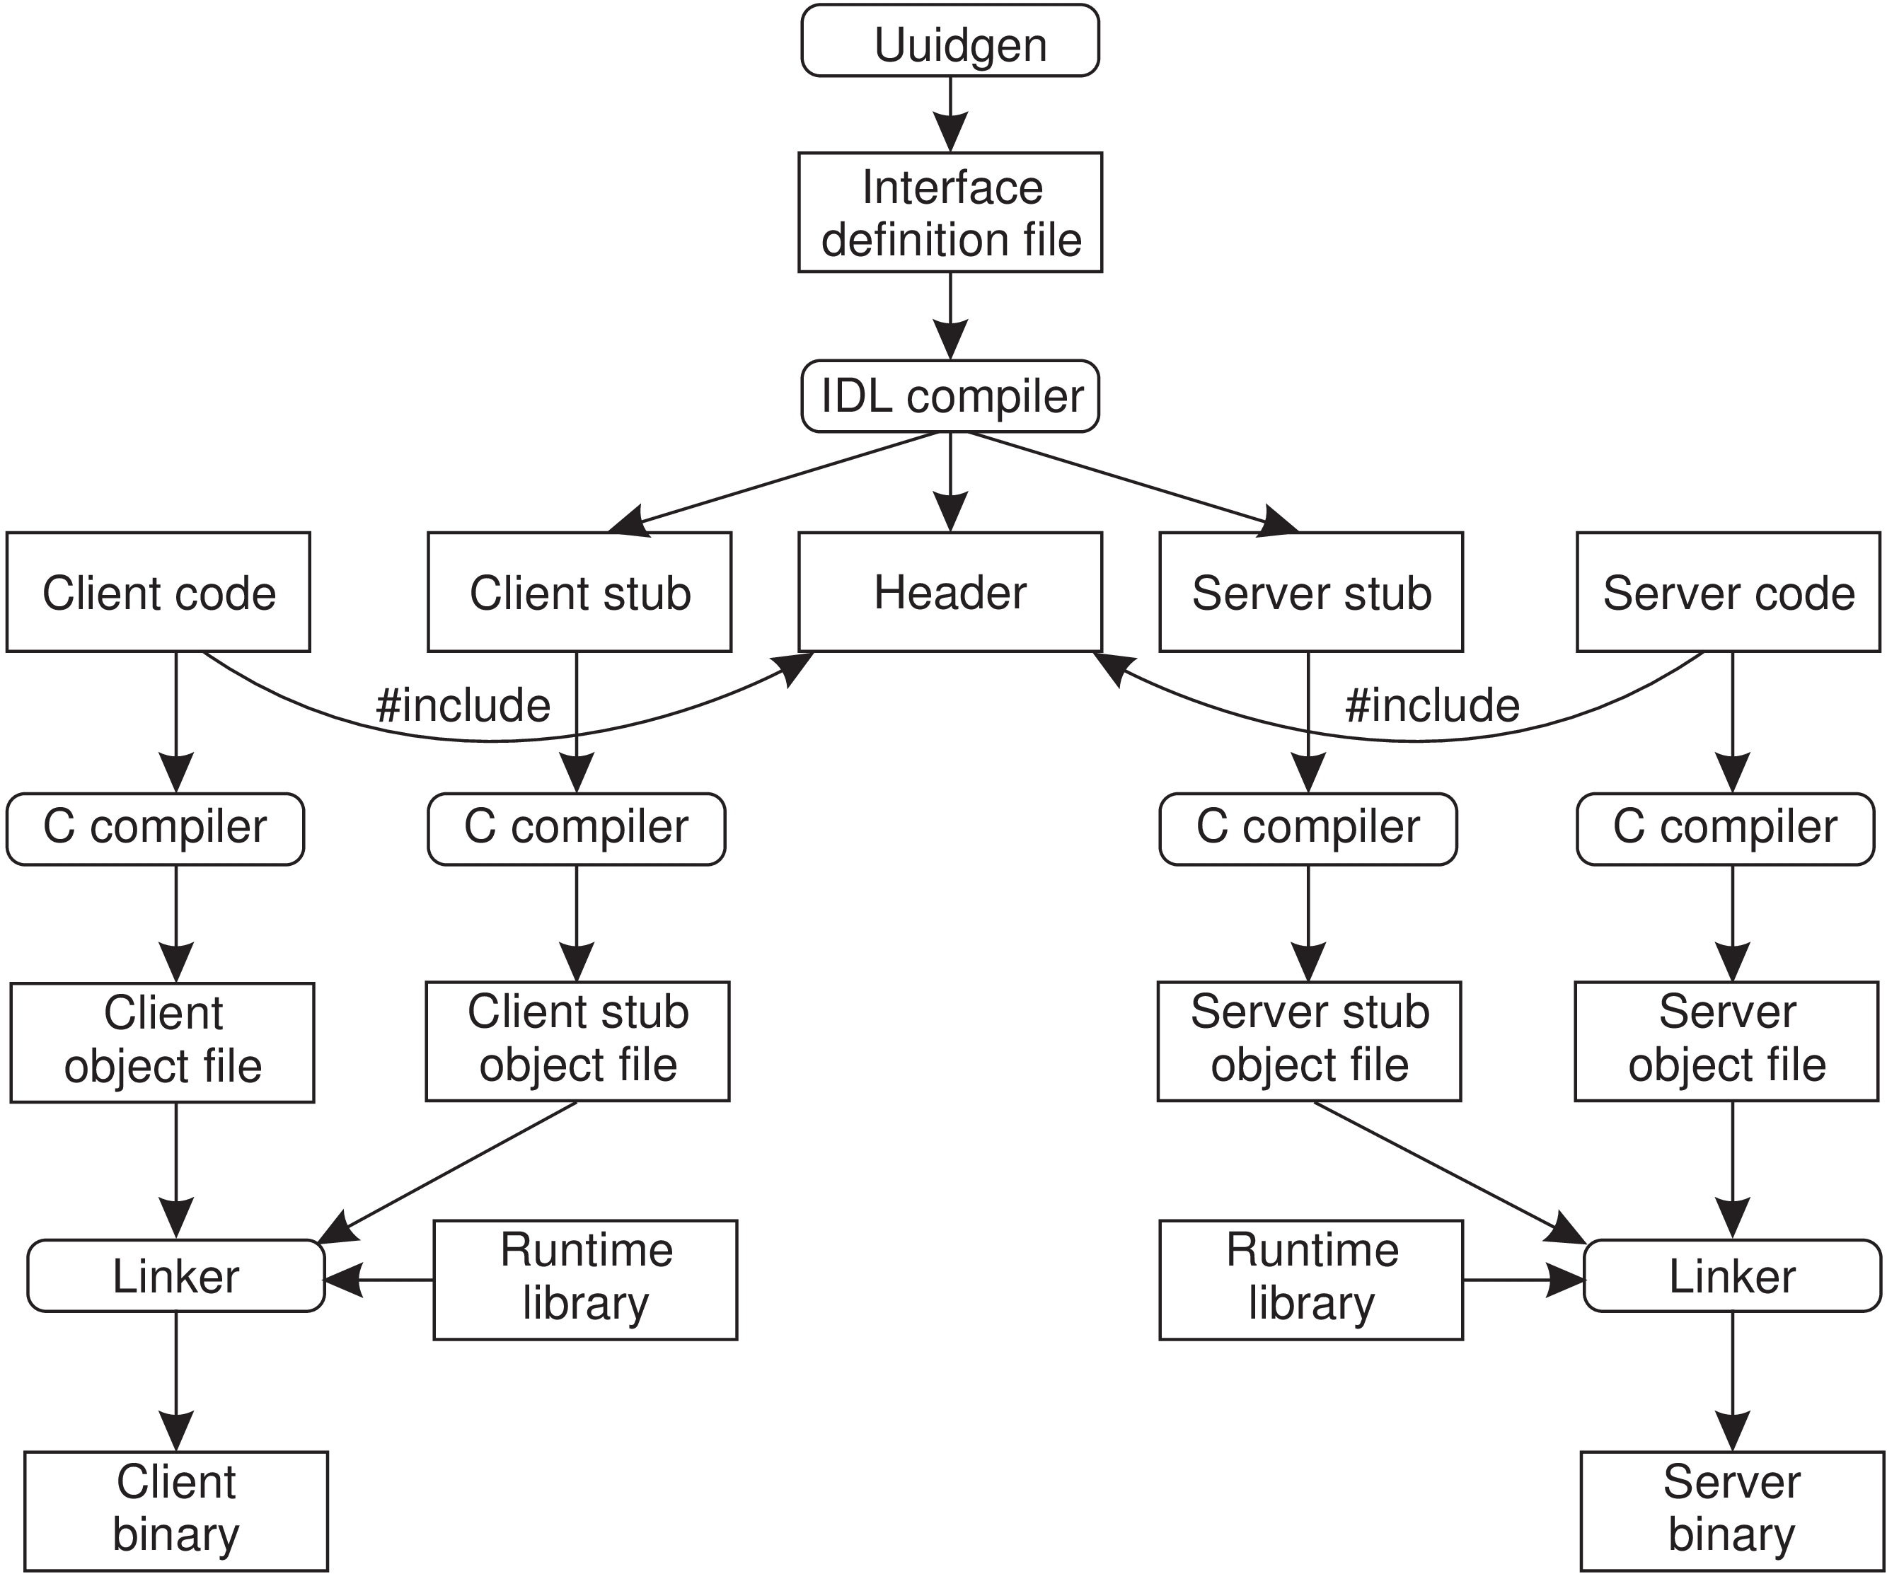
Figure 4.16: The steps in writing a client and a server in DCE RPC.

Slide 53
A crucial element in every IDL file is a globally unique identifier for the specified interface. The client sends this identifier in the first RPC message and the server verifies that it is correct.
In this way, if a client inadvertently tries to bind to the wrong server, or even to an older version of the right server, the server will detect the error and the binding will not take place.
As illustrated in Figure 4.16, the first step in writing a client/server application is usually calling the uuidgen program, asking it to generate a prototype IDL file containing an interface identifier guaranteed never to be used again in any interface generated anywhere by uuidgen.
Uniqueness is ensured by encoding in it the location and time of creation. It consists of a 128-bit binary number represented in the IDL file as an ASCII string in hexadecimal.

Slide 54
The next step is editing the IDL file, filling in the names of the remote procedures and their parameters.
When the IDL file is complete, the IDL compiler is called to process it. The output of the IDL compiler consists of three files:
• A header file (e.g., interface.h, in C terms).
The client stub.
The server stub.
The header file contains the unique identifier, type definitions, constant definitions, and function prototypes. It should be included (using #include) in both the client and server code.

Slide 55
The client stub contains the actual procedures that the client program will call. These procedures are the ones responsible for collecting and packing the parameters into the outgoing message and then calling the runtime system to send it. The client stub also handles unpacking the reply and returning values to the client.
Server stub contains the procedures called by the runtime system on the server machine when an incoming message arrives. These, in turn, call the actual server procedures that do work.
The next step is for the application writer to write the client and server code. Both of these are then compiled, as are the two stub procedures.
The resulting client code and client stub object files are then linked with the runtime library to produce the executable binary for the client. Similarly, the server code and server stub are compiled and linked to produce the server’s binary. At runtime, the client & server are started so that the application is actually executed as well.

Slide 56
Binding a client to a server
To allow a client to call a server, it is necessary that the server has been registered and is prepared to accept incoming calls.
Registration of a server makes it possible for a client to locate server and bind to it.
Finding the location of the server is done in two steps:
1. Locate the server’s machine.
2. Locate the server (i.e., the correct process) on that machine.
To communicate with a server, the client needs to know a port on the server’s machine to which it can send messages.

Slide 57
A port is used by the server’s operating system to distinguish incoming messages for different processes.
In DCE, a table of (server, port) pairs is maintained on each server machine by a process called the DCE daemon.
Before it becomes available for incoming requests, the server must ask the operating system for a port. It then registers this port with the DCE daemon. The DCE daemon records this information (including which protocols the server speaks) in the port table for future use.
The server also registers with the directory service by providing it the network address of the server’s machine and a name under which the server can be looked up. Binding a client to a server proceeds as shown in Figure 4.17.

Slide 58
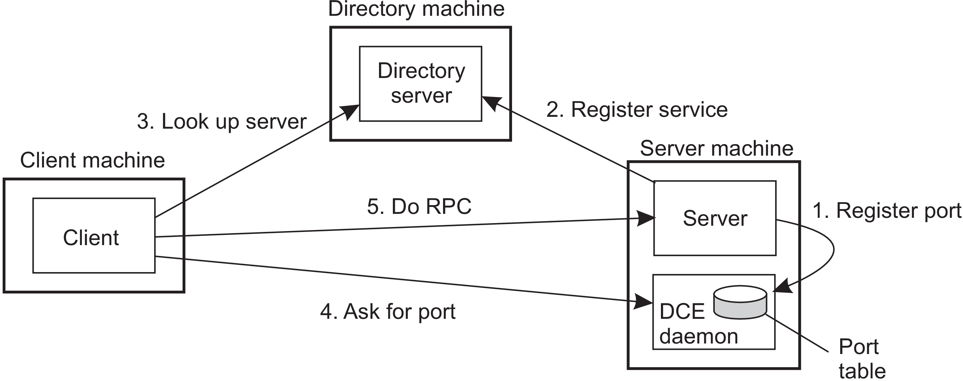
Figure 4.17: Client-to-server binding in DCE.

Slide 59
Let us assume that the client wants to bind to a video server that is locally known under the name /local/multimedia/video/movies.
It passes this name to the directory server, which returns the network address of the machine running the video server.
The client then goes to the DCE daemon on that machine (which has a well-known port), and asks it to look up the port of the video server in its port table.
Armed with this information, the RPC can now take place.
DCE also gives clients the ability to do more sophisticated searches for a suitable server when that is needed. Secure RPC is also an option where confidentiality or data integrity is crucial.

Slide 60
Performing an RPC
The actual RPC is carried out transparently and in the usual way. The client stub marshals the parameters to the runtime library for transmission using the protocol chosen at binding time.
When a message arrives at the server side, it is routed to the correct server based on the port contained in the incoming message.
The runtime library passes the message to the server stub, which unmarshals the parameters and calls the server. The reply goes back by the reverse route.
DCE provides several semantic options. The default is at-most-once operation, in which case no call is ever carried out more than once, even in the presence of system crashes.

Slide 61
Alternatively, it is possible to mark a remote procedure as idempotent (in the IDL file), in which case it can be repeated multiple times without harm.
For example, reading a specified block from a file can be tried over and over until it succeeds.
When an idempotent RPC fails due to a server crash, the client can wait until the server reboots and then try again.
Other semantics are also available (but rarely used), including broadcasting the RPC to all the machines on the local network.

Slide 62
4.3 MESSAGE-ORIENTED COMMUNICATION
Message-oriented communication is a type of communication in a distributed systems.
Simple transient messaging with sockets
Many distributed systems and applications are built directly on top of the simple message-oriented model offered by the transport layer.
As an example, we briefly discuss the socket interface as introduced in the 1970s in Berkeley Unix, and which has been adopted as a POSIX standard.

Slide 63
Socket
A communication end point to which an application can write data that are to be sent out over the underlying network, and from which incoming data can be read.
A socket forms an abstraction over the actual port that is used by the local operating system for a specific transport protocol.
Socket operations for TCP are shown in Figure 4.18.
Servers generally execute the first four operations, normally in the order given.

Slide 65
Socket
When calling the socket operation, the caller creates a new communication end point for a specific transport protocol.
Internally, creating a communication end point means that the local operating system reserves resources for sending and receiving messages for the specified protocol.
Bind
The bind operation associates a local address with the newly created socket.
For example, a server should bind the IP address of its machine together with a (possibly well-known) port number to a socket. Binding tells the operating system that the server wants to receive messages only on the specified address and port.
In the case of connection-oriented, the address is used to receive incoming connection requests.

Slide 66
Listen
The listen operation is called only in the case of connection-oriented communication.
It is a nonblocking call that allows the local operating system to reserve enough buffers for a specified maximum number of pending connection requests that the caller is willing to accept.
Accept
A call to accept blocks the caller until a connection request arrives.
When a request arrives, the local operating system creates a new socket with the same properties as the original one, and returns it to the caller.
This approach will allow the server to, for example, fork off a process that will subsequently handle the actual communication through the new connection.
The server can go back and wait for another connection request on the original socket.

Slide 67
Client side operations
At client side also, a socket must first be created using the socket operation, but explicitly binding the socket to a local address is not necessary, since the operating system can dynamically allocate a port when the connection is set up.
The connect operation requires that the caller specifies the transport-level address to which a connection request is to be sent.
The client is blocked until a connection has been set up successfully, after which both sides can start exchanging information through the send and receive operations.
Close
Finally, closing a connection is symmetric when using sockets, and is established by having both the client and server call the close operation.

Slide 68
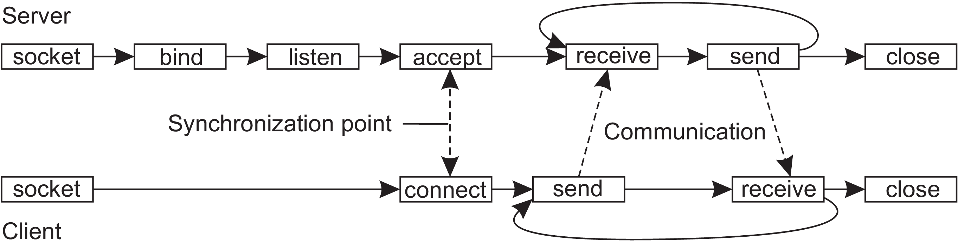
The general pattern followed by a client and server for connection-oriented communication using sockets is as shown in Figure 4.19.
Figure 4.19: Connection-oriented communication pattern using sockets.

Slide 69
Advanced transient messaging
Sockets essentially support only TCP or UDP, meaning that any extra facility for messaging needs to be implemented separately by an application programmer.
In practice, we do often need more advanced approaches for message-oriented communication to make network programming easier, to expand beyond the functionality offered by existing networking protocols, to make better use of local resources, and so on.

Slide 70
Using messaging patterns: ZeroMQ
One approach toward making network programming easier is based on the observation that many messaging applications, or their components, can be effectively organized according to a few simple communication patterns.
By subsequently providing enhancements to sockets for each of these patterns, it may become easier to develop a networked, distributed application.
ZeroMQ also provides sockets through which all communication takes place.
Actual message transmission takes place over TCP connections, and like TCP, all communication is essentially connection-oriented, meaning that a connection will first be set up between a sender and receiver before message transmission can take place.

Slide 71
An application programmer need not bother about the issues related to setting up and maintaining connections.
A socket may be bound to multiple addresses, effectively allowing a server to handle messages from very different sources through a single interface.
For example, a server can listen to multiple ports using a single blocking receive operation.
ZeroMQ sockets can thus support any-to-one communication instead of just one-to-one communication.
ZeroMQ sockets also support one-to-many communication, i.e., multicasting.

Slide 72
Essential to ZeroMQ is that communication is asynchronous: a sender will normally continue after having submitted a message to the underlying communication subsystem.
An interesting side effect of combining asynchronous with connection-oriented communication, is that a process can request a connection setup, and subsequently send a message even if the recipient is not yet up-and-running and ready to accept incoming connection requests, let alone incoming messages.
What happens, of course, is that a connection request and subsequent messages are queued at the sender’s side, while a separate thread as part of ZeroMQ’s library will take care that eventually the connection is set up and messages are transmitted to the recipient.

Slide 73
ZeroMQ establishes a higher level of abstraction in socket-based communication by pairing sockets: a specific type of socket used for sending messages is paired with a corresponding socket type for receiving messages. Each pair of socket types corresponds to a communication pattern.
The three most important communication patterns supported by ZeroMQ are request-reply, publish-subscribe, and pipeline.
Request-reply pattern
This is used in traditional client-server communication, like the ones normally used for remote procedure calls.
A client application uses a request socket (of type REQ) to send a request message to a server and expects the latter to respond with an appropriate response. The server is assumed to use a reply socket (of type REP).

Slide 74
The request-reply pattern simplifies matters for developers by avoiding the need to call the listen operation, as well as the accept operation.
Publish-subscribe pattern
Clients subscribe to specific messages that are published by servers. In effect, only the messages to which the client has subscribed will be transmitted.
If a server is publishing messages to which no one has subscribed, these messages will be lost. This pattern establishes multicasting messages from a server to several clients.
The server is assumed to use a socket of type PUB, while each client must use SUB type sockets. Each client socket is connected to the socket of the server.
By default, a client subscribes to no specific message. This means that as long as no explicit subscription is provided, a client will not receive a message published by the server.

Slide 75
Pipeline pattern
Characterized by the fact that a process wants to push out its results, assuming that there are other processes that want to pull in those results.
The essence of the pipeline pattern is that a pushing process does not really care which other process pulls in its results: the first available one will do just fine.
Likewise, any process pulling in results from multiple other processes will do so from the first pushing process making its results available.
The intention of the pipeline pattern is thus seen to keep as many processes working as possible, pushing results through a pipeline of processes as quickly as possible.

Slide 76
The Message-Passing Interface (MPI)
A technique for message based communication.
Socket based communication was insufficient for two reasons.
First: They were at the wrong level of abstraction by supporting only simple send and receive operations.
Second: Sockets were designed for general-purpose protocol stacks such as TCP/IP. They were not considered suitable for the proprietary protocols developed for high-speed interconnection networks, such as those used in high-performance server clusters.

Slide 77
As a consequence, most interconnection networks and high-performance multicomputers were shipped with proprietary communication libraries.
These libraries were mutually incompatible and not portable.
The need to be hardware and platform independent eventually lead to the definition of a standard for message passing, simply called the Message-Passing Interface or MPI.
MPI assumes communication takes place within a known group of processes.
Each group is assigned an identifier. Each process within a group is also assigned a (local) identifier.
A (groupID, processID) pair therefore uniquely identifies the source or destination of a message, and is used instead of a transport-level address.

Slide 78
At the core of MPI are messaging operations to support transient communication, of which the most intuitive ones are summarized in Figure 4.25.

Slide 79
MPI_bsend
This operation supports transient asynchronous communication.
The sender submits a message for transmission, which is generally first copied to a local buffer in the MPI runtime system. When the message has been copied, the sender continues.
The local MPI runtime system will remove the message from its local buffer and take care of transmission as soon as a receiver has called a receive operation.

Slide 80
MPI_send
This supports blocking send operation.
This operation blocks the caller until the specified message has been copied to the MPI runtime system at the sender’s side, or until the receiver has initiated a receive operation.
MPI_ssend
This operation supports synchronous communication by which the sender blocks until its request is accepted for further processing.

Slide 81
MPI_sendrecv
This operation supports strongest form of synchronous communication.
Using this operation the sender sends a request to the receiver and blocks until the latter returns a reply. Basically, this operation corresponds to a normal RPC.
Both MPI_send and MPI_ssend have variants that avoid copying messages from user buffers to buffers internal to the local MPI runtime system. These variants essentially correspond to a form of asynchronous communication.

Slide 82
MPI_isend
Using this operation, a sender passes a pointer to the message after which the MPI runtime system takes care of communication.
The sender immediately continues. To prevent overwriting the message before communication completes, MPI offers operations to check for completion, or even to block if required.
MPI_issend
Using this operation, a sender also passes only a pointer to the MPI runtime system.
When the runtime system indicates it has processed the message, the sender is then guaranteed that the receiver has accepted the message and is now working on it.

Slide 83
MPI_recv
This operation is called to receive a message; it blocks the caller until a message arrives.
MPI_irecv
This operation is an asynchronous variant of MPI_recv.
Using this operation the receiver indicates that it is prepared to accept a message.
The receiver can check whether or not a message has indeed arrived, or block until one does.

Slide 84
Message-oriented persistent communication
An important class of message-oriented middleware services, generally known as message-queuing systems, or just Message-Oriented Middleware (MOM).
Message-queuing systems provide extensive support for persistent asynchronous communication.
The essence of these systems is that they offer intermediate-term storage capacity for messages, without requiring either the sender or receiver to be active during message transmission.
Compared to sockets and MPI, message-queuing systems are targeted to support message transfers that are allowed to take minutes instead of seconds or milliseconds.

Slide 85
Message-queuing model
In this model, applications communicate by inserting messages in specific queues.
Messages are forwarded over a series of communication servers and are eventually delivered to the destination, even if it was down when the message was sent.
In practice, most communication servers are directly connected to each other. A message is generally transferred directly to a destination server.
In principle, each application has its own private queue to which other applications can send messages. A queue can be read only by its associated application, but it is also possible for multiple applications to share a single queue.

Slide 86
A sender is generally given only the guarantees that its message will eventually be inserted in the recipient’s queue.
No guarantees are given about when, or even if the message will actually be read, which is completely determined by the behavior of the recipient.
These semantics permit communication to be loosely coupled in time. There is thus no need for the receiver to be executing when a message is being sent to its queue. Likewise, there is no need for the sender to be executing at the moment its message is picked up by the receiver. The sender and receiver can execute completely independently of each other.
In fact, once a message has been deposited in a queue, it will remain there until it is removed, irrespective of whether its sender or receiver is executing.

Slide 87
Hence there are four combinations with respect to the execution mode of the sender and receiver, as shown in Figure 4.26.
In Figure 4.26(a), both the sender and receiver execute during the entire transmission of a message.
In Figure 4.26(b), only the sender is executing, while the receiver is passive, that is, in a state in which message delivery is not possible. Nevertheless, the sender can still send messages.
The combination of a passive sender and an executing receiver is shown in Figure 4.26(c). In this case, the receiver can read messages that were sent to it, but it is not necessary that their respective senders are executing as well.
Finally, in Figure 4.26(d), we see the situation that the system is storing (and possibly transmitting) messages even while sender and receiver are passive.

Slide 88
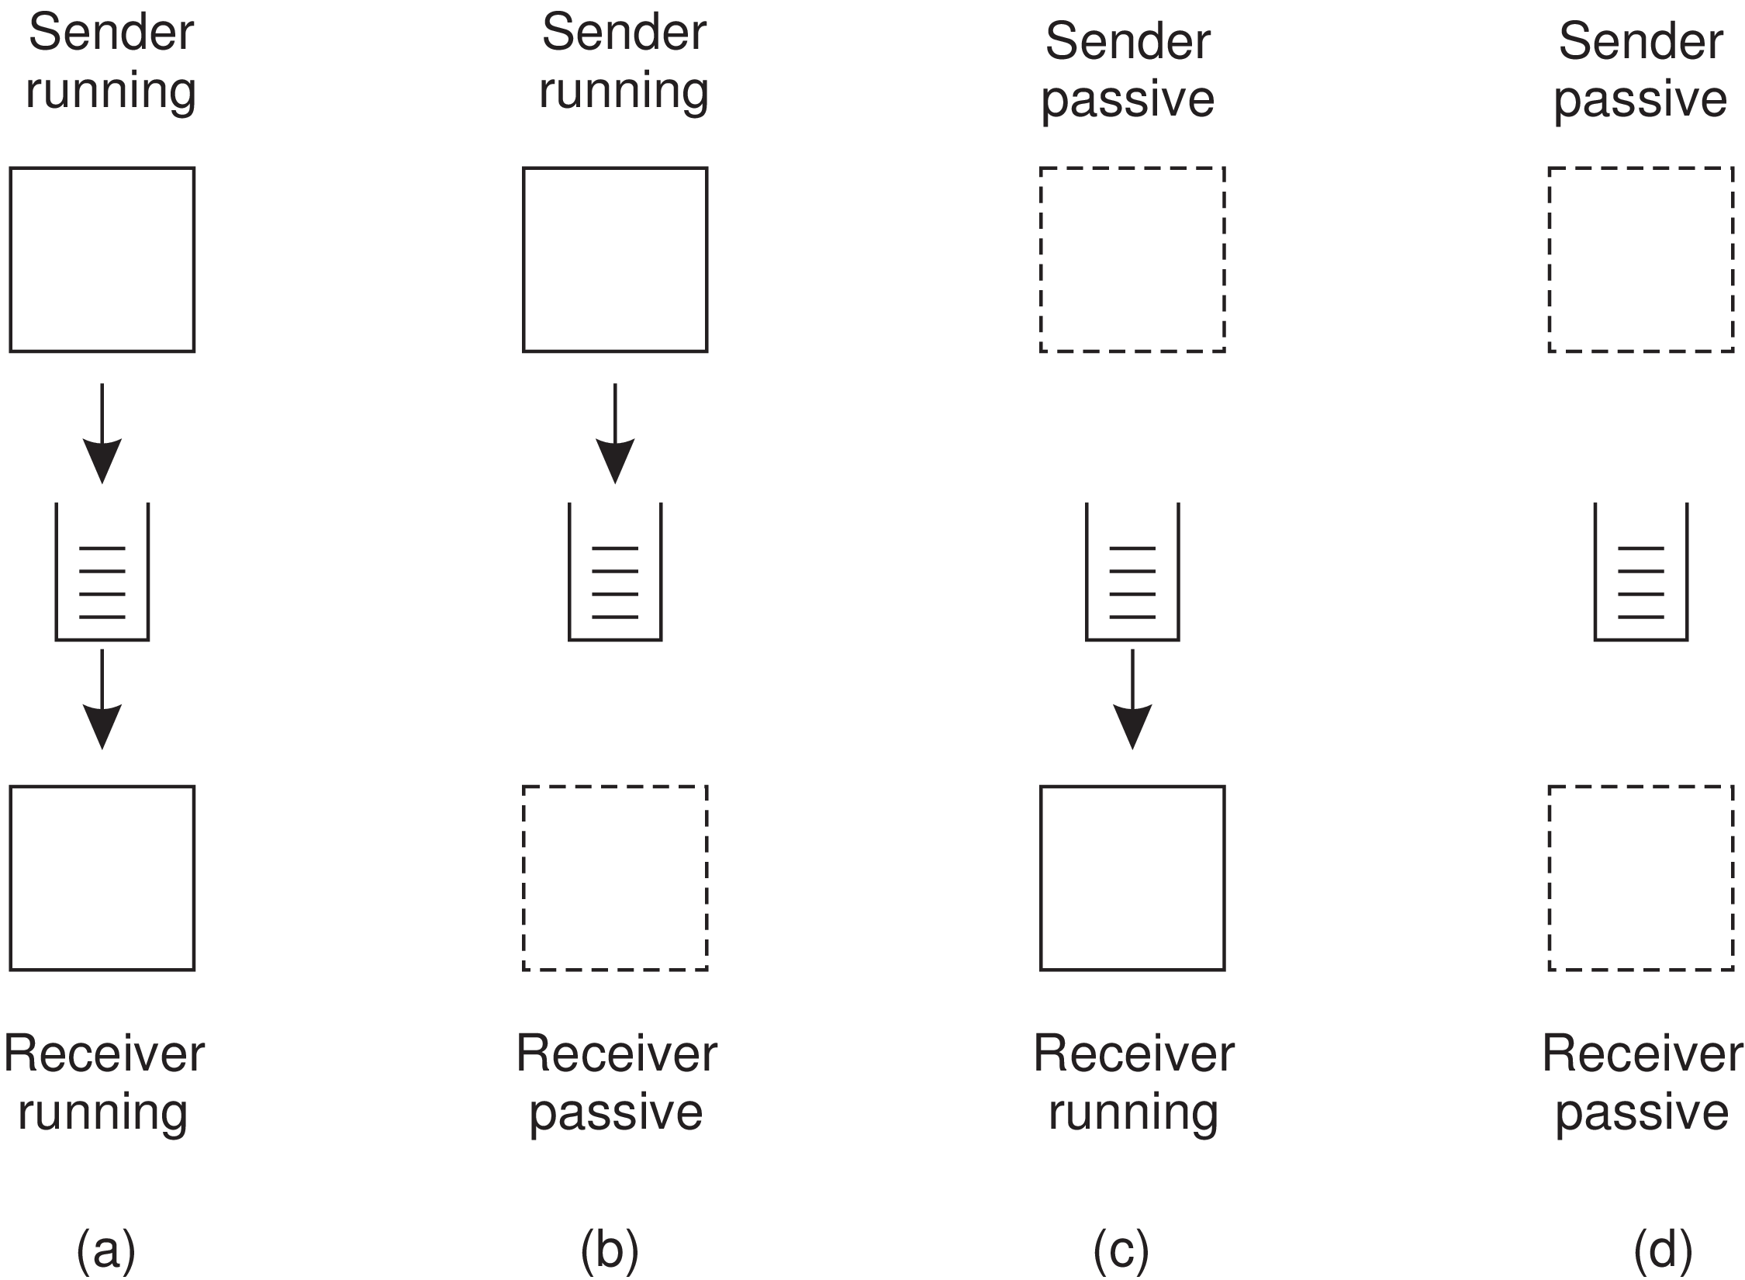
Figure 4.26: Four combinations for loosely-coupled communication using queues.

Slide 89
Messages can, in principle, contain any data.
The only important aspect from the perspective of middleware is that messages are properly addressed.
In practice, addressing is done by providing a systemwide unique name of the destination queue.
In some cases, message size may be limited, although it is also possible that the underlying system takes care of fragmenting and assembling large messages in a way that is completely transparent to applications.
An effect of this approach is that the basic interface offered to applications can be extremely simple, as shown in Figure 4.27.

Slide 91
Put
The put operation is called by a sender to pass a message to the underlying system that is to be appended to the specified queue. This is a nonblocking call.
Get
The get operation is a blocking call by which an authorized process can remove the longest pending message in the specified queue.
The process is blocked only if the queue is empty. Variations on this call allow searching for a specific message in the queue, for example, using a priority, or a matching pattern.

Slide 92
Poll
The nonblocking variant for get is given by the poll operation. If the queue is empty, or if a specific message could not be found, the calling process simply continues.
Notify
Most queuing systems also allow a process to install a handler as a callback function, which is automatically invoked whenever a message is put into the queue.
Callbacks can also be used to automatically start a process that will fetch messages from the queue if no process is currently executing.
This approach is often implemented by means of a daemon on the receiver’s side that continuously monitors the queue for incoming messages and handles accordingly.

Slide 93
General architecture of a message-queuing system
Queue managers: Queues are managed by queue managers. A queue manager is either a separate process, or is implemented by means of a library that is linked with an application.
Rule of thumb: An application can put messages only into a local queue. Getting a message is possible by extracting it from a local queue only.
If a queue manager QM_{A} handling the queues for an application A runs as a separate process, both processes QM_{A} and A will generally be placed on the same machine, or at worst on the same LAN.

Slide 94
If applications can put messages only into local queues, then clearly each message will have to carry information concerning its destination.
It is the queue manager’s task to make sure that a message reaches its destination. This brings us to a number of issues.
How the destination queue is addressed ?
To enhance location transparency, it is preferable that queues have logical, location-independent names.
Assuming that a queue manager is implemented as a separate process, using logical names implies that each name should be associated with a contact address, such as a (host, port)- pair, and that the name-to-address mapping is readily available to a queue manager, as shown in Figure 4.28.

Slide 95
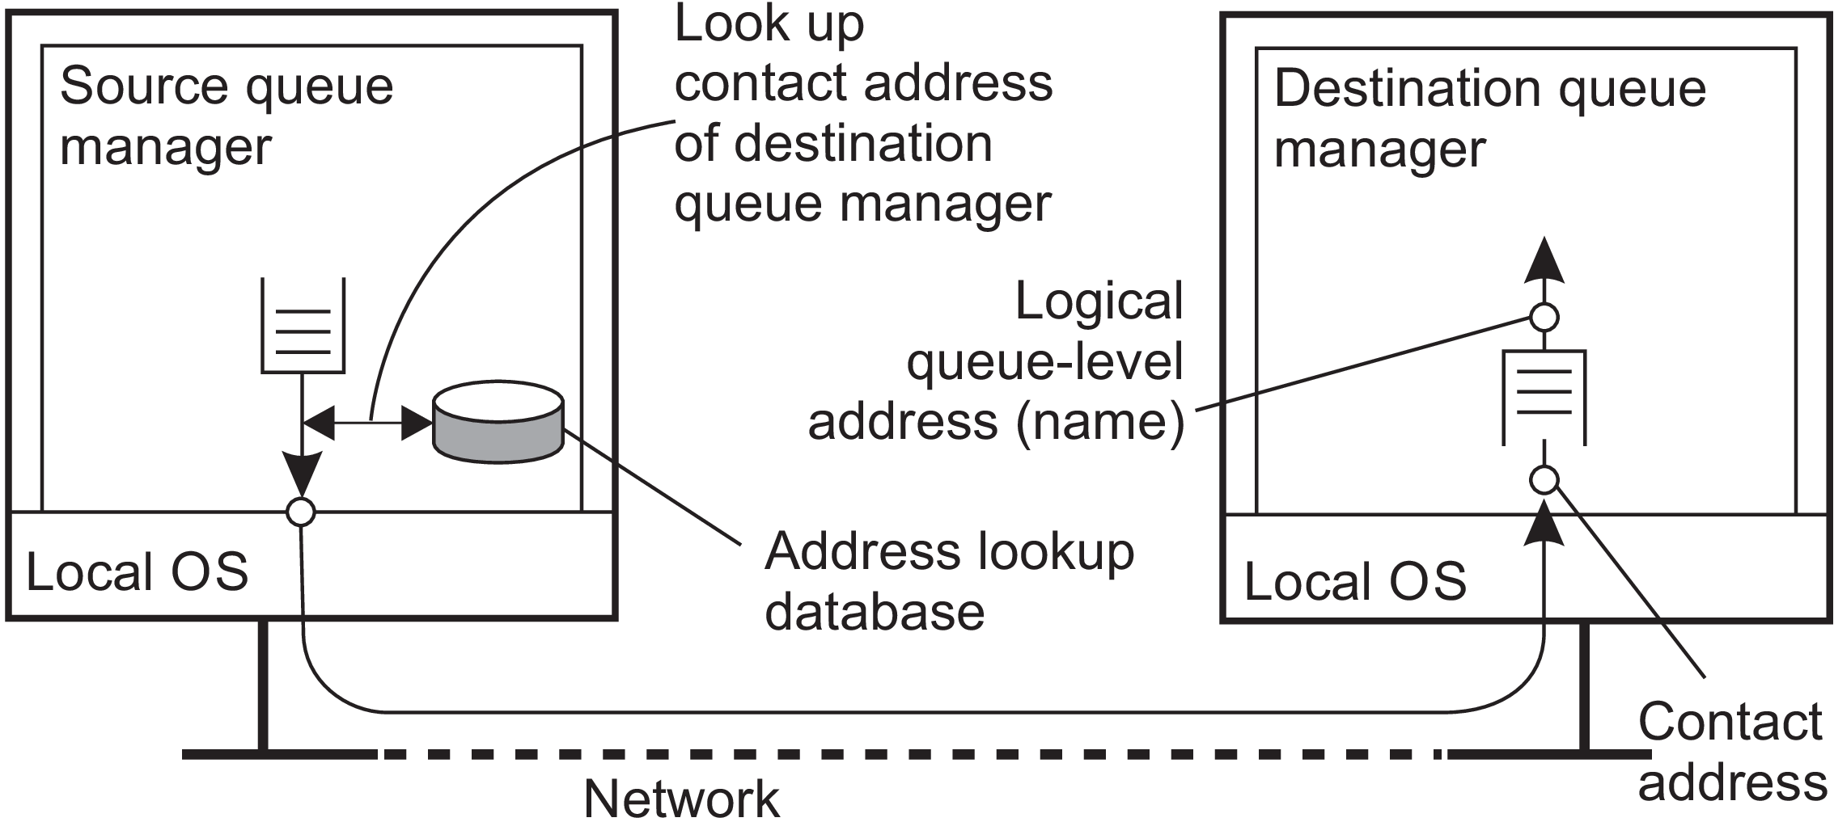
Figure 4.28: The relationship between queue-level naming and network-level addressing.

Slide 96
In practice, a contact address carries more information, notably the protocol to be used, such as TCP or UDP.
2) How name-to-address mapping is made available to a queue manager?
A common approach is to simply implement the mapping as a lookup table and copy that table to all managers.
Obviously, this leads to a maintenance problem, for every time that a new queue is added or named, many, if not all tables need to be updated.
3) How to efficiently maintaining name-to-address mappings?
If a destination queue at manager QM_{B} is known to queue manager QM_{A} , then QM_{A} can directly contact QM_{B} to transfer messages.
This means that (the contact address of) each queue manager should be known to all others.

Slide 97
4) Scalability problem
Faced when dealing with very large message-queuing systems.
There are often special queue managers that operate as routers: they forward incoming messages to other queue managers.
In this way, a message-queuing system may gradually grow into a complete, application-level, overlay network.
If only a few routers need to know about the network topology, then a source queue manager need only to know to which adjacent router, say R it should forward a message, given a destination queue.
Router R, in turn, may only need to keep track of its adjacent routers to see where to forward the message to, and so on.

Slide 98
Message brokers - Why required ?
An important application area of message-queuing systems is integrating existing and new applications into a single, coherent distributed information system.
If we assume that communication with an application takes place through messages, then integration requires that applications can understand the messages they receive.
This requires the sender to have its outgoing messages in the same format as that of the receiver, but also that its messages adhere to the same semantics as those expected by the receiver.
Sender and receiver essentially need to speak the same language, that is, adhere to the same messaging protocol.

Slide 99
The problem with this approach is that each time an application A is added to the system having its own messaging protocol, then for each other application B that is to communicate with A we will need to provide the means for converting their respective messages.
In a system with N applications, we need N×N messaging protocol converters. !!
An alternative is to agree on a common messaging protocol, as is done with traditional network protocols. Unfortunately, this approach will generally not work for message-queuing systems.
Given these problems, the general approach is to learn to live with differences, and try to provide the means to make conversions as simple as possible. This leads to the need of message brokers.

Slide 100
Message brokers
In message-queuing systems, conversions are handled by special nodes in a queuing network, known as message brokers.
A message broker acts as an application-level gateway in a message-queuing system.
Its main purpose is to convert incoming messages so that they can be understood by the destination application.
To a message-queuing system, a message broker is just another application, as shown in Figure 4.29. In other words, a message broker is generally not considered to be an integral part of the queuing system.

Slide 101
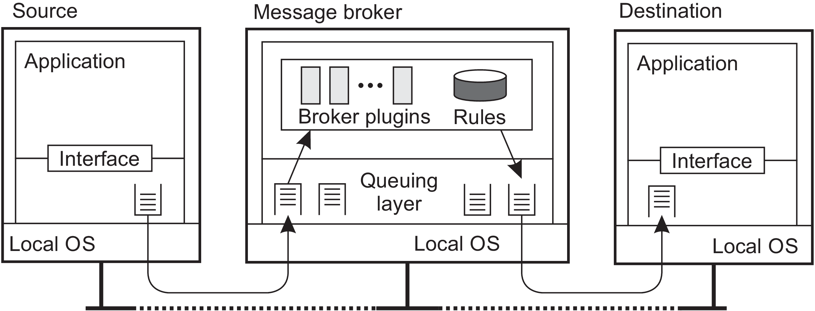
Figure 4.29: The general organization of a message broker in a message queuing system.

Slide 102
A message broker can be as simple as a reformatter for messages. For example, assume an incoming message contains a table from a database in which records are separated by a special end-of-record delimiter and fields within a record have a known, fixed length.
If the destination application expects a different delimiter between records, and also expects that fields have variable lengths, a message broker can be used to convert messages to the format expected by the destination.
For each pair of applications, we will have a separate subprogram capable of converting messages between the two applications.
In Figure 4.29, this subprogram is drawn as a plugin to emphasize that such parts can be dynamically plugged in, or removed from a broker.

Slide 103
In many cases a message broker is used for advanced enterprise application integration (EAI).
In this case, rather than (only) converting messages, a broker is responsible for matching applications based on the messages that are being exchanged.
In such a publish-subscribe model, applications send messages in the form of publishing.
In particular, they may publish a message on topic X, which is then sent to the broker. Applications that have stated their interest in messages on topic X, that is, who have subscribed to those messages, will then receive these messages from the broker.
At the heart of a message broker lies a repository of rules for transforming a message of one type to another.

Slide 104
Example: IBM’s WebSphere message-queuing system
Formerly known as MQSeries, it is now referred to as WebSphere MQ.
Overview
The basic architecture of an MQ queuing network is shown in Figure 4.30. All queues are managed by queue managers.
A queue manager is responsible for removing messages from its send queues, and forwarding those to other queue managers.
Likewise, a queue manager is responsible for handling incoming messages by picking them up from the underlying network and subsequently storing each message in the appropriate input queue.

Slide 105
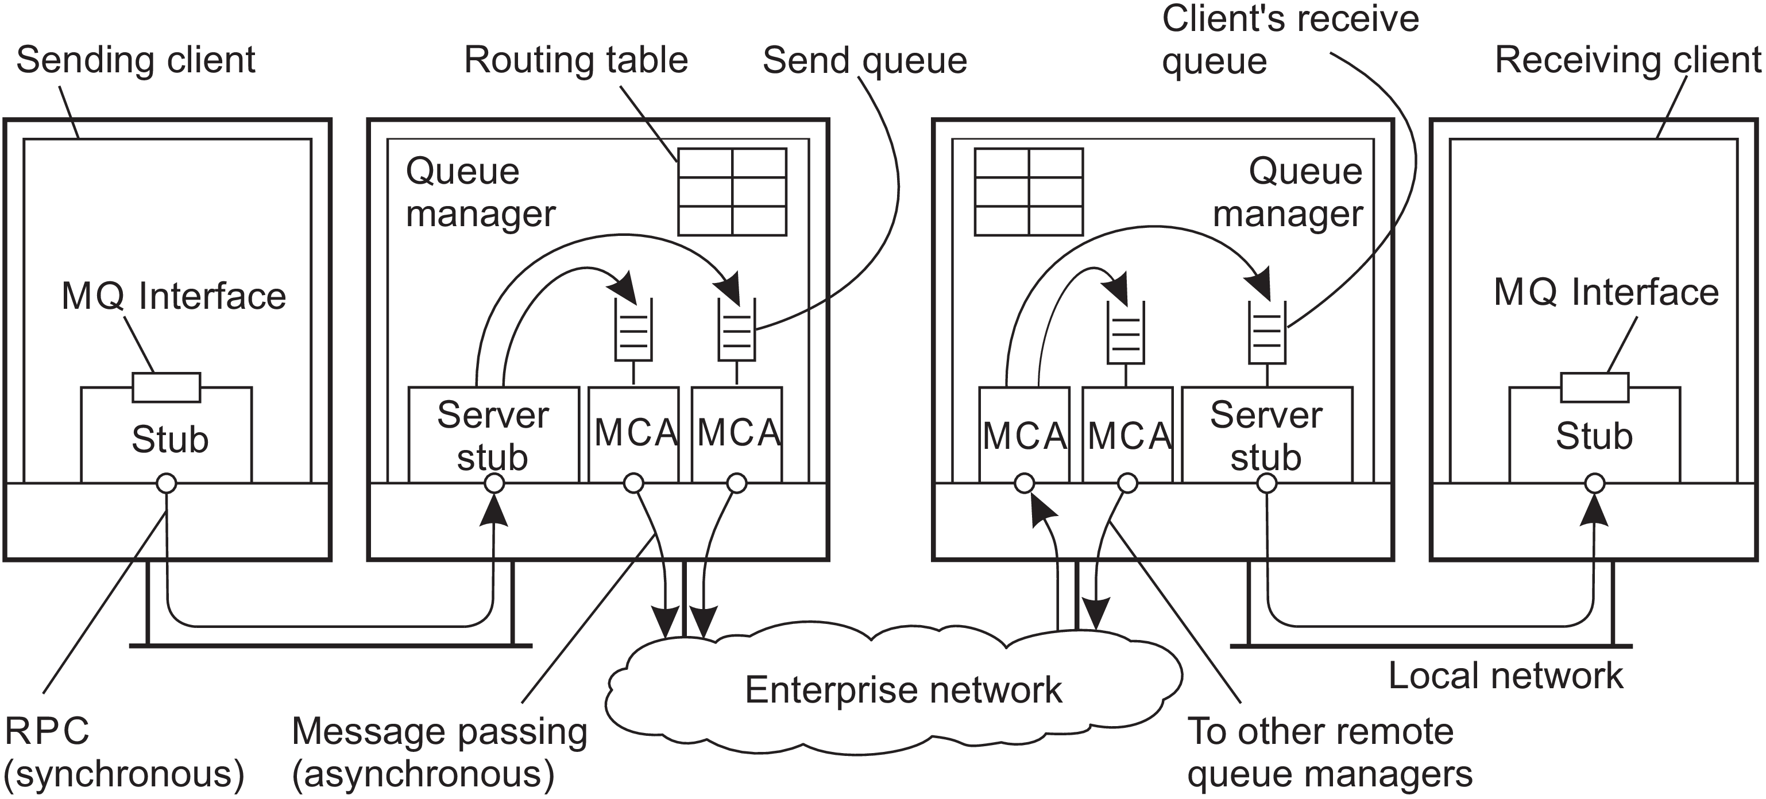
Figure 4.30: General organization of IBM’s message-queuing system.

Slide 106
To give an impression of what messaging can mean: a message has a maximum default size of 4 MB, but this can be increased up to 100 MB. A queue is normally restricted to 2 GB of data, but depending on the underlying operating system, this maximum can be easily set higher.
Queue managers are pairwise connected through message channels, which are unidirectional, reliable connection between a sending and a receiving queue manager, through which queued messages are transported.
For example, an Internet-based message channel is implemented as a TCP connection.
Each of the two ends of a message channel is managed by a message channel agent (MCA).

Slide 107
A sending MCA is basically doing nothing else than checking send queues for a message, wrapping it into a transport-level packet, and sending it along the connection to its associated receiving MCA.
Likewise, the basic task of a receiving MCA is listening for an incoming packet, unwrapping it, and subsequently storing the unwrapped message into the appropriate queue.
Channels
An important component of MQ is formed by the message channels. Each message channel has exactly one associated send queue from which it fetches the messages it should transfer to the other end.
Transfer along the channel can take place only if both its sending and receiving MCA are up and running.

Slide 108
One alternative is to have an application directly start its end of a channel by activating the sending or receiving MCA.
A better approach to start a sending MCA is to configure the channel’s send queue to set off a trigger when a message is first put into the queue.
That trigger is associated with a handler to start the sending MCA so that it can remove messages from the send queue.
Another alternative is to start an MCA over the network. In particular, if one side of a channel is already active, it can send a control message requesting that the other MCA is to be started. Such a control message is sent to a daemon listening to a well-known address on the same machine as where the other MCA is to be started.

Slide 109
Channels are stopped automatically after a specified time has expired during which no more messages were dropped into the send queue.
Each MCA has a set of associated attributes that determine the overall behavior of a channel. Some of the attributes are listed in Figure 4.31.

Slide 110
Attribute values of the sending and receiving MCA should be compatible and perhaps negotiated first before a channel can be set up.
For example, both MCAs should obviously support the same transport protocol.
An example of a nonnegotiable attribute is whether or not messages are to be delivered in the same order as they are put into the send queue. If one MCA wants FIFO delivery, the other must comply.
An example of a negotiable attribute value is the maximum message length, which will simply be chosen as the minimum value specified by either MCA.

Slide 111
Message Transfer
To transfer a message from one queue manager to another, it is necessary that each message carries its destination address, for which a transmission header is used.
An address in MQ (Message Queueing) consists of two parts.
First part: Consists of the name of the queue manager to which the message is to be delivered.
Second part: This is the name of the destination queue resorting under that manager to which the message is to be appended.

Slide 112
It is also required to specify the route that a message should follow.
Route specification is done by providing the name of the local send queue to which a message is to be appended. Thus it is not necessary to provide the full route in a message.
Routes are explicitly stored inside a queue manager in a routing table.
An entry in a routing table is a pair (destQM, sendQ).
destQM - Name of the destination queue manager.
sendQ - Name of the local send queue to which a message for that queue manager
should be appended.
Note: A routing table entry is called an alias in MQ.

Slide 113
A message needs to be transferred across multiple queue managers before reaching its destination. Whenever such an intermediate queue manager receives the message, it simply extracts the name of the destination queue manager from the message header, and does a routing table look-up to find the local send queue to which the message should be appended.
Each queue manager has a systemwide unique name that acts as its identifier. The problem with using these names is that replacing a queue manager, or changing its name, will affect all applications that send messages to it.
Alias: Problems can be alleviated by using a local alias for queue manager names. An alias allows the use of the same (logical) name for a queue, even if the queue manager of that queue changes. Changing the name of a queue manager requires that we change its alias in all queue managers. However, applications can be left unaffected.

Slide 114
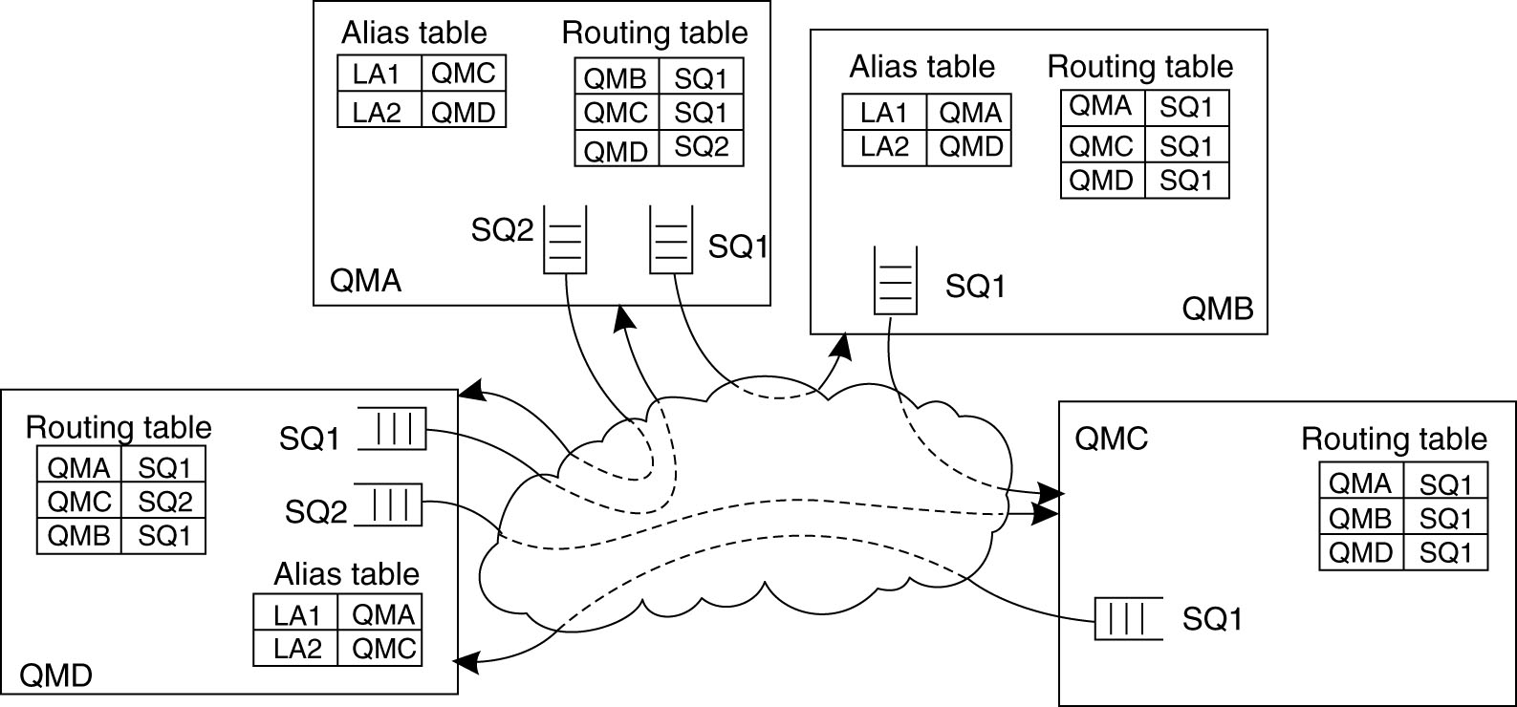
The principle of using routing tables and aliases is shown in Figure 4.32.
Figure 4.32: The general organization of an MQ queuing network using routing tables and aliases.

Slide 115
For example, an application linked to queue manager QMA can refer to a remote queue manager using the local alias LA1.
The queue manager will first look up the actual destination in the alias table to find it is queue manager QMC.
The route to QMC is found in the routing table, which states that messages for QMC should be appended to the outgoing queue SQ1, which is used to transfer messages to queue manager QMB.
The latter will use its routing table to forward the message to QMC.
The approach of routing and aliasing leads to a programming interface that is relatively simple, called the Message Queue Interface (MQI). The most important operations of MQI are summarized in Figure 4.33.

Slide 116
MQOPEN
To put messages into a queue, an application calls MQOPEN, specifying a destination queue in a specific queue manager.
The queue manager can be named using the locally-available alias. Whether the destination queue is actually remote or not is completely transparent to the application.

Slide 117
MQOPEN should also be called if the application wants to get messages from its local queue. Only local queues can be opened for reading incoming messages.
MQCLOSE
When an application is finished with accessing a queue, it should close it by calling MQCLOSE.
MQPUT & MQGET
Messages can be written to, or read from, a queue using MQPUT and MQGET, respectively.
In principle, Messages are removed from a queue on a priority basis. Messages with the same priority are removed on a first-in, first-out (FIFO) basis.
It is also possible to request for specific messages. Furthermore, MQ provides facilities to signal applications when messages have arrived, thus avoiding that an application will continuously have to poll a message queue for incoming messages.

Slide 118
Managing overlay networks
An important part of managing MQ systems is connecting the various queue managers into a consistent overlay network. This network needs to be maintained over time.
A major issue with MQ is that overlay networks need to be manually administrated. This administration not only involves creating channels between queue managers, but also filling in the routing tables.
Channel Control Function: At the heart of overlay management is the channel control function component, which logically sits between message channel agents. This allows an operator to monitor exactly what is going on at two end points of a channel. In addition, it is used to create channels and routing tables, but also to manage the queue managers that host the message channel agents.

Slide 119
Example: Advanced Message Queuing Protocol (AMQP)
An organization choosing to use a message-queuing system from manufacturer X, may have to settle for solutions that only X provides.
In 2006, a working group was formed to change this situation, which resulted in the specification of the Advanced Message-Queuing Protocol, or simply AMQP.
Basics
AMQP evolves around applications, queue managers, and queues.
Taking an approach that is common for many networking situations, we make a distinction between AMQP as a messaging service, the actual messaging protocol, and, finally, the messaging interface as offered to applications.

Slide 120
It is easiest to consider the situation of having only a single queue manager, running as a single, separate server forming the implementation of AMQP as a service.
An application communicates with this queue manager through a local interface.
Between an application and the queue manager communication proceeds according to the AMQP protocol. This situation is shown in Figure 4.34.
The AMQP stub shields the application (as well as the queue manager) from the details concerning message transfer and communication in general.
At the same time, it implements a message-queuing interface, allowing the application to make use of AMQP as a message-queuing service.

Slide 121
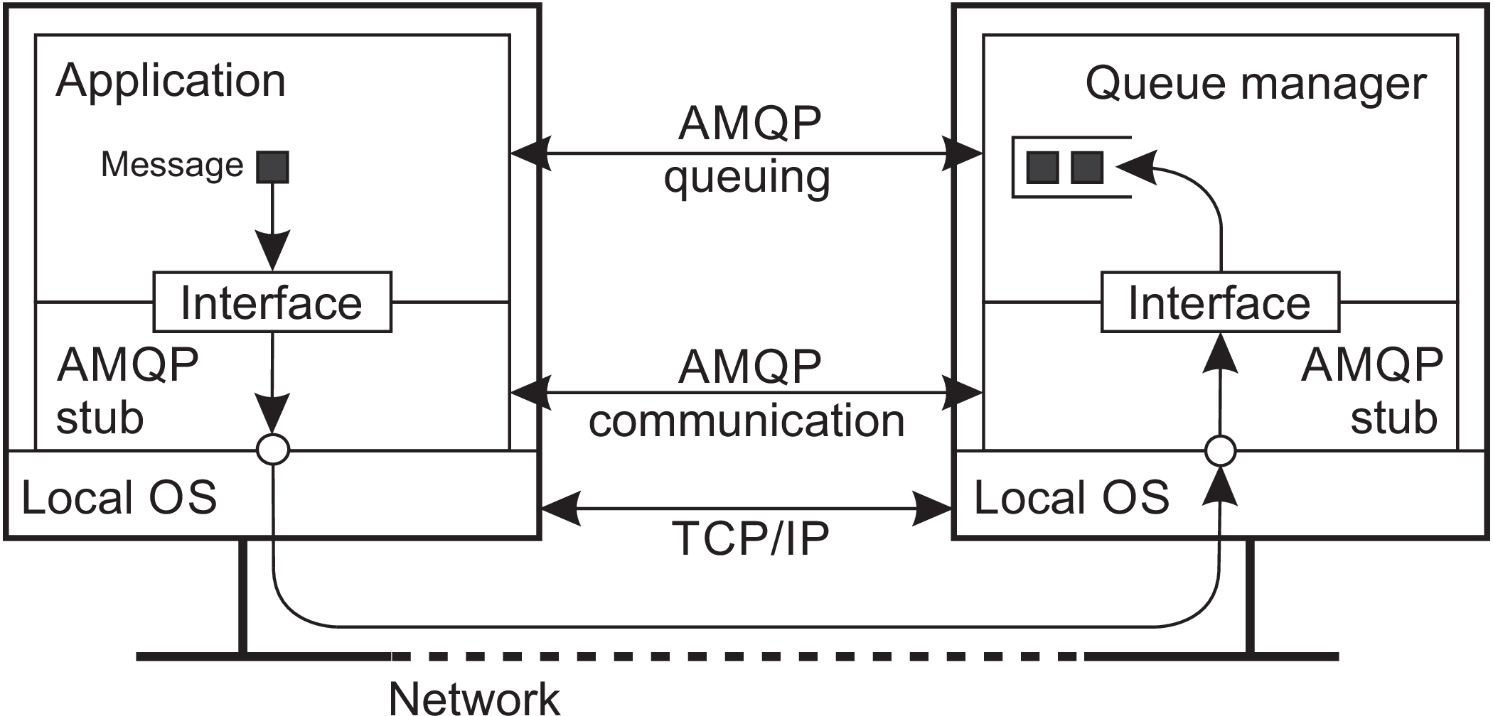
Figure 4.34: An overview of a single-server AMQP instance.

Slide 122
AMQP communication
AMQP allows an application to set up a connection to a queue manager; a connection is a container for a number of one-way channels.
Whereas the lifetime of a channel can be highly dynamic, connections are assumed to be relatively stable.
This difference between connection and channel allows for efficient implementations, notably by using a single transport-layer TCP connection to multiplex lots of different channels between an application and a queue manager.
In practice, AMQP assumes TCP is used for establishing AMQP connections.

Slide 123
Bidirectional communication is established through sessions: a logical grouping of two channels.
A connection may have multiple sessions, but note that a channel need not necessarily be part of a session.
To actually transfer messages, a link is needed. Conceptually, a link, or rather its end points, keep track of the status of messages that are being transferred.
Flow control is established through credits: a receiver can tell the sender how many messages it is allowed to send over a specific link.
When a message is to be transferred, the application passes it to its local AMQP stub. Each message transfer is associated with one specific link.

Slide 124
Message transfer normally proceeds in three steps.
At the sender’s side, the message is assigned a unique identifier and is recorded locally to be in an unsettled state. The stub subsequently transfers the message to the server, where the AMQP stub also records it as being in an unsettled state. At that point, the server-side stub passes it to the queue manager.
The receiving application (in this case the queue manager), is assumed to handle the message and normally reports back to its stub that it is finished. The stub passes this information to the original sender, at which point the message at the original sender’s AMQP stub enters a settled state.
The AMQP stub of the original sender now tells the stub of the original receiver that message transfer has been settled (meaning that the original sender will forget about the message from now on). The receiver’s stub can now also discard anything about the message, formally recording it as being settled as well.

Slide 125
AMQP messaging
Messaging formally takes place between two nodes, of which there are three types: a producer, a consumer, or a queue.
Typically, producer and consumer nodes represent regular applications, whereas queues are used to store and forward messages.
Indeed, a queue manager will typically consist of multiple queue nodes.
In order for message transfer to take place, two nodes will have to establish a link between them.
The receiver can indicate to the sender whether its message was accepted (meaning that it was successfully processed), or rejected. (Notification returned to sender)

Slide 126
AMQP also supports fragmentation and assembly of large messages for which additional notifications are sent.
Persistent messaging: AMQP supports persistent messaging. Achieving persistence is handled through several mechanisms.
First - A message can be marked as durable, indicating that the source expects any intermediate node, such as a queue, to be able to recover in the case of a failure. An intermediate node that cannot guarantee such durability will have to reject a message.
Second - A source or target node can also indicate its durability: if durable, will it maintain its state, or will it also maintain the (unsettled) state of durable messages? Combining the latter with durable messages effectively establishes reliable message transfer and persistent messaging.

Slide 127
4.4 MULTICAST COMMUNICATION
Multicast communication supports sending of data to multiple receivers.
Different application level multicasting techniques are discussed.
Application-level tree-based multicasting
The basic idea in application-level multicasting is that nodes organize into an overlay network, which is then used to disseminate information to its members.
Network routers are not involved in group membership. As a consequence, the connections between nodes in the overlay network may cross several physical links.
A crucial design issue is the construction of the overlay network. Two approaches.

Slide 128
First: Nodes may organize themselves directly into a tree, meaning that there is a unique (overlay) path between every pair of nodes.
Second: Nodes organize into a mesh network in which every node will have multiple neighbors and, in general, there exist multiple paths between every pair of nodes.
Second approach provides higher robustness: Alternate path, in case of node failure, for information dissemination.

Slide 129
Performance issues in overlays
Selection of nodes that participate in the tree does not take into account any performance metrics: it is purely based on the (logical) routing of messages through the overlay.
Figure 4.35 shows a small set of five nodes that are organized in a simple overlay network, with node ‘A’ forming the root of a multicast tree. The costs for traversing a physical link are also shown.
Now, whenever ‘A’ multicasts a message to the other nodes, it is seen that this message will traverse each of the links <B, Rb>, <Ra, Rb>, <E, Re>, <Rc, Rd>, and <D, Rd> twice.

Slide 130
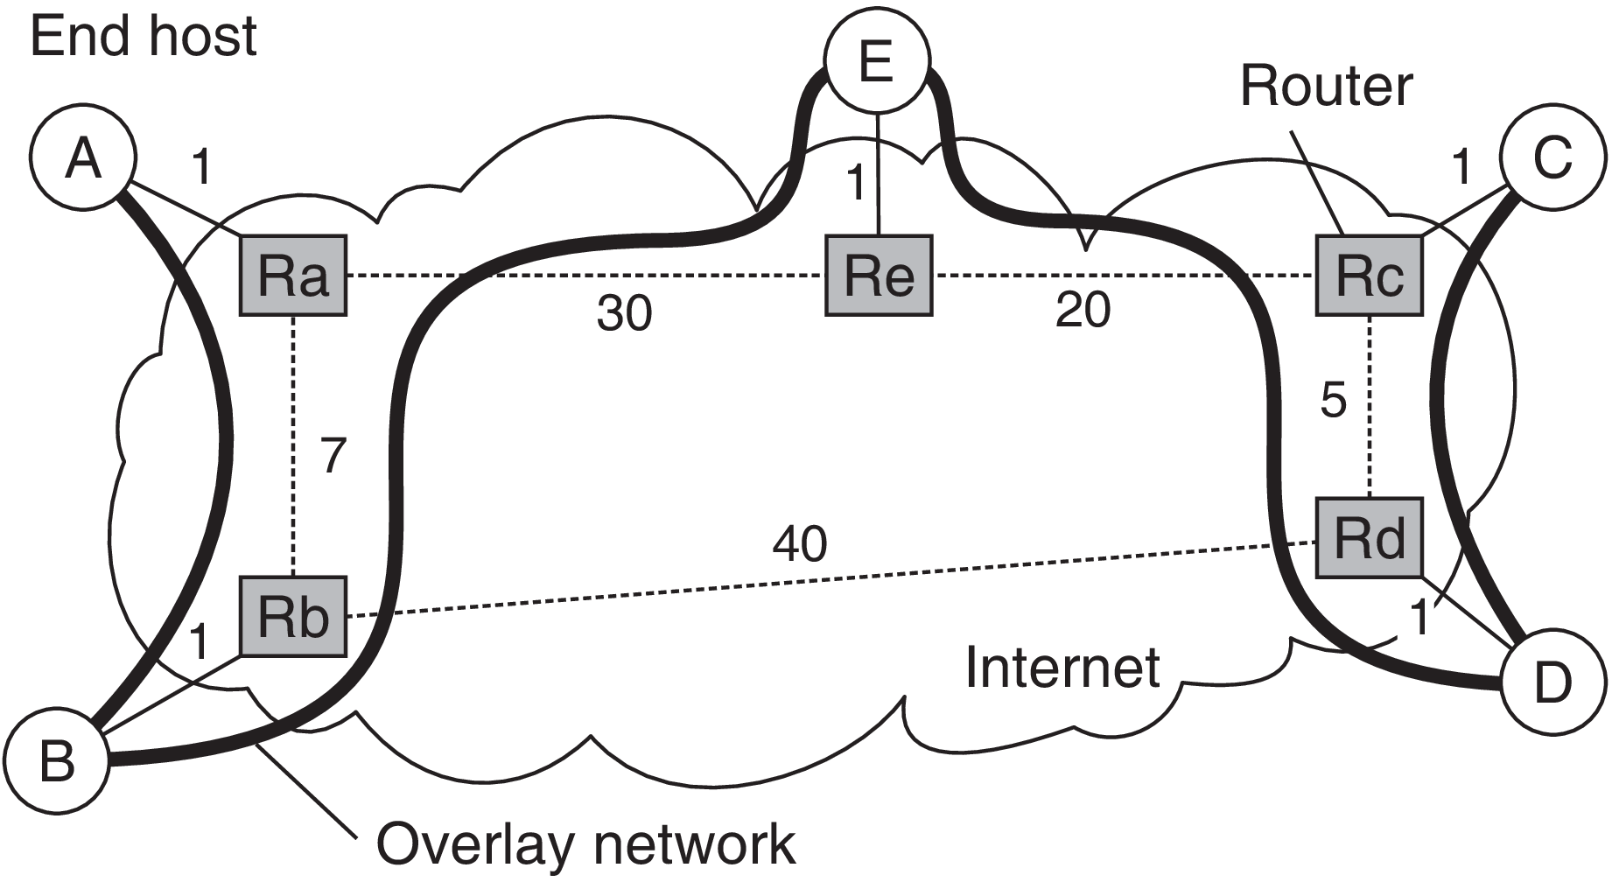
Figure 4.35: The relation between links in an overlay and actual network-level routes.

Slide 131
The overlay network would have been more efficient if we had not constructed overlay links <B, E>, and <D, E>, but instead <A, E> and <C, E>. Such a configuration would have saved the double traversal across physical links <Ra, Rb> and <Rc, Rd>.
The quality of an application-level multicast tree is generally measured by three different metrics: link stress, stretch, and tree cost.
1) Link stress
This is defined per link and counts how often a packet crosses the same link.
A link stress greater than 1 comes from the fact that although at a logical level a packet may be forwarded along two different connections, part of those connections may actually correspond to the same physical link, as shown in Figure 4.35.

Slide 132
2) Stretch or Relative Delay Penalty (RDP)
This measures the ratio in the delay between two nodes in the overlay, and the delay that those two nodes would experience in the underlying network.
For example, messages from B to C follow the route
B → Rb → Ra → Re → E → Re → Rc → Rd → D → Rd → Rc → C
in the overlay network, having a total cost of 73 units.
However, messages would have been routed in the underlying network along the path
B → Rb → Rd → Rc → C
with a total cost of 47 units, leading to a stretch of 1.55. (i.e., 73/47)
When constructing an overlay network the aggregated stretch should be minimized.

Slide 133
3) Tree cost
A global metric related to minimizing the aggregated link costs.
For example, if the cost of a link is taken to be the delay between its two end nodes, then optimizing the tree cost reduces to finding a minimal spanning tree in which the total time for disseminating information to all nodes is minimal.

Slide 134
Flooding-based multicasting
If we assume that an overlay corresponds to a multicast group, and thus that we need to broadcast a message, a naive (Simple) way of doing so is to apply flooding.
In this case, each node simply forwards a message m to each of its neighbors, except to the one from which it received m.
If a node keeps track of the messages it received and forwarded, it can simply ignore duplicates.
We will roughly see twice as many messages being sent as there are links in the overlay network, making flooding quite inefficient.

Slide 135
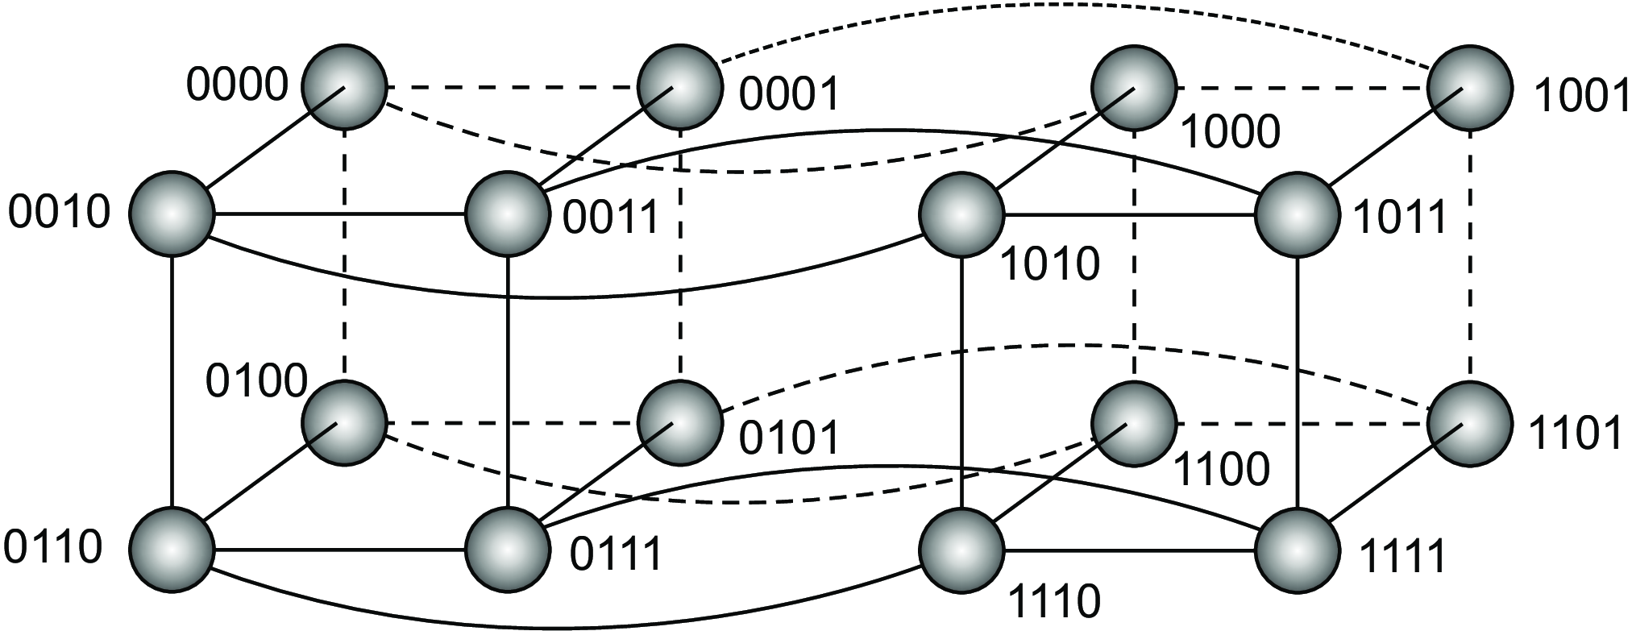
When dealing with a structured overlay, that is, one having a more or less deterministic topology, designing efficient flooding schemes is simpler. As an example, consider an n-dimensional hypercube, as in Figure 4.37 for the case n = 4.
Figure 4.37: A simple peer-to-peer system organized as a four-dimensional hypercube.

Slide 136
A simple and efficient broadcast scheme has been designed by Schlosser et al. and relies on keeping track of neighbors per dimension.
This is best explained by considering that every node in an n-dimensional hypercube is represented by a bit string of length n.
Each edge in the overlay is labeled with its dimension. For the case n = 4, node 0000 will have as its neighbors the set {0001, 0010, 0100, 1000}.
The edge between 0000 and 0001 is labeled “4” corresponding to changing the 4th bit when comparing 0000 to 0001 and vice versa. Likewise, the edge <0000, 0100> is labeled “2,” and so forth.
A node initially broadcasts a message m to all of its neighbors, and tags m with the label of the edge over which it sends the message.

Slide 137
1
Broadcasting node
4
1
4
3
2
3
4
1
2
2
4
3
4
3
Broad-
casting
node
1
A simple peer-to-peer system with few labelled edges
→ Edges are labeled in blue
→ Forwarding along edges with higher dimension.

Slide 138
Example: If node 1001 broadcasts a message, it will send the following:
(m , 1) to 0001
• (m , 2) to 1101
• (m , 3) to 1011
• (m , 4) to 1000
When a node receives a broadcast message, it will forward it only along edges that have a higher dimension.
Example, node 1101 will forward m only to nodes 1111 (joined to 1101 by an edge labeled “3”) and 1100 (joined by an edge with label “4”).

Slide 139
Gossip-based data dissemination
An important technique for disseminating information is to rely on epidemic behavior, also referred to as gossiping.
Observing how diseases spread among people, this approach was designed to spread information in very large-scale distributed systems.
The main goal of these epidemic protocols is to rapidly propagate information among a large collection of nodes using only local information. There is no central component by which information dissemination is coordinated.
We assume that all updates for a specific data item are initiated at a single node.

Slide 140
Information dissemination models
Epidemic algorithms are based on the theory of epidemics, which studies the spreading of infectious diseases.
In the case of large-scale distributed systems, instead of spreading diseases, they spread information.
Research on epidemics for distributed systems also aims at a completely different goal: whereas health organizations will do their utmost best to prevent infectious diseases from spreading across large groups of people, designers of epidemic algorithms for distributed systems will try to “infect” all nodes with new information as fast as possible.

Slide 141
Using the terminology from epidemics, a node that is part of a distributed system is called infected if it holds data that it is willing to spread to other nodes.
A node that has not yet seen this data is called susceptible.
Finally, an updated node that is not willing or able to spread its data is said to have been removed.
We assume we can distinguish old from new data, for example, because it has been timestamped or versioned. In this light, nodes are also said to spread updates.

Slide 142
A popular propagation model is that of anti-entropy. In this model, a node P picks another node Q at random, and subsequently exchanges updates with Q. There are three approaches to exchanging updates:
1. P only pulls in new updates from Q
2. P only pushes its own updates to Q
3. P and Q send updates to each other (i.e., a push-pull approach)
Pushing updates are not efficient for rapidly spreading updates. Here, updates can be propagated only by infected nodes. However, if many nodes are infected, the probability of each one selecting a susceptible node is relatively small.
Consequently, chances are that a particular node remains susceptible for a long period simply because it is not selected by an infected node.

Slide 143
Pull-based approach works much better when many nodes are infected. In that case, spreading updates is essentially triggered by susceptible nodes.
Chances are big that such a node will contact an infected one to subsequently pull in the updates and become infected as well.
If only a single node is infected, updates will rapidly spread across all nodes using either form of anti-entropy, although push-pull remains the best strategy.
Round: A spanning period in which every node will have taken the initiative once to exchange updates with a randomly chosen other node.
It can then be shown that the number of rounds to propagate a single update to all nodes takes O(log(N)), where N is the number of nodes in the system.

Slide 144
Rumor spreading
This is a specific variant of epidemic protocols.
Working
If node P has just been updated for data item x, it contacts an arbitrary other node Q and tries to push the update to Q. However, it is possible that Q was already updated by another node. In that case, P may lose interest in spreading the update any further, say with probability p_{stop}. In other words, it then becomes removed.
Rumor spreading is gossiping analogous to real life. When Bob has some hot news to spread around, he may phone his friend Alice telling her all about it. Alice, like Bob, will be really excited to spread the rumor to her friends as well. However, she will become disappointed when phoning a friend, say Chuck, only to hear that the news has already reached him. Chances are that she will stop phoning other friends, for what good is it if they already know?

Slide 145
Directional gossiping
For wide-area systems the actual network topology is taken into account to achieve better results.
In that case, nodes that are connected to only a few other nodes are contacted with a relatively high probability.
The underlying assumption is that such nodes form a bridge to other remote parts of the network; therefore, they should be contacted as soon as possible.
This approach is referred to as directional gossiping.

Slide 146
Removing data
Epidemic algorithms have side-effect: spreading the deletion of a data item is hard. Deletion of a data item destroys all information on that item.
Consequently, when a data item is simply removed from a node, that node will eventually receive old copies of the data item and interpret those as updates on something it did not have before.
The trick is to record the deletion of a data item as just another update, and keep a record of that deletion.
In this way, old copies will not be interpreted as something new, but merely treated as versions that have been updated by a delete operation.
The recording of a deletion is done by spreading death certificates.

Slide 147
The problem with death certificates is that they should eventually be cleaned up, or otherwise each node will gradually build a huge local database of historical information on deleted data items that is otherwise not used.
Dormant death certificates: Each death certificate is timestamped when it is created. If it can be assumed that updates propagate to all nodes within a known finite time, then death certificates can be removed after this maximum propagation time has elapsed.
However, to provide hard guarantees that deletions are indeed spread to all nodes, only a very few nodes maintain dormant death certificates that are never thrown away.
Assume node P has such a certificate for data item x. If by any chance an obsolete update for x reaches P, P will react by simply spreading the death certificate for x again.

Slide 148
~ ~ ~ END ~ ~ ~

