Slide 1
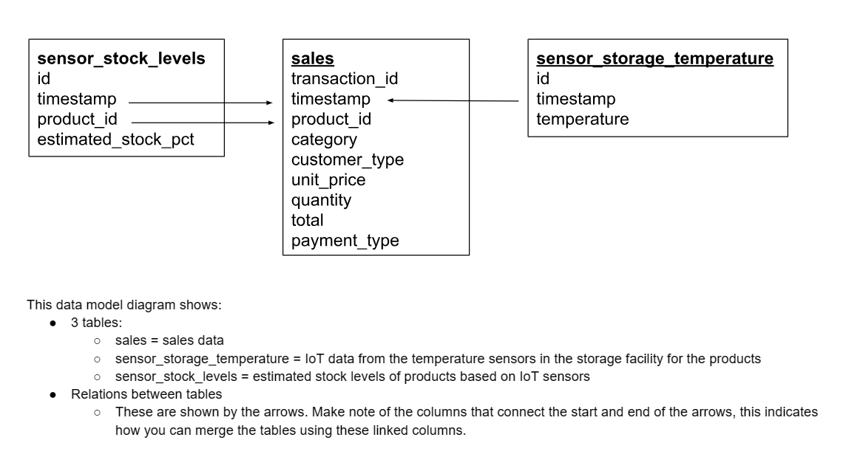
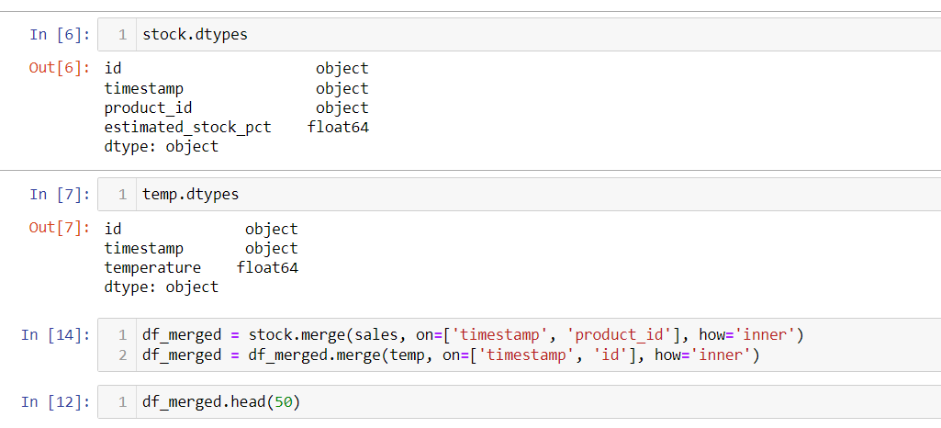
Model Training and Testing on the new data sets acquired
We initially only had the dataset sales on which performing ML did not yield any valuable insights, so we were given new datasets: Sensor stock levels and sensor storage temperature. My plan was to merge the datasets based on the design provided. However, we cannot merge these datasets since there are no common values in the fields as one can see in the images gives below. This was also verified by me using MS Excel and multiple values among the datasets.(Link to my other ML projects) .So, the datasets are virtually independent and hence cannot be merged and no new insights can be derived. However, the next slide contains insights from the previous tasks if this sufficiently solves the problem.

Slide 2
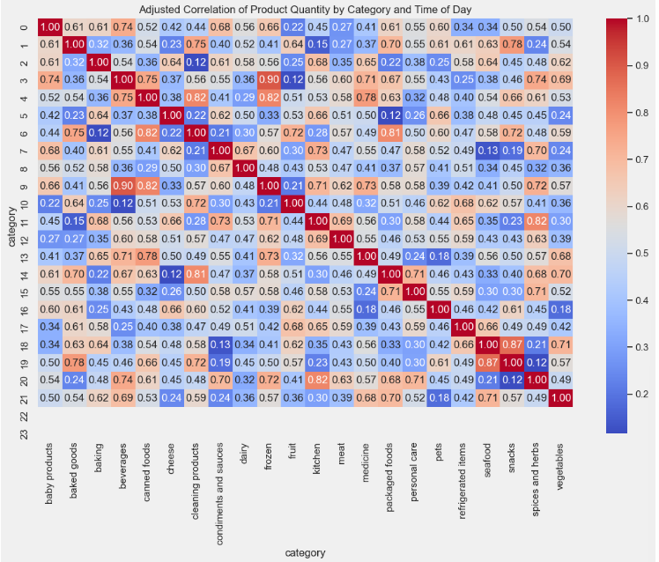
Attached link to the notebook file
In the image below we can see what product is sold most at what time of the day. So, Gala Store can make sure to stock more quantities of that product at that time of the day.

