Slide 1
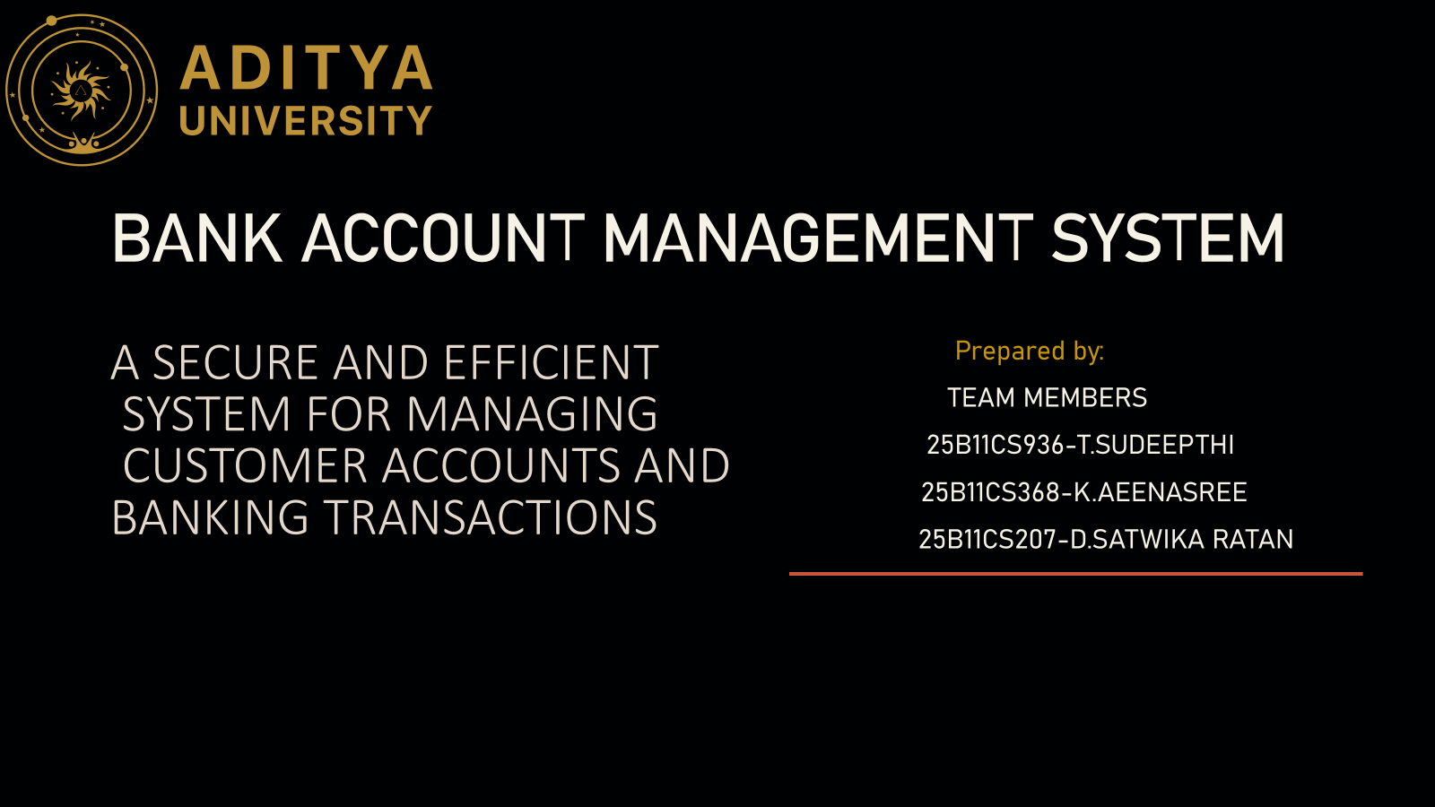

Slide 2
1. Project Abstract
The Bank Account Management System is designed to manage customer details, bank accounts and transactions in a centralized database. It supports account creation, deposits, withdrawals, balance enquiry and transaction history. The system aims to reduce manual work and errors while improving data security, consistency and accessibility. It uses DBMS concepts such as primary keys, foreign keys, authentication and transaction management.
ADITYA UNIVERSITY
2

Slide 3
2. Problem Statement
• Manual handling of bank accounts and transactions can be time-consuming and error-prone.
• Customers need quick access to account details, deposits, withdrawals and transaction history.
• Bank staff require a centralized system to manage customer information securely.
• The system should reduce duplication, improve accuracy and provide controlled access.
ADITYA UNIVERSITY
3

Slide 4
3. Objectives
• Create and manage customer bank accounts efficiently.
• Record deposits, withdrawals and other transactions accurately.
• Maintain current account balance and transaction history.
• Provide secure authentication and role-based access.
• Reduce manual work, data redundancy and transaction errors.
• Generate useful account and transaction reports.
ADITYA UNIVERSITY
4

Slide 5
4. End Users
CUSTOMER
BANK STAFF
ADMIN / DBA
Views account details, balance and transaction history.
Can request or perform permitted transactions.
Creates and updates customer accounts.
Processes deposits, withdrawals and service requests.
Manages users, permissions, database security, backup and system maintenance.
ADITYA UNIVERSITY
5

Slide 6
5. Functional Requirements
• Customer registration and profile management.
• Account creation, activation and closure.
• Deposit and withdrawal processing.
• Balance enquiry and transaction history.
• Customer and account search.
• Authentication, authorization and audit records.
• Reports for accounts and transactions.
ADITYA UNIVERSITY
6

Slide 7
6. Non-Functional Requirements
• Security – protect customer and transaction data.
• Reliability – transactions must be recorded correctly.
• Performance – common queries should respond quickly.
• Availability – authorized users should be able to access the system when required.
• Scalability – support growth in customers and transactions.
• Maintainability – database and application should be easy to update.
ADITYA UNIVERSITY
7

Slide 8
7. System Architecture
CLIENT / UI
→
APPLICATION LAYER
→
DBMS
→
DB
Customer & staff screens
Login, account and transaction forms
Authentication
Business rules
Transaction processing
SQL queries
Constraints
Transactions
Security
Customers
Accounts and
Transactions
Users interact through the application; the DBMS stores and protects the persistent data.
ADITYA UNIVERSITY
8

Slide 9
Entities, Keys, Relationships and Justification
Entity | Primary Key | Foreign Key
Bank | Bank_ID | —
Branch | Branch_ID | Bank_ID
Employee | Employee_ID | Branch_ID
Customer | Customer_ID | —
Account | Account_ID | Customer_ID, Branch_ID
Savings Account | Account_ID | Account_ID
Current Account | Account_ID | Account_ID
Transaction | Transaction_ID | Account_ID
Loan | Loan_ID | Customer_ID
Relationship | Card. | Justification
Bank has Branch | 1 : M | One bank runs many branches; each branch belongs to one bank.
Branch employs Employee | 1 : M | A branch has many employees; each employee works at one branch.
Branch maintains Account | 1 : M | A branch holds many accounts; each account is kept at one branch.
Customer owns Account | 1 : M | A customer can hold many accounts; each account has one owner.
Account records Transaction | 1 : M | An account has many transactions; each belongs to one account.
Customer applies Loan | 1 : M | A customer can take many loans; each loan belongs to one customer.
Account ISA Savings / Current | ISA | An account is either Savings or Current, sharing Account_ID.
ADITYA UNIVERSITY
11

Slide 10
Relational Schema
Table | Attributes
BANK | Bank_ID (PK), Bank_Name, Address
BRANCH | Branch_ID (PK), Branch_Name, Address, IFSC_Code, Bank_ID (FK → Bank)
EMPLOYEE | Employee_ID (PK), Employee_Name, Position, Join_Date, Branch_ID (FK → Branch)
EMPLOYEE_PHONE | Employee_ID (FK → Employee), Phoneno [PK: Employee_ID + Phoneno]
CUSTOMER | Customer_ID (PK), First_Name, Last_Name, Email, Address
CUSTOMER_PHONE | Customer_ID (FK → Customer), Phoneno [PK: Customer_ID + Phoneno]
ACCOUNT | Account_ID (PK), Open_Date, Balance, Customer_ID (FK → Customer), Branch_ID (FK → Branch)
SAVINGS_ACCOUNT | Account_ID (PK, FK → Account), Interest_Rate
CURRENT_ACCOUNT | Account_ID (PK, FK → Account), Overdraft_Amount
TRANSACTION | Transaction_ID (PK), Transaction_Type, Transaction_Date, Amount, Account_ID (FK → Account)
LOAN | Loan_ID (PK), Loan_Type, Loan_Amount, Interest_Rate, Loan_Date, Customer_ID (FK → Customer)
Multivalued Phoneno → separate phone tables. Composite Name → First_Name, Last_Name. Derived Age is not stored. ISA → Savings/Current share Account_ID.
ADITYA UNIVERSITY
10

Slide 11
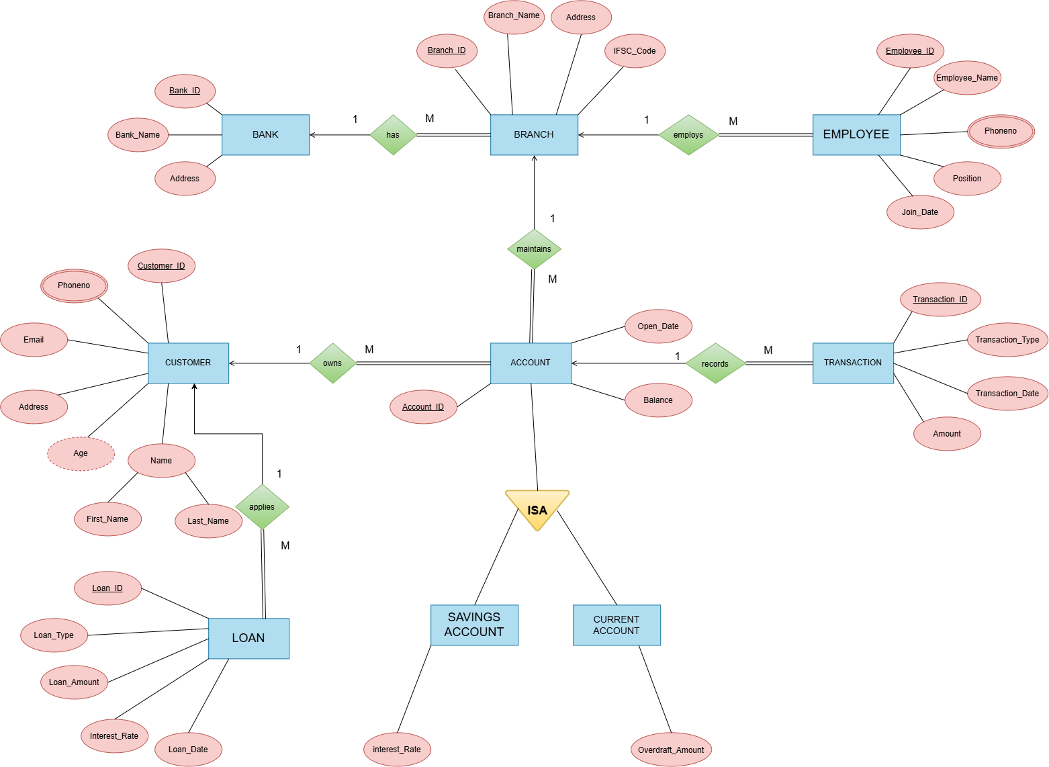
ER DIAGRAM

Slide 12
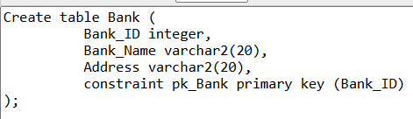
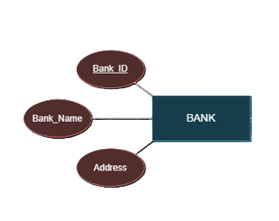
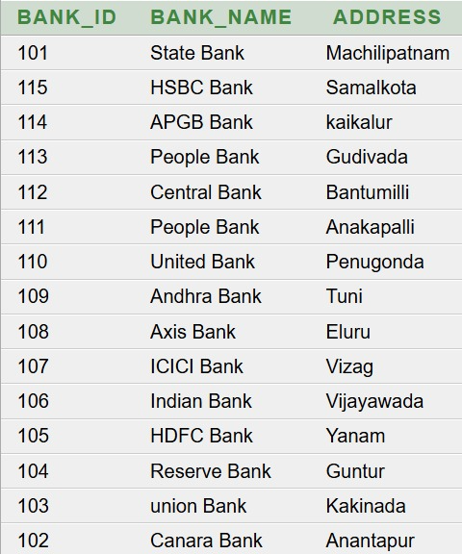
2.BANK TABLE

Slide 13
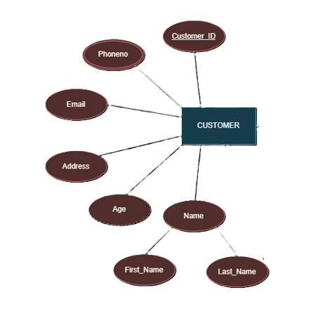
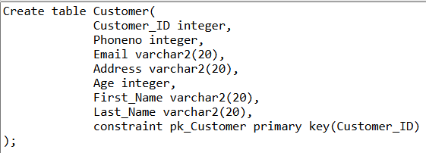
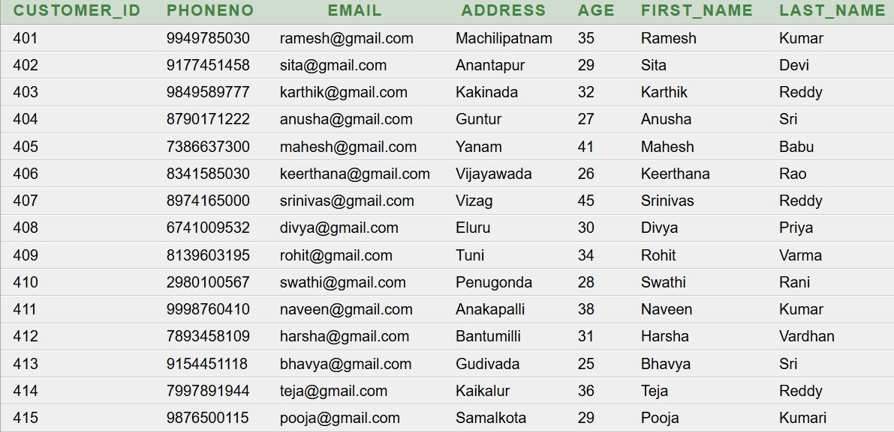
ENTITY SET TO TABLES
1.CUSTOMER TABLE

Slide 14
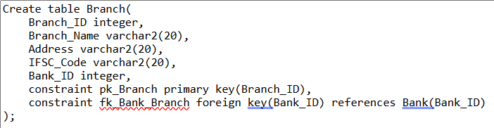
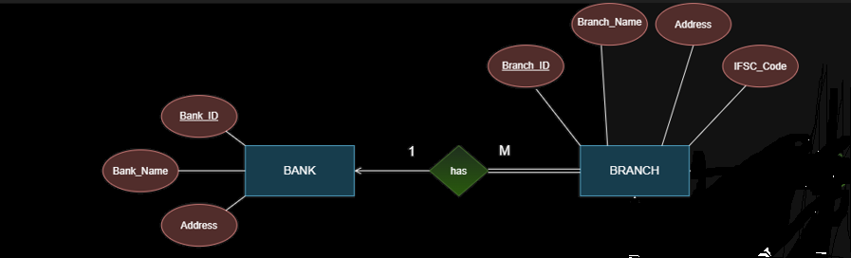
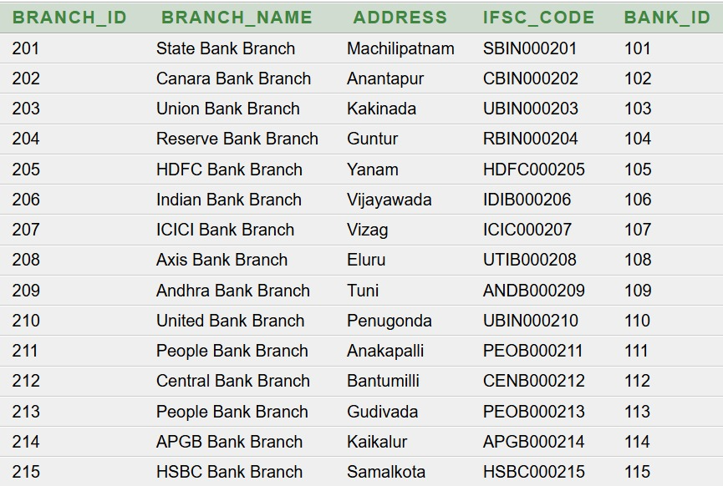
3.BRANCH TABLE

Slide 15
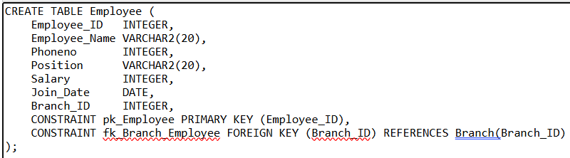
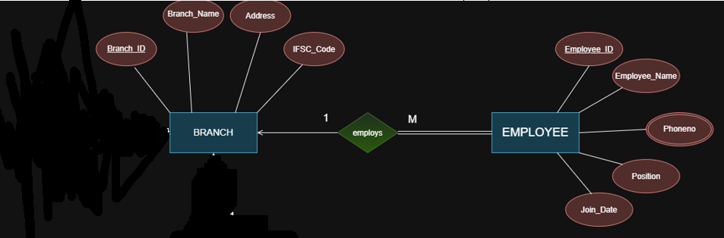
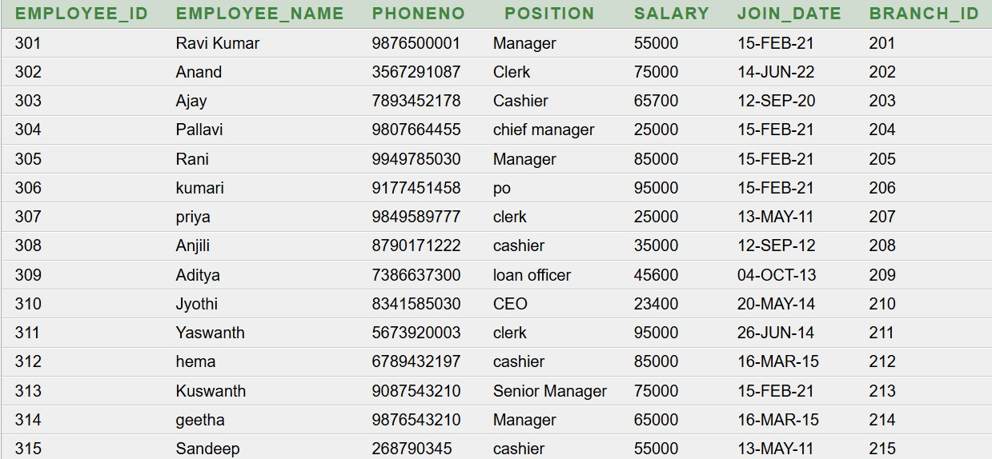
4.EMPLOYEE TABLE

Slide 16
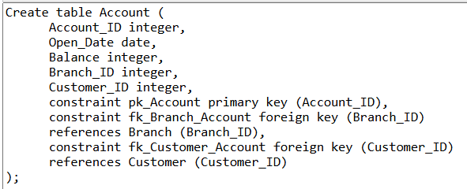
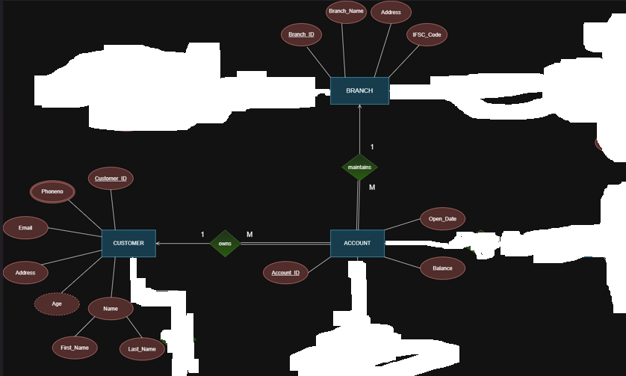
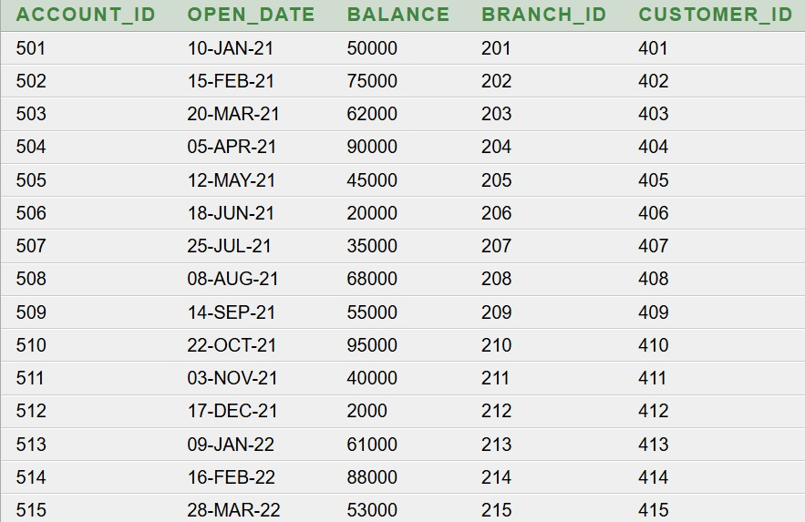
5.ACCOUNT TABLE

Slide 17
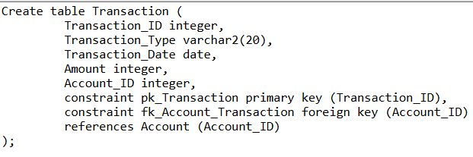
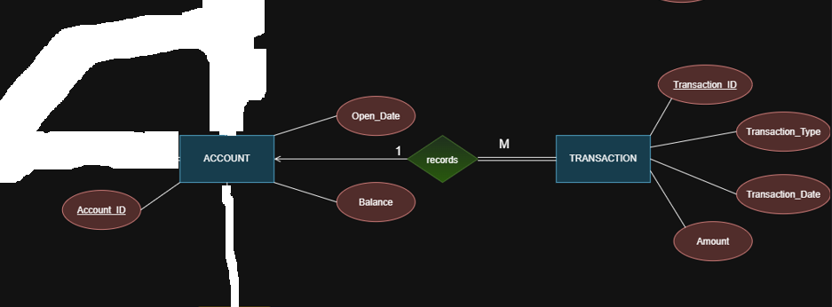
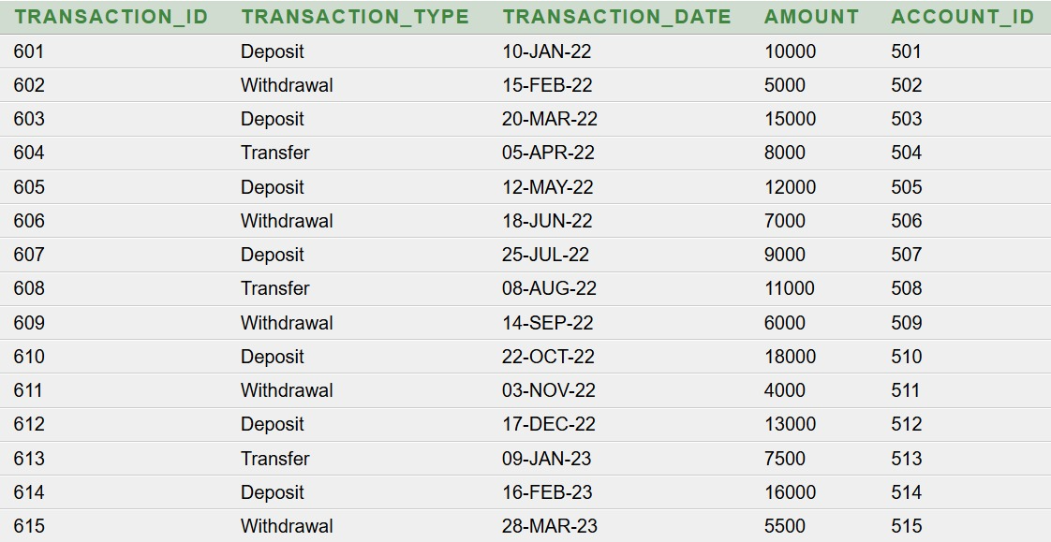
6.TRANSACTION TABLE

Slide 18
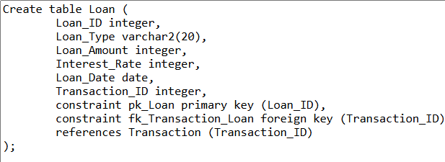
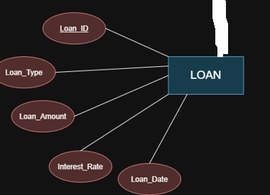
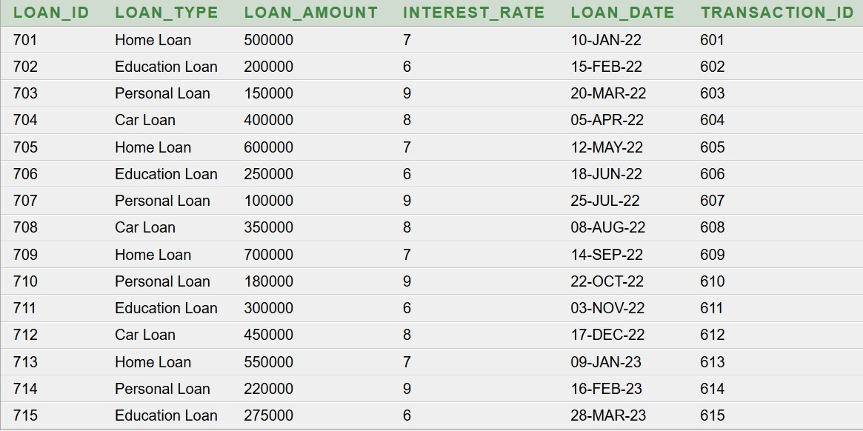
7.LOAN TABLE

Slide 19
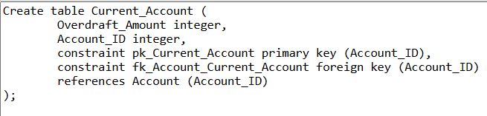
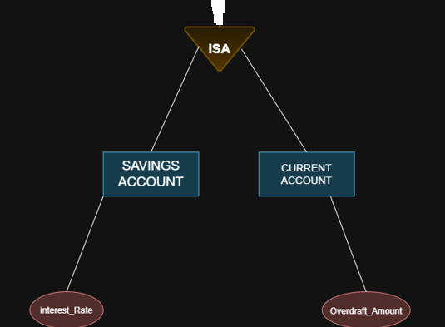
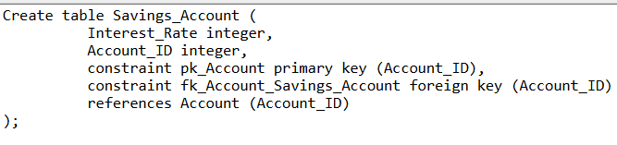
8.CURRENT_ACCOUNT TABLE
9.SAVINGS_ACCOUNT TABLE

Slide 20
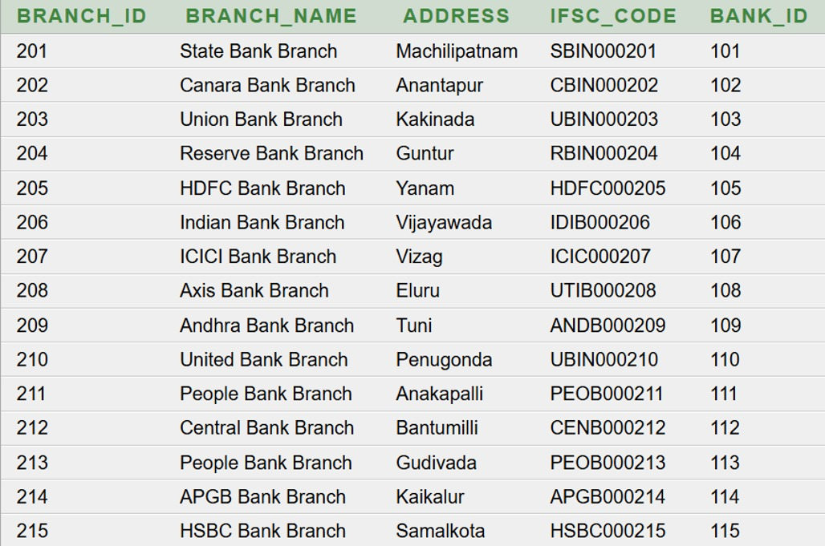
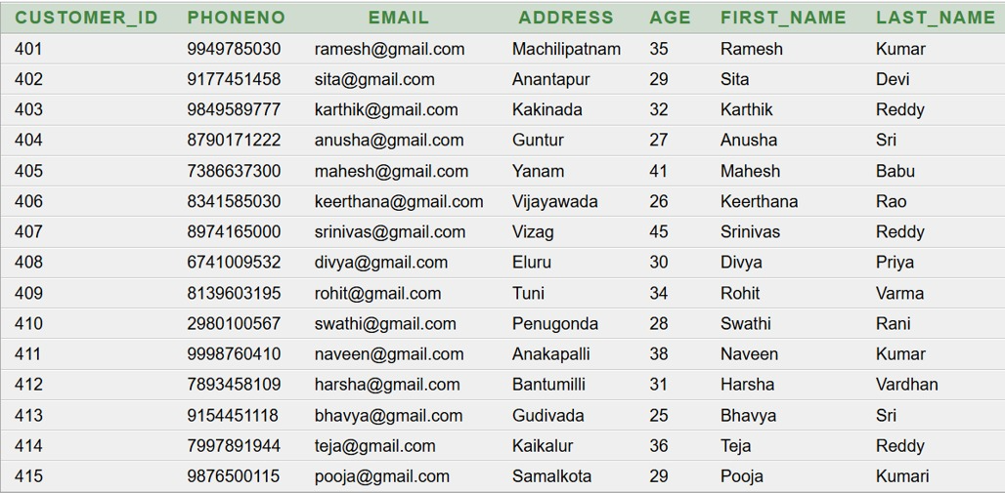
QUERIES
BASIC QUERIES
Query 1: DISPLAY ALL BRANCHES
Query 2: DISPLAY ALL CUSTOMERS
Select * from branch;
Select * from customer;

Slide 21
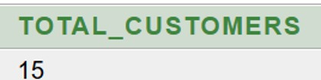
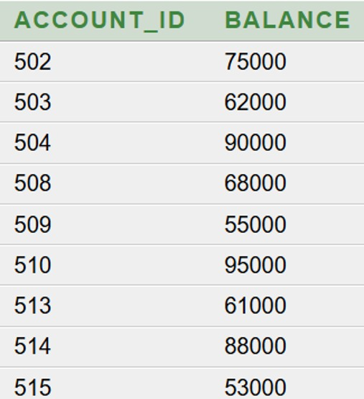
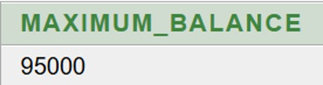
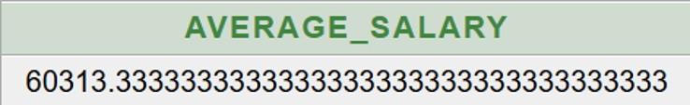
Query 3: DISPLAY ACCOUNTS HAVING BALANCE GREATER THAN 50000.
Query 4: Count the total number of customers.
SELECT COUNT(*) AS total_customers
FROM customer;
Select account_id, balance
From account
Where balance > 50000;
Query 5: Find the maximum account balance.
Query 6: Find the average salary of employee.
SELECT MAX(balance) AS maximum_balance
FROM account;
SELECT AVG(salary) AS average_salary
FROM employee;

Slide 22
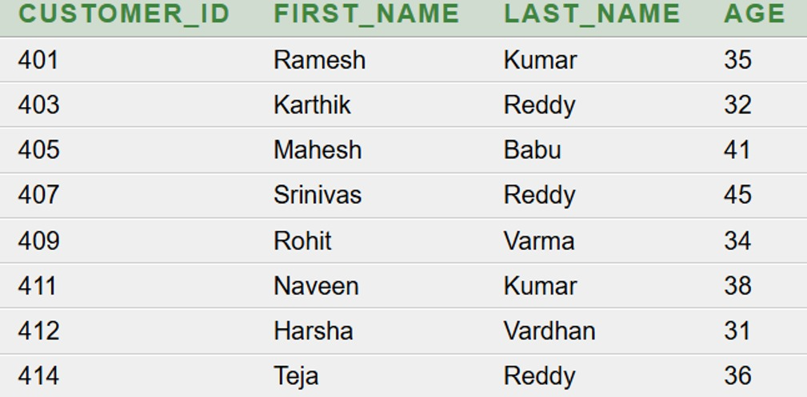
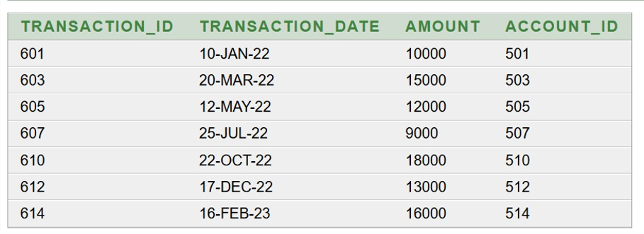
Query 7:Display customers whose age is greater than 30.
Query 8: Display all deposit transactions
SELECT customer_id, first_name, last_name, age
FROM customer
WHERE age > 30;
select transaction_id, transaction_date, amount, account_id from transaction where transaction_type = 'Deposit';

Slide 23
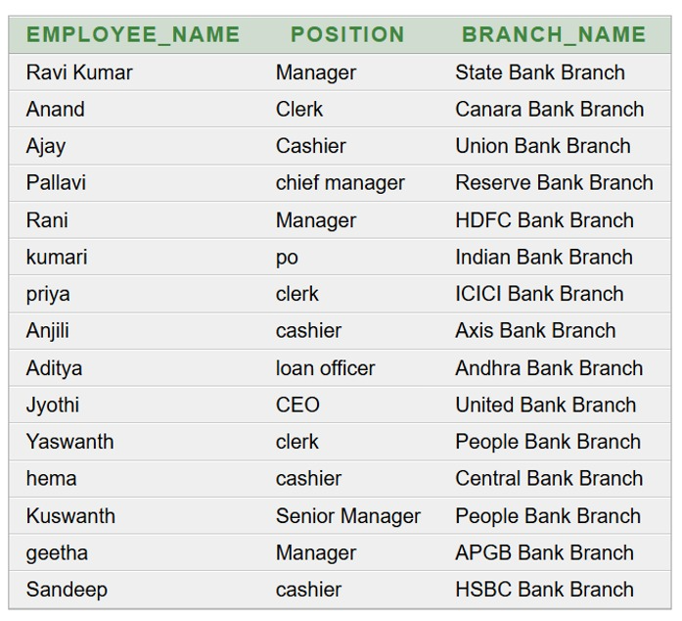
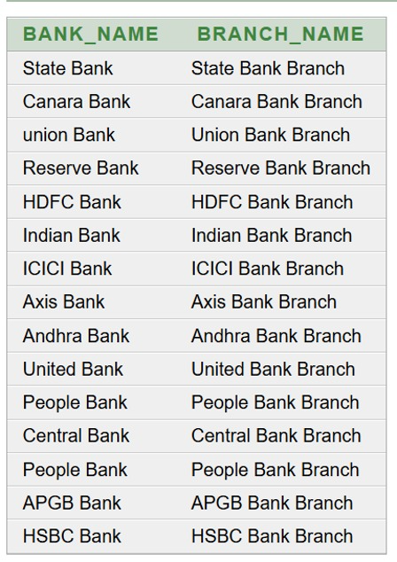
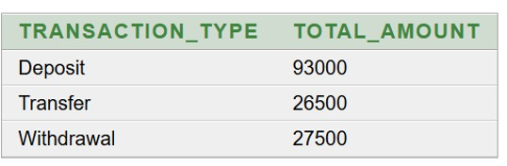
Query 9: Display bank names along with their branch names
Query 10: Display employee names along with their branch names
select b.bank_name, br.branch_name from bank b, branch br where b.bank_id = br.bank_id;
select e.employee_name, e.position, br.branch_name from employee e, branch br where e.branch_id = br.branch_id;
Query 11: Find the total transaction amount for each transaction type
select transaction_type, sum(amount) as total_amount from transactiongroup by transaction_type;

Slide 24
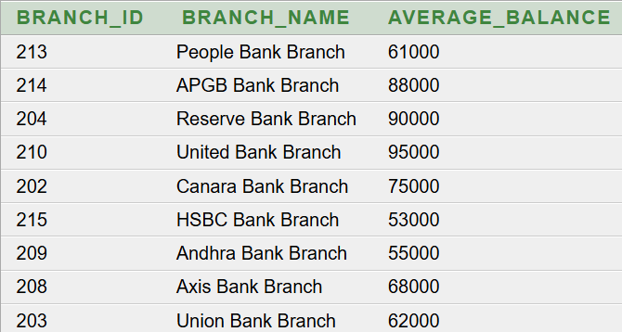
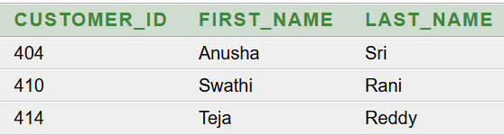
Query 12:
Display customers who have at least one account
with balance greater than 80000
select customer_id, first_name, last_name
from customer
where customer_id in
(select customer_id
from account
where balance > 80000);
Query 13:
Find branches whose average account balance
is greater than 50000
select br.branch_id, br.branch_name,
avg(a.balance) as average_balance
from branch br
join account a
on br.branch_id = a.branch_id
group by br.branch_id, br.branch_name
having avg(a.balance) > 50000;

Slide 25
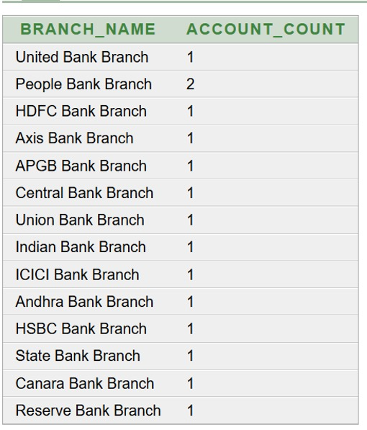
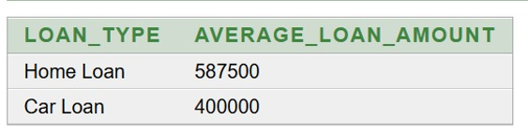
Query 14 :Find the number of accounts in each branch
Query 15: Find loan types whose average loan amount is greater than 300000
select br.branch_name, count(a.account_id) as account_count from branch br, account a where br.branch_id = a.branch_idgroup by br.branch_name;
select loan_type, avg(loan_amount) as average_loan_amount from loangroup by loan_typehaving avg(loan_amount) > 300000;

Slide 26
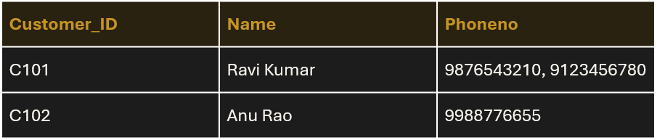
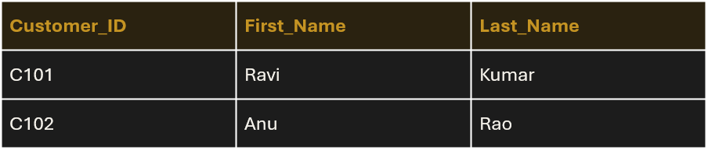
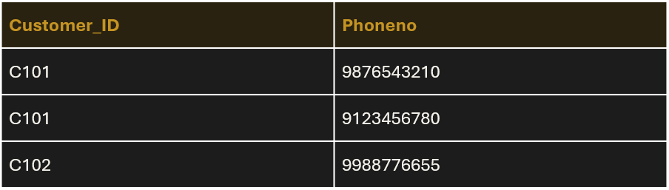
First Normal Form (1NF)
1NF: every column holds a single atomic value – no repeating groups or multi-valued cells.
BEFORE (violates the rule)
AFTER (rule satisfied)
CUSTOMER (Phoneno stores many values in one cell)
CUSTOMER (Name split into atomic columns)
Problem: two phone numbers sit in one cell, so searching or updating a single number is hard.
CUSTOMER_PHONE (one number per row)
Result: multi-valued Phoneno moved to its own table – 1NF.
ADITYA UNIVERSITY
16

Slide 27
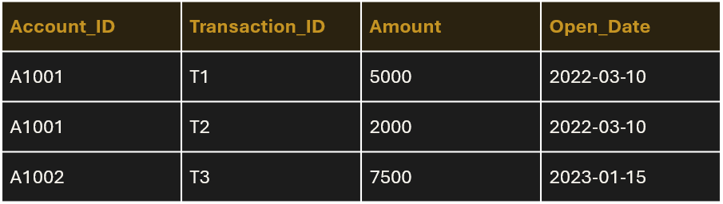
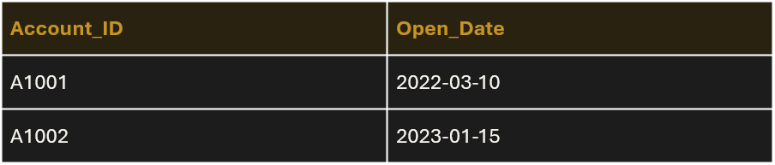
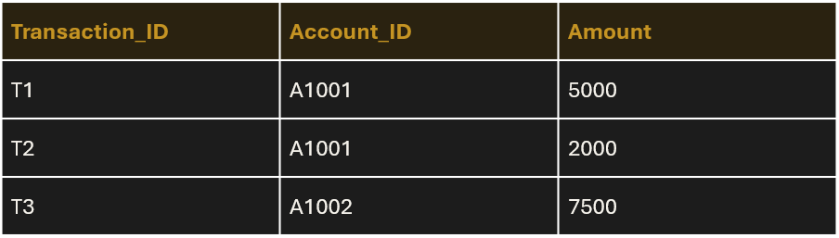
Second Normal Form (2NF)
2NF: 1NF + no partial dependency – every non-key attribute depends on the whole composite key.
BEFORE (violates the rule)
AFTER (rule satisfied)
ACCOUNT_TXN (PK: Account_ID + Transaction_ID)
ACCOUNT (Account_ID → Open_Date)
TRANSACTION (Transaction_ID → Account_ID, Amount)
Problem: Open_Date depends only on Account_ID (part of the key), so it repeats for every transaction of that account.
Result: partial dependency removed – 2NF.
ADITYA UNIVERSITY
17

Slide 28
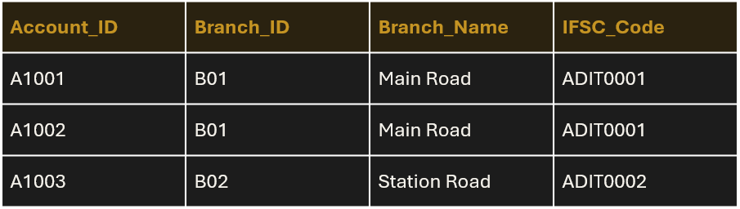
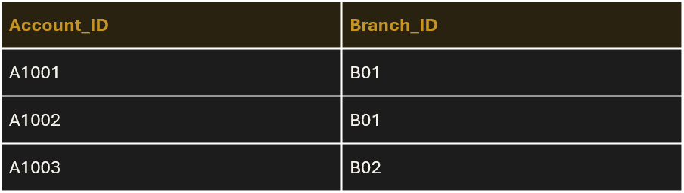
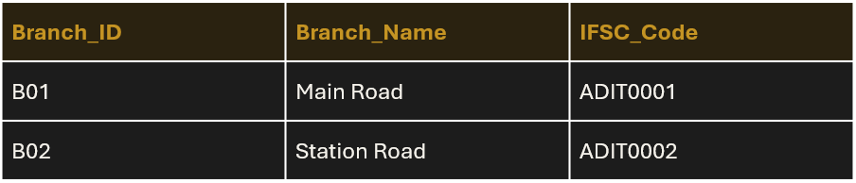
Third Normal Form (3NF)
3NF: 2NF + no transitive dependency – non-key attributes depend only on the key.
BEFORE (violates the rule)
AFTER (rule satisfied)
ACCOUNT (Branch details stored inside Account)
ACCOUNT (keeps only Branch_ID as FK)
Problem: Account_ID → Branch_ID → Branch_Name, IFSC_Code (transitive). Branch details repeat for every account.
BRANCH (branch details stored once)
Result: transitive dependency removed – 3NF.
ADITYA UNIVERSITY
18

Slide 29
Conclusion
The Bank Account Management System provides a secure and organized way to manage customers, accounts and transactions.
The ER design was converted to a normalized (3NF) relational schema with clear keys and relationships.
Using a DBMS improves data consistency, security, transaction reliability and accessibility.
ADITYA UNIVERSITY
19

Slide 30
THANK YOU
Any questions?
ADITYA UNIVERSITY
20

