Slide 1
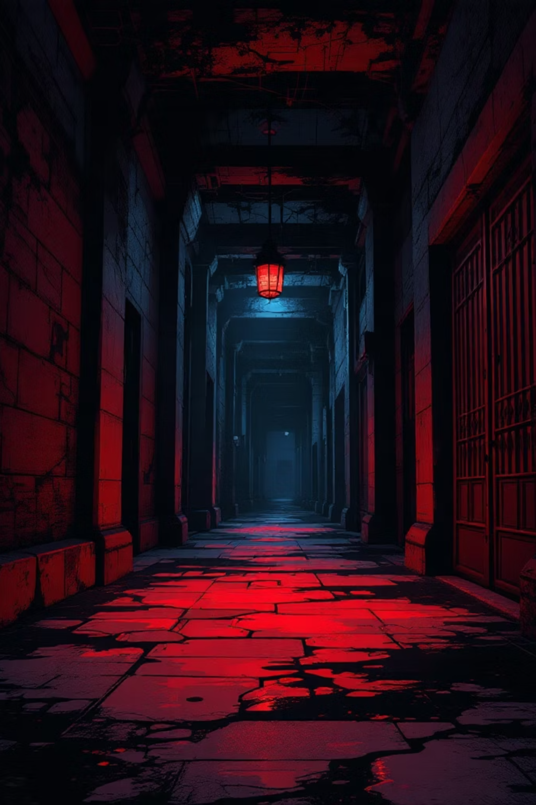
DarkMaze
A procedural horror maze game built in Unity
Survive the maze, collect the trinkets, and escape the entity.

Slide 2
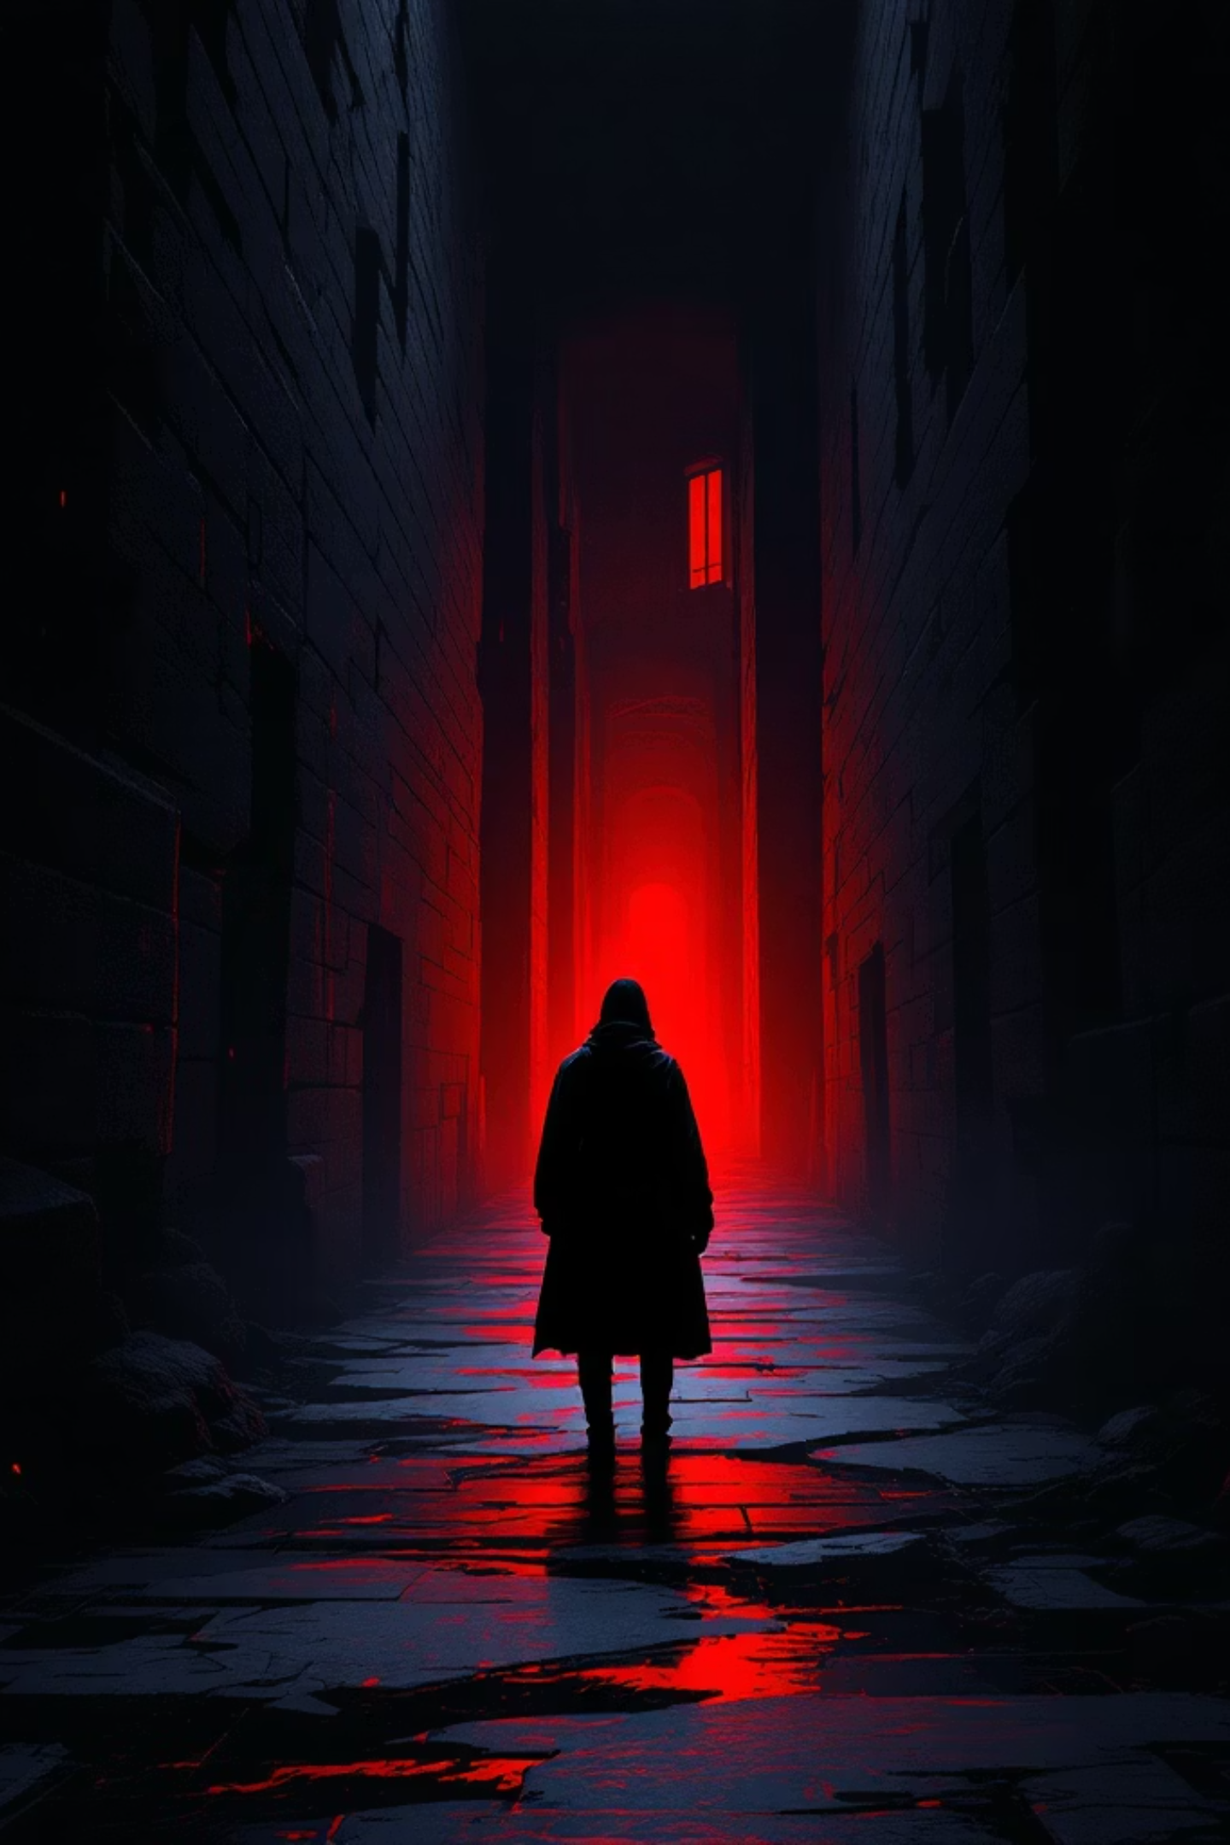
What is DarkMaze?
A third-person horror maze game where players explore a procedurally generated labyrinth, avoid demonic enemies, and collect trinkets. The final goal is to find the hidden 14th trinket and reach the exit.
Core promise: Exploration feels tense because the maze changes every run and danger is always nearby. This isn't just a maze game—it combines survival, stealth, and horror atmosphere into one terrifying experience.

Slide 3

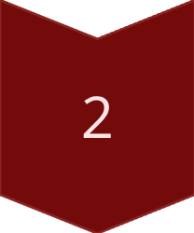




The Gameplay Loop
Spawn
Enter a newly generated maze
Navigate
Search corridors for trinkets
Avoid
Manage stamina and use flashlight wisely
Collect
Gather 14 trinkets to unlock escape
Escape
Reach the exit to survive
Tension Systems
Sprinting drains stamina rapidly
Crouching reduces detection chance
Flashlight helps visibility but reveals your position
Enemy proximity triggers heartbeat feedback

Slide 4
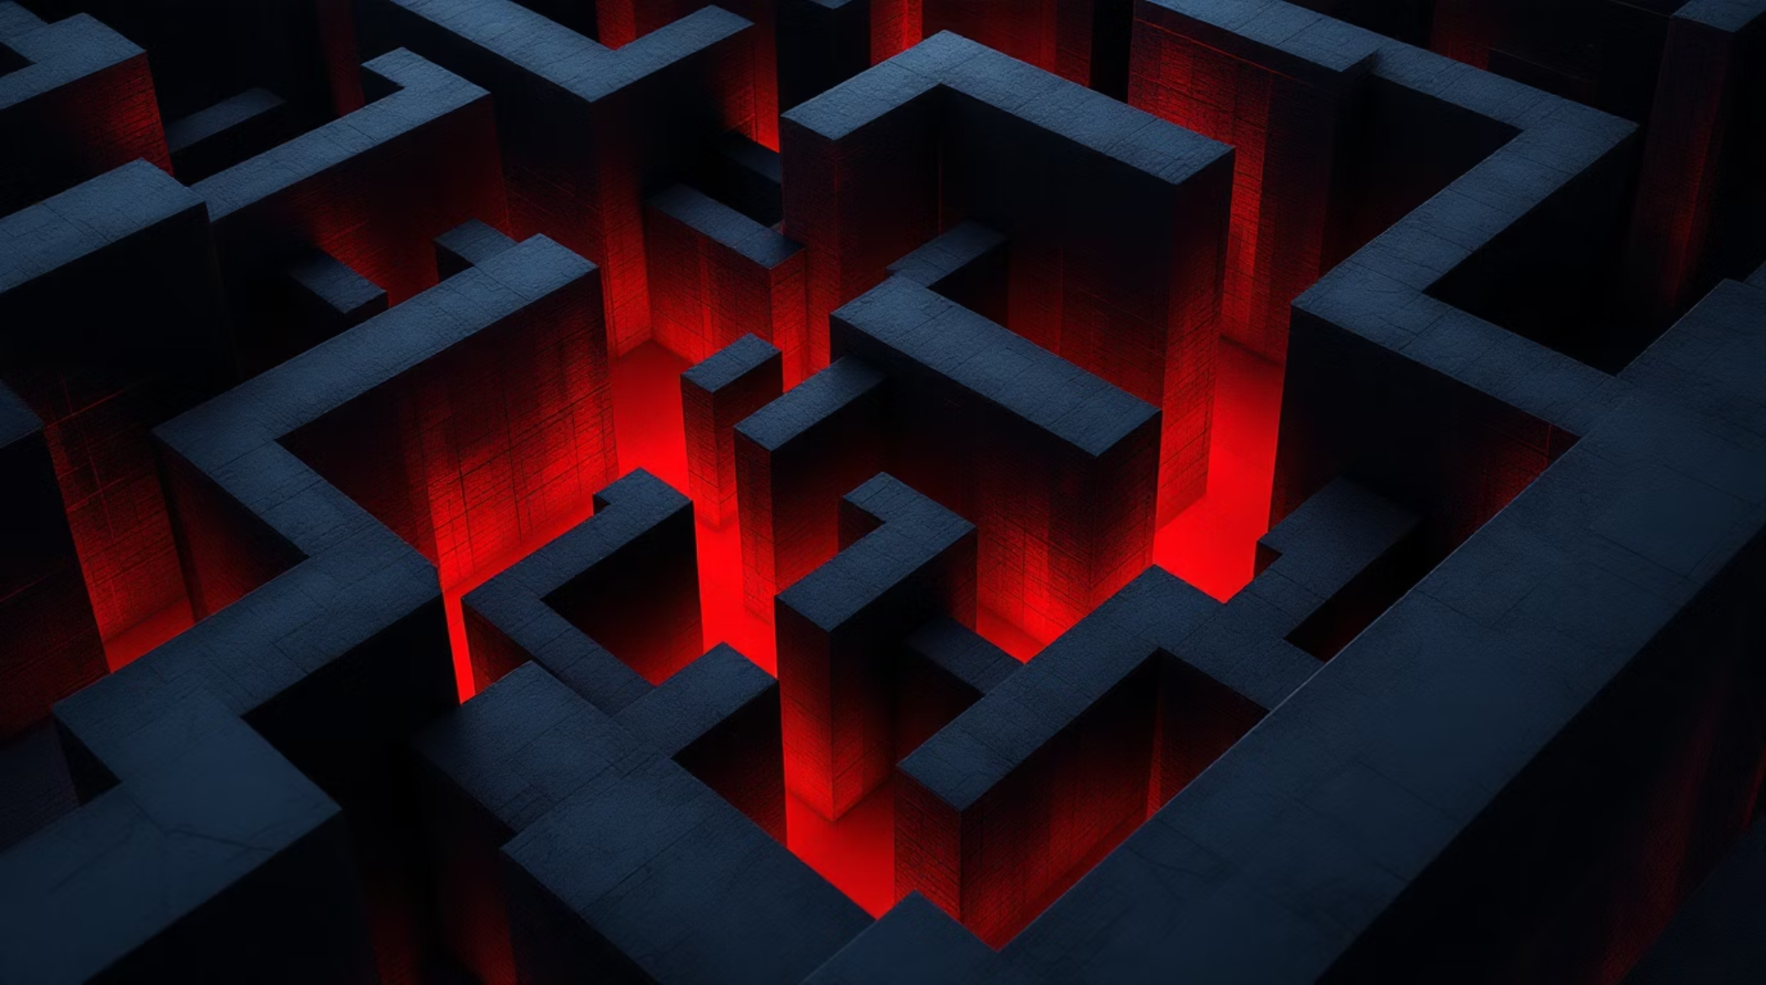
Procedural Maze Generation
How It Works
The maze is built at runtime using recursive backtracking algorithms. Dynamic wall, floor, and exit placement ensures each playthrough feels unique. Runtime NavMesh generation supports intelligent enemy movement.
Dead ends and edge cells naturally spread collectibles throughout the labyrinth.
Every Playthrough Different
Designed Readability
Infinite Replayability
Content placement keeps the map readable while maintaining unpredictability
The layout supports endless variations and strategic depth
Procedural generation guarantees fresh layouts and unexpected challenges

Slide 5
Player Systems & Controls
Movement & Actions
Resource Management
WASD or arrow keys for movement
Mouse look for camera control
Shift to sprint (drains stamina)
C or Ctrl to crouch
Space to jump
F to toggle flashlight
E to pick up trinkets
Esc to pause
Stamina Bar: Limits sustained sprinting, forcing strategic pacing
Health System: Hearts display survival state with damage feedback
Flashlight Battery: Drains while active, recharges when off
The player is vulnerable and must think before rushing. Every decision carries weight—sprint too much and you'll exhaust yourself; hide too long and the entity might find you.

Slide 6
Enemy Behavior
01
02
03
Patrol
Investigate
Chase
Enemies follow patrol routes through the maze
Noise and movement trigger investigation behavior
Direct line of sight initiates pursuit
04
05
Search
Return
Los of sight prompts area search patterns
Eventually returns to patrol after losing player
Detection Systems
Visual & Audio Cues
Vision cone for direct sight
Sound propagation for noise
Flashlight awareness
Red visual indicators intensify when enemies become aggressive. Heartbeat audio grows stronger as danger increases.
Design goal: The enemy feels smart without being unfair. Players are rewarded for crouching, moving carefully, and staying out of sight.

Slide 7
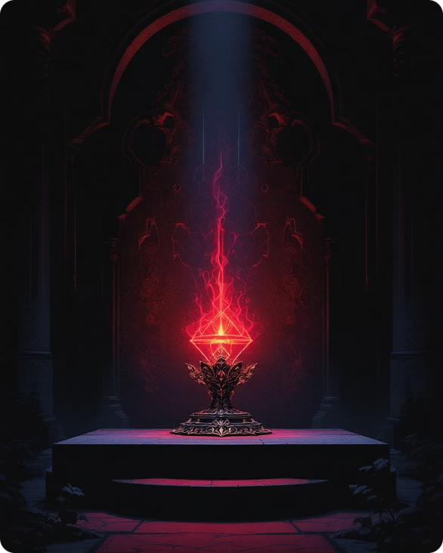
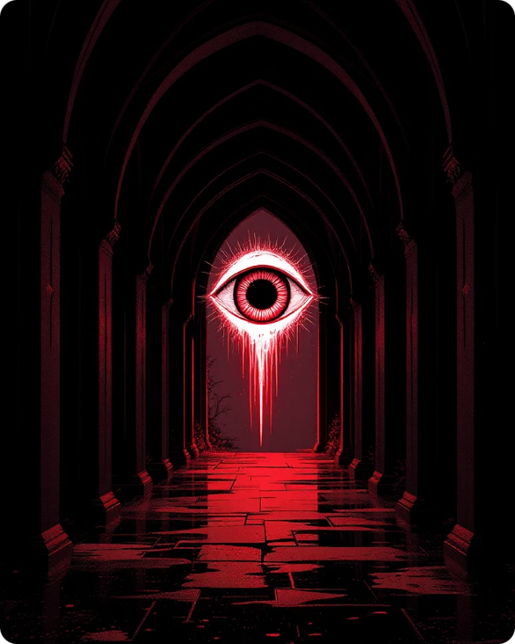
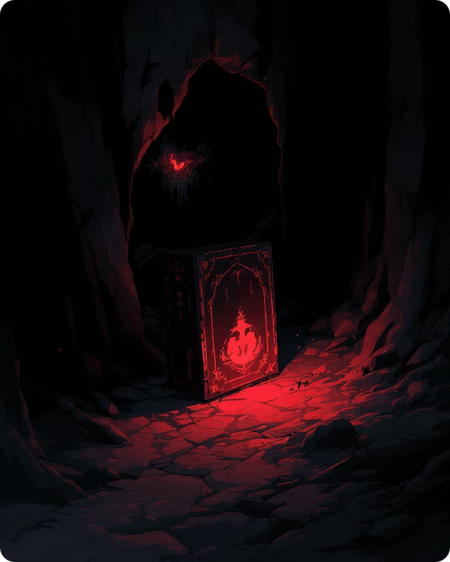


Collectibles & Guided Exploration
14 Trinkets
Guiding Eye
Hidden Final
Environmental Clues
Scattered throughout the maze for collection
Spectral entity guides players to most trinkets
The 14th trinket receives no direct guidance
Sky, fog, and ambient colors shift near the final trinket
Why it works: Early game feels guided and manageable. Late game becomes more mysterious and tense as the environment itself becomes part of the clue system.

Slide 8
UI & Player Feedback
Hud Elements
Visual & Audio Feedback
Minimap in upper-left corner
Trinket progress at top center
Stamina bar on lower-left
Flashlight battery indicator
Hearts and heartbeat warning
Damage flash on taking hits
Collection flash when gathering trinkets
Pause menu and game state screens
Death screen and win screen
The UI stays informative without breaking the horror tone. Players always know their current risk level through clear, immediate feedback systems.

Slide 9
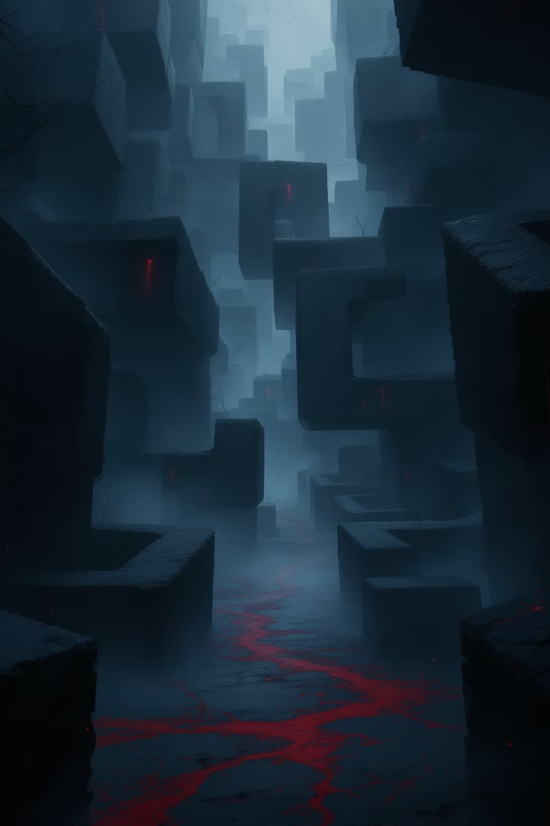
Atmosphere & Audio Design
Fog & Low Light
Creates claustrophobic feel with limited visibility
Soft Lighting
Pools of light and subtle color variation guide exploration
Procedural Audio
Ambient sounds synthesized at runtime for dynamic atmosphere
Heartbeat System
Audio grows stronger when enemies are near, intensifying tension
Visual Identity
Dark blue-gray palette establishes oppressive mood. Glowing trinkets and red enemy accents provide contrast. The spectral guiding eye serves as a memorable visual landmark throughout the labyrinth.

Slide 10
Technical Stack & Highlights
Core Tech
Engineering
Unity 6000.3.4f1
C# scripts
Input System package
uGUI with OnGUI HUD
NavMesh navigation
Bootstrap-driven scene setup
Single scene creates full game
Modular system separation
Runtime-generated materials, audio, lighting
Why DarkMaze Stands Out
Replayability
Tension
Procedural maze generation
Stealth and survival mechanics
Atmosphere
Innovation
Strong horror mood
Guided exploration with hidden twist
Escape the maze before the maze escapes you.

