Slide 1
Bulls and Cows Game with Entropy
A Comprehensive Insight into Game Mechanics and Entropy

Slide 2
Introduction
The Bulls and Cows game is a classic guessing game where user needs to guess the 4 digit Secret number.
Bulls: The number of digits that are correct and in the correct position.
Cows: The number of digits that are correct but in the wrong position.
This project integrates ENTROPY calculations to help the user calculate remaining Information needed to guess the Secret number and reduce uncertainty.
Combines theoretical principles of Information theory with practical gameplay.

Slide 3
Objectives
Implement Bulls and Cows game mechanics with feedback.
Apply Shannon entropy to quantify uncertainty dynamically.
Create an interactive and user-friendly web-based application.
Provide real-time visualizations to enhance player experience.

Slide 4

Theoretical Background : Entropy
Entropy measures the amount of information required to describe the outcome of a random variable.
Shannon entropy formula: Entropy, denoted as H(X), represents the average level of “Information” inherent in the possible outcomes of a random variable X.
Unit of Entropy : bits
It reflects the information needed to resolve uncertainty.

Slide 5
Entropy in Bulls and Cows
Entropy represents uncertainty remaining about guessing the secret number.
Initial state: Maximum entropy with all combinations possible
Mid-Game State : Feedback reduces possibilities, decreasing entropy dynamically.
Final State (Winning state): Entropy becomes zero.

Slide 6
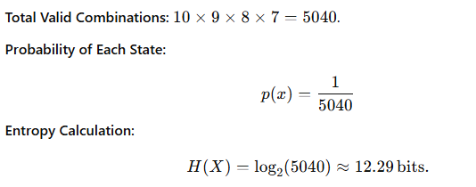
SHANNON Entropy CALCULATION
Entropy considered in this project is “Shannon Entropy”.
It is calculated as follows in this project :
Initial State : Even before any guess, the entropy represents the Maximum uncertainty, equivalent to 12.29 bits of information needed to identify the secret number.

Slide 7
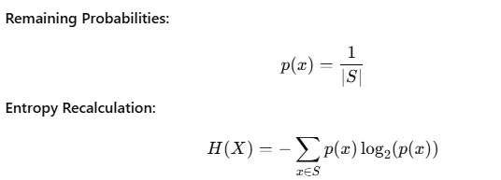
SHANNON Entropy CALCULATION
Mid-game State :After each guess, feedback (Bulls and Cows) reduces the valid states “S”.
As the size of S decreases, entropy reduces dynamically, reflecting the narrowing uncertainty.

Slide 8
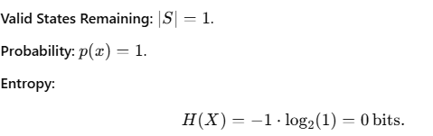
SHANNON Entropy CALCULATION
Final Winning State : When the secret number is correctly guessed, there is no uncertainty left, as the secret number is fully determined.
.

Slide 9
Practical Implementation
Implemented in Python with libraries:
"Streamlit" for Web Interface.
“Random" for secret number generation.
“Math" for entropy calculations.
User input validated and feedback provided.
Real-time entropy visualization through charts.

Slide 10
User Interaction
Players interact through a Streamlit-based web interface.
Real-time feedback on guesses (Bulls, Cows, and Entropy).
Entropy chart visualizes variation in uncertainty over the number of guesses .

Slide 11
Results and Insights
Demonstrated systematic reduction in uncertainty using entropy.
Entropy charts provided visual insights into gameplay progression.
Efficient implementation ensures seamless player interaction.

Slide 12
Conclusion
Successfully blended game mechanics with mathematical theoretical concepts.
Showcased real-world application of entropy.

Slide 13
Questions?
Feel free to ask any questions about the project!

