Slide 1
Unit – V
Security Management
Intrusion Detection - Password Management - Viruses and related Threats - Virus Countermeasures- Worms Security Risks – Firewall Design Principles - Trusted Systems -Systems- Log Management. Case study on Biometric deployment for secure password management.

Slide 2
1.Intrusion Detection
Intruders - tries to gain access to a system or to increase the range of privileges accessible on a system.
Significant issue for networked systems is hostile or unwanted access - either via network or local.
Classes of Intruders:
Masquerader - access controls to exploit a legitimate user's account.
Misfeasor - A legitimate user who accesses data, programs, or resources for which such access is not authorized.
Clandestine user - An individual who seizes supervisory control of the system.

Slide 3
Intruders
Intruder attacks range from the benign to the serious.
Benign end of the scale - wish to explore internets and see what is out there.
Serious end - attempting to read privileged data, perform unauthorized modifications to data, or disrupt the system.
Examples of Intrusion
Performing a remote root compromise of an e-mail server
Defacing a Web server.
Guessing and cracking passwords.
Copying a database containing credit card numbers.

Slide 4
Examples of Intrusion
Viewing sensitive data, including payroll records and medical information, without authorization.
Running a packet sniffer on a workstation to capture usernames and passwords.
Using a permission error on an anonymous FTP server to distribute pirated software and music files.
Dialing into an unsecured modem and gaining internal network access
Posing as an executive, calling the help desk, resetting the executive’s e-mail password, and learning the new password.
Using an unattended, logged-in workstation without permission

Slide 5
Intrusion Techniques
Aims to gain access and/or increase privileges on a system
Basic attack methodology includes:
- Target acquisition and information gathering
- Initial access
- Privilege escalation
- Covering tracks.
Key goal often is to acquire passwords.
Exercise access rights of owner.

Slide 6
Password Guessing
Attacker knows a login (from email/web page etc)
Attempts to guess password for it.
Defaults, short passwords, common word searches.
User info (variations on names, birthday, phone, common words/interests)
Exhaustively searching all possible passwords.
Check by login or against stolen password file.
Success depends on password chosen by user.
Surveys show many users choose poorly.

Slide 7
Password Capture
Watching over shoulder as password is entered.
Using a trojan horse program to collect.
Monitoring an insecure network login.
- eg. telnet, FTP, web, email.
Extracting recorded info after successful login (web history/cache, last number dialed etc).
Using valid login/password can impersonate user.
Users need to be educated to use suitable precautions/countermeasures.

Slide 8
Intrusion Detection
Inevitably will have security failures.
Able to detect and eject intruder, if detected quickly.
Act as deterrent - collect info to improve security.
Assume intruder will behave differently to a legitimate user.
But will have imperfect distinction between different kinds of users.

Slide 9
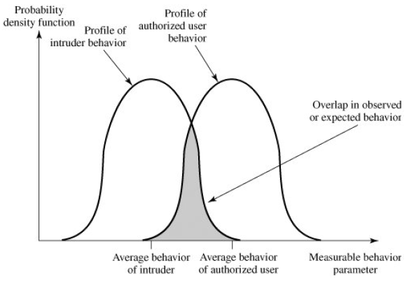
Behavior of Intruders and Authorized Users

Slide 10
Approaches to Intrusion Detection
Statistical Anomaly Detection - collection of data relating to the behavior of legitimate users over a period of time.
- Threshold - defining thresholds, independent of user, for the frequency of occurrence of various events.
- Profile based - each user is developed and used to detect changes in the behavior of individual accounts.
Rule-based detection - attempt to define a set of rules that can be used to decide that a given behavior is that of an intruder.
- Anomaly - Rules are developed to detect deviation from previous usage patterns.
- Penetration Identification - An expert system approach that searches for suspicious behavior.

Slide 11
Audit Records
Native Audit Records
- part of all common multi-user O/S.
- include accounting software that collects information on user activity.
- already present for use.
- may not have info wanted in desired form.
Detection-Specific Audit Records
- created specifically to collect wanted info.
- could be made vendor independent and ported to a variety of systems.
- Two accounting packages running on a machine at cost of additional overhead on system.

Slide 12
Fields in Audit Records
Subject: Initiators of actions(a terminal user).
Action: Operation performed by the subject on or with an object.
Object: Receptors of actions. Examples include files, programs etc.,
Exception-Condition: Denotes which, if any, exception condition is raised on return.
Resource-Usage: A list of quantitative elements in which each element gives the amount used of some resource.
Time-Stamp: Unique time-and-date stamp identifying when the action took place.

Slide 13
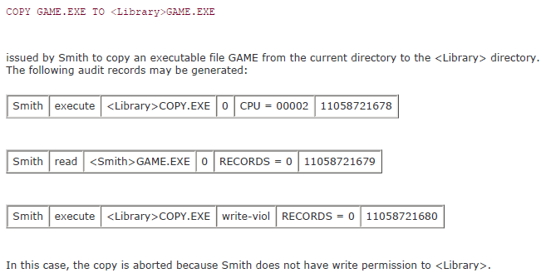
A Sample Audit Record

Slide 14
A.Statistical Anomaly Detection
Threshold Detection.
- Count occurrences of specific event over time.
- If exceed reasonable value assume intrusion.
- Alone is a crude & ineffective detector.
Profile Based.
- Characterize past behavior of users.
- Detect significant deviations from this.
- Profile usually multi-parameter.

Slide 15
Metrics for Profile-Based Intrusion Detection
Counter: A nonnegative integer that may be incremented but not decremented until it is reset by management action.
- counts certain event types over a particular period of time.
Gauge: A nonnegative integer that may be incremented or decremented.
- used to measure the current value of some entity.
Interval timer: The length of time between two related events.
Resource utilization: Quantity of resources consumed during a specified period.

Slide 16
Various Tests Performed for Intrusion Detection
Performed to determine whether current activity fits within acceptable limits.
Mean and standard deviation - gives a reflection of the average behavior and its variability.
Multivariate - based on correlations between two or more variables.
Markov process - used to establish transition probabilities among various states.
Time series - focuses on time intervals, looking for sequences of events that happen too rapidly or too slowly.
Operational - based on a judgment of what is considered abnormal, rather than an automated analysis of past audit records.

Slide 17
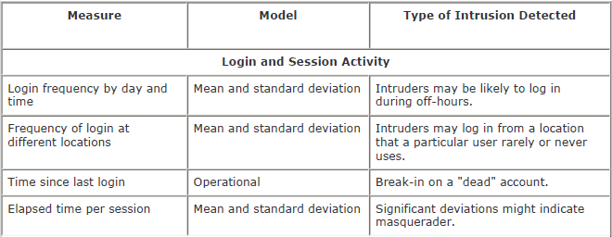
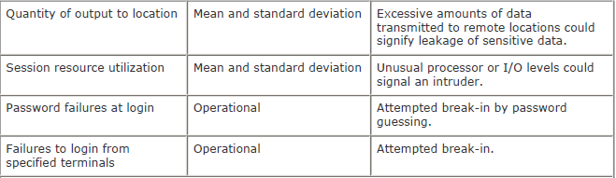
Tests used for different Activities

Slide 18
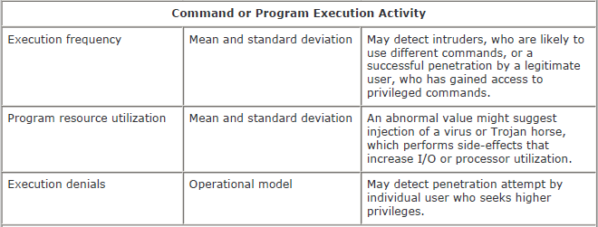
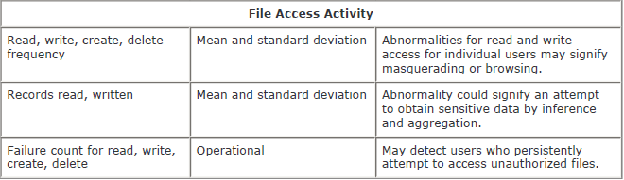
Tests used for different Activities

Slide 19
B.Rule-Based Intrusion Detection
Observe events on system & apply rules to decide if activity is suspicious or not
Rule-based Anomaly Detection
- analyze historical audit records to identify usage patterns & auto-generate rules for them.
- then observe current behavior & match against rules to see if conforms.
- like statistical anomaly detection does not require prior knowledge of security flaws.

Slide 20
Rule-Based Intrusion Detection
Rule-Based Penetration Identification.
- uses expert systems technology.
- with rules identifying known penetration, weakness patterns, or suspicious behavior.
- compare audit records or states against rules.
- rules usually machine & O/S specific.
- rules are generated by experts who interview & codify knowledge of security admins.
- quality depends on how well this is done.

Slide 21
Example - Type of Heuristic rules in NIDX
1. Users should not read files in other users' personal directories.
2. Users must not write other users' files.
3. Users who log in after hours often access the same files they used earlier.
4. Users do not generally open disk devices directly but rely on higher-level operating system utilities.
5. Users should not be logged in more than once to the same system.
6. Users do not make copies of system programs.

Slide 22
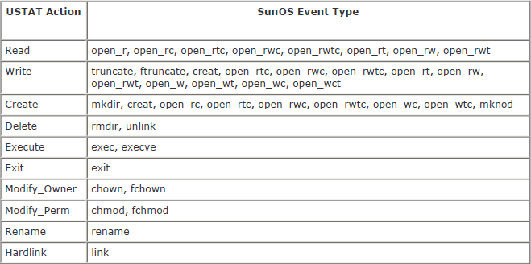
USTAT Actions versus SunOS Event Types

Slide 23
Base-Rate Fallacy
An intrusion detection system must detect proper intrusion.
Needs to detect a substantial percentage of intrusions with few false alarms.
- If too few intrusions detected -> false security
- If too many false alarms -> ignore / waste time
- This is very hard to do
- Existing systems seem not to have a good record

Slide 24
Distributed Intrusion Detection
traditional focus is on single systems
- but typically have networked systems.
- more effective defense has these working together to detect intrusions.
Issues
- dealing with varying audit record formats.
- integrity & confidentiality of networked data.
- centralized or decentralized architecture.

Slide 25
Components of Distributed ID
Host agent module: An audit collection module operating as a background process on a monitored system.
- Its purpose is to collect data on security-related events on the host and transmit these to the central manager.
LAN monitor agent module: Operates in the same fashion as a host agent module except that it analyzes LAN traffic and reports the results to the central manager.
Central manager module: Receives reports from LAN monitor and host agents and processes and correlates these reports to detect intrusion.

Slide 26
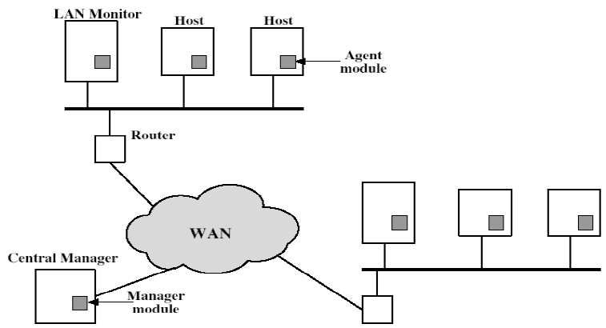
Distributed Intrusion Detection - Architecture

Slide 27
Distributed Intrusion Detection – Agent Implementation
When suspicious activity is detected, an alert is sent to the central manager.
The central manager includes an expert system that can draw inferences from received data.
- May also query individual systems for copies of Host Audit Reports to correlate with those from other agents.
The LAN monitor agent also supplies information to the central manager.
- Audits host-host connections, services used, and volume of traffic.
- It searches for sudden changes in network load, the use of security related services, and network activities such as rlogin.

Slide 28
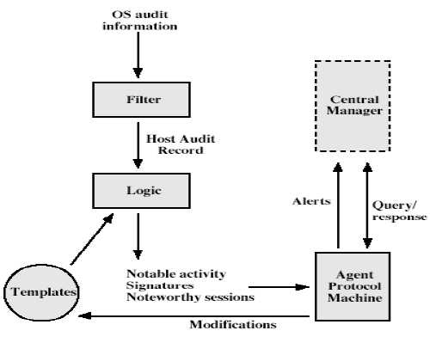
Distributed Intrusion Detection – Agent Implementation

Slide 29
Honeypots
Decoy systems to lure attackers
- Away from accessing critical systems.
- To collect information of their activities.
- To encourage attacker to stay on system so administrator can respond.
- Are filled with fabricated information.
- Instrumented to collect detailed information on attackers activities.
- Single or multiple networked systems.
- cf IETF Intrusion Detection WG standards.

Slide 30
Intrusion Detection Exchange Format
1. A requirements document, which describes the high-level functional requirements:
- Communication between intrusion detection systems.
- Requirements for communication between intrusion detection systems and with management systems.
- Scenarios will be used to illustrate the requirements.
2. A common intrusion language specification - describes data formats that satisfy the requirements.
3. A framework document - identifies existing protocols best used for communication between intrusion detection systems.
- Describes how the devised data formats relate to them.

Slide 31
2.Password Management
Front-line defense against intruders
Users supply both:
- login – determines privileges of that user.
- password – to identify them.
Passwords often stored encrypted.
Unix uses multiple DES (variant with salt)
Recent systems uses crypto hash function.
Should protect password file on system.

Slide 32
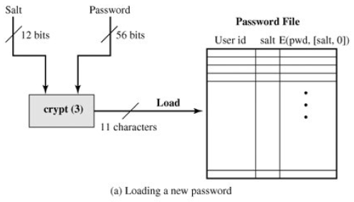
UNIX Password Scheme

Slide 33
Unix Password Scheme
Purpose of Salt in Unix:
It prevents duplicate passwords from being visible in the password file.
- Even if two users choose the same password, those passwords will be assigned at different times.
It effectively increases the length of the password without requiring the user to remember two additional characters.
- The number of possible passwords is increased by a factor of 4096, increasing the difficulty of guessing a password.
It prevents the use of a hardware implementation of DES, which would ease the difficulty of a brute-force guessing attack.

Slide 34
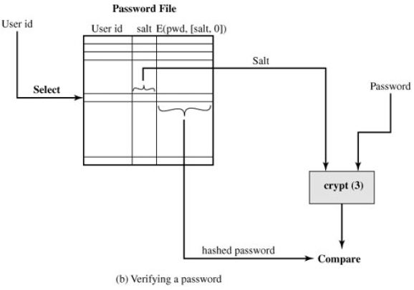
Unix Password Scheme

Slide 35
Password Studies
Purdue 1992 - many short passwords.
Klein 1990 - many guessable passwords.
Conclusion is that users choose poor passwords too often.
Need some approach to counter this.

Slide 36
Managing Passwords - Education
Can use policies and good user education.
Educate on importance of good passwords.
Give guidelines for good passwords.
Minimum length (>6)
Require a mix of upper & lower case letters, numbers, punctuation.
Not dictionary words.
Likely to be ignored by many users.

Slide 37
Managing Passwords - Computer Generated
Let computer create passwords.
If random likely not memorisable, so will be written down (sticky label syndrome)
Even pronounceable not remembered.
Have history of poor user acceptance.
FIPS PUB 181 one of best generators.
Has both description & sample code.
Generates words from concatenating random pronounceable syllables.

Slide 38
Managing Passwords - Reactive Checking
Reactively run password guessing tools.
Note that good dictionaries exist for almost any language/interest group.
Cracked passwords are disabled.
But is resource intensive.
Bad passwords are vulnerable till found.

Slide 39
Managing Passwords - Proactive Checking
Most promising approach to improving password security.
Allow users to select own password.
But have system verify it is acceptable.
Simple rule enforcement (see earlier slide).
Compare against dictionary of bad passwords.
Use algorithmic (Markov model or bloom filter) to detect poor choices.

Slide 40
3.Viruses and Other Related Threats
Computer viruses have got a lot of publicity.
One of a family of malicious software.
Effects usually obvious.
Have figured in news reports, fiction, movies. (often exaggerated)
getting more attention than deserved are a concern though.

Slide 41
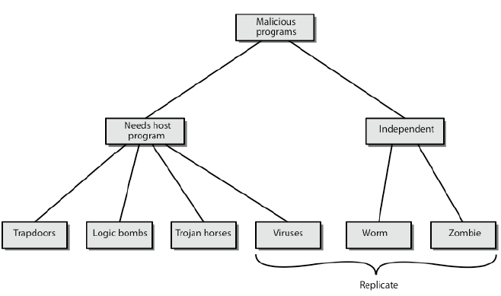
Malicious Software

Slide 42
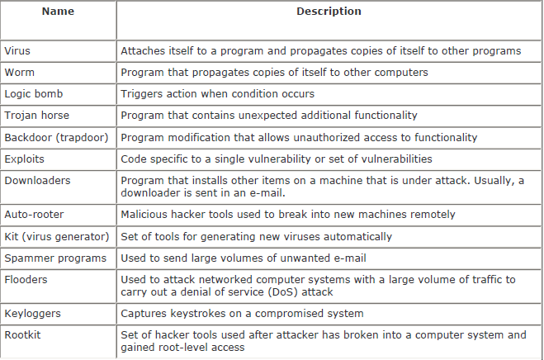
Malicious Software

Slide 43
Backdoor or Trapdoor
Secret entry point into a program.
Allows those who know access bypassing usual security procedures.
Have been commonly used by developers.
A threat when left in production programs allowing exploited by attackers.
Very hard to block in O/S.
Requires good software development & update.

Slide 44
Logic Bomb
One of oldest types of malicious software.
Code embedded in legitimate program.
Activated when specified conditions met.
- eg presence / absence of some file.
Particular date / time.
Particular user.
When triggered typically damage system.
Modify / delete files / disks, halt machine, etc.

Slide 45
Trojan Horse
Program with hidden side-effects.
Which is usually superficially attractive.
- eg game, software upgrade etc.
When run performs some additional tasks.
Allows attacker to indirectly gain access they do not have directly.
Often used to propagate a virus/worm or install a backdoor.
Simply to destroy data.

Slide 46
Zombie
Program which secretly takes over another networked computer.
Uses it to indirectly launch attacks.
Often used to launch distributed denial of service (DDoS) attacks.
Exploits known flaws in network systems.

Slide 47
Viruses
A piece of self-replicating code attached to some other code.
Similar in function with biological virus.
Both propagates itself & carries a payload.
Carries code to make copies of itself.
As well as code to perform some covert task.

Slide 48
Virus Phases
Dormant – The virus is idle. Waiting for trigger event.
Propagation – Replicating to programs/disks. places an identical copy of itself into other programs or into certain system areas on the disk.
Triggering – by event to execute payload. Virus is activated to perform the function for which it was intended.
Execution – The function is performed.
- details usually machine/OS specific
- exploiting features/weaknesses

Slide 49
Types of Viruses
Parasitic virus – attaches itself to executable files and replicates
Memory-resident virus - Lodges in main memory as part of a resident system program.
Boot sector virus - Infects a master boot record or boot record. Spreads when a system is booted from the disk containing the virus.
Stealth - explicitly designed to hide itself from detection by antivirus software.
Polymorphic virus - Mutates with every infection, making detection by the "signature" of the virus impossible.
Metamorphic virus - change their behavior as well as their appearance.

Slide 50
Macro Virus
Macro code attached to some data file.
Interpreted by program using file.
- eg Word / Excel macros.
Using auto command & command macros.
Code is now platform independent.
A major source of new viral infections.
Blur distinction between data and program files.
classic trade-off: "ease of use" vs "security”.
Have improving security in Word etc.
No longer dominant virus threat.

Slide 51
Email Virus
Spread using email with attachment containing a macro virus.
- Example: Melissa
Triggered when user opens attachment.
Even when mail viewed by using scripting features in mail agent.
Hence propagate very quickly.
Usually targeted at Microsoft Outlook mail agent & Word/Excel documents.
Need better O/S & application security.

Slide 52
Worms
Replicating but not infecting program.
Typically spreads over a network.
- Example: Morris Internet Worm in 1988.
Led to creation of CERTs.
Users distributed privileges or by exploiting system vulnerabilities
Widely used by hackers to create zombie PC's, subsequently used for further attacks, especially DoS.
Major issue is lack of security of permanently connected systems, especially PC's.

Slide 53
Worm Ability
Electronic mail facility: A worm mails a copy of itself to other systems.
Remote execution capability: A worm executes a copy of itself on another system.
Remote login capability: A worm logs onto a remote system as a user and then uses commands to copy itself from one system to the other.

Slide 54
Worm Operation Phases
Worm phases like those of viruses:
- Dormant.
- Propagation - search for other systems to infect, establish connection to target remote system and replicate self onto remote system
- Triggering.
- Execution.

Slide 55
Morris Worm
Best known classic worm.
Released by Robert Morris in 1988.
Targeted Unix systems.
Using several propagation techniques.
Simple password cracking of local password file.
Exploit bug in finger daemon.
Exploit debug trapdoor in send mail daemon.
If any attack succeeds then replicated self.

Slide 56
Recent Worm Attacks
New spate of attacks from mid-2001.
Code Red - used MS IIS bug
- probes random IPs for systems running IIS.
- had trigger time for denial-of-service attack.
- 2nd wave infected 360000 servers in 14 hours.
Code Red 2 - installed backdoor.
Nimda - multiple infection mechanisms.
SQL Slammer - attacked MS SQL server.
Sobig.f - attacked open proxy servers.
Mydoom - mass email worm + backdoor.

Slide 57
Worm Techology
Multiplatform - can attack a variety of platforms.
Multiexploit - penetrate systems in a variety of ways.
Ultrafast spreading - to accelerate the spread of a worm is to conduct a prior Internet scan to accumulate Internet addresses of vulnerable machines.
Polymorphic - To evade detection, skip past filters, and foil real-time analysis.
Metamorphic – changes appearance and behavior patterns.
Transport vehicles - rapidly compromise a large number of systems, they are ideal for spreading other distributed attack tools.
Zero-day exploit - exploit an unknown vulnerability that is only discovered by the general network community.

Slide 58
Virus Countermeasures
Best countermeasure against virus is prevention.
But in general not possible.
Need to do one or more of the following actions:
- Detection - of viruses in infected system.
- Identification - of specific infecting virus.
- Removal - restoring system to clean state by eliminating it.

Slide 59
Anti-Virus Software
First-generation
Scanner uses virus signature to identify virus.
Change in length of programs.
Second-generation
Uses heuristic rules to spot viral infection.
Crypto hash of program to spot changes.
Third-generation
Memory-resident programs identify virus by actions.
Fourth-generation
Packages with a variety of antivirus techniques.
- eg scanning & activity traps, access-controls.
Arms race continues.

Slide 60
Advanced Anti-Virus Techniques
Generic Decryption.
Use CPU Emulator to check program signature & behavior before actually running it.
- Uses Virus Signature Scanner and Emulation Control Module.
Digital Immune System (IBM).
- Integrated Mail system and Mobile program systems are two major trends in internet technology.
Other general purpose emulation & virus detection.
Any virus entering org is captured, analyzed, detection / shielding created for it and finally removed.

Slide 61
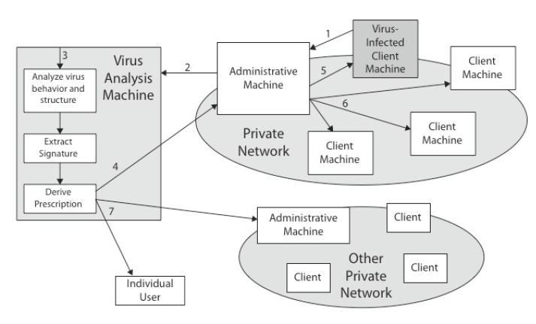
Digital Immune System

Slide 62
Behavior-Blocking Software
Integrated with host O/S.
Monitors program behavior in real-time.
- Eg. File Access, Disk Format, Executable Modes, system settings changes, network access.
For possibly malicious actions.
If detected can block, terminate, or seek ok.
Has advantage over scanners.
Malicious code runs before detection.

Slide 63
Distributed Denial of Service Attacks (DDoS)
Distributed Denial of Service (DDoS) attacks form a significant security threat.
Making networked systems unavailable.
By flooding with useless traffic.
Using large numbers of “zombies”.
Growing sophistication of attacks.
Defense technologies struggling to cope.

Slide 64
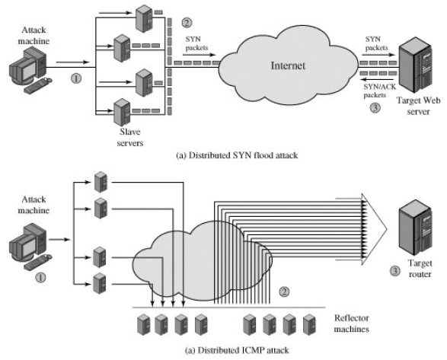
Distributed Denial of Service Attacks (DDoS)

Slide 65
Constructing the DDoS Attack Network
Must infect large number of zombies.
Needs:
1. Software to implement the DDoS attack.
2. An unpatched vulnerability on many systems.
3. Scanning strategy to find vulnerable systems.
Random, hit-list, topological, local subnet.

Slide 66
DDoS Countermeasures
Three broad lines of defense:
1. Attack prevention & preemption (before)
2. Attack detection & filtering (during)
3. Attack source traceback & ident (after)
Huge range of attack possibilities.
Hence evolving countermeasures.

Slide 67
4.Firewall Design Principles
Seen evolution of information systems.
Now everyone want to be on the Internet and to interconnect networks.
Has persistent security concerns.
Can’t easily secure every system in organisation.
Need "harm minimisation“.
A Firewall usually part of this.

Slide 68
What is a Firewall?
A choke point of control and monitoring.
Interconnects networks with differing trust.
Imposes restrictions on network services.
- Only authorized traffic is allowed.
Auditing and controlling access.
- Can implement alarms for abnormal behavior.
Is itself immune to penetration.
Provides perimeter defence.

Slide 69
Firewall Characteristics
Firewalls use to control access and enforce the site's security policy.
Service control: Determines the types of Internet services that can be accessed.
Direction control: Determines the direction in which particular service requests may be initiated and allowed to flow through the firewall.
User control: Controls access to a service according to which user is attempting to access it.
Behavior control: Controls how particular services are used.

Slide 70
Firewall Limitations
Cannot protect from attacks bypassing it.
- eg sneaker net, utility modems, trusted Organisations, trusted services (eg SSL/SSH).
Cannot protect against internal threats.
- eg disgruntled employee.
Cannot protect against transfer of all virus infected programs or files.
- because of huge range of O/S & file types.

Slide 71
Firewall Types
The three common types of firewalls: packet filters, application-level gateways and circuit-level gateways.
A.Packet-Filtering Router
A packet-filtering router applies a set of rules to each incoming and outgoing IP packet and then forwards or discards the packet.
The router is typically configured to filter packets going in both directions (from and to the internal network).
Filtering rules are based on information contained in a network packet.

Slide 72
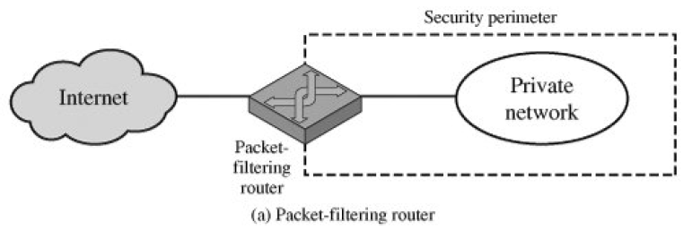
A.Firewalls – Packet Filters
Simplest of components.
Foundation of any firewall system.
Examine each IP packet (no context) and Permit or deny according to rules.
Hence restrict access to services (ports).
Possible default policies.
- That not expressly permitted is prohibited.
- That not expressly prohibited is permitted.

Slide 73
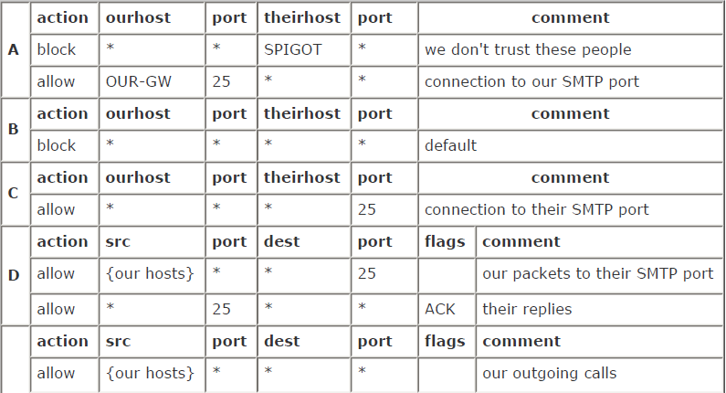
Packet-Filtering Examples

Slide 74
Attacks on Packet Filters
IP address spoofing.
- Fake source address to be trusted.
- Add filters on router to block.
Source routing attacks.
- Attacker sets a route other than default.
- Block source routed packets.
Tiny fragment attacks.
- Split header info over several tiny packets.
- Either discard or reassemble before check.

Slide 75
Firewalls – Stateful Packet Filters
Examine each IP packet in context.
Keeps tracks of client-server sessions.
Checks each packet validly belongs to one.
Better able to detect bogus packets out of context.

Slide 76
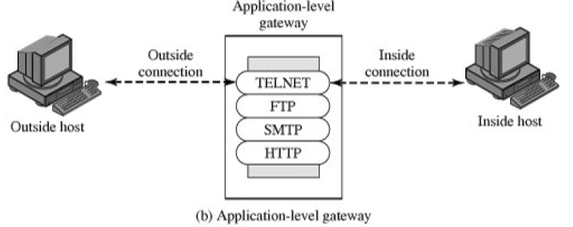
B.Firewalls - Application Level Gateway (or Proxy)
Also called a proxy server, acts as a relay of application-level traffic.
The user contacts the gateway using a TCP/IP application, such as Telnet or FTP.
If the gateway does not implement the proxy code for a specific application, the service is not supported.
The gateway can be configured to support only specific features of an application.

Slide 77
Application Level Gateway (or Proxy)
Use an application specific gateway / proxy.
Has full access to protocol.
- User requests service from proxy.
- Proxy validates request as legal.
- Then actions request and returns result to user.
Need separate proxies for each service.
- Some services naturally support proxying.
- Others are more problematic.
- Custom services generally not supported.

Slide 78
C.Firewalls – Circuit Level Gateway
Can be a stand-alone system.
Can be a specialized function performed by an application-level gateway for certain applications.
A circuit-level gateway does not permit an end-to-end TCP connection.
The gateway sets up two TCP connections
- one between itself and a TCP user on an inner host
- one between itself and a TCP user on an outside host.

Slide 79
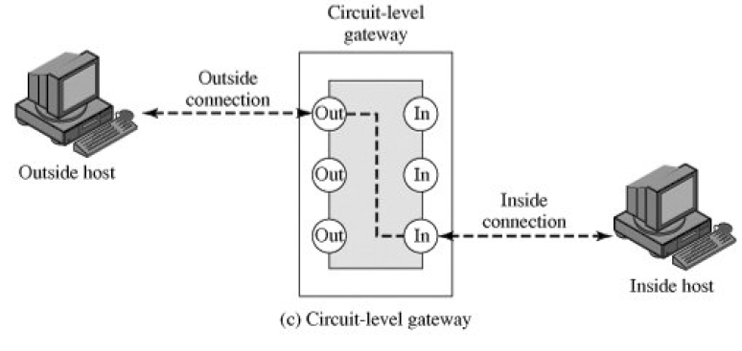
Circuit Level Gateway

Slide 80
Circuit Level Gateway
Imposes security by limiting which such connections (among two) are allowed.
Once created usually relays traffic without examining contents.
Typically used when trust internal users by allowing general outbound connections.
SOCKS commonly used for this.

Slide 81
Bastion Host
Highly secure host system.
Potentially exposed to "hostile" elements secured to withstand this.
May support 2 or more net connections.
May be trusted to enforce trusted separation between network connections.
Runs circuit / application level gateways or provides externally accessible services.

Slide 82
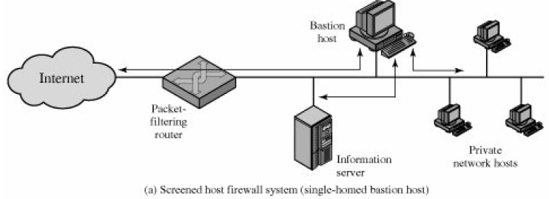
Firewall Configurations

Slide 83
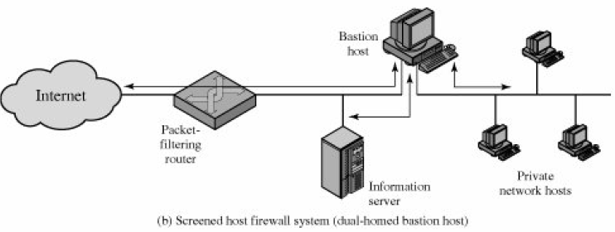
Firewall Configurations

Slide 84
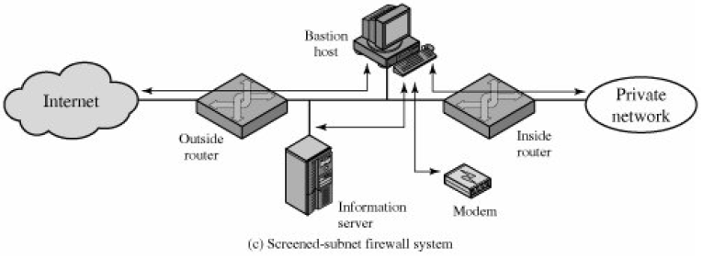
Firewall Configurations

Slide 85
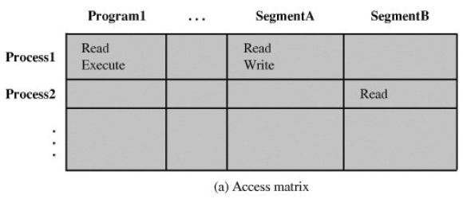
5.Trusted Systems
One way to enhance the ability of a system to defend against intruders and malicious programs.
Look at some basic concepts of data access control.

Slide 86
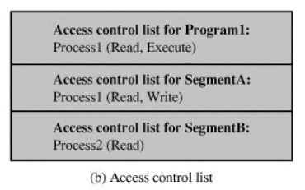
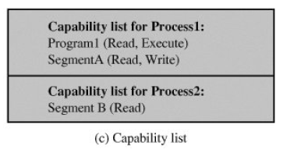
Access Control List & Capability List

Slide 87
Access Control
Given system has identified a user.
Determine what resources they can access.
General model is that of access matrix with.
- Subject - active entity (user, process)
- Object - passive entity (file or resource)
- Access right – way object can be accessed
Can decompose by
- Columns as access control lists
- Rows as capability tickets

Slide 88
Trusted Computer Systems
Information security is increasingly important.
Have varying degrees of sensitivity of information.
- Military info classifications: confidential, secret etc
Subjects (people or programs) have varying rights of access to objects (information).
Want to consider ways of increasing confidence in systems to enforce these rights.
Known as multilevel security
- subjects have maximum & current security level.
- objects have a fixed security level classification.

Slide 89
Bell LaPadula (BLP) Model
One of the most famous security models.
Implemented as mandatory policies on system.
Has two key policies:
1. No read up (simple security property)
- a subject can only read/write an object if the current security level of the subject dominates (>=) the classification of the object
2. No write down (*-property)
- a subject can only append/write to an object if the current security level of the subject is dominated by (<=) the classification of the object

Slide 90
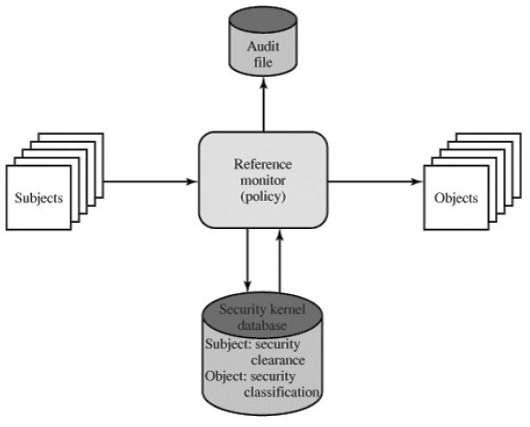
Reference Monitor Properties
Complete mediation: The security rules are enforced on every access, not just, for example, when a file is opened.
Isolation: The reference monitor and database are protected from unauthorized modification.
Verifiability: The reference monitor's correctness must be provable.

Slide 91
Evaluated Computer Systems
Governments can evaluate IT systems against a range of standards:
- TCSEC, IPSEC and now Common Criteria.
Define a number of “levels” of evaluation with increasingly stringent checking.
Have published lists of evaluated products.
Though aimed at government/defense use.
Can be useful in industry also.

