Slide 1
IBM University Engagement Project Submission PARKSHARE
AI-Powered Peer-to-Peer Smart Parking Platform
Exploring Agentic AI with IBM watsonx.ai and Granite

Slide 2


Project Tile – [AI-Powered Peer-to-Peer Smart Parking Platform ]
Domain of Project – [ Smart Mobility ]
Recent Passport Photo
Email ID
Mobile number [WhatsApp]
Student Name
Satyanarayana Annamneedi
annamneedisatyanarayana1114@gmail.com
9515696563

Slide 3
Problem Statement
The parking problem is also a visibility and utilization problem.
The Challenge
Drivers in unfamiliar or congested areas waste time searching for legal, nearby parking. Meanwhile, private parking spaces at homes and small properties often remain unused.
Why Existing Options Fall Short
Static listings and conventional parking apps do not fully connect local private-space owners with drivers or provide context-aware AI-assisted ranking and pricing insights.
Project Objective
Create a trusted marketplace where owners can list unused parking spaces.
Help drivers discover and book suitable parking based on real availability and context.
Use IBM Granite for AI-assisted recommendations and demand insights.
Protect the platform with authenticated APIs and server-side AI validation.
Provide separate driver, owner, and administrator workflows.
03

Slide 4
Proposed Solution
ParkShare turns unused private space into discoverable parking capacity.
ParkShare
is a full-stack smart parking marketplace connecting drivers with owners who can rent unused spaces. It combines real PostgreSQL data with IBM Granite reasoning through watsonx.ai.
Driver Experience
Search parking, review availability and pricing, receive AI-assisted recommendations, and create bookings.
Owner Experience
Register parking spaces, manage listings, monitor bookings, and access AI-generated demand and pricing insights.
Trusted AI Layer
The backend sends structured context to Granite and validates returned parking IDs, scores, and price suggestions.
AI assists decisions without becoming the source of truth.
04

Slide 5
Technology Used
Frontend
React + TypeScript TanStack routing Vite + responsive UI
Backend FastAPI Python
REST API architecture
Database PostgreSQL SQLAlchemy Alembic migrations
AI
IBM watsonx.ai
IBM Granite 4 H Small REST inference
Security
Engineering Git & GitHub Pytest
Environment-based config
JWT authentication
Role-aware access
Secret configuration
05

Slide 6
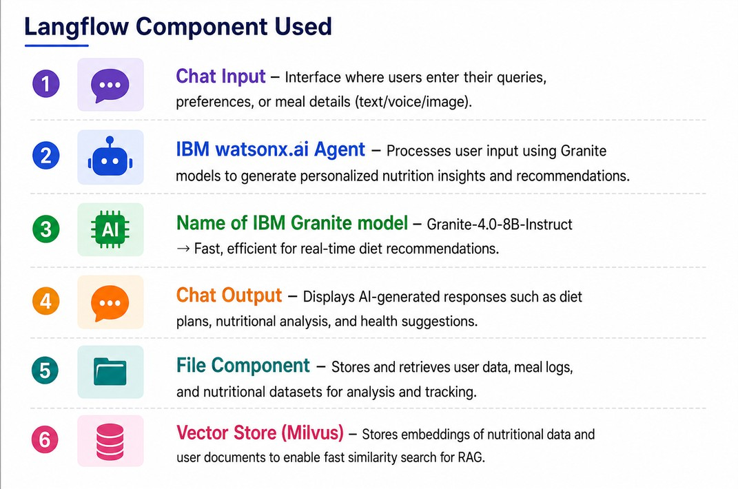

Slide 7
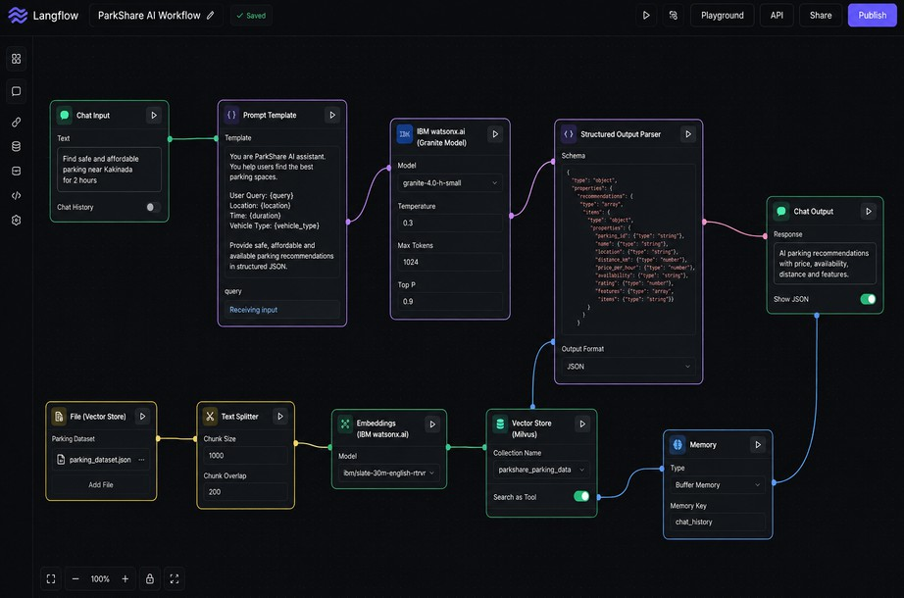
Langflow workflow -

Slide 8
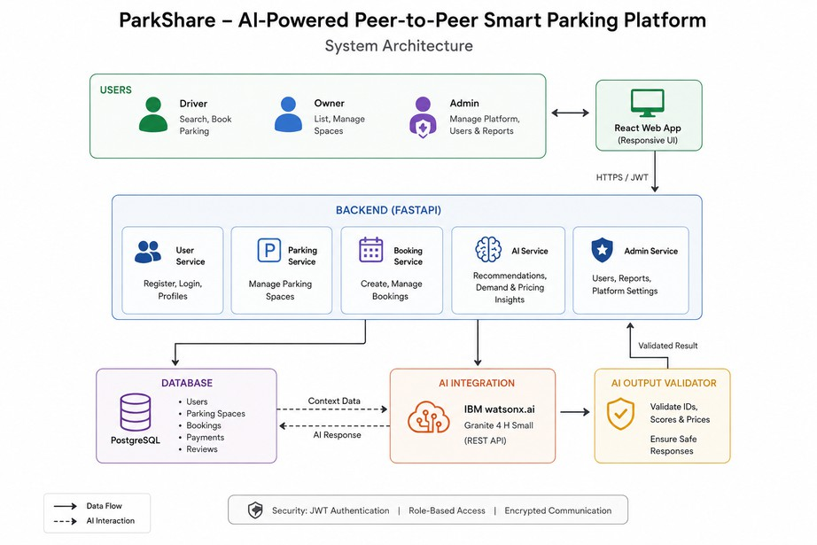
Architecture blueprint -

Slide 9
Role of Agentic AI in the Solution
ParkShare uses AI as a controlled decision-support layer — not as an unrestricted chatbot.
Context Awareness
Granite receives structured parking, owner, and booking context selected by the backend.
Goal-Driven Reasoning
AI ranks parking options and produces actionable demand or pricing insights.
Adaptive Decisions
Recommendations can change as availability, bookings, and platform context change.
Guardrailed Autonomy
Invented IDs are rejected and generated values are bounded before acceptance.
PostgreSQL and backend business rules remain authoritative.
09

Slide 10
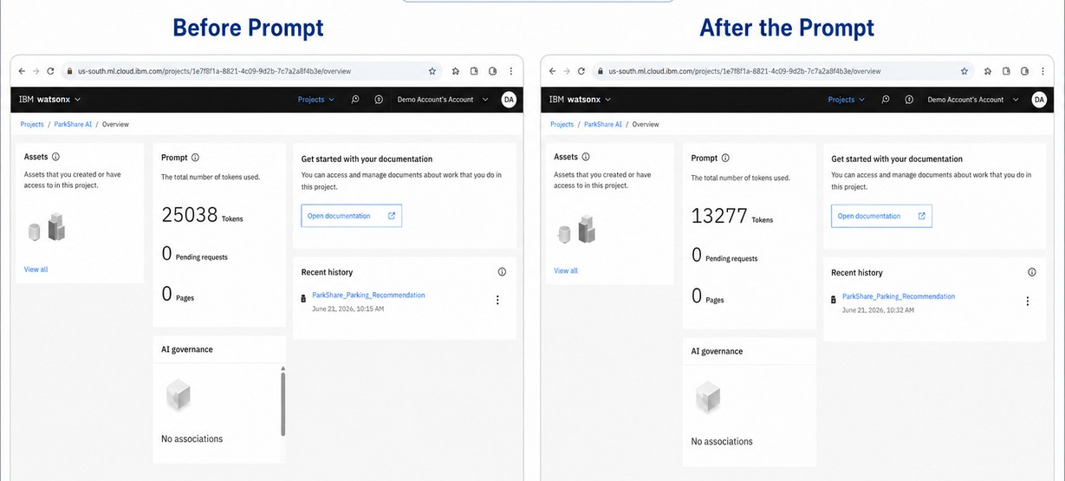
Token Usage & Prompt Efficiency
Exact token consumption must be taken from the watsonx.ai usage dashboard before final submission.

Slide 11
N ovelty and Uniqueness
Peer-to-Peer Parking Utilization
Converts unused private spaces into discoverable parking capacity.
AI-Assisted Ranking
Uses real platform context to support smarter parking recommendations.
Owner Demand Intelligence
Extends AI beyond search into demand and pricing support.
Validated AI Responses
Rejects hallucinated parking IDs and constrains scores and prices.
Role-Based Marketplace
Distinct driver, owner, and administrator workflows.
Production-Oriented AI Design
Separates authoritative data, AI reasoning, and validation.

Slide 12
GitHub Repository
Public Project Repository
https://github.com/satya-1114/ParkShare
Repository Includes Frontend source code FastAPI backend Database migrations
API reference and README Environment examples and tests
Submission Artifacts
Project source files IBM AI integration code
Presentation file to be added Problem statement PDF to be added
Important: keep backend/.env and all API secrets out of Git.

Slide 13
Future Scope
Live Maps & Navigation
Geospatial search, map visualization, route guidance, and distance estimation.
Smart Entry Verification
QR, ANPR, or IoT-based check-in/check-out for booking verification.
Predictive Demand Forecasting
Use booking patterns, time, events, and location signals.
Digital Payments & Payouts
Secure payments, owner payouts, refunds, and reconciliation.
EV & Accessibility Filters
EV charging, accessible parking, covered parking, and amenities.
Multilingual AI Assistant
Conversational parking assistance in regional languages.

Slide 14
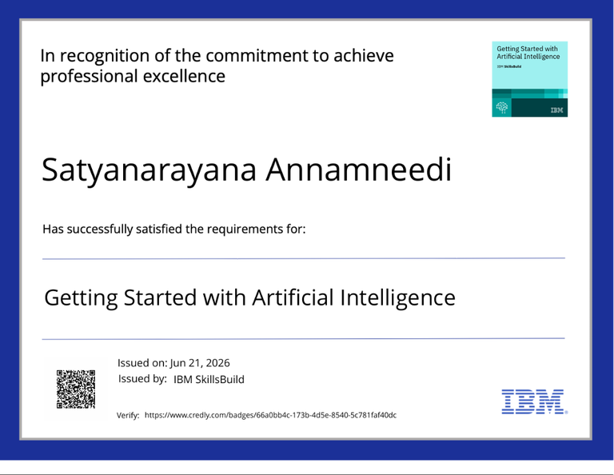
CertificateEarned
IBMSkillsBuild/Credly
Getting Started with Artificial Intelligence

Slide 15
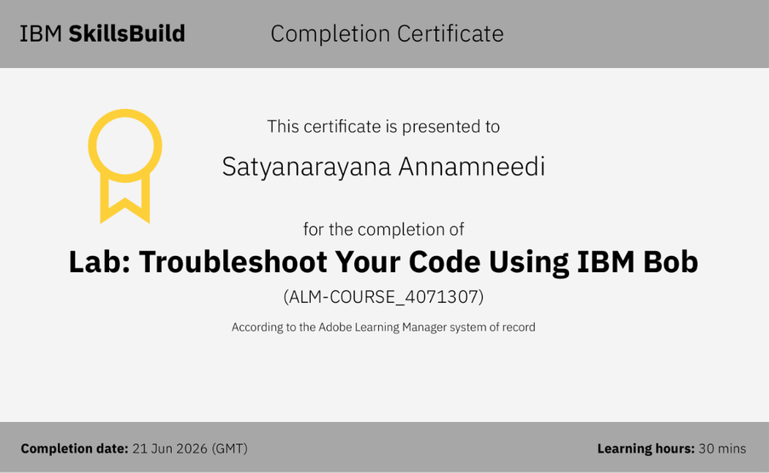
CertificateEarned
IBMSkillsBuild
Lab: Troubleshoot Your Code Using IBM Bob

Slide 16
THANK YOU
ParkShare
Smarter parking through trusted data and controlled AI reasoning.
Satyanarayana Annamneedi

