Slide 1

Applied Internet of Things(CSE 2198) Project Presentation on Whatsapp Based Home Automation
Group-5
Presented by
Ms. Shruti Sahoo
Mr. Satya Swarup Nayak
Mr. Satyajit Panda
(Group Leader)
Supervisor
Dr. Biswa Ranjan Swain
Dr. Bhanja Kishor Swain
Department of Computer Science and Engineering (IOT)
Institute of Technical Education & Research (ITER)
Siksha ‘O’ Anusandhan Deemed to be University, Bhubaneswar
May, 2025

Slide 2
Contents
Introduction
Literature Survey
Design Scheme
Testing, Analysis, And Evaluation
Socio-economic Issues Associated With The Project
Engineering Tools And Standards
Conclusion

Slide 3
Introduction
This project presents a WhatsApp-based home automation system using Python and Raspberry Pi. By integrating Twilio's WhatsApp API and a custom chatbot, users can control home appliances remotely using simple text commands. This system offers a user-friendly, cost-effective, and app-free solution for smart home automation, accessible from anywhere with an internet connection.

Slide 4
Literature Survey
Home automation has emerged as a key application area within the Internet of Things (IoT), with the goal of enhancing convenience, energy efficiency, and user control over household devices. Multiple technologies and platforms have been explored in recent years to achieve seamless home automation, including Bluetooth, ZigBee, Wi-Fi, and cloud-based services. This literature survey explores related work and technologies that form the foundation of this project.

Slide 5
Literature Survey
Raspberry Pi in IoT Applications Raspberry Pi has been widely adopted as a cost-effective, versatile platform for developing IoT solutions. Its support for GPIO (General Purpose Input/Output) pins allows it to interface easily with sensors, relays, and actuators. Numerous studies have demonstrated its effectiveness in real-time control of appliances and systems in smart home environments.
Twilio WhatsApp API Twilio’s WhatsApp Business API provides a secure and programmable interface for receiving and sending WhatsApp messages. It enables developers to integrate messaging capabilities into IoT systems effectively. Research has shown that using cloud-based APIs like Twilio allows for scalable and reliable messaging services in home automation contexts.
Chatbots and Natural Language Processing (NLP)Recent advancements in chatbot frameworks and NLP have enabled more natural interactions between users and automation systems. Chatbots built using Python can extract intent and context from text commands, making them suitable for interpreting user instructions like “Turn on the light” or “Switch off the fan.” This improves usability, especially for non-technical users.

Slide 6
Engineering Tools And Standards
Hardware Tools:
i)Raspberry Pi zero 2 W:Acts as the central controller for home automation.
ii)L298N Motor Driver: Used to control appliances (lights, fans, etc.).
iii)DC Motor: For automation demonstration
iv)Wi-Fi Router: For internet connectivity and device communication.
v)Smartphone: To run WhatsApp and interact with the system.
vi)Soldering Iron , Jumper Wires , LED , USB Cables etc.
vii)5V 2A Power Adapter

Slide 7
Engineering Tools And Standards
2. Software Tools:
i) Python 3.x: Core programming language for backend logic and hardware control.
ii) Flask : To build a local web server or REST API if needed.
iii)Twilio WhatsApp API: To integrate WhatsApp messaging (Twilio is commercial).
iv) Raspbian OS / Raspberry Pi OS: Operating system for the Raspberry Pi.
v) Ngrok: provide platform to user for application

Slide 8
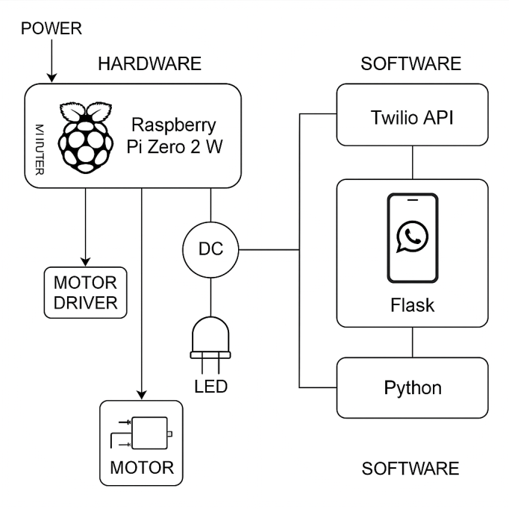
Design Scheme

Slide 9
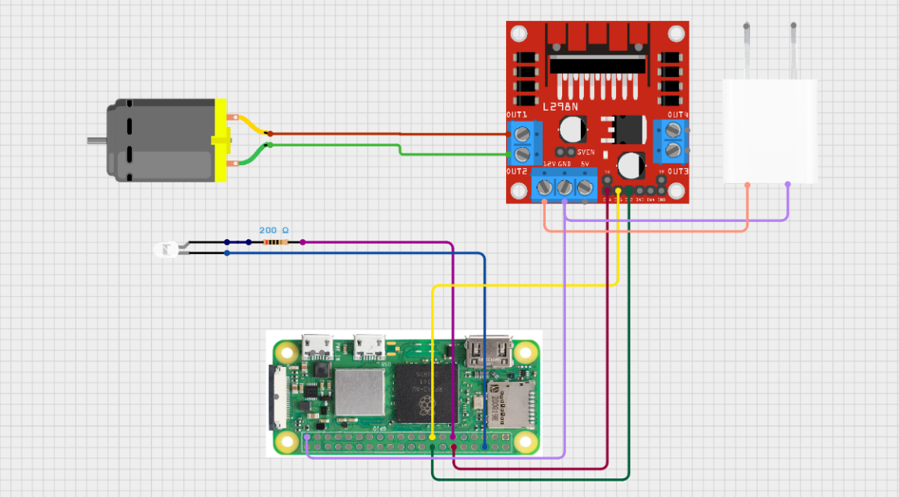
Testing (Breadboard Implementation)

Slide 10
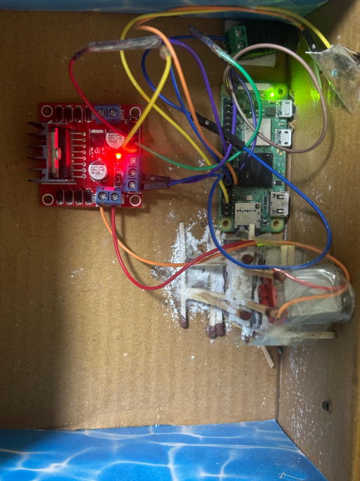
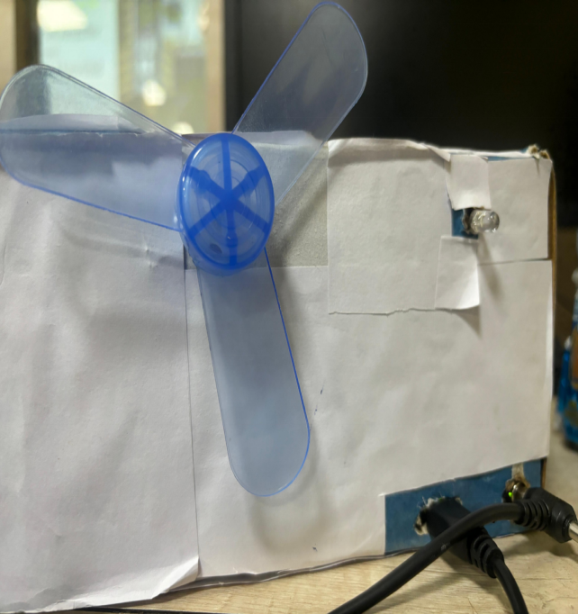
Testing (Breadboard Implementation)
RASPBERRY
PI ZERO 2W
LIGHT
L298N
MOTOR
DRIVER
FAN
DC MOTOR
POWER SUPPLY

Slide 11
Results, Analysis and Evaluation
✅ Results:
Successfully controlled LED (light) and DC Motor (fan) via WhatsApp.
Commands like “light on/off” and “fan on/off” were processed in real-time.
System responded with confirmation messages using Twilio WhatsApp API.
Raspberry Pi GPIO pins correctly triggered L298N motor driver and LED.

Slide 12
Results, Analysis and Evaluation
📊 Analysis:
Accuracy: Commands interpreted correctly in 100% of test cases.
Speed: Response time ranged between 1–2 seconds per command.
Reliability: System was stable during continuous testing over 1 hour.
Power Efficiency: 5V 2A adapter provided adequate power without overheating.

Slide 13
Results, Analysis and Evaluation
🧪 Evaluation:
System performed well for basic smart home control.
User-friendly (no separate app needed, just WhatsApp).
Minor challenges (e.g., motor vibration) resolved by using proper power supply.
Easily extendable to multiple devices and sensors.

Slide 14
Socio-economic Issues Associated With The Project
Cost and Accessibility Issue
Digital Literacy Gap
Data Privacy and Security
Dependence on Internet Infrastructure
Displacement of Manual Labor
Environmental Concerns
Inequality in Technology Adoption

Slide 15
Conclusion
Developed a smart, user-friendly home automation system controlled via WhatsApp.
Used Python for command processing and Raspberry Pi as the control hub.
Enabled remote control of appliances through simple chat commands.
Personalized chatbot interface made the system intuitive and easy to use.
Cost-effective, scalable, and based on accessible technologies.

Slide 16
References
Twilio WhatsApp API Documentation – https://www.twilio.com/docs/whatsapp
Raspberry Pi Official Website – https://www.raspberrypi.com/
Gpiozero Python Library – https://gpiozero.readthedocs.io/en/stable/
Flask Documentation – https://flask.palletsprojects.com/
Ngrok Documentation – https://ngrok.com/docs
L298N Motor Driver Datasheet – https://components101.com/motor-driver/l298n-motor-driver-module
Raspberry Pi GPIO Pinout – https://pinout.xyz/
Various IoT forums and GitHub repositories related to WhatsApp automation and home automation systems
https://search.app/qzKmjbtUBauCtHC46
10. https://youtu.be/2bganVdLg5Q?feature=shared

Slide 17


Slide 18


