Slide 1

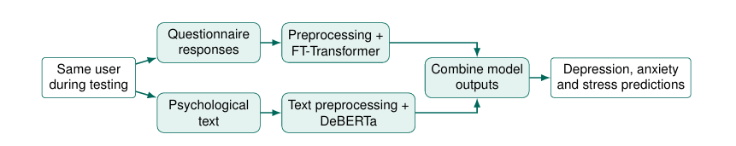
MENTAL HEALTH ANALYSIS USING MACHINE LEARNING MODELS
Presenter Names: M. V. S. Satya Mrudula | G. Rishikar Reddy | D. Vivek | T. S. L. Priyanka
Project Guide: Dr. M. Ramakrishna Murty
Introduction
Proposed Methodology
Mental health concerns such as depression, anxiety and stress may remain unnoticed until symptoms are reported or professional evaluation is received.
This project investigates a machine-learning framework that combines questionnaire responses and psychological text data to support early screening. It uses FT-Transformer for questionnaire data and DeBERTa for psychological text. Their outputs will be combined to generate screening predictions.
PROPOSED TWO-STREAM FRAMEWORK
Questionnaire pipeline:
Questionnaire data → data inspection and preprocessing → FT-Transformer
Psychological text pipeline:
Text data → text preprocessing → DeBERTa
Integration:
Outputs from both models → combine model outputs → predictions for depression, anxiety and stress.
DFD scope: questionnaire responses and psychological text are provided by the same user during testing. Dataset collection is complete; preprocessing, model development, integration, testing and evaluation are planned next.
Literature Review
RELATED WORK
[1] ShamsEldin et al. (2025) explored machine learning for predicting depression, anxiety and stress using psychometric data.
[2] Nemesure et al. (2021) studied prediction of depression and anxiety using electronic health records and machine learning.
[3] Bailey and Strunk (2023) investigated prediction of anxiety and depression symptoms over time using machine learning.
[4] Ahmed and Ahmed (2023) explored smartphone-based depression screening using explainable machine learning.
These studies show the potential of data-driven screening, while differences in data sources and populations make careful evaluation important. This project extends the approach by combining questionnaire and psychological text inputs.
Tools/ Technology / Algorithms
TOOLS
• Python, Pandas, NumPy
• Matplotlib, Seaborn
• Scikit-learn
ALGORITHMS
• FT-Transformer — questionnaire data
• DeBERTa — psychological text
Model performance will be assessed after preprocessing, training and testing; results are not yet available.
Research Gaps
• Many approaches rely on a single data source, limiting the range of information available.
• Questionnaire responses and psychological text require different preprocessing and modelling approaches.
• Model outputs need to be combined consistently to produce useful screening predictions for depression, anxiety and stress.
• Predictions should be communicated responsibly, with privacy protection and clear acknowledgement that screening is not clinical diagnosis.
References
Project Objectives
[1] T. ShamsEldin et al., “Artificial intelligence for predicting depression, anxiety and stress using psychometric data,” Scientific Reports, vol. 15, Art. no. 37282, 2025, doi: 10.1038/s41598-025-21301-1.
[2] M. D. Nemesure et al., “Predictive modeling of depression and anxiety using electronic health records…,” Scientific Reports, vol. 11, Art. no. 1980, 2021, doi: 10.1038/s41598-021-81368-4.
[3] B. Bailey and D. R. Strunk, “Predicting anxiety and depression over 12 months of the COVID-19 pandemic: A machine learning study,” Journal of Clinical Psychology, vol. 79, pp. 2388–2403, 2023, doi: 10.1002/jclp.23555.
[4] M. S. Ahmed and N. Ahmed, “A Fast and Minimal System to Identify Depression Using Smartphones: Explainable Machine Learning-Based Approach,” JMIR Formative Research, vol. 7, e28848, 2023, doi: 10.2196/28848.
[5] P. He, X. Liu, J. Gao, and W. Chen, “DeBERTa: Decoding-enhanced BERT with Disentangled Attention,” arXiv:2006.03654, 2020.
[6] “Revisiting Deep Learning Models for Tabular Data,” arXiv:2106.11959, 2021.
1. Analyse questionnaire responses using FT-Transformer.
2. Analyse psychological text using DeBERTa and combine both model outputs to generate screening predictions for depression, anxiety and stress.
Department of Artificial Intelligence and Data Science | GITAM School of CSE, GITAM Deemed to be University, Visakhapatnam

