Slide 1


Slide 2
The Rust Programming Language
Dmitri Nesteruk
Notes:
Hi and welcome to this course on Differential Equations. My name is Dmitri and I’m here to take your differential equations skills to a whole new level.

Slide 3
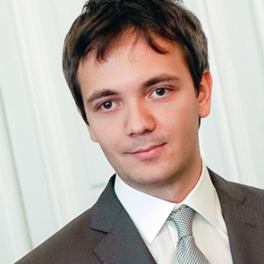
Your Instructor
Dmitri Nesteruk
Quant finance professional
Math, finance, computing (including HPC)
Conference speaker, blogger, podcaster, etc.
This is a course on Rust
Live coding

Slide 4
What’s Rust?
A New Programming Language
Made by the Mozilla Corporation
Already had a 1.0 release
Native code
Powerful and safe
An alternative C/C++, D, Go, …
Introduces new and interesting concepts

Slide 5
What’s in the Course?
Introduction
Types and Variables
Control Flow
Data Structures
Functions
Lifetime
Odds & Ends

Slide 6
Course Goals
Solve problems in Rust
Understand Rust’s strengths and weaknesses
Effectively leverage Rust’s memory safety guarantees
Write applications and libraries
Test and document your code

Slide 7
Are You Ready?
Let’s Go!

